Slide 1
The National FAA Safety Team Presents
Topic of the Month
February
Maintenance Placards
<Audience>
<Presenter>
< >
Notes:
2017/5-24-107 (I) PP Original Author: J. Steuernagle May 2017 POC: K. CloverAFS-850 Operations Lead Office 562-888-2020
Presentation Note: This is the title slide for Maintenance Placards
Presentation notes (stage direction and presentation suggestions) will be preceded by a Bold header: the notes themselves will be in Italic fonts.
Program control instructions will be in bold fonts and look like this: (Click) for building information within a slide; or this: (Next Slide) for slide advance.
Some slides may contain background information that supports the concepts presented in the program.
Background information will always appear last and will be preceded by a bold Background: identification.
We have included a script of suggested dialog with each slide. Presenters may read the script or modify it to suit their own presentation style.
The production team hope you and your audience will enjoy the show. Break a leg!
(Next Slide)

Slide 2
Welcome
Exits
Restrooms
Emergency Evacuation
Breaks
Sponsor Acknowledgment
Set phones & pagers to silent or off
Other information
Notes:
Presentation Note: Here’s where you can discuss venue logistics, acknowledge sponsors, and deliver other information you want your audience to know in the beginning.
You can add slides after this one to fit your situation. (Next Slide)

Slide 3
Overview
GAJSC* Safety Enhancements
Out of service Placards
Basic Maintenance Awareness for Pilots
*General Aviation Joint Steering Committee
Notes:
In this presentation we’ll talk a little bit about recommendations from a work group that studies loss of control. The General Aviation Joint Steering Committee or GAJSC is a government/industry group that studies GA accidents and makes recommendations for adoption of what they call safety enhancements. One of their safety enhancements addresses the problem of operating aircraft before they are ready to be returned to service after maintenance. It doesn’t happen often but some General Aviation accidents have resulted from pilots inadvertently flying aircraft that were not airworthy. The GAJSC feels that an “Out of Service” placard conspicuously placed in the cockpit can go a long way toward preventing such accidents. We’ll discuss several scenarios in the following slides.
We’ll also discuss some basic maintenance knowledge that all pilots need in order to communicate effectively with mechanics and to operate aircraft safely after maintenance work has been done.
Presentation Note: If you’ll be discussing additional items, add them to this list (Next Slide)

Slide 4
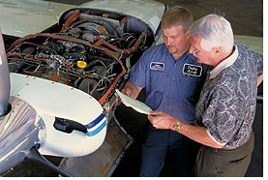
Keeping pilots in the loop
14 CFR 91.3 – PIC Responsibility and authority
  (a) is ….. the final authority …..
14 CFR 91.103 PIC Preflight action
  …. shall …. become familiar with all available information ….
Notes:
Pilots in Command are responsible for the airworthiness of aircraft they fly.
That’s made abundantly clear in CFR 91.3 , “the pilot in command is directly responsible for and the final authority as to the operation of that aircraft.”
And CFR 91.103. , “the pilot in command shall become familiar with all available information concerning that flight” Airworthiness is definitely one critical information category but how available is it really? And how do we become familiar with mechanical issues that we may not be qualified to evaluate?
(Next Slide)

Slide 5
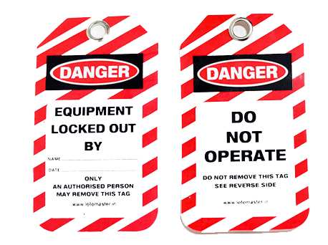
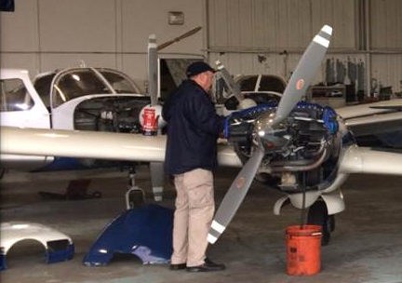
Return to service
Out of service while undergoing maintenance.
  Documentation not required.
Must be returned to service after maintenance.
Notes:
14 CFR Part 43 describes who is authorized to perform maintenance on US-Registered aircraft, Who is authorized to inspect those aircraft, and who is authorized to return aircraft to service after maintenance has been done. Ironically formal return to service documentation is required but no documentation is required when an aircraft is taken out of service.
Most aircraft owners are up to speed on the status of their machines and rental fleets usually have aircraft status boards or squawk sheets to review. But every once in a while there’s a nasty surprise for pilots who take flight – or try to – in aircraft that aren’t ready to be returned to service. (Click)
The GAJSC feels that GA Safety would be enhanced if an Aircraft Out of Service Placard or sticker were placed in the pilot’s field of view beginning when the aircraft is taken out of service for maintenance. The placard would only be removed when the return to service documentation is complete.
Of course owners and operators are free to make their own placards to post in the cockpits of aircraft scheduled for maintenance. Pilots should make sure that all maintenance has been performed and documented before removing the placards.
(Next Slide)

Slide 6
Enhanced preflight after maintenance
Confirm maintenance documentation
  Aircraft & engine logbooks
    Also check for required inspections
      Annual, 100 hour, pitot/static, avionics, etc.
Inspect all areas
  Use a checklist
  Pay particular attention to areas that have been worked on.
  Ensure that the aircraft has been serviced properly
    Appropriate Fuel & Oil
Notes:
It’s always a good idea to do an enhanced preflight on aircraft that have just been returned to service. Occasionally you’ll find an expensive tool left behind but more importantly you may spot hoses or electrical connections that have not been reestablished after work was done. Your preflight should start with the aircraft documentation. Make sure the maintenance work has been documented in the appropriate aircraft logbook and check that the aircraft has been returned to service. Ensure that the tach and/or hour meter readings are correct. If the aircraft was test flown there may be a discrepancy between the logbook time and what you see on the panel.
Also make sure that all the required inspections have been performed and documented.
When looking the aircraft over; take your time. Use a checklist to make sure you don’t miss anything and pay particular attention to the areas that were worked on including any disconnections that may have been required to access the parts that were serviced. Make sure the machine has been serviced with the proper type and grade of fuel and oil.
(Next Slide)

Slide 7
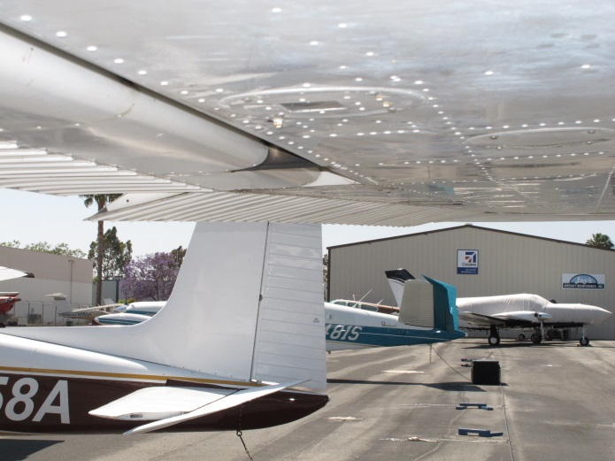
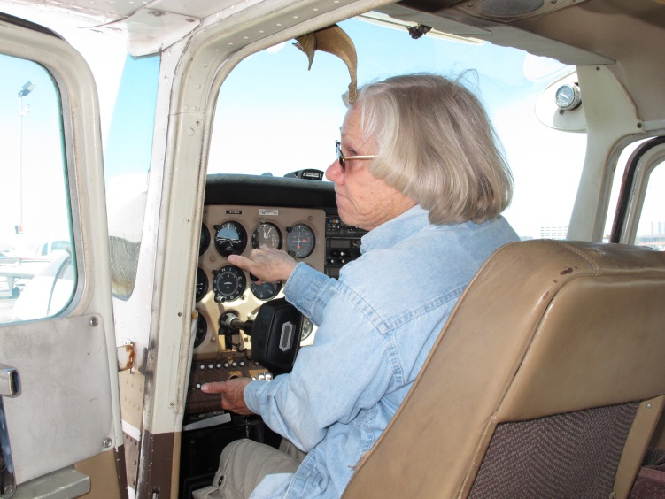
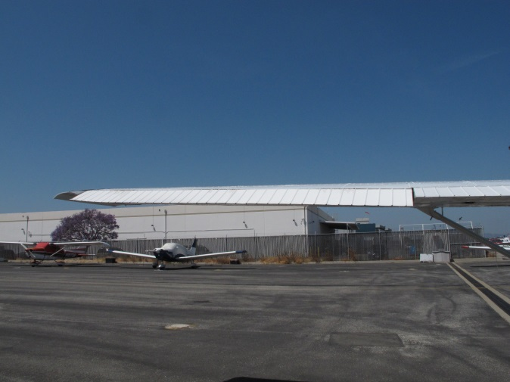
Important!
What’s wrong with these pictures?
Notes:
This preflight item is important enough to warrant it’s own slide. What do you think it is? Pause for a few seconds then (Click)
Presentation Note: Allow the audience to guess – then…..
That’s right. It doesn’t happen often but if your flight controls are connected so that you’re turning right when you command turns to the left or pushing forward raises the nose, there will be little time to learn how to fly with reversed controls.
(Next Slide)

Slide 8
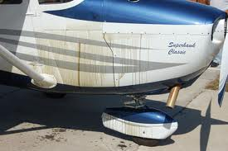
Run up, taxi back, do another preflight
This MAY be your chance to catch something that wasn’t quite right, quite tight, or quite ready for flight. Ask yourself what items might cause an accident if they’re not quite right? Trust your mechanic, but this is your chance to VERIFY that the aircraft is safe & airworthy!
Notes:
After maintenance, why not head to your run up area, perform one, and then return to your starting point. Shut down, get out, and look over everything. Special attention should be paid to things like oil leaks, loose fasteners, and so on. Then, if everything is OK, perhaps its time to fly. As a reminder, for the first flight, stay in the pattern, within gliding distance of your runway.
(Next Slide)

Slide 9
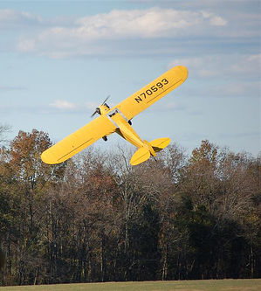
Questions?
Notes:
Presentation Note: You may wish to provide your contact information and main FSDO phone number here. Modify with
Your information or leave blank.
(Next Slide)

Slide 10
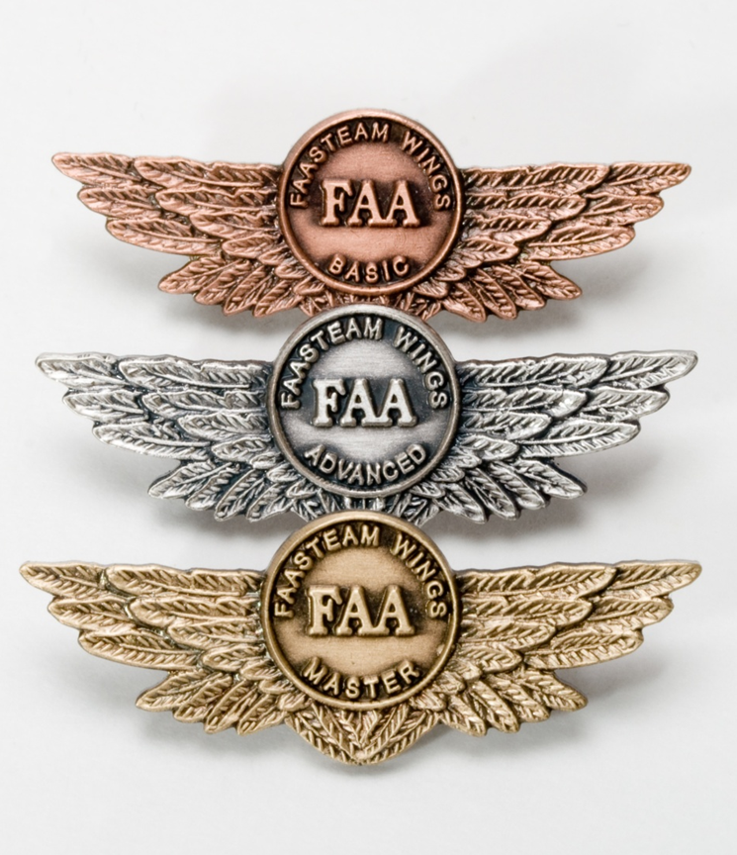
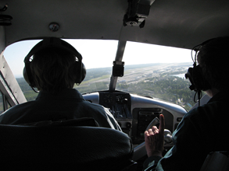
Proficiency and Peace of Mind
Fly regularly with your CFI
Perfect Practice
Document in WINGS
Notes:
There’s nothing like the feeling you get when you know you’re playing your A game and in order to do that you need a good coach (Click)
So fly regularly with a CFI who will challenge you to review what you know, explore new horizons, and to always do your best. Of course you’ll
have to dedicate time and money to your proficiency program but it’s well worth it for the peace of mind that comes with confidence. (Click)
Vince Lombardi, the famous football coach said, “Practice does not make perfect. Only perfect practice makes perfect.” For pilots that means
flying with precision. On course, on altitude, on speed all the time. (Click)
And be sure to document your achievement in the Wings Proficiency Program. It’s a great way to stay on top of your game and keep you flight review current.
(Next Slide)

Slide 11
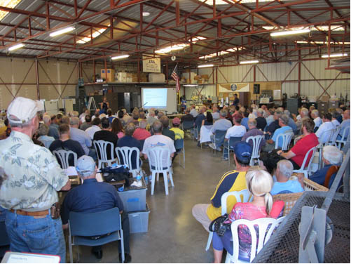
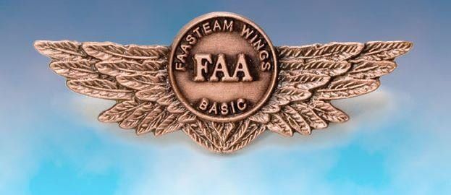
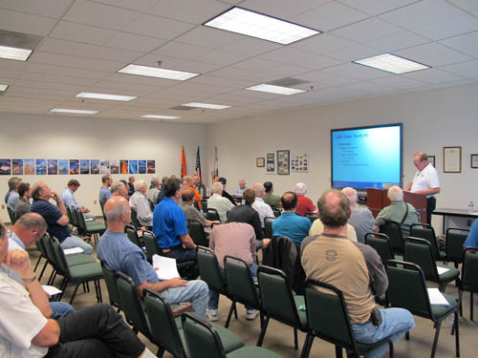
Thank you for attending
You are vital members of our GA safety community
Notes:
Your presence here shows that you are vital members of our General Aviation Safety Community. The high standards you keep and the examples you set are a great credit to you and to GA.
Thank you for attending.
(Next Slide)

Slide 12
The National FAA Safety Team Presents
Topic of the Month
February
Maintenance Placards
<Audience>
<Presenter>
< >
Notes:
(The End)

