Slide 1
The National FAA Safety Team Presents
Topic of the Month August
Maneuvering Flight
<Audience>
<Presenter>
< >
Notes:
2017/10-13-116 (I) PP Original Author: J. Steuernagle March 2017 POC: K. CloverAFS-920 Operations Lead Office 562-888-2020
Presentation Note: This is the title slide for Maneuvering Flight
Presentation notes (stage direction and presentation suggestions) will be preceded by a Bold header: the notes themselves will be in Italic fonts.
Program control instructions will be in bold fonts and look like this: (Click) for building information within a slide; or this: (Next Slide) for slide advance.
Some slides may contain background information that supports the concepts presented in the program.
Background information will always appear last and will be preceded by a bold Background: identification.
We have included a script of suggested dialog with each slide. Presenters may read the script or modify it to suit their own presentation style.
The production yoteam hope u and your audience will enjoy the show. Break a leg!
(Next Slide)

Slide 2
Welcome
Exits
Restrooms
Emergency Evacuation
Breaks
Sponsor Acknowledgment
Set phones & pagers to silent or off
Other information
Notes:
Presentation Note: Here’s where you can discuss venue logistics, acknowledge sponsors, and deliver other information you want your audience to know in the beginning.
You can add slides after this one to fit your situation. (Next Slide)

Slide 3
Overview
> 25% of Fatal Accidents occur in Maneuvering Flight
Half involve Stall Spin
Maneuvering Flight Tasks
Maneuvering Flight Accidents
Tips for Success
Notes:
We want to take just a few minutes to talk about maneuvering flight. (Click)
It’s still the phase of flight where most fatal GA accidents occur – more than 25% of all fatal accidents – and half or those accidents involve a Stall/Spin Scenario (Click)
We’ll describe common Maneuvering Flight tasks. (Click)
And we’ll discuss common maneuvering flight accident scenarios. (Click)
Finally we’ll offer some tips for successful maneuvering flight task accomplishment
Presentation Note: If you’ll be discussing additional items, add them to this list (Next Slide)

Slide 4
Maneuvering Flight Involves:
Takeoffs, landings & go-arounds
Go-arounds, stalls & spins
Formation, aerobatics, & training
Forced landings, buzzing, & photography
All of the above & more.
Notes:
Presentation Note: Ask the audience to answer this question. When they have answered; click to reveal the correct answers.
Let’s begin by defining maneuvering flight. Maneuvering flight involves which of the items on the list. (Click)
That’s right – All of the above and more.
(Next Slide)

Slide 5
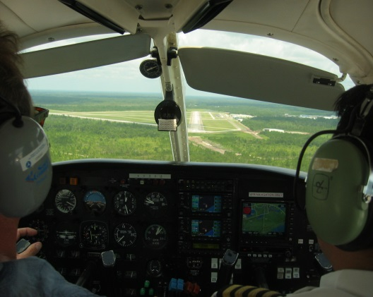
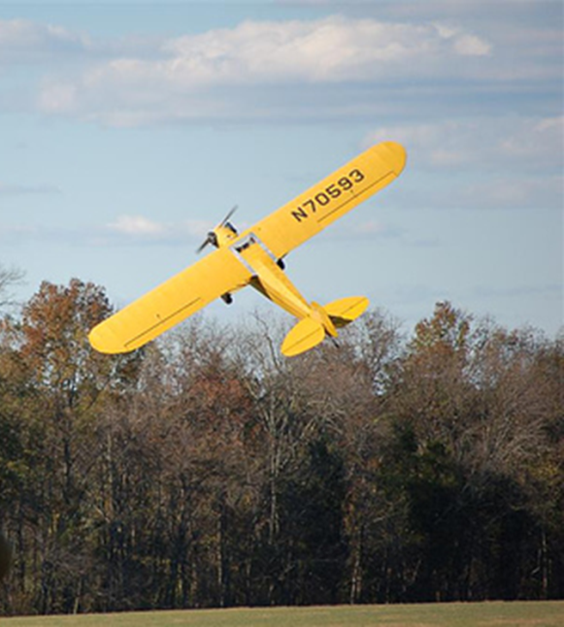
Maneuvering Flight Involves:
Notes:
Any time we’re turning, climbing, or descending we’re maneuvering. It’s an essential part of flying and that’s why we introduce it early in the learning process.
(Next Slide)

Slide 6
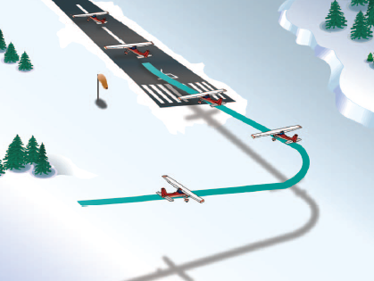
Stall/Spin Accidents
In the traffic pattern
Takeoff 28 %
Approach 18 %
Go Around 6 %
Crosswind
Maneuvering 41%
Notes:
Stall/Spin Accidents are deadly and they almost always involve maneuvering flight.
More than half of Stall/Spin accidents occur in the traffic pattern and most of the rest involve maneuvering – usually too close to the ground for recovery.
(Next Slide)

Slide 7
Stalls
Notes:
We teach stalls early on in the learning process. Stall practice is intended to not only build proper recovery technique but equally importantly to build stall awareness so that the pilot responds correctly to emergent stall situations thus preventing the stall.
(Next Slide)

Slide 8
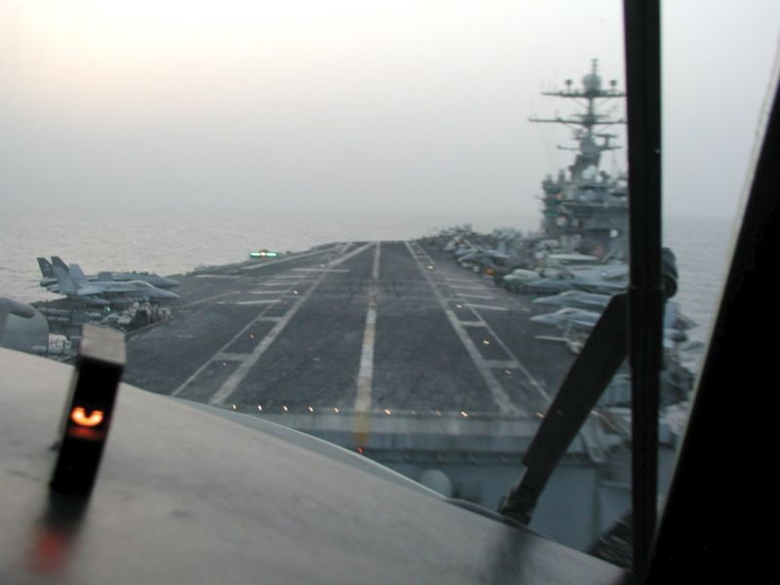
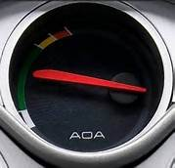
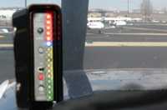
Angle of Attack
Notes:
There are a number of affordable options in angle of attack sensing & display that should go a long way toward reducing the number of stall/spin accidents but they’re a subject of another Topic of the Month. For now we’ll say they’re available and aircraft owners & operators should look into them.
(Next Slide)

Slide 9
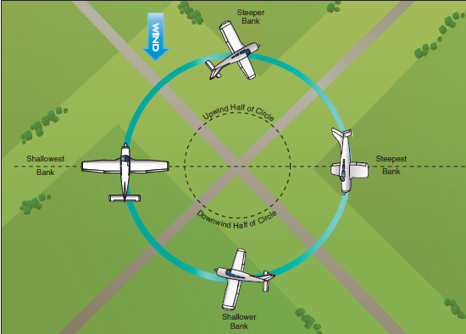
Turns about a point
Notes:
Every student pilot has practiced turns around a point. A training maneuver designed to build skill in wind compensation, aircraft ground track control, orientation, and division of attention.
(Next Slide)

Slide 10
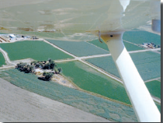
Moose Stalls
Notes:
We are taught stall awareness, stall recovery, and stall prevention. And we’re taught turns about a point. We are never taught stall recovery while turning about a point though. That’s a good thing because at the altitudes we typically use for the ground reference maneuvers any stall would likely take us dangerously close to the ground and a spin would ensure we crashed before we could recover.
(Click)
So for a few unprepared pilots the first time they get to practice stalls while turning about a point is when they’re concentrating on something on the ground. They’re called moose stalls in Alaska, coyote stalls in Arizona, and roo stalls in Australia - all so named because they result from low altitude maneuvering around something of interest on the ground. No matter where you fly they’re to be avoided.
(Next Slide)

Slide 11
Safety Tip
Fly past – then turn & fly back
Notes:
Here’s a safety tip. When you’re trying to view something on the ground why not fly past the target in straight & level flight, then concentrate on turning the airplane and fly back for another view of the target. That way you don’t have to deal with the demanding task of maintaining a constant radius turn about the target.
(Next Slide)

Slide 12
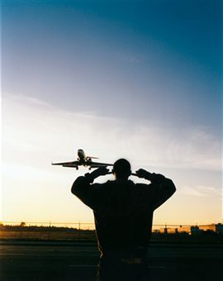
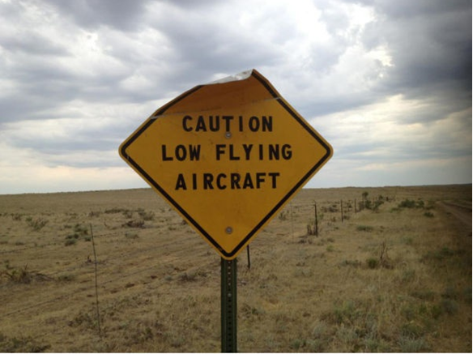
Buzzing – 32%
Notes:
Yes – I know it’s exciting to go fast close to the ground and some folks get a rush from having an airplane dangerously close overhead. We don’t know how many successful buzz jobs are done but we do know that buzzing is involved in 32% of maneuvering accidents and they’re usually fatal. So the Safety Tip on buzzing is – don’t do it. (Click)
There’s another reason to fly higher and that has to do with being a good neighbor. Especially in urban areas helicopter and airplane noise pollution are problems we can all help to solve. We pilots need to understand the importance of good community relations. We can’t expect our neighbors to look favorably on airport improvement funding if our activities scare or annoy them.
(Next Slide)

Slide 13
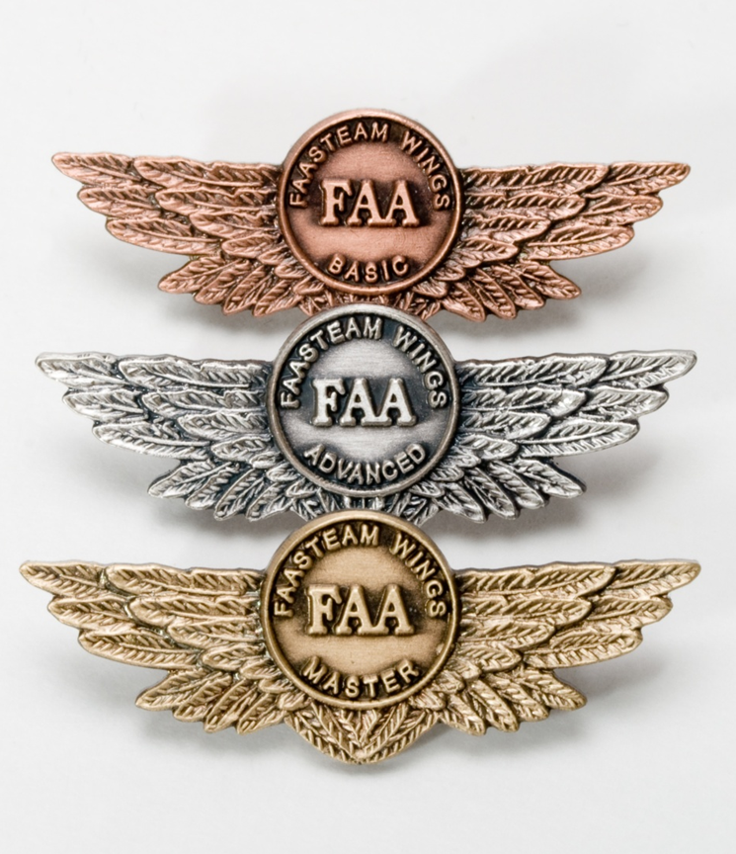
Safety Tip
Practice
Stalls & slow flight
Flight training maneuvers
Takeoffs & Landings
Instrument Maneuvers
Notes:
An airplane owner once asked an experienced instructor pilot, “What’s the best thing to put in my airplane to increase safety?”
Without hesitation, the instructor answered, “Gasoline”. (Click)
That’s right – the most effective safety tool for any pilot is practicing the art and science of flying. That means more than
a monthly trip for the hundred dollar hamburger. Book some time with a CFI at least once a year to practice the items on this list. (Click)
And be sure to document your achievement in the Wings Proficiency Program. It’s a great way to stay on top of your game.
(Next Slide)

Slide 14
Questions?
Notes:
Presentation Note: You may wish to provide your contact information and main FSDO phone number here. Modify with
Your information or leave blank.
(Next Slide)

Slide 15
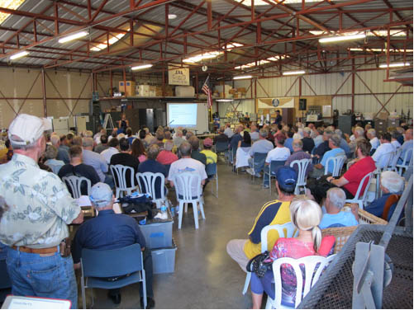
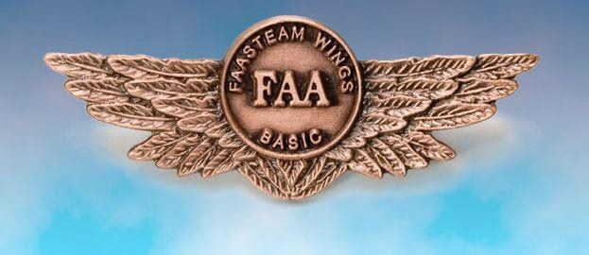
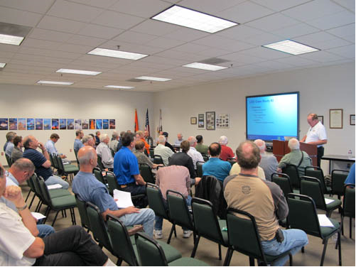
Thank you for attending
You are vital members of our GA safety community
Notes:
Your presence here shows that you are vital members of our General Aviation Safety Community. The high standards you keep and the examples you set are a great credit to you and to GA.
Thank you for attending.
(Next Slide)

Slide 16
The National FAA Safety Team Presents
Topic of the Month August
Maneuvering Flight
<Audience>
<Presenter>
< >
Notes:
(The End)

