Slide 1
The National FAA Safety Team Presents
Topic of the Month - December
Aircraft Performance and Performance Monitoring
<Audience>
<Presenter>
< >
Notes:
2018/4-5-125 (I) PP Original Author: John Steuernagle FAA SPPM 11/23/2015; POC (Kevin Clover), FAA SPPM Operations Lead, Office 562-888-2020; revised by (Name) (MM/DD/YYYY)
Presentation Note: This is the title slide for Aircraft Performance
Presentation notes (stage direction and presentation suggestions) will be preceded by a Bold header: the notes themselves will be in Italic fonts.
Program control instructions will be in bold fonts and look like this: (Click) for building information within a slide; or this: (Next Slide) for slide advance.
Some slides may contain background information that supports the concepts presented in the program.
Background information will always appear last and will be preceded by a bold Background: identification.
We have included a script of suggested dialog with each slide. Presenters may read the script or modify it to suit their own presentation style.
The production team hope you and your audience will enjoy the show. Break a leg!
(Next Slide)

Slide 2
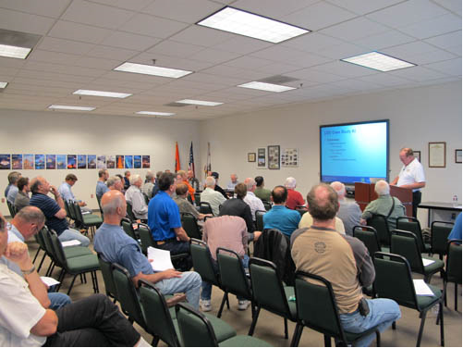
Welcome
Exits
Restrooms
Emergency Evacuation
Breaks
Set phones & pagers to silent or off
Sponsor Acknowledgment
Other information
Notes:
Presentation Note: Here’s where you can discuss venue logistics, acknowledge sponsors, and deliver other information you want your audience to know in the beginning.
You can add slides after this one to fit your situation.
(Next Slide)

Slide 3
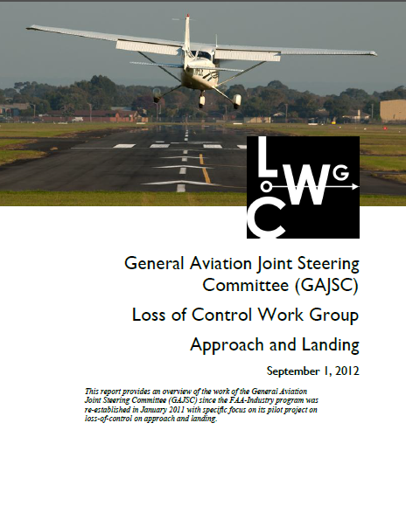
Overview
Loss of Control & System/Component Failure Work Group* Recommendations
Aircraft Performance Parameters
Aircraft Limitations
Tips and Tricks
* General Aviation Joint Steering Committee
Notes:
In this presentation we’ll talk a little bit about recommendations from a work group that studies General Aviation mishaps. We’ll talk about aircraft performance parameters and calculations. We’ll also offer suggestions that will help you with aircraft performance prediction. Aircraft limitations will be discussed and, along the way, we’ll give you some tips and tricks that will help you to avoid performance-based accidents in any aircraft.
Presentation Note: If you’ll be discussing additional items, add them to this list
(Next Slide)

Slide 4
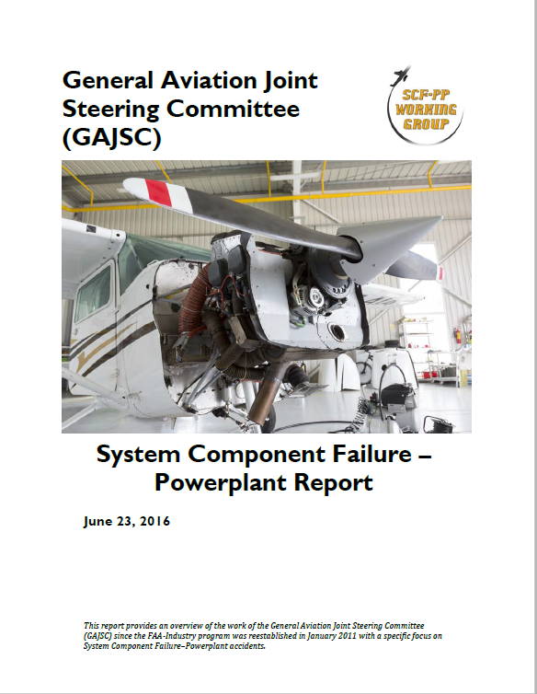
GAJSC* System/component Failure Workgroup Findings
GA Aircraft Performance Monitoring
Performance prediction
Failure prediction
* General Aviation Joint Steering Committee
Notes:
The General Aviation Joint Steering Committee is a government/industry group that studies GA mishaps. Here are some findings of their recent study of System and/or Component Failure accidents. This workgroup recommends that aircraft performance be monitored in order to develop realistic performance expectations and to predict system or component failure.
(Next Slide)

Slide 5
Flight Data Monitoring
Notes:
Flight data monitoring has been around since before the jet age and modern airplanes make extensive use of automated technology to optimize performance and to predict failures before they occur.
(Next Slide)

Slide 6
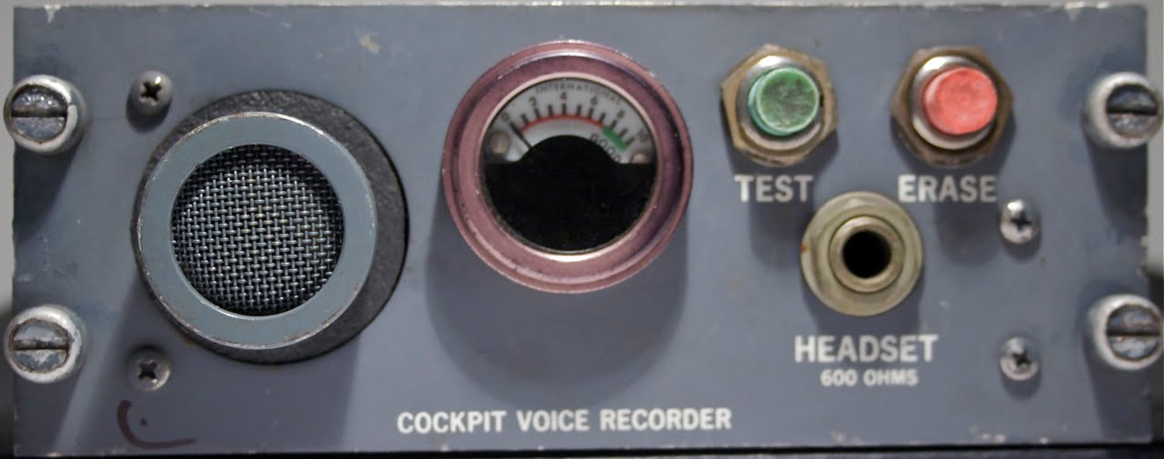
Flight Data Monitoring
FOQA
Cockpit Voce Recorder (CVR)
Flight Data Recorder (FDR)
Notes:
In its’ simplest form, FDM consists of a cockpit voice recorder that records at least the most recent 15 minutes of crew conversations, and a flight data recorder that preserves such things as engine parameters, control position, heading, altitude, and airspeed data. (Click)
The equipment and processes to acquire and distribute the data are collectively known as Flight Operational Quality Assurance or FOQA (pronounced: Fohqua)
But this equipment is only for the big guys right? General Aviation aircraft don’t have anything like this ……………………. Or do they?
(Next Slide)

Slide 7
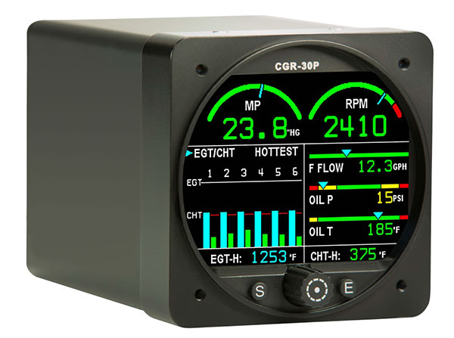
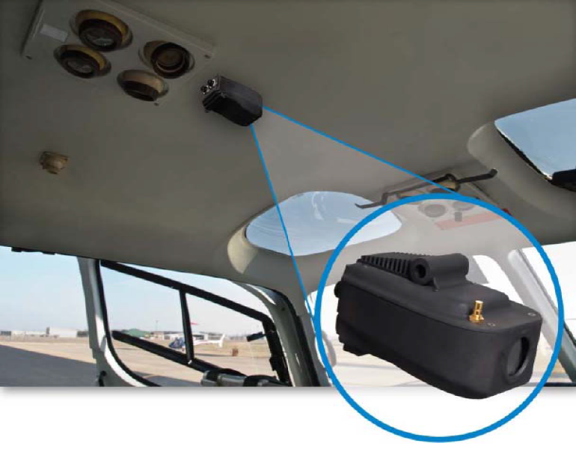
Flight Data Monitoring for GA
Flight Data
Flight Data + Visual
Notes:
While it’s true that most GA aircraft don’t have dedicated automatic flight data recording devices now; we will be able to enjoy the benefits of equipage in the future. In the meantime it’s often surprising to see what we already have. (Click)
Manufacturers are already offering self-contained flight data and visual data recorders for GA airplanes and helicopters. Most operators of this equipment must periodically down load and analyze the recorded data – often with the aid of dedicated computer programs.
(Next Slide)

Slide 8
Flight Data Monitoring for GA
Notes:
Even without dedicated equipment, pilots can do much the same thing by tracking engine power, fuel flow, oil temperature and pressure. Panel mounted GPS systems and many hand held units are already capable of recording position, heading, speed, and altitude. Some engine monitors have recording capability and many aircraft owners participate in oil analysis programs – a tool for gauging engine health and heading off expensive or, in some cases, disastrous problems. Some aircraft – particularly helicopters are equipped with metallic chip detectors that can forecast engine and transmission failures in time to make a safe landing.
(Next Slide)

Slide 9
GAJSC* LOC Workgroup Findings
Lack of Aeronautical Decision Making Skills
Lack of single – pilot CRM skills
Incorrect calculation or perception of aircraft performance
Operations at edges of Weight & Balance Envelope are especially dangerous!
* General Aviation Joint Steering Committee
Notes:
Here are some more GAJSC findings. We’ll reference their recent study of Loss of Control accidents. Most fatal GA Loss of Control accident investigations cite inadequacies in Aeronautical Decision Making and - a subset of ADM - Single-pilot Cockpit Resource Management skills. Occasionally investigations have discovered causal factors resulting from unreasonable expectations of aircraft performance – especially when operating at the edges of the aircraft weight and balance envelope. That’s why the Loss of Control Work Group suggests improvement in pilots’ understanding and calculation of aircraft performance.
(Next Slide)

Slide 10
3 Questions
How much can I haul?
How far can I go?
How long will it take me?
How fast can I fly?
Notes:
When we speak of aircraft performance we’re usually answering 3 basic questions:
How much can I haul?
How far can I go?
How long will it take me?
It sounds simple but an exquisite set of interdependent variables must be considered in order to answer each of these questions. Most of these variables have to do with aircraft performance but the most important variable does not.
(Next Slide)

Slide 11
Aircraft Performance
Aircraft Weight & Balance
Pilot & Passengers
Cargo
Fuel
Information for aircraft performance calculations
Notes:
A good way to plan a flight is to decide how much weight you want to haul to what destination. Start with crew and passengers. Then add cargo. If these items alone exceed your aircraft’s capability you’ll either have to make multiple trips or get a bigger aircraft.
Once you know how much you want to haul you can figure out how much fuel you can take and that – together with your weather information will tell you how far you can go. If you have enough to get to the destination plus alternate plus reserve you’re golden. If not – you’ll have to plan an en route fuel stop.
Now it’s time to run a weight and balance calculation to make sure you will be operating within weight and balance limitations and to have information to use in predicting aircraft performance.
(Next Slide)

Slide 12
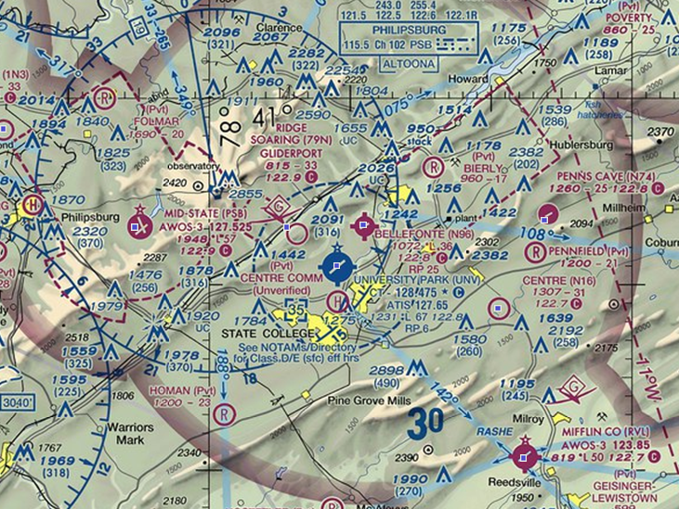
Aircraft Performance
Aircraft Weight & Balance
Pilot & Passengers
Cargo
Fuel
Route of flight
Departure, En route, Destination & Alternate Wx
Departure & Arrival Airports
Runway lengths & obstructions
Density altitudes
Add 50% for safety
Notes:
But wait – there’s more. You’ll also have to consider your departure & arrival airports runway lengths, obstructions & expected density altitude. If the field is short and/or obstructed you may not be able to safely fly with a full load. One more thing – Just because the book says the aircraft can do it doesn’t mean you can do it. Pilot skill and experience count for a lot when you’re trying to duplicate POH performance figures. So be conservative when you calculate your performance and consider adding a safety factor. Some pilots add 50% to their takeoff and landing calculations for safety.
Now we can figure all of this out by consulting the POH right? Maybe not. There’s one more huge variable to consider and I bet you know what it is.
(Next Slide)

Slide 13
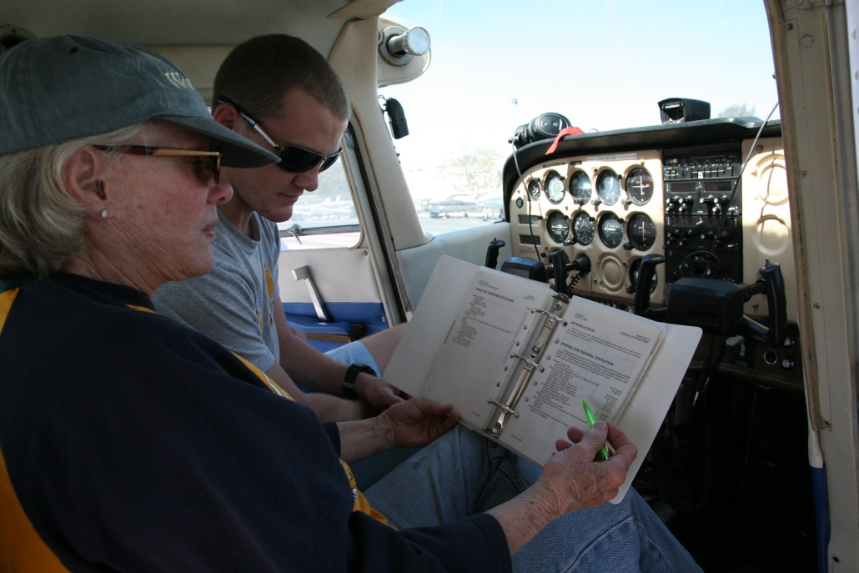
What’s the greatest variable?
The Pilot
Documented Performance
Mission weight and density altitude
Fly with a CFI
Notes:
So what’s the greatest variable in all this?
That’s right – the pilot. Let’s face it. The POH figures and all of our calculations don’t mean much if we can’t duplicate them in our flying. That’s why it’s important to document your performance capability at least yearly with a CFI. Fly at a typical mission weight and try to duplicate or simulate mission density altitudes. That way you’ll know what you and your aircraft can do.
(Next Slide)

Slide 14
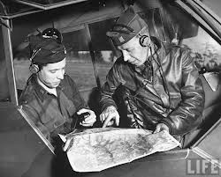
What’s my baseline?
Pilot & Aircraft Performance Reference
Environmental Circumstances
Pilot Performance
Decreased Performance
Increased Performance
Notes:
In order to know what performance you and your flying machine are capable of; you’ll need to establish a baseline. Think of your baseline as an omnibus reference that relates pilot and aircraft performance under a given set of environmental circumstances on a given day.
Human factors such as fatigue and environmental factors such as higher density altitudes will result in performance below the baseline while proficiency training and lighter loading will likely result in above baseline performance.
The key point to remember is that for any given flight; you need to determine how you and your aircraft will perform. Your baseline is the foundation of that determination.
(Next Slide)

Slide 15
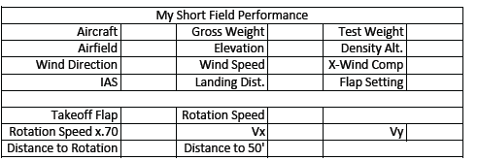
What’s my baseline?
https://www.faasafety.gov/gslac/ALC/lib_categoryview.aspx?categoryId=35
Notes:
Here’s a sample baseline calculation sheet extracted from the Alaskan Off-Airport Operations Guide available on FAASafety.gov at the URL below.
To establish your baseline we suggest you load your aircraft with a typical mix of fuel, cargo, and passengers. (We recommend that one of those passengers be your CFI.) Calculate your test weight and note runway condition, elevation, density altitude, wind direction and speed. (Click)
Also note what rotation and climb speeds you intend to use and calculate 70% of the rotation speed. We’ll explain why that’s important in the next slide.
Next you’ll fly several takeoffs and landings noting your performance on each trial. When you’re done you can average your performance figures and complete your baseline chart.
(Next Slide)

Slide 16
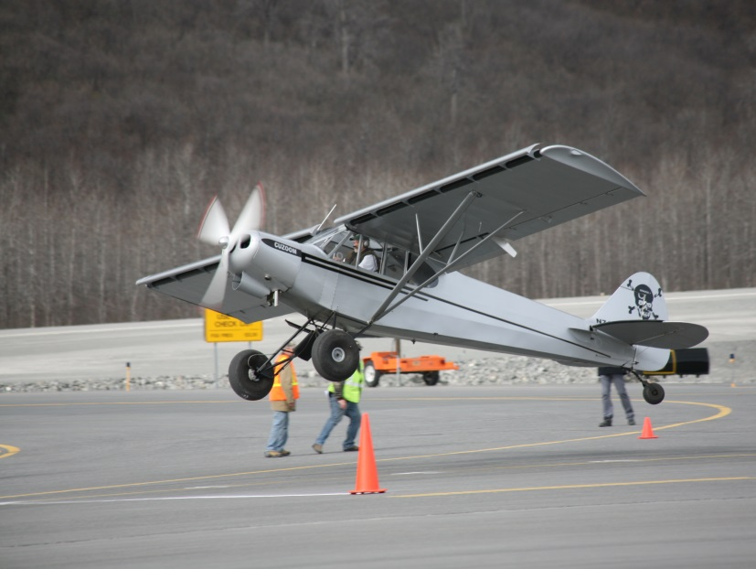
Takeoff calculations
Density altitude
Fixed pitch add 15% per 1000 feet DA to 8000 ft.
Constant speed add 12% per 1000 feet DA to 6000 ft.
50/70 Rule – no obstruction
60 x .7 = 42
30/70 Rule - obstruction
Notes:
Here are some rules of thumb when making takeoff calculations. (Click)
If you have a fixed pitch prop, add 15% to your calculated takeoff distance for each 1000 foot increase in density altitude up to 8000 feet. (Click)
For constant speed props add 12% per 1000 feet of density altitude up to 6000 feet. (Click)
When planning takeoff from short unobstructed runways establish a landmark at 50% of your calculated takeoff distance. (Click)
When on the take off roll you should have 70% of your rotation speed at that point. If you don’t – the safest thing is to abort the takeoff and reduce weight or wait for more favorable wind and temperature conditions. In this example we’re assuming a rotation speed of 60 knots or MPH. 70% of 60 is 42. The number you’ll want to see at the halfway point (Click)
If you must clear obstructions on takeoff you’ll need to have 70% of your rotation speed by the time you’ve travelled 30% of your available takeoff distance.
(Next Slide)

Slide 17
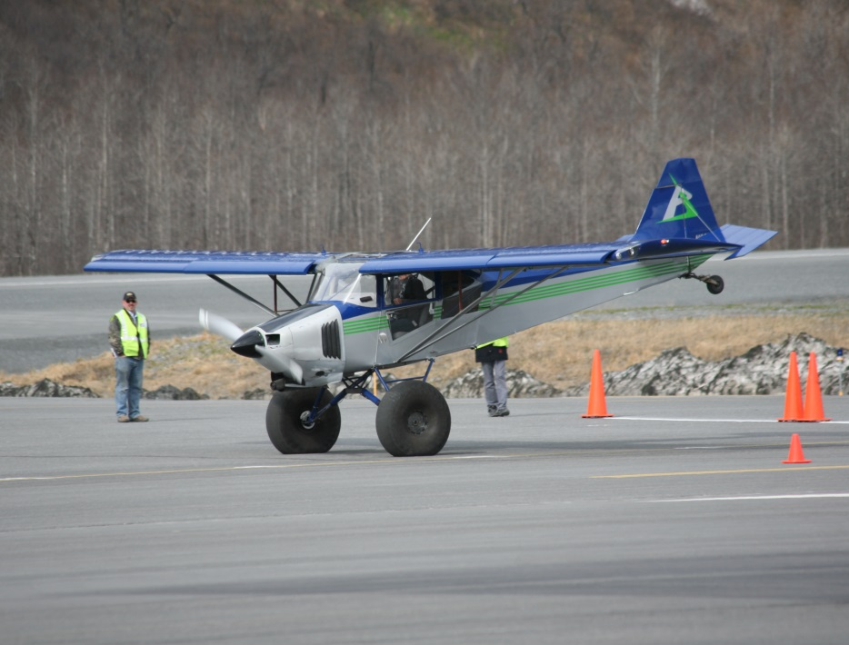
Approach & Landing
Stabilized short field final approach
Full flaps
1.3vso
Don’t cut final short
Go around if not stable
Notes:
You’ll want to be stabilized on final approach with full flaps at 1.3 times the stalling speed in landing configuration.
Don’t cut your final short. Make it long enough to be stabile and go around if you’re unstable.
By the way – the photos on this and the previous slide are of an annual takeoff and landing competition held in Valdez, Alaska. We strongly suggest you don’t try this at home without some quality instruction.
(Next Slide)

Slide 18
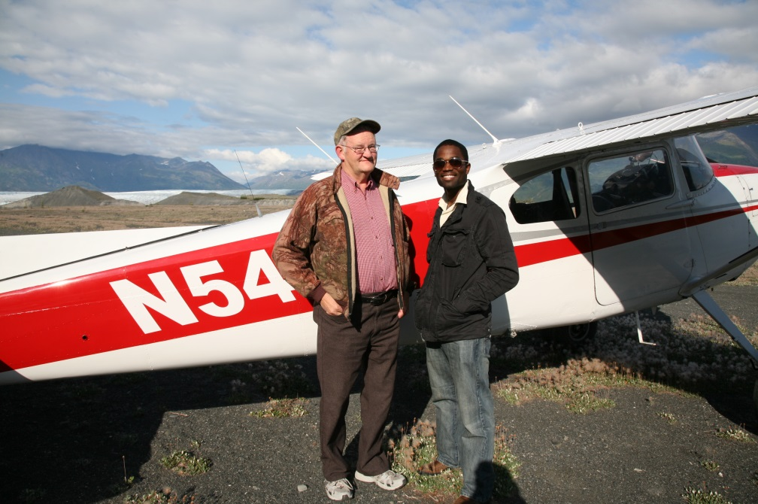
What’s the greatest variable?
The Pilot
Documented Performance
Mission weight and density altitude
Fly with a CFI
I’M SAFE
Notes:
Once again – the greatest variable is the pilot but if you document your baseline performance at mission weight and density altitude and fly regularly with a CFI, you’re well on your way to safer flying and fewer nasty surprises.
(Next Slide)

Slide 19
Limitations : Where do they come from?
Physics
Max Gross Weight
Static load testing
Vne (Never Exceed Speed)
Critical for structural integrity (Wings, Control surfaces, Empennage)
Violations usually result in bent metal – or worse.
Regulation
Based on Physics but usually include a safety factor
Notes:
Before we go let’s have a few words on aircraft limitations and where they come from.
Limitations are derived from Physical Laws. For example Certification testing involves, among other things, loading an airframe to the point of structural failure. Max Gross Weight is determined in part with reference to that testing. Vne is derived in part from flight testing where the onset of control flutter is experienced. Violation of physical limitations often results in structural failure.
Regulatory limitations are based on physics too but they usually include a safety factor.
(Next Slide)

Slide 20
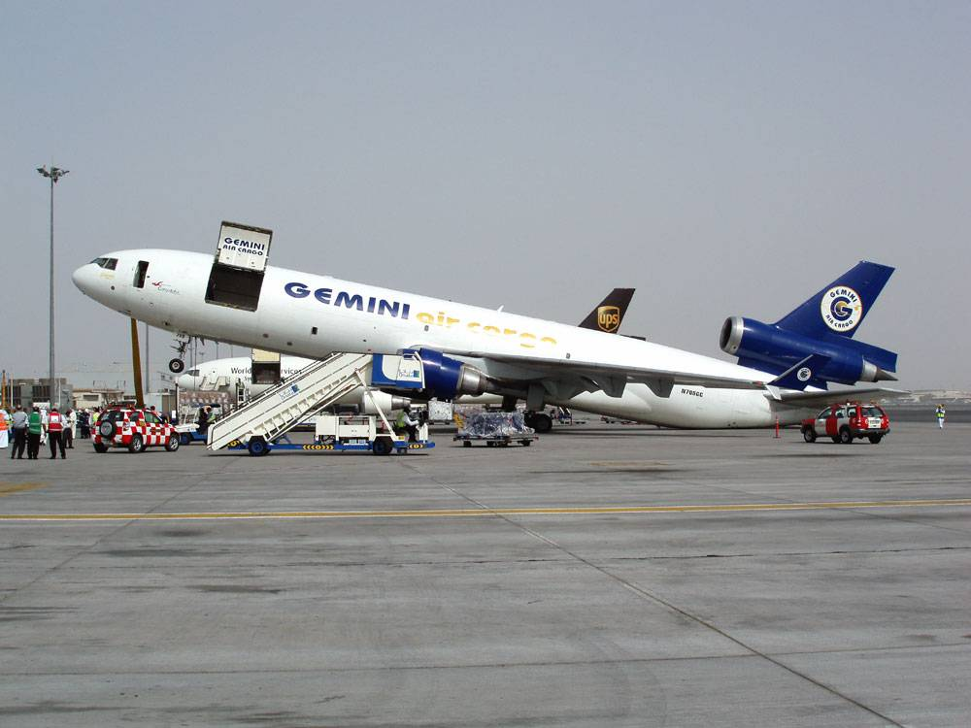
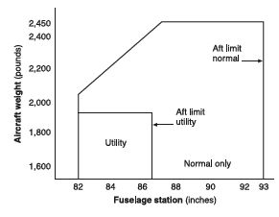
Limitations
Weight & Center of Gravity (balance)
Weight, load composition, and cg position relative to datum
Notes:
Here are some common limitations categories: (Click)
Weight and Center of Gravity. We’re used to seeing maximum gross weight limitations. Some aircraft also have gross weight limitations for takeoff and landing. The composition of the weight is important too. It makes a difference whether the weight is comprised of passengers, cargo, or fuel. Baggage areas often have weight limitations and many aircraft have a zero fuel weight limitation. The calculated center of gravity location must fall within acceptable limits as well.
I know what you’re thinking, “I’ve been a little over on occasion and nothing bad has happened. Here’s the thing. Manufacturers calculate airframe life limits based on operations at max gross weight. Operating above that weight introduces additional stress and fatigue into the airframe and that will cause it to fail sooner than predicted. How much sooner? That’s hard to tell because you don’t know how often and for how long it was overloaded or whether it was overstressed in flight.
(Next Slide)

Slide 21
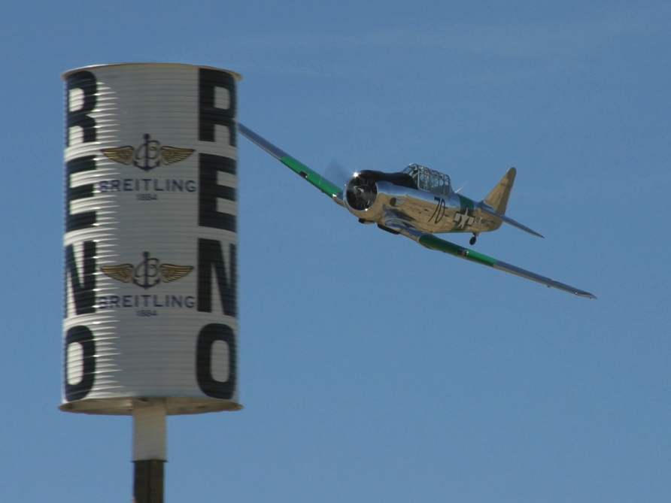
Limitations
Speed
Aircraft design limits, configuration and flight environment
Vne, Vfe, Vle,
Va
50 ft/sec = 34mph
25 ft/sec = 17 mph
Notes:
We’re all familiar with speed limitations. They too are based on flight physics and component strength. And they’re dependent on design limits, aircraft configuration, and the flight environment. We’ve already mentioned Vne as an example of an aircraft design limitation. Vfe and Vle have to do with configuration of flaps and landing gear.
We all know that operating in the yellow arc of the airspeed indicator is reserved for smooth air but how turbulent can it be to operate within the arc? The answer is – not very. (Click)
Certification standards require the airframe to withstand 50 foot per second vertical gusts. But that’s at Va – design maneuvering speed. At higher speeds a 25 foot per second gust is the limit and these are very common in light to moderate turbulence. So the guideline here is, “if the air isn’t perfectly smooth don’t operate in the yellow arc.”
(Next Slide)

Slide 22
Limitations
Aerodynamic Loading
Gs
Normal Category 3.8 Positive 1.52 Negative
Utility Category 4.4 1.76
Aerobatic Category 6.0 3.00
Notes:
And limitations are established for aerodynamic loading for normal, utility, and aerobatic certification categories. Some general aviation aircraft are certified in more than one category with weight and balance limitations associated with each category.
Finally we leave you with this thought: Many limitations are easy to exceed so pilots must be careful to operate their aircraft within their limitations all the time. We owe it to ourselves and those who fly the aircraft after us for years into the future.
(Next Slide)

Slide 23
Questions?
Notes:
Presentation Note: You may wish to provide your contact information and main FSDO phone number here. Modify with
Your information or leave blank.
(Next Slide)

Slide 24
Proficiency and Peace of Mind
Fly regularly with your CFI
Perfect Practice
Document in WINGS
Notes:
There’s nothing like the feeling you get when you know you’re playing your A game and in order to do that you need a good coach (Click)
So fly regularly with a CFI who will challenge you to review what you know, explore new horizons, and to always do your best. Of course you’ll have to dedicate time and money to your proficiency program but it’s well worth it for the peace of mind that comes with confidence. (Click)
Vince Lombardi, the famous football coach said, “Practice does not make perfect. Only perfect practice makes perfect.” For pilots that means flying with precision. On course, on altitude, on speed all the time. (Click)
And be sure to document your achievement in the Wings Proficiency Program. It’s a great way to stay on top of your game and keep you flight review current.
(Next Slide)

Slide 25
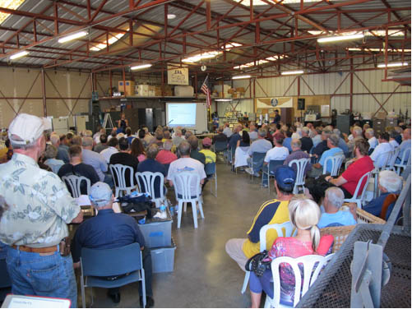
Thank you for attending
You are vital members of our GA safety community
Notes:
Your presence here shows that you are vital members of our General Aviation Safety Community. The high standards you keep and the examples you set are a great credit to you and to GA.
Thank you for attending.
(Next Slide)

Slide 26
The National FAA Safety Team Presents
Topic of the Month - December
Aircraft Performance and Performance Monitoring
<Audience>
<Presenter>
< >
Notes:
(The End)

