Slide 1
The National FAA Safety Team Presents
Topic of the Month – November
CFIT & Overreliance on Automation
<Audience>
<Presenter>
< >
Notes:
2019/04-19-161(I)PP Original Author: John Steuernagle; POC Kevin Clover, AFS-850 Operations Lead, Office 562-888-2020
Presentation Note: This is the title slide for CFIT and Overreliance on Automation
Presentation notes (stage direction and presentation suggestions) will be preceded by a Bold header: the notes themselves will be in Italic fonts.
Program control instructions will be in bold fonts and look like this: (Click) for building information within a slide; or this: (Next Slide) for slide advance.
Some slides may contain background information that supports the concepts presented in the program.
Background information will always appear last and will be preceded by a bold Background: identification.
We have included a script of suggested dialog with each slide. Presenters may read the script or modify it to suit their own presentation style.
The production team hope you and your audience will enjoy the show. Break a leg!
(Next Slide)

Slide 2
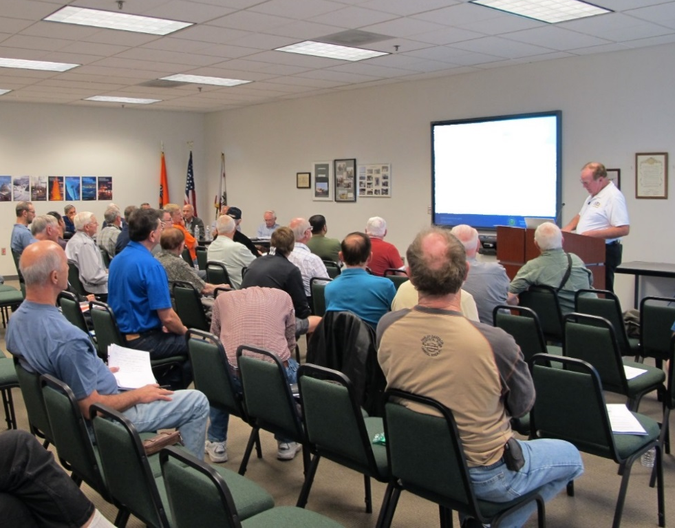
Welcome
Exits
Restrooms
Emergency Evacuation
Breaks
Sponsor Acknowledgment
Set phones and pagers to silent or off
Other information
Notes:
Presentation Note: Here’s where you can discuss venue logistics, acknowledge sponsors, and deliver other information you want your audience to know in the beginning.
You can add slides after this one to fit your situation.
(Next Slide)

Slide 3
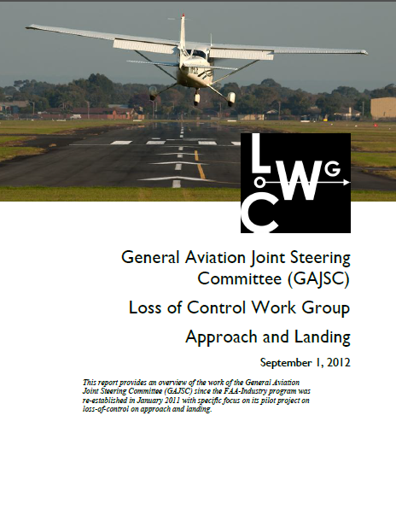
Overview
The CFIT Accident
SRM solutions and *GAJSC safety enhancements
Technology Solutions
Recommendations
*GAJSC – General Aviation Joint Steering Committee
Notes:
In this presentation we’ll talk a little bit about Controlled Flight Into Terrain (CFIT) Accidents and recommendations (termed safety enhancements) from the General Aviation Joint Steering Committee - a work group that studies General Aviation Accidents. We’ll discuss some Safety Risk Management and Technological solutions to CFIT challenges and, finally; we’ll give you some recommendations that will help you to avoid CFIT accidents.
Presentation Note: If you’ll be discussing additional items, add them to this list
(Next Slide)

Slide 4
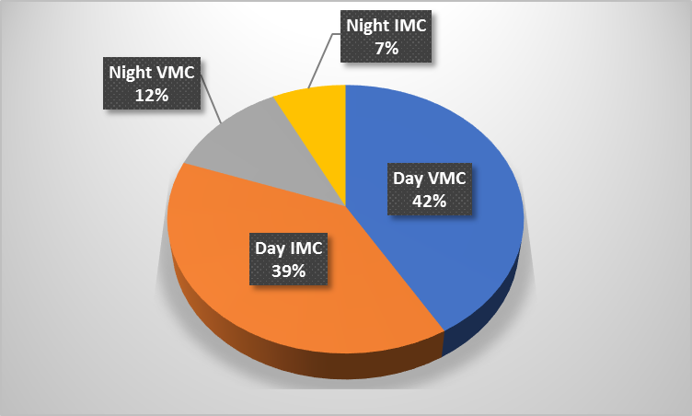
The CFIT Accident
Unintentional Collision with Terrain while an Aircraft is Under Positive Control
In one year
41 CFIT Accidents
56% Fatal
Inexperienced Pilots?
Dark Night and/or IMC?
Flight Environment
Notes:
CFIT is defined as an unintentional collision with terrain while an aircraft is under positive control.
For this presentation we looked at a typical year in which we see about forty CFIT Accidents at least half of which are fatal. (Click)
It’s logical to think that CFIT accidents usually involve inexperienced pilots in dark night and/or instrument meteorological conditions. (Click)
In fact, in a typical year more than 75 percent of CFIT accidents occur in daylight and more than half of those are in visual conditions.
(Next Slide)

Slide 5
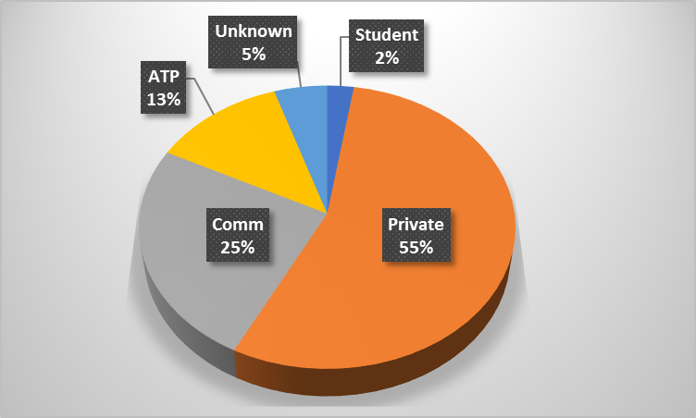
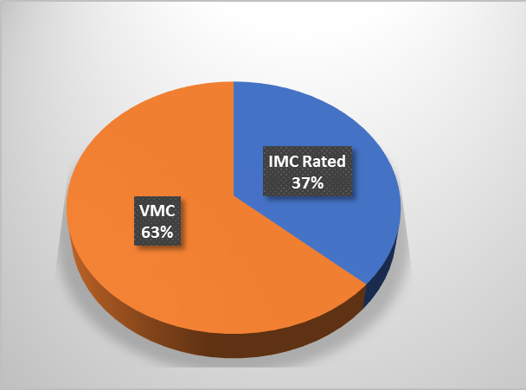
The CFIT Accident
Pilot Certificate Level
Instrument Rating
Notes:
As we might expect – the majority of CFIT pilots hold Private certificates but Commercial and ATP pilots and flight instructors are well represented too.
You might think that most CFIT Pilots are not instrument rated and that’s correct. (Click)
But in a typical year, more than a third of CFIT pilots hold instrument ratings.
(Next Slide)

Slide 6
The CFIT Accident
Continued VFR into IMC
Accidents are almost always fatal
11 Accidents in study group
25% of total
6 Pilots were instrument rated
5 were not instrument rated
Notes:
Continued VFR into IMC is the deadliest accident precursor. We don’t know how often pilots are successful in pursuing the impossible dream. Undoubtedly some get away safely but continued VFR into IMC accidents are usually fatal. (Click)
Of the 41 accidents in our study group, 11 – or 25% of the total – were preceded by Continued VFR into IMC and they were all fatal. You’d think that VFR pilots would more often be involved in Continued VFR accidents but they were evenly split in this study group.
(Next Slide)

Slide 7
The CFIT Accident
IFR Procedural Mistakes
Flight below minimum en route or crossing altitudes
Descent below MDA
Failure to fly assigned heading or altitude
Wire Strikes
Common in – but not exclusive to - Ag Operations
Most are below 200 Ft. AGL
Many wires are unmarked
Notes:
IFR procedural mistakes account for a significant portion of CFIT accidents each year. Instrument pilots must be sure they’re complying with all aspects of the clearances they accept and the procedures they fly. (Click)
Wire Strikes are often cited in CFIT accident reports and they are common in Agricultural Operations but more than half of them are not associated with Ag flying. It’s true that there are some very high towers around and their support wires can extend well beyond the tower itself. But there are relatively few collisions with tall towers or their support structures. (Click)
In fact, most wire strikes occur below 200 feet AGL. You’ve got to wonder; what required the pilots to be that low – especially in the vicinity of wires? (Click)
And be aware that many wires are unmarked. Give yourself some room. A little extra altitude – even 500 feet – will keep you above 90% of the wires.
(Next Slide)

Slide 8
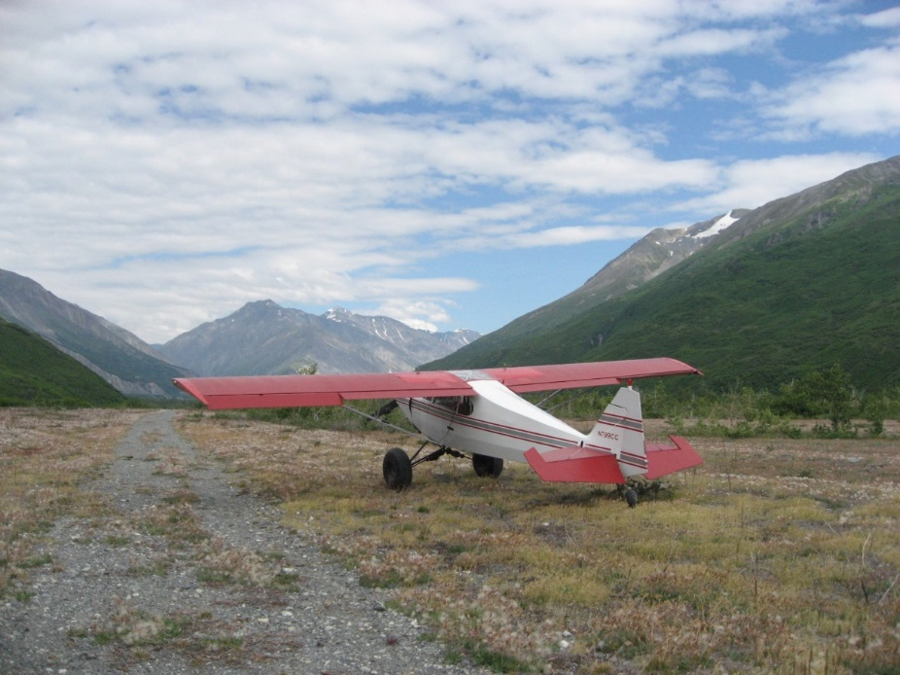
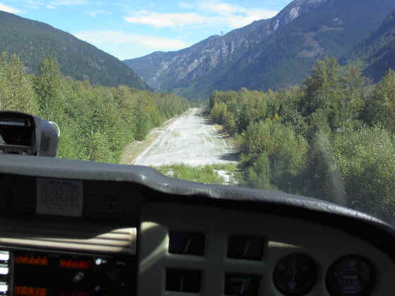
The CFIT Accident
Unrealistic aircraft performance expectations
Density Altitude
Short and/or obstructed runways
Weight and balance
Carb ice
Tailwinds
Notes:
Some CFIT accidents are caused by unrealistic expectations for aircraft performance. High Density Altitude combined with a short and/or obstructed runway and aircraft at near gross weight have resulted in collisions with obstacles on take off. Carburetor or induction system ice can reduce climb performance with the same result. And tailwinds on approach or takeoff can precede CFIT.
(Next Slide)

Slide 9
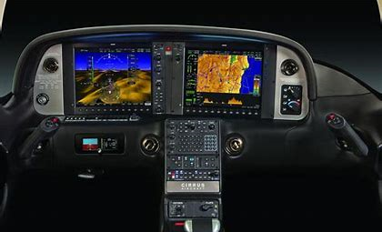
Automation is a wonderful thing
Flies with precision and accuracy
Reduces pilot workload
Notes:
Automation is without a doubt a wonderful thing. Today’s autopilots and associated nav equipment fly our GA aircraft with greater precision and accuracy than most pilots are capable of achieving. Pilot workload is markedly reduced. You can arrive at your destination refreshed – not in a state of physical and mental exhaustion. Those are all good things and, on balance, we’re safer with automation than we ever were before but……
(Next Slide)

Slide 10
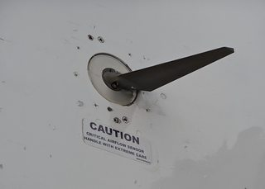
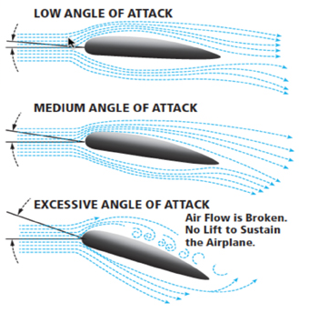
Automation is a wonderful thing ….. but
There are limitations
Notes:
Because automation has limitations and failure modes, pilots must understand the operational parameters, logic, and limitations inherent in their automated equipment. They must be able to recognize when automation is operating as intended and when it is not and they must be prepared to fly their aircraft when automated systems fail. (Click)
We’re all familiar with recent air carrier mishaps in which automation was a factor. Autopilots – like pilots must have good data input in order to fly precisely or, in some cases, in order to fly at all. Pilots receive data input through their senses. Those data are interpreted and the information thus derived is used to make decisions and to control the aircraft. Faulty data can lead to faulty decisions so data quality must be constantly evaluated throughout the flight. Faulty sensor input can cause autopilots to respond inappropriately to aircraft attitude changes.
(Next Slide)

Slide 11
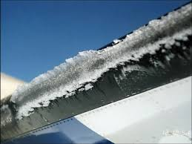
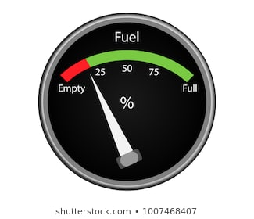
Automation is a wonderful thing ….. but
There are limitations
Notes:
Most general aviation autopilots will hold a heading and many will hold altitude as well. These features have led to surprises though. Pilots flying on autopilot at night have failed to notice ice accretion until the autopilot disconnects when it can no longer maintain altitude. (Click)
And lateral fuel imbalances that you’d be sure to notice while hand flying can be masked by the autopilot until it disconnects because it can no longer keep wings level. A sudden heading excursion is not the best way to become aware that you’ve forgotten to switch fuel tanks.
(Next Slide)

Slide 12
Automation is a wonderful thing ….. but
Stay ahead of the airplane!
“Never let the airplane take you somewhere that your brain didn’t get to five minutes earlier.”
Notes:
There are a few automation systems that integrate aircraft position and terrain information and we’ll see more in the future but the fact is – we are unlikely to be flying with them anytime soon. Therefore it’s imperative that we remain responsible for adequate terrain and obstruction clearance whether hand-flying or on autopilot. This is relatively easy to do in good Day-VFR weather conditions but night, IMC, or reduced visibility conditions are another matter. (Click)
Or as the old saying goes, “never let the airplane take you somewhere that your brain didn’t get to five minutes earlier”.
(Next Slide)

Slide 13
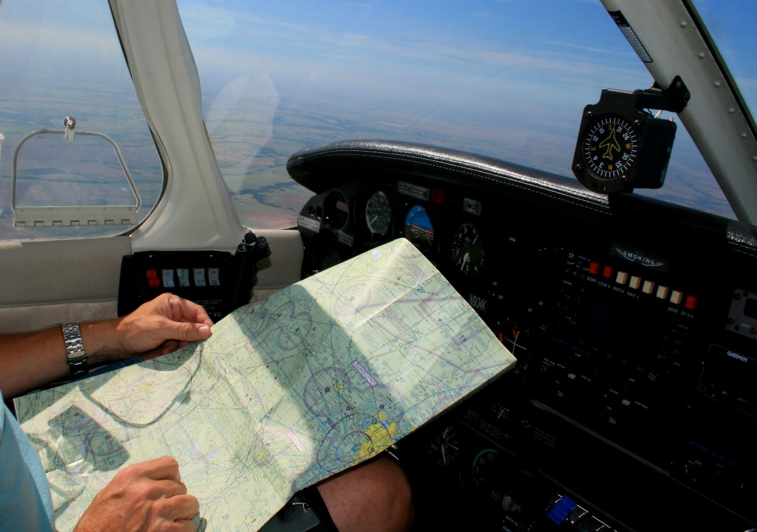
Automation is a wonderful thing ….. but
Breeds complacency
Erodes pilot confidence
Notes:
Perhaps the most insidious aspect of automation is its propensity to breed complacency and erode pilot confidence. Here’s how that works: (Click)
The more time we spend on autopilot, the less time is available to maintain our hands-on skills. Instrument approaches on autopilot are so precise that it’s tempting to “let George do it” all the time but, how would you feel if that was your policy and “George” decided to take a break in the middle of an instrument approach? That might be a time when you wished you’d spent some recent time hand-flying “on the gauges”. It’s a fact that the less time people spend in practicing a skill, the less confidence they have in their performance.
Of course it’s also true that the less you use automation the less confidence you’ll have in it. Achieving a balance between hands-on and automated flying is important.
(Next Slide)

Slide 14
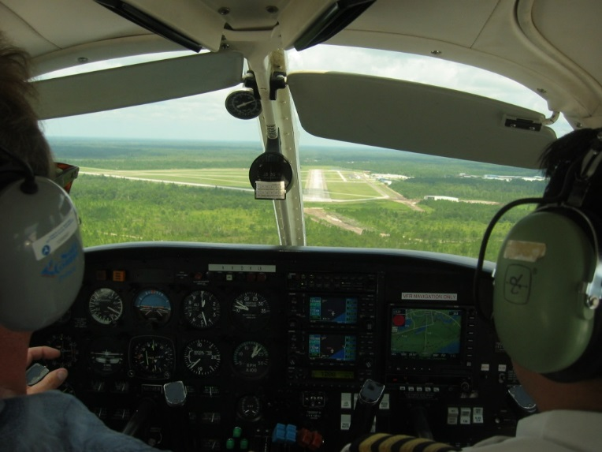
Recommendations:
Thoroughly understand the automation in your aircraft
Including data sources and their failure modes
Normal operations
Failure modes and emergency operations
Know all the ways to disconnect
Practice hand flying regularly
Participate in regular proficiency training
Fly as often as you can
Notes:
Here are our recommendations for successful human/automation relationships. (Click)
Make sure you understand how your automation works and how it behaves when it isn’t working.
Understand where your automation is getting its information and how it will respond if that information is missing or flawed.
There are at least 2 ways to disconnect your automation – many aircraft have more. Know all the ways to quickly disconnect your automation and revert to hand flying. (Click)
Practice hand flying regularly. Many experienced instrument pilots hand-fly at least one instrument approach on each flight. That way they keep their skill and confidence levels high. (Click)
Commit to regular proficiency training. It’s the best way to keep on top of your game. (Click)
And finally, fly as often as you can. After all we love to do it and the more we fly – the better we get – especially if we’re training with a really good coach.
(Next Slide)

Slide 15
Questions?
Notes:
Presentation Note: You may wish to provide your contact information and main FSDO phone number here. Modify with your information or leave blank.
(Next Slide)

Slide 16
Have you earned your WINGS?
Proficient Pilots are:
Confident
Capable
Safe
WINGS will keep you on top of your game
Notes:
Have you earned your WINGS? Proficiency is key to success in almost every thing worth doing – especially flying. Proficient pilots are confident, capable, and safe.
WINGS is a proficiency training system specifically designed for general aviation pilots and, regular participation will keep you on top of your flying game.
(Next Slide)

Slide 17
The Paul & Fran Burger 2019 WINGS $10,000 Sweepstakes
Complete WINGS Phases and WIN Cash Awards!
https://www.mywingsinitiative.org/
Notes:
Now there’s even more reasons to participate in WINGS. Every time you complete a WINGS Phase you’re eligible to win cash the WINGS Sweepstakes.
The sweepstakes is generously funded by Paul Burger, a long time advocate for general aviation safety and a retired aviator who believes participation in this program saves lives.
(Next Slide)

Slide 18
How To Win – It’s Easy
Whenever you complete a WINGS phase, select WINGS Sweepstakes on the Team Member Award section of your My WINGS page
Or Visit www.mywingsinitiative.org & click on “Sweepstakes Entry”
Complete the form, get chances to win one of 10 cash prizes!
Four $1,500, Four $750,Two $500 Winners
Notes:
After you’ve completed a phase of WINGS you can enter the sweepstakes by clicking on “Claim Rewards” in the “WINGS – at a glance” section of your My WINGS page and select WINGS Sweepstakes. Or you can go directly to the mywingsinitiative.org website to complete your entry form.
(Next Slide)

Slide 19
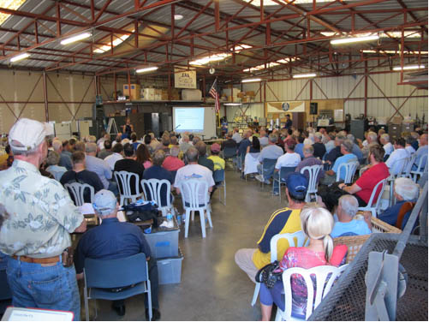
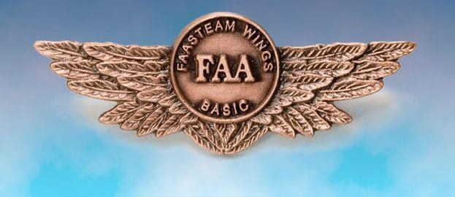
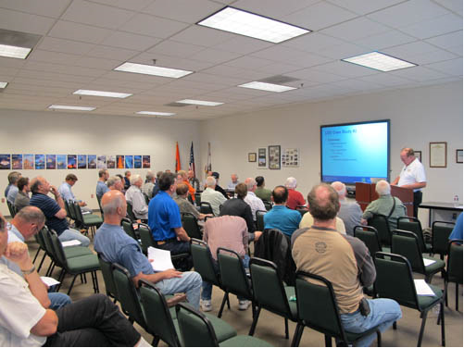
Thank you for attending
You are vital members of our GA safety community
Notes:
Your presence here shows that you are vital members of our General Aviation Safety Community. The high standards you keep and the examples you set are a great credit to you and to GA.
Thank you for attending.
(Next Slide)

Slide 20
The National FAA Safety Team Presents
Topic of the Month – November
CFIT & Overreliance on Automation
<Audience>
<Presenter>
< >
Notes:
(The End)

