Slide 1
The National FAA Safety Team Presents
Topic of the Month – January Distractions and Interruptions
<Audience>
<Presenter>
< >
Notes:
2019/05-09-163(I)PP Original Author: John Steuernagle; POC Kevin Clover, AFS-850 Operations Lead, Office 562-888-2020
Presentation Note: This is the title slide for Distractions and Interruptions.
Presentation notes (stage direction and presentation suggestions) will be preceded by a Bold header: the notes themselves will be in Italic fonts.
Program control instructions will be in bold fonts and look like this: (Click) for building information within a slide; or this: (Next Slide) for slide advance.
Some slides may contain background information that supports the concepts presented in the program.
Background information will always appear last and will be preceded by a bold Background: identification.
We have included a script of suggested dialog with each slide. Presenters may read the script or modify it to suit their own presentation style.
The production team hope you and your audience will enjoy the show. Break a leg!
(Next Slide)

Slide 2
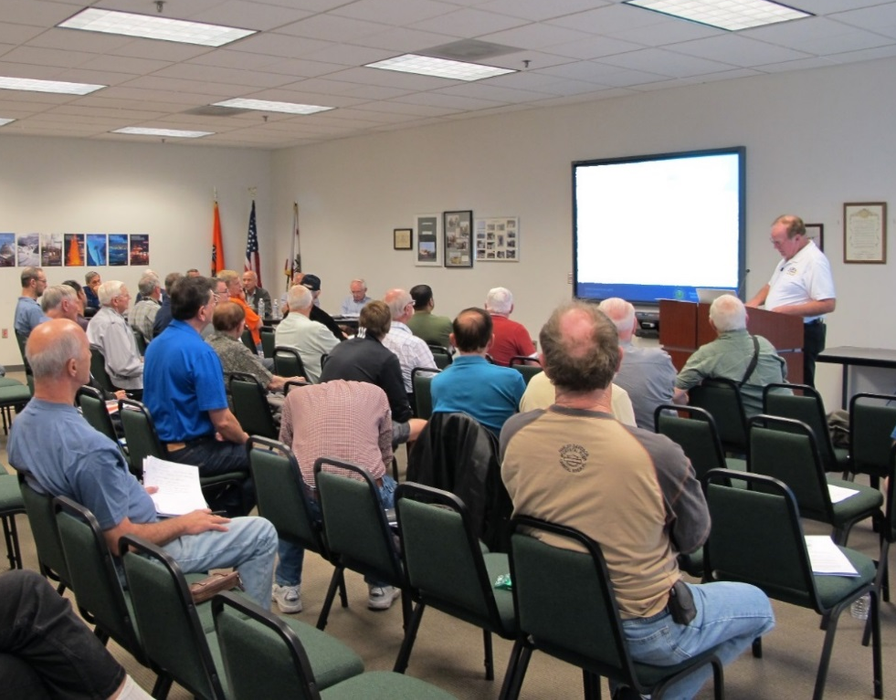
Welcome
Exits
Restrooms
Emergency Evacuation
Breaks
Sponsor Acknowledgment
Set phones and pagers to silent or off
Other information
Notes:
Presentation Note: Here’s where you can discuss venue logistics, acknowledge sponsors, and deliver other information you want your audience to know in the beginning.
You can add slides after this one to fit your situation.
(Next Slide)

Slide 3
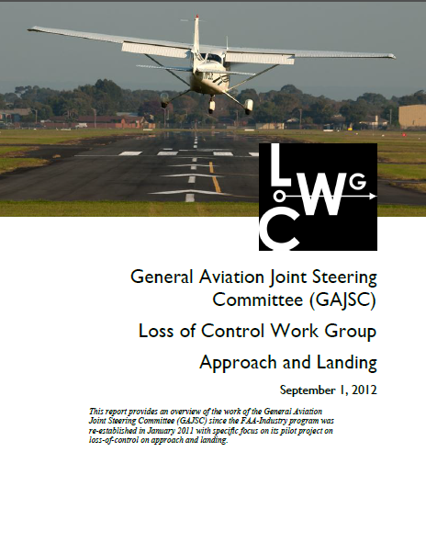
Overview
Aeronautical Decision Making Deficiencies
Dealing with Distractions
Distraction Accident Statistics
Dealing with Interruptions
Recommendations
*GAJSC – General Aviation Joint Steering Committee
Notes:
The General Aviation Joint Steering Committee has determined that Aeronautical Decision Making deficiencies have led to significant numbers of General Aviation accidents. (Click)
In this presentation we’ll discuss one aspect of ADM: dealing with distractions; a hazard that we need to manage whenever we’re walking, driving a vehicle, or flying a plane. (Click)
We’ll cite some statistics on distracted driving and discuss how distraction led to the loss of an airliner. (Click)
We’ll also talk about interruptions – a type of distraction that can be a significant hazard when it occurs in a critical operational phase. (Click)
As usual, we’ll offer some suggestions and best practices for dealing with distractions and interruptions.
Presentation Note: If you’ll be discussing additional items, add them to this list
(Next Slide)

Slide 4
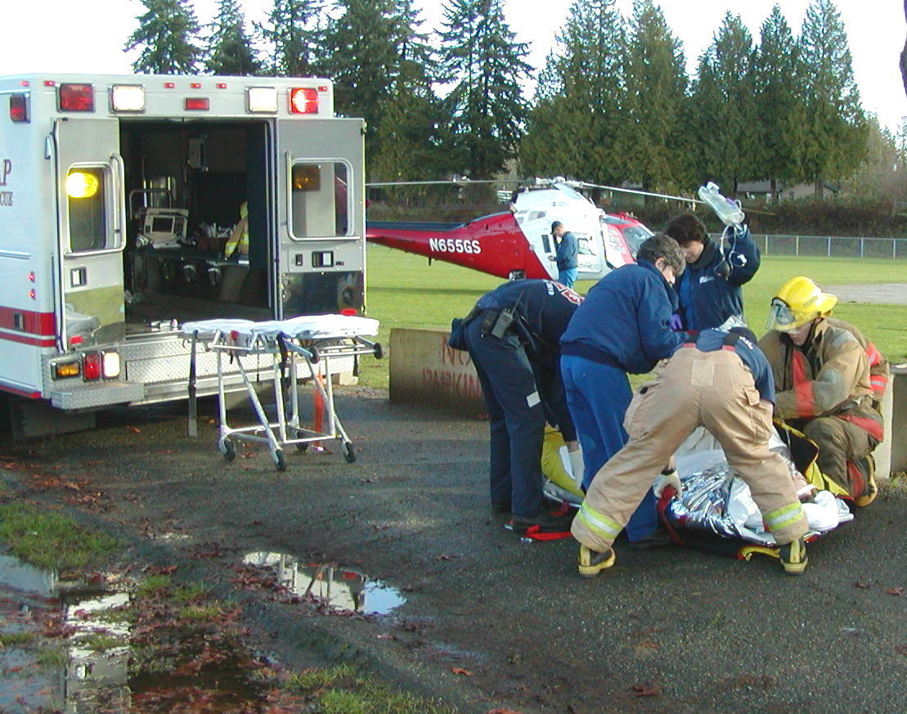
Motor vehicle statistics - 2016
Distracted driving a factor in 25% of all (7,277,000) accidents
1,819,250 accidents
3,439 fatal accidents
562 *collateral fatalities
* pedestrians, bicyclists, others
Notes:
In 2016 there were more than seven million motor vehicle accidents in the United States.
Twenty five percent roughly 1.8 million of those accidents involved distracted driving.
3,439 of those accidents were fatal and there were 562 additional people died because they were simply in the wrong place at the wrong time.a
(Next Slide)

Slide 5
A problem for aviators too
Data not as clear but….
NTSB Most-wanted list
Notes:
Distraction is a problem for aviators too. Although the data aren’t as clear distraction is cited often enough to make its’ elimination an item on the NTSBs Most Wanted List of safety improvements.
(Next Slide)

Slide 6
Distractions
Visual
Manual
Cognitive
Notes:
Distractions come in three basic categories: (Click)
Visual – taking your eyes off outside terrain, traffic, and aircraft attitude references or inside instrumentation. (Click)
Manual – taking your hands off of the aircraft controls. (Click)
Cognitive – taking your mind off of flying. (Click)
By the way, texting while driving is particularly dangerous because it combines all three.
(Next Slide)

Slide 7
Routines
Familiar
Comfortable
Predictable
Multi Tasking Opportunities
Notes:
Many aspects of our lives are routine. With experience we’re comfortable in our daily commuting. We’re familiar with the route and traffic and we can accurately predict our travel time. That comfort can lead some of us to take advantage of multi-tasking opportunities and that can lead to trouble. The truth is that no one multi tasks very well. In order to deal with any interruption or distraction we must divert our attention from the task at hand.
Most pilots are comfortable with their routine flying and many feel that they can successfully divide their attention between flying and dealing with distractions but for drivers and pilots alike; diversion of attention from the task at hand can result in a collision. In the next slide we’ll take a look at a classic aviation example.
(Next Slide)

Slide 8
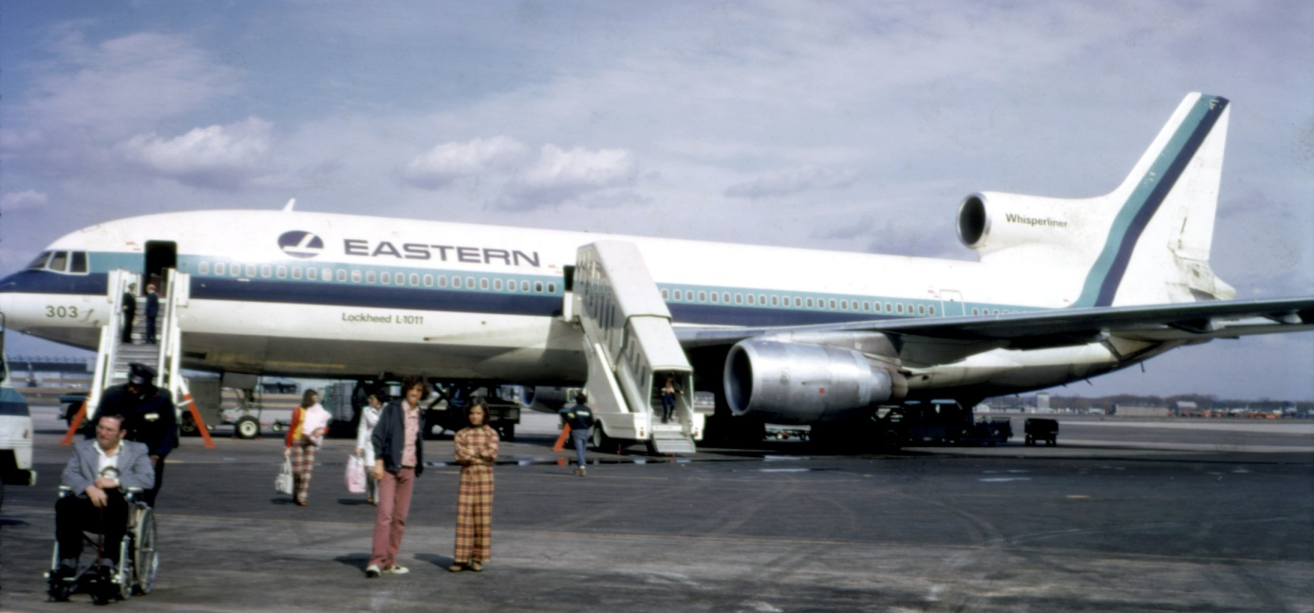
Eastern Airlines 401
L1011 Tri Star
CPT, FO, FE
29 Dec 1972
Night over unlit terrain
101 Fatalities
75 Survivors
Notes:
On the night 29 December 1972 Eastern Airlines flight 401 was on the final approach leg to Miami when the nose gear extended light failed to illuminate. The crew abandoned the approach and requested holding instructions to give them time to work the problem. They were assigned a holding fix over the Everglades swamp at 2,000 feet MSL. With the aircraft on autopilot, the flight engineer was dispatched to confirm nose gear status via a small porthole located in the avionics bay below the cockpit. The crew remaining in the cockpit discussed the problem with a company employee who was riding sitting in a jump seat. While en route to the holding pattern the aircraft slowly lost altitude and crashed when the left wingtip hit the ground in a turn.
The NTSB determined that the autopilot was engaged in control wheel steering mode. That meant that the airplane would respond to pressure on the flight controls and maintain attitude when that pressure was released. The investigators surmised that the Captain inadvertently bumped the control column when he turned in his seat to speak with the flight crew and jump seat rider. The descent was so gradual that no one noticed it and their preoccupation with the landing gear light distracted them from monitoring the aircraft instruments. With no ground lights to reference it would have been difficult if not impossible to visually gauge their height over the swamp.
(Next Slide)

Slide 9
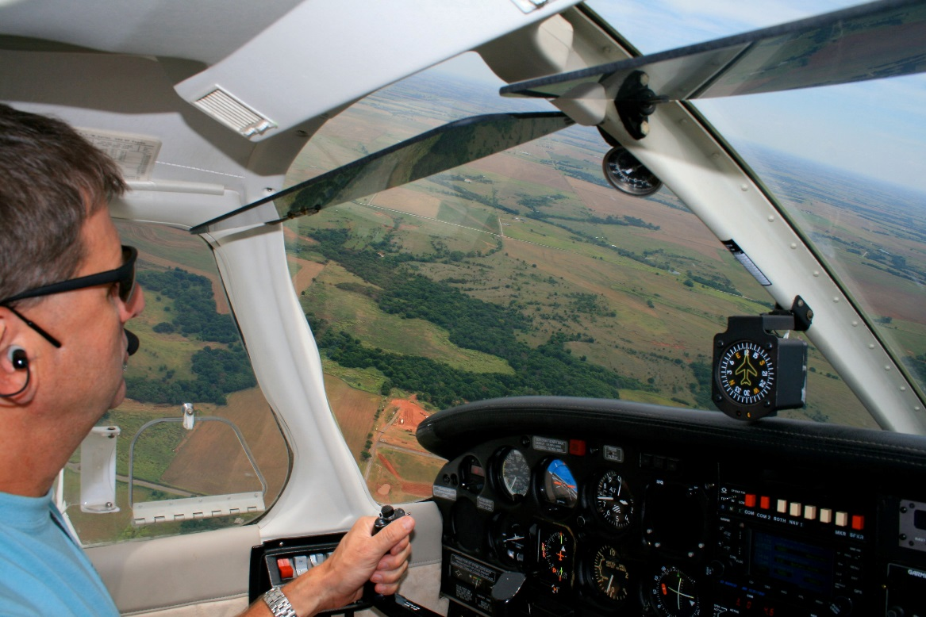
GA Pilots -
Pilot in Command
Cabin attendant
Tour guide
Zoo keeper
Fly the Airplane!
Notes:
We GA pilots don’t usually have a crew to assist us in our many and varied duties. (click)
We are Pilots in Command of course, (click)
But on a typical GA flight we may also be the cabin attendant, tour guide, or even zoo keeper if family pets are on board.
All of these can provide distractions from our job which is of course to - pause for audience to answer - (Click)
“Fly the Airplane”.
(Next Slide)

Slide 10
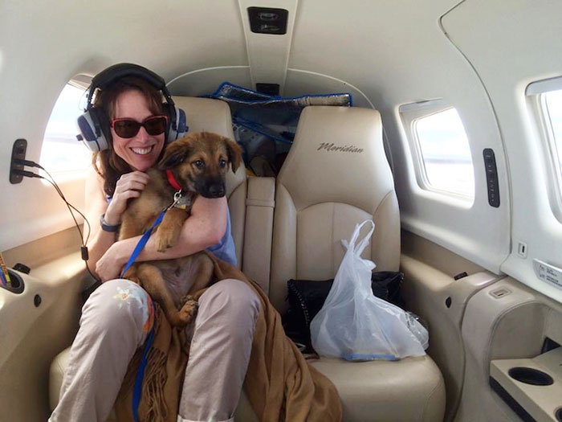
Managing distractions
Use checklists
Manage passenger expectations
Sterile cockpit procedures
Assign tasks to passengers
Traffic spotting
Checklist reading
Trust but verify
Zoo keeping
Notes:
Managing distractions and interruptions is a skill all GA Pilots need to cultivate. (Click)
Comprehensive checklists for normal and emergency operations are key to safe flying but they can’t help if pilots don’t use them. So commit to using checklists on every flight. We’ll discuss checklists further in the next slide (Click)
Next – manage your passenger expectations before you start. Explain that there are critical times during taxi and flight where conversation must be limited to safety of flight items. Explain that there must be no extraneous conversation during taxi, takeoff and climb, descent, approach, and landing. Tell your passengers that you will let them know when it’s safe to speak. (Click)
Many pilots find it helpful to assign tasks to passengers who are willing to accept them. Traffic spotting is a good choice as is checklist reading but be sure to verify that all checklist items have been read in the proper sequence and responded to by the PIC. (Click)
Zoo keeping is an obvious choice for passenger tasking.
(Next Slide)

Slide 11
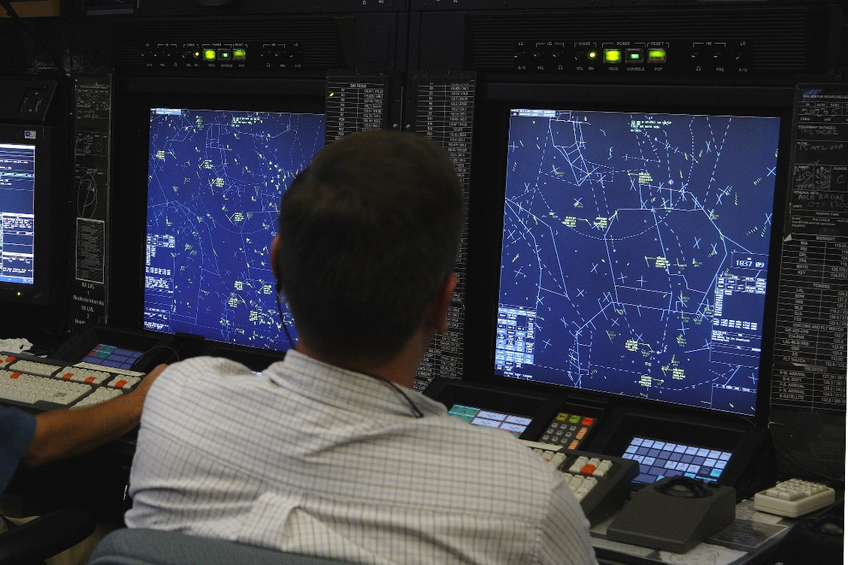
Managing distractions
Manage ATC expectations
Changes to routing, clearance, speed, etc.
Maneuvering requests for spacing
Fly the Airplane!
Understand the request
Ask for repeat or clarification as necessary
Know you can safely comply
Exercise PIC prerogative
Say again
Unable
Standby
Notes:
Air traffic control distractions can be even more compelling than those provided by our passengers. Controllers have the big picture and they issue instructions that will keep traffic flowing smoothly. They don’t know what you’re dealing with though,o they may issue instructions and expect compliance at times when pilot workload is very high. At times like these, we have to keep our priorities straight and, as we’ve said before, our first priority is (Click)
Fly The Airplane! With the airplane under control, you can devote time and energy to the distraction. It’s essential to understand the request so don’t hesitate to ask for clarification. Once you understand the request you can determine if it’s safe to comply. Then – and only then – you can agree to the request. If you’re too busy to deal with the request – fly the airplane and (Click)
Exercise your pilot in command prerogative to say, “ Say Again, Unable, or Standby”.
(Next Slide)

Slide 12
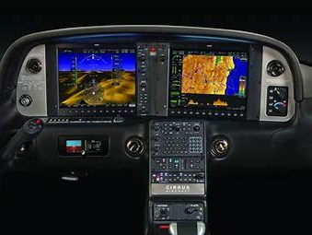
Managing distractions
Manage publications, avionics, and systems
Cockpit organization
Equipment familiarity
Basic aircraft control
Navigation/Communication functions
Failure modes
System monitoring
Notes:
Searching for a chart, checklist, or procedure is a distraction no pilot should have to deal with. Make sure your cockpit is organized with all the reference materials readily
Available. Arrange publications in order of their use making sure that you have access to departure and arrival procedures and taxi charts.
Many of today’s aircraft have amazing avionics packages that integrate flight information on cockpit displays. These installations can be distractions in themselves so it’s very important for pilots to thoroughly understand them. First and foremost we must be able to fly the airplane referencing the cockpit displays. Then we must be able to control
navigation and communication functions and finally, it’s essential to thoroughly understand system failure modes.
Be sure to integrate system monitoring with aircraft control. If you observe a system warning or malfunction, make sure you pay attention to aircraft position and control while you’re dealing with the anomaly. As we learned earlier, devoting all of your attention to a small problem can lead to a much bigger problem.
(Next Slide)

Slide 13
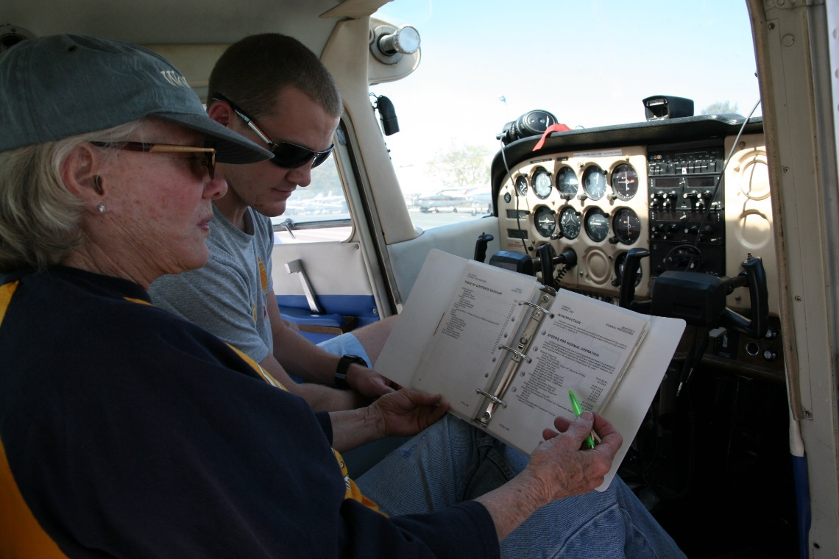
Checklist discipline
Do
Run all relevant checklists on every flight
Don’t
Run checklists while taxiing
If interrupted:
Start checklist from beginning or
Repeat item (s) checked before interruption occurred
Notes:
Do – without exception - run relevant checklists on every flight.
Especially during single-pilot operations; don’t run checklists while taxiing. It’s too easy to stray on the taxi route or pass a holding point. Be sure to consult a taxi chart before and during taxi.
If a checklist is interrupted it’s very easy to miss an item or group of items if you restart the checklist at the wrong place. A good practice is to start the checklist from the beginning after you’ve dealt with the interruption. Failing that, at least back up one or more items from where the interruption occurred and restart the checklist from that point.
(Next Slide)

Slide 14
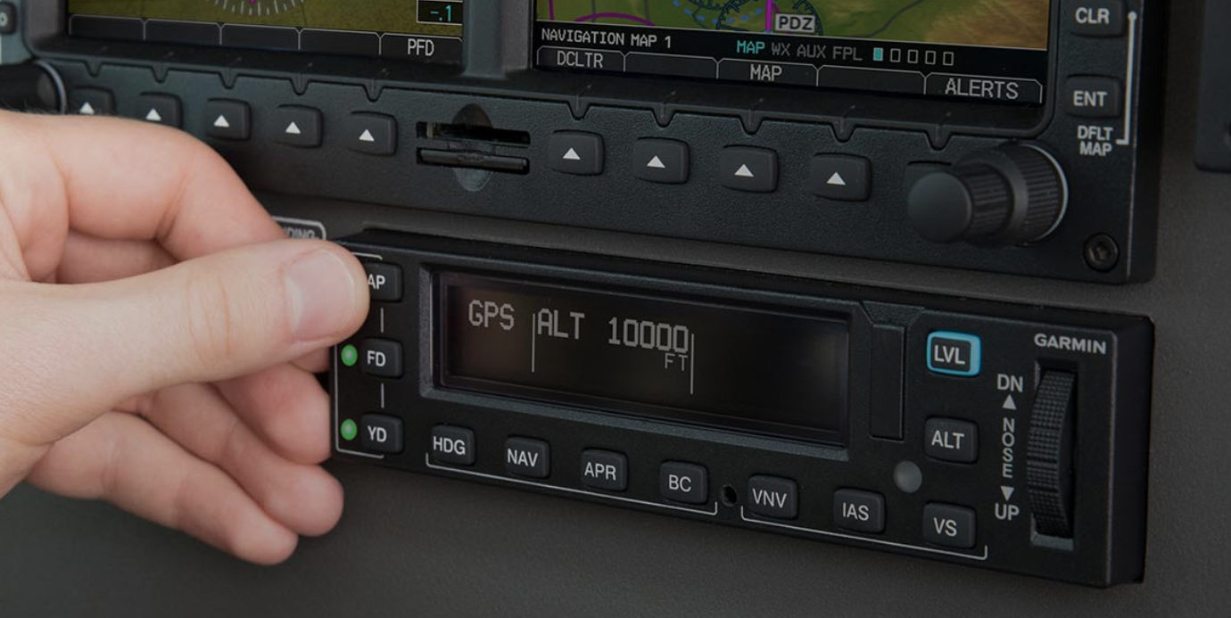
Use the autopilot
Confirm mode, attitude, & flight path
Don’t set it and forget it
Reconfirm periodically
Notes:
Even the most rudimentary autopilots are quite useful when dealing with interruptions or distractions. If you use the autopilot though; confirm that it is operating and in the mode you expect before diverting your attention from aircraft attitude and flight path. And, to avoid nasty surprises such as the example cited earlier, be sure to reconfirm autopilot operation throughout the flight.
(Next Slide)

Slide 15
Questions?
Notes:
Presentation Note: You may wish to provide your contact information and main FSDO phone number here. Modify with your information or leave blank.
(Next Slide)

Slide 16
Have you earned your WINGS?
Proficient Pilots are:
Confident
Capable
Safe
WINGS will keep you on top of your game
Notes:
Have you earned your WINGS? Proficiency is key to success in almost every thing worth doing – especially flying. Proficient pilots are confident, capable, and safe.
WINGS is a proficiency training system specifically designed for general aviation pilots and, regular participation will keep you on top of your flying game.
(Next Slide)

Slide 17
The Paul & Fran Burger 2019 WINGS $10,000 Sweepstakes
Complete WINGS Phases and WIN Cash Awards!
https://www.mywingsinitiative.org/
Notes:
Now there’s even more reasons to participate in WINGS. Every time you complete a WINGS Phase you’re eligible to win cash the WINGS Sweepstakes.
The sweepstakes is generously funded by Paul Burger, a long time advocate for general aviation safety and a retired aviator who believes participation in this program saves lives.
(Next Slide)

Slide 18
How To Win – It’s Easy
Whenever you complete a WINGS phase, select WINGS Sweepstakes on the Team Member Award section of your My WINGS page
Or Visit www.mywingsinitiative.org & click on “Sweepstakes Entry”
Complete the form, get chances to win one of 10 cash prizes!
Four $1,500, Four $750,Two $500 Winners
Notes:
After you’ve completed a phase of WINGS you can enter the sweepstakes by clicking on “Claim Rewards” in the “WINGS – at a glance” section of your My WINGS page and select WINGS Sweepstakes. Or you can go directly to the mywingsinitiative.org website to complete your entry form.
(Next Slide)

Slide 19
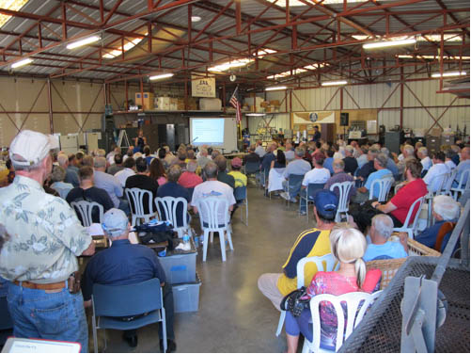
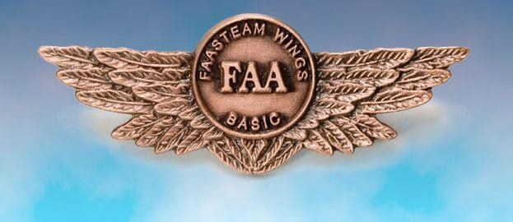
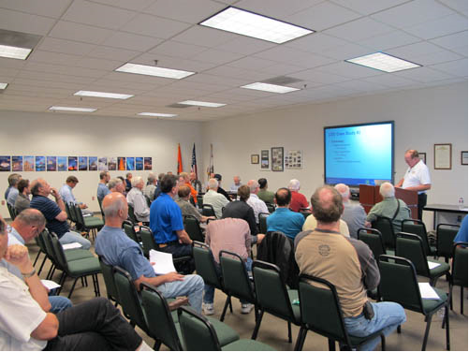
Thank you for attending
You are vital members of our GA safety community
Notes:
Your presence here shows that you are vital members of our General Aviation Safety Community. The high standards you keep and the examples you set are a great credit to you and to GA.
Thank you for attending.
(Next Slide)

Slide 20
The National FAA Safety Team Presents
Topic of the Month – January Distractions and Interruptions
<Audience>
<Presenter>
< >
Notes:
(The End)

