Slide 1
The National FAA Safety Team Presents
Topic of the Month – April
Stabilized Approach and Go-Around For the GA Pilot
<Audience>
<Presenter>
< >
Notes:
(QMS File Number 2019/06-20-167(I)PP) Original Author: H.Metzler POC: K. CloverAFS-850 Operations Lead Office 562-888-2020 Revision
Presentation Note: This is the title slide for Stabilized Approach and Go-Around
Presentation notes (stage direction and presentation suggestions) will be preceded by a Bold header: the notes themselves will be in Italic fonts.
Program control instructions will be in bold fonts and look like this: (Click) for building information within a slide; or this: (Next Slide) for slide advance.
Some slides may contain background information that supports the concepts presented in the program.
Background information will always appear last and will be preceded by a bold Background: identification.
We have included a script of suggested dialog with each slide. Presenters may read the script or modify it to suit their own presentation style.
The production team hope you and your audience will enjoy the show. Break a leg!
(Next Slide)

Slide 2

WINGS Pilot Proficiency Program
Please initial registration sheet if you preregistered
If you did not preregister:
  Please go to faasafety.gov and on the home page locate this seminar under upcoming seminars and register for this seminar &
  Complete the sign in sheet with your name, email address (associated with faasafety.gov account), & phone number.
  Please PRINT LEGIBLY
To learn more about WINGS contact your local WINGSPro
Notes:
You could have this slide showing while folks are arriving.
To receive WINGS credit the email address provided must be the same as the email for your faasafety.gov account. You should receive WINGS credit no later than 2 weeks (you can adjust this time frame) from the date of the seminar. Have the WINGSPro’s in the audience stand up.
(Next Slide)

Slide 3

Welcome
Exits
Restrooms
Emergency Evacuation
Breaks
Sponsor Acknowledgment
Set phones & pagers to silent or off
Other information
Notes:
Presentation Note: Here’s where you can discuss venue logistics, acknowledge sponsors, and deliver other information you want your audience to know in the beginning.
You can add slides after this one to fit your situation. (Next Slide)

Slide 4
Objective
Review Approaches and Landings
Stabilized Approach Concept
Go-Around (Rejected Landing)
Opportunities to Practice
Notes:
Share the objectives with the audience
(Next Slide)

Slide 5
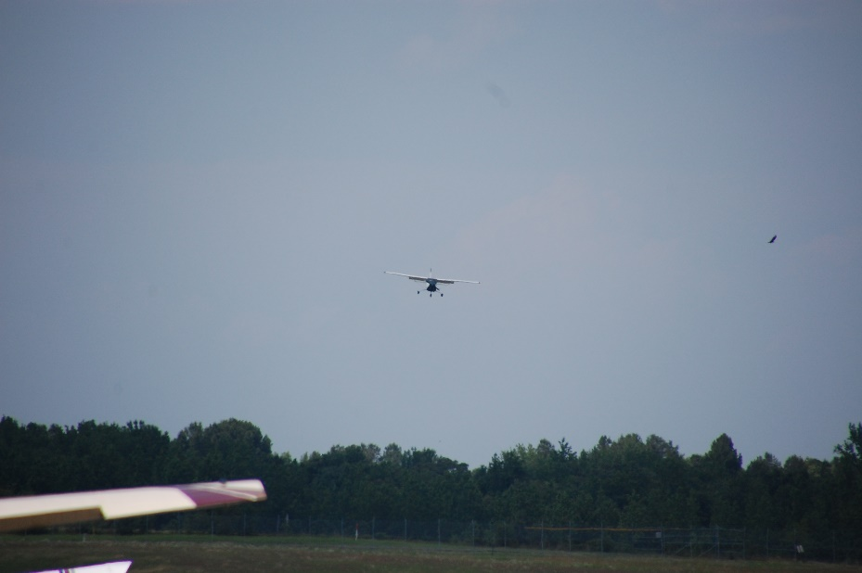
As pilots we have all seen it – the aircraft on final that is way to high and fast or way to low and slow – and all other combinations. As we think back to those sights – how did the landing turn out?
Notes:
Discuss with the audience different approaches that we have witnessed. Let the audience share their stories
(Next Slide)

Slide 6
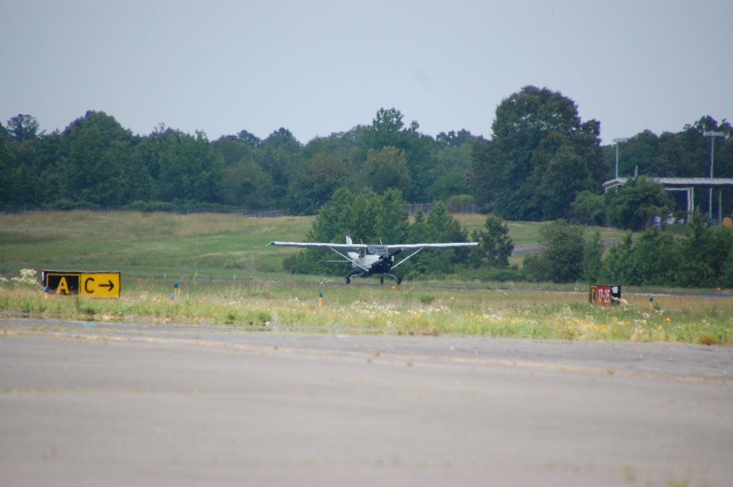
A stabilized approach will give you the best chance for a safe landing
What is a stabilized approach?
Notes:
Takeoffs are optional but landings are mandatory. Explain how a stabilized approach is the safest way to experience a safe landing. Lead into the question what is a stabilized approach? To define a stabilized approach we need to review normal approach and landing as described in the airplane flying handbook in chapter 8. Remind the audience that all FAA Handbooks are free and available on faa.gov
Having the aircraft trimmed on the stabilized approach with help the pilot make a safe landing
Having the aircraft on a stabilized approach will allow for the pilot to recognize the proper landing attitude which will help make a safe landing
The aircraft on a stabilized approach will help prevent a loss of aircraft control during touchdown and roll out
(Next Slide)

Slide 7
Normal Approach and Landing
A normal approach and landing involves the use of procedures for what is considered a normal situation; that is, when engine power is available, the wind is light, or the final approach is made directly into the wind, the final approach path has no obstacles and the landing surface is firm and of ample length to gradually bring the airplane to a stop. The selected landing point is normally beyond the runway’s approach threshold but within the first One Third portion of the runway.
Notes:
Airplane flying Handbook Page 8-2
(Next Slide)

Slide 8
Approach Pattern and Landing Five Phases
The base leg
The final approach
The round out (flare)
The touchdown
The after-landing roll
Notes:
Page 8-2
It must be remembered that the manufacturer’s recommended procedures, including airplane configuration and airspeeds, and other information relevant to approaches and landings in a specific make and model airplane are contained in the Federal Aviation Administration (FAA)-approved Airplane Flight Manual and/or Pilot’s Operating Handbook (AFM/POH) for that airplane. If any of the information in this chapter differs from the airplane manufacturer’s recommendations as contained in the AFM/POH, the airplane manufacturer’s recommendations take precedence.
(Next Slide)

Slide 9
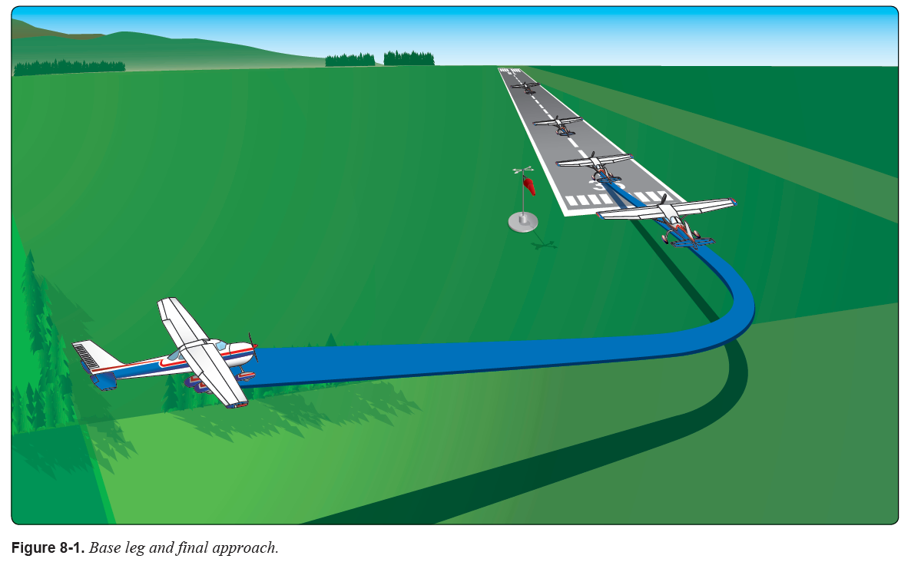
Base Leg
One of the more important judgements made by the pilot in any landing approach
Notes:
Page 8-2
The placement of the base leg is one of the more important judgments made by the pilot in any landing approach. [Figure 8-1] The pilot must accurately judge the altitude and distance from which a gradual, stabilized descent results in landing at the desired spot. The distance depends on the altitude of the base leg, the effect of wind, and the amount of wing flaps used. When there is a strong wind on final approach or the flaps are used to produce a steep angle of descent, the base leg must be positioned closer to the approach end of the runway than would be required with a light wind or no flaps. Normally, the landing gear is extended and the before-landing check completed prior to reaching the base leg.
After turning onto the base leg, start the descent with reduced power and airspeed of approximately 1.4 VSO, which is the stalling speed with power off, landing gear and flaps down. For example, if VSO is 60 knots, the speed should be 1.4 times 60 or 84 knots. Landing flaps may be partially lowered, if desired, at this time. Full flaps are not recommended until the final approach is established. A drift correction is established and maintained to follow a ground track perpendicular to the extension of the centerline of the runway on which the landing is to be made. Since the final approach and landing are normally made into the wind, there is somewhat of a crosswind during the base leg. This requires that the airplane be angled sufficiently into the wind to prevent drifting farther away from the intended landing spot.
The base leg is continued to the point where a medium to shallow-banked turn aligns the airplane’s path directly with the centerline of the landing runway. This descending turn is completed at a safe altitude and dependent upon the height of the terrain and any obstructions along the ground track. The turn to the final approach is sufficiently above the airport elevation to permit a final approach long enough to accurately estimate the resultant point of touchdown while maintaining the proper approach airspeed. This requires careful planning as to the starting point and the radius of the turn. Normally, it is recommended that the angle of bank not exceed a medium bank because the steeper the angle of bank, the higher the airspeed at which the airplane stalls. Since the base-to-final turn is made at a relatively low altitude, it is important that a stall not occur at this point. If an extremely steep bank is needed to prevent overshooting the proper final approach path, it is advisable to discontinue the approach, go around, and plan to start the turn earlier on the next approach rather than risk a hazardous situation.
(Next Slide)

Slide 10
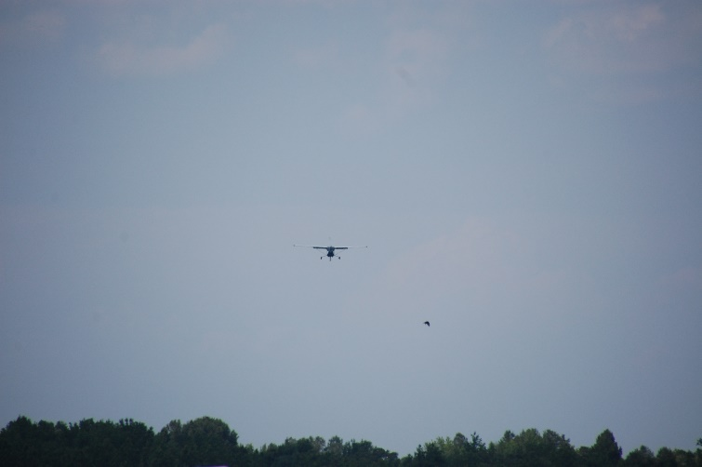
Final Approach
After the base-to-final approach turn is completed, the longitudinal axis of the airplane is aligned with the centerline of the runway or landing surface so that drift (if any) is recognized immediately. On a normal approach, with no wind drift, the longitudinal axis is kept aligned with the runway centerline throughout the approach and landing.
Notes:
Page 8-3 After aligning the airplane with the runway centerline, the final flap setting is completed and the pitch attitude adjusted as required for the desired rate of descent. Slight adjustments in pitch and power may be necessary to maintain the descent attitude and the desired approach airspeed. In the absence of the manufacturer’s recommended airspeed, a speed equal to 1.3 VSO should be used. If VSO is 60 knots, the speed should be 78 knots. When the pitch attitude and airspeed have been stabilized, the airplane is re-trimmed to relieve the pressures being held on the controls.
(Next Slide)

Slide 11
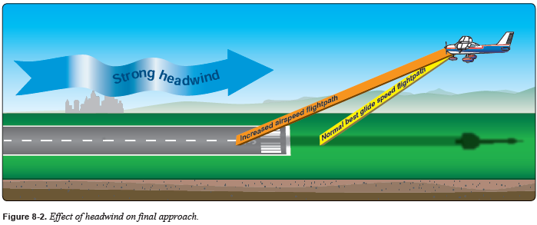
Final Approach
A stabilized descent angle is controlled throughout the approach so that the airplane lands in the center of the first third of the runway.
Notes:
Page 8-3 The descent angle is affected by all four fundamental forces that act on an airplane (lift, drag, thrust, and weight). If all the forces are constant, the descent angle is constant in a no-wind condition. The pilot controls these forces by adjusting the airspeed, attitude, power, and drag (flaps or forward slip). The wind also plays a prominent part in the gliding distance over the ground [Figure 8-2]; the pilot does not have control over the wind but corrects for its effect on the airplane’s descent by appropriate pitch and power adjustments.
(Next Slide)

Slide 12
Stabilized Final Approach
The objective of a good, stabilized final approach is to descend at an angle and airspeed that permits the airplane to reach the desired touchdown point at an airspeed that results in minimum floating just before touchdown; in essence, a semi-stalled condition.
Both the descent angle and the airspeed must be accurately controlled.
Notes:
Page 8-3 and 8-4
Considering the factors that affect the descent angle on the final approach, for all practical purposes at a given pitch attitude there is only one power setting for one airspeed, one flap setting, and one wind condition. A change in any one of these variables requires an appropriate coordinated change in the other controllable variables. For example, if the pitch attitude is raised too high without an increase of power, the airplane settles very rapidly and touches down short of the desired spot. For this reason, never try to stretch a glide by applying back-elevator pressure alone to reach the desired landing spot. This shortens the gliding distance if power is not added simultaneously. The proper angle of descent and airspeed is maintained by coordinating pitch attitude changes and power changes.
To accomplish this, it is essential that both the descent angle and the airspeed be accurately controlled. Since on a normal approach the power setting is not fixed as in a power-off approach, the power and pitch attitude are adjusted simultaneously as necessary to control the airspeed and the descent angle, or to attain the desired altitudes along the approach path. By lowering the nose and reducing power to keep approach airspeed constant, a descent at a higher rate can be made to correct for being too high in the approach. This is one reason for performing approaches with partial power; if the approach is too high, merely lower the nose and reduce the power. When the approach is too low, add power and raise the nose.
(Next Slide)

Slide 13
Use of Flaps
Flap extension has a definite effect on the airplane’s pitch behavior. The increased camber from flap deflection produces lift primarily on the rear portion of the wing. This produces a nose-down pitching moment; however, the change in tail loads from the downwash deflected by the flaps over the horizontal tail has a significant influence on the pitching moment. Consequently, pitch behavior depends on the design features of the particular airplane.
Notes:
Page 8-4
Flap deflection of up to 15° primarily produces lift with minimal drag. The airplane has a tendency to balloon up with initial flap deflection because of the lift increase. The nose-down pitching moment, however, tends to offset the balloon. Flap deflection beyond 15° produces a large increase in drag. Also, deflection beyond 15° produces a significant nose-up pitching moment in high-wing airplanes because the resulting downwash increases the airflow over the horizontal tail.
The time of flap extension and the degree of deflection are related. Large flap deflections at one single point in the landing pattern produce large lift changes that require significant pitch and power changes in order to maintain airspeed and descent angle. Consequently, there is an advantage to extending flaps in increments while in the landing pattern. Incremental deflection of flaps on downwind, base leg, and final approach allow smaller adjustments of pitch and power compared to extension of full flaps all at one time.
(Next Slide)

Slide 14
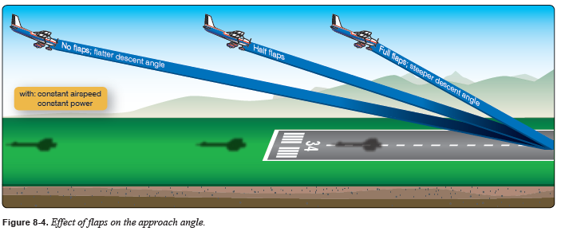
Use of Flaps
When the flaps are lowered, the airspeed decreases unless the power is increased or the pitch attitude lowered.
Notes:
Page 8-4 and 8-5
On final approach, the pilot must estimate where the airplane lands through judgment of the descent angle. If it appears that the airplane is going to overshoot the desired landing spot, more flaps are used, if not fully extended, or the power reduced further and the pitch attitude lowered. This results in a steeper approach. If the desired landing spot is being undershot and a shallower approach is needed, both power and pitch attitude are increased to readjust the descent angle. Never retract the flaps to correct for undershooting since that suddenly decreases the lift and causes the airplane to sink rapidly.
(Next Slide)

Slide 15
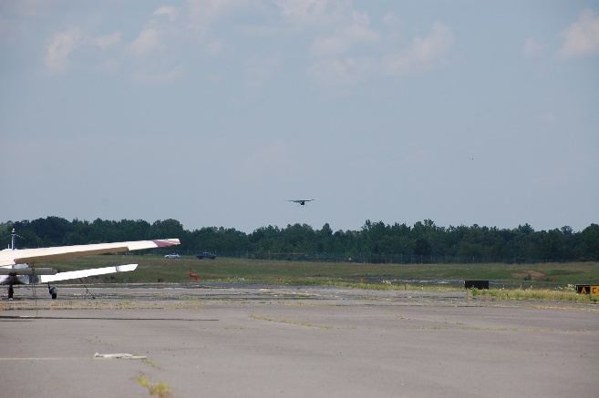
Stabilized Approach Concept
A stabilized approach is one in which the pilot establishes and maintains a constant angle glide path towards a predetermined point on the landing runway. It is based on the pilot’s judgment of certain visual clues and depends on the maintenance of a constant final descent airspeed and configuration.
Notes:
The airplane flying handbook page 8-9
(Next Slide)

Slide 16
Objective of Stabilized Approach
The objective of a stabilized approach is to select an appropriate touchdown point on the runway, and adjust the glide path so that the true aiming point and the desired touchdown point basically coincide
It is essential that deviations from the desired glide path be detected early so that only slight and infrequent adjustments to glide path are required.
Notes:
Page 8-10
Immediately after rolling out on final approach, adjust the pitch attitude and power so that the airplane is descending directly toward the aiming point at the appropriate airspeed, in the landing configuration, and trimmed for “hands off” flight. With the approach set up in this manner, the pilot is free to devote full attention toward outside references. Do not stare at any one place, but rather scan from one point to another, such as from the aiming point to the horizon, to the trees and bushes along the runway, to an area well short of the runway, and back to the aiming point. This makes it easier to perceive a deviation from the desired glide path and determine if the airplane is proceeding directly toward the aiming point.
If there is any indication that the aiming point on the runway is not where desired, an adjustment must be made to the glide path. This in turn moves the aiming point. For instance, if the aiming point is short of the desired touchdown point and results in an undershoot, an increase in pitch attitude and engine power is warranted. A constant airspeed must be maintained. The pitch and power change, therefore, must be made smoothly and simultaneously. This results in a shallowing of the glide path with the aiming point moving towards the desired touchdown point. Conversely, if the aiming point is farther down the runway than the desired touchdown point resulting in an overshoot, the glide path is steepened by a simultaneous decrease in pitch attitude and power. Once again, the airspeed must be held constant. It is essential that deviations from the desired glide path be detected early so that only slight and infrequent adjustments to glide path are required.
(Next Slide)

Slide 17
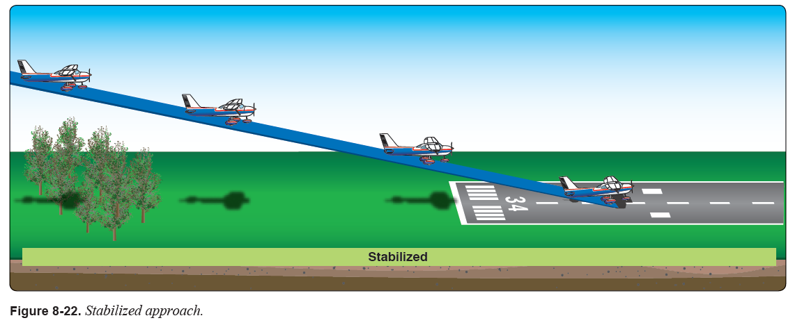
Stabilized Approach
Notes:
This slide is showing where the pilot is maintaining a constant angle glide path towards a predetermined point on the landing runway. It is based on the pilot’s judgement of certain visual clues and depends on the maintenance of a constant final descent airspeed and configuration. An airplane descending on final approach at a constant rate and airspeed is traveling in a straight line toward a spot on the ground ahead.
(Next Slide)

Slide 18
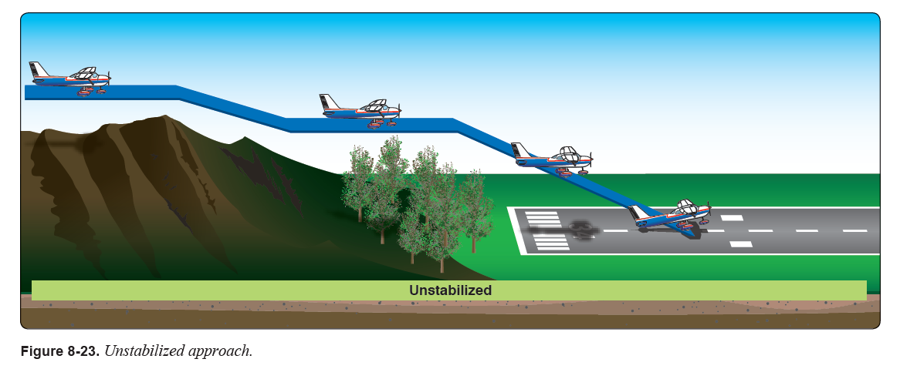
Unstabilized Approach
Notes:
It is obvious that this pilot is not following the stabilized approach concept that we saw in the previous slide. The hazardous with this type of approach is it creates a hazard of overcorrecting with an erratic flight path that could cause a stall while on final or excessive speed that would lead to a very long landing. Additionally, being low over terrain in case of engine failure adds unnecessary risk.
Overcorrecting
Excessive speed
Inadequate compensation for wind drift on final approach
Failure to recognize wind velocity aloft
Failure to adequately compensate for flap extension
Poor trim technique on final approach
Attempting to maintain altitude or reach the runway using elevator alone
Focusing too close to the airplane resulting in a too high round out
Focusing too far from the airplane resulting in a too low round out
Attempting to land in crosswinds that exceed the airplane’s maximum demonstrated crosswind component
(Next Slide)

Slide 19
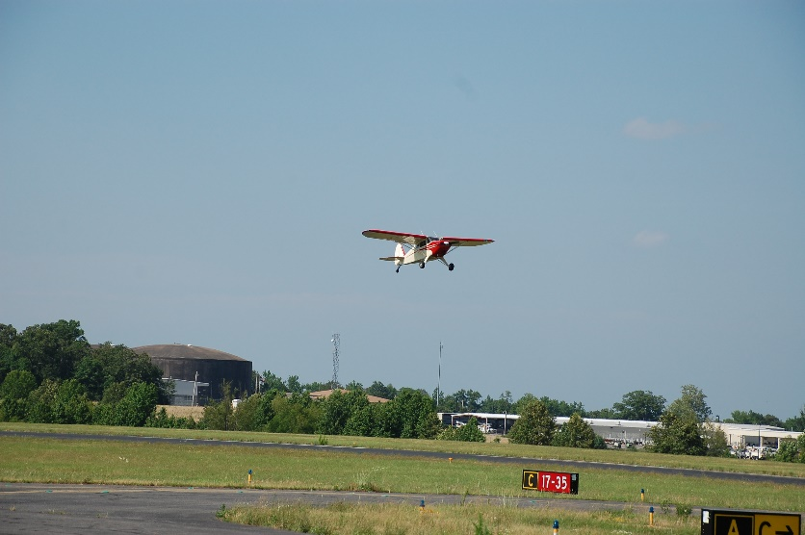
Go-Arounds (Rejected Landing)
Whenever landing conditions are not satisfactory, a go-around is warranted.
Notes:
(Next Slide)

Slide 20
Go-Arounds (Rejected Landing)
There are many factors that can contribute to unsatisfactory landing conditions
  air traffic control (ATC) requirements,
  unexpected appearance of hazards on the runway,
  overtaking another airplane,
  wind shear,
  wake turbulence,
  mechanical failure, and/or
  an unstable approach
Notes:
Page 8-12
examples of reasons to discontinue a landing approach and make another approach under more favorable conditions.
(Next Slide)

Slide 21
Go-Arounds (Rejected Landing)
The assumption that an aborted landing is invariably the consequence of a poor approach, which in turn is due to insufficient experience or skill, is a fallacy.
The go-around maneuver is an alternative to any approach and/or landing.
Once the decision to go-around has been made STICK TO IT
Notes:
Page 8-12
The go-around is not strictly an emergency procedure. It is a normal maneuver that is also used in an emergency situation. Like any other normal maneuver, the go-around must be practiced and perfected. The flight instructor needs to emphasize early on, and the pilot must be made to understand, that the go-around maneuver is an alternative to any approach and/or landing.
(Next Slide)

Slide 22
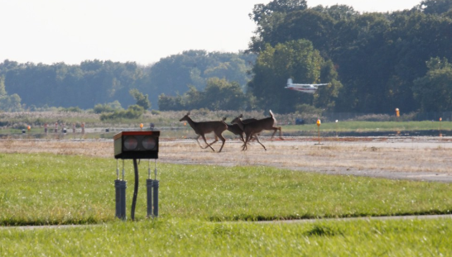
Go-Arounds (Rejected Landing)
There are many reasons for go-arounds that are not always related to pilot’s ability to fly a stabilized approach.
With each landing the pilot needs to consider (brief) the go-around prior to landing.
The pilot needs a plan before the plan is needed.
Notes:
Review the before landing checklist with a CFI and decide where it would be best to consider (brief) the go-around.
It is imperative that go-arounds are practiced and the pilot is proficient.
(Next Slide)

Slide 23

Opportunity to Practice
WINGS Flight Topic 1 ASEL – A070405-07
FAASAFETY.GOV
Notes:
(Next Slide)

Slide 24

Opportunity to Practice
Another great way to stay proficient is flying once a quarter with a CFI. The FAASTeam has developed the flight topic of the quarter to help promote pilot proficiency.
FAASAFETY.GOV
Notes:
Here’s a link to the WTOQ Checklist:
https://www.faasafety.gov/files/events/GL/GL09/2019/GL0993322/WINGS_Topic_of_the_Quarter_Ck-List.pdf
**Have printed copies of the TOQ checklist available to hand out – another option is to have on a personal device and airdrop to folks in the audience.
(Next Slide)

Slide 25
Let’s Review
What is a stabilized approach?
What are some factors that can unstabilize the approach?
What about a crosswind?
Notes:
the pilot is maintaining a constant angle glide path towards a predetermined point on the landing runway. It is based on the pilot’s judgement of certain visual clues and depends on the maintenance of a constant final descent airspeed and configuration. An airplane descending on final approach at a constant rate and airspeed is traveling in a straight line toward a spot on the ground ahead.
Unstabilized approach
Overcorrecting
Excessive speed
Inadequate compensation for wind drift on final approach
Failure to recognize wind velocity aloft
Failure to adequately compensate for flap extension
Poor trim technique on final approach
Attempting to maintain altitude or reach the runway using elevator alone
Focusing too close to the airplane resulting in a too high round out
Focusing too far from the airplane resulting in a too low round out
Attempting to land in crosswinds that exceed the airplane’s maximum demonstrated crosswind component
(Next Slide)

Slide 26
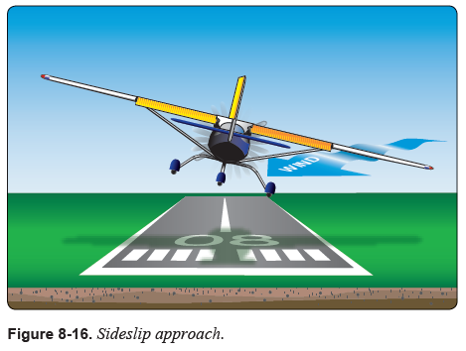
Crosswind
It is extremely important that the airplane’s ground track and longitudinal axis maintain alignment with the runway centerline throughout the final approach.
If at any point the aircraft is not stabilized and in alignment with the runway and cannot be easily corrected a go-around should be executed.
Notes:
See page 8-15 of the airplane flying handbook for more information
The airplane manufacturer recommendations in the AFM/POH always take priority over any recommended procedure outside of the AFM/POH.
Wind Gust – is a sudden, brief increase in speed of the wind. According to U.S. Weather observing practice, gusts are reported when the peak wind speed reaches at least 16 knots and the variation in wind speed between the peaks and lulls is a least 9 knots. The duration of a gust is usually less than 20 seconds.
SURFACE WIND: In tens of degrees and knots. Omitted when less than 6 knots. Gusts indicated by a "G" followed by maximum speed.
One procedure is to use the normal approach speed plus one-half of the wind gust factors. If the normal speed is 70 knots, and the wind gusts are 15 knots, an increase of airspeed to 77 knots is appropriate. In any case, the airspeed and the number of flaps used should conform to airplane manufacturer recommendations in the AFM/POH.
Ref. Airplane flying handbook page 8-18
Crosswind control and the ability to do is essential to a stabilized approach
Consider wind shear – turbulence
(Next Slide)

Slide 27
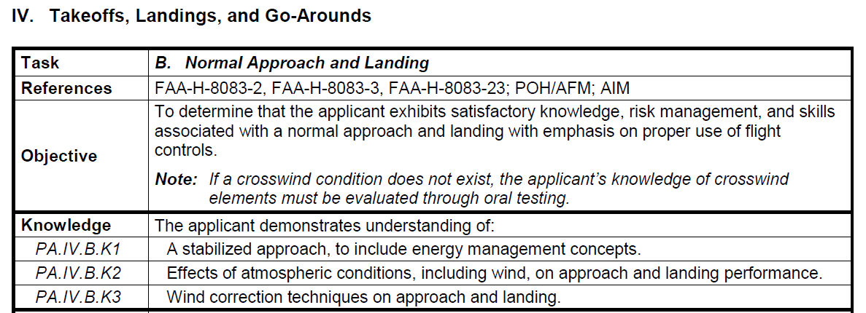
ACS Standard for Private Pilot
Notes:
Note that the applicant must be able to demonstrate understanding of a stabilized approach, to include energy management concepts.
(Next Slide)

Slide 28
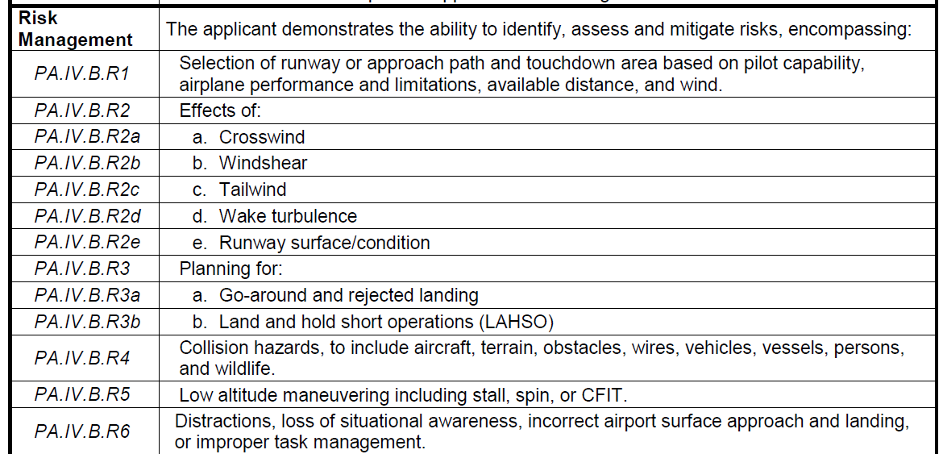
ACS Standard for Private Pilot
Notes:
Additionally the applicant must demonstrate the ability to identify, assess and mitigate risks, encompassing:
Selection of runway or approach path and touchdown area based on:
Pilot capability
Airplane performance and limitations
Available distance, and
Wind
Plan for the go-around and rejected landing
(Next Slide)

Slide 29
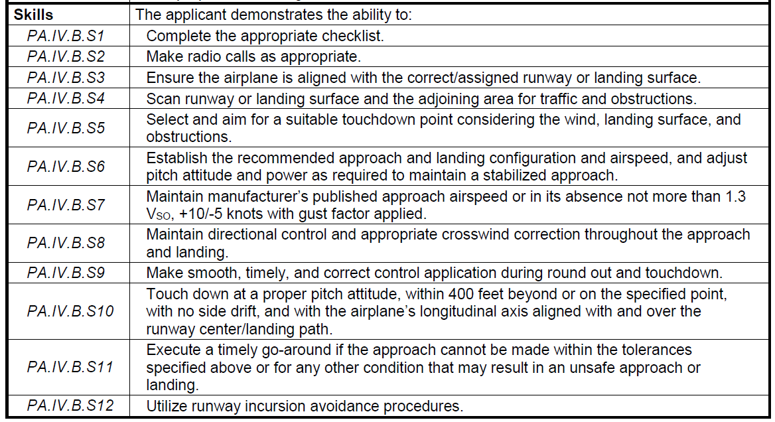
ACS Standard for Private Pilot
Notes:
The applicant must demonstrate the ability to
establish the recommended approach and landing configuration and airspeed, and adjust pitch attitude and power as required to maintain a stabilized approach
execute a timely go-around if the approach cannot be made within the tolerances specified above or for any other condition that may result in an unsafe approach or landing:
published approach speed or 1.3 Vso, +10/-5 Knots with gust factor applied – what constitutes a gust?
(Next Slide)

Slide 30
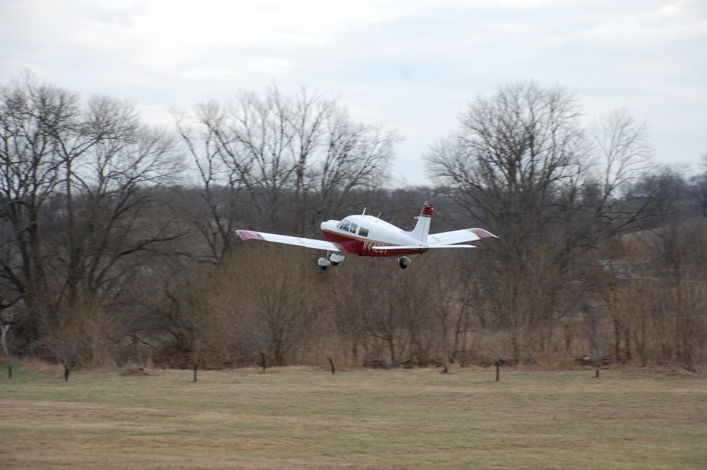
Questions?
Notes:
Presentation Note: You may wish to provide your contact information and main FSDO phone number here. Modify with Your information or leave blank.
(Next Slide)

Slide 31
Summary
Review Approaches and Landings
Stabilized Approach Concept
Go-Around (Rejected Landing)
Opportunities to Practice
Notes:
(Next Slide)

Slide 32

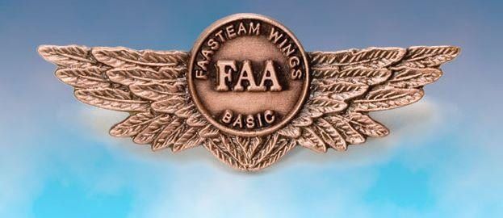
Thank You for Attending
You are vital members of our GA safety community!
Talk to a WINGSPro to learn more about WINGS
You can turn your phones back on
Notes:
Your presence here shows that you are vital members of our General Aviation Safety Community. The high standards you keep and the examples you set are a great credit to you and to GA.
Acknowledge WINGSPros that are in attendance before closing. Have them stand to be identified.
Thank everyone for attending.
(Next Slide)

Slide 33
The National FAA Safety Team Presents
Topic of the Month
September
Stabilized Approach and Go-Around For the GA Pilot
<Audience>
<Presenter>
< >
Notes:
(The End)

