Slide 1
The National FAA Safety Team Presents
Aeronautical Decision Making (ADM)
<Audience>
<Presenter>
< >
Notes:
2020/12/04-180(I)PP Original Author: J Steuernagle 12/04/2020); POC Kevin Clover AFS-850 Ops Lead; Office 562-888-2020 Revised by:
Presentation note: This is the title slide for Aeronautical Decision Making (ADM).
Script - We have included a script of suggested dialog with most slides. The script will always appear in a non-italic font. Presenters may read the script or modify it to suit their own presentation style. See template slides 5 and 6 for examples of a slides with script.
Presentation Instructions - (stage direction and presentation suggestions) will be preceded by a Bold header: the instructions themselves will be in Italic fonts. See slide 2 for an example of a slide with Presentation Instructions only.
Program control instructions - will be in bold fonts and look like this: (Click) for building information within a slide; or this: (Next Slide) for slide advance.
Background information - Some slides may contain background information that supports the concepts presented in the program. Background information will always appear last and will be preceded by a bold Background: identification.
The production team hope you and your audience will enjoy the show. Break a leg!
(Next Slide)

Slide 2
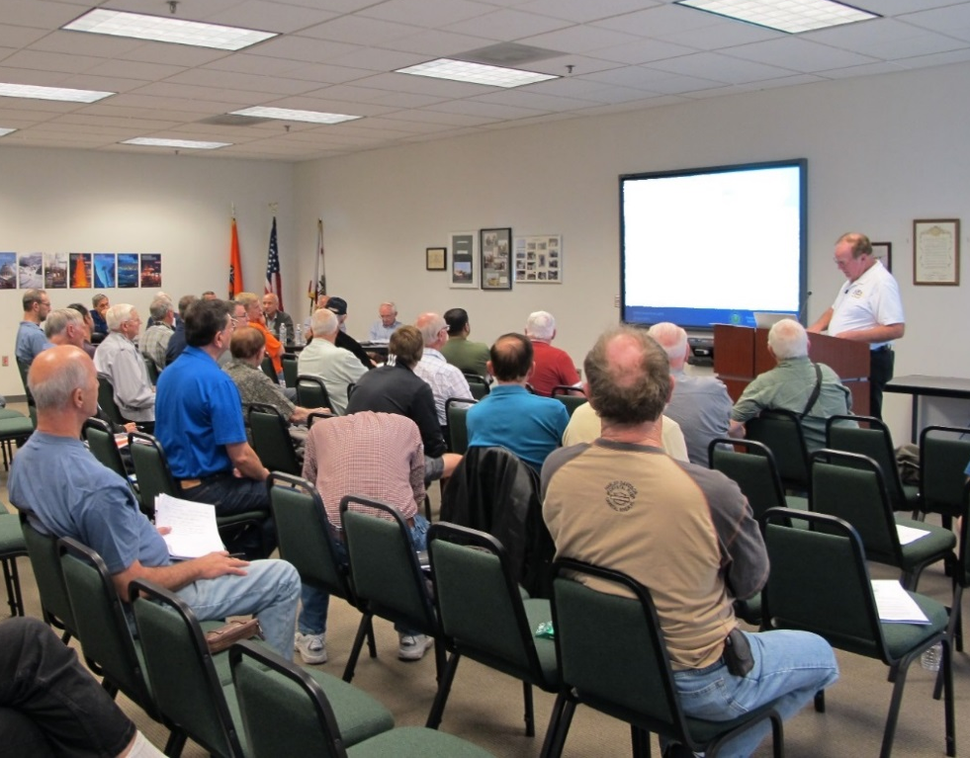
Welcome
Exits
Restrooms
Emergency Evacuation
Breaks
Set cell phones and pagers to silent or off
Sponsor Acknowledgment
Other information
Notes:
Presentation Note: Here’s where you can discuss venue logistics, acknowledge sponsors, and deliver other information you want your audience to know in the beginning.
You can add slides after this one to fit your situation.
(Next Slide)

Slide 3
Overview
ADM History
Safety Benefits of ADM
Present & Future ADM Methodologies and Technologies
Safety Resource Management
Notes:
We want to take just a few minutes to talk about Aeronautical Decision Making or ADM.
We’ll discuss the History and safety benefits of ADM,
As well as present and future ADM methodologies and technologies.
And we’ll address the challenge of managing multiple informational and operational resources.
Presentation Note: If you’ll be discussing additional items, add them to this list
(Next Slide)

Slide 4
In the beginning
Aeronautical Decision Making – A process used by pilots to consistently determine the best course of action in response to a given set of circumstances.
Continuous process from preflight to tie down.
Notes:
Orville and Wilbur practiced ADM before, briefly during, and after their historic first flight on 17 December 1903. Nearly 120 years later pilots are still using ADM to determine the best course of action. (Click)
Presentation note: Read the ADM definition – then:
In other words ADM is what pilots intend to do based on the latest information they have.
(Next Slide)

Slide 5
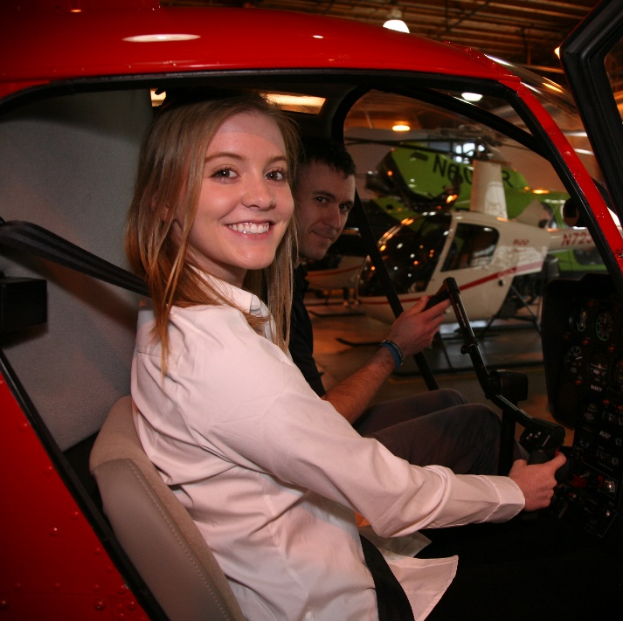
3 P Model
Perceive
Gather all relevant information
Notes:
The ADM process begins during preflight planning, continues throughout the flight and ends with a post flight analysis.
In it’s simplest form ADM is a 3-step process beginning with perception. The pilot gathers all relevant information from disparate sources in order to perceive the mission and the environment within which it will be flown. As we’ll see later, effective resource management is an essential flight management skill. Information gathering begins before takeoff and continues throughout the flight.
(Next Slide)

Slide 6
3 P Model
Perceive
Gather all relevant information
Process
Analyze information and determine best course of action
Notes:
Pilots process the information they gather; analyzing it to determine the best course of action. This analysis continues throughout the flight as new information is received.
(Next Slide)

Slide 7
3 P Model
Perceive
Gather all relevant information
Process
Analyze information and determine best course of action
Perform
Implement the chosen course of action
Notes:
Once a course of action is chosen it’s implemented but we’re not done yet. Performance results become information to be perceived and analyzed
In the course of that analysis, the pilot will decide whether to continue with the chosen action or to choose a different course to pursue.
We mentioned that resource management is essential to effective processing of perceived information. Let’s take a closer look at the resource management process.
(Next Slide)

Slide 8
ADM Tools
Flight Risk Assessment Tools (FRATs)
Documented process for risk management
FRAT Apps
Mobile risk management programs
Notes:
There are a number of Flight Risk Assessment Tools (FRATS) that can make your ADM and risk management easier. FRATs can be as simple as a printed checklist or more complex with numerical values assigned to common hazards, risks and mitigations.
(Next Slide)

Slide 9
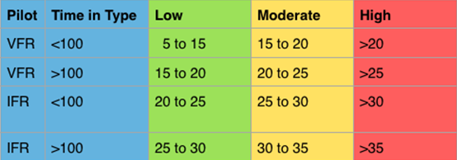
FAAST FRAT
Can’t cover all possible flight hazards
Does address common GA accident causal factors
Safety Risk Management - 101
Notes:
No FRAT can cover all possible flight hazards but this one – produced by the FAASTeam– does address some factors that are common to GA accidents. We hope it’s use will prompt you to learn more about Safety Risk Management.
To get your copy here’s what you do……….
(Next Slide)

Slide 10
FAAST FRAT
Navigate to FAASafety.gov
Click on Resources then click on Library
https://www.faasafety.gov/gslac/ALC/lib_categoryview.aspx?categoryId=31
Notes:
Navigate to FAASafety.gov
Click on Resources, then click on Library. The QR code or URL on screen will take you to the FRAT Category in the library.
Presentation note: The QR code on screen will open the FRAT Category on FAASafety.gov
(Next Slide)

Slide 11
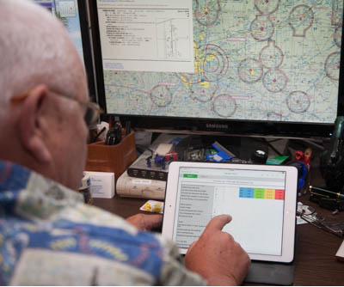
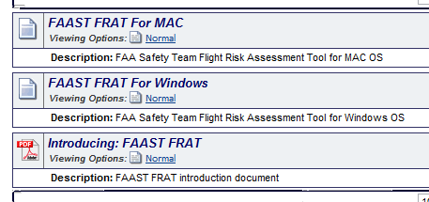
FAAST FRAT
Click on Flight Risk Assessment Tool
Download appropriate FRAT for your computer.
Notes:
Click on Flight Risk Assessment Tool (FRAT).
Then download the appropriate FRAT for your computer.
(Next Slide)

Slide 12
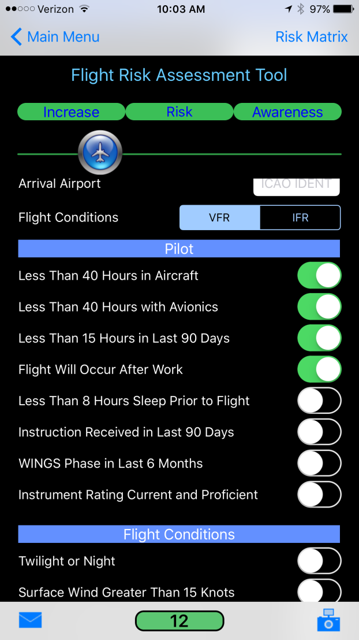
FRAT Apps
Available for mobile devices
Search for FRAT in your mobile App store.
Notes:
There are also a number of mobile FRAT Apps available for Apple and Android Devices. Search for FRATS in your mobile emporium.
(Next Slide)

Slide 13
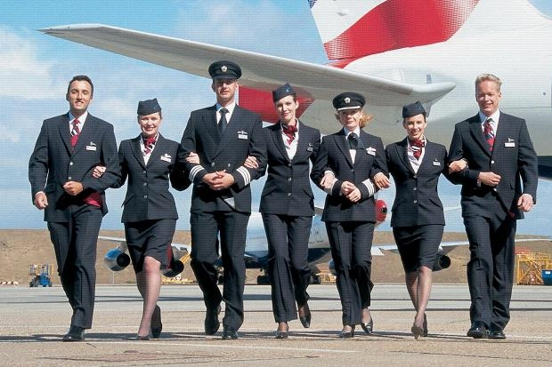
Crew Resource Management (CRM)
Notes:
Crew Resource Management is another essential component of ADM. In the beginning, the captain was in charge and made all the decisions in isolation. (Click)
These days the captain’s still the final authority but the crew and other internal and external resources are involved in the decision making process and that’s a very good thing. The captain manages those resources to effect safe, efficient, and hopefully profitable operations.
(Next Slide)

Slide 14
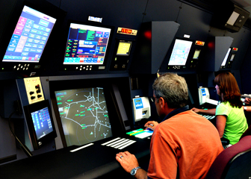
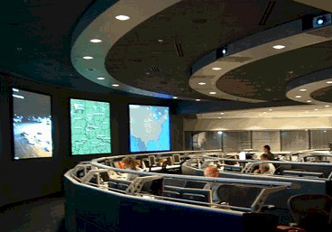
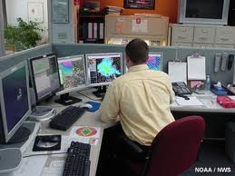
ATC, Flight Dispatch, & Flight Following
Notes:
Captains draw on a host of external resources provided by Air Traffic Controllers of course but also (Click)
Flight Dispatch and Flight Following personnel (Click)
Meteorologists, and Maintenance specialists.
And, through pilot reports, other pilots in the air.
(Next Slide)

Slide 15
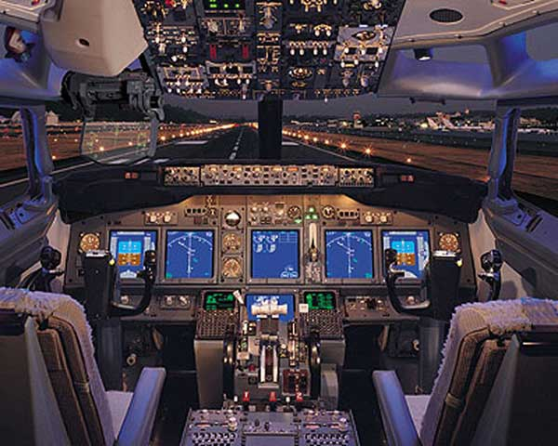
Automation Resources
Notes:
And of course they have autopilot and flight management resources to manage as well. (Click)
(Next Slide)

Slide 16
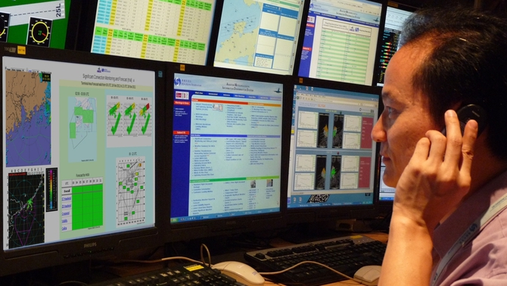
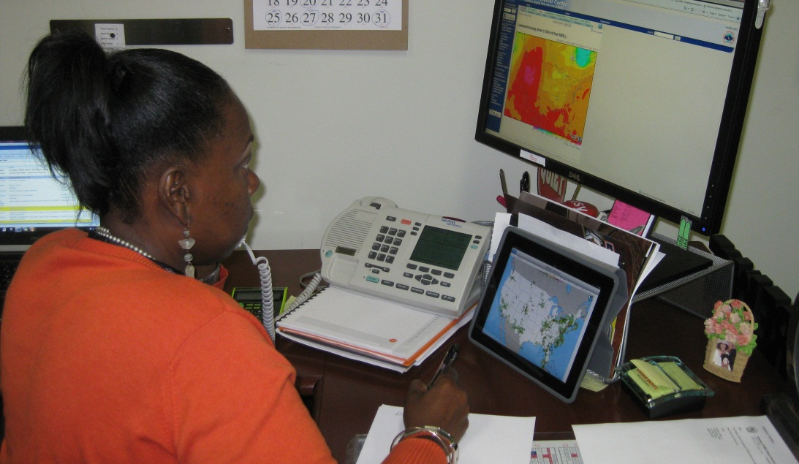
Preflight Resources
Notes:
General Aviation Single-pilot operations offer many opportunities for resource management but most of the human resources aren’t in the airplane with you.
As you complete your flight planning , a call to Flight Service will get you the latest weather and operational information including TFR’s. Many pilots use this call to confirm the information they’ve already accessed on line. And a route briefing just before takeoff will attest to the fact that you have the latest TFR information.
In the air those same specialists are available for consultation. They’re just a radio call away.
(Next Slide)

Slide 17
Passengers
Set Pax. Expectations
Preflight brief
Safety items
Sterile cockpit
Give them jobs to do
Traffic lookout
Chart holder
Checklist reader
Zoo keeper
Notes:
Passengers can go a couple of ways: They can, and will if you let them, distract you from your piloting; or they can be a valuable part of the crew. (Click)
Set passenger expectations before you start engines. Give them a synopsis of the flight route and what they’ll see and hear. (Click)
Cover the standard safety items such as restraints, smoking, & egress. (Click)
And insist on a sterile cockpit for taxi, takeoff, climb, descent, & landing. (Click)
Give your passengers jobs to do. (Click)
Traffic spotting assistance is always appreciated. We know of one pilot who pays his kids a buck for each target they spot before he does. The last we checked, he’s
into them for more than a hundred. Passengers can also be chart holders and, with training & supervision, checklist readers. If family pets are carried they should
also be assigned zoo keeper duties.
All of these things make the time pass more quickly and increase the safety and enjoyment of flight.
(Next Slide)

Slide 18
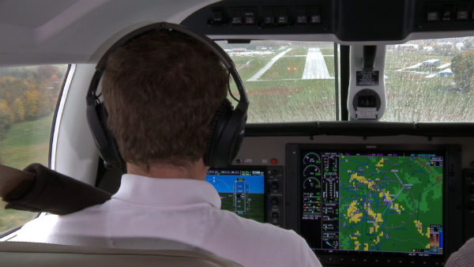
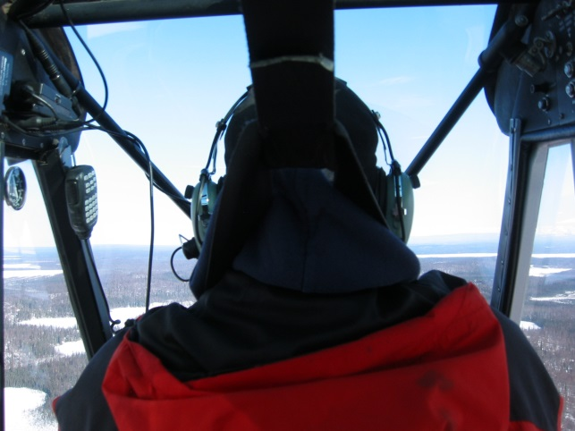
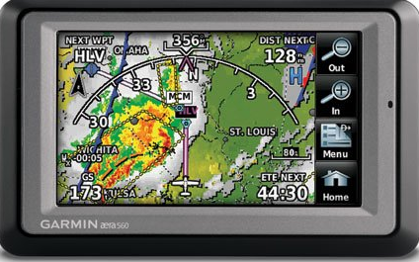
In-flight Resources
Notes:
You may be piloting a plane with the latest glass cockpit equipment that displays traffic and weather. But you might be flying older technology aircraft with a mobile device for navigation and weather data assistance. Either way it’s nice to confirm what you’re seeing with weather specialists or controllers on the ground.
(Next Slide)

Slide 19
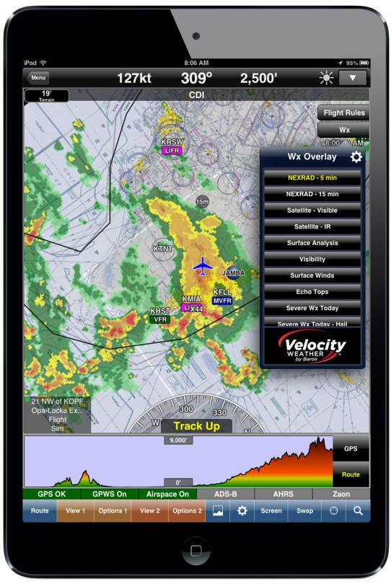
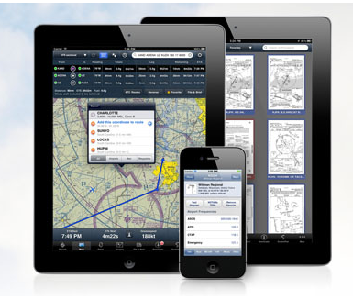
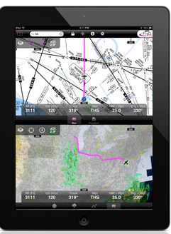
Tablet Apps
Notes:
There are a host of tablet-based aviation apps available these days and many pilots are using them. Be sure you’re thoroughly familiar with your app of choice and that you have the latest information uploaded before flight. We suggest an alternate power supply to guard against dark screens when you need them most.
Here’s a couple of additional tips:
Practice with your device on the ground before flying with it. Find out where best to locate it and practice all in-flight app functions while scanning for traffic.
Don’t let the app distract you from important flying tasks and, even though your app depicts all airspace boundaries; give yourself some room. Fly at least 2 miles outside all airspace
you don’t have clearance to enter. When it comes to pilot deviations, ATC radar trumps i-pad every time.
(Next Slide)

Slide 20
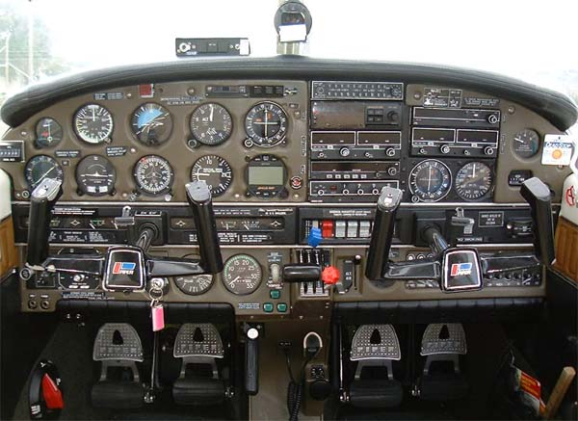
Autopilot systems
AP Maintenance
Practice w/all modes & functions
Don’t neglect hand flying skills
Notes:
Finally – many GA aircraft are equipped with autopilot systems. These valuable crew members can take care of basic wing leveling and, in many cases, navigation tasks while you’re attending to other matters but you have to know how to use them: (Click)
Make sure your autopilot system is properly maintained and functions properly. (Click)
Practice using the autopilot in all modes and functions. (Click)
Don’t neglect your hand flying skills. They deteriorate quickly. Many pilots recommend hand flying alternating between hand flown and autopilot approaches. We recommend 2 hand flown approaches for each autopilot approach.
(Next Slide)

Slide 21
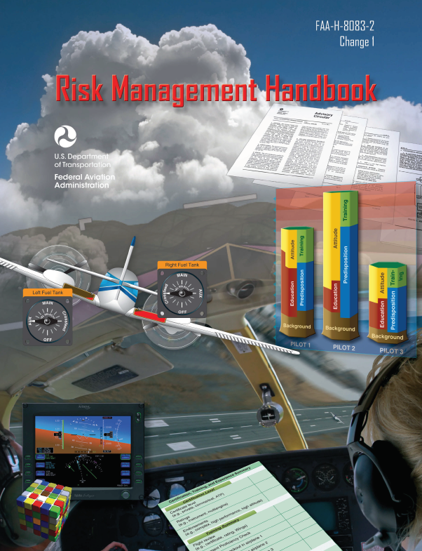
References
Aviation Risk Management Handbook (FAA-H-8083-2) – Chapters Five and Six
https://www.faa.gov/regulations_policies/handbooks_manuals/aviation/media/risk_management_hb_change_1.pdf
Article – Managing Yourself – Flight Training Magazine December 2000
http://flighttraining.aopa.org/magazine/2000/December/200012_Features_Managing_Yourself.html
Notes:
(Next Slide)

Slide 22
Questions?
Notes:
Presentation Note: You may wish to provide your contact information and main FSDO phone number here. Modify with
Your information or leave blank.
(Next Slide)

Slide 23
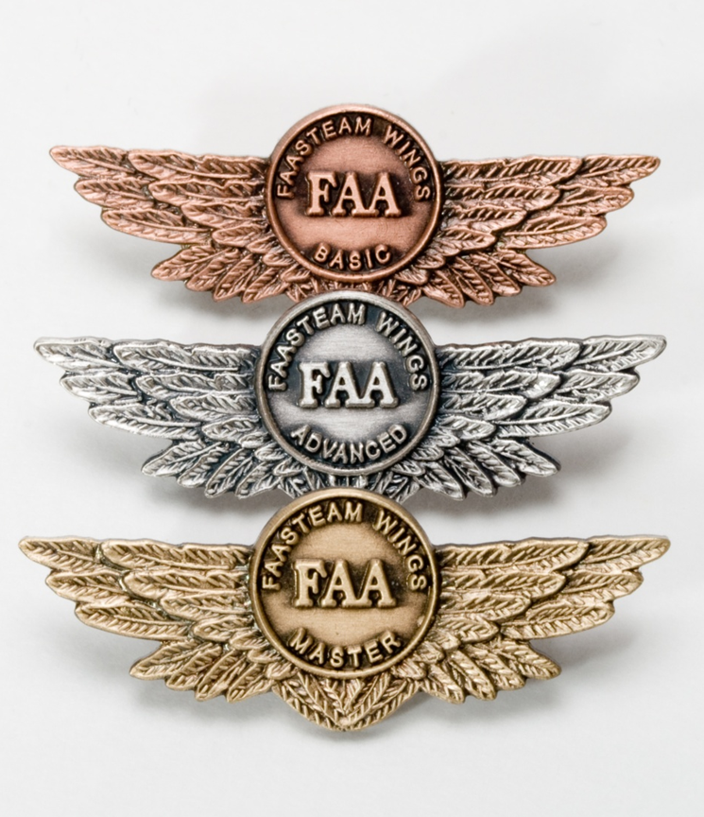
Proficiency and Peace of Mind
Fly regularly with your CFI
Perfect Practice
Document in WINGS
Notes:
There’s nothing like the feeling you get when you know you’re playing your A game and in order to do that you need a good coach (Click)
So fly regularly with a CFI who will challenge you to review what you know, explore new horizons, and to always do your best. Of course you’ll have to dedicate time and money to your proficiency program but it’s well worth it for the peace of mind that comes with confidence. (Click)
Vince Lombardi, the famous football coach said, “Practice does not make perfect. Only perfect practice makes perfect.” For pilots that means flying with precision. On course, on altitude, on speed all the time. (Click)
And be sure to document your achievement in the Wings Proficiency Program. It’s a great way to stay on top of your game and keep you flight review current.
(Next Slide)

Slide 24
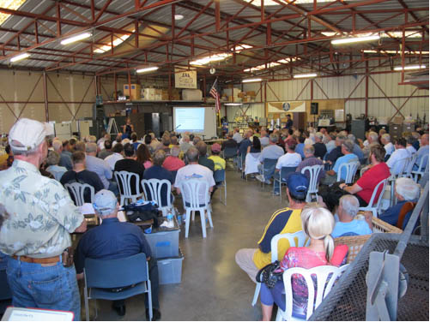
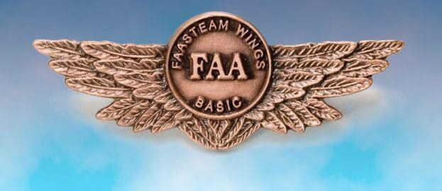
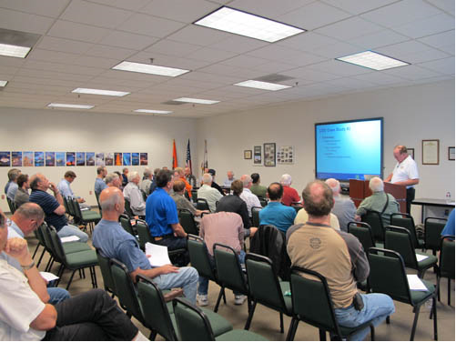
Thank you for attending
You are vital members of our GA safety community
Notes:
Your presence here shows that you are vital members of our General Aviation Safety Community. The high standards you keep and the examples you set are a great credit to you and to GA.
Thank you for attending.
(Next Slide)

Slide 25
The National FAA Safety Team Presents
Aeronautical Decision Making (ADM)
<Audience>
<Presenter>
< >
Notes:
(The End)

