Slide 1
Managing Component Failures
Notes:
2021/01-27-216(I)PP Original Author: Jay M Flowers; POC Kevin Clover, AFS-850 Operations Lead, Office 562-888-2020
Presentation Note: This is the title slide for Managing Component Failure.
Script - We have included a script of suggested dialog with most slides. The script will always appear in a non-italic font. Presenters may read the script or modify it to suit their own presentation style. See template slides 5 and 6 for examples of a slides with script.
Presentation Notes and Instructions - (stage direction and presentation suggestions) will be preceded by a Bold header: the instructions themselves will be in Italic fonts. See slides 2, for an example of slides with Presentation Instructions only.
Program control instructions - will be in bold fonts and look like this: (Click) for building information within a slide; or this: (Next Slide) for slide advance.
Background information - Some slides may contain background information that supports the concepts presented in the program.
Background information will always appear last and will be preceded by a bold Background: identification.
The production team hope you and your audience will enjoy the show. Break a leg!
(Next Slide)

Slide 2


Welcome
Exits
Restrooms
Emergency Evacuation
Silence Phones
Sponsor Acknowledgment
Notes:
Presentation Note: Here’s where you can discuss venue logistics, acknowledge sponsors, and deliver other information you want your audience to know in the beginning.
You can add slides after this one to fit your situation.
(Next Slide)

Slide 3
FAA Defines: Com·po·nent
Any self-contained part, combination of parts, subassemblies or units, which perform a distinctive function necessary to the operation of the airframe, powerplant, or propeller.
Notes:
FAA Define Component as:
Any self-contained part, combination of parts, subassemblies or units, which perform a distinctive function necessary to the operation of the airframe, powerplant, or propeller.
(Next Slide)

Slide 4
Objective:
Discuss Component Failure accident data
Review & case study – Door Opening in Flight
Unexpected Failure Realities
Processing and dealing with Emergencies
Scenario to think about
Brief Accident Review
Closing thoughts and best practices
Notes:
Objective for todays discussion:
Discuss Component Failure accident data
Review & case study – Door Opening in Flight
Unexpected Failure Realities
Processing and dealing with Emergencies
Scenario to think about
Brief Accident Review
Closing thoughts and best practices
(Next Slide)

Slide 5
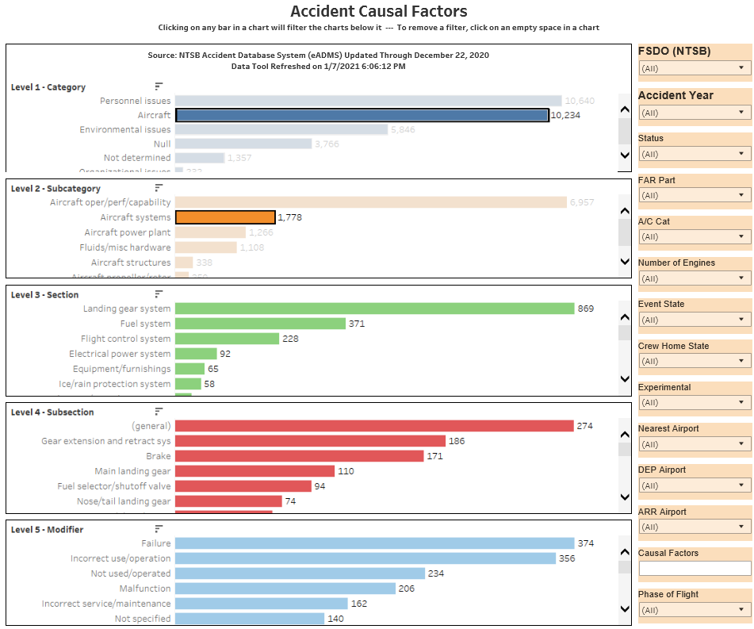
Notes:
Presentation note: The current accident Causal Factors data can be looked up in the FATDAT and placed here. The data in the slide is from 10/01/2009 to 01/11/2021.
In this look, there were over 10,200 aircraft related causal factors, 1,778 of those were aircraft systems (that’s 17% of the factors found to cause the accident).
Over time, this number has remained fairly constant.
Systems generally found to be faulty:
Landing Gear Systems (48%)
Fuel Systems (20%)
Flight Control Systems (13%)
Electrical Power Systems (5%)
These four comprise 86% of the total aircraft system failures. IT DOES HAPPEN!
(Next Slide)

Slide 6

Human Characteristics Common
To Unexpected Failures
Usually Close to the ground
Result of a Configuration Change
No indication there was a prior
concern or issue
Limited Response time “What the….!”
Fact – Recovery success is based on trained response to abnormal events or emergencies!
Notes:
Characteristics Common To Unexpected Failures
Usually Close to the ground
Result of a Configuration Change
Generally no time to use a checklist
Limited Response time: “What the….!”
Your chances of success improve if your responses
to abnormal events or emergencies are
thought about ahead of time!!
Presentation note: An example you might use:
Helicopter engine failures that require autorotation. These must be practiced so that the response from the pilot is quick and assertive.
Multi-engine pilots need to be current and proficient with engine-out procedures on takeoff. With both single and multi-engine aircraft an engine out situation close to the ground requires a pre-planned course of action.
ME pilots practice this throughout their training, but many single pilots don’t have any pre-planned idea of what they will do or where they will go in such a case.
You can think of other emergencies where this kind of pre-planning will make for a better outcome.
(Next Slide)

Slide 7
The Five Stages of Grief
Denial - “This Can’t be Happening!”
Anger - “I can’t believe this is happening
Bargaining - “If you’ll just get me out of this…”
Depression - The hazardous attitude of Resignation
Acceptance - “This IS happening, I’ll take action!”
Notes:
Here are the Five Stages in Detail, as theorized by Elisabeth Kubler-Ross:
The stages, popularly known by the acronym DABDA, include:^{[2]}
Denial — One of the first reactions is Denial, wherein the survivor imagines a false, preferable reality.
Anger — When the individual recognizes that denial cannot continue, it becomes frustrated, especially at proximate individuals. Certain psychological responses of a person undergoing this phase would be: "Why me? It's not fair!"; "How can this happen to me?"; '"Who is to blame?"; "Why would God let this happen?".
Bargaining — The third stage involves the hope that the individual can avoid a cause of grief. Usually, the negotiation for an extended life is made with a higher power in exchange for a reformed lifestyle. Other times, they will use anything valuable against another human agency to extend or prolong the life. People facing less serious trauma can bargain or seek compromise.
Depression — "I'm so sad, why bother with anything?"; "I'm going to die soon so what's the point?"; "I miss my loved one, why go on?"
During the fourth stage, the individual becomes saddened by the certainty of death. In this state, the individual may become silent, refuse visitors and spend much of the time mournful and sullen.
Acceptance — "It's going to be okay."; "I can't fight it, I may as well prepare for it."
In this last stage, individuals embrace mortality or inevitable future, or that of a loved one, or other tragic event. People dying may precede the survivors in this state, which typically comes with a calm, retrospective view for the individual, and a stable condition of emotions.
(Next Slide)

Slide 8

ABOUT THOSE FIRST FOUR…..
In the case of many unexpected situations in aircraft,
if the pilot allows the first four of the five ‘stages of grief’ to
occur, precious altitude, distance and time are compromised!!
You MUST go DIRECTLY to
#5: ACCEPT that the
UNEXPECTED has occurred,
and take action.
Which Brings Us To…
Notes:
ABOUT THOSE FIRST FOUR…..
In the case of many unexpected situations in aircraft, if the pilot allows the first four of the five ‘stages of grief’ to
occur, precious altitude, distance and time are compromised!!
You MUST go DIRECTLY to #5: ACCEPT that the UNEXPECTED has occurred, and take action.
When dealing with the unexpected, particularly if at low altitude on takeoff or landing, there is the element of surprise. Talk to any pilot who has experienced an engine failure on takeoff who DID NOT brief what they would do below leveling off at the cruise altitude, and they will tell you about the ‘Denial’ phase.
CFIs, when planning to surprise a student with a simulated engine failure, landing gear system problem, allow at least 5 seconds (often longer) before expecting them to react. Practice and preparation will likely reduce this reaction time. You can think of and explain similar reactions from pilots that involve Anger, Bargaining, or Depression.
(Next Slide)

Slide 9
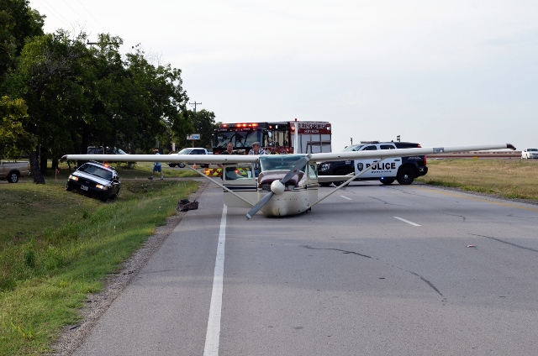
What ARE You Going to Do?
Imagine The Unexpected Failure then, apply the following objectives:
#1 Get out of the emergency alive!
#2
Prepare for Landing
Notes:
What ARE You Going to Do?
Imagine The UNEXPECTED SITUATION or EMERGENCY then apply the following objectives:
#1 Get out of the emergency alive!
#2 Prepare for Landing
Our theme throughout this presentation: think about the unexpected ahead of time!!! In the comfort of your home or office, it is much easier to think through your responses to such an event in light of these two (and there are others!) objectives.
(Next Slide)

Slide 10
PRACTICE makes PERFECT…
Example: While at cruise your cabin door
suddenly pops open!
What can you do to prevent this “failure” from becoming an “Emergency” and possibly an accident?
Review, visualize and practice how you would
handle this situation.
Notes:
PRACTICE makes PERFECT
Example: While at cruise your cabin door suddenly pops open!
What can you do to prevent this “failure” from becoming an “Emergency” and possibly an accident?
Review, visualize and practice how you would
handle this situation.
Knowledge and skill are your Super Power.
Once created, it is important to regularly review and commit to memory procedures you’ve practiced. We’re not dealing with the kind of emergency where there is time to pull out the AFM or a printed checklist to make sure we did all the steps however reviewing those emergencies are just as important. In these situations there’s not time for that, things are happening too quick, to low to the ground!! A Best Practice you may find helpful is to sit in your aircraft and follow the step by step process of recovery which would include touching the controls and managing the issue mentally.
(Next Slide)

Slide 11
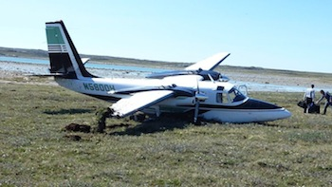
PRACTICE makes PERFECT
Think it through:
Example: Engine failure
What will be the indications?
What must I Manage?
Practice will make the difference in the final outcome of any unexpected failure!
Work with your experiences
Notes:
PRACTICE makes PERFECT
Think it through
Example: Engine Failure
What will be the indications?
What must I Manage?
Practice will make the difference in the final outcome of any unexpected failure!
Work with your experiences
Unfortunately for Sully’s crew, they never professionally trained for a duel engine out emergency, over highly volatile terrain, landing onto a river?
Who does that?
Years of expertise, knowledge of the aircraft, aircraft systems, skill of the crew, training, and the determination to Fly the Airplane is one facet of the outcome in this or any emergency! Another key element to survival of any accident or incident is the training, education, and location of the EMS services on the ground once you get there.
(Next Slide)

Slide 12

CHAIR FLY!!
Regularly practice emergencies, in the comfort of your
favorite chair…
Notes:
CHAIR FLY!!
Regularly practice emergencies, in the comfort of your favorite chair…and you’ll be ready when, hopefully never,
the time comes when you have to manage the unexpected!
Like our pilot buddy here, practicing your emergency procedures regularly, and imagining what you will do, will expose areas where you need more knowledge or practice. NOW you have a chance to sort it out and come up with a plan of action that works better and/or makes more sense.
(Next Slide)

Slide 13

Scenario
Cruising along at 5500 feet the aircraft suddenly starts to vibrate. Dull at first and violently within the next couple of seconds. What do you do?
Notes:
Scenario #1:
Cruising along at 5000 feet the aircraft suddenly starts to vibrate. Dull at first and violently within the next couple of minutes. What do you do?
(Next Slide)

Slide 14
Initial Action: What Just Happened?
#1 - Fly the airplane!
Reduce Power
Disengage the AP
Tighten that seat belt
Consider engine shutdown
Note: If a portion of the propeller has broken free, generally the vibration will continue at any power setting.
Notes:
Initial Action: What just happened?
#1 - Fly the airplane!
Reduce Power
Note: If a portion of the propeller has broken free, generally the vibration will continue at any power setting.
Disengage the AP
Tighten that seat belt
Consider engine shutdown
If a reduction in power either lessens the degree of the vibration or eliminates the vibration, something, either the engine or the propeller will fail. If a portion of a propeller has departed the aircraft the only action may be to shut off the suspected engine immediately.
What do you do?
(Next Slide)

Slide 15
Secondary Actions:
Fly the airplane!
  Checklist - breaks through the distraction
  Prepare for a Landing – directly in front of or below the aircraft is best
  Communicate – remember the far reaching aspects of altitude.
  Is there Time to Troubleshoot?
    What lessens the degree of vibration?
  Power reduction – Monitor gauges, note changes
  Reduce speed, increase speed, flaps, gear, elevator trim
Notes:
Secondary Actions:
Fly the airplane!
Checklist - time permitting, checklist breaks through the distraction and will remind you, make you think
Look for a place to land – a spot directly in front or below is best
Communicate – ATC, AFSS, ATCT; remember the far reaching aspects of altitude.
What lessens the degree of vibration?:
Power reduction – Monitor engine gauges, note changes
Reduce speed, increase speed, flaps, gear, elevator trim
Troubleshooting the issue will not only give you something to report to the mechanic but it will give you an overall look at
what you are dealing with. KNOW WHAT YOU HAVE, WORK WITH IT!
(Next Slide)

Slide 16
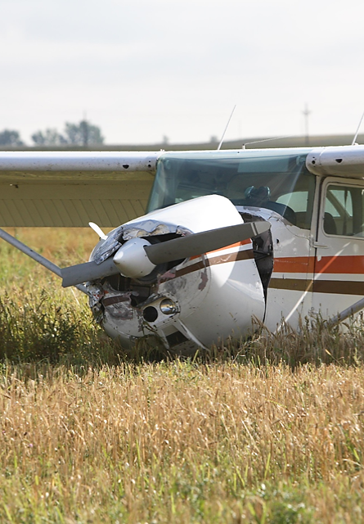
Secondary Action:
Propeller? – issues to expect:
  Is it possible a piece of the propeller has already departed the aircraft?
  Secondary damage to the aircraft?
    If so, did it possibly hit?:
  Tire
  Fuel Tank
  Wing strut, Tail, or wing surfaces
  Tears engine off of its mount?
Notes:
Secondary Action:
Propeller – issues to expect:
Is it possible a piece of the propeller has already departed the aircraft?
Secondary damage to the aircraft?
If so, did it possibly hit?:
Tire
Fuel Tank
Wing strut
Tail or wing surfaces
Tears engine off of its mount?
(Next Slide)

Slide 17
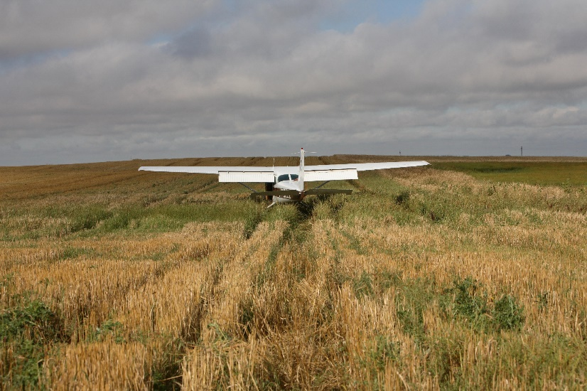
Secondary Actions:
  Admit it! You’re not going to make your destination!
Act: The Engine Must be Shut down!
  Establish - Best Glide
  Continue - Landing site
  Always - Fly the Airplane
Notes:
Secondary Actions:
Admit it! You’re not going to make your destination!
Act: The Engine Must be Shut down!
Establish - Best Glide
Continue - Landing site
Always - Fly the Airplane
(Next Slide)

Slide 18
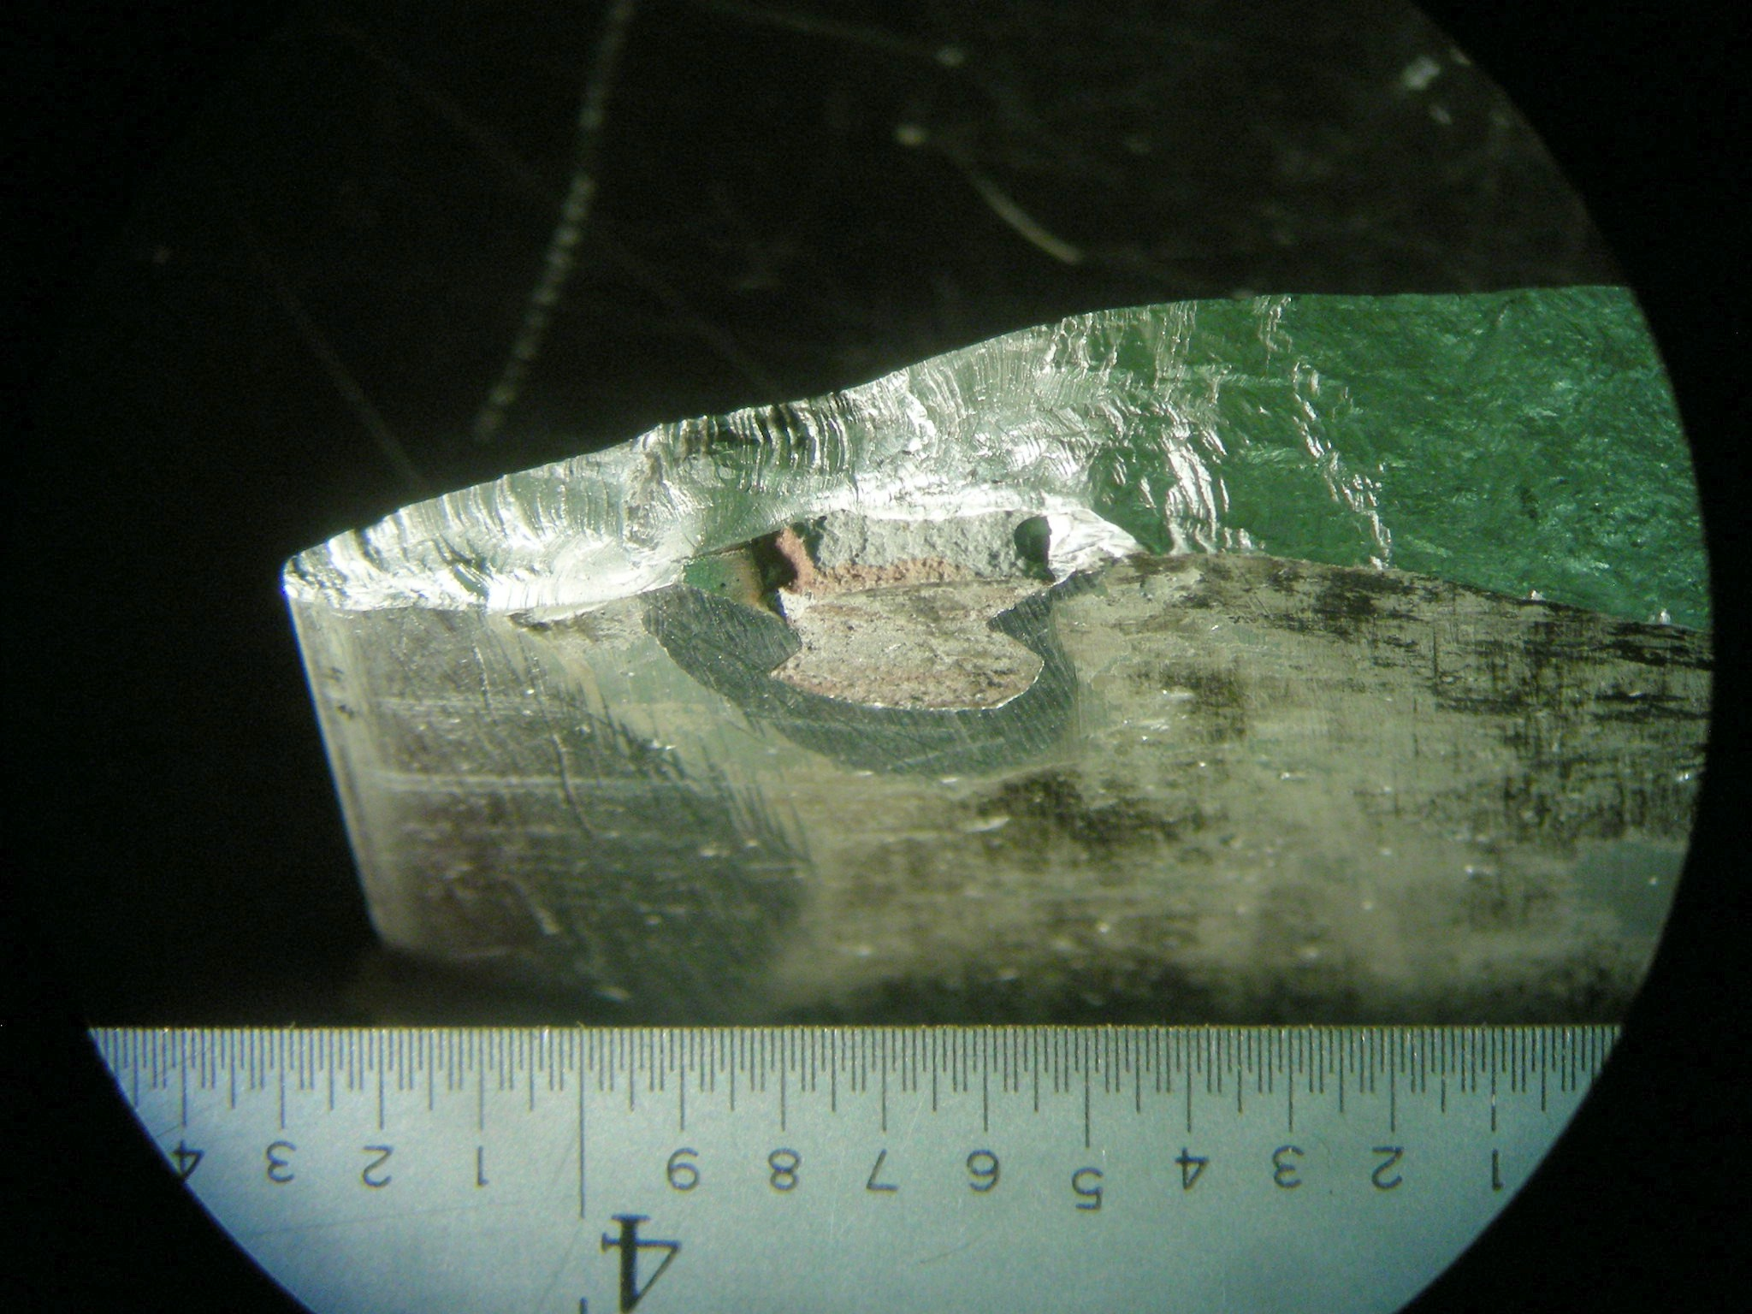
Notes:
The manufacturer was tasked with finding out why the blade failed. At first there were no indications of why the blade should have failed.
Upon further Investigation and stripping the propeller of its paint, the investigation found a reveling point of interest. They found that the propeller had been repaired with a commonly used epoxy resin. It is unknown how long the propeller had been operated with this repair.
(Next Slide)

Slide 19
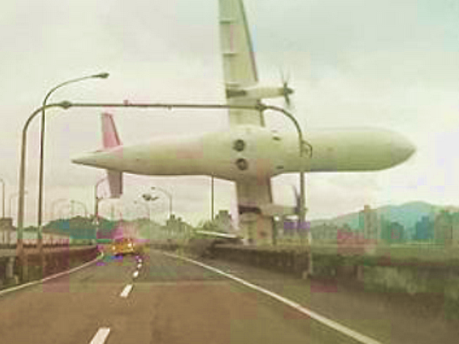
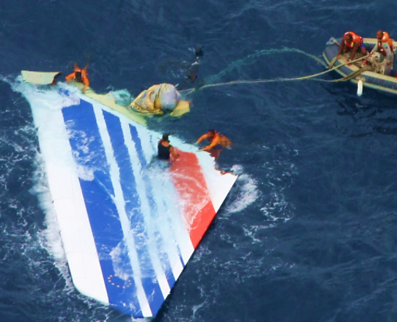
History is telling us:
TransAsia ATR 72
Loss of Control due to lack of system knowledge
Air France 447 (Atlantic Ocean)
Loss of Control due to inability to recognize a deep stall
Notes:
History is telling us that:
TransAsia ATR 72 – Loss of Control due to lack of system knowledge
Air France 447 (Atlantic Ocean) – Loss of Control due to inability to recognize a deep stall
These accidents could have been avoided given the crews ability to manage the unexpected events with their aircraft.
(Next Slide)

Slide 20
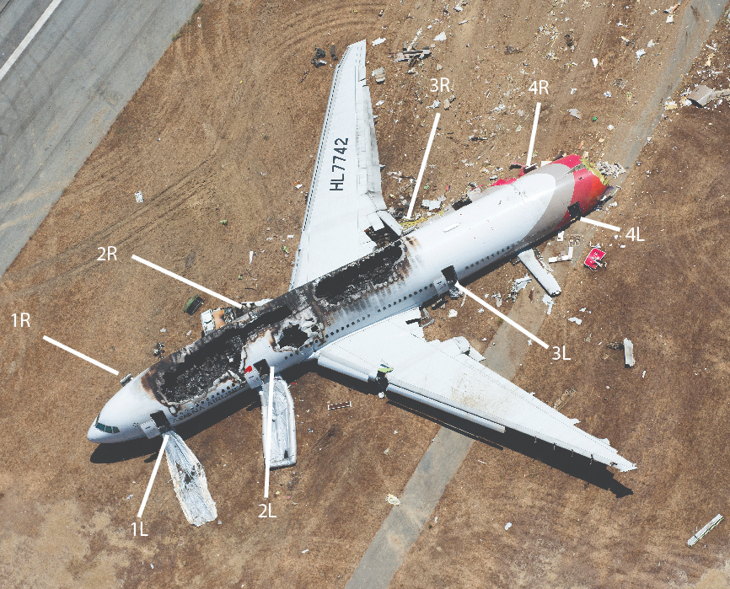
Lessons Learned:
Asiana Flt 214 (SFO)
Loss of Control Inability to handfly aircraft on VFR day for landing
30 Non Accident related Findings
27 Safety Rec. from the NTSB
  Airline Specific
  Aircraft Manufacturer Specific
  Fire Fighting
  Airport
Notes:
History is telling us that:
Asiana Flt 214 (SFO) – Loss of Control Inability to handfly aircraft on VFR day for landing
Loss of Control Inability to handfly aircraft on VFR day for landing
30 Non Accident related Findings
27 Safety Rec. from the NTSB
Airline Specific
Aircraft Manufacturer Specific
Fire Fighting
Airport
Note/Factual: The National Transportation Safety Board determined that the probable cause of this accident was the flight crew’s mismanagement of the airplane’s descent during the visual approach, the pilot flying’s unintended deactivation of automatic airspeed control, the flight crew’s inadequate monitoring of airspeed, and the flight crew’s delayed execution of a go-around after they became aware that the airplane was below acceptable glidepath and airspeed tolerances. Contributing to the accident were; (1) the complexities of the autothrottle and autopilot flight director systems that were inadequately described in Boeing’s documentation and Asiana’s pilot training, which increased the likelihood of mode error; (2) the flight crew’s nonstandard communication and coordination regarding the use of the autothrottle and autopilot flight director systems; (3) the pilot flying’s inadequate training on the planning and executing of visual approaches; (4) the pilot monitoring/instructor pilot’s inadequate supervision of the pilot flying; and (5) flight crew fatigue which likely degraded their performance.
The safety issues discussed in the report relate to the need for the following:
Adherence of Asiana pilots to standard operating procedures (SOP) regarding callouts. The flight crew did not consistently adhere to Asiana’s SOPs involving selections and callouts pertaining to the auto-flight system’s mode control panel. This lack of adherence is likely the reason that the PF did not call out “flight level change” when he selected FLCH SPD. As a result, and because the PM’s attention was likely on changing the flap setting at that time, the PM did not notice that FLCH SPD was engaged.
Reduced design complexity and enhanced training on the airplane’s auto-flight system. The PF had an inaccurate understanding of how the Boeing 777 A/P and A/T systems interact to control airspeed in FLCH SPD mode, what happens when the A/T is overridden and the throttles transition to HOLD in a FLCH SPD descent, and how the A/T automatic engagement feature operates. The PF’s faulty mental model of the airplane’s automation logic led to his inadvertent deactivation of automatic airspeed control. Both reduced design complexity and improved systems training can help reduce the type of error made by the PF.
Opportunity at Asiana for new instructors to supervise trainee pilots in operational service during instructor training. The PM was an experienced 777 captain who was on his first flight as an instructor pilot supervising a trainee captain gaining operating experience. The PM did not have the opportunity during his instructor training to supervise and instruct a trainee during line operations while being observed by an experienced instructor. Such an opportunity would have improved the PM’s awareness of the dynamic and often unpredictable challenges that an instructor must deal with when supervising a trainee during line operations.
Guidance for Asiana pilots on use of flight directors during a visual approach. During the accident flight, after the A/P was disconnected, the PM loosely followed Asiana’s informal practice, which was to turn both flight directors (F/Ds) off and then turn the PM’s F/D back on when conducting a visual approach. However, the two F/D switches were not both in the off position at the same time. If they had been, the A/T mode would have changed to speed mode and maintained the approach speed of 137 knots. In addition, during a visual approach, F/D pitch and roll guidance is not needed and can be a distraction.
More manual flight for Asiana pilots. Asiana’s automation policy emphasized the full use of all automation and did not encourage manual flight during line operations. If the PF had been provided with more opportunity to manually fly the 777 during training, he would most likely have better used pitch trim, recognized that the airspeed was decaying, and taken the appropriate corrective action of adding power. FAA guidance and a recent US regulatory change support the need for pilots to regularly perform manual flight so that their airplane handling skills do not degrade.
A context-dependent low energy alert. The airplane was equipped with a low airspeed alerting system that was designed to alert flight crews to low airspeed in the cruise phase of flight for the purpose of stall avoidance. However, this accident demonstrates that existing low-airspeed alert systems that are designed to provide pilots with redundant aural and visual warning of impending hazardous low-airspeed conditions may be ineffective when they are developed for one phase of flight (i.e., cruise) and are not adequately tailored to reflect conditions that may be important in another phase of flight (e.g., approach). During the approach phase of flight, a low airspeed alert may need to be designed so that its activation threshold takes airspeed (kinetic energy), altitude (potential energy), and engine response time into account.
Research that examines the injury potential from significant lateral forces in airplane crashes and the mechanism that produces high thoracic spinal injuries. In this accident, the dynamics were such that occupants were thrown forward and experienced a significant lateral force to the left during the impact sequence. One passenger sustained serious head injuries as a result of striking the arm rest of the seat that was in front of and to his left. While current Federal Aviation Administration (FAA) dynamic seat certification requirements do include testing row/row seat interactions with seats positioned slightly off the longitudinal axis, they would not likely approximate the forces encountered in this accident. Further, there was a high number of serious injuries to the high thoracic spine in this accident, and the mechanism that produces these injuries is poorly understood.
Evaluation of the adequacy of slide/raft inertia load certification testing. The forces experienced by the slide/rafts during the impact sequence far exceeded their certification limits, leading to overload failures of the slide/raft release mechanisms on the 1R and 2R slide/rafts. Given the critical nature of these evacuation devices and their proximity to essential crewmembers, slides and slide/rafts must be certified to sufficient loads so that they will likely function in a survivable accident. Although this exact accident scenario is unlikely to occur again, the data obtained during this accident investigation could prove useful for future slide/raft design.
Aircraft rescue and firefighting (ARFF) training for officers placed in command of an aircraft accident. The arriving incident commander placed an officer in charge of the fire attack who had not received ARFF training, and this individual made decisions that reflected his lack of ARFF training. Although no additional injuries or loss of life could be attributed to the fire attack supervisor’s lack of ARFF training, it demonstrates the potential strategic and tactical challenges associated with having non ARFF trained personnel in positions of command at an airplane accident.
Guidance on when to pierce the fuselage of a burning airplane with a skin-piercing nozzle. The airport’s fire department had two vehicles equipped with high-reach extendable turrets (HRETs) that were not used to the best of their capabilities in the initial attack. This was partially the result of departmental guidance that discouraged penetration of the fuselage using the skin-piercing nozzles on the HRETs until all of the occupants were known to have evacuated the airplane. Current FAA guidance provides information on how to pierce but does not include any guidance on when to pierce.
Integration of the medical supply buses at SFO into the airport’s preparation drills. Although the airport’s emergency procedures manual called for airport operations personnel to deliver the airport’s two emergency medical buses to the accident site, neither of the medical buses arrived. Further, the monthly emergency drills conducted by the airport did not include deployment of the buses either as a matter of routine or as part of the unique scenario being evaluated. This lack of integration of the medical buses into the airport’s preparation drills likely played a part in their lack of use in the initial response to the accident.
Guidance or protocols for ensuring the safety of passengers and crew at risk of being struck or rolled over by a vehicle during ARFF operations. In this case, only one passenger was at significant risk for a vehicle strike due to her close proximity to the burning airplane; however, there are other accident scenarios in which many injured or deceased persons could be located near an accident airplane. There is currently no guidance or any recommended protocols for ensuring the safety of passengers and crew at risk of being struck or rolled over by a vehicle during ARFF operations.
Requirements for ARFF staffing. Seven ARFF vehicles and 23 ARFF personnel from SFO’s fire department were involved in the initial response to the accident. This equipment level exceeded the FAA-required minimum of three vehicles, and there is currently no FAA-required minimum staffing level. Because of the amount of available ARFF vehicles and personnel, the airport firefighters were able to perform exterior firefighting and send firefighters into the airplane who rescued five passengers who were unable to self-evacuate amid rapidly deteriorating cabin conditions. Due to the lack of an FAA-required minimum staffing level, passengers involved in an aviation accident at a smaller airport may not be afforded the same level of protection that the passengers of flight 214 had.
Improvements in emergency communications at SFO. Numerous problems with communications occurred during the emergency response, the most critical being the inability for responding mutual aid units to speak directly with units from the airport on a common radio frequency. Although some of the communications difficulties encountered during the emergency response, including the lack of radio interoperability, have been remedied, others, such as the breakdown in communications between the airport and city dispatch centers, should be addressed.
Increased FAA oversight of SFO’s emergency procedures manual. Although the airport had submitted, and the FAA had approved in December 2012, an updated emergency procedures manual, the airport had not yet distributed or trained personnel on the updated manual when the accident occurred and was still actively operating with the manual approved by the FAA in December 2008.
(Next Slide)

Slide 21
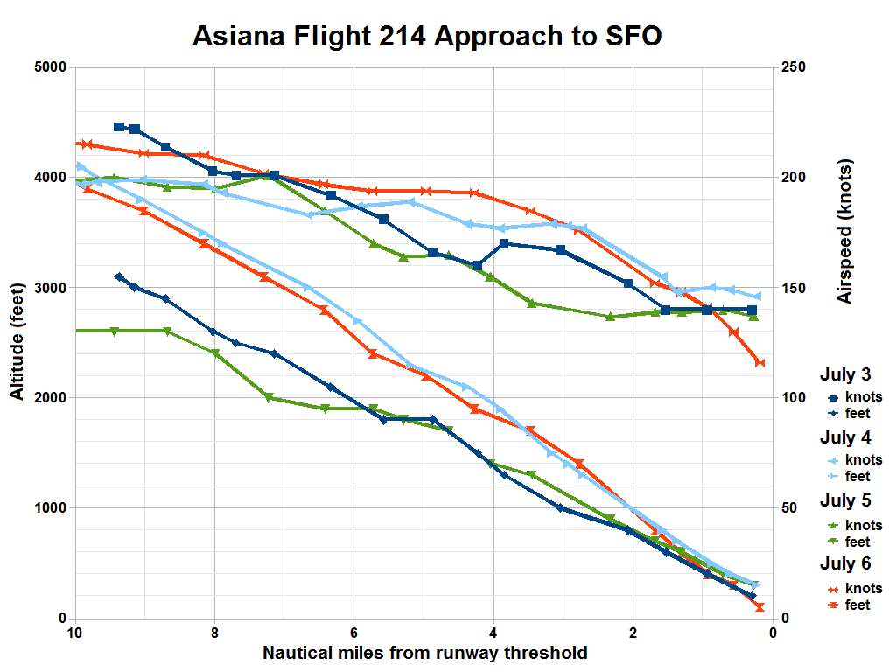
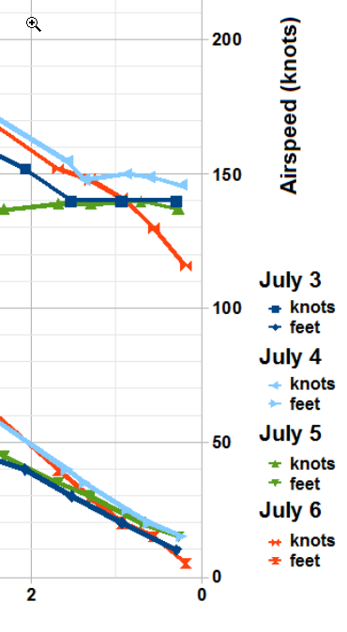
Notes:
As you can see in this graphic, the crew had a good 3 day run prior to the accident.
On this particular flight the crew experienced a rather unique combination of aircraft configuration and circumstances which led to the very hard landing.
The NTSB concluded the Pilot Flying deactivated auto throttle, only one flight director (Instructor’s) was active, and both pilots failed to adequately monitor airspeed during the approach.
Automation complexity, crew coordination, instructional supervision inadequacies, and fatigue were also mentioned.
Many of you might say, “that couldn’t happen to me, I don’t even have an autopilot”. What can we take away from this example?
Be aware that, when things are happening too quickly for us to keep up with or we don’t understand exactly what’s going on, it behooves us to buy some time to understand the situation. Tough to do if you have no power but easy in this case.
A go-around would have given the crew plenty of opportunity to sort things out & be better prepared for the landing.
(Next Slide)

Slide 22
15 Safety Recommendations including:
Adherence of Company to standard operating procedures (SOP) regarding callouts.
Reduced design complexity and enhanced training on the airplane’s auto-flight system.
Guidance for Company pilots on use of flight directors during a visual approach.
More manual flight for Company pilots.
Notes:
15 Safety Recommendations including:
Adherence of Company to standard operating procedures (SOP) regarding callouts.
Reduced design complexity and enhanced training on the airplane’s auto-flight system.
Guidance for Company pilots on use of flight directors during a visual approach.
More manual flight for Company pilots.
As a GA Pilot, are these recommendations something you can use in your day to day flying?
Your Personal Minimums – Just like an Company SOP, the standards and procedures you set for yourself must be adhered to.
Checklist Usage
Landing Gear Operational procedures – Hand on the handle/move the handle/verify as selected/three green no red/gear is down/gear mirror
When is the last time you read up on the auto-pilot system in your aircraft? Actually performed a preflight test?
What are the AP limits? Roll ±18 degrees left or right…etc.
As a GA Pilot, your guidance may be the owners manual, have you ever read it? Understand all the limits of operation?
May have learned a best practice in SIM training
Is it easier to justify a smooth ride for you passengers if you turn the AP ON? If so, your flying skills are not what they need to be.
(Next Slide)

Slide 23
Thoughts for continued safety:
Scenario Based Training - Plan, practice, evaluate
  Review/Determine factors which affect the outcome of a failure in your aircraft
  Develop a strategy for mitigating associated risks
  Train utilizing your mitigation strategies
  Review your outcomes and adjust for additional risks found.
Work with your CFI, adjust scenario(s) as your knowledge and skill increase.
THINK AHEAD, CHALLENGE YOURSELF!
Notes:
Thoughts for continued safety:
Scenario Based Training - Plan, practice, evaluate
Determine factors which are affected by a failure(s)
Develop a strategy for mitigating associated risks
Train utilizing your mitigation strategies
Review your outcomes and adjust for additional risks found.
Work with you CFI, adjust scenario(s) as your knowledge and skill increase.
THINK AHEAD, CHALLENGE YOURSELF!
(Next Slide)

Slide 24



One More Reason to Train with WINGS
WINGS Industry Sweepstakes!
The Paul and Fran Burger 2021 $10,000 WINGS Sweepstakes
https://www.wingsindustry.com/WINGS-Sweepstakes
Notes:
One More Reason to Train with WINGS?
WINGS Industry Sweepstakes!
Paul and Fran Burger are offering $10,000 in their sweepstakes again this year!
The WINGS Sweepstakes mission is to reduce the nation's accident and incident rate by increasing pilot participation in the WINGS FAASTeam Pilot Proficiency Program. The WINGS program has courses based on real world accident and incident causes so flight instructors, pilots and student pilots get training that can truly make a difference.
Studies indicate that pilots who complete WINGS phases are safer aviators. Please join us in saving lives.
Learn about the program and its many benefits at : https://www.wingsindustry.com/WINGS-Sweepstakes
The 2020 Sweepstakes awards 10 cash prizes! Prize levels include:
Four (4) $1,500
Four (4) $750
Two (2) $500
(Next Slide)

Slide 25

Pilots never stop learning, and those who participate in regular proficiency training are competent, confident, and safe.
Earn WINGS awards and recognition based on a combination of practical knowledge and hands-on coaching. Skill will be the result of your efforts.
Get started now!
Notes:
The WINGS Pilot Proficiency Program.
Pilots never stop learning, and those who participate in regular proficiency training are competent, confident, and safe.
Earn WINGS awards and recognition based on a combination of practical knowledge and hands on coaching or skill
Get started now!
(Next Slide)

Slide 26

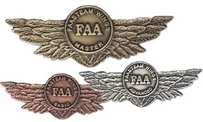
WINGS and Pilot Proficiency
What a Pair!
Notes:
Credit for this meeting is available from FAASafety.gov. Please be certain to sign the attendance roster prior to your departure. Join us on the web at FAASafety.gov for more learning options.
(Next Slide)

Slide 27
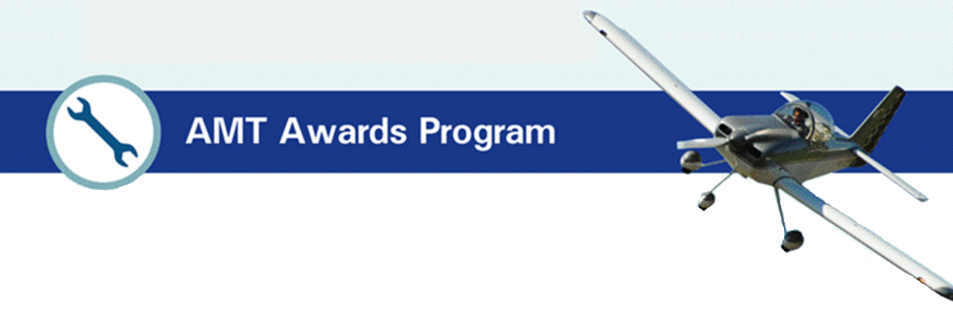
The AMT Awards program can help you fulfill your commitment to aviation maintenance excellence through continuing education and training.
Earn annual awards based on core training hours at Bronze, Silver, and Gold levels.
Get started now!
Notes:
The AMT Awards Program.
The AMT Awards program can help you fulfill your commitment to aviation maintenance excellence through continuing education and training.
Earn annual awards based on core training hours at Bronze, Silver, and Gold levels.
Get started now!
(Next Slide)

Slide 28
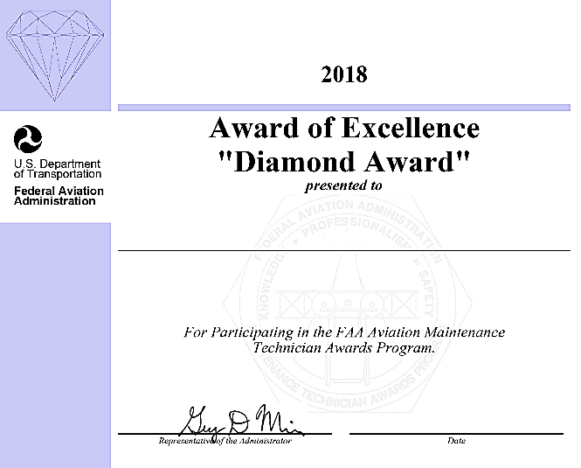
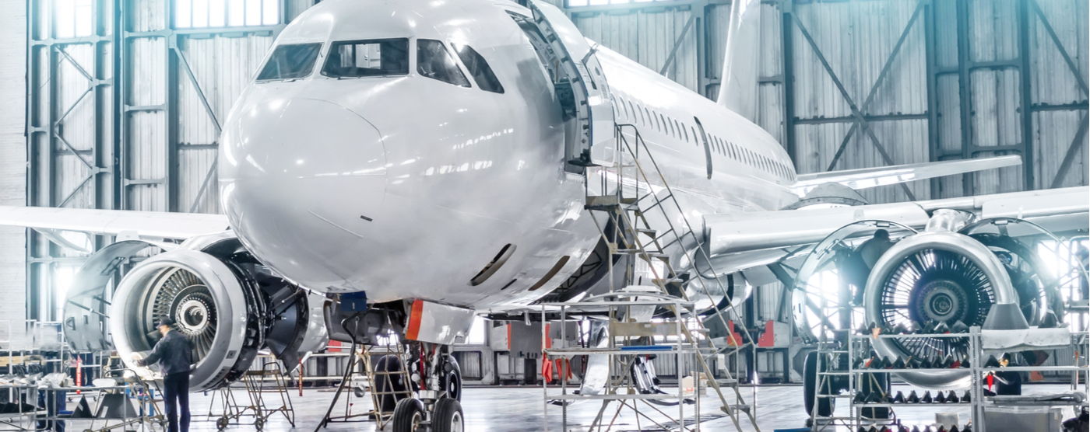
Team AMT for the Employer
Notes:
Aviation safety begins on the ground and in the hangar. As an AMT you are an invaluable member of the aviation safety team.
Having the proper "tools" to do your job involves more than just filling your tool box with nice, shiny wrenches. The FAA Safety Team (FAASTeam) is committed to helping you achieve the highest level of safety by providing "tools" and resources to enhance your knowledge and proficiency.
(Next Slide)

Slide 29
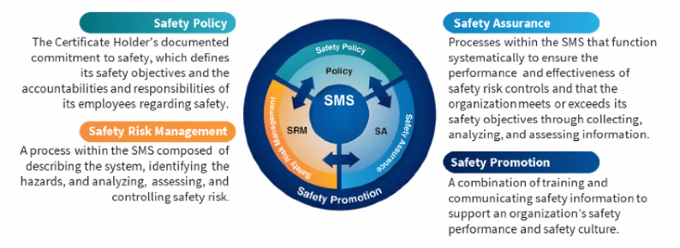

Safety Management Systems (SMS)
Coming to General Aviation
https://www.faa.gov/about/initiatives/gasafetyoutreach
Notes:
Safety Management Systems are a set of policies and processes that can increase the safety and efficiency of any flight operation. And FAA is bringing SMS to General Aviation. You may have heard of SMS but thought it was only for large organizations but actually SMS can be scaled to fit any operation large or small.
There are 4 major components to a Safety Management System (Click)
Safety Policy – a documented commitment to safety that runs from the head of an organization to its newest member. (Click)
Safety Risk Management – a process that identifies hazards within an operation, determines to what extent an identified hazard may impact flight safety, and controls the risk of occurrence to an acceptable level. (Click)
Safety Assurance – By collecting and analyzing information derived from safety performance data Safety Assurance ensures the performance and effectiveness of Safety Risk Controls. (Click)
Safety Promotion communicates safety information and commitment throughout the organization. (Click)
You can find more information about Safety Management Systems at the URL on the Screen.
(End)

Slide 30


Contact Us:
FLIGHT STANDARDS DISTRICT OFFICE
XXX FSDO, Your State
1234 Somewhere Drive
Flatland, XX XXXXX
(000) XXX-XXXX
Notes:
Have questions regarding the program or aviation safety in general, contact your local FAASTeam Representatives, FAASTeam program Manager or your local Flight Standards Office for assistance.
(Next Slide)

Slide 31
Managing Component Failures
Notes:
(The End)

