Slide 1
The National FAA Safety Team Presents
Topic of the Month – November
Hindsight bias and CFIT
<Audience>
<Presenter>
< >
Notes:
2024/09-10-322(I)PP Original Author: John Steuernagle; POC John Steuernagle National FAASTeam Operations Program Manager, Office 562-888-2020
Presentation Note: This is the title slide for CFIT and Plan Continuation Bias
Script - We have included a script of suggested dialog with most slides. The script will always appear in a non-italic font. Presenters may read the script or modify it to suit their own presentation style. See template slides 5 and 6 for examples of a slides with script.
Presentation Instructions - (stage direction and presentation suggestions) will be preceded by a Bold header: the instructions themselves will be in Italic fonts. See slides 2, 3, and 4 for examples of slides with Presentation Instructions only.
Program control instructions - will be in bold fonts and look like this: (Click) for building information within a slide; or this: (Next Slide) for slide advance.
Background information - Some slides may contain background information that supports the concepts presented in the program.
Background information will always appear last and will be preceded by a bold Background: identification.
The production team hope you and your audience will enjoy the show. Break a leg!
(Next Slide)

Slide 2


Welcome
Exits
Restrooms
Emergency Evacuation
Breaks
Sponsor Acknowledgment
Set phones and pagers to silent or off
Other information
Notes:
Presentation Note: Here’s where you can discuss venue logistics, acknowledge sponsors, and deliver other information you want your audience to know in the beginning.
You can add slides after this one to fit your situation.
(Next Slide)

Slide 3
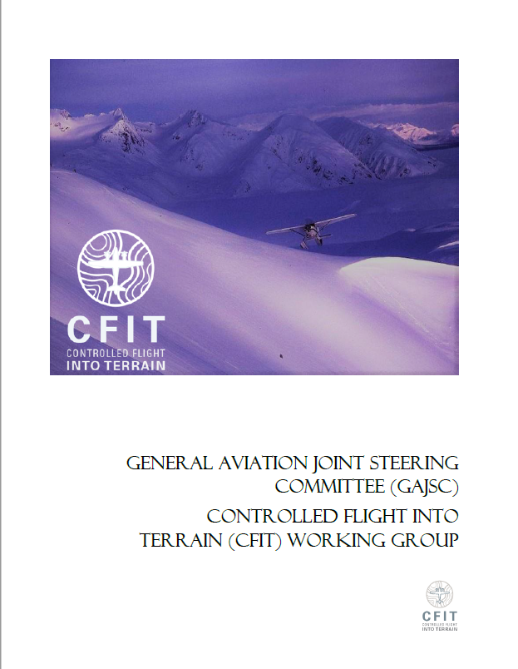
Overview
Hindsight Bias
*GAJSC – General Aviation Joint Safety Committee
Notes:
The General Aviation Joint Steering Committee (GAJSC) Controlled Flight Into Terrain (CFIT) work group report suggests that human biases may be significant factors in CFIT accidents. In this presentation we’ll talk a little bit about a human bias that makes it difficult for us to learn from the mistakes of others. We’ll review some CFIT case studies, and we’ll offer some thoughts on how to effectively manage things that we can control and plan for dealing with things that are beyond our control. Finally, we’ll offer a few suggestions for maintaining pilot proficiency.
Presentation Note: If you’ll be discussing additional items, add them to this list
(Next Slide)

Slide 4
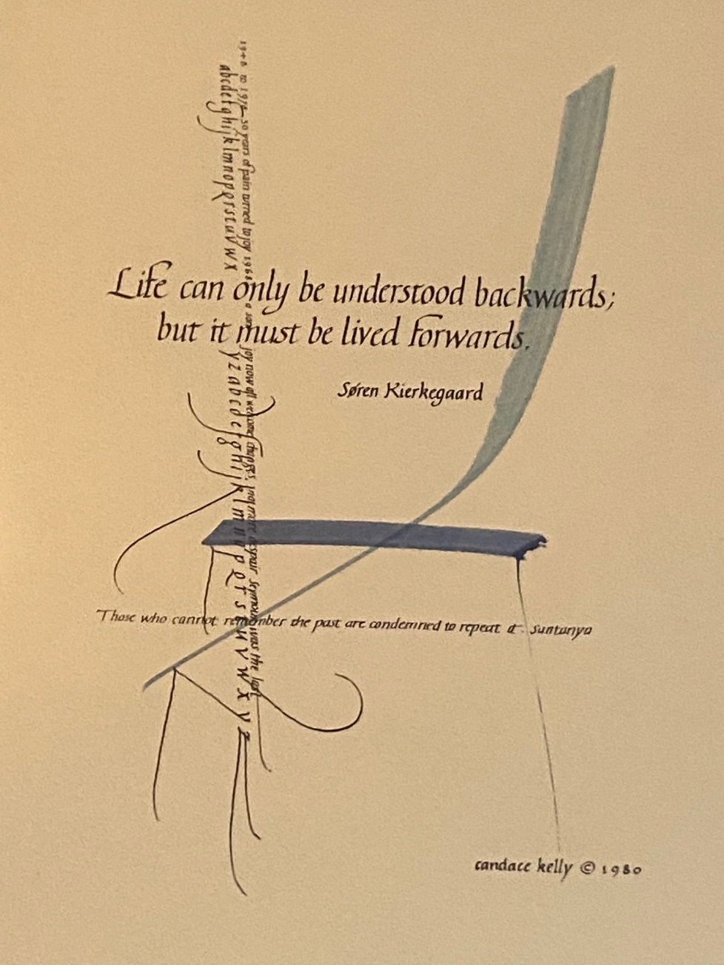
Understanding life
“Life can only be understood backwards,
but it must be lived forwards.”
Soren Kierkegaard
Notes:
The Danish philosopher Soren Kierkegaard was right in his observation that life must be lived forwards but can only be understood backwards.
The actions we take in the present, produce future results that, if planning, knowledge, skill, and circumstances allow, will yield intended results.
Most of the time things work out well but occasionally we need to look back to event precursors to discover what went wrong and how to prevent future occurrences. And when we do that, our understanding may be compromised by a human bias that has to do with hindsight.
(Next Slide)

Slide 5

Almost home
Notes:
The remote village airport lay at the mouth of a mountain pass. The mountain tops were often obscured in clouds and there were no instrument approach options, so pilots frequently approached the field by flying through the pass beneath the cloud layer. A dogleg in the pass prevented seeing from one end to the other so ceiling and visibility had to be carefully assessed before committing to a transit. Upon entering the pass, the pilot broadcast a position report and villagers waiting at the airport expected the aircraft to land about 10 minutes later. With no further communication from the aircraft, search and rescue parties entered the pass. The wreckage was found about 6 miles from the airport.
(Next Slide)
“

Slide 6
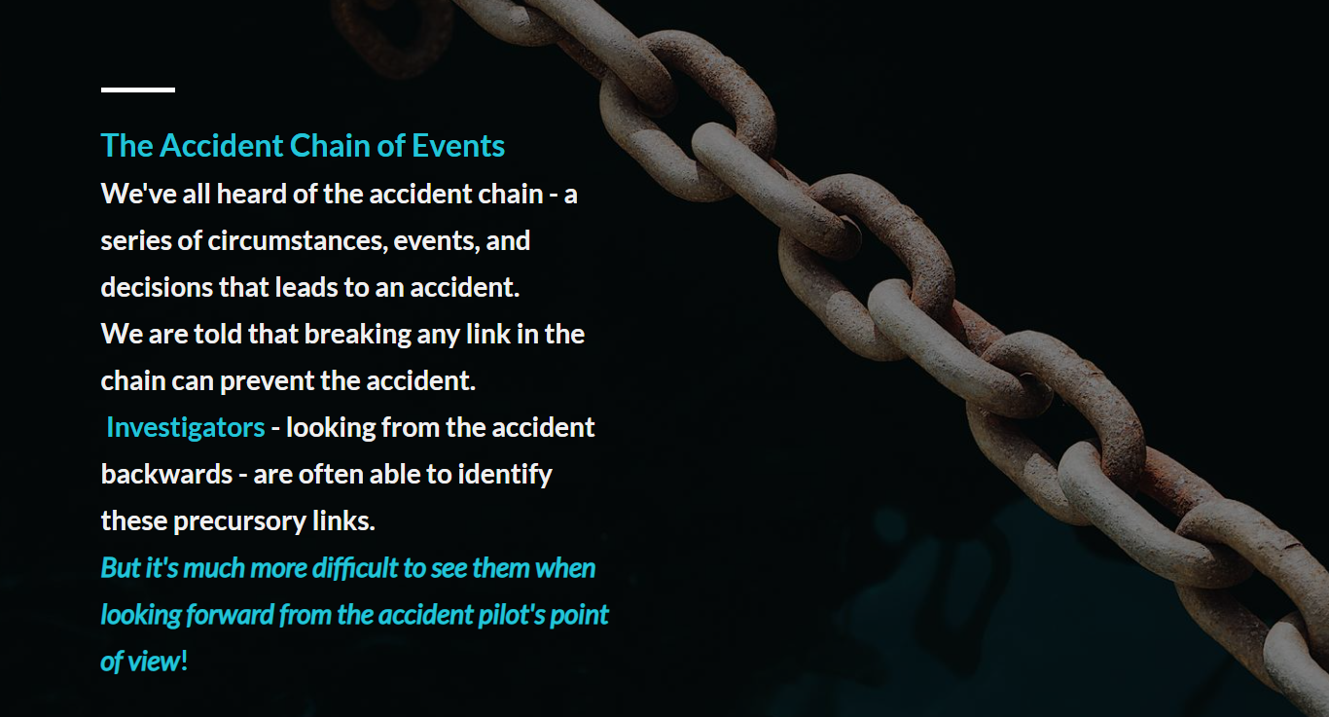
The Accident Chain of Events
Circumstances
Decisions
Actions
Investigators look backward
to Identify precursory links
Pilots must look Forward
Much more difficult to do -
Notes:
We’re all familiar with the accident chain of events (Click)
– a series of circumstances, decisions, and actions that lead to an accident. We are told that breaking any link in the chain can prevent the accident (Click)
Investigators, looking backward from an accident event are often able to reconstruct the links in the chain. (Click)
But pilots must look forward and those precursors are much more difficult see from the pilot’s point of view. We’ll keep that in mind as we begin to discuss Hindsight Bias.
(Next Slide)

Slide 7

Hindsight Bias
Predictable
  I knew it would happen
Inevitable
  It had to happen
Memory Distortion
I said it would happen
Predictable
Inevitable
Memory Distortion
Notes:
Hindsight bias refers to the human tendency to think that events are more predictable than they actually are. Although our General Aviation safety record is exemplary, there will be some accidents. It’s inevitable. Thus, it’s easy to say, “It had to happen.” (Click)
Predicting when and where accidents will occur is a little more difficult. To be sure, some aviation operations are riskier than others, so you’d expect to see higher accident rates. But pilot knowledge, skill, and aircraft capability are usually higher in high-risk operations, so accident rates are lower than what one might expect. Still, when an accident does occur, it’s easy to say, “ I knew it would happen,” after the fact. (Click)
It’s impossible to remember everything we say and to whom we said it. Memories dim and distort over time and it’s not unusual for us to think, “I knew it would happen, and I said so.” (Click)
That’s how hindsight bias works, and all humans are subject to it so what’s the problem?
(Next Slide)

Slide 8

We know what but we don’t know why…
Notes:
When we construct an accident chain backwards – especially when the accident pilot can’t be interviewed, we know what happened, but it’s much more difficult to know why. Reading accident reports can be frustrating in this regard. “The pilot failed to obtain/maintain flying speed,” is a great description of what happened but why did the pilot stall the airplane? Was the pilot distracted? was there an unreasonable expectation of aircraft performance?
And how about “Inadvertent Flight into Instrument Meteorological Conditions (IMC)? This is where CFIT comes into the conversation.
(Next Slide)

Slide 9
Inadvertent flight into IMC
That could never happen to me.
That could happen to me.
Notes:
Unplanned transition from visual flying to Instrument Meteorological Conditions is one of the deadliest accident precursors. Most pilots know of an Inadvertent IMC story or two and, using twenty-twenty hindsight it’s easy to think, “Yep – I knew that was going to happen. In fact, I said something about it last week.” (Click)
And, although we don’t say it, we think, “that could never happen to me.”
Well, if we stop there, we lose the opportunity to ponder why it happened, how a seemingly capable pilot arrived at the decision to pursue what turned out to be the impossible dream. And thinking, “that could never happen to me,” can easily result in overconfidence in our knowledge, and skill. (Click)
It’s much healthier to think, “I can see how that could happen to me and here’s what I need to do to prevent it.”
(Next Slide)
“

Slide 10



People cannot easily avoid
those actions they did not
intend to commit.
How did the pilot perceive the environment?
How were perceptions processed to plan for action?
What actions were taken?
What would I do in the same circumstances?
Gold
Seal
This Photo by Unknown Author is licensed under CC BY-SA
Notes:
And here’s another really important point. People cannot easily avoid those actions they didn’t intend to commit.
It’s very difficult to see that the choices you’re making are directing you along a path to tragedy. Whatever the activity, people rarely set out to create a disaster and yet – sometimes – circumstances, operational environments, and human decisions combine with decidedly unfavorable results. (Click)
So, when we’re contemplating accidents that have already happened, it’s very beneficial to consider what the pilot was dealing with, what information was available and how would a pilot of similar experience perceive it, process it’s meaning and perform actions to address the issue. (Click)
Finally, we ask ourselves what we would do in the same circumstances. This is a best practice for overcoming Hindsight Bias in our attempts to understand why accidents happen.
To end our program, let’s consider a few tips to reduce the chances of Controlled Flight into Terrain.
(Next Slide)

Slide 11
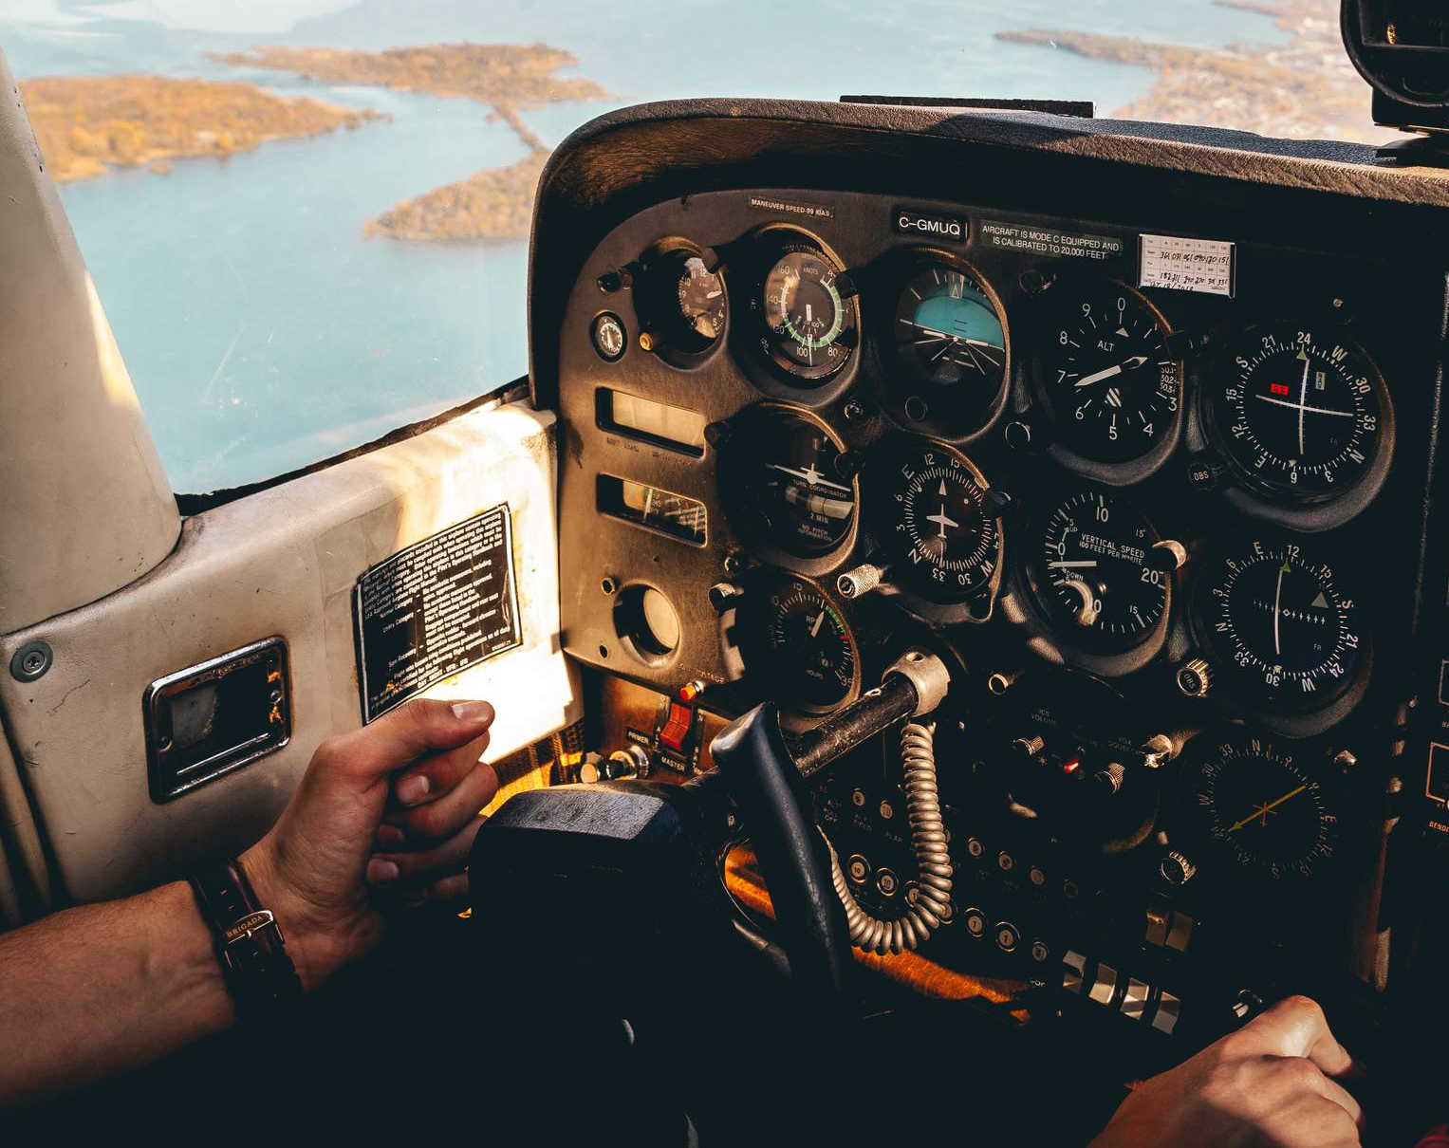
CFIT Avoidance Tips
Don’t fly below minimum safe altitudes
Don’t fly in the mountains at night.
Don’t fly beneath an overcast if you don’t have room to make a 180⁰ turn.
Do avoid towers and wires.
Notes:
Here are a few things we can do to avoid CFIT. (Click)
Don’t fly below minimum safe altitudes. Maintain at least 1,000 feet above the highest obstacles along your route. (Click)
Don’t fly in the mountains at night. Over the mountains is okay but don’t try to negotiate low-level passes and routes – especially in remote areas. (Click)
Don’t fly beneath an overcast if you don’t have enough room to make a 180º turn. (Click)
Do stay well clear of towers and wires.
(Next Slide)

Slide 12

CFIT Avoidance Tips
Fly the aircraft!
  Perfect practice makes perfect
  Even basic autopilots are helpful.
Notes:
Of course, the number one priority on any flight is to Fly the Aircraft! That’s easy to do in good weather; much harder to do if you’re coping with deteriorating weather and navigating to an alternate airport.
There are definitely times when any pilot approaches task saturation and that’s not a comfortable place to be. Regular practice, guided by a Flight Instructor, and honed to perfection, is the best preparation for all flight challenges.
An autopilot is well worth considering for VFR and IFR flying. Even a basic wing leveler can reduce pilot workload and make more time for in-flight decision making.
(Next Slide)

Slide 13

CFIT Avoidance Tips
Realistic preflight planning w/alternate(s)
Objective in-flight plan performance assessment
Deal with small problems before they become big ones.
  Diversion to alternate is a small problem.
  Not enough fuel to get there is a big one.
Objective pilot performance assessment
Maintain proficiency with WINGS.
Notes:
It’s important to note that there are multiple influences associated with any flight. Pilots need to effectively manage those influences to ensure a safe outcome. (Click)
The process begins with realistic preflight planning that considers pilot and aircraft capabilities as well as mission requirements. The process should include consideration of factors that could compromise success and alternative plans for dealing with them. (Click)
While in flight, pilots must continually and objectively assess how well the flight is conforming to plan. In addition to route progress and weather, fuel state and performance monitoring must be considered. There will always be variations from plan most of which won’t compromise the safe completion of the flight; but they should be noted and dealt with. (Click)
Deal with problems and variances as soon as they are noted. That way you can take care of small problems before they become big ones. In the grand scheme; diversion to an alternate is a small problem – especially if you’ve planned for it. But not having enough fuel to reach the alternate is a big problem. (Click)
Pilots must be prepared to cope with any challenges that occur in flight and in order to do that we must know what we and our aircraft are capable of. That requires an objective assessment of our performance – preferably made by a flight instructor. Your instructor can help you to develop and document Personal Performances minimums. (Click)
And finally; we must maintain our proficiency in order to meet our performance minimums. A regular program of proficiency training with a CFI is best and we urge you to consider the FAA WINGS Pilot Proficiency Program.
(Next Slide)

Slide 14

Have you earned your WINGS?
Proficient Pilots are:
  Confident
  Capable
  Safe
WINGS will keep you
on top of your game
Notes:
Have you earned your WINGS? Proficiency is key to success in almost everything worth doing – especially flying. Proficient pilots are confident, capable, and safe.
WINGS is a proficiency training system specifically designed for general aviation pilots and, regular participation will keep you on top of your flying game.
(Next Slide)

Slide 15
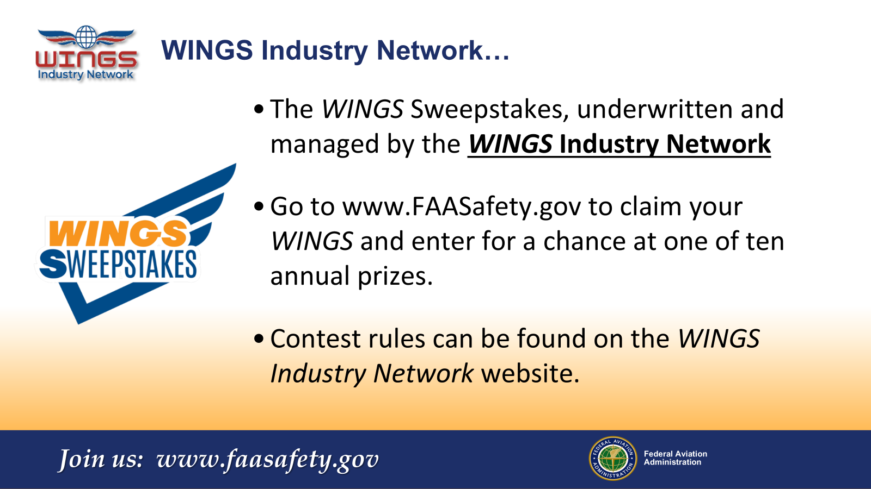
Notes:
Every time you complete a WINGS Phase, you’re eligible to win cash in the WINGS Sweepstakes.
The sweepstakes is generously funded by the WINGS Industry Network. https://wingsindustry.com to learn more and enter the sweepstakes.
Just navigate to http://www.mywingsinitiative.org or scan the QR code for details. By the way, Instructors can also enter the sweepstakes.
(Next Slide)

Slide 16

Questions?
Notes:
Presentation Note: You may wish to provide your contact information and main FSDO phone number here. Modify with your information or leave blank.
(Next Slide)

Slide 17



Thank you for attending
You are vital members of our GA safety community
Notes:
Your presence here shows that you are vital members of our General Aviation Safety Community. The high standards you keep and the examples you set are a great credit to you and to GA.
Thank you for attending.
(Next Slide)

Slide 18
The National FAA Safety Team Presents
Topic of the Month – November
CFIT & Plan Continuation Bias
<Audience>
<Presenter>
< >
Notes:
(The End)

