Slide 1
The National FAA Safety Team Presents
Topic of the Month - July
Tailwheel Transition
Notes:
2024/09-10-323(I)PP Original Authors: Jay Flowers and John Steuernagle; POC John Steuernagle, National FAASTeam Program Manager (Operations), Office 562-264-5484.
Presentation note: This is the title slide for FY2026 Topic of the Month – July – Tailwheel Transition.
Script - We have included a script of suggested dialog with most slides. The script will always appear in a non-italic font. Presenters may read the script or modify it to suit their own presentation style. See template slides 3 and 4 for examples of a slides with script.
Presentation Instructions - (stage direction and presentation suggestions) will be preceded by a Bold header: the instructions themselves will be in Italic fonts. See slides 2 for an example of slides with Presentation Instructions only.
Program control instructions - will be in bold fonts and look like this: (Click) for building information within a slide; or this: (Next Slide) for slide advance.
Background information - Some slides may contain background information that supports the concepts presented in the program.
Background information will always appear last and will be preceded by a bold Background: identification.
The production team hope you and your audience will enjoy the show. Break a leg!
(Next Slide)

Slide 2
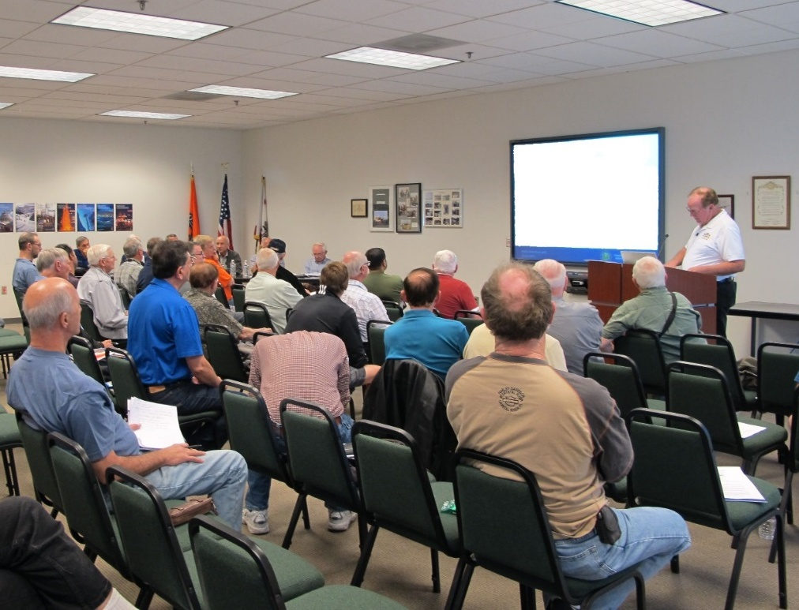
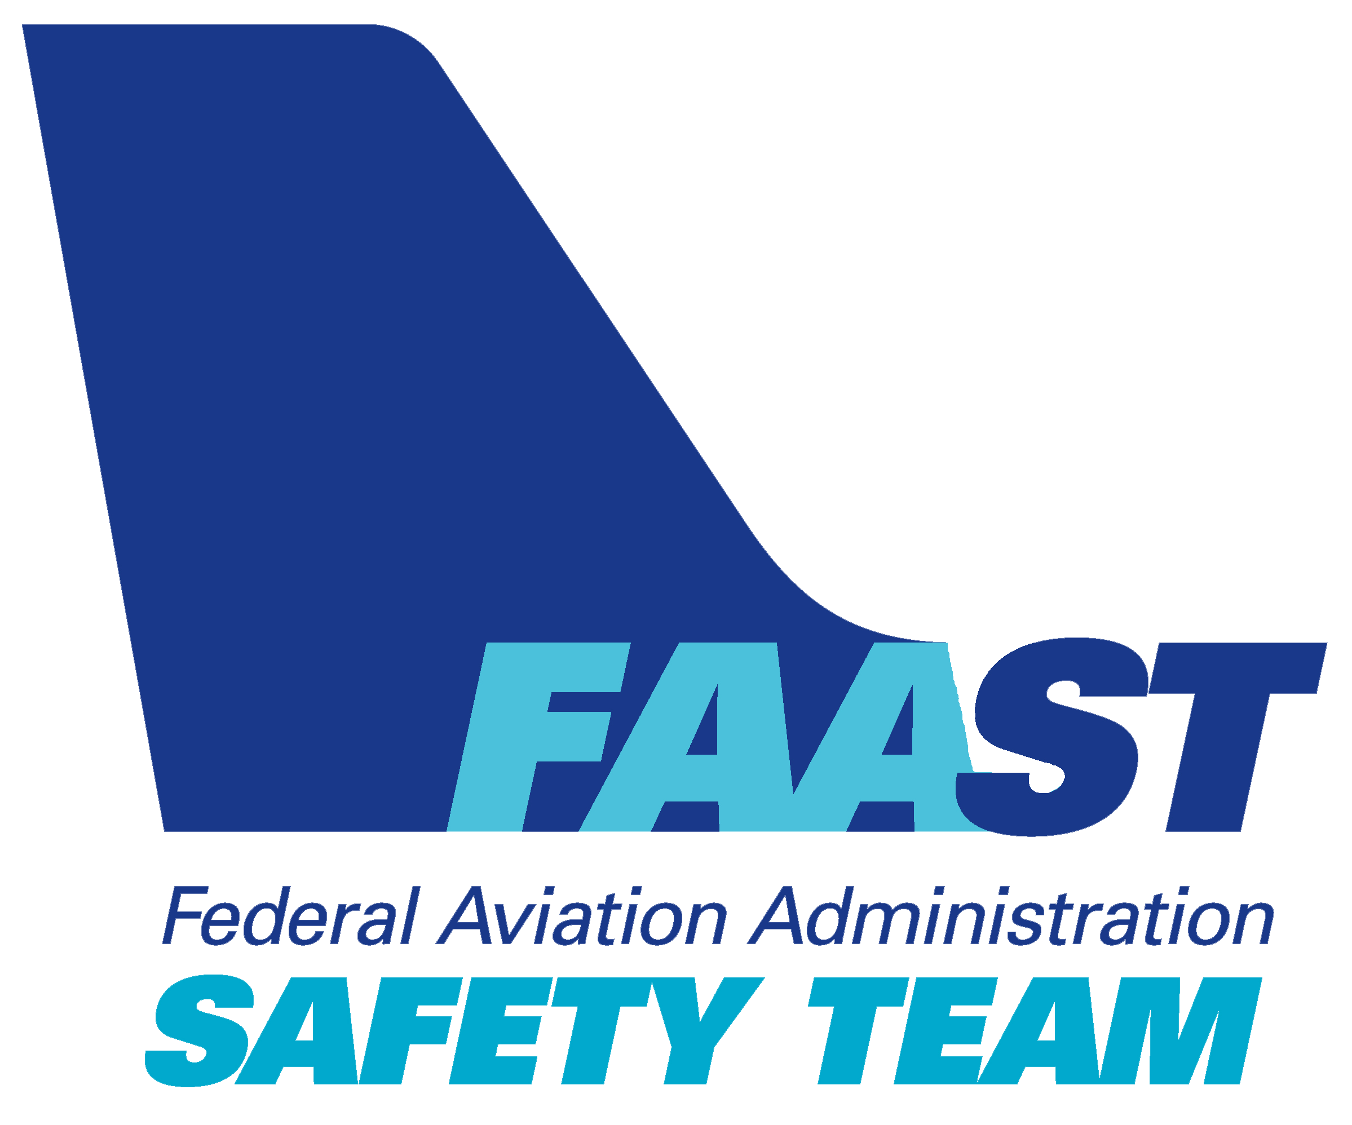
Welcome
Exits
Restrooms
Emergency Evacuation
Breaks
Silence Phones & Devices
Sponsor Acknowledgment
Other
Notes:
Presentation Note: Here’s where you can discuss venue logistics, acknowledge sponsors, and deliver other information you want your audience to know in the beginning.
You can add slides after this one to fit your situation.
(Next Slide)

Slide 3

Overview
General Aviation Joint Safety Committee (GAJSC) & FAA Accident Study Findings
Proficiency Training
  Practice the fundamentals
  Learn something new.
Notes:
This presentation will address a long-standing safety enhancement from the General Aviation Joint Safety Committee (Click)
– Proficiency Training. If you’ve been around for a while, you’ve heard us tout the benefits of proficiency training for certificated pilots. (Click)
We know that we need to practice our fundamental piloting operations if we want to bring our “A” Game to the airport every time we fly. (Click)
But today we’re going to talk about maintaining proficiency in the context of learning something new.
Presentation Note: If you’ll be discussing additional items, add them to this list.
(Next Slide)

Slide 4
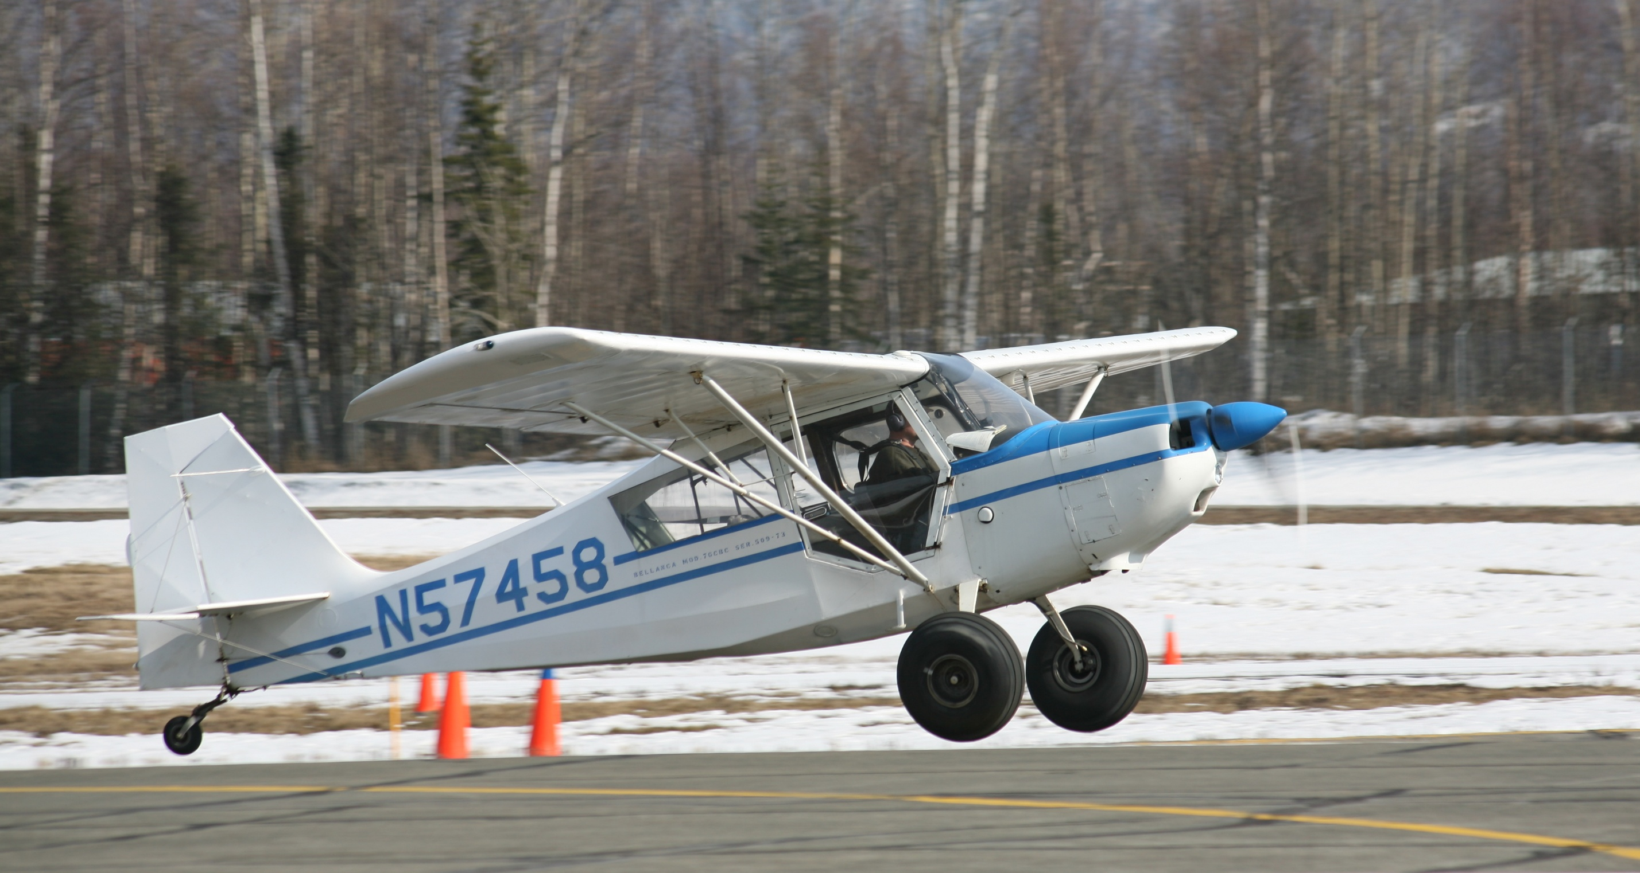
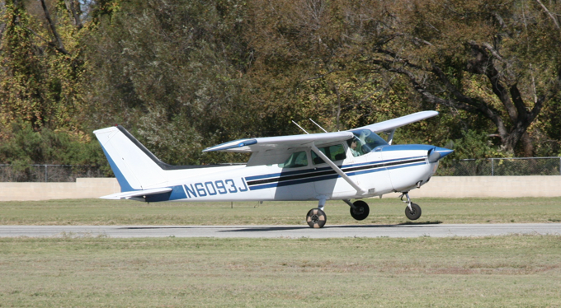
Expanding your horizons
Notes:
Most 21st Century pilots learned to fly in something like this Cessna. a Piper Cherokee, or Tomahawk, or perhaps a Beechcraft Musketeer. If you’ve been flying for a while and you’re looking for a new challenge it may be time to expand your horizons with Tailwheel Aircraft Instruction and an endorsement.
Flying a taildragger will test your stick and rudder skills and, depending on the aircraft you choose, you may need to embrace some old technology.
(Next Slide)

Slide 5
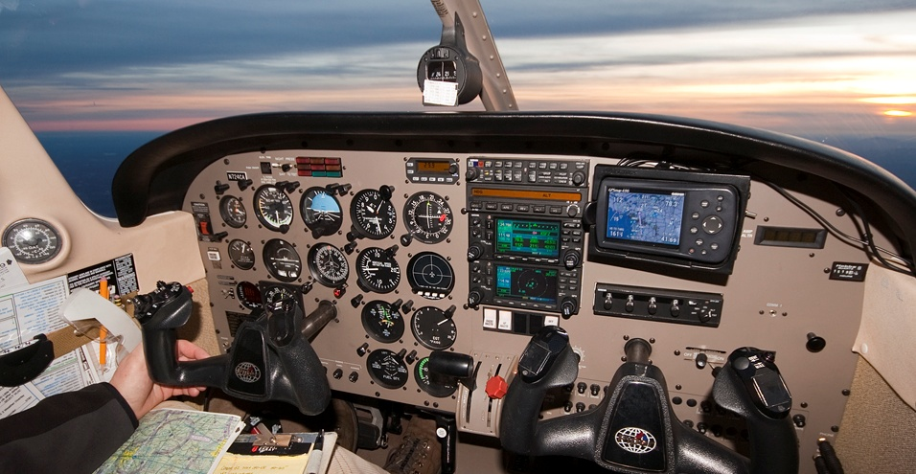
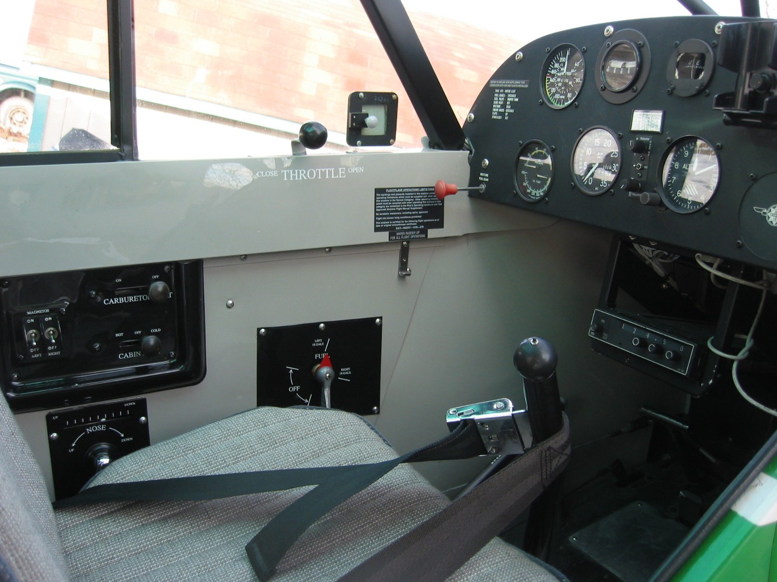
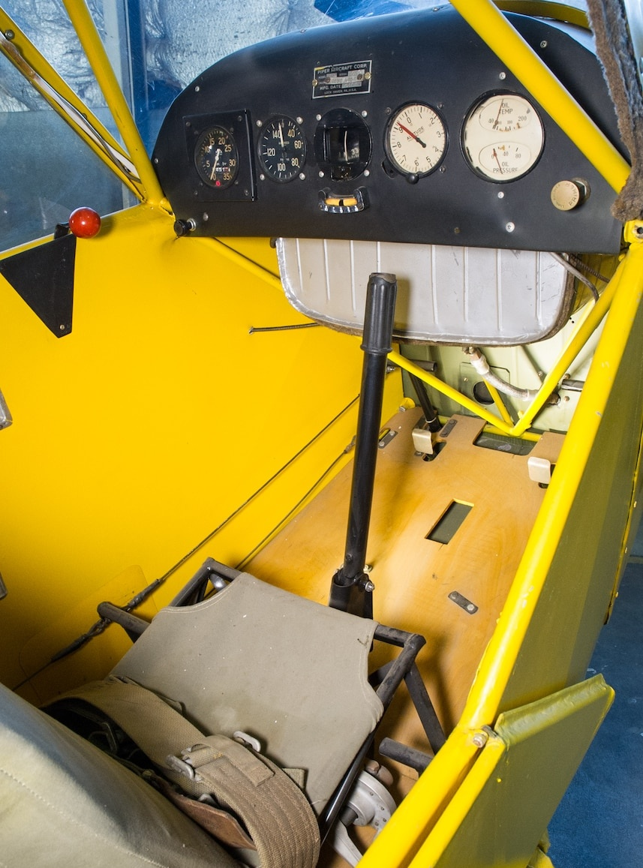
Notes:
Most of us are used to managing a suite of instruments and avionics like this or we’re flying with even newer multi-function displays. You’ll see modern panels in tailwheel aircraft of course but if you’d really like to explore the basics of flight, you’re more likely to do it in something like this. (Click)
Or this. (Click)
Who can tell us what these are?
Presentation note: Pause for the audience to answer. Then:
If you’re lucky enough to train in a J3 Cub, Taylorcraft, or Aeronca you’ll surely be exploring the mysteries of heel brakes.
(Next Slide)

Slide 6
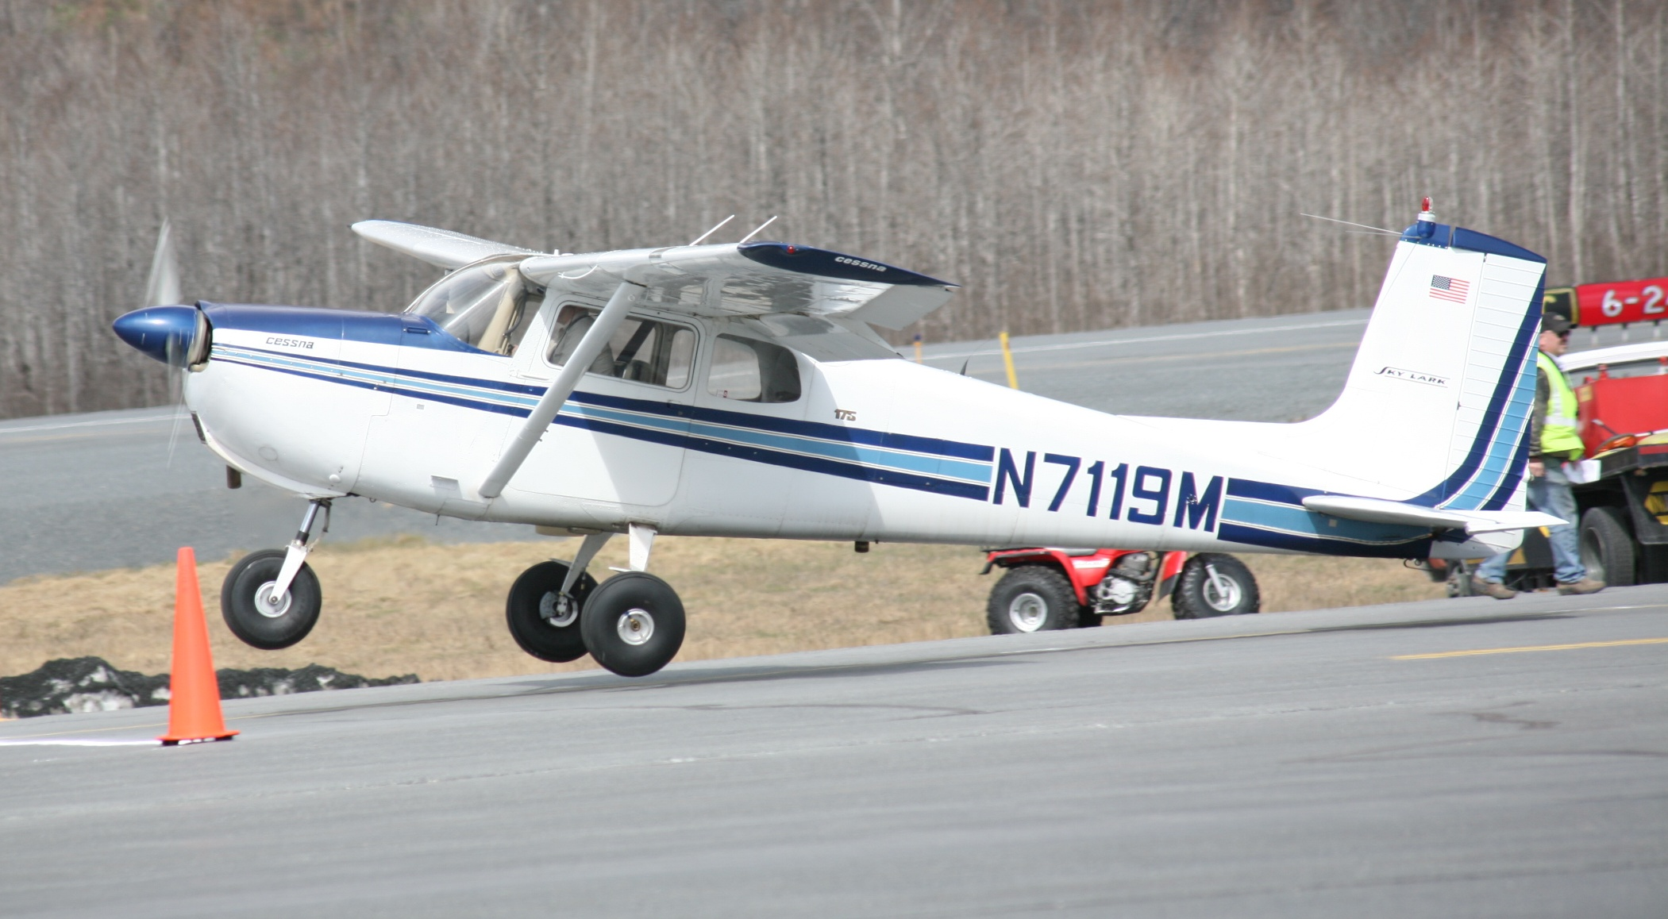
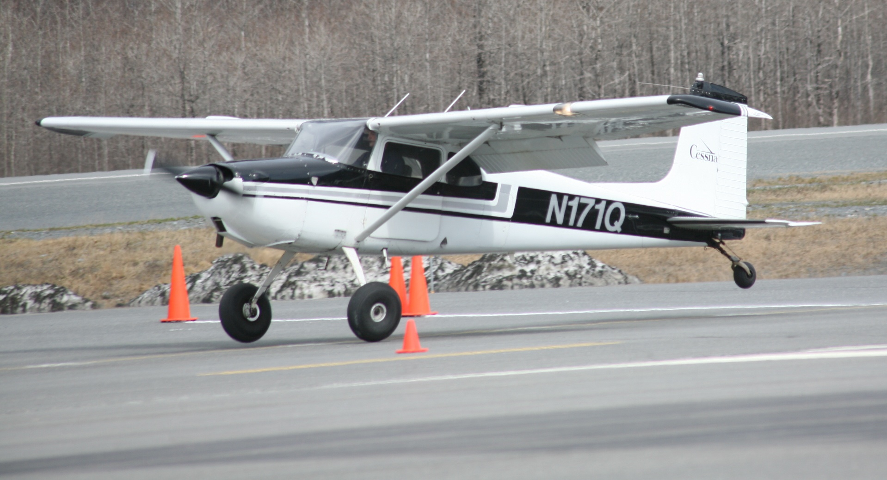
Notes:
You may have heard that, once you’re in the air, (Click)
a tailwheel airplane flies like a nosewheel airplane of similar weight and performance.
That’s true with one notable exception.
(Next Slide)

Slide 7
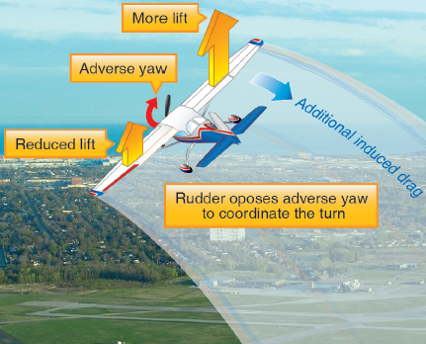
Adverse Yaw
Notes:
Just a little review here. Most of us can recall ground school discussions of adverse yaw and the necessity of coordinating rudder and aileron input when turning. Over time we’ve internalized that discussion, and we apply rudder as needed to coordinate our turns without thinking much about it. Flying old taildraggers will quickly get you thinking about adverse yaw again. In some airplanes, rudder/aileron coordination is an absolute necessity. Attempting to turn these airplanes without coordinating will result in a bank in one direction accompanied by a yaw in the other direction with the airplane proceeding straight forward in a slip.
With that said, let’s get back on the ground and talk about tailwheel designs.
(Next Slide)

Slide 8
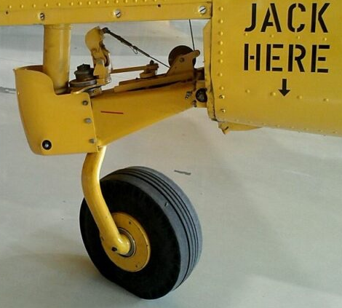
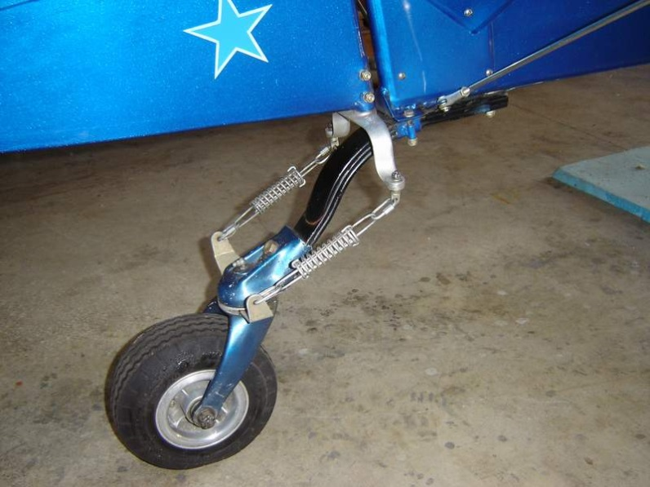
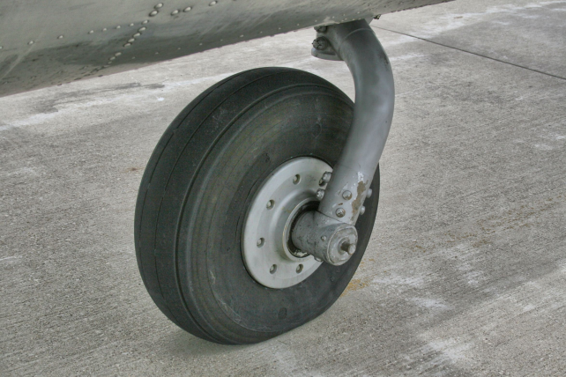
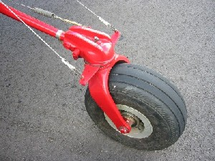
3 Tailwheel types
Steerable Swiveling-Breakaway
Locking
Castering
Notes:
Steerable/Swiveling tailwheels are connected to the rudder and are usually a Steerable-Breakaway style. This is what you are most likely to see. These tailwheels employ an engaged ‘castor’ mechanism which allows a steering arc of 16 to 18 degrees either side of center, then becoming full swiveling. (Click)
Locking tailwheels are generally found on larger airplanes like the AT6 shown here or a DC-3 and they may be retractable. They are sometimes installed in smaller aircraft such as the Pitts ‘Haigh’ tailwheel, or Cessna 185. (Click)
Castering tailwheels are not connected to the rudder, and they cannot be locked into position.
Next let’s consider tailwheel design and performance advantages.
(Next Slide)

Slide 9
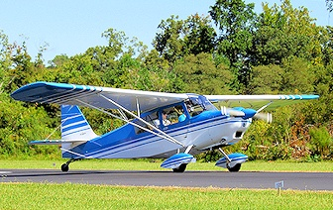
Tailwheel Advantages…
Supports less aircraft weight
Lighter construction
Unimproved surface operations
Greater propeller clearance
Notes:
Tailwheels are positioned much further from aircraft centers of gravity than nosewheels. Thus, they support less weight, and they need not be as robust as nosewheels so total aircraft weight is reduced. Tailwheel aircraft are better for operations to unimproved surfaces because aircraft weight is distributed over a larger area. And of course, tailwheel configurations provide much greater propeller clearance.
(Next Slide)

Slide 10
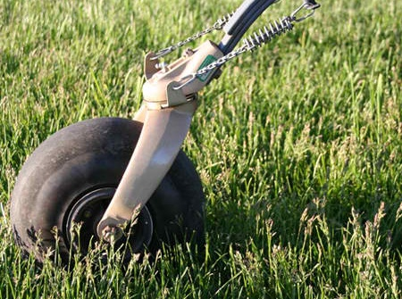
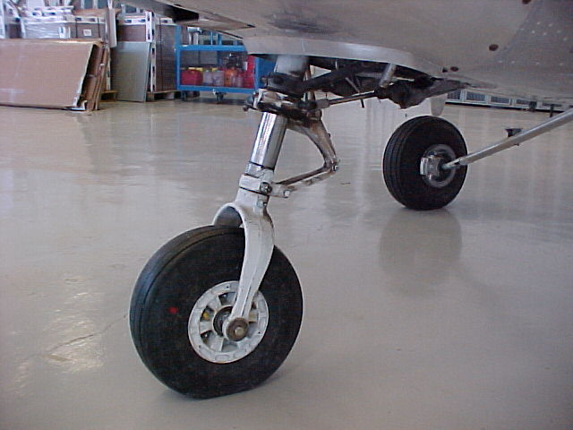
Tailwheel Advantages…
Lighter
Less parasitic drag
Simple manufacture
Easy to maintain
Increased useful load
Greater cruise speeds
Vs.
Notes:
Tailwheels are significantly lighter and produce less parasitic drag than nosewheels. They are relatively simple to manufacture and easy to maintain. And tailwheel aircraft enjoy greater useful loads and higher cruise speeds than their nosewheel equivalents.
You may be wondering, “If tailwheel designs are so superior, why aren’t more of them being made?”
Well, there are a couple of reasons and they both have to do with ground operations.
(Next Slide)

Slide 11
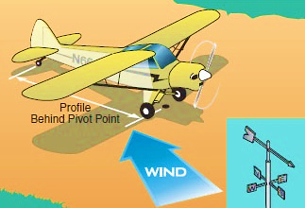
Directional control
Notes:
A tailwheel pilot’s greatest challenge is directional control. Tailwheels are positioned well aft of the main gear on a long lever. Thus, relatively little tail displacement can result in large directional excursions. As taxi turns are started, the aircraft begins to pivot on one or the other of the main wheels. From that point, with the CG aft of that pivot point, the forward momentum of the plane acts to continue and even tighten the turn without further steering inputs. Ordinarily, removal of rudder pressure does not stop a turn that has been started, and it is necessary to apply an opposite input (opposite rudder) to bring the aircraft back to straight-line travel. Frequent small corrections are required to follow the taxi route.
The three point taxi attitude also results in reduced visibility forward so Tailwheel taxis consist of a series of small Zig-Zag or S-turns to clear the area ahead. With a little practice in calm wind conditions and a commitment to going slow, transitioning pilots can taxi with precision and confidence. Then it’s time to deal with wind.
Tailwheel aircraft taxi at higher angles of attack than nosewheel craft so headwinds and crosswinds generate some lift. Correct flight control position is crucial to maintaining control. Like a wind vane, tailwheel airplanes will try to turn their noses into the wind and, especially in variable wind direction and gusty conditions, pilots will be challenged to maintain control. Upwind taxi turns are relatively easy to accomplish in taildraggers. Downwind turns are another story and may, in fact, be impossible if the wind is strong enough. Once again, small, timely corrections are key to success.
(Next Slide)

Slide 12
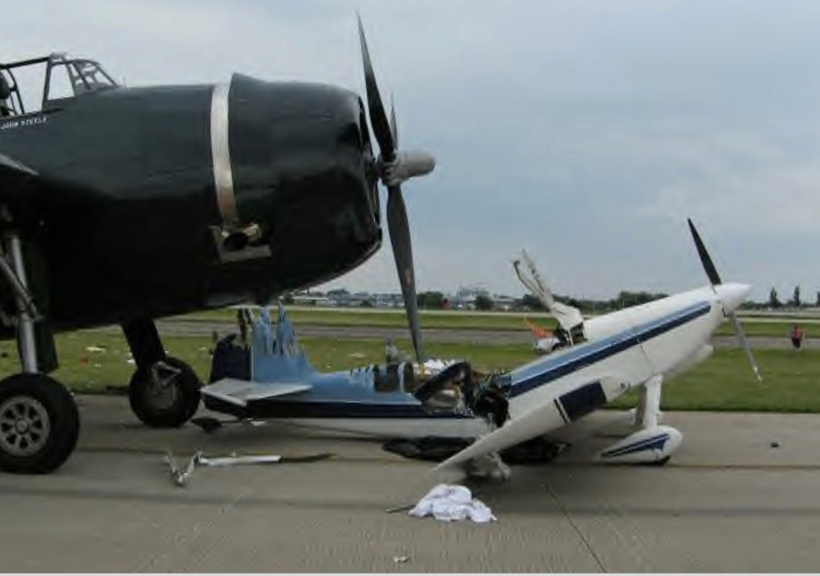
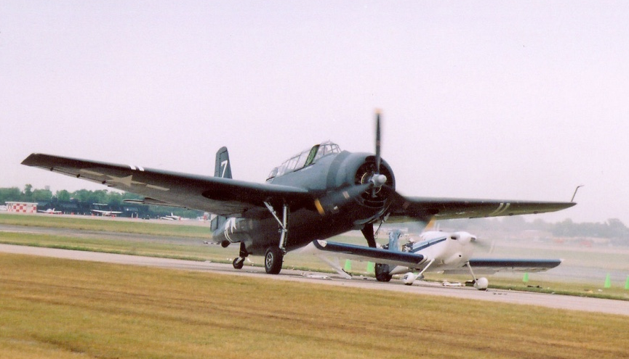
S-turns are essential
Notes:
The necessity of making S-turns and taking it slow in taxi operations cannot be overemphasized. No matter which tailwheel airplane you’re flying, you can’t see what’s directly in front of your nose while taxiing. The Avenger pilot thought he was following a Tundra aircraft that subsequently exited the taxiway. The Avenger pilot spotted the aircraft in front of the Tundra and thought that was his traffic to follow. He never saw the RV-6 before impact.
(Next Slide)
Background: See NTSB Accident Investigation Report CHI06FA206.

Slide 13
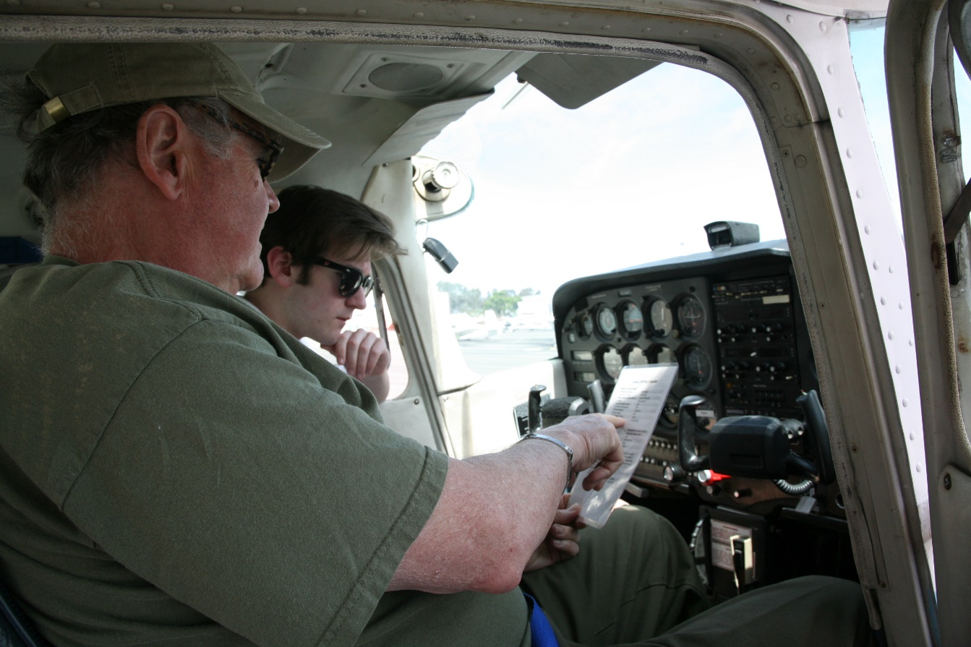
Choosing a Flight Instructor
Experienced in
  Tailwheel operations
  Aircraft make & model
Ask around:
  Local tailwheel pilots
  EAA Chapters
  Type clubs
Notes:
Unless you already know or have been referred to a tailwheel instructor you’ll need to research your options. Asking local tailwheel pilots for recommendations is a good place to start. Local EAA Chapters and type clubs are also great sources for flight instructor referrals. Obviously, you’ll want an instructor who is experienced in the aircraft and ideally, you’ll want someone with a proven record of student accomplishments.
Speaking of aircraft – what’s the best choice for tailwheel instruction? There are a lot of options to consider, and it may come down to what aircraft your chosen instructor has available. Let’s look at some of the options.
(Next Slide)

Slide 14
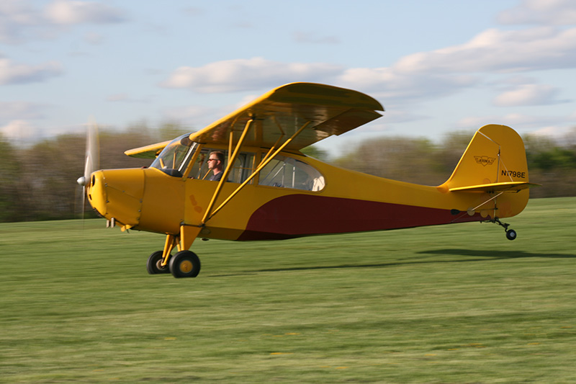
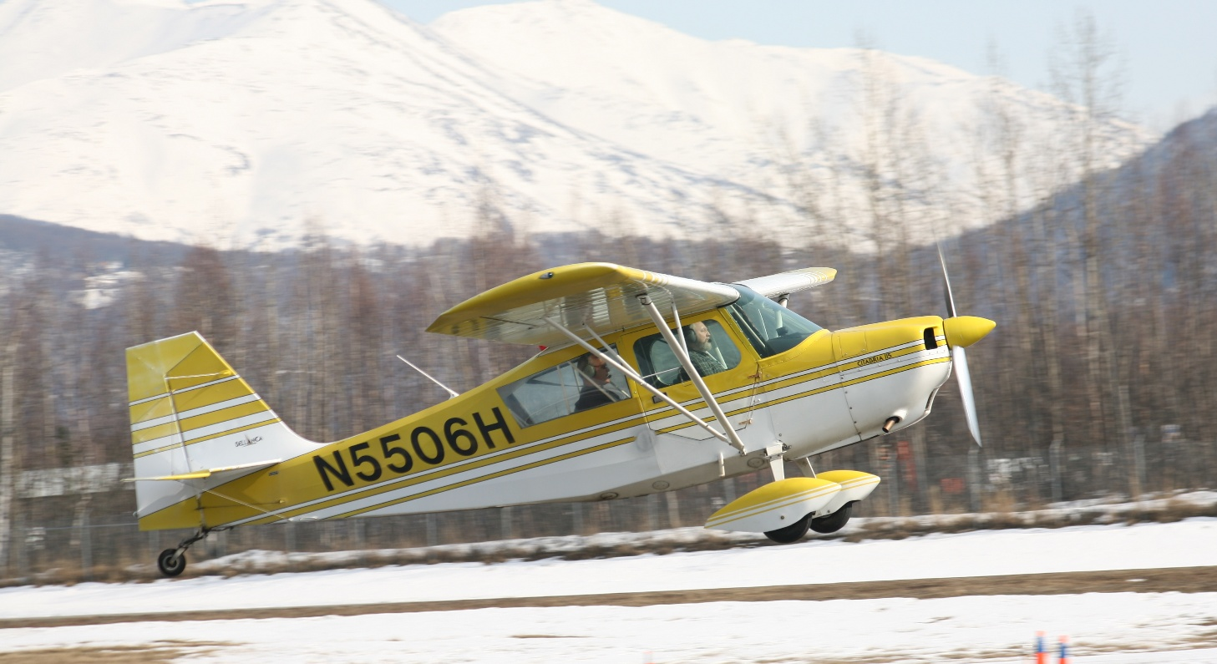
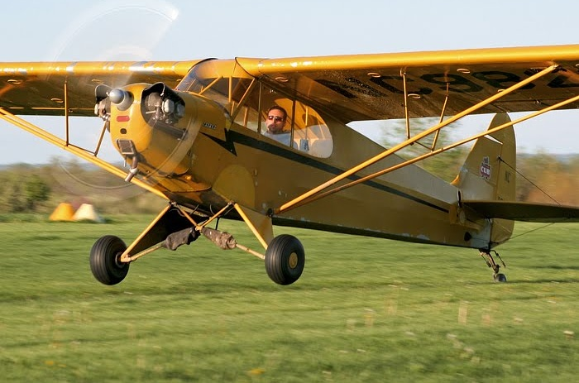
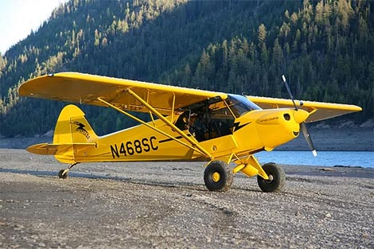
Choosing an airplane
This Photo by Unknown Author is licensed under CC BY-NC-ND
This Photo by Unknown Author is licensed under CC BY-NC-ND
Notes:
Many tailwheel training aircraft feature tandem seating. The classic Piper J3 is soloed from the back seat. (Click)
While the Piper Super Cubs are soloed from the front. (Click)
As are the Aeronca Champ and Champion Citabrias.
(Next Slide)

Slide 15
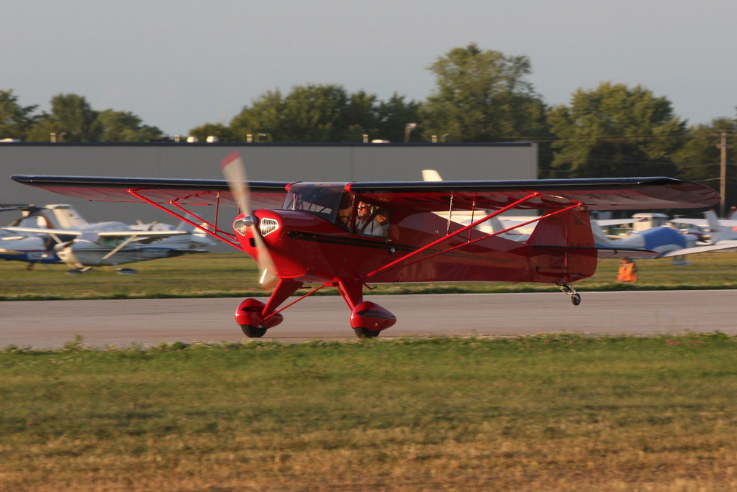
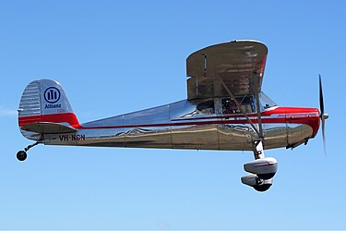
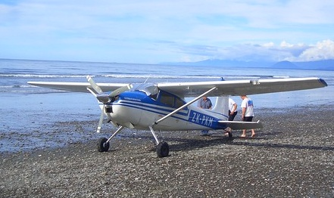
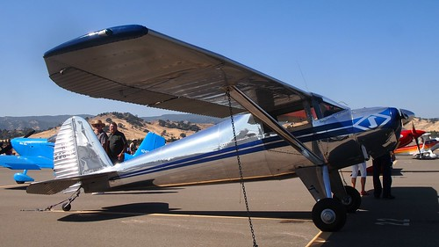
Choosing an airplane
This Photo by Unknown Author is licensed under CC BY
This Photo by Unknown Author is licensed under CC BY-ND
This Photo by Unknown Author is licensed under CC BY
This Photo by Unknown Author is licensed under CC BY-SA
Notes:
Cessna tailwheel options range from 2seat 120s and 140s to 4 seat 180s and 185s. (Click)
As are Tailorcraft (Click)
and harder to find Luscombe models. All of these feature side-by-side seating.
(Next Slide)

Slide 16
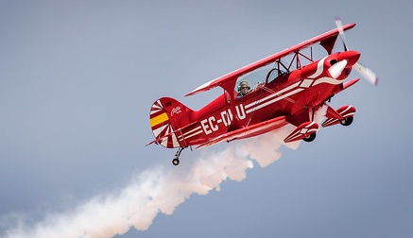
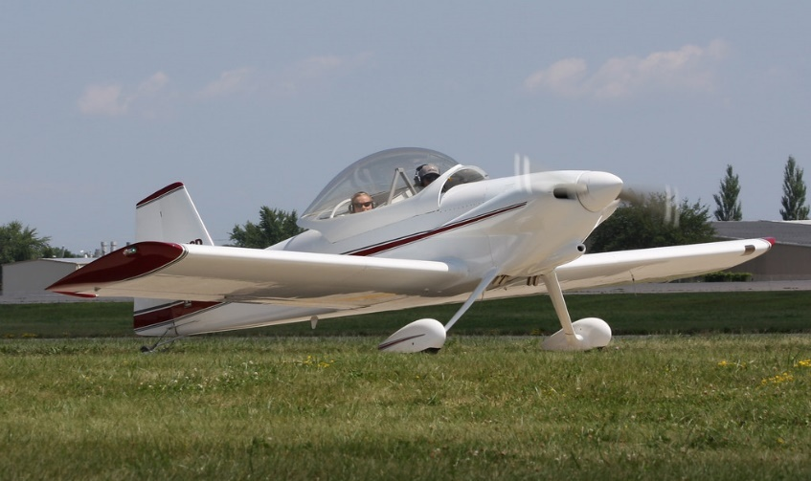
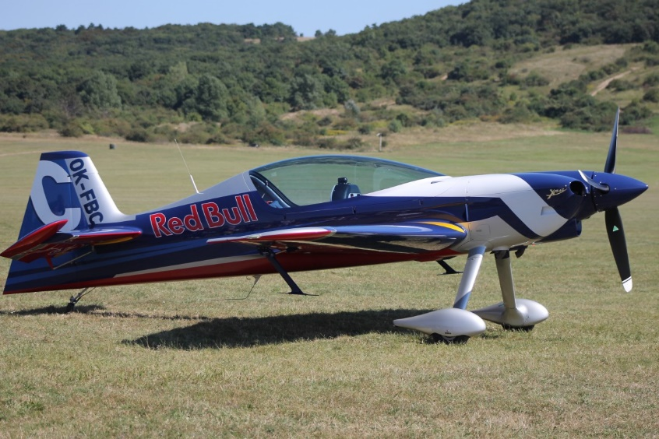
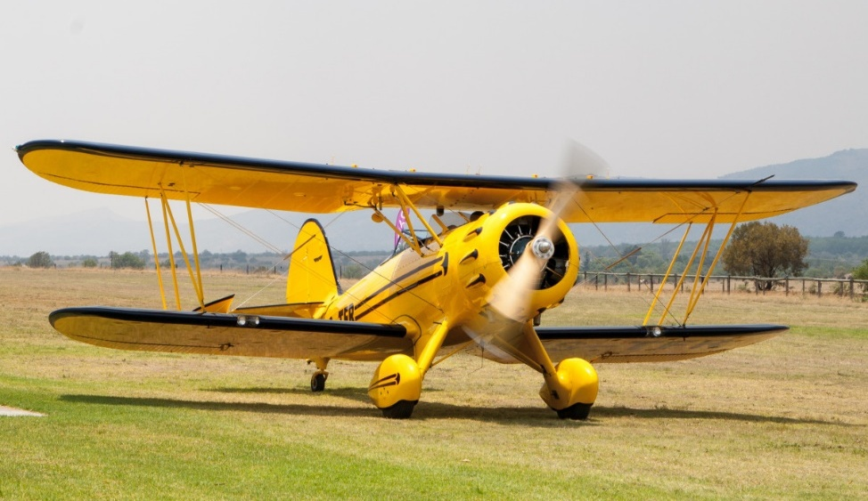
Choosing an airplane
This Photo by Unknown Author is licensed under CC BY
This Poto by Unknown Author is licensed under CC BY-NC-ND
Notes:
And the list goes on. There are a lot of old and new tailwheel airplanes to choose from. You just have to look a little harder to find them.
(Next Slide)

Slide 17
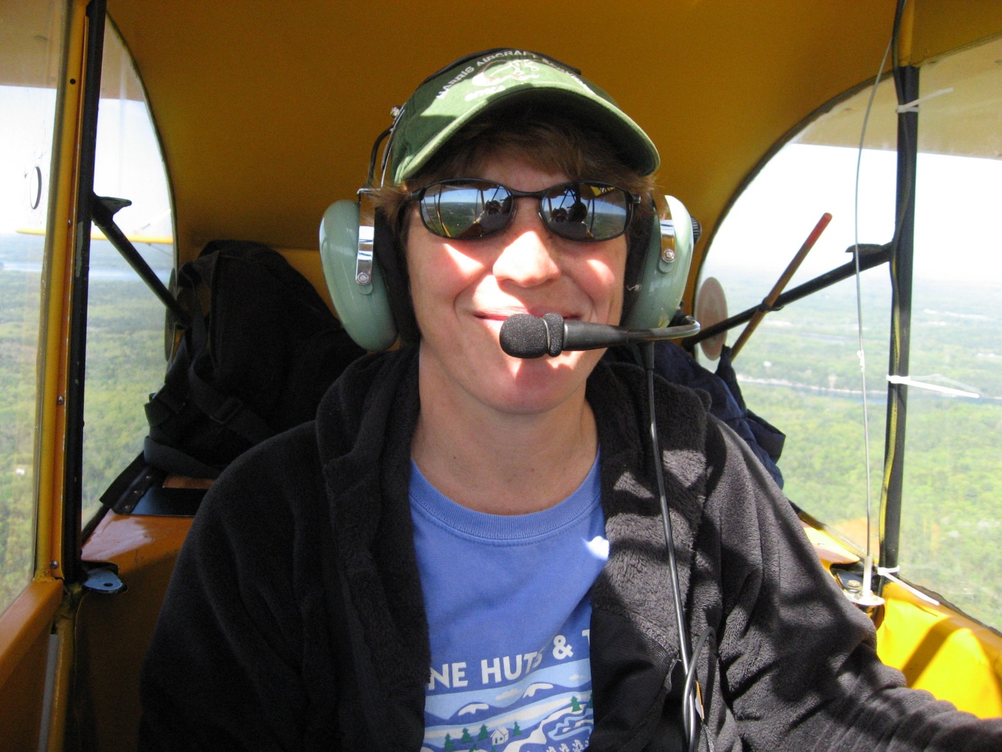
Expanding your horizons
Notes:
Tailwheel pilots are in the minority these days but mastering a taildragger is still something well worth pursuing. There’s nothing like the feeling of accomplishment you get from flying a Cub from a grass field with a little wind to make things interesting. It’s guaranteed to put a smile on your face.
(Next Slide)

Slide 18
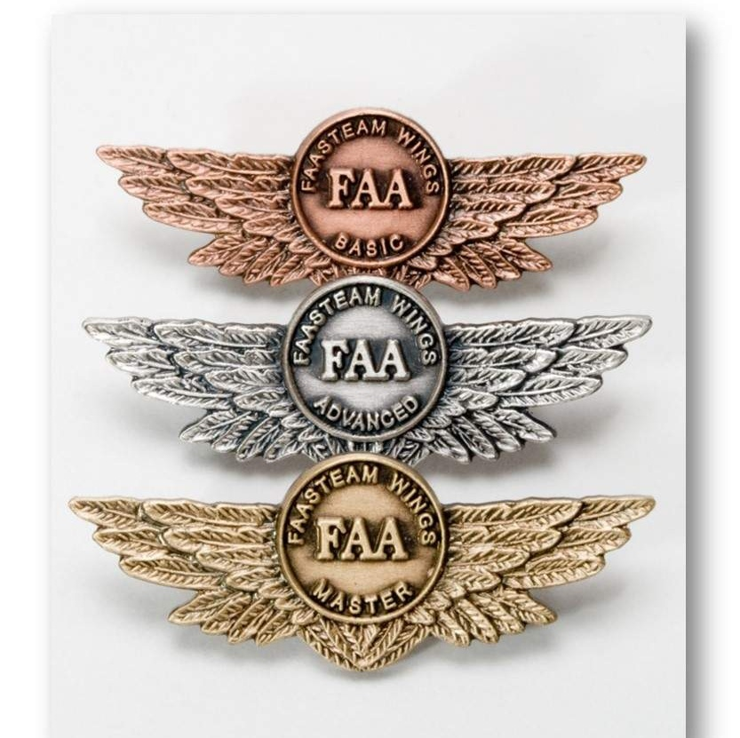
Thank you!
Aviate - Reduce levels of automation to a point where you are comfortable in managing your flight path.
Navigate - Manage your flight path to ensure you are clear of terrain, obstacles, and air traffic.
Communicate - With your aircraft under control in safe airspace; communicate and act on your intentions.
Notes:
Well, that concludes this presentation. Thanks very much for your participation. We applaud your dedication to excellence in aviation safety education and we invite you to continue your journeys to excellence in the FAA WINGS Pilot Proficiency Program.
Please accept our best wishes for safe flying and remember to always, (Click)
Aviate - Maintain aircraft control and reduce levels of automation to a point where you are comfortable in managing your flight path. (Click)
Navigate - Manage your flight path to ensure you are clear of terrain, obstacles, and air traffic. (Click)
Communicate - With your aircraft under control in safe airspace; communicate and act on your intentions.
(Next Slide)

Slide 19
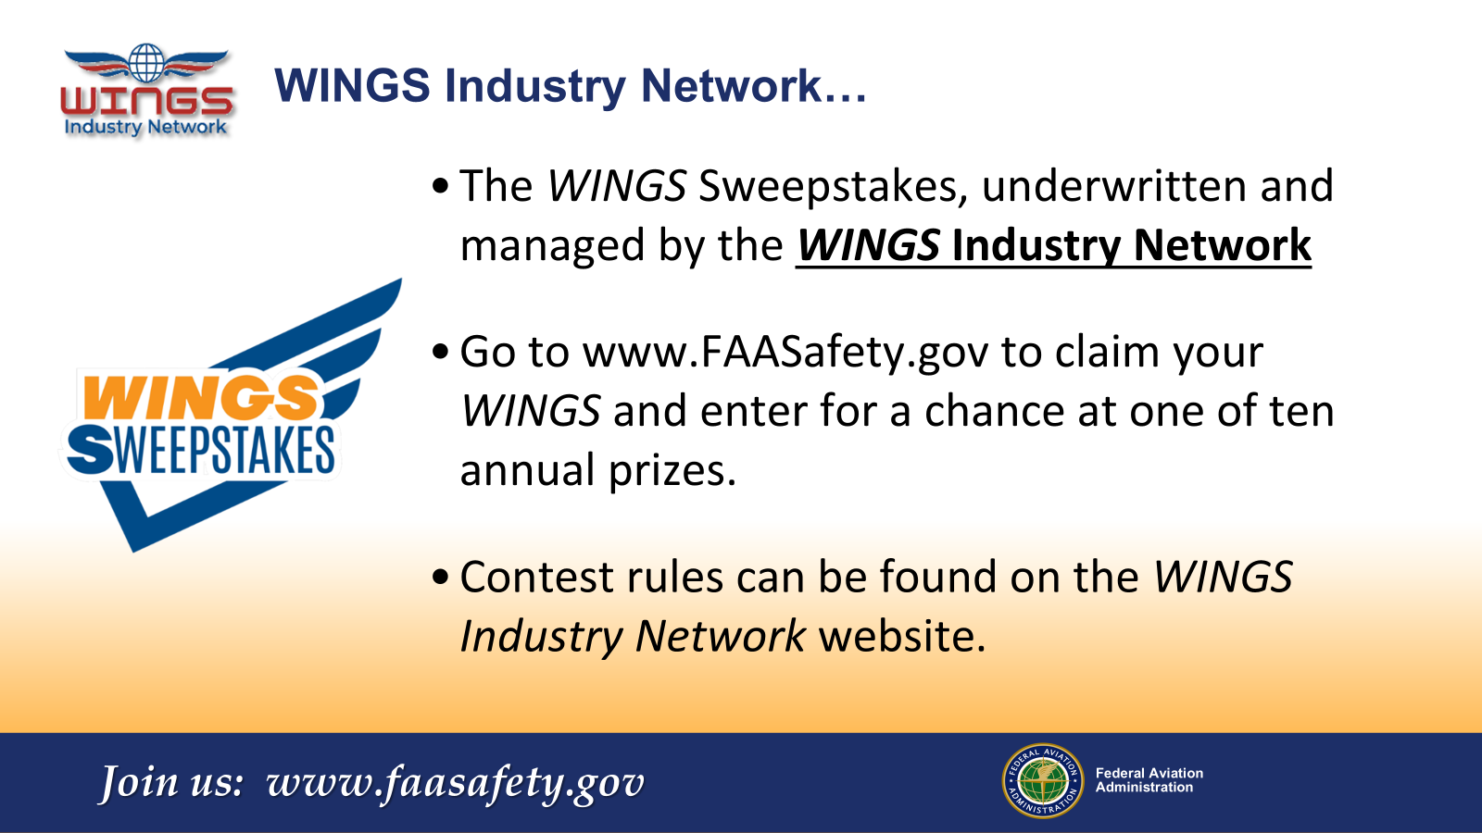
Notes:
Every time you complete a WINGS Phase, you’re eligible to win cash in the WINGS Sweepstakes.
The sweepstakes is generously funded by the WINGS Industry Network. https://wingsindustry.com to learn more and enter the sweepstakes.
Just navigate to http://www.mywingsinitiative.org or scan the QR code for details. By the way, Instructors can also enter the sweepstakes.
(Next Slide)

Slide 20
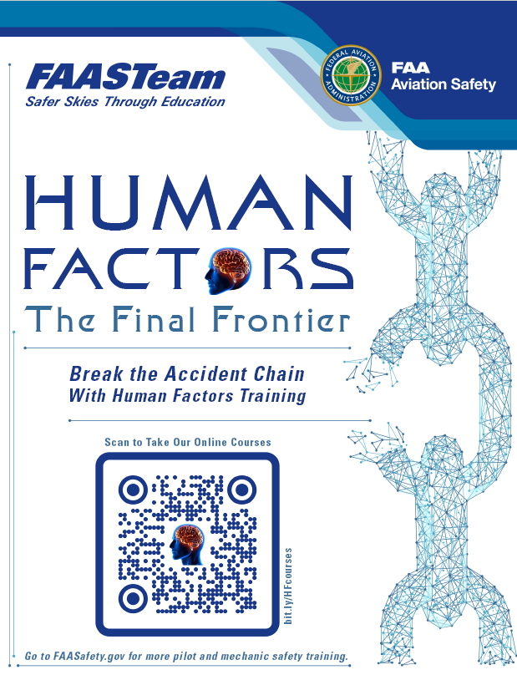
Begin (or continue) your Human Factors journey here
http://bit.ly/HFcourses
Notes:
If you’re looking to expand your knowledge horizon we encourage you to explore the Human Factors series of courses on FAASafety.gov. Navigate to the URL or scan the QR code on screen for a FAASTeam Human Factors course catalog that features direct links to each of the courses.
(Next Slide)

Slide 21
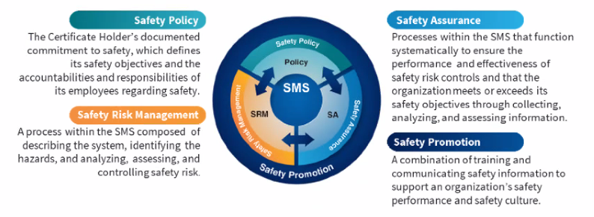
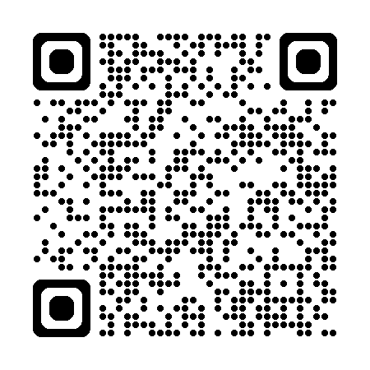
Safety Management Systems (SMS)
Coming to General Aviation
Safety Management System (SMS) | Federal Aviation Administration (faa.gov)
Notes:
Safety Management Systems are a set of policies and processes that can increase the safety and efficiency of any flight operation. And FAA is bringing SMS to General Aviation. You may have heard of SMS but thought it was only for large organizations but actually, SMS can be scaled to fit any operation large or small.
There are 4 major components to a Safety Management System (Click)
Safety Policy – a documented commitment to safety that runs from the head of an organization to its newest member. (Click)
Safety Risk Management – a process that identifies hazards within an operation, determines to what extent an identified hazard may impact flight safety, and controls the risk of occurrence to an acceptable level. (Click)
Safety Assurance – By collecting and analyzing information derived from safety performance data Safety Assurance ensures the performance and effectiveness of Safety Risk Controls. (Click)
Safety Promotion communicates safety information and commitment throughout the organization. (Click)
You can find more information about Safety Management Systems at the URL on the Screen.
(Next Slide)

Slide 22
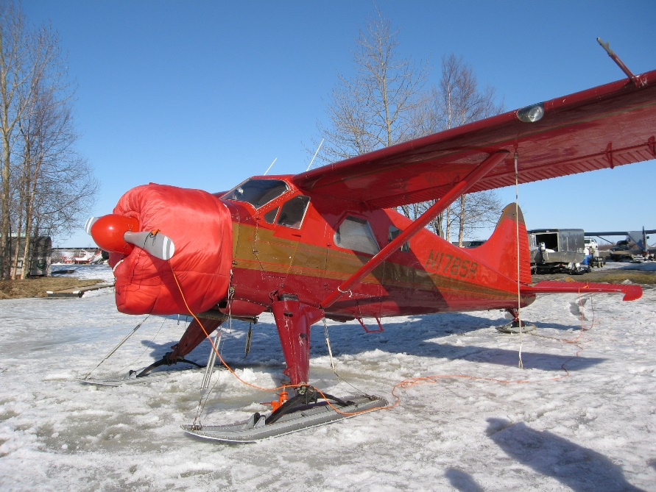

Questions?
Notes:
Presentation Note: You may wish to provide your contact information and main FSDO phone number here. You can also add WINGSPro contact information.
Modify with your information or leave blank.
(Next Slide)

Slide 23
The National FAA Safety Team Presents
Topic of the Month - July
Tailwheel Transition
Notes:
(The End)

