Slide 1
The National FAA Safety Team Presents
Topic of the Month – August
Pre-flight & In-flight Weather Resources
Notes:
2024/09-10-324(I)PP Original Author: John Steuernagle 01/30/2019; Revised by AJR B-6 07/01/2020; Revised 01/24/2025 JS; POC John Steuernagle, National FAASTeam Program Manager - Operations Office (562-264-5484).
Presentation Note: This is the title slide for Pre-Flight and In-Flight Weather Resources.
Script - We have included a script of suggested dialog with most slides. The script will always appear in a non-italic font. Presenters may read the script or modify it to suit their own presentation style. See template slides 5 and 6 for examples of a slides with script.
Presentation Instructions - (stage direction and presentation suggestions) will be preceded by a Bold header: the instructions themselves will be in Italic fonts. See slides 2, for an example of slides with Presentation Instructions only.
Program control instructions - will be in bold fonts and look like this: (Click) for building information within a slide; or this: (Next Slide) for slide advance.
Background information - Some slides may contain background information that supports the concepts presented in the program.
Background information will always appear last and will be preceded by a bold Background: identification.
The production team hope you and your audience will enjoy the show. Break a leg!
(Next Slide)

Slide 2


Welcome
Exits
Restrooms
Emergency Evacuation
Breaks
Phones & pagers to silent or off
Sponsor Acknowledgment
Other information
Notes:
Presentation Note: Here’s where you can discuss venue logistics, acknowledge sponsors, and deliver other information you want your audience to know in the beginning.
You can add slides after this one to fit your situation.
(Next Slide)

Slide 3

Overview
*GAJSC Safety Enhancement – Weather Technology
Pre-flight weather resources
  Not a comprehensive list
  Sample of government resource
  available today
  Many third-party resources are
  also available
In-flight weather resources
  Not a comprehensive list
  Sample of resources available today
*General Aviation Joint Safety Committee
Notes:
The General Aviation Joint Safety Committee is a government/industry group that looks at GA mishap experience and makes recommendations (they call them safety enhancements) for safety improvement. This program addresses their recommendation that GA pilots be apprised of advances in weather technology that can enhance the safety of flight.
In this program, we’ll discuss automated resources that are available for you to conduct a preflight briefing. We also discuss weather information resources that are available to general aviation pilots in flight.
Technology is advancing so quickly that we can’t claim our list of resources is at all comprehensive but rather a sampling of what’s available to pilots today.
Presentation Note: If you’ll be discussing additional items, add them to this list.
(Next Slide)

Slide 4
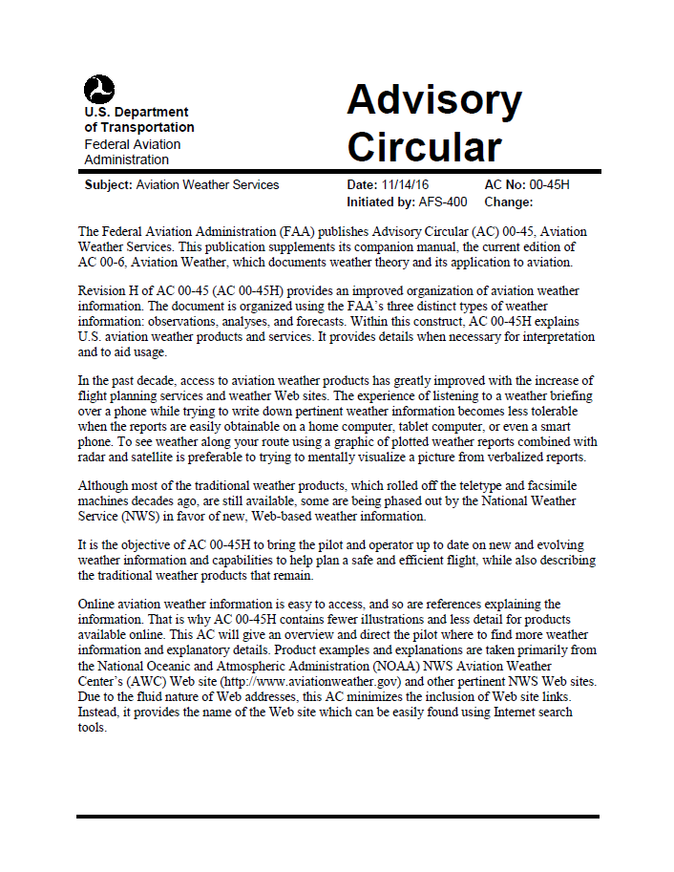
Resources
AC 00-45H Aviation Weather Service
  Comprehensive list of FAA, NWS services
  and products
  Includes FIS-B (Flight Information Service-
  Broadcast) products available through ADS-B
  in data link
AC 91-92: Pilot’s Guide to a Preflight
Briefing (expected early 2021)
Additional information resources will
be cited at the end of this presentation.
Notes:
Much of the information presented here is taken from FAA Advisory Circular 00-45H – Aviation Weather Services. This publication contains a comprehensive list of weather services and products from the National Weather Service (NWS) and FAA including a list of Flight Information Service-Broadcast (FIS-B) products that are available through ADS-B-In data link.
Note: AC 00-45H will be superseded in late 2020 or early 2021 by the Aviation Weather Handbook to be published by Flight Standards. It will also replace several other handbooks related to weather
AC 00-6 Aviation Weather (08/23/2016)
AC 00-24 Thunderstorms (02/19/2013)
AC 00-30 Clear Air Turbulence Avoidance (03/22/2016)
AC 00-54 Pilot Windshear Guide (11/25/1988)
AC 00-57 Hazardous Mountain Winds and Their Visual Indicators (09/10/1997)
(Click)
We’ll list additional information resources at the end of this presentation.
(Next Slide)

Slide 5
AC 91-92 Pilot’s Guide to a Preflight Briefing
Encourages pilots to conduct regulatory compliant preflight self-briefings
Shows pilots how to conduct a regulatory compliant preflight self-briefing using automated resources
Assists pilots in complying with Title 14 of the Code of Federal Regulations (14 CFR) part 91, §§ 91.103 that states each pilot in command shall become familiar with all available information concerning their flight before departure
Replaces FAA publications:
  General Aviation Pilot’s Guide to Preflight Weather Planning, Weather self-Briefings, and Weather Decision Making
  How to Obtain a Good Weather Briefing
Notes:
We also reference AC 91-92 Pilot’s Guide to a Preflight Briefing that replaces 2 previous publications and offers valuable information on the conduct of self briefings.
(Next Slide)

Slide 6


Weather analysis and decision making are big parts of our job.
Notes:
Weather analysis and decision making are big parts of every pilot’s job. We know the weather at our departure airport but en route weather is less certain. (Click)
And of course, we need to know if weather conditions will permit a landing at our destination.
(Next Slide)

Slide 7
Preflight to tie down
Process
Perform
Perceive
Perceive
  Gather weather information
Process
  Analyze weather information
Perform
  Make and act upon
  operational decisions
Notes:
Weather information gathering, analysis, and decision making begin with the preflight and continue throughout. While en route we need to continually: (Click)
Perceive present weather conditions and gather additional weather information from various sources. (Click)
Process weather information by comparing present weather with forecasts and by relating present and expected weather conditions to aircraft and pilot performance capabilities. (Click)
Perform by making operational decisions and acting upon them. (Click)
This process continues throughout the flight. Our perception of the results of our performance decisions further informs and refines our analysis.
(Next Slide)

Slide 8
Pre-flight Self-Briefing
Prior to every flight, pilots should gather all information vital to the nature of the flight
Using automated resources, pilots can conduct a regulatory compliant preflight briefing without contacting Flight Service
Pilots who prefer to contact Flight Service are still encouraged to conduct a self-briefing prior to calling
  Provides familiarity of meteorological and aeronautical conditions applicable to the route of flight
  Promotes a better understanding of weather information
Notes:
Regulations require that, during our pre-flight planning, we gather all pertinent information with regard to each flight.
We can use automated weather information resources to gather weather information without contacting Flight Service
Pilots can still contact Flight Service, but they are highly encouraged to conduct a self-briefing prior to the call. That way they’ll have
a good idea and understanding of weather conditions before speaking with a briefer.
(Next Slide)

Slide 9
Pre-flight Know Before You Go
1) Adverse Conditions | Weather advisories (SIGMETs, AIRMETs, Convective SIGMETs, Center Weather Advisories, Aviation Watch Notification Messages) NOTAMs (airport/runway closures, TFRs, etc.) IFR conditions, low-level windshear, thunderstorms, reported icing, frontal zones
2) Synopsis | Weather systems and/or air masses
3) Current Conditions | Current observations (e.g., METARs, PIREPs) for departure, en route, and destination Satellite and radar imagery
4) Forecast Conditions | Forecast information (departure, en route, and destination)
5) Winds Aloft | Winds aloft forecast (interpolate between levels and stations) Temperature at proposed altitude
6) Notices to Airmen (NOTAM) | Departure, en route, and destination
7) Restricted or Special Use Airspace | Prohibited Areas P-40, P-56, and the Special Flight Rules Area (SFRA) for Washington, DC
8) ATC Delays | ATC delays and/or flow control advisories
Notes:
Flight Service uses this general list of elements for providing Standard Weather Briefings.
It is recommended that this list be used when conducting a preflight self-briefing using automated resources.
Using this list of elements when conducting a preflight self-briefing regardless of the automated resource will assist a pilot in complying with Title 14 of the Code of Federal Regulations (14 CFR) part 91, §§ 91.103.
There are also interactive graphics (e.g. GFA or 1800wxbrief.com Interactive map) available that depict some of these elements to assist in understanding what information is applicate to the route of flight.
(Next Slide)

Slide 10
Sample Pre-flight Self-Briefing Resources
1800wxbrief.com | Leidos Flight Service – FAA Contract Vendor
weathercams.faa.gov | Alaska, Canada & “lower 48”
aviationweather.gov | NOAA/Government Web Site for aviation weather
Fly.faa.gov/flyfaa/usmap.jsp | FAA Flight Delay Information
nhc.noaa.gov | National Hurricane Center (HNC)
notams.aim.faa.gov/notamSearch | Federal NOTAM System (FNS)
spc.noaa.gov | NOAA Storm Prediction Center
ssd.noaa.gov/VAAC/vaac.html | Volcanic Ash Advisory Centers (VAAC)
sua.faa.gov | Special Use Airspace
tfr.faa.gov/tfr3/?page=list | Temporary Flight Restrictions
weather.gov | National Weather Service Forecast Office
weather.gov/aawu | Alaska Aviation Weather Unit (AAWU)
weather.gov/hfo | National Weather Service Forecast Office Honolulu, HI
www.wpc.ncep.noaa.gov | Weather Prediction Center
Notes:
Here’s a list government and third-party automated resources that may be used for conducting pre-flight self-briefings
Presentation note: Pause on this slide to allow audience to photograph the reference list. While they’re doing that you can read some of the FAQs below. When discussion is complete (Next Slide)
FAQ on using automated preflight resources. You may get some of the questions listed below. If so, refer to the answer listed.
Q1: Does my self-briefing need to be recorded or documented by the automation sites(s) I use?
A1: There is no requirement for a self-brief to be recorded
If you prefer to record your self-briefing preparation, consider invoking the Standard Briefing functionality on 1800wxbrief.com; third-party applications may also offer a recorded briefing functionality
Q2: I like the Graphical tools (GFA, Interactive Maps) when conducting preflight planning. Do I still need to use the “Standard Briefing” functionality on the planning website or app that provides a full textual briefing?
A2: Full textual (aka Standard Briefing) functionality is not required to be invoked
The goal is to conduct a comprehensive preflight self-briefing; if you have done this (i.e., covered all the checklist items) using the graphical tools, you do not need to invoke a full textual briefing
However, the Standard Briefing functionality is a good idea as a double check that you have not missed something in your own workflow
Q3: If I conduct a self-brief and still decide to call Flight Service, will they know what I have done online?
A3: YES, if you have used 1800wxbrief.com and requested a standard briefing
YES, if you have used a third-party application that links to your 1800wxbrief.com account and uses an approved standard briefing product (check with your particular third-party vendor)
NO, if you have used just the graphical functionality on 1800wxbrief.com, AWC, or third-party sites
If you plan to call Flight Service, then invoking the Standard Briefing functionality from 1800wxbrief.com (or a third-party application that shares your 1800wxbrief.com credentials) will allow the Specialist to see your briefing details and save you time

Slide 11
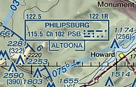
In-flight Weather Sources
Flight Service (FSS) en route weather
Frequencies depicted on VOR data block
    FSS transmits and receives on 122.5
    or receives on 122.1 & transmits on 115.5 (VOR)
Notes:
Let’s begin with FAA Flight Service. FSS stations provide en route weather via voice communication in a couple of different ways. In this example, aircraft flying near the Philipsburg VOR can contact Flight Service on 122.5 Mhz. (Click)
or they can receive on 122.1 Mhz. and transmit over the Philipsburg VOR on 115.5 Mhz. If you choose the VOR communication option, be sure to enable voice on your VOR receiver and adjust the audio volume so you can hear the FSS transmissions.
(Next Slide)

Slide 12


In-flight Weather Service Products – Radio or Datalink
Near Real Time or older | Forecasts old news
METARs – Surface Observations | Graphical Forecasts for Aviation (GFA)
SPECIs – Special METAR Reports | Terminal Aerodrome Forecasts - TAFs
SIGMETs (WSs) – Non-convective weather hazards to all aircraft | Winds & Temperatures Aloft
Convective SIGMETs (WSTs) – Convective weather hazards to all aircraft
AIRMETS (WAs) – Weather hazards to light aircraft
PIREPs - Pilot reports of flight conditions
NOTAMs – Notices to Airmen
Compare forecasts to real time observations to get the best weather picture.
Gold Seal
Notes:
Here are some of the products available for en route access. You may receive this information via radio (flight Service) or via data link. More about data link later.
Whenever you access weather information it’s important to know how old that information is. Some of the products in the left-hand column could be more than an hour old when you receive them. Others may be quite recent. That’s why it’s important to note the times when observations were taken and/or the product validity time span.
Products in the right-hand column will be older than those in the left. (Click)
Forecasts work best when you compare them with more current weather observations. That way you can see if weather is developing earlier or later than the forecast schedule.
PIREPs – Pilots are the best resource for reporting inflight weather conditions and confirming forecasts are correct or not.
(Next Slide)

Slide 13
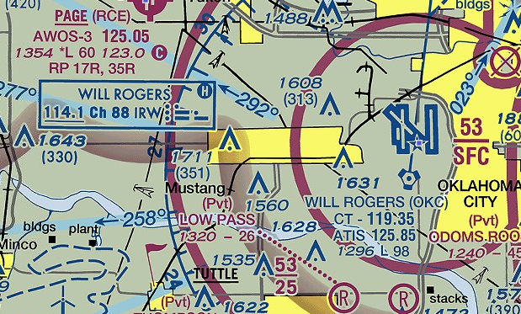
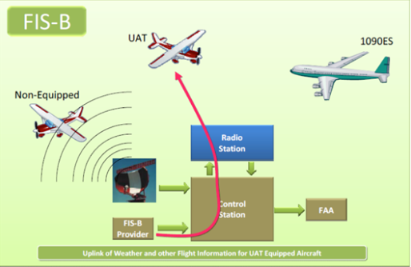
In-flight Weather Sources
Hazardous in-flight Weather Advisory Service (HIWAS)
Flight Information Services-Broadcast (FIS-B)
Notes:
The letter H in a VOR data block indicates a couple of things:
the ability to receive HIWAS (Hazardous in-flight Weather Advisory broadcasts. As the name implies, these were pre-recorded advisories of hazardous weather conditions. (Click)
It also indicates that you’re consulting an outdated chart because HIWAS was decommissioned in January of 2020. (Click)
Most US-registered aircraft are equipped with ADS-B Out. For those of us who are also equipped with ADS-B In, FAA is providing an impressive set of weather information products collectively known as Flight Information Services – Broadcast or FIS-B.
(Next Slide)

Slide 14
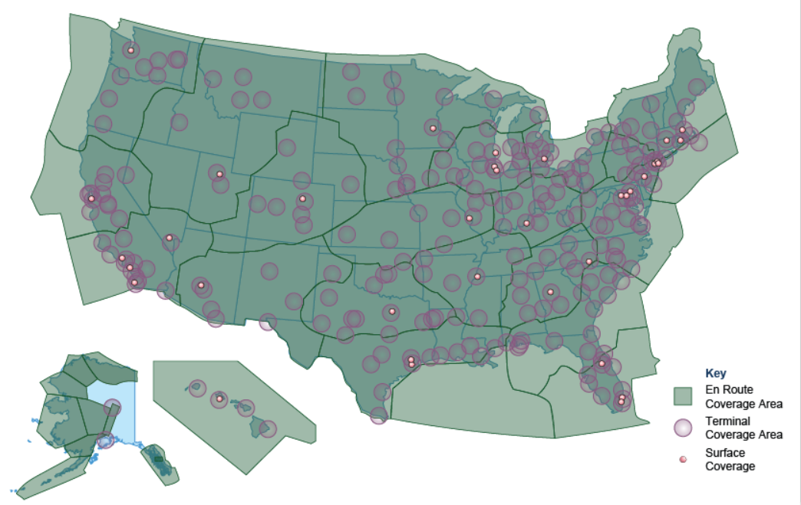
ADS-B – In Applications
Automatic Dependent Surveillance – Rebroadcast (ADS-R)
Traffic Information Services - Broadcast (TIS-B)
Flight Information Services - Broadcast (FIS-B)
Notes:
Although ADS-B In equipment is not required, there are some compelling reasons why pilots are installing it. As you can see from the coverage map, en route ADS-B In service is available throughout the country. With ADS-B In you get a suite of traffic, weather, and flight information products. Let’s see how it works.
(Next Slide)

Slide 15
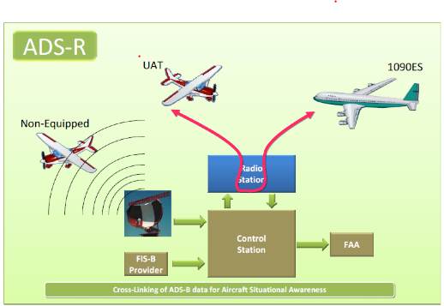
ADS-R
UAT ADS-B In aircraft receive UAT ADS-B out traffic directly
ADS-R relays ADS-B Out Information to ADS-B In-equipped aircraft
Notes:
UAT equipped ADS-B In aircraft receive traffic information directly from UAT ADS-B out aircraft. (Click)
ADS-R rebroadcasts traffic information derived from UAT and 1090 Extended Squitter positions so that even though the two systems don’t exchange information directly, traffic information is available to both.
There’s also a way for ADS-B in users to see aircraft that are not ADS-B Out equipped.
(Next Slide)

Slide 16
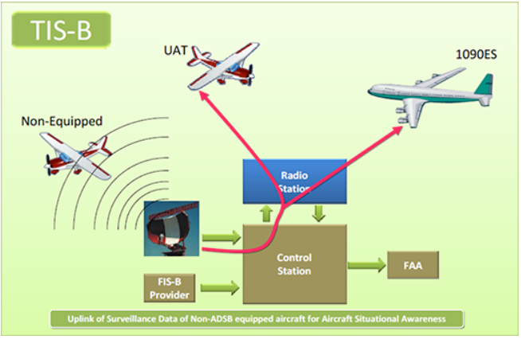
TIS-B
Available to ADS-B In aircraft at and below 24,000 feet
Positional data collected from all aircraft is transmitted to ADS-B In aircraft
Notes:
The ADS-B system transmits TIS-B data on both links to equipped aircraft flying within coverage. TIS-B uses data from ADS-B, radar, Wide Area Multilateration (WAM), and surface multilateration systems like ASDE-X to create accurate near-real-time position reports.
In order to receive TIS-B information you must be ADS-B In equipped, within coverage of an ADS-B ground station and an FAA radar or multilateration system.
Background: Multilateration systems are employed to provide surveillance outside of radar coverage.
Wide Area Multilateration (WAM) is comprised of a network of relatively small sensors that can be deployed in areas that are problematic for radar installations. WAM capabilities an be combined within a set of ADS-B ground stations.
Surface Multilateration consists of sensors deployed on airports. The data provided by these sensors is integrated with airport surveillance radar and ADS-B sensor data to create an accurate picture of ground traffic on the airport. The equipment and sensors is collectively known as Airport Surface Detection Equipment (ASDE-X)
(Next Slide)

Slide 17
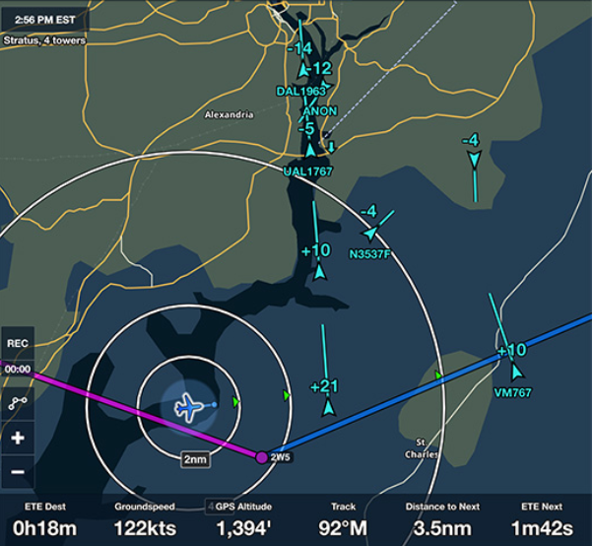
Caution
ADS-B traffic picture may
not be complete
Good adjunct to visual scan but…
We still need to look
outside for traffic.
Notes:
ADS-B In is not guaranteed to display all traffic in a given area. It’s a great situational awareness and collision avoidance tool but it’s also a compelling distraction. We still need to look outside our windows.
(Next Slide)

Slide 18
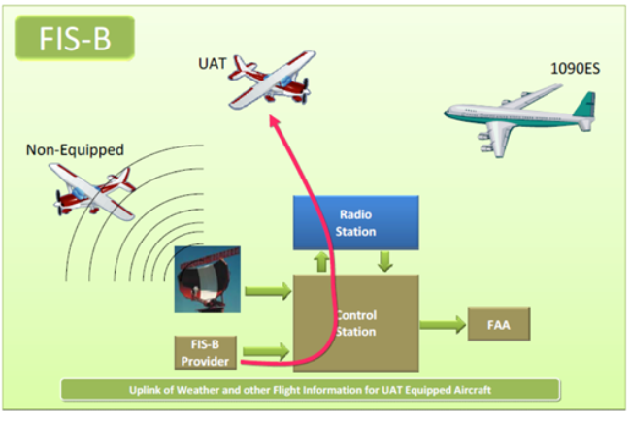
FIS-B
Available to ADS-B UAT equipped aircraft
System broadcasts aeronautical information products from the FAA and weather products from the National Weather Service
Notes:
FIS-B information is available to UAT (Universal Access Transceiver) equipped aircraft only. The system broadcasts aeronautical information products from the FAA and weather products from the National Weather Service.
(Next Slide)

Slide 19
FIS-B Products
AIRMETs | TAFs
Convective SIGMETs | Amended TAFs
SIGMETS | Winds & Temperature Aloft
METARS | Lightning
SPECIs | Turbulence
National NEXRAD | Icing
Regional NEXRAD | Cloud Tops
D-NOTAMs | Graphical AIRMETs
FDC-NOTAMs | Center Weather Advisories
PIREPS | TIS-B Service Status
Special Use Airspace (SUA) Status
Notes:
Here’s a list of text and graphical FIS-B products – available free of charge to ADS-B In users. As you can see – it’s quite extensive and more products may be added in the future.
(Next Slide)

Slide 20
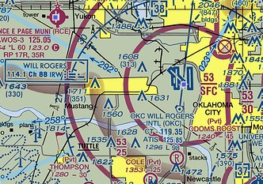
In-flight Weather Sources
Automatic Terminal Information Service (ATIS)
Notes:
We’re all familiar with the Automatic Terminal Information Service available at most towered airports. ATIS provides basic weather and runway information but what about non-towered airports?
(Next Slide)

Slide 21
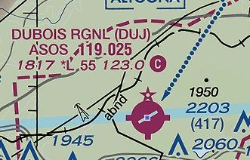
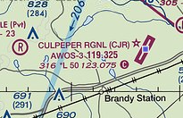
In-flight Weather Sources
Automated Surface Observing System (ASOS)
Automated Weather Observing System (AWOS)
Notes:
Many smaller airports are served by ASOS or AWOS automated weather observing systems. In fact, most of the weather data used to produce aviation weather reports and forecasts is now gathered by automated systems. These systems are constantly updating weather observations and averaging the data to give an accurate picture of present conditions. There are about one thousand ASOS and even more AWOS systems deployed throughout the United States.
(Next Slide)

Slide 22
ASOS Information
METAR Element | Information Provided
Wind Direction, Speed, & Character | Tens of degrees – Knots, Gusts
Visibility | Up to & including 10 statute miles
Runway Visual Range (RVR) | At selected sites
Basic present weather | Type and intensity
Obstructions to vision | Fog, mist, haze, & freezing fog
Sky condition | Cloud height and amount to 12,000 Ft. AGL CLR, FEW, SCT, BKN, OVC
Ambient & Dew point Temperatures | Degrees Celsius
Pressure | Altimeter Setting In. Hg.
Remarks | Automated, Manual, & Plain Language – depending on service level
Notes:
Here’s a chart of what’s available from an ASOS installation. At some locations information may be augmented by human observers.
Presentation note: Take a minute or so to discuss the information provided by ASOS, then:
(Next Slide)

Slide 23
AWOS Information
AWOS Type | Information Provided
AWOS-A | Altimeter Setting
AWOS-AV | Altimeter Setting & Visibility
AWOS-1 | Altimeter Setting, Wind speed & direction, Temperature, Dew Point, & Density Altitude
AWOS-2 | AWOS-1 plus Visibility
AWOS-3 | AWOS-2 plus Cloud & Ceiling Data
AWOS-3P | AWOS-3 plus Precipitation Discriminator
AWOS-3PT | AWOS-3P plus Thunderstorm/Lightning
AWOS-3T | AWOS-3 plus Thunderstorm/Lightning
AWOS-4 | AWOS-3 plus precipitation type and accumulation, freezing, thunderstorm, & runway surface information
Notes:
As you can see there is a wide range of information available from AWOS depending on the type of equipment installed. (Click)
Most of the AWOS installations are a variation of AWOS-3 so you’ll have Altimeter Setting, Wind, Temperature (older installations may report in degrees Fahrenheit), Dew Point, Density Altitude, Cloud and Ceiling data. Newer installations may add precipitation type and thunderstorm/lightning information.
(Next Slide)

Slide 24
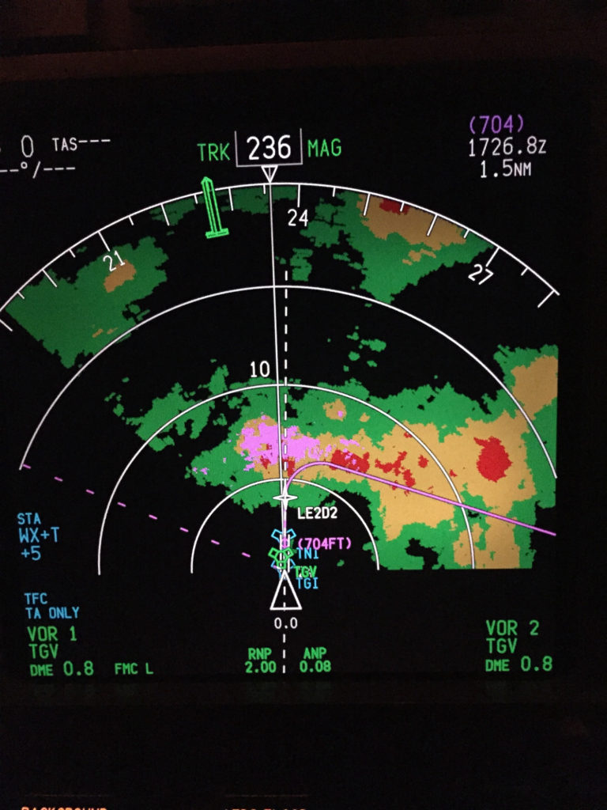
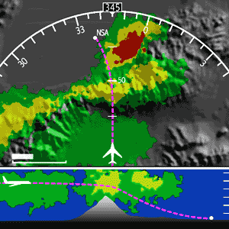
Airborne Weather Radar
Notes:
For those of us who can afford it, Airborne Weather Radar is a very useful information source. It does require interpretation though and there are some limitations to consider.
(Next Slide)

Slide 25
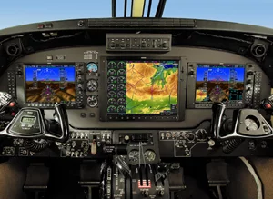
Airborne Weather Radar
Real Time
May not show all precipitation
Good for tactical avoidance
New users should seek instruction
Notes:
Airborne radar looks at precipitation and pilots know that the heavier the precipitation – the greater the associated turbulence will be. Because radar returns are immediate it’s a good choice for tactical weather avoidance. Heavy precipitation can mask additional precipitation behind it so it’s best to find wide clear areas so you can get a good picture of what’s beyond the radar return.
If you’re a new radar user be sure to get some instruction on operation and interpretation before you base tactical decisions on radar information.
(Next Slide)

Slide 26
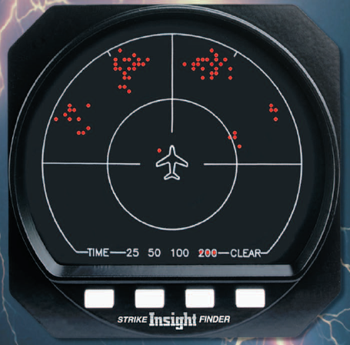
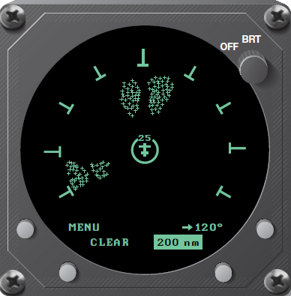
Strike Finder & Storm Scope
Real Time
Doesn’t show precipitation
Good for tactical avoidance
Instruction recommended for new users
Notes:
Another real time solution is lightning detection equipment. Although it doesn’t show precipitation it does indicate lightning strikes that accompany convective weather. Some installations integrate radar and storm scope information on a multi-function display.
As with radar, instruction is highly recommended for new users.
(Next Slide)

Slide 27
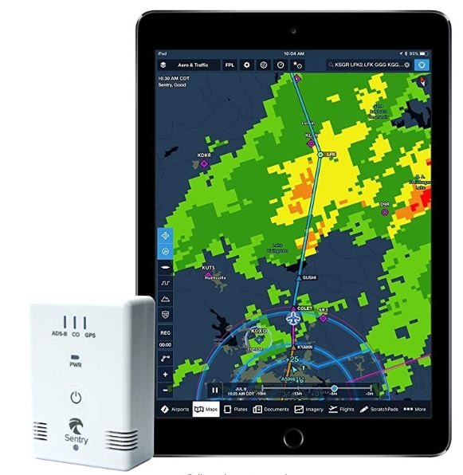
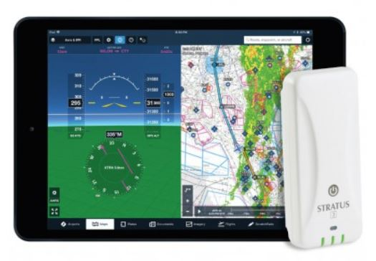
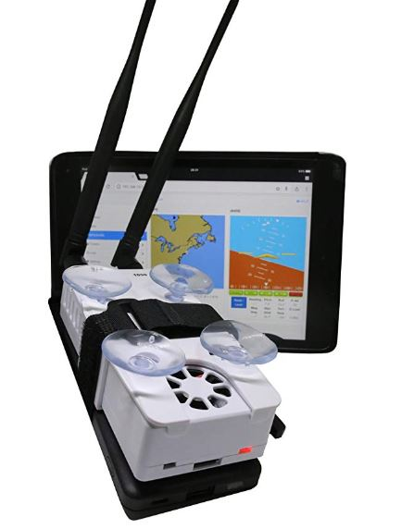
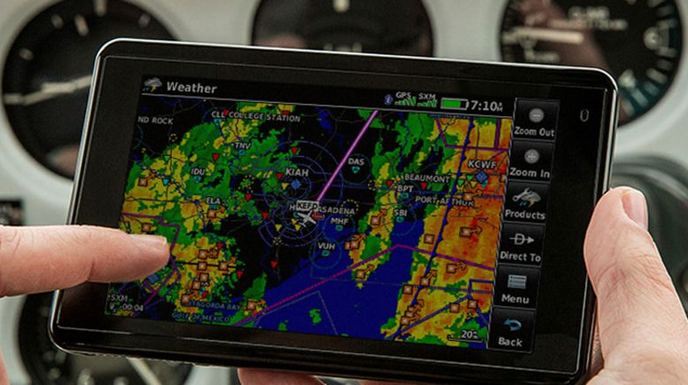
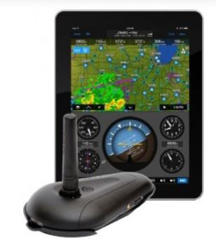

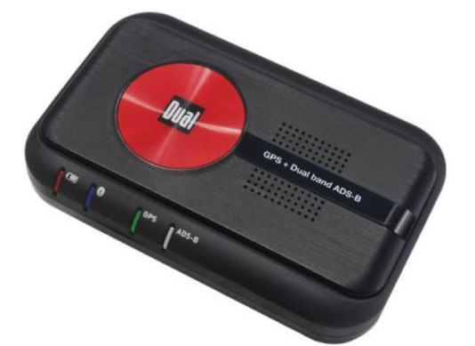
Portable ADS-B Receivers
Notes:
If you don’t want to equip with a panel-mounted ADS-B In, there are many portable ADS-B Receivers to choose from. These receivers can transmit text and graphics to a variety of portable devices and displays. One caution here – you’ll need to have sufficient battery capacity or auxiliary power available to power receivers and displays for the planned duration of your flight and any delays or diversions that may occur.
(Next Slide)

Slide 28
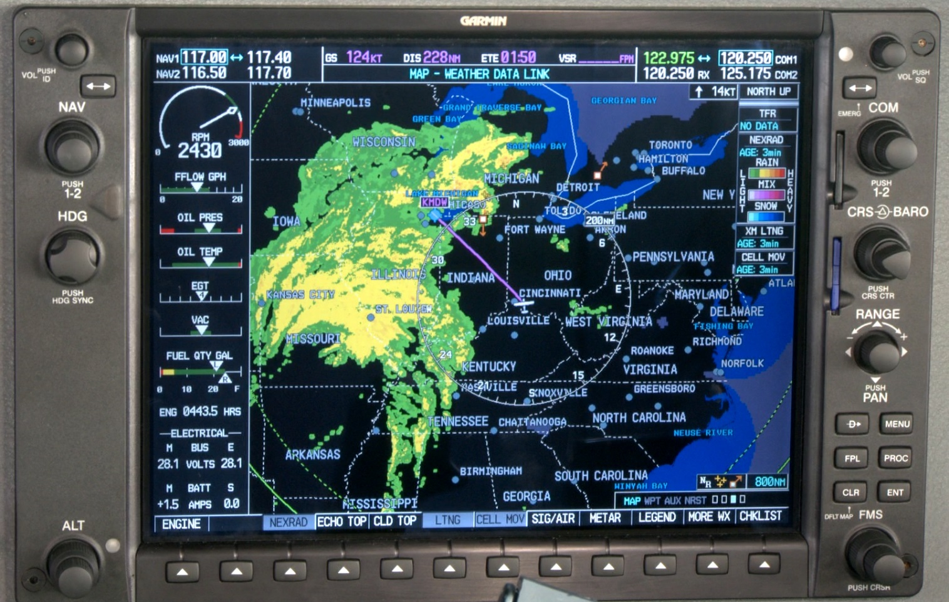
XM Weather
Near Real Time
  2.5 Minute update
  Look for time stamp
Good for strategic planning
Notes:
XM Radio is a subscription service that provides test, graphical, and audio information to en route users. XM Weather imagery is processed in near real time – usually at two and a half-minute intervals. But the imagery information could be older so, as with any weather information, be sure to check the time that the graphic data was collected.
(Next Slide)

Slide 29
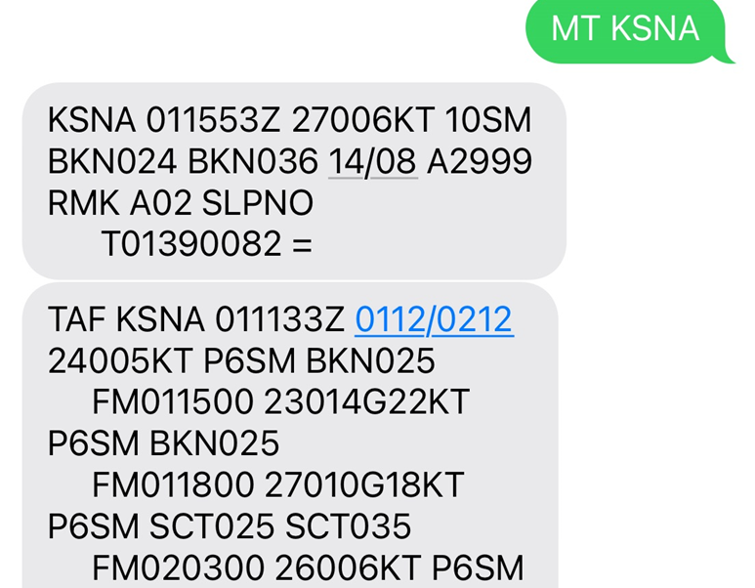
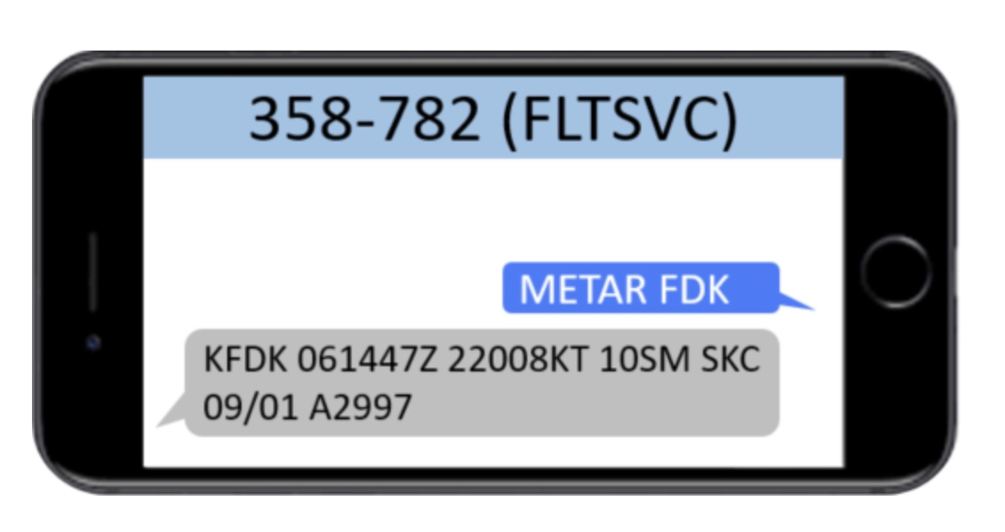
SMS Messaging
Notes:
And here’s another free service from FAA Flight Service. Simply text your request for Metar or TAF information to 358-782 and you’ll get a quick reply. (Click)
Texting MT followed by an airport identifier will return Metar and TAF information as shown here.
Presentation note: Pause briefly if audience members are copying slide information. Then:
(Next Slide)

Slide 30
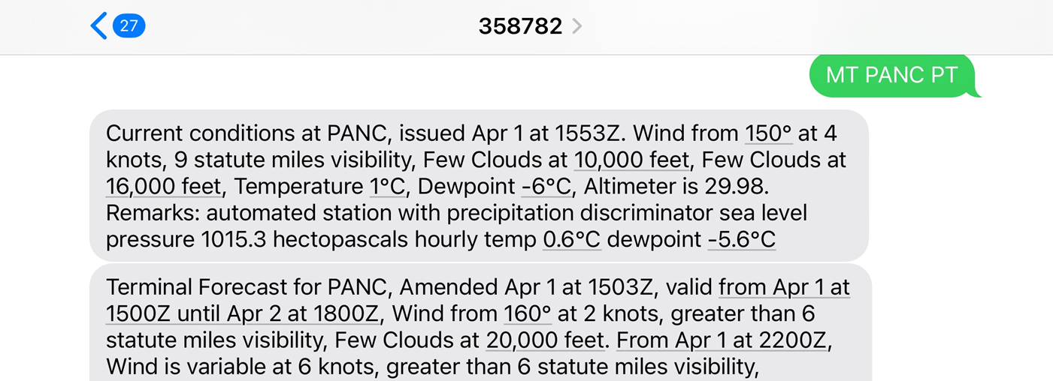
SMS Messaging
Notes:
For plain text just append “PT” to the end of your request.
(Next Slide)

Slide 31

Air Traffic Control
Limited ability and time to
forward weather information
You can learn a lot by
just listening.
Don’t wait until the last minute
to make diversion requests.
Notes:
Air traffic controllers are another in-flight weather information resource. They do have the ability to show weather on their displays, but that capability is limited and when you most need information they may be
too busy – dealing with re routing requests – to provide it.
You can learn a lot by monitoring air traffic control frequencies though. You’ll hear what pilots are requesting and what ATC can provide. If you make your weather decisions with that in mind your requests are more likely to be granted.
Once again – don’t wait till the last minute to request a diversion. ATC needs some time to process your request.
(Next Slide)

Slide 32

Cautions & Tips
Don’t fixate on the equipment
  Cockpit displays don’t tell the whole story
    We still have to look outside
Understand what the displays tell you… and what they don’t.
  You may not see all the traffic in your area
  or all the weather ahead
Make weather avoidance decisions early
  Don’t wait till you’re close to choose a route
  Refine your decisions as more information
  becomes available
Notes:
In-cockpit information displays can be compelling distractions. Don’t fixate on the box to the exclusion of other flight management tasks. Cockpit displays – no matter how sophisticated and comprehensive they may be – don’t tell the whole story. A big part of our job is still looking out the window.
It’s important to thoroughly understand what the displays are telling you, and just as important, what they aren’t. Displays may not depict all the traffic in your area or all the weather ahead.
Generally speaking it’s best to make in-flight decisions early rather than waiting until the last minute to act. Landing to refuel is much less stressful if you have an hour or so of fuel remaining. Likewise rerouting or diversion is easier if you have some maneuvering room and time to select the best alternative.
By continuous reference to all weather resources available to you in the cockpit, you’ll have a comprehensive picture of the weather and any decisions will be well informed.
(Next Slide)

Slide 33




Proficiency training works!
Sports
Medicine
Aviation
Notes:
Can you imagine how well professional athletes would perform if they didn’t practice between games or stay in shape during the off season? (Click)
Would you choose to be treated by doctors who had no continuing education since graduating from medical school? (Click)
Or how about a professional pilot flight crew who never train for emergencies?
Pros know that proficiency is not a destination but rather a journey that never ends.
Regular training keeps the them at peak performance every time they take to the air.
(Next Slide)

Slide 34


Proficiency Training Works
Increases confidence
Increases comfort
Expands horizons
Keeps us safe
Earning any WINGS phase qualifies for a Flight Review!
Notes:
Proficiency training works for General Aviation pilots too. Pilots who participate in the FAA WINGS Pilot Proficiency program fly with more confidence. They and their passengers are comfortable in the air. And proficiency training can expand our horizons by exploring the operational capabilities of our present aircraft or introducing us to more complex and capable planes as well as more challenging destinations.
Most importantly - proficiency training keeps us safe. (Click)
And pilots who earn WINGS phases also qualify for a flight review.
(Next Slide)

Slide 35

Why WINGS?
Proficient Pilots are:
  Confident
  Capable
  Safe
WINGS will keep you
on top of your game
Notes:
So why WINGS? Well proficiency is key to success in almost every thing worth doing – especially flying. Proficient pilots are confident, capable, and safe.
WINGS is a proficiency training system specifically designed for general aviation pilots and, regular participation will keep you on top of your flying game.
(Next Slide)

Slide 36


Go to FAASTeam Team Member Rewards page to learn more about how to enter a chance to win one of ten annual prizes
Notes:
Every time you earn a WINGS phase, you’re eligible to enter the WINGS Sweepstakes sponsored by the WINGS Industry Network. Flight Instructors can also enter once for each WINGS phase they validate. Click on the QR code for details.
(Next Slide)

Slide 37


Safety Management Systems (SMS)
Coming to General Aviation
Safety Management System (SMS) | Federal Aviation Administration (faa.gov)
Notes:
Safety Management Systems are a set of policies and processes that can increase the safety and efficiency of any flight operation. And FAA is bringing SMS to General Aviation. You may have heard of SMS but thought it was only for large organizations but actually, SMS can be scaled to fit any operation large or small.
There are 4 major components to a Safety Management System (Click)
Safety Policy – a documented commitment to safety that runs from the head of an organization to its newest member. (Click)
Safety Risk Management – a process that identifies hazards within an operation, determines to what extent an identified hazard may impact flight safety, and controls the risk of occurrence to an acceptable level. (Click)
Safety Assurance – By collecting and analyzing information derived from safety performance data Safety Assurance ensures the performance and effectiveness of Safety Risk Controls. (Click)
Safety Promotion communicates safety information and commitment throughout the organization. (Click)
You can find more information about Safety Management Systems at the URL on the Screen.
(Next Slide)

Slide 38
References
AC 00-45H Aviation Weather Services
  https://www.faa.gov/documentlibrary/media/advisory_circular/ac_00-45h.pdf
AC 00-63A Use of Flight Deck Displays of Digital Weather and Aeronautical Information
  https://www.faa.gov/documentLibrary/media/Advisory_Circular/AC_00-63A.pdf
AC 90-114B Automatic Dependent Surveillance-Broadcast Operations
  https://www.faa.gov/documentLibrary/media/Advisory_Circular/AC_90-114B.pdf
Notes:
Here are a few references for additional information:
I’ll leave this slide on screen while I take some questions from the audience.
AC 90-114B Automatic Dependent Surveillance-Broadcast Operations
AC 00-63A Use of Flight Deck Displays of Digital Weather and Aeronautical Information (This AC has a Change Revision CH2 coming out very shortly) This AC addresses both the Federal Aviation Administration (FAA) FIS–Broadcast (FIS-B) provided through the Automatic Dependent Surveillance–Broadcast (ADS-B) Universal Access Transceiver (UAT) network and non-FAA FIS systems provided through commercial data link services.
Presentation note: Take questions from the audience while they copy information from the screen. Then:
(Next Slide)

Slide 39
References
Aeronautical Information Manual
  Chapter 7 – Safety of Flight
    Section 1 - Meteorology
FAA ADS-B Information
  Automatic Dependent Surveillance-Broadcast (ADS-B) | Federal Aviation Administration
Automated Surface Observing Systems
  https://www.weather.gov/asos/
  https://www.faa.gov/air_traffic/weather/asos/
Notes:
Here are some more references for additional information:
I’ll leave this slide on screen while I take some questions from the audience.
Presentation note: Take questions from the audience while they copy information from the screen. Then:
(Next Slide)

Slide 40

Questions?
Notes:
Presentation Note: You may wish to provide your contact information and main FSDO phone number here. You can also add WINGSPro contact information.
Modify with your information or leave blank.
(Next Slide)

Slide 41


Thank you for attending
You are vital members of our GA safety community
Notes:
Your presence here shows that you are vital members of our General Aviation Safety Community. The high standards you keep and the examples you set are a great credit to you and to GA.
Thank you for attending.
(Next Slide)

Slide 42
The National FAA Safety Team Presents
Topic of the Month – August
Pre-flight & In-flight Weather Resources
Notes:
(The End)

