Slide 1
The National FAA Safety Team Presents
Topic of the Month July
Fly the Aircraft First
<Audience>
<Presenter>
< >
Notes:
2017/9-22-114 (I) PP Original Author: J. Steuernagle March 2017 POC: K. CloverAFS-850 Operations Lead Office 562-888-2020
Presentation Note: This is the title slide for Fly the Aircraft First
Presentation notes (stage direction and presentation suggestions) will be preceded by a Bold header: the notes themselves will be in Italic fonts.
Program control instructions will be in bold fonts and look like this: (Click) for building information within a slide; or this: (Next Slide) for slide advance.
Some slides may contain background information that supports the concepts presented in the program.
Background information will always appear last and will be preceded by a bold Background: identification.
We have included a script of suggested dialog with each slide. Presenters may read the script or modify it to suit their own presentation style.
The production team hope you and your audience will enjoy the show. Break a leg!
(Next Slide)

Slide 2
Welcome
Exits
Restrooms
Emergency Evacuation
Breaks
Set phones & pagers to silent mode or off
Sponsor Acknowledgment
Other information
Notes:
Presentation Note: Here’s where you can discuss venue logistics, acknowledge sponsors, and deliver other information you want your audience to know in the beginning.
You can add slides after this one to fit your situation.
(Next Slide)

Slide 3
Overview
A case study on distraction
Loss of Control Work Group Recommendations
Tips & Tricks
Notes:
In this presentation we’ll talk a little bit about distractions and how they contribute to accidents. We’ll look at some recommendations from a work group that studies loss of control. We’ll offer a few tips & tricks to help you manage distractions in flight.
Presentation Note: If you’ll be discussing additional items, add them to this list (Next Slide)

Slide 4
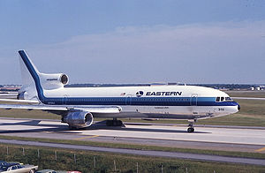
EA 401
29 December 1972
JFK – MIA
3 Flt. Crew 1 Non Rev.
Nose Gear Light Out
CWS Mode Engaged
99 Fatalities
Notes:
On 29 December 1972 Eastern Airlines Flight 401, Lockheed L-1011, was scheduled to fly from JFK in New York to Miami International Airport in Florida.
3 flight crew and one non-revenue company employee were in the cockpit as the flight began the approach to Miami.
After extending the landing gear on final approach the first officer noticed the nose wheel down & locked light was not illuminated. The approach was aborted and the aircraft entered a 2,000 foot holding pattern west of the airport The crew engaged the autopilot while all 4 cockpit occupants engaged in trouble shooting the problem. When the autopilot was engaged it was inadvertently placed in Control Wheel Steering (CWS) mode. In this mode the airplane would maintain the attitude last commanded by the pilot. One of the pilots – most likely the Captain – bumped the control column as he turned to speak with the flight engineer. The airplane was placed in a shallow descent that was maintained all the way to the ground. Four professional aviators – any one of whom could have detected the descent – were so focused on a non-critical task that they failed to detect and arrest the descent.
(Next Slide)

Slide 5
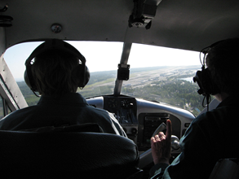
A matter of priority
Fly the Aircraft First!
Notes:
We’ve all heard it many times, “when your flight plan is unraveling and you’re trying to decide where to go and how to get there while dealing with passengers and ATC; the most important thing to do is always,” (Click)
That’s right. Fly the Airplane!
(Next Slide)

Slide 6
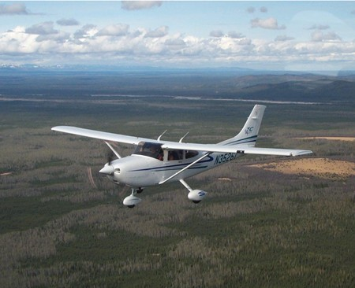
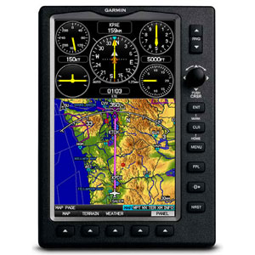
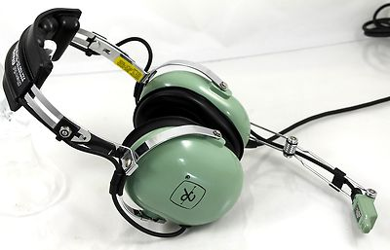
A matter of priority
Aviate
Navigate
Communicate
Notes:
Expressed another way the 3 things pilots must do in order of priority are: (Click)
Aviate – maintain aircraft control at all times. (Click)
Navigate – manage navigation systems and tasks including fuel reserves (Click)
Communicate – with passengers and ATC
That’s good advice. Loss of Control is the number one cause of fatal aircraft accidents. It doesn’t matter if we’re navigating and communicating perfectly if we lose control of the aircraft and crash.
That’s why the General Aviation Joint Steering Committee recommends this awareness raising program.
(Next Slide)

Slide 7
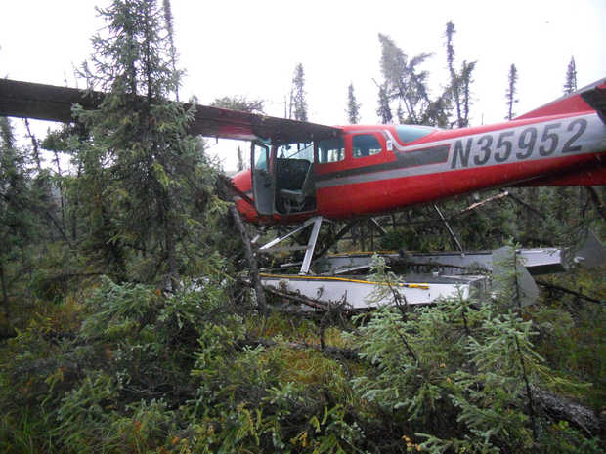
Fly the Aircraft First!
High stress
Short time frame
Limited options
Off airport landing?
Notes:
I know we all talk the Fly the Aircraft First talk but can we walk the talk? By that we mean of course; are we really prepared to fly the airplane under high stress to a safe – perhaps off airport – landing?
(Click)
The pilot of this aircraft had a total engine failure – mechanical – not fuel related – while en route at low altitude in Alaska. ANC13LA085
Navigation was simple – we’ll be on the ground in a minute or two - well before we can get to anything that even remotely resembles an airport.
Communication was also simple – there was no one within radio range to talk to.
We’re not likely to be as successful as this pilot unless we think about what we’re going to do in various possible emergency situations and unless we prepare do deal with problems.
(Next Slide)

Slide 8
Preparing for Problems
Prepare
Performance numbers, weather, route, flight plan, survival gear
Plan
Runway data, climb & descent profiles, escape routes, go no-go points & alternates
Practice – at mission weight
Short & soft field T.O. s & Ldgs.
Power off Appchs. & Ldgs.
Notes:
How do we prepare for problems? (Click)
Well we make sure we know our performance numbers including best power off glide speed for the aircraft & environment we’re going to fly in. We have a good weather brief and we update along the route so we always know where the best weather is. We plan our route with alternate landing areas in mind. This means we may elect to take a longer route that offers better alternatives for off airport landings. We file a flight plan and request flight following service We have survival gear appropriate to the mission on board and we know how to use it. (Click)
We plan and brief each takeoff, approach, and landing to include climb & descent expectations, go no-go points, escape routes, and alternates. En route we keep within gliding distance of suitable landing areas for as much of the flight as possible (Click)
And we practice emergency procedures, short and soft field takeoffs and landings; power off approaches and landings. It’s important to practice these maneuvers at our expected mission weight. An aircraft with a solo pilot and half tanks performs much better than one at close to max gross weight. Pilots need to be comfortable at the higher weights in order to be successful in real emergencies.
(Next Slide)

Slide 9
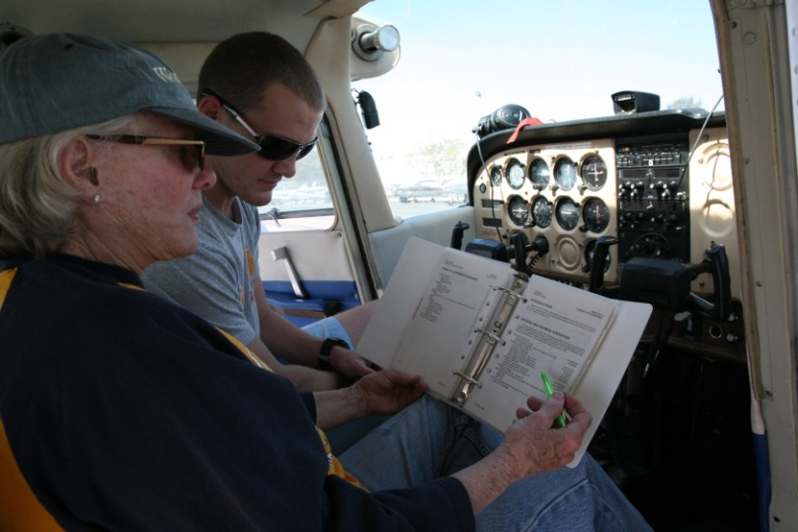
Tips & Tricks
Fatal Distractions
Set passenger expectations
Sterile Cockpit
Give passengers a job
Let George do it
Use the autopilot
Wing leveling only in Turbulence
Proficiency Training
Notes:
Passengers – and in some cases animals - have been known to provide fatal distractions so pilots must set expectations before flight. In addition to the standard seat belts, exits, and emergency equipment brief, take some time to explain your role and theirs. Insist on a sterile cockpit – no conversation that is not directly related to safety of flight during critical times. Give your passengers a job to do such as scanning for traffic. We know of one pilot who pays his kids a dollar for each aircraft they spot before he does. After one flight alone he had to visit an ATM to pay off his debt. (Click)
When your workload is increasing, by all means use the autopilot if you have one. Practice with and without the autopilot. If you never use the autopilot you won’t have confidence in it while dealing with an emergency. If you always use the autopilot you won’t have confidence in yourself. One more caveat here. Don’t engage altitude hold if you’re in significant turbulence. Basic wing leveling is what you want. That way the autopilot won’t overstress the airplane or disengage while trying to maintain altitude. (Click)
And finally, seek regular proficiency training with your CFI.
(Next Slide)

Slide 10
Reading List
Airplane Flying Handbook - Chapter 16
http://www.faa.gov/regulations_policies/handbooks_manuals/aviation/airplane_handbook/media/airplane_flying_handbook.pdf
Risk Management Handbook Chapter - 6
http://www.faa.gov/regulations_policies/handbooks_manuals/aviation/media/risk_management_hb_change_1.pdf/
Notes:
Finally here are some reading resources for you to consider (Click)
Chapter 16 of the Airplane Flying Handbook deals with Emergency Procedures (Click)
And Chapter 6 of the Risk Management Handbook discusses Single-Pilot Resource Management.
(Next Slide)

Slide 11
Questions?
Notes:
Presentation Note: You may wish to provide your contact information and main FSDO phone number here. Modify with
Your information or leave blank.
(Next Slide)

Slide 12
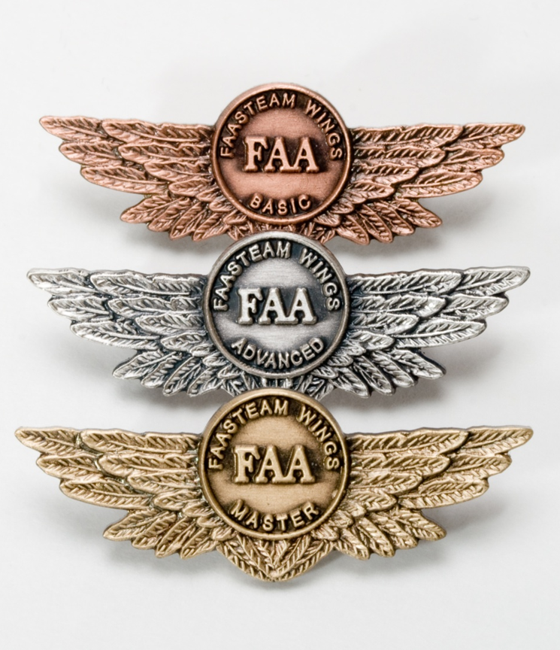
Proficiency and Peace of Mind
Fly regularly with your CFI
Perfect Practice
Document in WINGS
Notes:
There’s nothing like the feeling you get when you know you’re playing your A game and in order to do that you need a good coach (Click)
So fly regularly with a CFI who will challenge you to review what you know, explore new horizons, and to always do your best. Of course you’ll have to dedicate time and money to your proficiency program but it’s well worth it for the peace of mind that comes with confidence. (Click)
Vince Lombardi, the famous football coach said, “Practice does not make perfect. Only perfect practice makes perfect.” For pilots that means flying with precision. On course, on altitude, on speed all the time. (Click)
And be sure to document your achievement in the Wings Proficiency Program. It’s a great way to stay on top of your game and keep you flight review current.
(Next Slide)

Slide 13
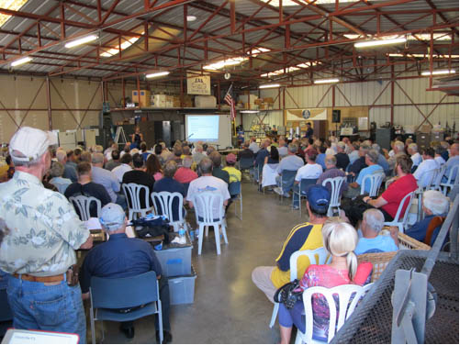
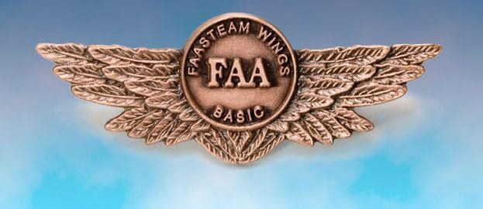
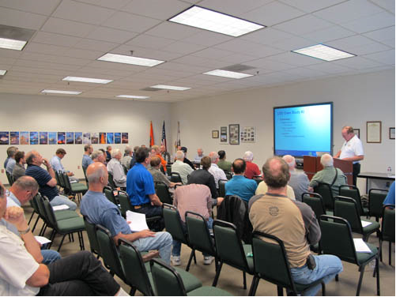
Thank you for attending
You are vital members of our GA safety community
Notes:
Your presence here shows that you are vital members of our General Aviation Safety Community. The high standards you keep and the examples you set are a great credit to you and to GA.
Thank you for attending.
(Next Slide)

Slide 14
The National FAA Safety Team Presents
Topic of the Month July
Fly the Aircraft First
<Audience>
<Presenter>
< >
Notes:
(QMS File Number) Original Author: J. Steuernagle March 2017 POC: K. CloverAFS-850 Operations Lead Office 562-888-2020
Presentation Note: This is the title slide for Fly the Aircraft First
Presentation notes (stage direction and presentation suggestions) will be preceded by a Bold header: the notes themselves will be in Italic fonts.
Program control instructions will be in bold fonts and look like this: (Click) for building information within a slide; or this: (Next Slide) for slide advance.
Some slides may contain background information that supports the concepts presented in the program.
Background information will always appear last and will be preceded by a bold Background: identification.
We have included a script of suggested dialog with each slide. Presenters may read the script or modify it to suit their own presentation style.
The production team hope you and your audience will enjoy the show. Break a leg!
(Next Slide)

