Slide 1
The National FAA Safety Team Presents
Topic of the Month - August
Use of Weather Information
<Audience>
<Presenter>
< >
Notes:
2019/02-15-151(I)PP Original Author: Delia Colvin; POC (Kevin Clover), AFS-850 Operations Lead, Office 562-888-2020; revised by (Name) (MM/DD/YYYY)
Presentation Note: This is the title slide for Use of Weather Information.
Presentation notes (stage direction and presentation suggestions) will be preceded by a Bold header: the notes themselves will be in Italic fonts.
Program control instructions will be in bold fonts and look like this: (Click) for building information within a slide; or this: (Next Slide) for slide advance.
Some slides may contain background information that supports the concepts presented in the program.
Background information will always appear last and will be preceded by a bold Background: identification.
We have included a script of suggested dialog with each slide. Presenters may read the script or modify it to suit their own presentation style.
The production team hope you and your audience will enjoy the show. Break a leg!
(Next Slide)

Slide 2
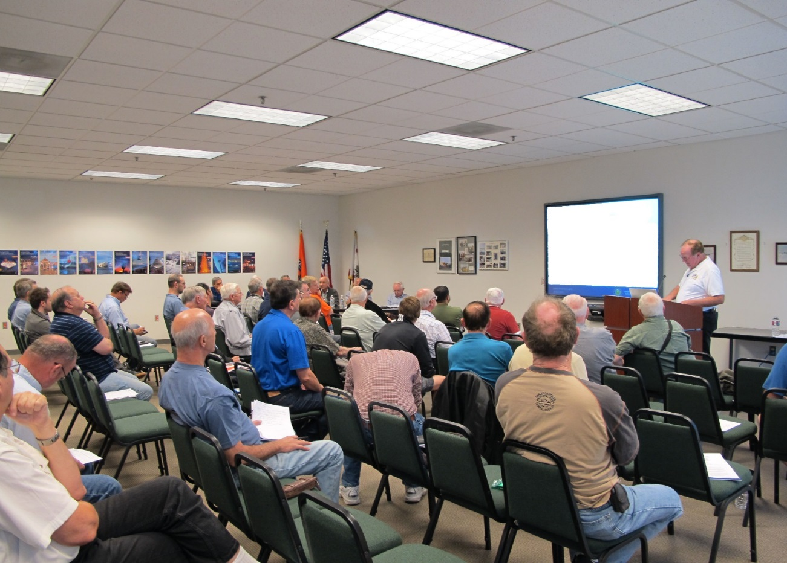
Welcome
Exits
Restrooms
Emergency Evacuation
Breaks
Set phones & pagers to silent or off
Sponsor Acknowledgment
Other information
Notes:
Presentation Note: Here’s where you can discuss venue logistics, acknowledge sponsors, and deliver other information you want your audience to know in the beginning.
You can add slides after this one to fit your situation.
(Next Slide)

Slide 3
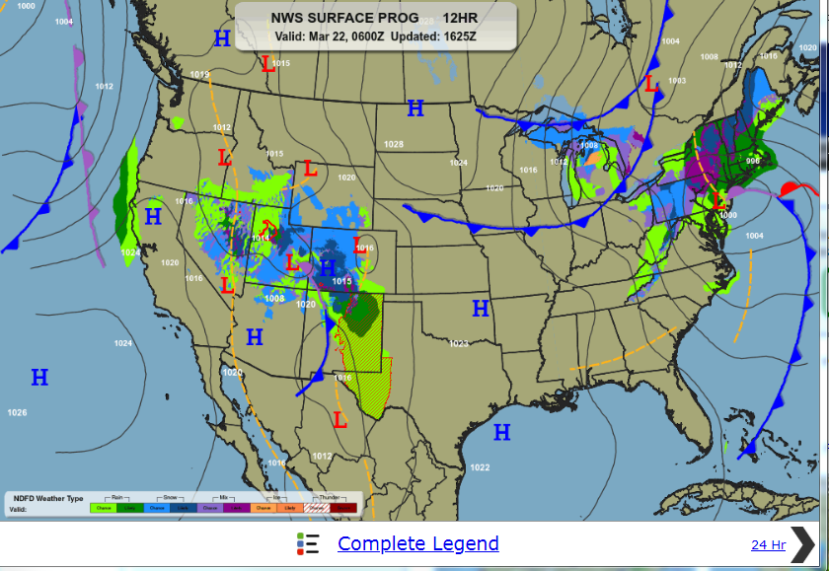
Overview
Use of Weather Information
Where to find it
How to use it
Produced by:
Delia Colvin
Fly Rite Pilot Education
Notes:
In the video presentation that follows, we’ll discuss where to find weather information and how to use it to make solid pre and inflight decisions .
Presentation Note: If you’ll be discussing additional items, add them to this list
(Next Slide)

Slide 4
Notes:
Presentation note: Click on the video progress bar to start the video presentation.
You will need to establish a path from your presentation computer to your presentation sound system.
When the presentation video ends – advance to:
(Next Slide)

Slide 5
Questions?
Notes:
Presentation Note: You may wish to provide your contact information and main FSDO phone number here. Modify with
Your information or leave blank.
(Next Slide)

Slide 6
Proficiency and Peace of Mind
Fly regularly with your CFI
Perfect Practice
Document in WINGS
Notes:
There’s nothing like the feeling you get when you know you’re playing your A game and in order to do that you need a good coach (Click)
So fly regularly with a CFI who will challenge you to review what you know, explore new horizons, and to always do your best. Of course you’ll have to dedicate time and money to your proficiency program but it’s well worth it for the peace of mind that comes with confidence. (Click)
Vince Lombardi, the famous football coach said, “Practice does not make perfect. Only perfect practice makes perfect.” For pilots that means flying with precision. On course, on altitude, on speed all the time. (Click)
And be sure to document your achievement in the Wings Proficiency Program. It’s a great way to stay on top of your game and keep you flight review current.
(Next Slide)

Slide 7
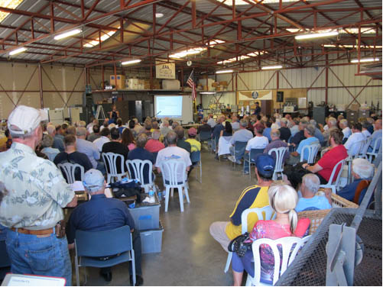
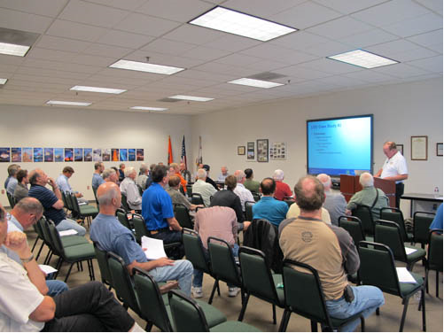
Thank you for attending
You are vital members of our GA safety community
Notes:
Your presence here shows that you are vital members of our General Aviation Safety Community. The high standards you keep and the examples you set are a great credit to you and to GA.
Thank you for attending.
(Next Slide)

Slide 8
The National FAA Safety Team Presents
Topic of the Month - August
Use of Weather Information
<Audience>
<Presenter>
< >
Notes:
(The End)

Slide 9
The National FAA Safety Team Presents
Topic of the Month - January
Introduction to Safety Risk Management (SRM)
<Audience>
<Presenter>
< >
Notes:
(The End)

