Slide 1
The National FAA Safety Team Presents
Topic of the Month - October
Do Not Issue – Do Not Fly
<Audience>
<Presenter>
< >
Notes:
2019/02-15-157(I)PP Original Author: John Steuernagle; POC Kevin Clover, AFS-850 Operations Lead, Office 562-888-2020
Presentation Note: This is the title slide for Do not Issue – Do not Fly
Presentation notes (stage direction and presentation suggestions) will be preceded by a Bold header: the notes themselves will be in Italic fonts.
Program control instructions will be in bold fonts and look like this: (Click) for building information within a slide; or this: (Next Slide) for slide advance.
Some slides may contain background information that supports the concepts presented in the program.
Background information will always appear last and will be preceded by a bold Background: identification.
We have included a script of suggested dialog with each slide. Presenters may read the script or modify it to suit their own presentation style.
The production team hope you and your audience will enjoy the show. Break a leg!
(Next Slide)

Slide 2
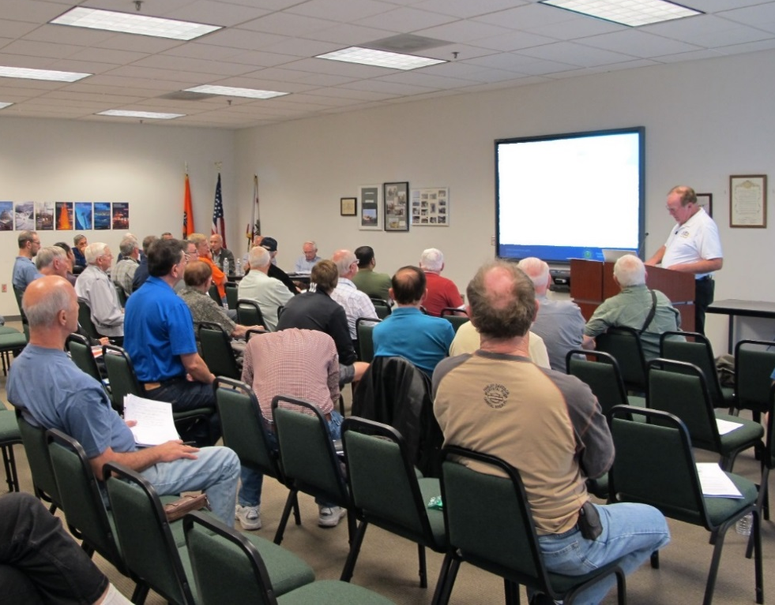

Welcome
Exits
Restrooms
Emergency Evacuation
Breaks
Sponsor Acknowledgment
Set phones and pagers to silent or off
Other information
Notes:
Presentation Note: Here’s where you can discuss venue logistics, acknowledge sponsors, and deliver other information you want your audience to know in the beginning.
You can add slides after this one to fit your situation. (Next Slide)

Slide 3
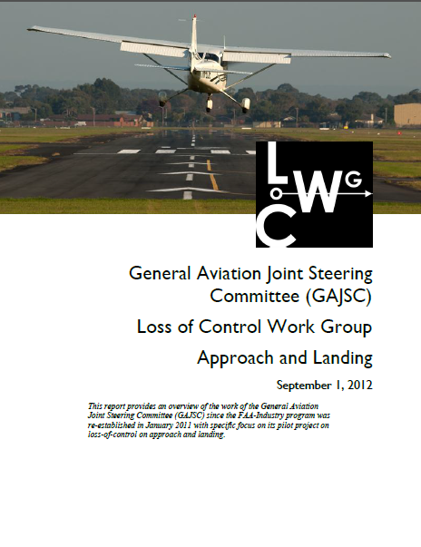
Overview
General Aviation Joint Steering Committee (GAJSC) & FAA Accident Study Findings
Flying and Medications
FAA Do Not Issue & Do Not Fly lists
Notes:
In this presentation we’ll talk a little bit about a recent GAJSC and FAA studies that feature some interesting findings with respect to pilots and medications
We’ll talk generally about flying while medicating and specifically about FAA’s Do not Issue (medical certificates) and Do not Fly Lists of over-the-counter and
prescription drugs.
Presentation Note: If you’ll be discussing additional items, add them to this list
(Next Slide)

Slide 4
FAA Findings
In a 2011 FAA study involving pilot fatalities….
  570 out of 1,353 pilots tested positive for medications/drugs.
  511 of the 570 (90%), were flying under CFR Part 91.
Extent of Impairment – Undetermined
  But cause for concern
Notes:
In a 2011 study from the FAA’s CAMI Toxicology Lab drugs/medications were found in 570 pilots (42%) from 1,353 total fatal pilots tested. Most of the pilots with positive drug results, 511 (90%), were flying under CFR Part 91.”. (Click)
While there were a couple instances of recreational drugs, the majority were prescription or over the counter medications. Antihistamines were the most commonly found. Left undetermined was the extent of pilot impairment – if any – due to drug use but the issue is cause for concern for several reasons:
(Next Slide)

Slide 5

What’s the Problem
Not easy to determine extent of impairment
  Different medication effects for different people
  Post-mortem redistribution and sample type
Don’t know about pilot’s condition
  Pre-existing medical condition requiring medication
AME not consulted?
Drug interactions
Notes:
So what’s the problem:
First of all – We all know that some medications may compromise a pilot’s ability to control the aircraft and/or adversely affect judgment and decision-making. (Click)
What’s not so obvious is it’s difficult for investigators to say for sure that pilot performance was compromised because the effect of drugs and medications varies widely among individuals. In addition, post-mortem redistribution of a substance creates some confusion as to the actual blood levels prior to the accident. The amount of a substance may vary considerably in different tissues. (Click)
A less obvious problem poses the question; what pre-existing physical condition requires the use of medication in the first place? (Click)
It’s not unusual to find that pilots are evaluated and treated for conditions that are not revealed to their Aviation Medical Examiners. In those cases an AME doesn’t have an opportunity to review the complete medical history of diagnoses and treatments for some of the pilots they examine. (Click)
There’s also the issue of drug interactions but we’ll get to that a little bit later. (Next Slide)

Slide 6
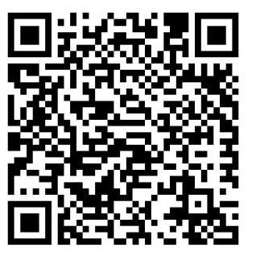
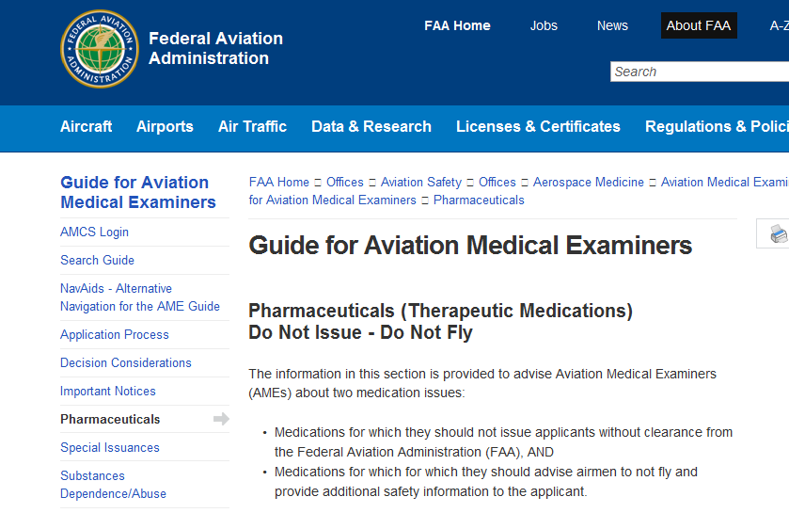
Do not issue – Do not fly
https://tinyurl.com/l43gpcu
Notes:
You and your Aviation Medical Examiner can access lists of medications that preclude medical certificate issuance (Do not Issue) or medications that are not
compatible with safe flight operations (Do not Fly). Those lists are available at the website shown on the screen.
In the following slides we’ll take a quick look at drugs on the list.
Presentation Note: You can access the Do not Issue – Do not Fly lists at this URL: https://www.faa.gov/about/office_org/headquarters_offices/avs/offices/aam/ame/guide/pharm/dni_dnf/
(Next Slide)

Slide 7

Do not issue medications
Angina Meds – dilation of arteries
Anticholingerics - block involuntary muscle movements
Cancer treatments – chemotherapy, radiation therapy
Controlled Substances – altered mental state
Some Diabetic meds – blood sugar, dizziness
Dopamine agonists – affect mood and movement
Centrally Acting Hypertensives – lower blood pressure
Selected Psychiatric or Psychotropic Meds – altered mental state
Malaria and Seizure Meds
High-dose Steroids
Smoking and Weight Loss Meds
Notes:
Although Medical Examiners may not issue medical certificates to pilots who are taking medicines on this list; they may be able to suggest alternative allowable medicines.
But in order to have that conversation you’ll need to disclose ALL the medications – prescribed and OTC – to your AME.
(Next Slide)

Slide 8
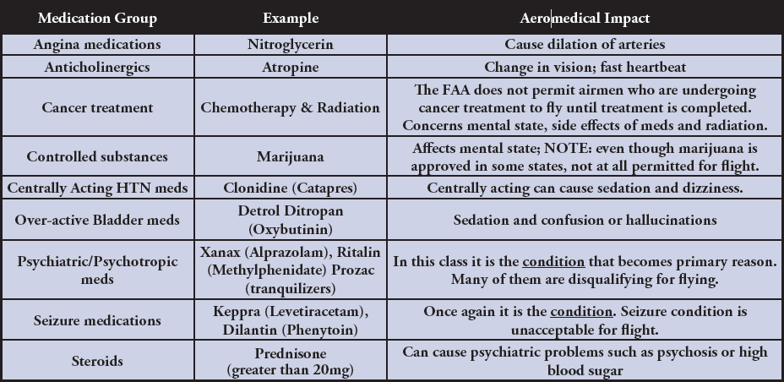
Aeromedical Impact Examples
Notes:
Here’s a little insight as to why some drugs appear on the Do not Issue - Do not Fly lists.
Obviously the impact of these drugs can be serious. The extent of impairment depends on the individual but the use of these drugs
and the underlying diseases they treat are obvious disqualifying factors for medical certification.
(Next Slide)

Slide 9
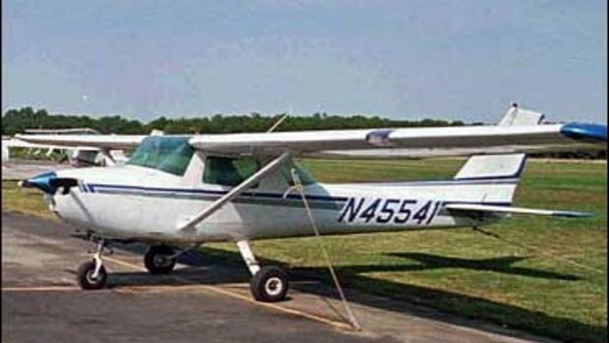
Do not fly medications
Allergy Meds
Muscle relaxants
OTC dietary supplements
Pain Meds
Sleep Aids
Pre-medication or Pre-procedure drugs
Any prescribed or OTC drug that may cause drowsiness or cautions operators of vehicles or machinery
Notes:
While these drugs may not disqualify applicants for medical certificates, they do preclude flying until the effects of the drug are no longer present.
(Next Slide)

Slide 10

Sleep Aids & Cough Medications
Both likely to contain antihistamines which may cause drowsiness or sedation
  “Hang Over” effect
  Side effects may last several days
Short term use only
Notes:
A word on OTC sleep aids and cough medications: (Click)
Sleep aids obviously are intended to promote sleep but their effects – resembling a hangover - may persist into the several days – not a good idea if you’re going flying. (Click)
Also – tolerance to active ingredients builds quickly so you’ll find you’re taking more and more medicine to achieve the same result. (Click)
All OTC medications are intended for temporary use. Taking them for longer than the recommended time may mask symptoms of a significant or serious underlying medical condition.
(Next Slide)

Slide 11

How long must I wait?
FAA recommends waiting five times the dosage interval.
  Particularly true for any medication causing drowsiness.
Four times per day = 6-hour intervals
  5 x 6 = 30 hours
Notes:
If you’ve been taking a medication that precludes flying, how long must you wait after ceasing the medication before you return to the air? (Click)
This is a good question for your AME to answer but the general rule is to wait until 5 times the dosage interval has passed. (Click)
For example; if you take a medication 4 times a day (6-hour intervals) you should wait at least 30 hours before resuming pilot duties.
(Next Slide)

Slide 12
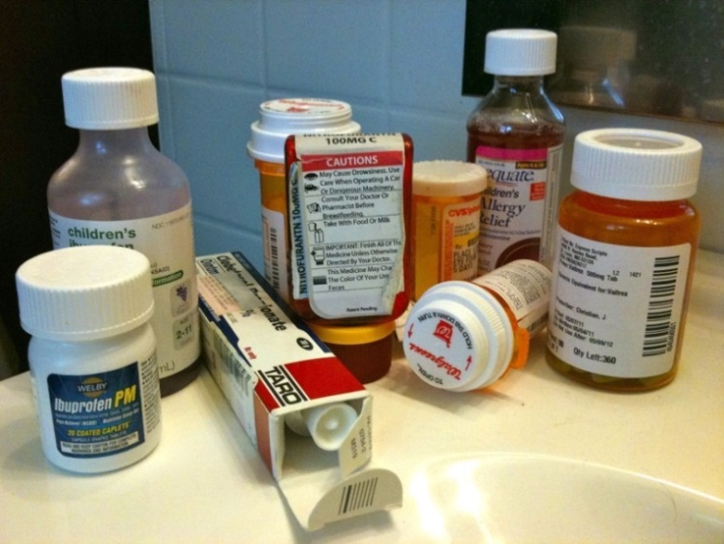
Combining Medications
Prescriptions with Prescriptions
  Does prescribing Provider know you fly?
  Does your AME know about all the medications you take and conditions you have?
Prescriptions with OTC
  Consult your AME and/or Regional Flight Surgeon
  and/or consult your Pharmacist
Notes:
Look into any medicine cabinet and you’re likely to find a mixture of OTC and prescription meds. Who’s responsible for assessing the affects and possible drug interactions? Making those assessments is something they don’t teach us in pilot school so this may also be a good time to seek some professional help. Before you do that though let’s talk about prescription drugs alone or in combination.
Does your prescribing doctor know you fly? Maybe a more suitable drug could be prescribed if your doctor knows you’re a pilot.
Even more importantly, does your AME know about all the drugs you take and the conditions for which you take them?
Combining prescription and OTC drugs introduces another challenge – the self medicating pilot. Once again it’s safer to consult your AME and/or pharmacist before adding OTC meds to your system.
We’re not going to address recreational drugs here. We all know that flying is about the best recreation there is. It’s not safe and not legal to fly under the influence.
We will look at one case from the GAJSC study though. We’ll discuss it with respect to the PAVE checklist that’s familiar to most if not all of us. I think you’ll find the case study illuminating.
(Next Slide)

Slide 13
Tips
Consult your AME before flying while using prescription and/or OTC Drugs.
Make sure your AME knows about all the drugs you take and the medical conditions requiring their use.
Let your prescribing doctor know that you are a pilot.
Ask about adverse effects associated with drug combinations.
In between doctor visits you’re self assessing your condition before each flight. Ground yourself when you’re not fit to fly.
Notes:
Finally – here are some tips for safe flying while taking prescribed or OTC medications.
Consult your AME before flying while using prescription and/or OTC Drugs.
Make sure your AME knows about all the drugs you take and the medical conditions requiring their use.
Let your prescribing doctor know that you are a pilot.
Ask about adverse effects associated with drug combinations.
In between doctor visits you’re self assessing your condition before each flight. Ground yourself when you’re not fit to fly.
(Next Slide)

Slide 14
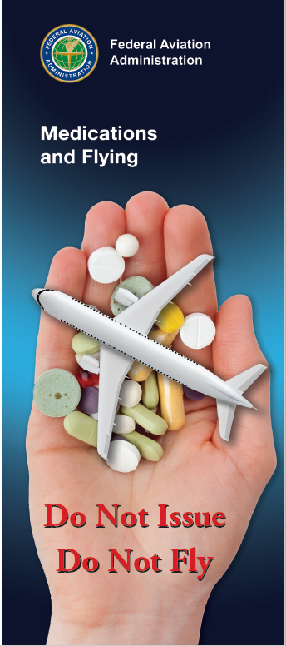
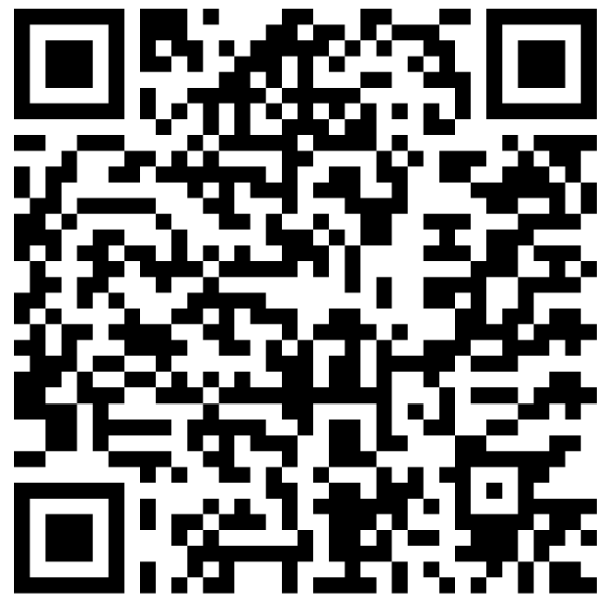
For more information
https://tinyurl.com/y94lokh8
Notes:
Much of the information in this presentation was taken from FAA’s Medications and Flying Brochure. You can download a copy at the URL or QR code on the screen.
(Next Slide)

Slide 15

Questions?
Special Thanks to:
  Jon M. Grazer, MD
  William J. Tsai, MD
  G. J. Salazar, MD, MPH
Notes:
Presentation Note: You may wish to provide your contact information and main FSDO phone number here. Modify with
your information or leave blank.
(Next Slide)

Slide 16

Have you earned your WINGS?
Proficient Pilots are:
  Confident
  Capable
  Safe
WINGS will keep you
on top of your game
Notes:
Have you earned your WINGS? Proficiency is key to success in almost every thing worth doing – especially flying. Proficient pilots are confident, capable, and safe.
WINGS is a proficiency training system specifically designed for general aviation pilots and, regular participation will keep you on top of your flying game.
(Next Slide)

Slide 17
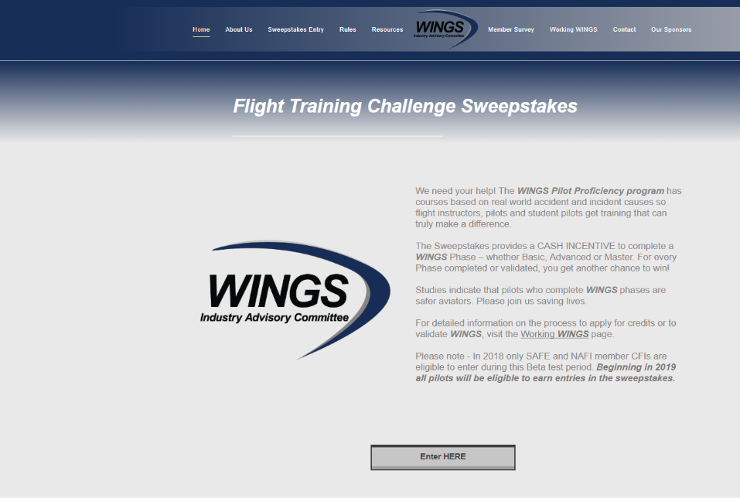
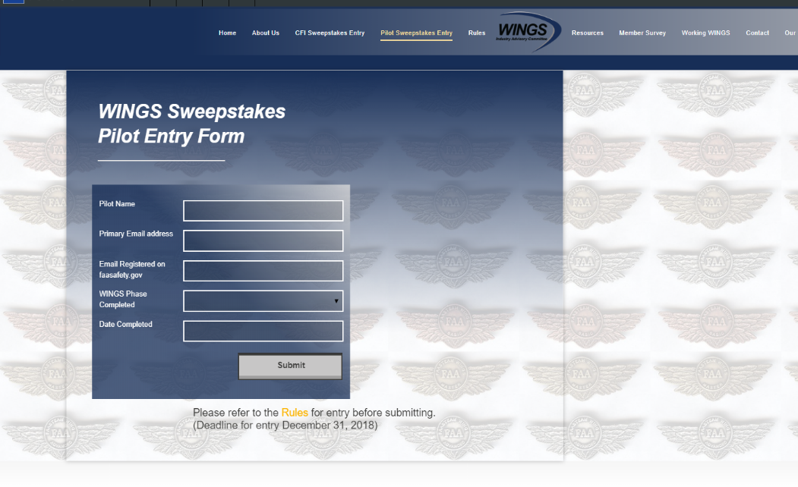
The Paul & Fran Burger 2019
WINGS $10,000 Sweepstakes
Complete WINGS Phases and WIN Cash Awards!
www.mywingsiniative.org
Notes:
Now there’s even more reasons to participate in WINGS. Every time you complete a WINGS Phase you’re eligible to win cash the WINGS Sweepstakes.
The sweepstakes is generously funded by Paul Burger, a long time advocate for general aviation safety and a retired aviator who believes participation in this program saves lives. VISIT WWW.MYWINGSINIATIVE.ORG to learn more and enter the sweepstakes.
(Next Slide)

Slide 18

How To Win – It’s Easy
Whenever you complete a WINGS phase, select WINGS Sweepstakes on the Team Member Award section of your My WINGS page
Or Visit www.mywingsinitiative.org & click on “Sweepstakes Entry”
Complete the form, get chances to win one of 10 cash prizes!
Four $1,500, Four $750,Two $500 Winners
Notes:
After you’ve completed a phase of WINGS you can enter the sweepstakes by clicking on “Claim Rewards” in the “WINGS – at a glance” section of your My WINGS page and select WINGS Sweepstakes. Or you can go directly to the mywingsinitiative.org website.
(Next Slide)

Slide 19
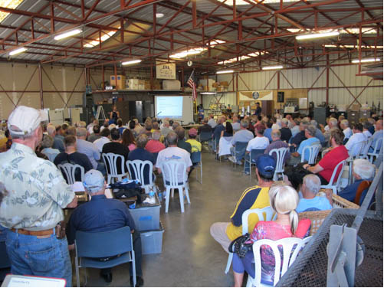
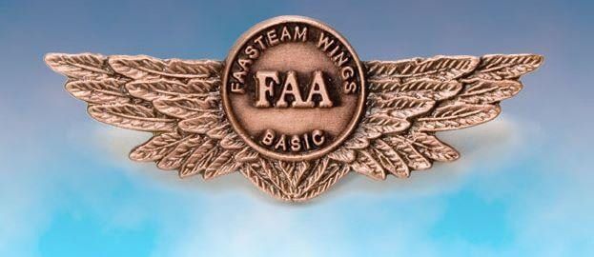
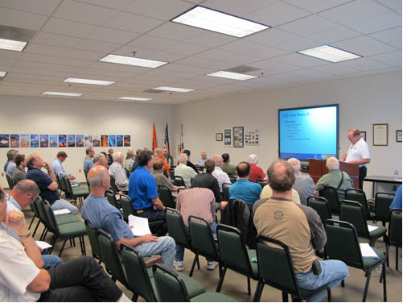
Thank you for attending
You are vital members of our GA safety community
Notes:
Your presence here shows that you are vital members of our General Aviation Safety Community. The high standards you keep and the examples you set are a great credit to you and to GA.
Thank you for attending.
(Next Slide)

Slide 20
The National FAA Safety Team Presents
Topic of the Month - October
Do Not Issue – Do Not Fly
<Audience>
<Presenter>
< >
Notes:
(The End)

