Slide 1
The National FAA Safety Team Presents
Topic of the Month – March Pilot Proficiency Training
<Audience>
<Presenter>
< >
Notes:
2018/5-14-128(I)PP Original Author: J. Steuernagle April 2018 POC: K. CloverAFS-920 Operations Lead Office 562-888-2020 Revised by: Name Date
Presentation Note: This is the title slide for Pilot Proficiency Training
Presentation notes (stage direction and presentation suggestions) will be preceded by a Bold header: the notes themselves will be in Italic fonts.
Program control instructions will be in bold fonts and look like this: (Click) for building information within a slide; or this: (Next Slide) for slide advance.
Some slides may contain background information that supports the concepts presented in the program.
Background information will always appear last and will be preceded by a bold Background: identification.
We have included a script of suggested dialog with each slide. Presenters may read the script or modify it to suit their own presentation style.
The production team hope you and your audience will enjoy the show. Break a leg!
(Next Slide)

Slide 2
Welcome
Exits
Restrooms
Emergency Evacuation
Breaks
Set cell phones and pagers to silent or off
Sponsor Acknowledgment
Other information
Notes:
Presentation Note: Here’s where you can discuss venue logistics, acknowledge sponsors, and deliver other information you want your audience to know in the beginning.
You can add slides after this one to fit your situation.
(Next Slide)

Slide 3
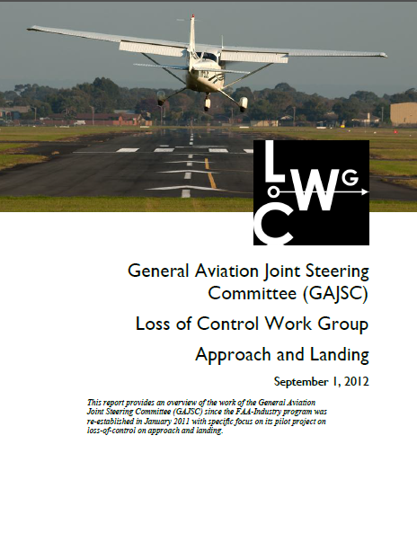
Overview
Loss of Control Accidents
Loss of Control Work Group* Recommendations
Benefits of Proficiency Training
How to get the most from your training
*General Aviation Joint Steering Committee (GAJSC)
Notes:
In this presentation we’ll talk a little bit about Loss of Control Accidents and Proficiency Training recommendations from the GAJSC - a work group that studies loss of control. We’ll talk about the benefits of proficiency training and offer suggestions that will help you to get the most from the experience.
Presentation Note: If you’ll be discussing additional items, add them to this list
(Next Slide)

Slide 4
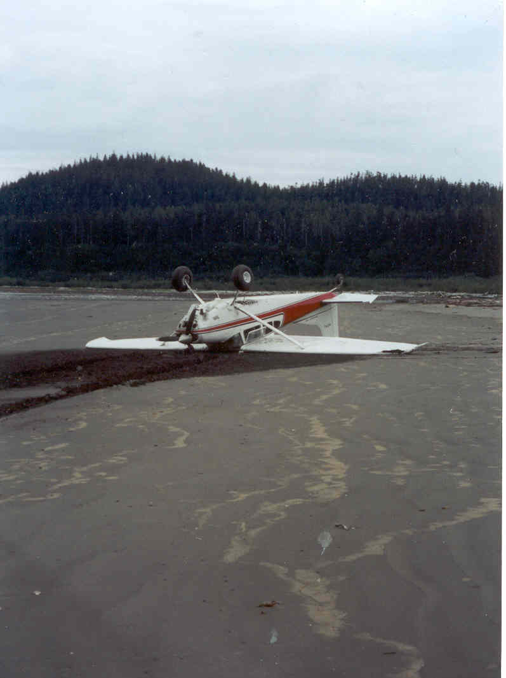
Loss of Control
The Most lethal GA accident precursor
Disorientation (Continued VFR into IMC)
Distraction
Inappropriate response to emergent event
Lack of aircraft handling skill
Inadequate risk management
Proficiency Training addresses all of these.
Notes:
Loss of control is the most lethal General Aviation accident precursor and there are 5 principal reasons why LOC occurs. (Click)
We’ve all heard about disorientation following intentional or inadvertent continued VFR into Instrument Meteorological Conditions. Indeed more than 90 percent of GA accidents that occur in this phase of flight are fatal. Advancements in pilot training and aircraft equipment have reduced the numbers of Continued VFR into IMC accidents so they’re not the top GA fatal accident cause. Loss of Control during maneuvering flight has that distinction. (Click)
Sometimes accidents occur while pilots are distracted by something on the ground or in the airplane. The term “Moose Stall” is familiar to Alaskan pilots. More than a few Alaskan aviators have lost control while maneuvering for a better view of a moose on the ground. Low altitude maneuvering for aerial photography is another activity that generates opportunities for loss of control due to distraction. (Click)
The FAASTeam has done several programs on the “Startle Response” that human quality that delays or inhibits response to hazards that occur suddenly. There are many stories of pilots who lost control of their aircraft while maneuvering to return to the airport following an engine failure on takeoff or climb out. (Click)
Lack of – or rusty aircraft handling skill has contributed to loss of control in crosswind operations. (Click)
And finally, inadequate risk management has led many pilots into situations that they lacked the skill to cope with. (Click)
The beautiful thing about proficiency training is that: through it, you can maintain and improve pilot performance with respect to each of these loss of control precursors; making it much less likely that LOC will occur.
(Next Slide)

Slide 5
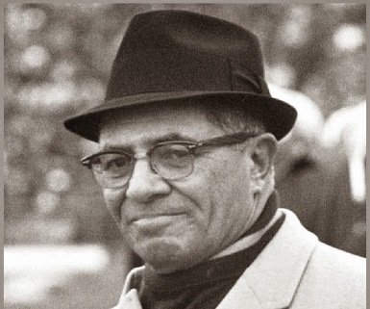
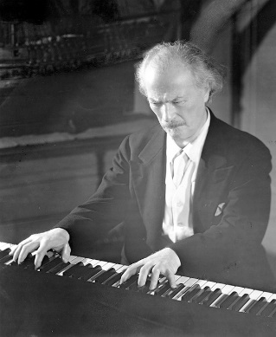
Practice makes perfect?
“Practice does not make perfect. Only perfect practice makes perfect”. Vince Lombardi – football coach
“If I miss one day’s practice – I notice it. If I miss 2 days – the critics notice it; and if I miss 3 days – the audience notices it”. Ignacy Paderewski – concert pianist
Notes:
We’ve all heard the phrase, “practice makes perfect”. But does it really? (Click)
According to Vince Lombardi only perfect practice makes perfect. In other words you must execute plays and procedures perfectly in practice if you expect to them to be perfect in the big game, or - in the case of pilots – in flight. (Click)
This quote is attributed to Paderewski (Pad er ev ski) and many other professional musicians. It acknowledges the necessity of regular practice in order to stay on top of your game. In our case we might substitute co-pilots and passengers for critics and the audience. The main takeaway is, of course, that no matter what your profession, regular practice to perfection is essential to operating at the top of your game.
(Next Slide)

Slide 6
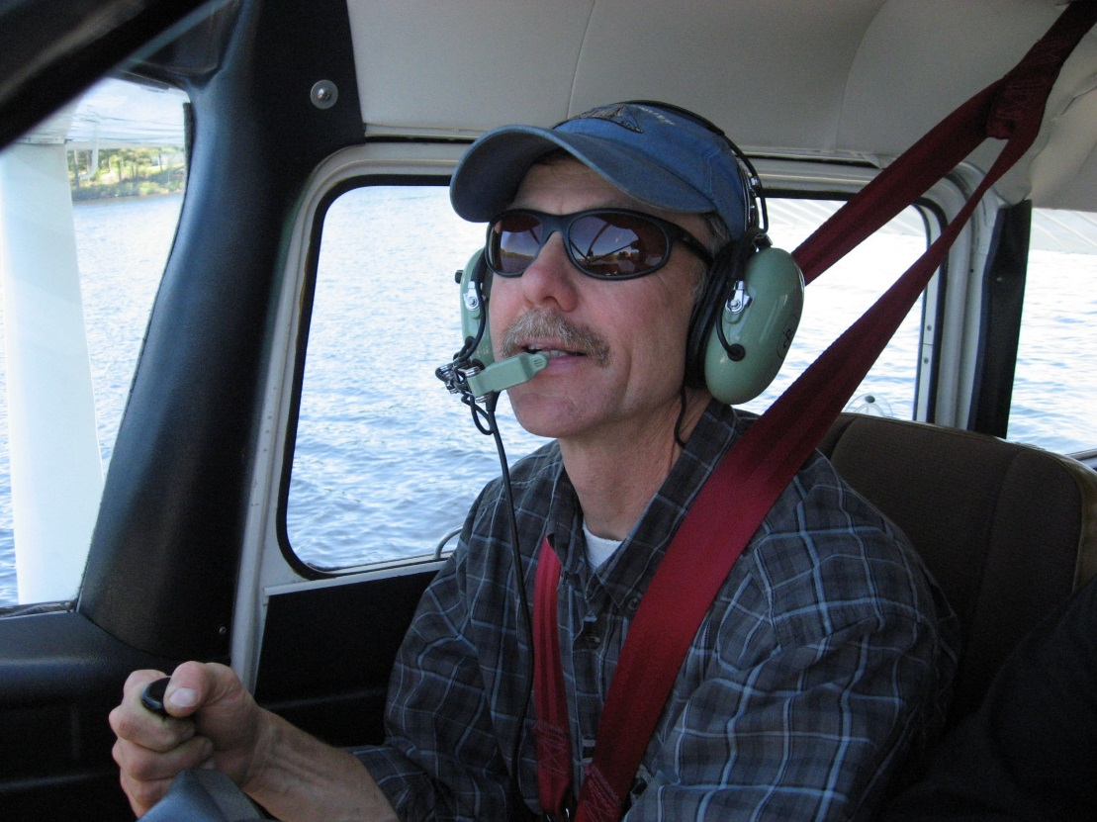
Beyond the $100.00 hamburger
Stalls & slow flight
Ground reference maneuvers
Short & soft takeoffs & landings
Power-off landings
Instrument flying
Notes:
Most of us have a favorite destination for that hundred dollar hamburger. We’ve been there before, the route is familiar, and we often bring the family along. That’s not the ideal proficiency flight though. Proficiency flying should involve less frequently practiced evolutions such as stalls, slow flight, ground reference maneuvers, takeoffs and landings, and instrument flying.
While it’s good to practice at typical mission weights, passengers may not enjoy the experience; at least not as much as straight and level to a popular destination.
And passengers are not usually good at critiquing performance or offering useful suggestions for improvement. For that you need a coach.
(Next Slide)
(Next Slide)

Slide 7
Can we go it alone?
Have a plan
What you’re going to do
Acceptable performance standards
Document your results
Progress monitor
Personal minimums
Want more bang for your proficiency buck?
Consider hiring a coach
Notes:
Can we maintain and enhance our proficiency while flying solo? That’s a good question and the answer is yes ….. sort of. All practice hours are worthwhile but some are definitely more worthwhile than others. If you’re going to practice on your own you need to make the most of each opportunity. Here are some suggestions: (Click)
First of all we strongly suggest that you have a plan that lists what maneuvers and evolutions you’re going to fly and what the acceptable performance standards will be for each item. Write your plan on paper and take it with you on your flight. Check off each maneuver completed and whether or not you met the standard. (Click)
Back on the ground – document your results. That way you can see progress and you’ll have information to document your baseline performance that will, in turn, feed into your personal minimums. More about that later. (Click)
For now – let’s just say solo proficiency flying is useful but there’s a way to get much more bang for your proficiency buck and that’s to hire a coach.
(Next Slide)

Slide 8
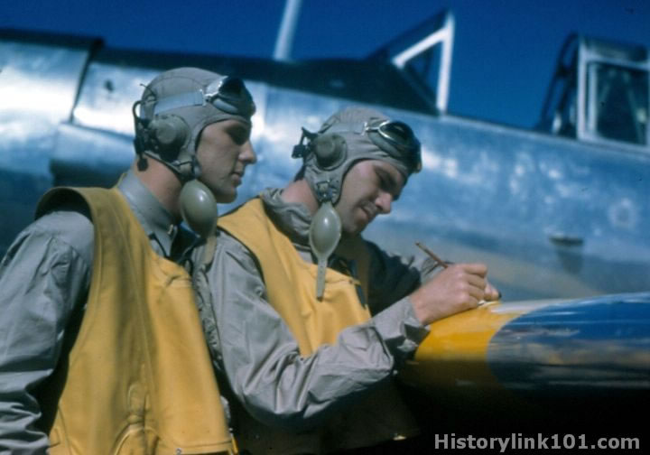
Flight coach
Rated in the airplane
Familiar with the environment
Keen observer
Teacher
Motivator
Develop your Pilot Performance Baseline
Document your results
Notes:
Every profession relies on coaching to keep practitioners sharp. All Flight Instructors are trained in performance evaluation and critique and most make great coaches. Obviously you’re going to look for a coach who’s expert in the airplane you’ll be flying and familiar with the flight environment. For best results you want a keen observer and teacher who will push you to excellence in flying. (Click)
Together you and your CFI can develop your Pilot Performance Baseline that you can use for flight planning. As you do when you fly solo – be sure to document your results.
(Next Slide)

Slide 9
What’s my baseline
Aircraft
Mission weight
Maximum wind experienced
In aircraft type
Airfield
Typical for mission
Seek local knowledge
Notes:
In order to establish personal minimums you need to have a baseline – think of it as your personal, documented, demonstration of performance. We suggest you document your performance at least once a year with a CFI. Try to pick a day when you can experience actual cross-wind conditions in the airplane you usually fly and loaded to your typical mission weight. Select an airfield that’s typical for the missions you fly. If you’re planning trips to a short, obstructed runway; try to find something similar to train on. Gather information about the destination airfield from pilots who’ve flown there and share that information with your instructor. That will help your CFI to construct realistic scenarios for you to fly.
(Next Slide)

Slide 10
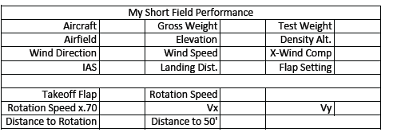
What’s my baseline?
Gold Seal
Notes:
Here’s a chart that some pilots use to document their wind, takeoff and landing performance. We’ll tell you where you can find this and other useful charts at the end of this program.
Once you’ve completed the chart you’ll have a performance baseline to work with. You can adjust the performance expectations to compensate for human factors such as stress and fatigue and you can also adjust your baseline as you gain experience and skill. If you want to adjust your baseline we strongly suggest that you do it with a CFI. That way you’ll have an objective assessment of your capabilities and a flight instructor may offer suggestions and instruction for improving your baseline performance.
(Next Slide)

Slide 11
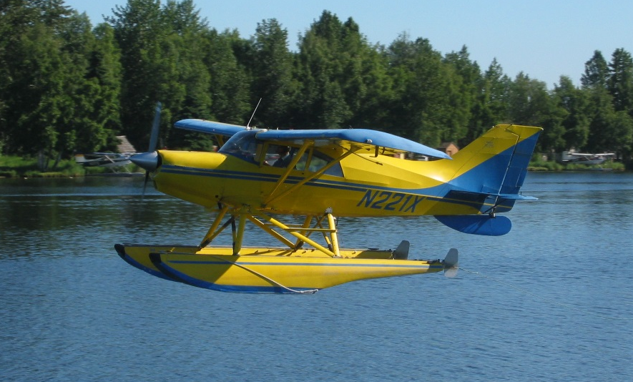
Expand your horizons
Notes:
Pilots usually think of proficiency training in terms of their usual aviation operations but if you are willing to expand your horizons there are host of options to make proficiency flying more interesting. Twin engine turbine or instrument training can boost capability and confidence in cross country operations. Seaplane and tailwheel training are particularly satisfying for folks who learned in nose wheel airplanes.
And even if you don’t take on the challenges of another rating or airframe, there’s another great way to expand your horizons.
(Next Slide)

Slide 12
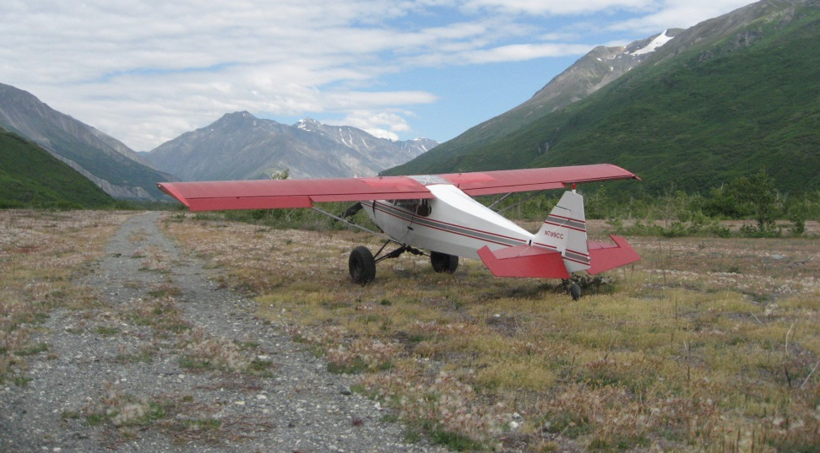
Operations Environments
Notes:
Training in new operational environments builds confidence too. If you learned to fly at a small country airport you’re probably very comfortable in a non-towered environment. How about a trip to a major metropolitan airport with your flight coach? The traffic and rapid pace of ATC communications can be daunting at first but mastering the environment can be very satisfying.
Likewise, big city pilots who are comfortable with busy towered operations can be overwhelmed when operating to non-towered or back country airstrips. Back country transition training can acquaint you with the nuances of rural environments and ensure your wilderness flying can be done safely.
(Next Slide)

Slide 13
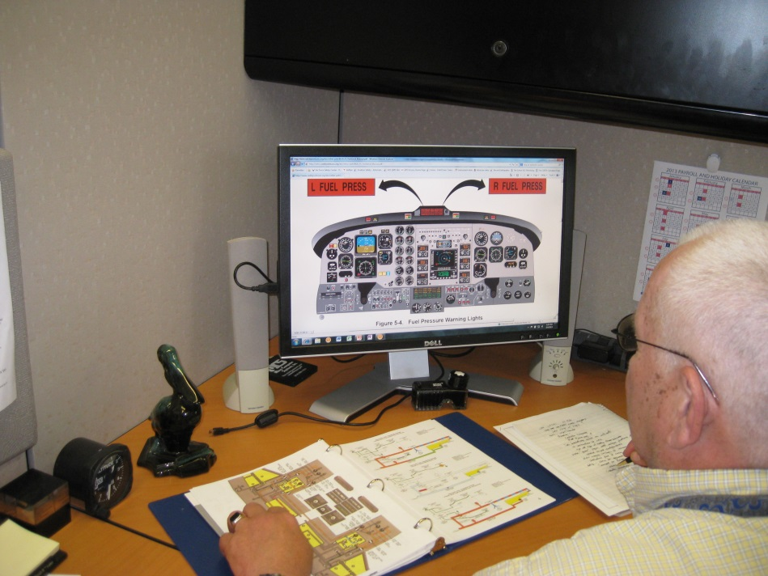
Read the book
Pilot’s Operating Handbook
Performance Charts
Speeds for safe operation
Weight & balance
Mission planning
Emergency procedures
Systems
Notes:
Whatever proficiency training you do, you’re ahead of the game if you study the book first.
Be sure to know these cold before flying with your coach :
Emergency procedures
Speeds, power settings, & configurations for normal operations
As you progress with your study note any questions you have and review them when you fly with your CFI
(Next Slide)

Slide 14
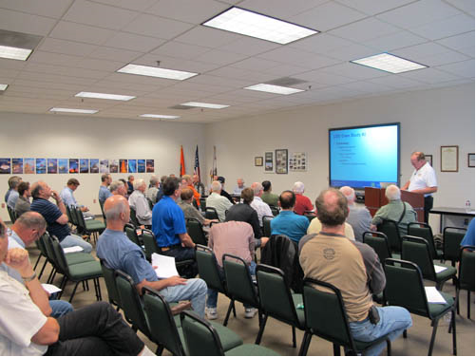
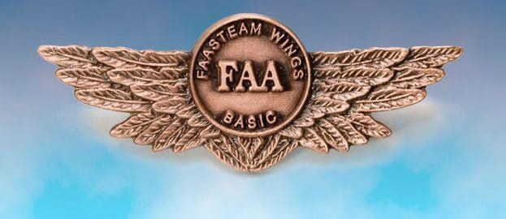
Document your training
WINGS Pilot Proficiency Program
On line records retention
Tailored to common GA accident precursors
And to your flying experience
Seminars and Webinars near you
http://faasafety.gov
Notes:
FAA’s WINGS Pilot Proficiency Program is an excellent way to document your training. Your training record is retained on line and always available to you and to your CFI.
Wings knowledge and flight activities are designed to address common general aviation accident precursors and your flight activities can be further customized to fit your operations and experience. And there are hundreds of WINGS seminars, webinars, and on line course available to you each year.
It’s all available on one website: FAASafety.gov
(Next Slide)

Slide 15
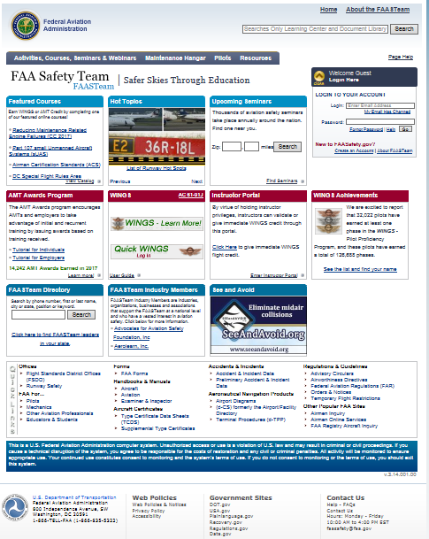
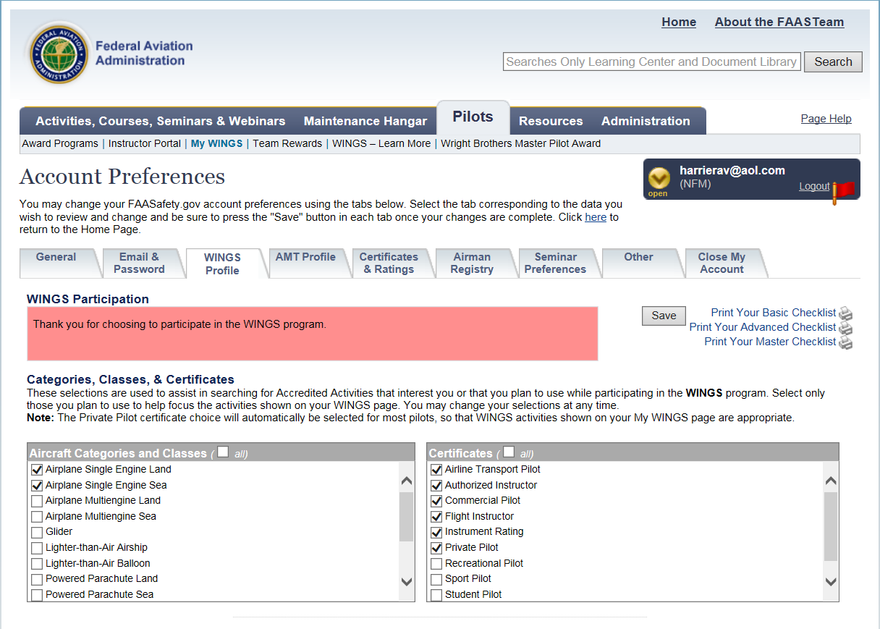
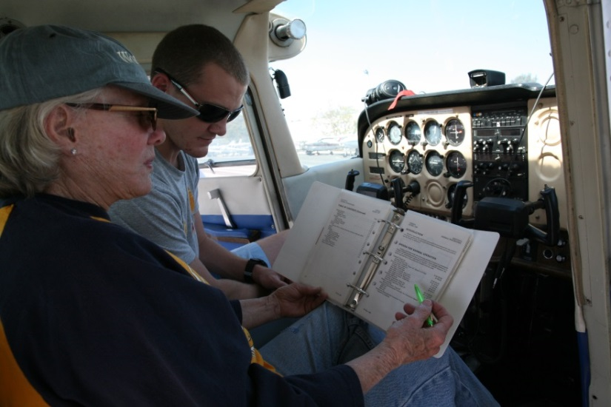
WINGS – easy as 1, 2, 3
Create an account on http://faasafety.gov
Complete your WINGS Pilot Profile
Attend a WINGS seminar or take a WINGS flight
Notes:
Getting started in WINGS is as easy as one, two, three.
Create an account on FAASafety.gov
Complete your WINGS Pilot Profile
Attend a WINGS seminar or take a WINGS flight with your CFI.
(Next Slide)

Slide 16
Register for knowledge credit
Notes:
You can pre-register for credit on FAASafety.gov or you can register via the sign-in sheet at the seminar door.
(Next Slide)

Slide 17
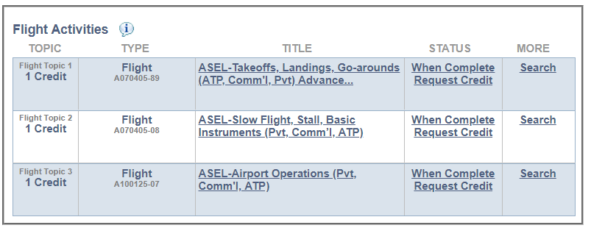
Notes:
You’ll need to request credit for each flight activity. It’s easy to do. Just go to your “My Wings” page and click on request credit after the activity has been completed.
(Next Slide)

Slide 18
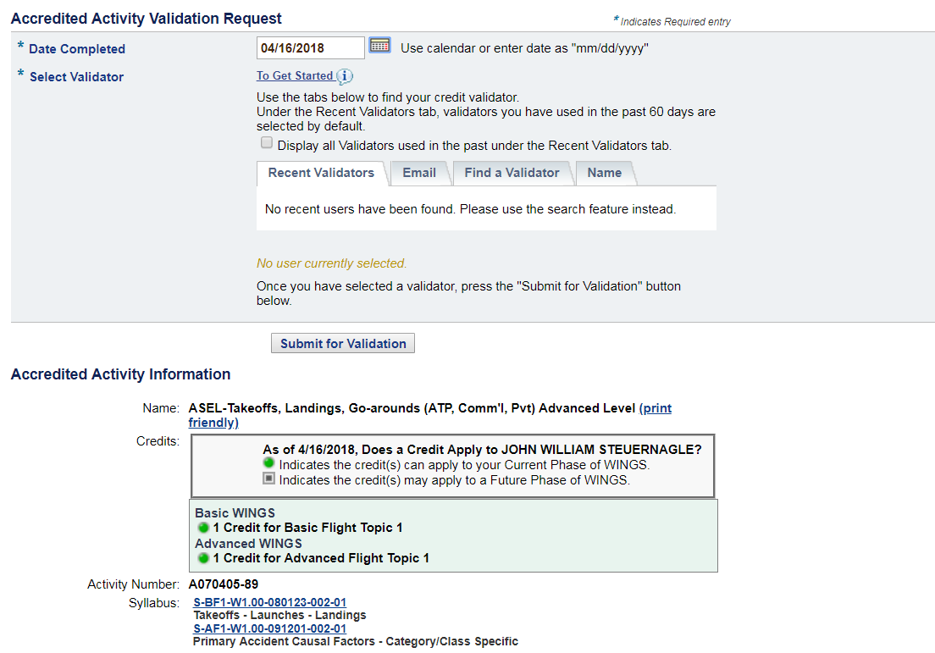
Request Validation of Flight Activities
Notes:
You’ll see a screen that looks like this. Normally CFIs validate flight credit and requests are sent to them. But if your CFI doesn’t participate in WINGS you can find a credit validator near you.
(Next Slide)

Slide 19
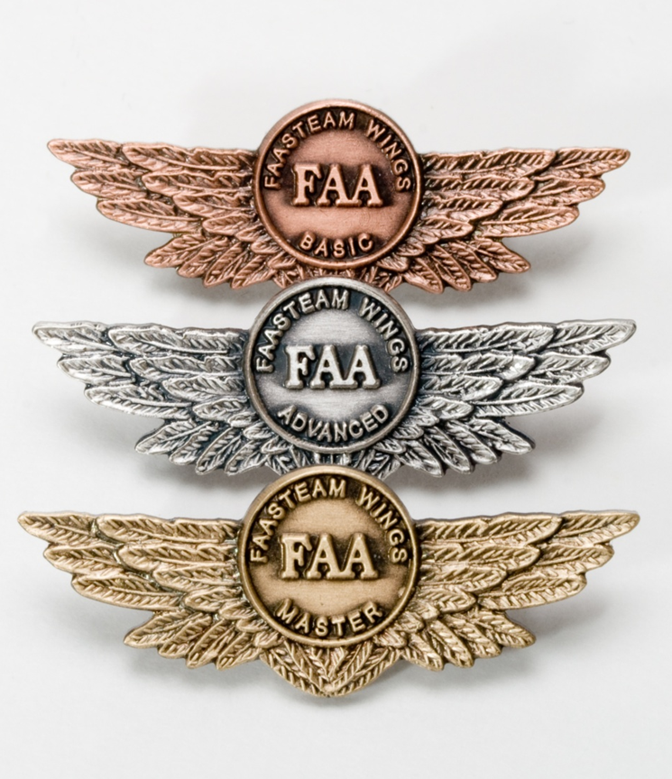
Proficiency and Peace of Mind
Fly regularly with your CFI
Perfect Practice
Document in WINGS
Notes:
There’s nothing like the feeling you get when you know you’re playing your A game and in order to do that you need good coaching (Click)
So fly regularly with a CFI who will challenge you to review what you know, explore new horizons, and to always do your best. Of course you’ll have to dedicate time and money to your proficiency program but it’s well worth it for the peace of mind that comes with confidence. (Click)
Vince Lombardi, the famous football coach said, “Practice does not make perfect. Only perfect practice makes perfect.” For pilots that means flying with precision. On course, on altitude, on speed all the time. (Click)
And be sure to document your achievement in the Wings Proficiency Program. It’s a great way to stay on top of your game and keep you flight review current.
(Next Slide)

Slide 20
Special for CFIs
https://www.mywingsinitiative.org/
Notes:
By the way – CFI’s in the audience are encouraged to navigate to mywingsinitiative.org for information on WINGS for CFIs.
(Next Slide)

Slide 21
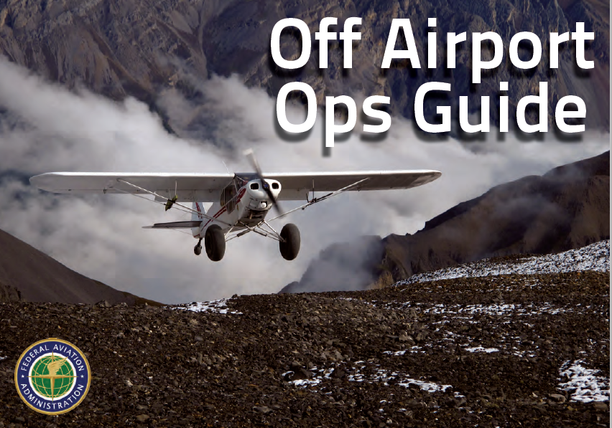
References
FAASafety.gov
Information and enrollment for WINGS Pilot Proficiency Program
Off Airport Ops Guide
Baseline performance determination examples
https://www.faasafety.gov/gslac/ALC/libview_normal.aspx?id=135893
Personal Minimums Development Guide
https://www.faasafety.gov/gslac/ALC/lib_categoryview.aspx?categoryId=15&r_s=50&r_c=50
Notes:
Here are a few references for additional information:
FAASafety.gov is the FAASTeam website where you’ll find a wealth of safety information. You can enroll and track your progress in the FAA WINGS Pilot Proficiency Program here.
Look in the FAASafety.gov library for the Off Airport Operations Guide. In it you’ll find instructions for developing a short field performance baseline together with other useful information on operating to small fields.
Also in the FAASafety.gov Library – the Personal Minimums Development Guide – Your documented proficiency performance can be used to develop minimums that are tailored to you, your aircraft, and your mission.
I’ll leave this slide on screen while I take some questions from the audience.
Presentation note: Take questions from the audience while they copy information from the screen. Then:
(Next Slide)

Slide 22
Questions?
Notes:
Presentation Note: You may wish to provide your contact information and main FSDO phone number here. Modify with
Your information or leave blank.
(Next Slide)

Slide 23
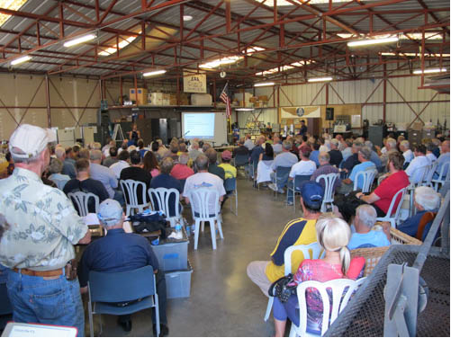
Thank you for attending
You are vital members of our GA safety community
Notes:
Your presence here shows that you are vital members of our General Aviation Safety Community. The high standards you keep and the examples you set are a great credit to you and to GA.
Thank you for attending.
(Next Slide)

Slide 24
The National FAA Safety Team Presents
Topic of the Month – March Pilot Proficiency Training
<Audience>
<Presenter>
< >
Notes:
(The End)

