Slide 1
The National FAA Safety Team Presents
Topic of the Month – May Owner/Mechanic Relations
Notes:
2020/10-05-207(I)PP Original Author: (Gary Knaggs) (10/1/2020); POC (Guy Minor), AFS-850 (A/W Lead), Office (707-704-3530); revised by Original
This is the title slide for Owner/Mechanic Relations.
Script - We have included a script of suggested dialog with most slides. The script will always appear in a non-italic font. Presenters may read the script or modify it to suit their own presentation style. See template slides 5 and 6 for examples of a slides with script.
Presentation Instructions - (stage direction and presentation suggestions) will be preceded by a Bold header: the instructions themselves will be in Italic fonts. See slides 2, 3, and 4 for examples of slides with Presentation Instructions only.
Program control instructions - will be in bold fonts and look like this: (Click) for building information within a slide; or this: (Next Slide) for slide advance.
Background information - Some slides may contain background information that supports the concepts presented in the program. Background information will always appear last and will be preceded by a bold Background: identification.
The production team hope you and your audience will enjoy the show. Break a leg!
(Next Slide)

Slide 2
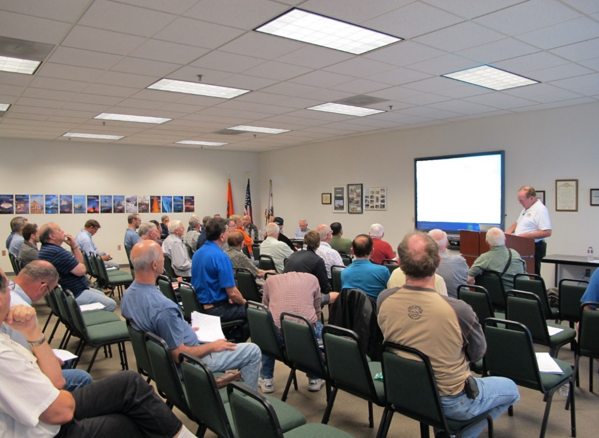
Welcome
Exits
Restrooms
Emergency Evacuation
Breaks
Phones & pagers to silent or off
Sponsor Acknowledgment
Other information
Notes:
Presentation Instruction: Here’s where you can discuss venue logistics, acknowledge sponsors, and deliver other information you want your audience to know in the beginning. You can add slides after this one to fit your situation.
(Next Slide)

Slide 3
Overview
Who is Responsible? For the airworthiness of the aircraft
What the Owner/Operator should expect to see at the maintenance facility
What the maintainer (A&P, IA, Repair Station) is responsible for when performing/completing the job
Notes:
The items we will cover during the presentation include:
Who is responsible?
What the Owner/Operator should expect to see at the maintenance facility
What the maintainer (A&P, IA, Repair Station) is responsible for when performing/completing the job
The owner of a General Aviation aircraft received all/most of his or her information about piloting a plane from their CFI, but have received very little information about owning or maintaining an aircraft. If the owner hasn’t spent much time with their local A&P or repair facility, there is usually a lack of knowledge.
This presentation is a starting point to help owners/operators/pilots understand their aircraft’s maintenance needs and understand their relationship and maintenance facility.
(Next Slide)

Slide 4
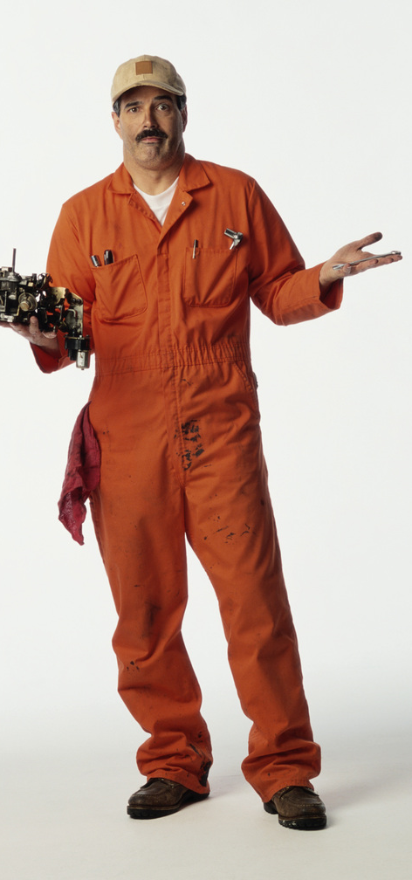
Objectives
To give owner/operators/mechanics information on:
Who’s responsible for the airworthiness of the aircraft
What the owner should expect to see
What mechanics should do to the aircraft during
annual/condition inspection
Notes:
Presentation Note: Click through the three bullet points then use the script
We designed this presentation with the General Aviation pilot/owner/operator in mind who may have no idea what to expect from their mechanic. Most pilots think airworthiness issues are their mechanics’ problem and that owners are not responsible for anything airworthy about their aircraft. They also have a misconception that mechanics are all created equal no matter what they charge for services. The fact is that some mechanics, whether knowingly or not, cut corners to save a buck. This presentation contains tips for aircraft owners and operators to ask about when choosing a new mechanic or re-evaluating their present mechanics.
(Next Slide)

Slide 5
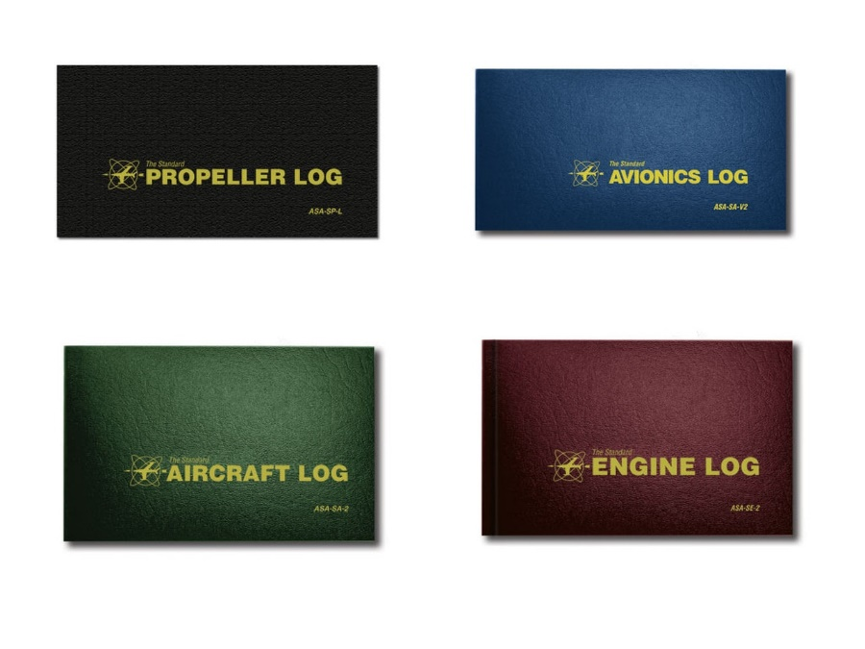
Objectives
To give owner/operators/mechanics information on:
What the logbook entry MUST contain
What the logbook SHOULD contain
How the mechanic should document
compliance with AD’s
Notes:
Presentation Note: Click through the three bullet points then use the script
Regulations are a MINIMUM standard and may not reflect all of the best practices that a professional mechanic should follow. Yes, they should follow the rule, but a true professional will go above the minimum standard as a standard practice of their routine.
Their attention to detail will give an aircraft owner a good indication of how professional they are, and if their safety culture is positive.
(Next Slide)

Slide 6
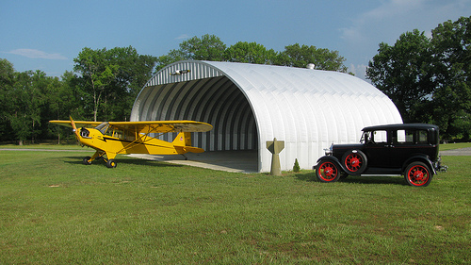
Let’s go on a little trip
Notes:
Let’s go on a little trip to the maintenance hangar
(Next Slide)

Slide 7
Who’s Responsible?
14 CFR Part 91.403(a) says the owner/operator is
primarily responsible for maintaining the aircraft in an airworthy condition to include
AD compliance
14 CFR Part 91.7 says No person may operate a
civil aircraft unless it is in an airworthy condition.
AND
The pilot in command of a civil aircraft is responsible for determining whether that aircraft is in condition for safe flight. The pilot in command shall discontinue the flight when un-airworthy mechanical, electrical, or structural conditions occur.
Notes:
Presentation Note: Read the slide to the audience. The information is foundational to this presentation
This slide is the foundation of keeping an aircraft airworthy and keeping operators safe.
Who is responsible for the airworthiness of an aircraft? It is tempting to say that it is the mechanic who worked on the airplane, but it is the aircraft owner who is ultimately responsible for an aircraft’s airworthiness. This concept is critical and means that owners need to learn maintenance regulations. It will not only keep them out of trouble, but it will also increase the operational safety of the aircraft. Aircraft owners should be proactive in their approach to maintenance performed on their aircraft.
(Next Slide)

Slide 8
Airworthiness Certificate
.
6. TERMS AND CONDITIONS
Unless sooner surrendered, suspended, revoked, or a termination date is otherwise established by the Administrator, this airworthiness certificate is effective as long as the maintenance, preventive maintenance , and alterations are performed in accordance with Parts 21, 43, and 91, of the Federal Aviation Regulations, as appropriate, and the aircraft is registered in the United States.
VOID
Notes:
When is the last time that you have read block 6 of an airworthiness certificate? It has some excellent information that all aircraft owners and operators should know.
(Click)
Let’s all read it… Unless sooner surrendered, suspended, revoked, or a termination date is otherwise established by the Administrator, this airworthiness certificate is effective as long as the maintenance, preventive maintenance , and alterations are performed in accordance with Parts 21, 43, and 91, of the Federal Aviation Regulations, as appropriate, and the aircraft is registered in the United States.
(Next Slide)

Slide 9
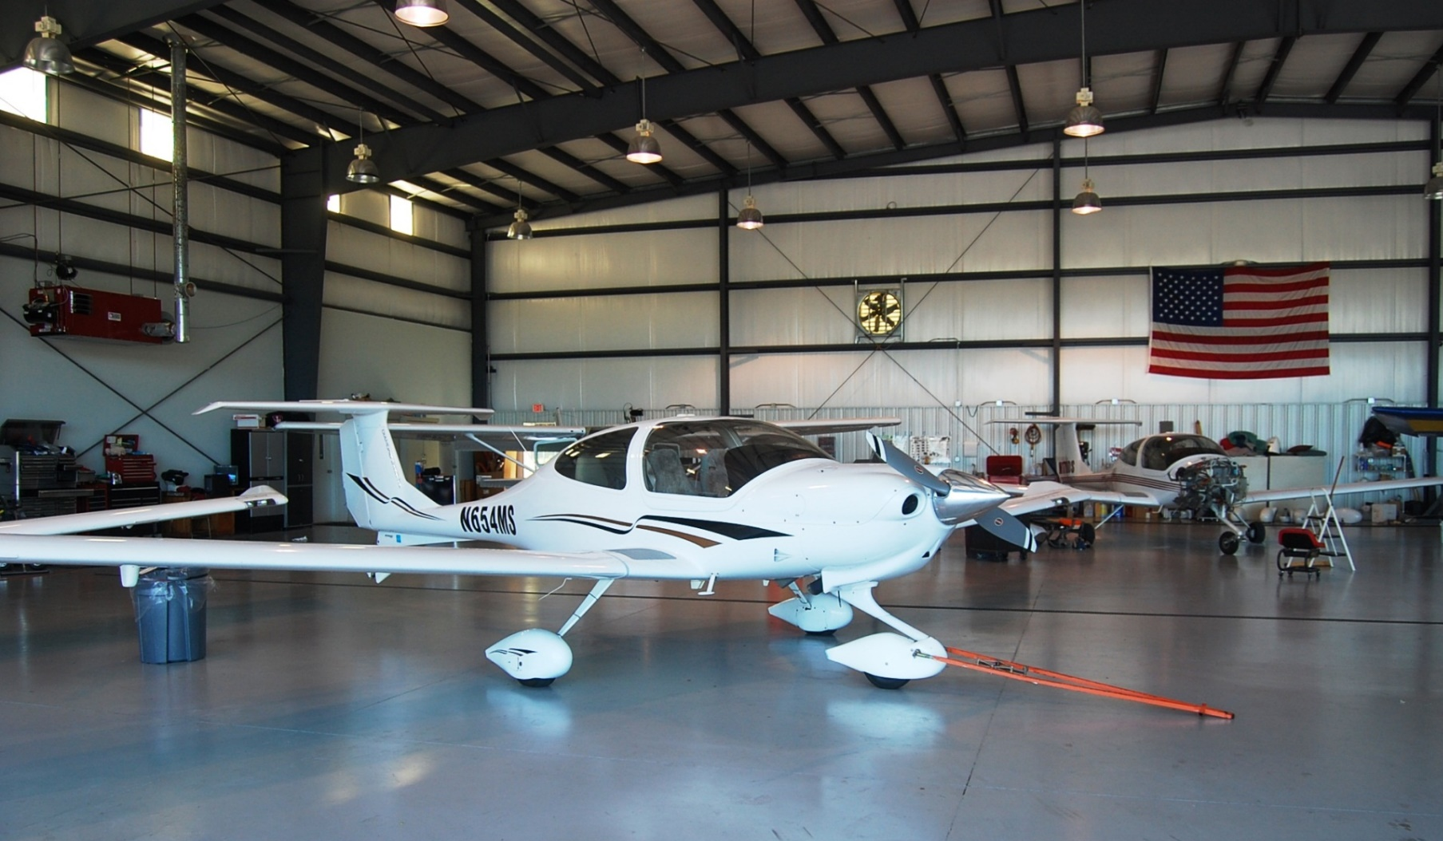
Arrival at the Maintenance Hangar
Notes:
(Next Slide)

Slide 10
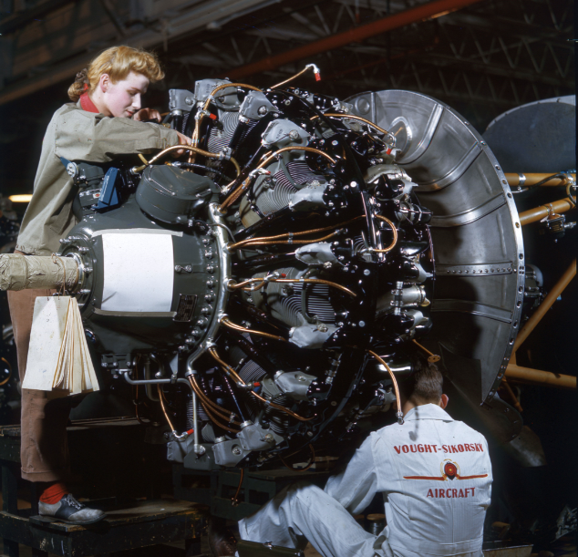
What You Should Expect To See
A clean, neat and organized shop area
Proper storage of materials and parts
Adequate lighting
Adequate tooling and equipment
Notes:
(Click) A clean and neat shop area is an excellent indicator of a mechanic’s organizational skills. It is also a good indicator of his/her professionalism.
(Click) If parts and materials are not stored correctly, it can seriously affect the airworthiness of the item. For example, if maintainers do not protect parts from dust and humidity, they can become contaminated with dust and dirt or corrode.
(Click) If they do not have adequate lighting to perform inspections, they cannot see any potential problems.
(Click) They are required by regulation to have adequate tools and equipment to perform an inspection and maintenance on aircraft.
(Next Slide)

Slide 11
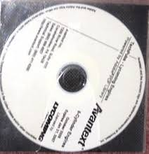
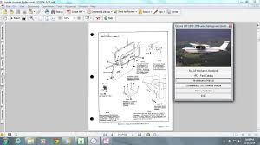
What to ask your mechanic
Do they have current, relevant and approved data?
Current
Relevant
Approved
Notes:
Presentation Note:
Click on each of the bullet points below
Data could not be more critical. Maintenance and Parts manuals have, in some cases, become very expensive to buy and maintain. Therefore some mechanics may not choose to keep their manuals updated. There can be severe consequences of not having current repair data.
(Click) Ask the mechanic if the manual they are using for the aircraft is current. Call the tech support line of the aircraft’s manufacturer and ask them what the current revisions are for the plane.
(Click) Ask the mechanic if they have the manual for this specific aircraft.
(Click) Ask the mechanic if they have the approved data for any maintenance or alterations they might perform outside the maintenance manual.
(Next Slide)

Slide 12
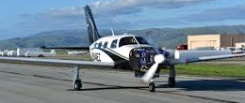
What your mechanic must do
In accordance with 14 CFR Section 43.15 during annual/100 hour mechanics must:
Use a Checklist that meets Appendix D of Part 43 at a minimum
In accordance with 14 CFR Section 43.13 they must:
Use approved parts and materials
Approved for Return to Service
Repair Station LGFR1243
Joe Mechanic
In accordance with 14 CFR Section 43.15 during annual/100 hour they must:
Run the Aircraft
Notes:
Regulations state what the mechanic must do as a minimum standard. The next three bullet points come directly from 14 CFR 43.15 and .13. These are excellent minimum standards, but maintainers can do more.
Per 14 CFR Section 43.15 during annual/100 hour, maintainers must:
Perform the inspection to determine whether the aircraft meets all applicable airworthiness requirements by using:
(Click)
A checklist that meets Appendix D of Part 43
Type Certificate Data Sheets (TCDS)
Supplemental Type Certificates (STC)
Airworthiness Certificate (Parts 21, 43, and 91)
Manufacturers Airworthiness Limitations
(Click) All maintenance personnel are required to use parts that are traceable and have a known history. These parts should carry some sort of serviceable tag or FAA Form 8130-3 when the mechanic receives them. If the mechanic can’t prove where the part came from or determine the part’s airworthiness, they cannot use it on an aircraft. Ask to see, or better yet, require the mechanic to provide the paperwork for all parts installed on the plane.
Parts Manufacturer Approval or PMA parts are not original manufacturers parts but they have been approved by the FAA for installation on certain aircraft models. There is a list of effective aircraft that goes with each PMA part. If the make and model airplane is not on the list, the part cannot be installed on the plane without further approval, such as a Field Approval, from the FAA.
(Click) When finished, the Mechanic, IA, or Repair Station must Run the engine to check for proper operation
(Next Slide)

Slide 13
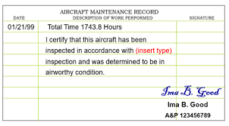
What your mechanic must write
What your Logbook Entry must contain
14 CFR Section 43.9(a) says for maintenance other than inspections:
Description
Date
Name Signature, Certificate, and Type
14 CFR Section 43.11(a) says for inspections:
The type of Inspection
The date of the inspection and aircraft total time in service (not necessarily tach time)
The signature, certificate number, kind of certificate held by the person approving or disapproving for return to service
Notes:
After maintenance has been performed, the aircraft logbooks must contain: (Click)
A description of the work performed. (Click)
The date of completion of the work performed. (Click)
The name of the person performing the work if other than the person approving for return to service. The signature, certificate number and type of certificate held by the person approving the work. The signature constitutes the approval for return to service only for the work performed. (Click)
14 CFR section 43.11 requires the mechanic to include all of these components for a proper sign-off and return to service after they have performed an inspection. (Click)
(1) The Type of inspection (Click)
(2) The inspection Date and the aircraft Total Time in Service and, (Click)
The signature, certificate number, and the kind of certificate held by the person approving or disapproving return to service.
Note: Aircraft total time almost always is not tach time. And frequently, it’s not Hobbs meter time either. The aircraft records are the only place to find total time and usually only after some research.
If the mechanic has discovered a discrepancy and the aircraft owner chooses not to repair it then the mechanic should sign off the log books as unairworthy and must give the aircraft owner a list of discrepancies. They may then take it to another mechanic for further repairs. Remember: If the aircraft owner flies it to the other mechanic a Special Flight Permit “ferry permit” must be obtained before the flight.
(Next Slide)

Slide 14
For Inspections, your Logbook Entry must contain
If approved for return to service…similarly worded statement- “I certify that this aircraft has been inspected in accordance with a (insert type) inspection and was determined to be in airworthy condition”
If not approved for return to service…similarly worded statement- “I certify that this aircraft has been inspected in accordance with (insert type) inspection and a list of discrepancies and unairworthy items dated (date) has been provided to the aircraft owner or operator
Notes:
Presentation Note: Click on each bullet point and read the slide content as you give the presentation
(Click) What are the differences between Discrepancies and Unairworthy Items?
(Click) Can a pilot fly the aircraft with open Unairworthy Items? How can this be done? By using a Special Flight Permit (Ferry Permit)
(Next Slide

Slide 15
What your Logbook Entry should contain
Part and serial numbers for parts removed
Part and serial numbers for parts installed
Specific reference to approved data used to perform a task
Reference to approval documents for parts installed (FAA Form 8130-3 or RTS Tags)
Aircraft Make/model AD’s, whether they apply or not
Any other comments deemed important by the mechanic (never too much information)
Notes:
Slide 15
Maintainers are required to do good work and meet the 14 CFR 43.13 Performance rules. The point of good logbook entries is that they prove the mechanic did a good job - that the mechanic covered all the bases. This means that the more information - the better.
Documenting part and serial numbers for parts that were removed and installed is very beneficial – especially if the part is a subject of a current or future service bulletin or Airworthiness Directive.
Likewise references to the approved data and documents used in task performance support the assertion that the work was done properly.
Pertinent AD’s should be recorded in the logbooks, whether they apply to their specific model/serial number or not.
A pertinent AD may be one that covers the make and model of aircraft or component but does not apply because of the serial number applicability for example. The AD should still be recorded in the logbook to show that the mechanic did not ignore the AD but found that it was inapplicable. This also makes it easier for owners to show the AD status of their aircraft.
All of these entries may be considered “above the minimum standard” but they will keep the owner/operator out of trouble should an FAA inspector ask for the information. With thorough documentation, aircraft owners can show that their mechanics followed proper procedures.
(Next Slide)

Slide 16
How AD’s Must Be Signed Off
ONE TIME AD’s
AD number including revision date
Method of Compliance
RECURRING AD’s
Everything above, plus
Time and/or Date when the
next action is required
AD’s C/W through 09/2019
Notes:
Our system requires AD’s to ensure the safe operation of aircraft. AD compliance must be documented (Click)
One time AD documentation must include the AD number and revision date if applicable, the method of compliance, and compliance date. (Click)
Recurring Ads are documented in the same way and the time in service or date of the next required action must be included.
Some people say that some AD’s are not important. Recently there was an incident where an AD had not been complied with for 32 years. Thirty-two mechanics missed it. It was a simple placard AD about not operating a prop at a certain rpm for extended periods. The placard was missing. One day, as the plane flew along, the prop came apart due to a crack in the blade caused by harmonic vibration. Luckily the pilot was quick enough and good enough to get the engine shut down before the engine shook out of the mount. He landed the aircraft and walked away. It could’ve ended much worse. Something as simple as a missing placard can kill.
It is the owner/operator’s responsibility to keep up with AD’s status on their aircraft. More importantly, if they don’t, it could kill.
(Click) This, (Click) doesn’t cut it. It is like waving a red flag. For some odd reason it is almost never true. If you want to challenge an inspector to prove a statement wrong, put this one in your logbook.
(Next Slide)

Slide 17
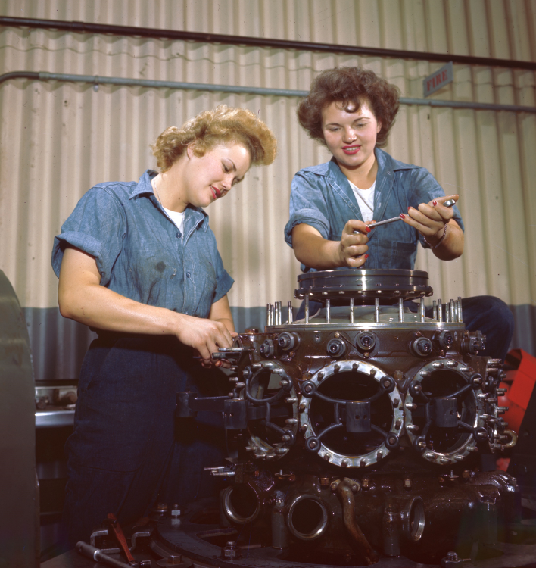
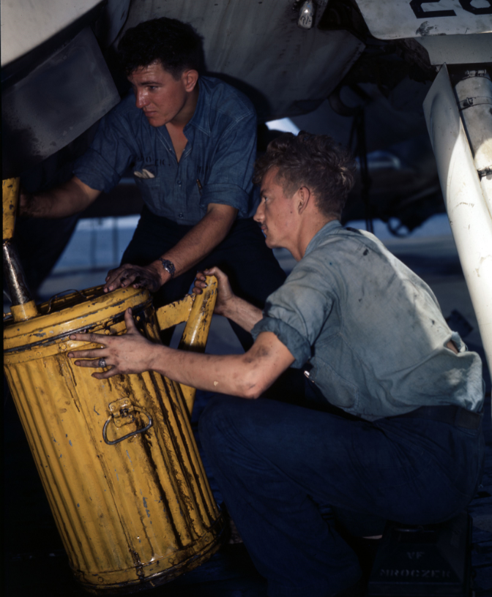
Does Your Mechanic Have a Positive Safety Culture?
A Clean, Neat, Well-Lighted Shop
Adequate, Calibrated and Organized Tools
Current, Relevant and Approved Data
Use of Approved and Traceable Parts
Proper Logbook Entries, including AD’s
Notes:
To review: Professionals do not cut corners. They will stand up to owners and tell them that their aircraft needs repair to be airworthy. They will have all the current publications, approved data, and approved parts. They will be trained appropriately and make more than minimum logbook entries.
Ask these questions. Does the maintainer have: (Click)
A Clean, Neat, Well Lighted Shop? (Click)
Adequate, Calibrated, and Organized Tools? Both in the maintainers’ toolbox and the shop areas. (Click)
Current, Relevant, and Approved Data? (Click)
Use of Approved and Traceable Parts? (Click)
Proper Logbook Entries to Include ADs?
If the answer is not yes to all these questions, it should cause the aircraft owner to reflect.
(Next Slide)

Slide 18
Questions?
Notes:
Presentation Instruction: You may wish to provide your contact information and main FSDO phone number here. Modify with
Your information or leave blank.
(Next Slide)

Slide 19
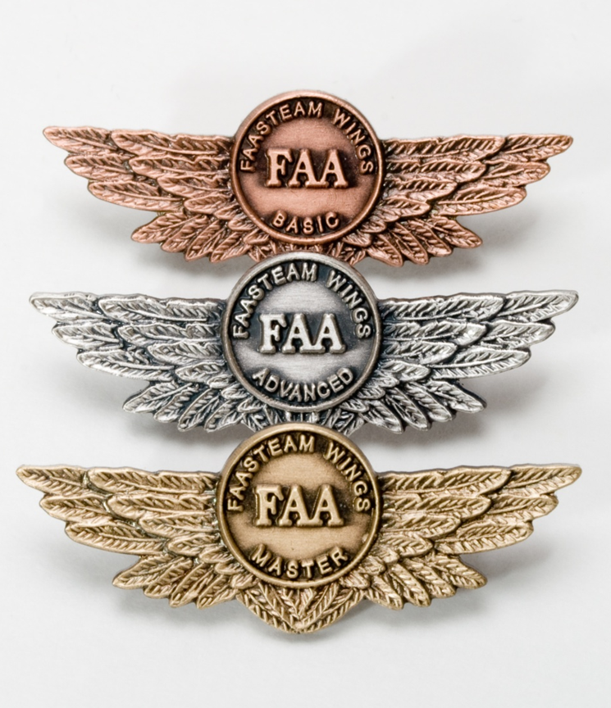
Proficiency and Peace of Mind
Fly regularly with your CFI
Perfect Practice
Document in WINGS
Notes:
There’s nothing like the feeling you get when you know you’re playing your A game and in order to do that you need a good coach (Click)
So fly regularly with a CFI who will challenge you to review what you know, explore new horizons, and to always do your best. Of course you’ll have to dedicate time and money to your proficiency program but it’s well worth it for the peace of mind that comes with confidence. (Click)
Vince Lombardi, the famous football coach said, “Practice does not make perfect. Only perfect practice makes perfect.” For pilots that means flying with precision. On course, on altitude, on speed all the time. (Click)
And be sure to document your achievement in the Wings Proficiency Program. It’s a great way to stay on top of your game and keep you flight review current.
(Next Slide)

Slide 20
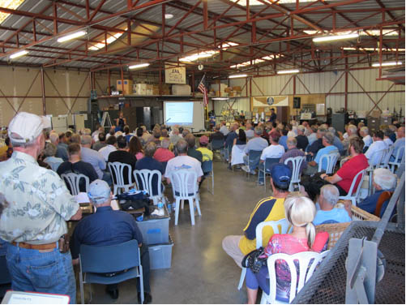
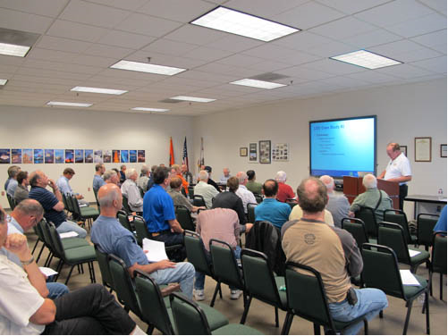
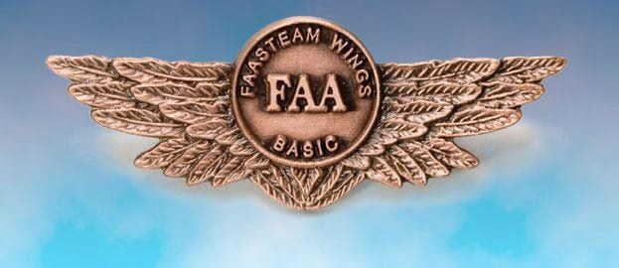
Thank you for attending
You are vital members of our GA safety community
Notes:
Your presence here shows that you are vital members of our General Aviation Safety Community. The high standards you keep and the examples you set are a great credit to you and to GA.
Thank you for attending.
(Next Slide)

Slide 21
The National FAA Safety Team Presents
Topic of the Month – May Owner/Mechanic Relations
Notes:
(The End)

