Slide 1
The National FAA Safety Team Presents
Topic of the Month - October
Pilots and Medications
<Audience>
<Presenter>
< >
Notes:
2020/10-09-209(I)PP Original Author: John Steuernagle; POC Kevin Clover, AFS-920 Operations Lead, Office 562-888-2020
Presentation Note: This is the title slide for Pilots and Medications
Script - We have included a script of suggested dialog with most slides. The script will always appear in a non-italic font. Presenters may read the script or modify it to suit their own presentation style. See template slides 5 and 6 for examples of a slides with script.
Presentation Instructions - (stage direction and presentation suggestions) will be preceded by a Bold header: the instructions themselves will be in Italic fonts. See slides 2, for an example of slides with Presentation Instructions only.
Program control instructions - will be in bold fonts and look like this: (Click) for building information within a slide; or this: (Next Slide) for slide advance.
Background information - Some slides may contain background information that supports the concepts presented in the program.
Background information will always appear last and will be preceded by a bold Background: identification.
The production team hope you and your audience will enjoy the show. Break a leg!
(Next Slide)

Slide 2
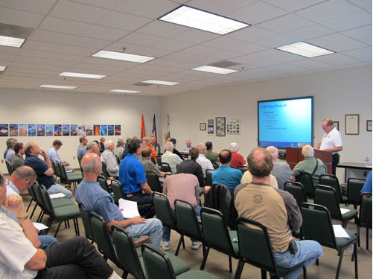
Welcome
Exits
Restrooms
Emergency Evacuation
Breaks
Sponsor Acknowledgment
Set phones and pagers to silent or off
Other information
Notes:
Presentation Note: Here’s where you can discuss venue logistics, acknowledge sponsors, and deliver other information you want your audience to know in the beginning.
You can add slides after this one to fit your situation.
(Next Slide)

Slide 3
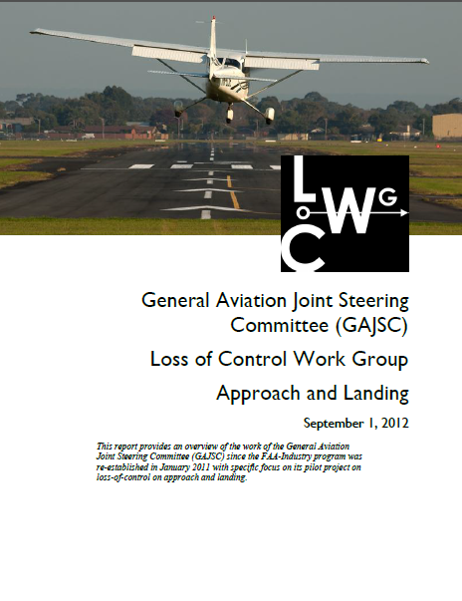
Overview
General Aviation Joint Steering Committee (GAJSC) & FAA Accident Study Findings
Flying and Medications
Drug/Medication Combinations
Tips and Case Study
Notes:
In this presentation we’ll talk a little bit about a recent GAJSC and FAA studies that feature some interesting findings with respect to pilots and medications
We’ll talk generally about flying while medicating and the problems associated with taking multiple drugs.
Finally we’ll offer some tips for safe flying while on medications and we’ll discuss a case study.
Presentation Note: If you’ll be discussing additional items, add them to this list
(Next Slide)

Slide 4
FAA Findings
In a 2011 FAA study involving fatal pilots
  570 out of 1,353 pilots tested positive for medications/drugs.
  511 of the 570 (90%), were flying under CFR Part 91.
Extent of Impairment – Undetermined
  But cause for concern
Notes:
In a 2011 study from the FAA’s CAMI Toxicology Lab drugs/medications were found in 570 pilots (42%) from 1,353 total fatal pilots tested. Most of the pilots with positive drug results, 511 (90%), were flying under CFR Part 91.”.
While there were a couple instances of recreational drugs, the majority were prescription or over the counter medications. Antihistamines were the most commonly found. Left undetermined was the extent of pilot impairment – if any – due to drug use but the issue is cause for concern for several reasons:
(Next Slide)

Slide 5

What’s the Problem
Not easy to determine extent of impairment
  Different medication effects for different people
  Post-mortem redistribution and sample type
Don’t know about pilot’s condition
  Pre-existing medical condition requiring medication
AME not consulted?
Drug interactions
Notes:
So what’s the problem:
First of all – We all know that some medications may compromise a pilot’s ability to control the aircraft and/or adversely affect judgment and decision-making. (Click)
What’s not so obvious is it’s difficult for investigators to say for sure that pilot performance was compromised because the effect of drugs and medications varies widely among individuals. In addition, post-mortem redistribution of a substance creates some confusion as to the actual blood levels prior to the accident. The amount of a substance may vary considerably in different tissues. (Click)
A less obvious problem poses the question; what pre-existing physical condition requires the use of medication in the first place? (Click)
It’s not unusual to find that pilots are evaluated and treated for conditions that are not revealed to their Aviation Medical Examiners. In those cases an AME doesn’t have an opportunity to review the complete medical history of diagnoses and treatments for some of the pilots they examine. (Click)
There’s also the issue of drug interactions but we’ll get to that a little bit later.
(Next Slide)

Slide 6

Federal Drug Labeling Standards
Provide information for:
Patients
Healthcare professionals
Both
It Depends
Notes:
Fortunately – the FDA requires standard labeling for prescription and over-the-counter (OTC) medications
but are those labeling standards primarily for patients or healthcare providers or both.
Presentation Note: Ask for a show of hands with respect to each statement then (Click)
As it turns out the correct answer is it depends on the type of drug and the packaging. OTC labeling is for the medication user, while prescription labeling is primarily for healthcare providers.
(Next Slide)

Slide 7
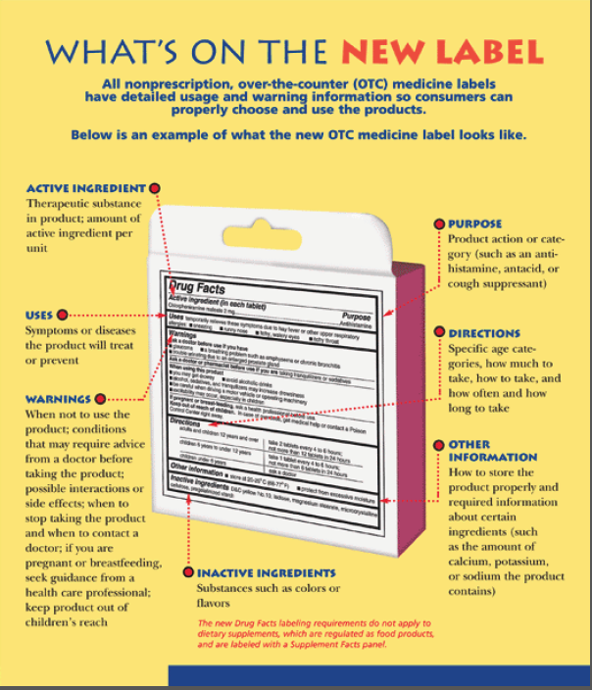
OTC Medication Labeling
Read the label
Labeling Standards
  Directed to medication users
  In non-technical language
Notes:
Food and Drug Administration (FDA) OTC (Over the Counter) labeling requirements are directed to users so be sure to read the label before you medicate and fly.
(Next Slide)

Slide 8
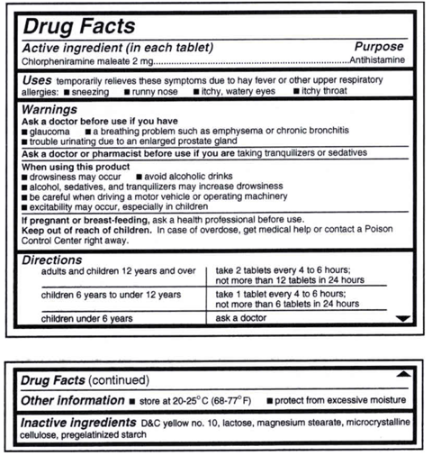
OTC Medication Labeling
Read the label
  Active Ingredient(s)
  Purpose
  Uses
  Warnings
  Directions
Notes:
The standard OTC Label will tell you the active ingredients, purpose, and uses for the drug as well as warnings and directions for use.
Note in this example we’re looking at an antihistamine that we might take to address cold symptoms.
Note the warnings of drowsiness and those associated with driving a motor vehicle or operating machinery. Do you think it would be safe to fly while using this drug? How long will it reside in your system? How soon would you be safe to fly after stopping the drug?
You won’t find the answers to any of those questions on the label. This might be a good time to consult your AME.
(Next Slide)

Slide 9

Sleep Aids & Cough Medications
Both likely to contain antihistamines which may cause drowsiness or sedation
  “Hang Over” effect
  Side effects may last several days
Short term use only
Notes:
A word on OTC sleep aids and cough medications: (Click)
Both are likely to cause drowsiness or sedation. (Click)
Sleep aids obviously are intended to promote sleep but their effects – resembling a hangover - may persist for several days – not a good idea if you’re going flying. (Click)
Also – tolerance to active ingredients builds quickly so you’ll find you’re taking more and more medicine to achieve the same result.
All OTC medications are intended for temporary use. Taking them for longer than the recommended time may mask symptoms of a significant or serious underlying medical condition.
(Next Slide)

Slide 10

How long must I wait?
FAA recommends waiting five times the dosage interval.
  Particularly true for any medication causing drowsiness.
Four times per day = 6-hour intervals
  5 x 6 = 30 hours
Notes:
If you’ve been taking a medication that precludes flying, how long must you wait after ceasing the medication before you return to the air? (Click)
This is a good question for your AME to answer but the general rule is to wait until 5 times the dosage interval has passed. (Click)
For example; if you take a medication 4 times a day (6-hour intervals) you should wait at least 30 hours before resuming pilot duties.
(Next Slide)

Slide 11

Prescription Medications
May recommend not operating a motor vehicle
  Includes cars, airplanes, boats, etc.
May be prescribed individually
  Perhaps by different Healthcare Providers
  Interactions may not be addressed or unknown
Prescription drug labeling
  Directed to Healthcare Provider
Notes:
Prescription meds are different. They’re often stronger versions of what you can get over-the-counter. Many carry a warning to not operate motor vehicles or perform tasks that require alertness. Remember boats and planes are considered motor vehicle and piloting an airplane certainly requires alertness!
Prescription drugs are often prescribed individually – sometimes by different healthcare providers. Interactions may not be addressed or may be unknown.
Unlike those for OTC products, the labeling standards for prescription drugs are primarily for the use of medical professionals so they’re not as helpful to the lay public. Be sure to remind your prescribing healthcare provider you are a pilot and ask how the drug is likely to affect your motor skills, judgment, and decision-making.
(Next Slide)

Slide 12
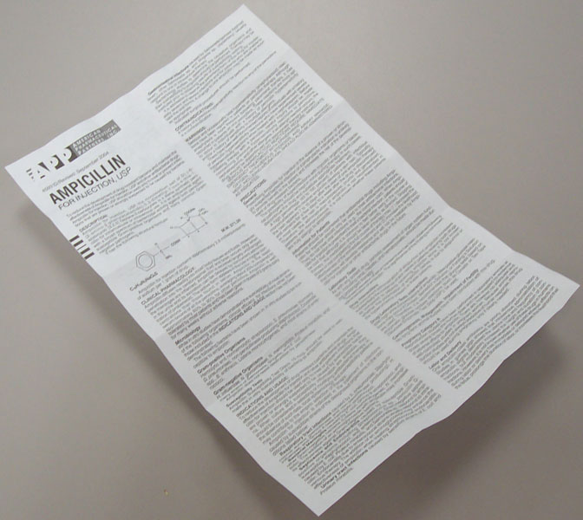
Prescription Drug Labeling
Known by several names including: “prescribing information” or “package insert”
Intended for Healthcare providers, but available to anyone
  May be several pages long in very small print
  Very technical language
Notes:
Per Food and Drug Administration (FDA) the acceptable names are: prescribing information, package insert, professional labeling, direction circular, package circular.
This information is intended for health professionals and is rarely given to the patient although it is readily available on line. Currently it consists of written document included in the medication box or attached to a container, but FDA is trying to change this to electronic format. Highly detailed information in technical language and in a standard format.
(Next Slide)

Slide 13
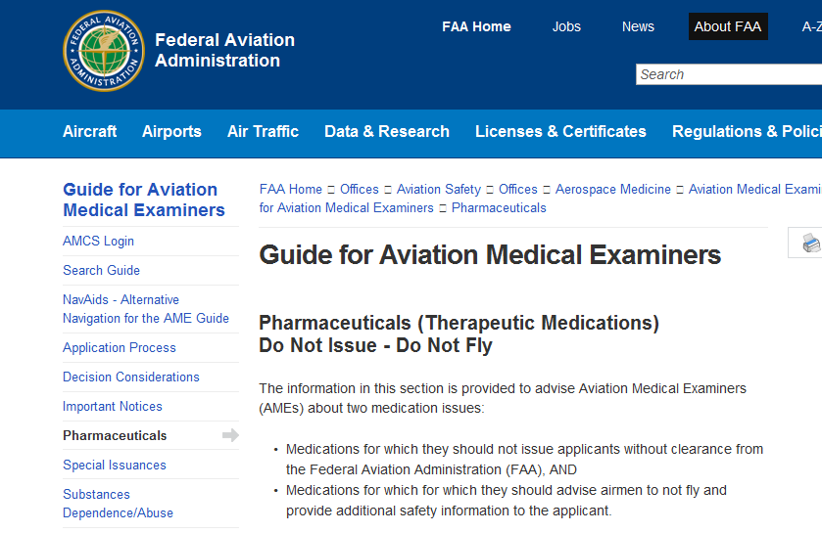
Do not issue - Do not fly
Notes:
The FAA maintains a list of many medications that should not be taken while in flight status Tahomay preclude the issuance of any medical certificate or. The lists of medications in this section are not meant to be all-inclusive or comprehensive, but rather address the most common concerns. The easiest way to access the list is to Search for “Do Not Issue – Do Not Fly”. You’ll be directed to the web page shown here.
There are other lists available to members of pilot organizations and to the public. If you don’t see your medication on the list or if you have any questions call your AME or Regional Flight Surgeon for the latest information. For your Regional Flight Surgeon search “Regional Flight Surgeon Contact Information”.
(Next Slide)

Slide 14
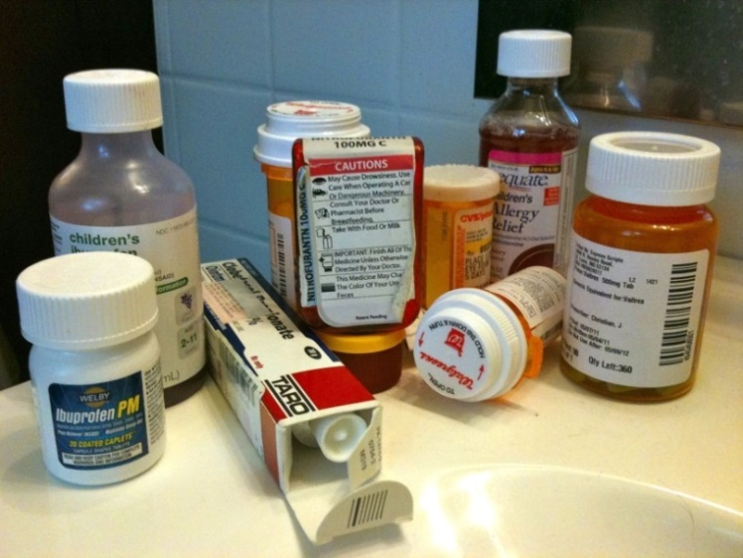
Combining Medications
Prescriptions with Prescriptions
  Does the Prescribing Provider know you fly?
  Does your AME know about all the medications you take and conditions you have?
Prescriptions with OTC
  Consult your AME and/or Regional Flight Surgeon
  and/or consult your Pharmacist
Notes:
Look into any medicine cabinet and you’re likely to find a mixture of OTC and prescription meds. Who’s responsible for assessing the affects and possible drug interactions? Making those assessments is something they don’t teach us in pilot school so this may also be a good time to seek some professional help. Before you do that though let’s talk about prescription drugs alone or in combination.
Does your prescribing doctor know you fly? Maybe a more suitable drug could be prescribed if your doctor knows you’re a pilot.
Even more importantly, does your AME know about all the drugs you take and the conditions for which you take them?
Combining prescription and OTC drugs introduces another challenge – the self medicating pilot. Once again it’s safer to consult your AME and/or pharmacist before adding OTC meds to your system.
We’re not going to address recreational drugs here. We all know that flying is about the best recreation there is. It’s not safe and not legal to fly under the influence.
We will look at one case from the GAJSC study though. We’ll discuss it with respect to the PAVE checklist that’s familiar to most if not all of us. I think you’ll find the case study illuminating.
(Next Slide)

Slide 15

FAA Clarifies Marijuana and CBD Policy
Positive tests of THC disqualify certain certifications
even if it is a trace from CBD products.
Cannabis remains illegal at the Federal level and US DOT continues to test for THC presence.
Commercial CBD products, not approved by the
FDA, may be mislabeled and contain detectible
levels of THC.
CBD oil is not accepted as an affirmative defense
against a positive drug test.
Notes:
Several states including have legalized the use of hemp and it’s derivatives such as CBD which is short for Cannabidiol, a chemical compound from the Cannabis plant, commonly referred to as marijuana.
Because of the popularity of CBD Products, the Federal Air Surgeon’s office received a number of inquiries about marijuana use. Although, not a prescription or over-the-counter drug, it is important to caution airman on the use of hemp or it’s derivatives as no allowances will be made by the FAA for pilots who wish to use cannabis medicinally.
(Next Slide)

Slide 16

LOC Case Study
Pilot
  Private Pilot
  Total Time ……975
  Time in type ….44
Aircraft
  TBM 700
NTSB Number
  MIA08FA141
Notes:
The case involved a private pilot with just under a thousand hours total time with 44 of those hours in the TBM 700.
(Next Slide)

Slide 17
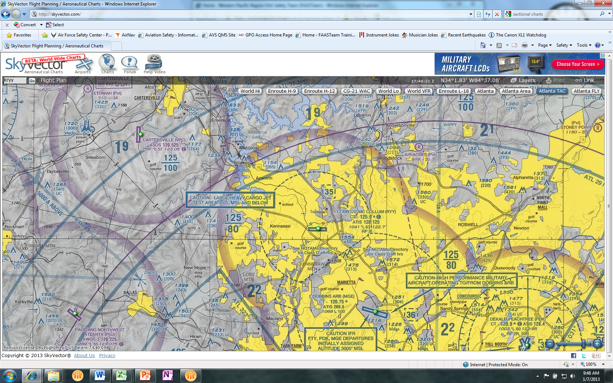
LOC Case Study
enVironment
  Cobb County Field, GA (KRYY)
  Runway 9/27 1078 MSL 6311x100’
  Final Approach to Runway 9
  Weather
    5,500 BKN, 10 SM
    Wind 120@6
Notes:
During approach to runway 9, at Cobb County Field near Atlanta, GA, the tower controller instructed the pilot to perform an “S” turn 3 miles from the runway. The pilot initiated the “S” turn to the left, and after turning back to the right towards the runway to complete the other half of the turn, the controller advised the pilot that he did not need to finish the maneuver, and could turn onto final approach. The last recorded ground speed was 89 knots when the pilot banked the airplane sharply to the left. Witnesses stated that the airplane seemed to do a wing over onto its back and go straight down.
Subsequent flight simulation tests revealed that while making a steep turn and not adding power, as the bank angle increased the airspeed would decrease and the airplane would enter an aerodynamic stall.
The National Transportation Safety Board determines the probable cause(s) of this accident as follows: The pilot’s failure to maintain airspeed during final approach resulting in an aerodynamic stall.
As an additional comment they also stated: “It is unclear what role, if any, the medication or the condition for which it might have been used played in the accident.”
(Next Slide)

Slide 18
Notes:
Here’s a larger view of the area.
The flight path is not to scale but you get the idea.
(Next Slide)

Slide 19

LOC Case Study
Toxicology Findings
  Alfuzosin
    Prostate
  Bisoprolol*
    Blood pressure
  Ezetimibe/Simvastatin*
    Cholesterol
  Quinine
    Unapproved use for Arthritis, Night Leg Cramps
  Tramadol
    For moderate to severe pain
*Known to AME and FAA
Notes:
Toxicology testing indicated that the pilot had been using tramadol, a prescription painkiller with potentially impairing effects. The pilot had not reported its use on his most recent application for airman medical certificate approximately 20 months prior to the accident. It is unclear what role, if any, the medication or the condition for which it might have been used played in the accident.
Alfuzosin – a medicine to reduce symptoms from and enlarged prostate, Bisoprolol – a beta-blocker for blood pressure control, Quinine – although not FDA approved it is taken by some for arthritis and nighttime leg cramps, Ezetimibe/Simvastatin – used to lower elevated blood cholesterol, and Tramadol – for moderate to severe pain, were found in the toxicology study. Tramadol carries a warning not to operate motor vehicles or potentially hazardous machinery. Of these only Bisoprolol and Ezetimibe/Simvastatin were known to the pilot’s Aviation Medical Examiner and the FAA.
The National Transportation Safety Board determined the probable cause(s) of this accident as follows: The pilot’s failure to maintain airspeed during final approach resulting in an aerodynamic stall.
As an additional comment they also stated: “It is unclear what role, if any, the medication or the condition for which it might have been used played in the accident.”
(Next Slide)

Slide 20

Tips
Consult your AME before flying while using prescription and/or OTC Drugs.
Make sure your AME knows about all the drugs you take and the medical conditions requiring their use.
Let your prescribing doctor know that you are a pilot
Ask about adverse effects associated with drug combinations.
In between doctor visits you’re self assessing your condition before each flight. Ground yourself when you’re not fit to fly.
Notes:
Finally – here are some tips for safe flying while taking prescribed or OTC medications.
Consult your AME before flying while using prescription and/or OTC Drugs.
Make sure your AME knows about all the drugs you take and the medical conditions requiring their use.
Let your prescribing doctor know that you are a pilot.
Ask about adverse effects associated with drug combinations.
In between doctor visits you’re self assessing your condition before each flight. Ground yourself when you’re not fit to fly.
(Next Slide)

Slide 21

Questions?
Special Thanks to:
  Jon M. Grazer, MD
  William J. Tsai, MD
  G. J. Salazar, MD, MPH
Notes:
Presentation Note: You may wish to provide your contact information and main FSDO phone number here. Modify with
your information or leave blank.
(Next Slide)

Slide 22
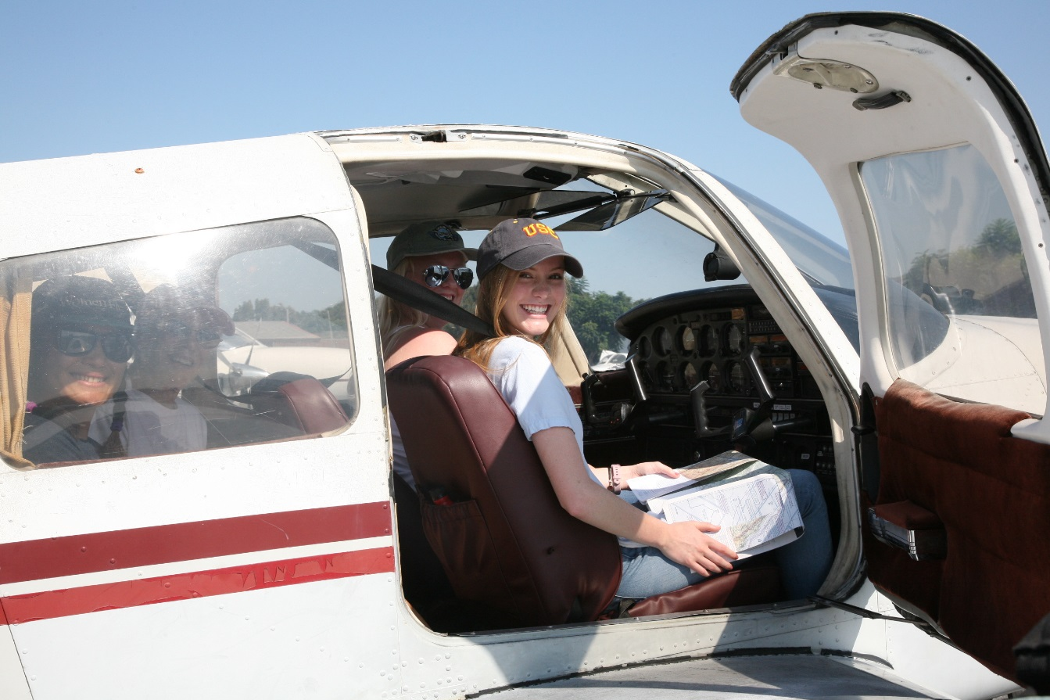
Have you earned your WINGS?
Proficient Pilots are:
  Confident
  Capable
  Safe
WINGS will keep you
on top of your game
Notes:
Have you earned your WINGS? Proficiency is key to success in almost every thing worth doing – especially flying. Proficient pilots are confident, capable, and safe.
WINGS is a proficiency training system specifically designed for general aviation pilots and, regular participation will keep you on top of your flying game.
(Next Slide)

Slide 23
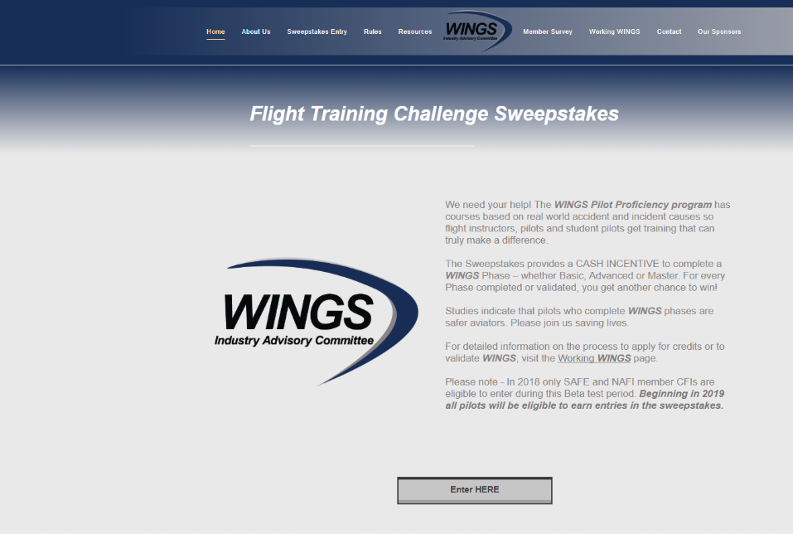
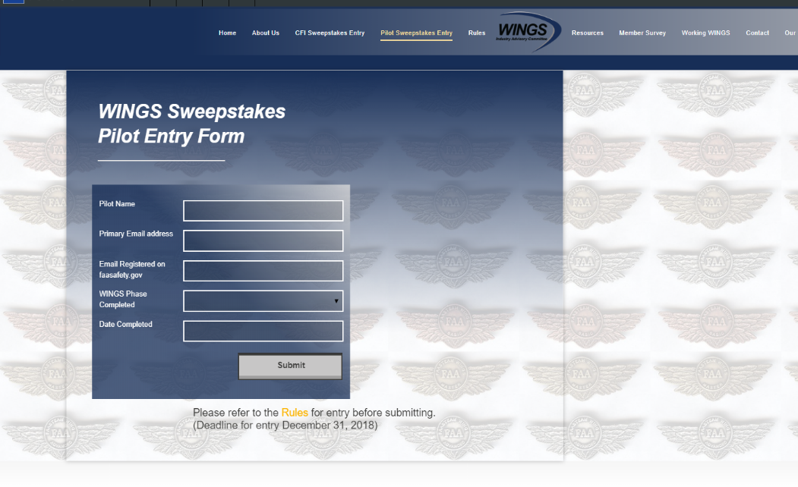
The Paul & Fran Burger 2019
WINGS $10,000 Sweepstakes
Complete WINGS Phases and WIN Cash Awards!
http://www.mywingsinitiative.org/
Notes:
Now there’s even more reasons to participate in WINGS. Every time you complete a WINGS Phase you’re eligible to win cash the WINGS Sweepstakes.
The sweepstakes is generously funded by Paul Burger, a long time advocate for general aviation safety and a retired aviator who believes participation in this program saves lives.
(Next Slide)

Slide 24

How To Win – It’s Easy
Whenever you complete a WINGS phase, select WINGS Sweepstakes on the Team Member Award section of your My WINGS page
Or Visit www.mywingsinitiative.org & click on “Sweepstakes Entry”
Complete the form, get chances to win one of 10 cash prizes!
Four $1,500, Four $750,Two $500 Winners
Notes:
After you’ve completed a phase of WINGS you can enter the sweepstakes by clicking on “Claim Rewards” in the “WINGS – at a glance” section of your My WINGS page and select WINGS Sweepstakes. Or you can go directly to the mywingsinitiative.org website to complete your entry form.
(Next Slide)

Slide 25
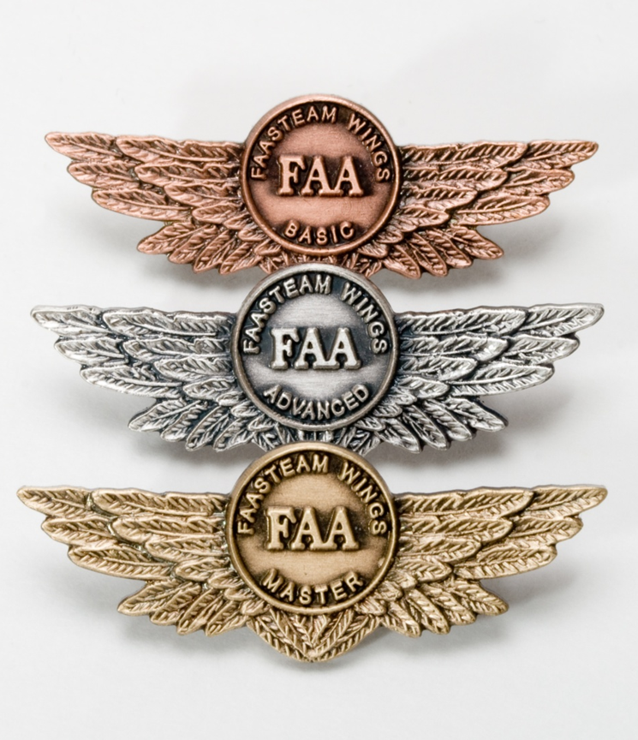
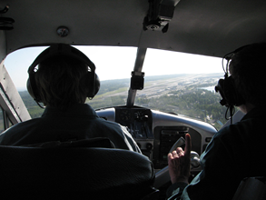
Proficiency and Peace of Mind
Fly regularly with your CFI
Perfect Practice
Document in WINGS
Notes:
There’s nothing like the feeling you get when you know you’re playing your A game and in order to do that you need a good coach (Click)
So fly regularly with a CFI who will challenge you to review what you know, explore new horizons, and to always do your best. Of course you’ll
have to dedicate time and money to your proficiency program but it’s well worth it for the peace of mind that comes with confidence. (Click)
Vince Lombardi, the famous football coach said, “Practice does not make perfect. Only perfect practice makes perfect.” For pilots that means
flying with precision. On course, on altitude, on speed all the time. (Click)
And be sure to document your achievement in the Wings Proficiency Program. It’s a great way to stay on top of your game and keep you flight review current.
(Next Slide)

Slide 26
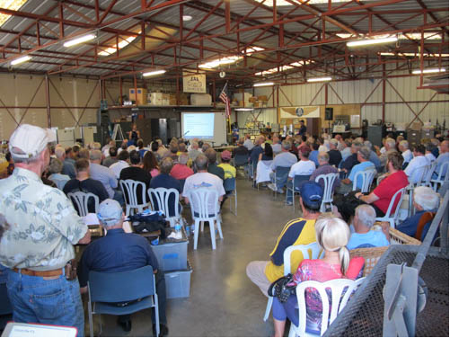
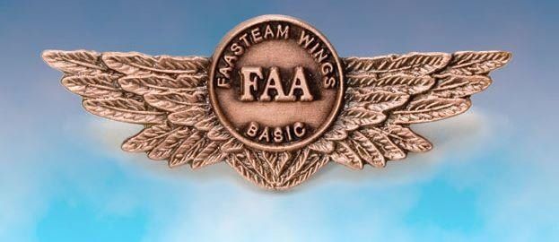
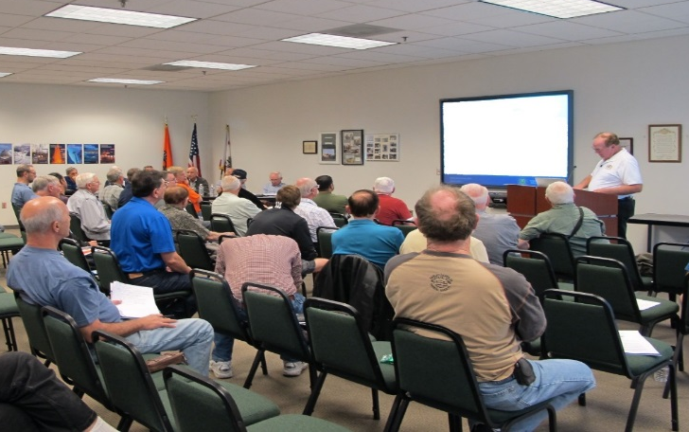

Thank you for attending
You are vital members of our GA safety community
Notes:
Your presence here shows that you are vital members of our General Aviation Safety Community. The high standards you keep and the examples you set are a great credit to you and to GA.
Thank you for attending.
(Next Slide)

Slide 27
The National FAA Safety Team Presents
Topic of the Month - October
Pilots and Medications
<Audience>
<Presenter>
< >
Notes:
(The End)

