Slide 1
The National FAA Safety Team Presents
Topic of the Month – March
Pilot Proficiency and WINGS
Notes:
2021/03-11-221(I)PP Original Author: John Steuernagle 03/17/2021; POC Kevin Clover AFS-850 Operations Lead, Office (562-888-2020 revised by (Name) (MM/DD/YYYY)
Presentation Note: This is the title slide for Pilot Proficiency and WINGS
Script - We have included a script of suggested dialog with most slides. The script will always appear in a non-italic font. Presenters may read the script or modify it to suit their own presentation style. See template slides 5 and 6 for examples of a slides with script.
Presentation Instructions - (stage direction and presentation suggestions) will be preceded by a Bold header: the instructions themselves will be in Italic fonts. See slides 2, for an example of slides with Presentation Instructions only.
Program control instructions - will be in bold fonts and look like this: (Click) for building information within a slide; or this: (Next Slide) for slide advance.
Background information - Some slides may contain background information that supports the concepts presented in the program. Background information will always appear last and will be preceded by a bold Background: identification.
The production team hope you and your audience will enjoy the show. Break a leg!
(Next Slide)

Slide 2
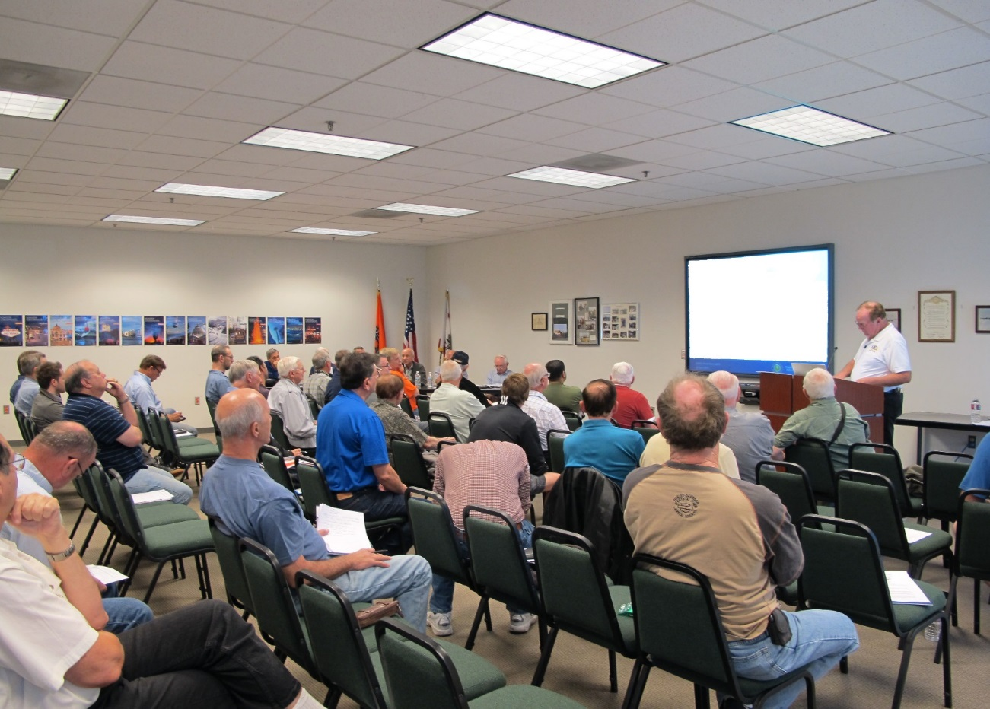
Welcome
Exits
Restrooms
Emergency Evacuation
Breaks
Phones & pagers to silent or off
Sponsor Acknowledgment
Other information
Notes:
Presentation Note: Here’s where you can discuss venue logistics, acknowledge sponsors, and deliver other information you want your audience to know in the beginning.
You can add slides after this one to fit your situation.
(Next Slide)

Slide 3
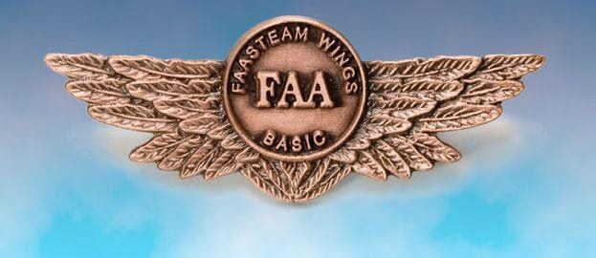
Overview
Top 5 reasons to be a WINGS Pilot
Getting started with WINGS
WINGS Topic of the Quarter
Notes:
Today’s presentation is all about WINGS – FAA’s Pilot Proficiency Program. We’ll begin with the top 5 reasons to be a WINGS Pilot
Next we’ll show how easy it is to get started on your personal Path to Proficiency.
And we’ll talk about the WINGS Topic of the Quarter Program.
So let’s get started with reason number five.
Presentation Note: If you’ll be discussing additional items, add them to this list.
(Next Slide)

Slide 4
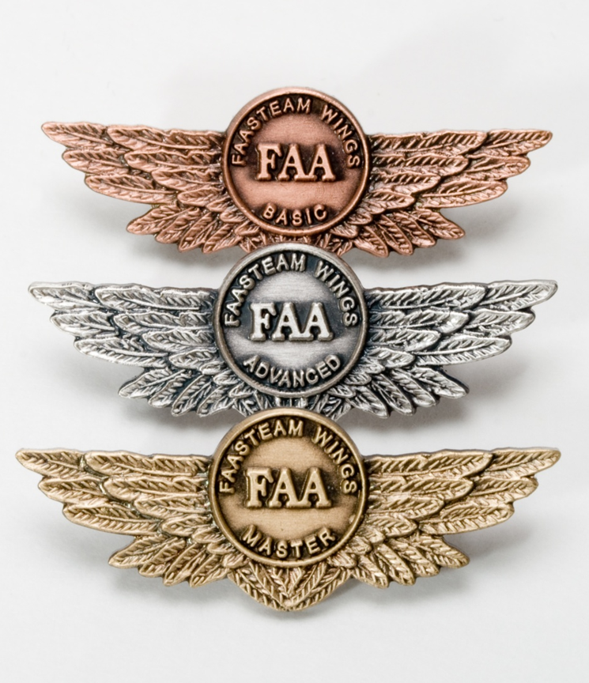
5. WINGS training yields awards
WINGS recognition
GA Safety Community
WINGS logbook
WINGS pin
WINGS rewards
WINGS insurance discounts
Notes:
Documented WINGS proficiency training earns awards. To be clear – we don’t choose proficiency training because it’s easy or because we’re looking for bling but it is nice to be recognized for our achievements. As a WINGS pilot you are recognized as a member in good standing of the General Aviation Safety Community. All of your WINGS training is permanently recorded in your online WINGS logbook and when you earn a WINGS phase you can receive a lapel pin. (Click)
Aircraft insurance carriers recognize the value of regular Proficiency Training and they may offer premium discounts to WINGS pilots. And there’s yet another reward opportunity for every pilot who earns a WINGS phase.
(Next Slide)

Slide 5
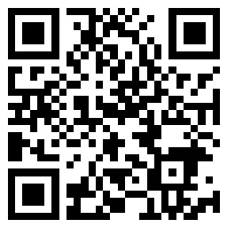
https://www.wingsindustry.com/WINGS-Sweepstakes
Notes:
Every time you complete a WINGS Phase you’re eligible to win cash the WINGS Sweepstakes.
The sweepstakes is generously funded by Paul Burger, a long time advocate for general aviation safety and a retired aviator who believes participation in this program saves lives. Visit www.wingsindustry.com to learn more and enter the sweepstakes.
Just navigate to https://www.wingsindustry.com/WINGS-Sweepstakes or scan the QR code for details. By the way, Instructors can also enter the sweepstakes. But there are even better reasons to participate in WINGS.
(Next Slide)

Slide 6
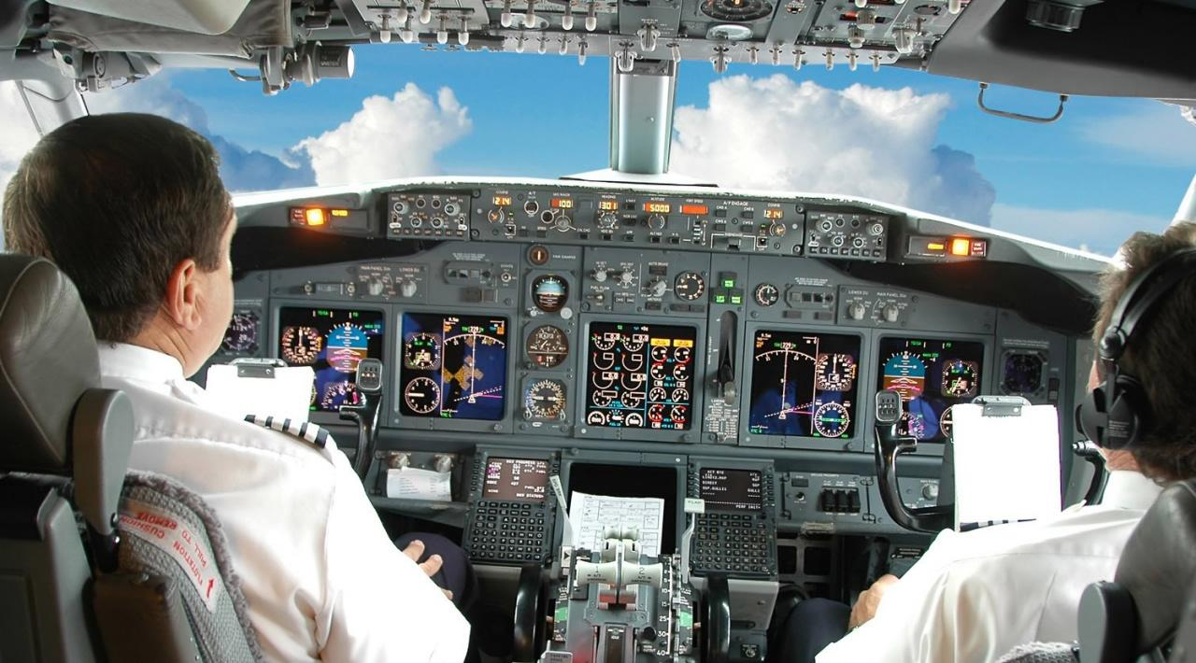
4. Proficiency training works!
Sports
Medicine
Aviation
Notes:
Reason number four – proficiency training works!
Can you imagine how well professional athletes would perform if they didn’t practice between games or stay in shape during the off season? (Click)
Would you choose to be treated by doctors who had no continuing education since graduating from medical school? (Click)
Or how about a professional pilot flight crew who never train for emergencies?
(Next Slide)

Slide 7
The Path to Proficiency
The path to proficiency doesn’t end with a check-ride. It continues throughout your flying career.
Notes:
Pros know that proficiency is not a destination but rather a journey that never ends. Regular training keeps them at peak performance every time they take to the air. Pilots who follow the Path to Proficiency are well aware of their capabilities and their limitations. They dedicate time and resources to training and practice. And they understand that continuing education through Proficiency Training is essential to keeping them on top of their game.
(Next Slide)

Slide 8
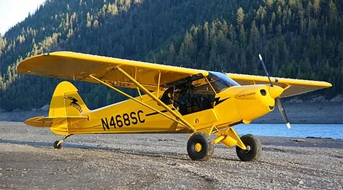
4. Proficiency training works!
Increases confidence
Increases comfort
Keeps us safe
Earning any WINGS phase qualifies for a Flight Review!
Notes:
Proficiency training works for General Aviation pilots too. WINGS is a proficiency training system specifically designed for GA pilots and, regular participation will keep you on top of your flying game. Pilots who participate in the FAA WINGS Pilot Proficiency program fly with more confidence. They and their passengers are comfortable in the air.
Most importantly - proficiency training keeps us safe. (Click)
And pilots who earn WINGS phases also qualify for a flight review.
(Next Slide)

Slide 9
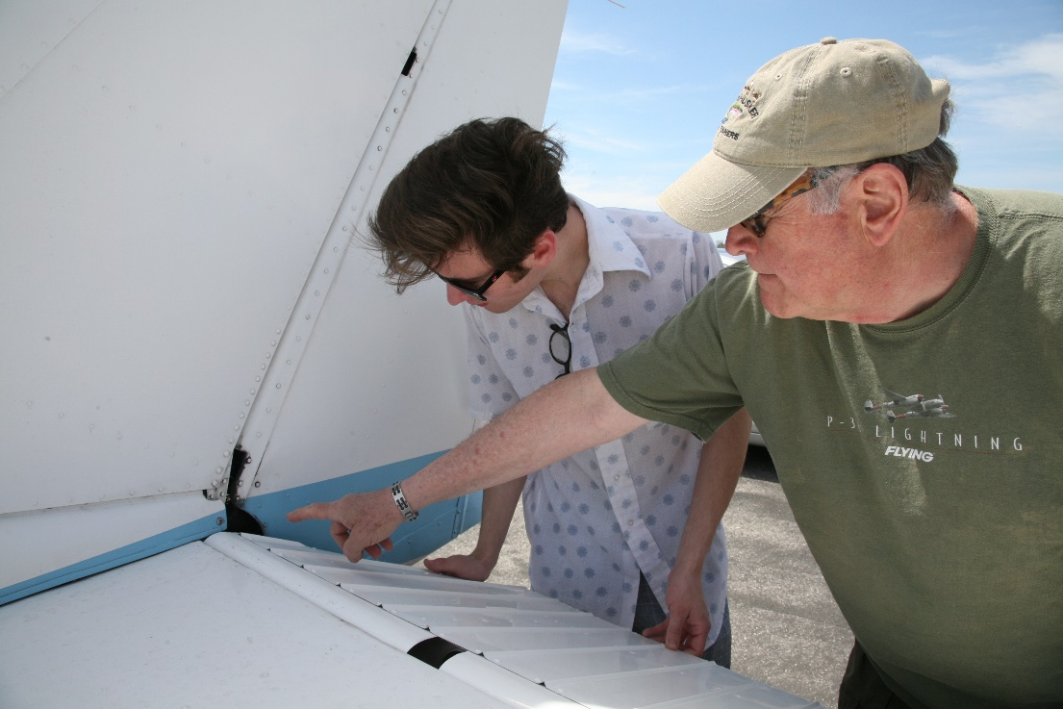
3. WINGS coaching gets results!
WINGS CFIs are:
Expert in the airplane
Familiar with the environment
Keen observers
Teachers
Motivators
Develop your Personal Minimums
Conditions for safe flight
Keyed to individual performance
Document and periodically review
Notes:
Reason number three – WINGS coaching gets results! Every profession relies on coaching to keep practitioners sharp. All Flight Instructors are trained in performance evaluation and critique and most make great coaches. WINGS Instructors are expert in your aircraft and the training environment. They are keen observers and teachers who will push you to excellence in flying. (Click)
Together you and your WINGS CFI can develop your Personal Minimums – A set of conditions, procedures, rules, criteria, and guidelines that help pilots to decide when it’s safe to fly. As the name implies, your Personal Minimums are unique to you and keyed to your demonstrated ability. In consultation with your coach, you’ll develop and document your personal minimums based on your individual performance. Pilot performance levels are not constant. They change over time and WINGS pilot performance continues to improve. WINGS training gives you regular opportunities to review and update your pilot performance profile and personal minimums but you need a reference point to start.
(Next Slide)

Slide 10
What’s your personal performance baseline?
Aircraft
Mission weight
Maximum wind experienced
In aircraft type
Airfield
Typical for mission
Seek local knowledge
Notes:
In order to establish personal minimums you need to have a baseline – think of it as your personal, documented, demonstration of performance. We suggest you document your performance at least once a year with a WINGS CFI. Try to pick a day when you can experience actual cross-wind conditions in the airplane you usually fly and loaded to your typical mission weight. Select an airfield that’s typical for the missions you fly. If you’re planning trips to a short, obstructed runway; try to find something similar to train on. Gather information about the destination airfield from pilots who’ve flown there and share that information with your instructor. That will help your CFI to construct realistic scenarios for you to fly.
(Next Slide)

Slide 11
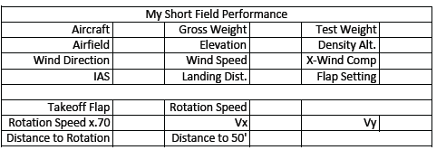
Defining your baseline?
Gold Seal
Notes:
Here’s a chart that some pilots use to document their wind, takeoff and landing performance. We’ll tell you where you can find this and other useful charts at the end of this program.
Once you’ve completed the chart you’ll have a performance baseline to work with. You can adjust the performance expectations to compensate for human factors such as stress and fatigue and you can also adjust your baseline as you gain experience and skill. If you want to adjust your baseline we strongly suggest that you do it with a WINGS CFI. That way you’ll have an objective assessment of your capabilities and your WINGS flight instructor can coach you with suggestions and instruction for improving your baseline performance.
(Next Slide)

Slide 12
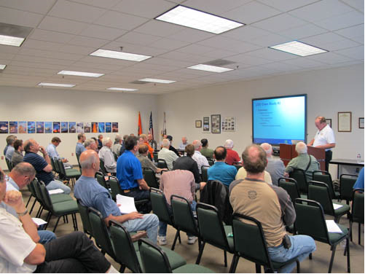
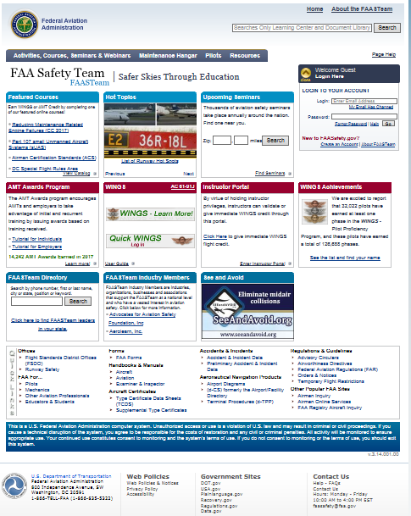
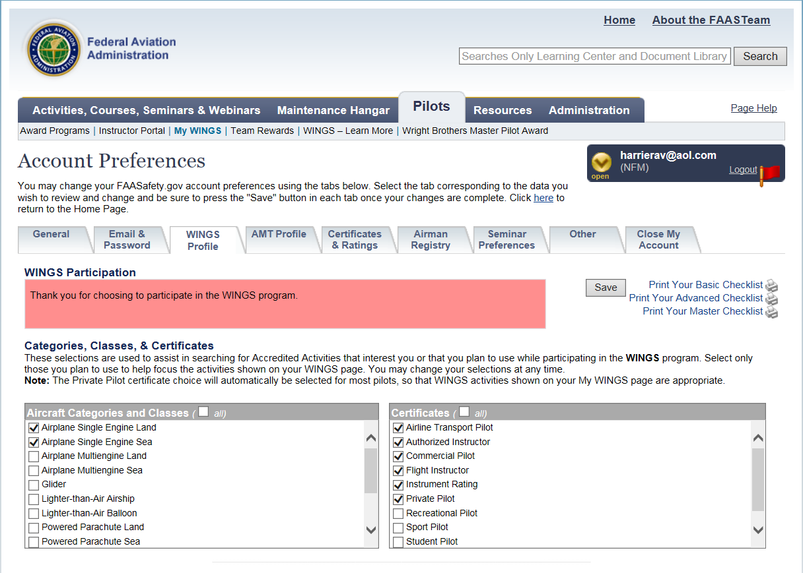
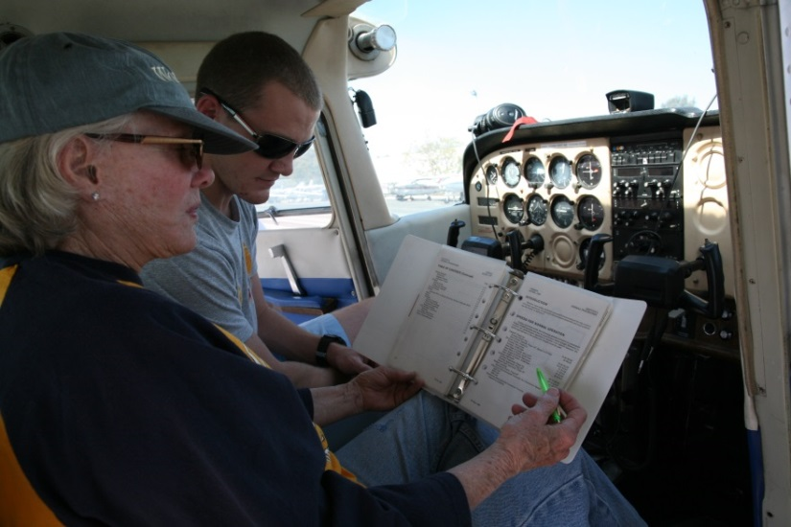
WINGS – easy as 1, 2, 3
Create an account on http://faasafety.gov
Complete your WINGS Pilot Profile
Attend a WINGS seminar or take a WINGS flight
Notes:
Getting started in WINGS is as easy as one, two, three.
Create an account on faasafety.gov
Complete your WINGS Pilot Profile
Attend a WINGS seminar or take a WINGS flight with your CFI.
(Next Slide)

Slide 13
Register for knowledge credits
Notes:
For seminars and webinars you can pre-register for credit on FAASafety.gov or, in the case of live seminars, you can register via the sign-in sheet at the seminar door.
(Next Slide)

Slide 14
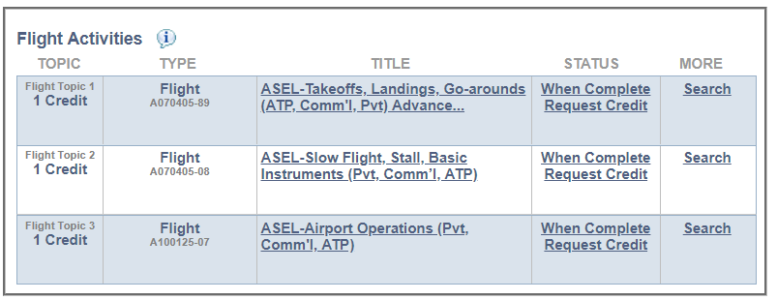
Request flight credits
Notes:
You’ll need to request credit for each flight activity with your CFI. It’s easy to do. Just go to your “My Wings” page and click on request credit after the activity has been completed.
(Next Slide)

Slide 15
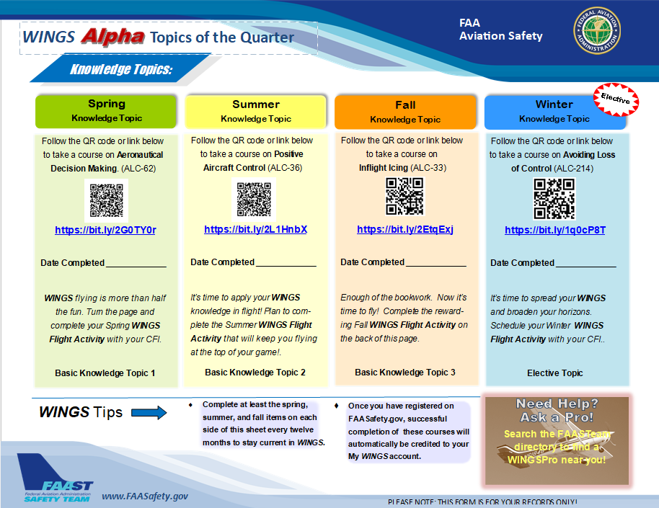
WINGS Topic of the Quarter
On line proficiency courses
Self-paced
Do it at home
Build solid decision making skills on the ground and in the air.
Notes:
Proficiency Training works best if it’s not done all at once, but rather spaced out at regular intervals. The WINGS Topic of the Quarter program consists of eight activities pursued over the course of one year. Because a full year’s proficiency is mapped out for you, It’s an excellent way to get started with WINGS.
Each quarter, WINGS Pilots take an on-line safety course. All courses are self-paced. Most take no more than an hour or two and they can be completed at home. Our online courses build solid decision making skills that you’ll employ on the ground and in the air.
(Next Slide)

Slide 16
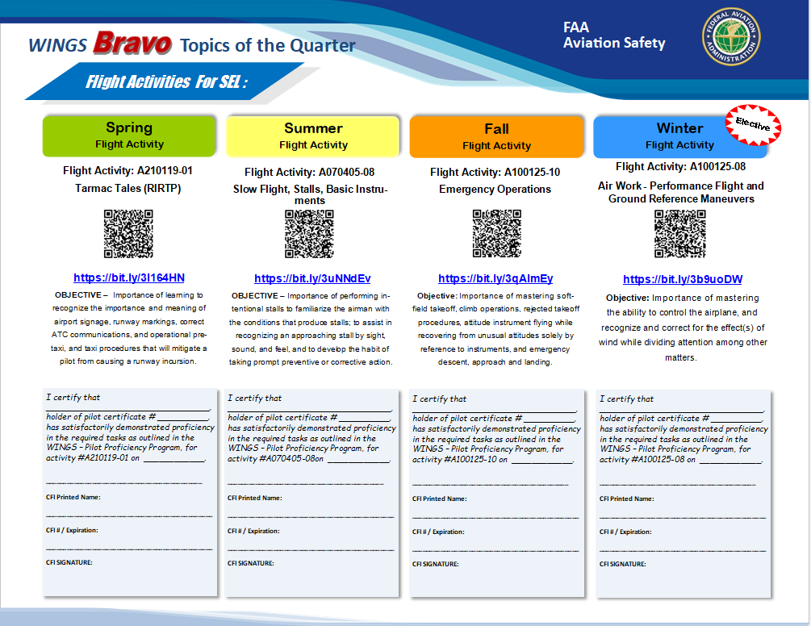
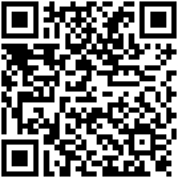
WINGS Topic of the Quarter
Rewarding Flight Activities
With your CFI
faasafety.gov\resources\library\WINGS
Notes:
Program participants also fly with a Flight Instructor to complete a WINGS Flight Activity at least once each quarter. (Click)
To access WINGS Topic of the Quarter Checklists and other WINGS information just navigate to FAASafety.gov. then click on Resources\Library\WINGS or scan the QR code on screen.
(Next Slide)
Background: You can access the FAASafety.gov library here: https://faasafety.gov/gslac/ALC/lib_categoryview.aspx?categoryId=39

Slide 17
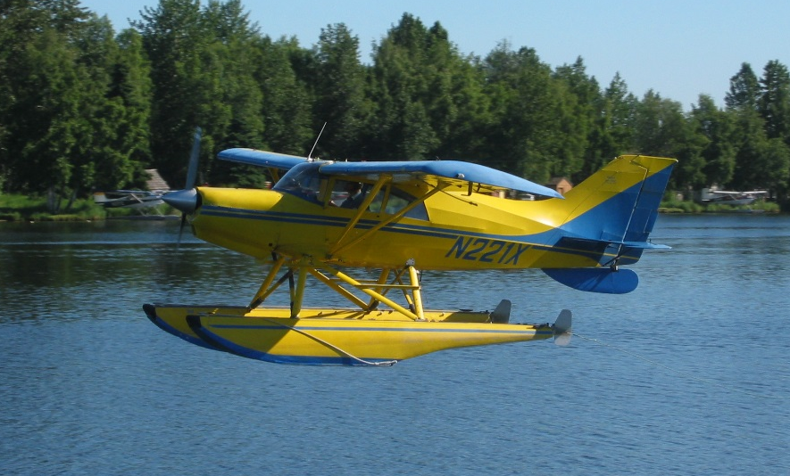
2. WINGS expands your horizons
Notes:
Number 2 – WINGS proficiency training expands your horizons.
Pilots usually think of proficiency training in terms of their usual aviation operations but if you’re willing to expand your horizons there are a host of options that go well beyond the hundred dollar hamburger to make proficiency flying more interesting. Twin engine, turbine, or instrument training can boost capability and confidence in cross country operations. Seaplane and tailwheel training are particularly satisfying for folks who learned in nose wheel airplanes.
And even if you don’t take on the challenges of another rating or airframe, there’s another great way to expand your horizons.
(Next Slide)

Slide 18
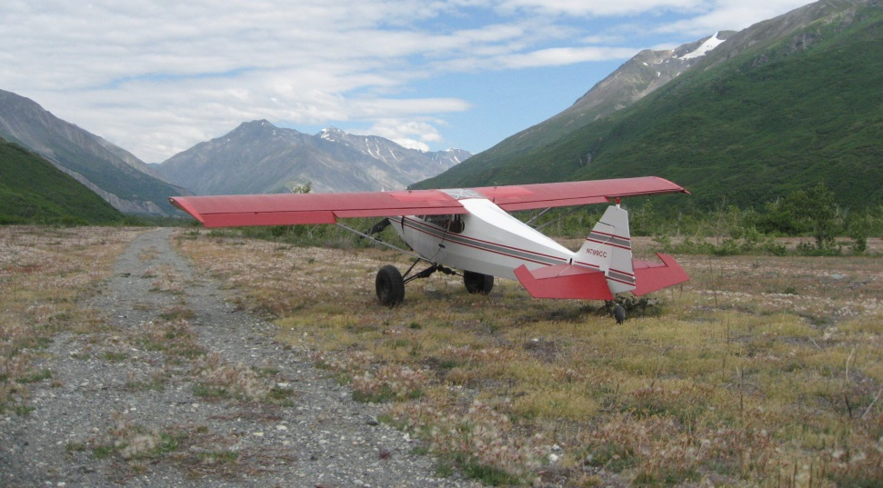
2. WINGS expands your horizons
Environmental training
Notes:
Training in new operational environments builds confidence too. If you learned to fly at a small country airport you’re probably very comfortable in a non-towered environment. How about a trip to a major metropolitan airport with your flight coach? The traffic and rapid pace of ATC communications can be daunting at first but mastering the environment can be very satisfying.
Likewise, big city pilots who are comfortable with busy towered operations can be overwhelmed when operating to non-towered or back country airstrips. Back country transition training can acquaint you with the nuances of rural environments and ensure your wilderness flying can be done safely.
(Next Slide)

Slide 19
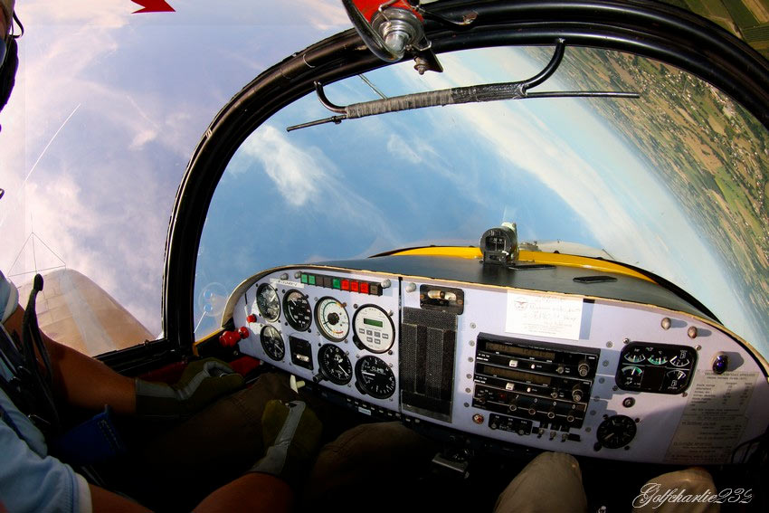
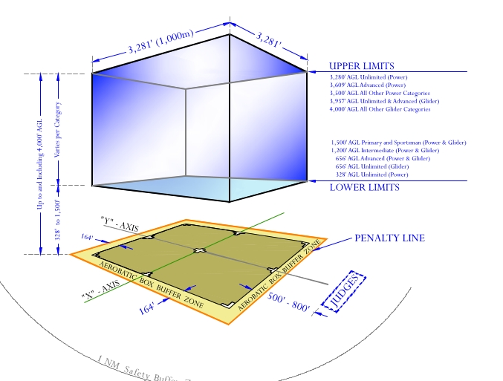
2. WINGS expands your horizons
Stall/Spin/Aerobatic training
Slow flight and stall review
Unusual attitude and Upset Maneuver training
Spin training
Basic and advanced aerobatic training
Notes:
A solid review of stalls, slow flight and spins is a great way to prevent loss of control accidents and it’s a natural stepping stone to aerobatic training. Once again WINGS CFIs can coach you to realize your maximum performance potential. Here’s a list of available training to consider:
Begin with a review of stalls and slow flight. This should be done at least annually to maintain peak performance.
Unusual attitude training and review are essential for VFR and Instrument pilots alike. Upset maneuver training includes unusual attitudes but may exceed typical unusual attitude pitch and bank values. Upset maneuver training is common in large airplane operations and includes over and under speed situations.
Spin training begins with incipient spin recognition and prevention and progresses to multiple-turn spins and precision recoveries.
Basic and advanced aerobatic training leverages all of your performance and progresses to competency and comfort in any aircraft attitude.
(Next Slide)

Slide 20
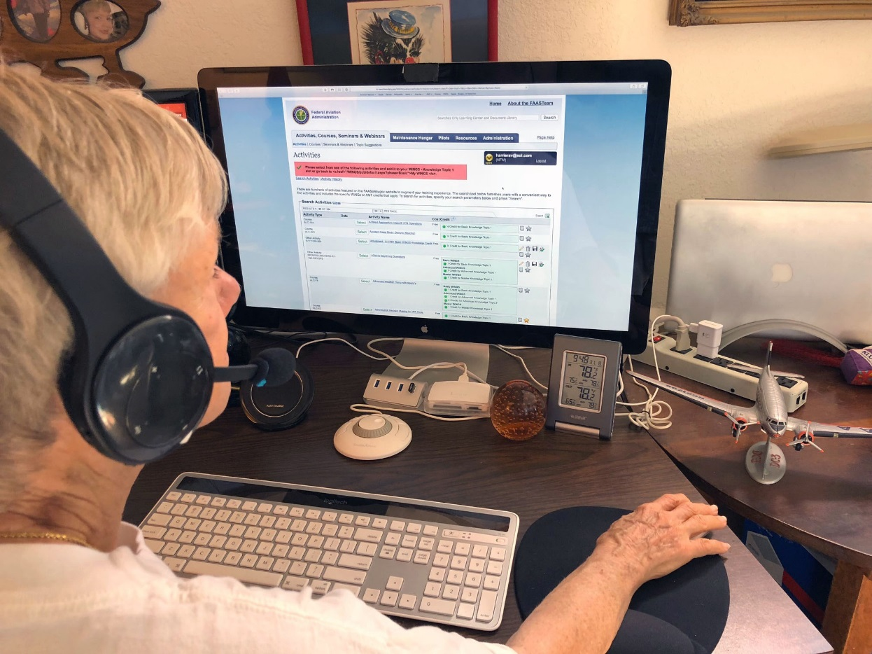
Need help with WINGS?
Contact your local WINGSPro
Or your FAASTeam Program Manager (FPM)
Notes:
WINGS is a robust proficiency training program that works for all pilot certification levels and all general aviation aircraft. As such, it can be a little intimidating at first. That’s why volunteer WINGSPros in your area are available to help you with anything related to WINGS. Here’s how to find your local WINGSPro(s).
Presentation note: You may want to introduce local WINGSPros in attendance and ask them to present this section.
(Next Slide)

Slide 21
Find your WINGSPro
Notes:
To find your local WINGSPros just navigate to FAASafety.gov. Hover over the resources tab and click on FAASTeam Directory.
(Next Slide)

Slide 22
Notes:
First select your region and district in this drop down box. (Click)
Next type WINGSPro in the key word box, (Click)
Then click on search. (Click)
Your WINGSPros will appear in the list below.
Presentation note: We suggest that you modify this slide with your local WINGSPro information.
(Next Slide)

Slide 23
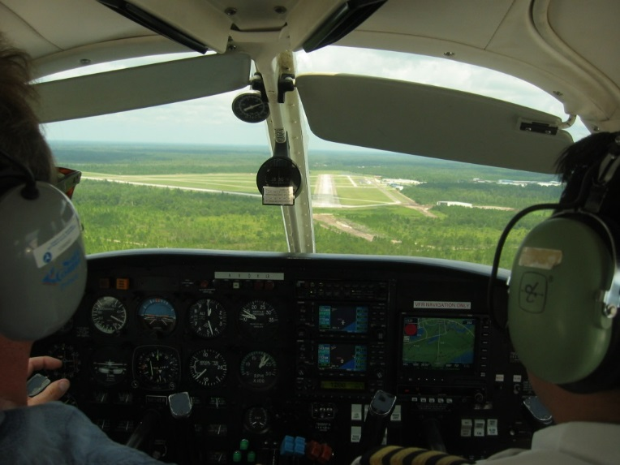
1. WINGS pilots are:
Competent
Confident
Safe
Notes:
Finally WINGS training yields Proficiency and Peace of Mind. There’s nothing like the feeling you get when you know you’re playing your A game and in order to do that you need good coaching. (Click)
WINGS pilots are Competent. They fly regularly with WINGS CFIs who challenge them to review what they know, explore new horizons, and to always do their best. Vince Lombardi, the famous football coach said, “Practice does not make perfect. Only perfect practice makes perfect”. For pilots that means flying with precision, on course, on altitude, on speed all the time. (Click)
WINGS pilots are Confident. They are well aware of their capabilities and their limitations. They are coached to exercise sound pre and in-flight risk management so they are rarely surprised by unanticipated conditions. Of course they must dedicate time and money to their proficiency programs but it’s well worth it for the peace of mind that comes with confidence. (Click)
And, most importantly; WINGS pilots and their passengers enjoy the benefits of safe flight operations every time they take to the air.
(Next Slide)

Slide 24
Why WINGS?
WINGS Training yields rewards!
WINGS Proficiency training works!
WINGS coaching gets results!
WINGS broadens your horizons!
1. WINGS pilots are:
Competent!
Confident!
Safe!
Notes:
So here they are again. The top 5 reasons to choose WINGS. Proficiency is key to success in almost every thing worth doing – especially flying. Proficient pilots are competent, confident, and safe.
(Next Slide)

Slide 25
References
FAASafety.gov
Information and enrollment for WINGS Pilot Proficiency Program
Off Airport Ops Guide
Baseline performance determination examples
https://www.faasafety.gov/gslac/ALC/libview_normal.aspx?id=135893
Personal Minimums Development Guide
https://www.faasafety.gov/gslac/ALC/lib_categoryview.aspx?categoryId=15&r_s=50&r_c=50
WINGS Information and Guidance
https://faasafety.gov/gslac/ALC/lib_categoryview.aspx?categoryId=39
Notes:
Here are a few references for additional information:
FAASafety.gov is the FAASTeam website where you’ll find a wealth of safety information. You can enroll and track your progress in the FAA WINGS Pilot Proficiency Program here.
Look in the FAASafety.gov library for the Off Airport Operations Guide. In it you’ll find instructions for developing a short field performance baseline together with other useful information on operating to small fields.
Also in the FAASafety.gov Library – the Personal Minimums Development Guide – Your documented proficiency performance can be used to develop minimums that are tailored to you, your aircraft, and your mission.
The Library also contains additional WINGS Information and Guidance
I’ll leave this slide on screen while I take some questions from the audience.
Presentation note: Take questions from the audience while they copy information from the screen. Then:
(Next Slide)

Slide 26
Questions?
Notes:
Presentation Note: You may wish to provide your contact information and main FSDO phone number here. You can also add WINGSPro contact information.
Modify with your information or leave blank.
(Next Slide)

Slide 27
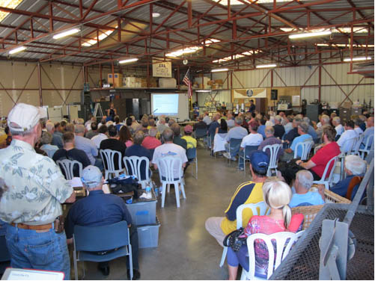
Thank you for attending
You are vital members of our GA safety community
Notes:
Your presence here shows that you are vital members of our General Aviation Safety Community. The high standards you keep and the examples you set are a great credit to you and to GA.
Thank you for attending.
(Next Slide)

Slide 28
The National FAA Safety Team Presents
Topic of the Month – March
Pilot Proficiency and WINGS
Notes:
(The End)

