Slide 1
The National FAA Safety Team Presents
Topic of the Month – December
Aircraft Performance Calculation
<Audience>
<Presenter>
< >
Notes:
2022/03-14-245(I)PP Original Author: John Steuernagle; POC Kevin Clover, AFS-850 Operations Program Manager, Office 562-888-2020
Presentation Note: This is the title slide for Aircraft Performance Calculation
Script - We have included a script of suggested dialog with most slides. The script will always appear in a non-italic font. Presenters may read the script or modify it to suit their own presentation style. See template slides 5 and 6 for examples of a slides with script.
Presentation Instructions - (stage direction and presentation suggestions) will be preceded by a Bold header: the instructions themselves will be in Italic fonts. See slides 2, 3, and 4 for examples of slides with Presentation Instructions only.
Program control instructions - will be in bold fonts and look like this: (Click) for building information within a slide; or this: (Next Slide) for slide advance.
Background information - Some slides may contain background information that supports the concepts presented in the program. Background information will always appear last and will be preceded by a bold Background: identification.
The production team hope you and your audience will enjoy the show. Break a leg!
(Next Slide)

Slide 2
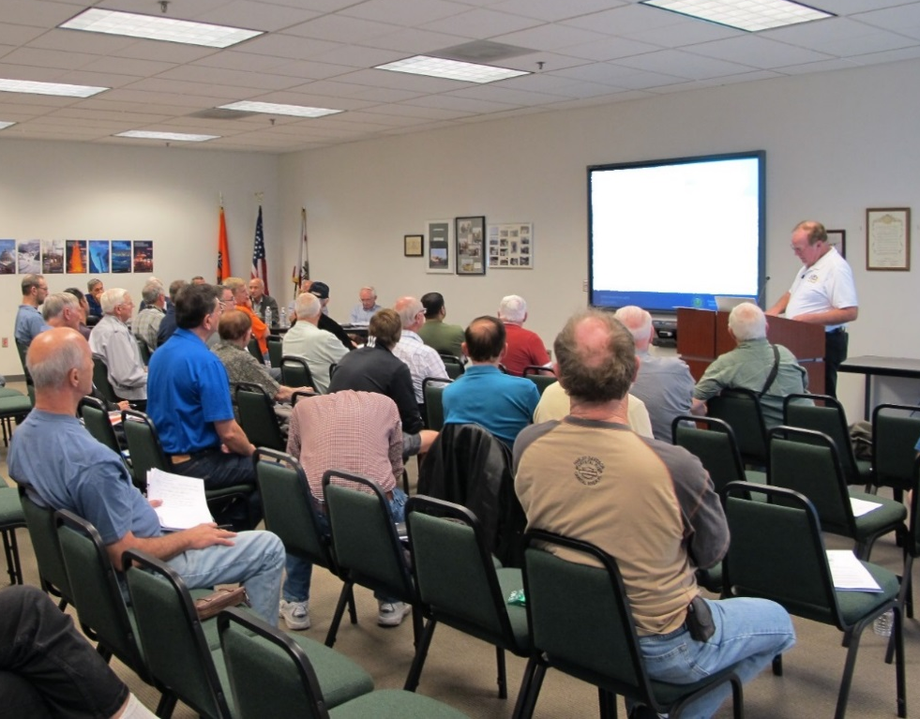
Welcome
Exits
Restrooms
Emergency Evacuation
Breaks
Sponsor Acknowledgment
Set phones and pagers to silent or off
Other information
Notes:
Presentation Note: Here’s where you can discuss venue logistics, acknowledge sponsors, and deliver other information you want your audience to know in the beginning.
You can add slides after this one to fit your situation.
(Next Slide)

Slide 3
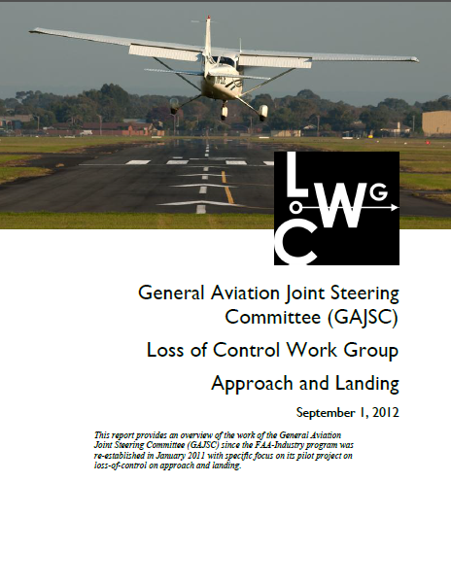
Overview
Aircraft Performance Awareness
*GAJSC safety enhancements
Human Solutions
Technology Solutions
Recommendations
*GAJSC – General Aviation Joint Steering Committee
Notes:
In this presentation we’ll talk a little bit about aircraft performance and how faulty performance expectations have led to accidents.
We’ll cite General Aviation Joint Steering Committee accident studies and safety enhancements that relate to aircraft performance.
We’ll offer some human and some technology-centered performance calculation solutions
And finally, we’ll give you our recommendations for increased aircraft performance awareness
Presentation Note: If you’ll be discussing additional items, add them to this list
(Next Slide)

Slide 4
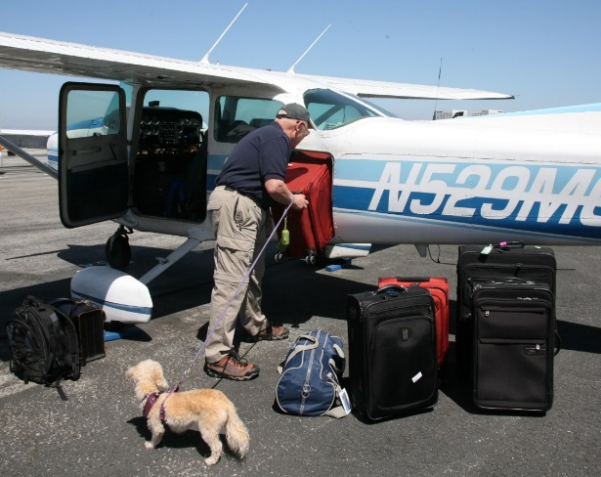
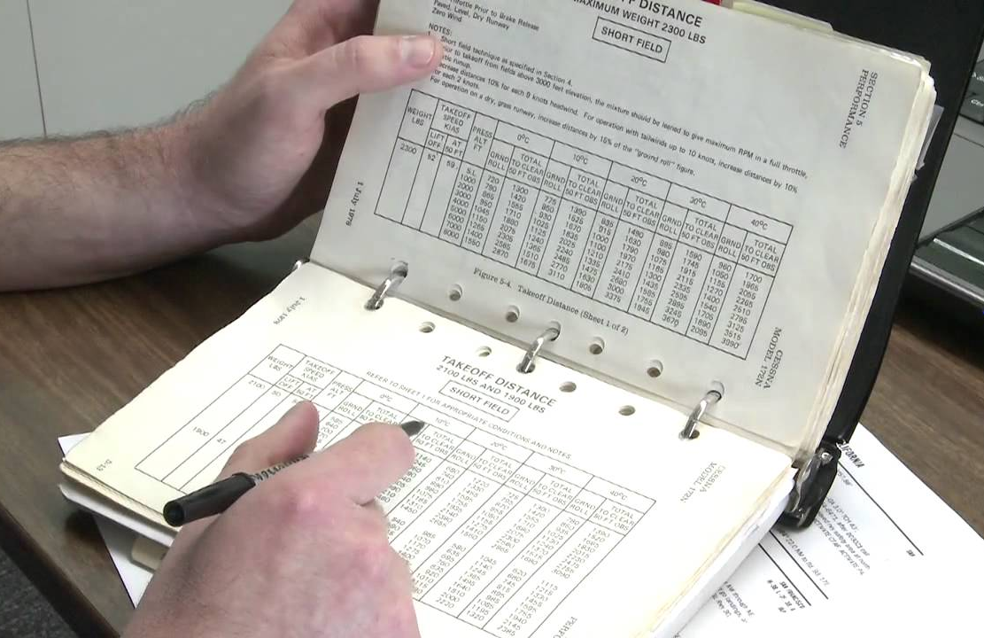
How often have you heard….
She’ll haul anything you can fit in the door
Relax - It flew in here – it’ll fly out
We’ve got plenty of fuel
Notes:
How often have you heard these statements. You may even have said them yourself. Each of these statements relates to aircraft and pilot performance expectations.
Occasionally, in the course of accident investigation, we discover that those expectations were unreasonable.
In order to be confident in their performance predictions, pilots need to process some information before taking off. Some of the information is available in the POH and some
is derived through calculations.
(Next Slide)

Slide 5
Pilots need to know
Weight and Balance calculations
Takeoff weight and CG location
Don’t guess – weigh it!
Location, location, location
Objects may shift ……
Notes:
Here we see a lot of luggage and a small plane. This pilot might find a way to get all the baggage inside the plane but can the aircraft meet his performance expectations
while carrying this load? What are some of the things that pilots need to know to answer the question? (Click)
Weight and balance limitations come immediately to mind. Are the takeoff weight and center of gravity within acceptable limits? Let’s face it; many pilots haven’t done a weight and balance calculation in years but, especially if you’re going to be operating near max gross weight, you’ve got to know how much your plane, fuel, passengers, and luggage weighs. (Click)
This is not a good time to estimate weight. Don’t guess – weigh it. (Click)
Where you distribute that weight matters. Make sure you’re well within the center of gravity envelope. Too far aft and you’re inviting a stall – too far forward and you may get a nasty surprise when you try to flare for landing. (Click)
One more thing – make sure your cargo is secure. Use a cargo net, cargo straps, and seat belts to make sure your cargo stays put throughout the flight.
(Next Slide)

Slide 6
Pilots need to know
Takeoff and climb calculations
Density Altitude
Runway length, composition, condition, and slope
Obstacle clearance
Aircraft configuration
Normal, short field, soft field
Notes:
Well we’ve made our weight and balance calculations and adjusted our loading to be within limits but there’s more work to be done.
Before we take off we need to know what sort of performance to expect and, more importantly, what to do if we don’t get it.
We’ll need to determine density altitude. That figure will be used to refine our takeoff and climb performance calculations.
We’ll also have to know how much runway we have available for takeoff – and for landing if we have to return to the field. Is the runway paved, grass, gravel, or mud?
Is it contaminated with snow or water. These considerations will help us to choose a normal, short-field, or soft-field takeoff configuration and technique. Once that’s decided we can get into the POH to determine how much distance will be required to takeoff and climb over any obstacles on the departure path.
We’re getting close but there’s still more to be done before we launch.
(Next Slide)

Slide 7
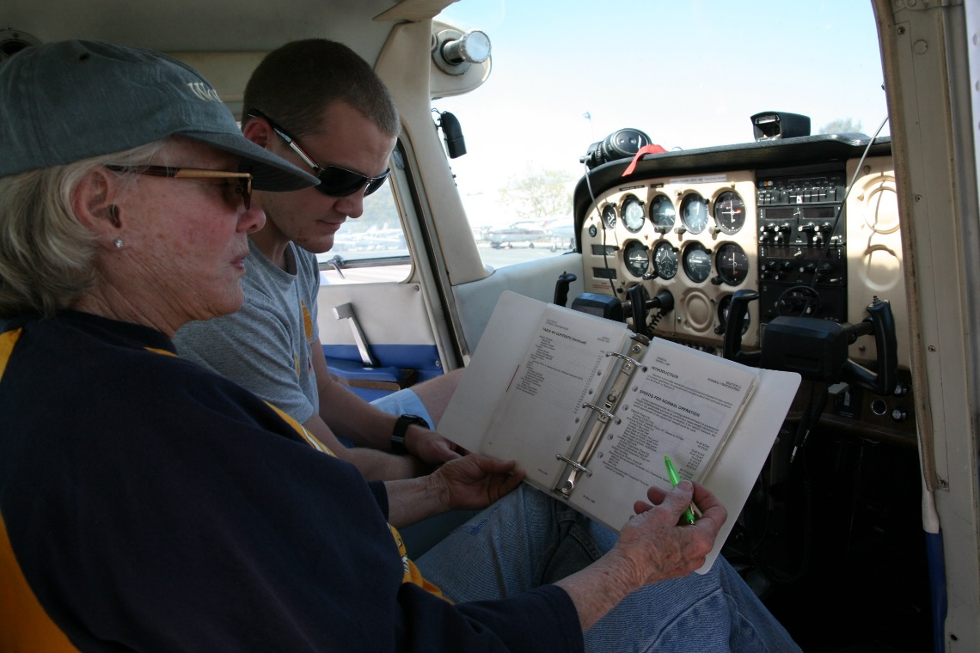
Pilots need to know
Takeoff and departure calculations
Rejected takeoff decision point
50/70 rule
60 Kts or Mph rotation speed
60 x 70% = 42
2,200 ft. available
2,200 x 50% = 1,100
Terrain and obstructions
Forced landing opportunities
Notes:
Now that we know how much runway we need it’s time to consider what will happen if we have to abort the takeoff. The 50/70 rule of thumb will be helpful here.
The rule goes like this. If you haven’t attained seventy percent of your flying speed by the time you’re half way down the available runway it’s time to abort the takeoff. Whether you’re working with knots or miles per hour the math is the same. If your takeoff speed is 60 – 70 percent of that number is 42. Assuming you have 2,200 feet of runway available, you need to see 42 knots or miles per hour at the half-way point on the runway. Obviously – if you have eight to ten thousand feet of runway to work with, you can delay your abort decision. (click)
We should also be mindful of terrain elevation and obstructions along our departure plan. They may dictate our departure path. (click)
and while we’re looking at terrain we should identify forced landing opportunities near the field.
(Next Slide)

Slide 8
Pilots need to know
Return to airport decision criteria
Loss of control accidents are usually fatal
Go/No-go – what’s your number?
Determine with a CFI
In each airplane you fly
At operational weight at altitude
Consider Startle Response
3-second delay
Brief return to airport criteria for each takeoff
Notes:
This topic is extremely controversial and a comprehensive discussion would take more than an hour. We’ll just cover some of the most important points here.
Every year we see accidents resulting from Loss of Control after pilots decide to return to the airport in response to emergencies during takeoff or climb out. More often than not a partial or complete loss of power prompts the decision to return to the field. (click)
Loss of Control accidents are usually fatal and these are no exception to the rule. That’s why it’s imperative for pilots to understand all the factors involved and commit to the appropriate course of action before the need arises. (click)
The question of course is; Is it safer to land straight ahead or to return to the airport for landing. We know that, if we have three to five thousand feet of altitude to work with, returning to the airport should be no problem. We also know that there’s a number below which it’s just too dangerous to turn back. The problem is that most of us don’t know what that number is.
The safe way to find your number is to work at altitude with your Flight Instructor. Simulate power loss on climb out and see how much altitude is lost in a 200 degree turn. We say 200 degrees because, if the power loss occurs while you’re on runway heading, a 180 degree likely won’t get you aligned with the runway. Do this exercise at your typical operational weight and wait approximately 3 seconds after the simulated power loss to begin maneuvering. This delay is necessary because humans typically don’t react immediately to startling events.
They take a few moments to process the event before taking action.
(Next Slide)

Slide 9
Pilots need to know
Cruise performance
Power setting & fuel consumption
Altitude, wind, & ground speed
En route fuel availability
Notes:
Having enough fuel for every flight or landing to refuel en route should be a no brainer but pilots still make off airport landings due to running out of gas. So lets consider what pilots need to know in order to predict cruise performance.
We’ll need to consult the POH for power setting and fuel consumption information at our planned cruising altitude. The winds aloft forecast will give us information from which we can calculate our expected ground speed. Factor in time to climb, approach, and land plus not less than 30 minutes reserve and you’ll have a good idea of how much fuel you’ll need.
Keep abreast of your fuel state while en route and be sure to check en route fuel availability before you launch.
(Next Slide)

Slide 10
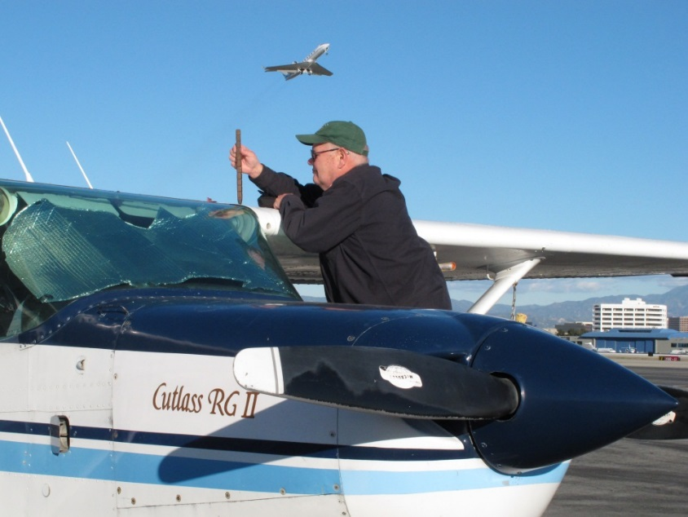
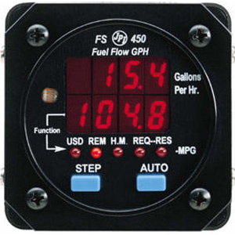
Pilots need to know
Cruise performance
Power setting & fuel consumption
Altitude, wind, & ground speed
En route fuel availability
Notes:
By the way – unless they’re reading empty, aircraft fuel gauges give at best, an approximation of how much fuel you have on board. Fuel flow computers give a much better picture but most require pilots to input fuel quantity so starting with the right fuel state is paramount. Regardless of how you’re equipped, It’s a good practice to double check fuel quantity when you’re launching with less than full tanks.
(Next Slide)

Slide 11
Recommendations:
Gold Seal
Be aware of en route fuel state
Confirm “time in your tanks” hourly
Don’t wait to land & refuel
Too easy to press on
Don’t land with less than one hour of fuel
You’ll always have VFR reserves
Notes:
Here are some gold seal best practices that are recommended for all pilots (Click)
It’s essential to keep track of your available fuel. Hourly – or whenever you switch tanks – calculate how long you can fly with your remaining fuel. Compare that to your predicted time to destination. If it looks as if you’re going to dip into your fuel reserve, it’s time to plan an en route fuel stop. (Click)
Don’t wait till your close to your destination to refuel. The closer you get – the more you’ll be tempted to continue on your reserve fuel supply. (Click)
Many pilots plan their flights so that they never land with less than one hours’ fuel in their tanks. That way they know they always meet VFR fuel reserve requirements. Whether or not this practice meets IFR reserve requirements depends on how far it is to your alternate airport.
(Next Slide)

Slide 12
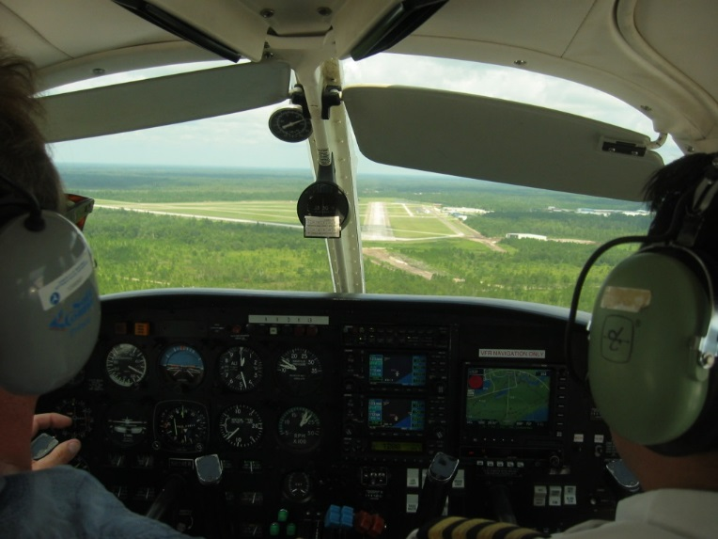
Recommendations:
Gold Seal
Brief each takeoff, approach, and landing
Runway and available distance for takeoff or landing
Aircraft configuration and target airspeeds
Rejected takeoff or landing decision point
Departure/approach path
Return to airport altitude
Forced landing opportunities
Notes:
Briefing each and every takeoff, approach, and landing is another gold seal best practice. Vocalizing important points and procedures just before takeoff or landing keeps them uppermost in your mind where they’re available for ready reference if something unforeseen happens. (Click)
Brief the assigned runway and available distance for takeoff or landing. Include aircraft configuration and target airspeeds. Vocalize your rejected takeoff or go-around decision point.
Include the departure or approach path and the altitude below which you’ll not attempt a return to the airport.
Finally, brief forced landing opportunities close to the airport.
(Next Slide)

Slide 13
Questions?
Notes:
Presentation Note: You may wish to provide your contact information and main FSDO phone number here. Modify with your information or leave blank.
(Next Slide)

Slide 14
Have you earned your WINGS?
Proficient Pilots are:
Confident
Capable
Safe
WINGS will keep you on top of your game
Notes:
Have you earned your WINGS? Proficiency is key to success in almost every thing worth doing – especially flying. Proficient pilots are confident, capable, and safe.
WINGS is a proficiency training system specifically designed for general aviation pilots and, regular participation will keep you on top of your flying game.
(Next Slide)

Slide 15
http://www.mywingsinitiative.org/
Notes:
Every time you complete a WINGS Phase you’re eligible to win cash in the WINGS Sweepstakes.
The sweepstakes is generously funded by Paul Burger, a long time advocate for general aviation safety and a retired aviator who believes participation in this program saves lives. VISIT WWW.MYWINGSINITATIVE.ORG to learn more and enter the sweepstakes.
Just navigate to http://www.mywingsinitiative.org or scan the QR code for details. By the way, Instructors can also enter the sweepstakes. But there are even better reasons to participate in WINGS.
(Next Slide)

Slide 16
How To Win – It’s Easy
Whenever you complete a WINGS phase, select WINGS Sweepstakes on the Team Member Award section of your My WINGS page
Or Visit www.mywingsinitiative.org & click on “Sweepstakes Entry”
Complete the form, get chances to win one of 10 cash prizes!
Four $1,500, Four $750,Two $500 Winners
Notes:
After you’ve completed a phase of WINGS you can enter the sweepstakes by clicking on “Claim Rewards” in the “WINGS – at a glance” section of your My WINGS page and select WINGS Sweepstakes. Or you can go directly to the mywingsinitiative.org website to complete your entry form.
(Next Slide)

Slide 17
Safety Management Systems (SMS) Coming to General Aviation
https://www.faa.gov/about/initiatives/gasafetyoutreach
Notes:
Safety Management Systems are a set of policies and processes that can increase the safety and efficiency of any flight operation. And FAA is bringing SMS to General Aviation. You may have heard of SMS but thought it was only for large organizations but actually SMS can be scaled to fit any operation large or small.
There are 4 major components to a Safety Management System (Click)
Safety Policy – a documented commitment to safety that runs from the head of an organization to its newest member. (Click)
Safety Risk Management – a process that identifies hazards within an operation, determines to what extent an identified hazard may impact flight safety, and controls the risk of occurrence to an acceptable level. (Click)
Safety Assurance – By collecting and analyzing information derived from safety performance data Safety Assurance ensures the performance and effectiveness of Safety Risk Controls. (Click)
Safety Promotion communicates safety information and commitment throughout the organization. (Click)
You can find more information about Safety Management Systems at the URL on the Screen.
(Next Slide)

Slide 18
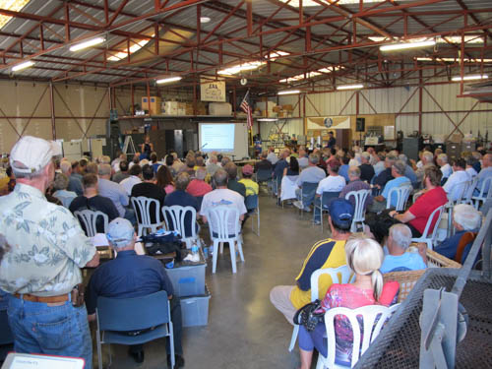
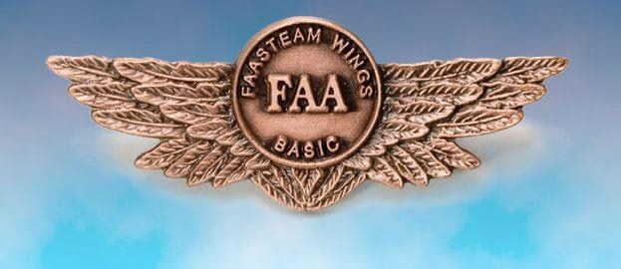
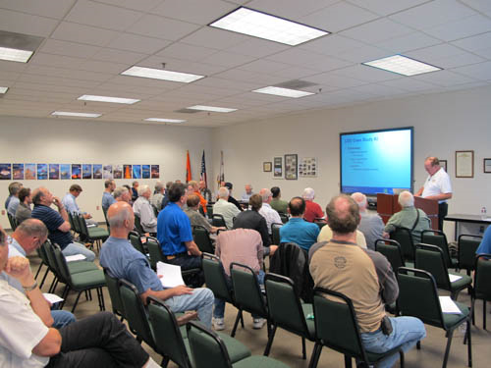
Thank you for attending
You are vital members of our GA safety community
Notes:
Your presence here shows that you are vital members of our General Aviation Safety Community. The high standards you keep and the examples you set are a great credit to you and to GA.
Thank you for attending.
(Next Slide)

Slide 19
The National FAA Safety Team Presents
Topic of the Month – December
Aircraft Performance Calculation
<Audience>
<Presenter>
< >
Notes:
(The End)

