Slide 1
The National FAA Safety Team Presents
Topic of the Month July
Fly the Aircraft First
<Audience>
<Presenter>
< >
Notes:
2022/03-17-252(I)PP Original Author: J. Steuernagle March 2017 POC: K. Clover, National FAASTeam Program Mgr. (Operations) Office 562-888-2020 Revised by: J. Steuernagle May 2022
Presentation Note: This is the title slide for Fly the Aircraft First
Script - We have included a script of suggested dialog with most slides. The script will always appear in a non-italic font. Presenters may read the script or modify it to suit their own presentation style.
Presentation Instructions - (stage direction and presentation suggestions) will be preceded by a Bold header: the instructions themselves will be in Italic fonts. See slides 2, for an example of slides with Presentation Instructions only.
Program control instructions - will be in bold fonts and look like this: (Click) for building information within a slide; or this: (Next Slide) for slide advance.
Background information - Some slides may contain background information that supports the concepts presented in the program. Background information will always appear last and will be preceded by a bold Background: identification.
The production team hope you and your audience will enjoy the show. Break a leg!
(Next Slide)

Slide 2
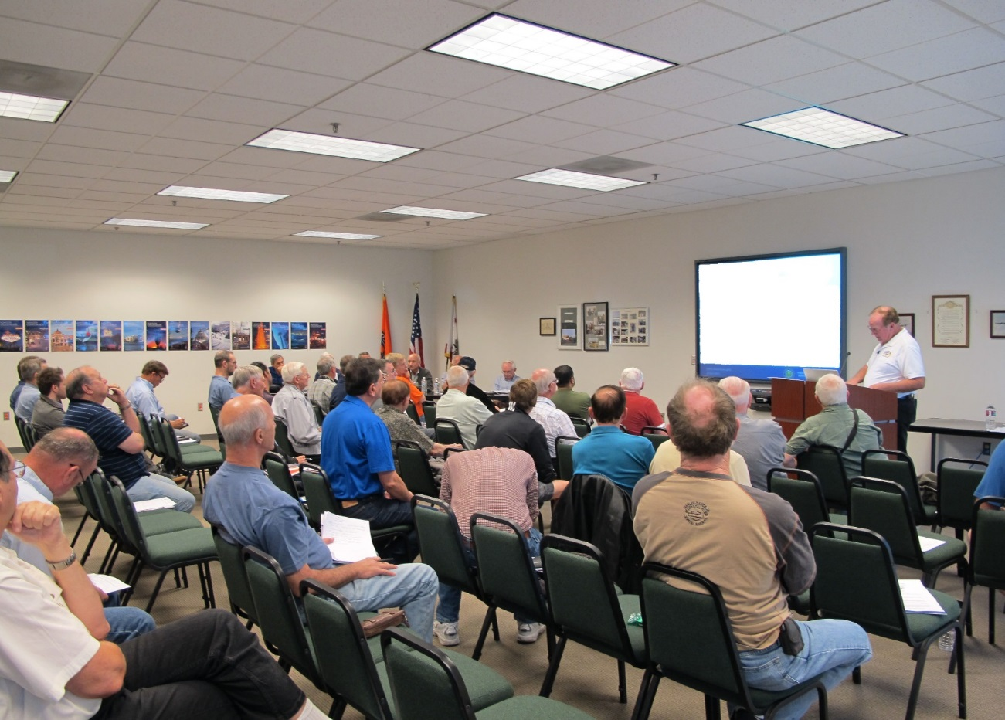
Welcome
Exits
Restrooms
Emergency Evacuation
Breaks
Set phones & pagers to silent mode or off
Sponsor Acknowledgment
Other information
Notes:
Presentation Note: Here’s where you can discuss venue logistics, acknowledge sponsors, and deliver other information you want your audience to know in the beginning.
You can add slides after this one to fit your situation.
(Next Slide)

Slide 3
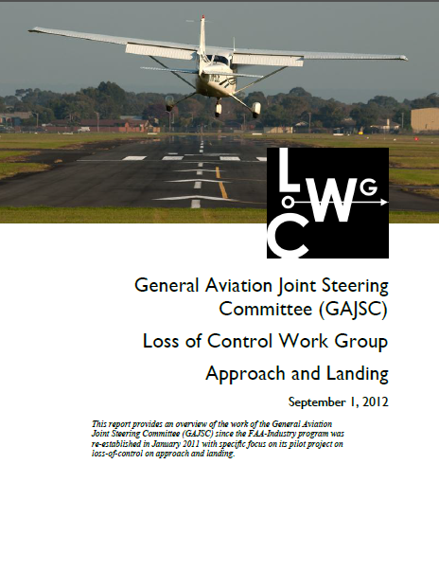
Overview
A case study on distraction
Loss of Control Work Group Recommendations
Tips & Tricks
* General Aviation Joint Steering Committee
Notes:
In this presentation we’ll talk a little bit about distractions and how they contribute to accidents. We’ll look at some recommendations from a work group that studies loss of control. We’ll offer a few tips & tricks to help you manage distractions in flight.
Presentation Note: If you’ll be discussing additional items, add them to this list (Next Slide)

Slide 4
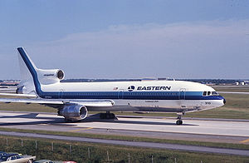
EA 401
29 December 1972
JFK – MIA
3 Flt. Crew 1 Non Rev.
Nose Gear Light Out
CWS Mode Engaged
99 Fatalities
Notes:
On 29 December 1972 Eastern Airlines Flight 401, Lockheed L-1011, was scheduled to fly from JFK in New York to Miami International Airport in Florida.
3 flight crew and one non-revenue company employee were in the cockpit as the flight began the approach to Miami.
After extending the landing gear on final approach the first officer noticed the nose wheel down & locked light was not illuminated. The approach was aborted and the aircraft entered a 2,000 foot holding pattern west of the airport The crew engaged the autopilot while all 4 cockpit occupants engaged in trouble shooting the problem. When the autopilot was engaged it was inadvertently placed in Control Wheel Steering (CWS) mode. In this mode the airplane would maintain the attitude last commanded by the pilot. One of the pilots – most likely the Captain – bumped the control column as he turned to speak with the flight engineer. The airplane was placed in a shallow descent that was maintained all the way to the ground. Four professional aviators – any one of whom could have detected the descent – were so focused on a non-critical task that they failed to detect and arrest the descent.
(Next Slide)

Slide 5
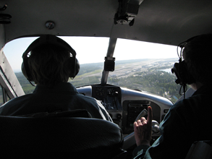
A matter of priority
Fly the Aircraft First!
Notes:
We’ve all heard it many times, “when your flight plan is unraveling and you’re trying to decide where to go and how to get there while dealing with passengers and ATC; the most important thing to do is always,” (Click)
That’s right. Fly the Airplane!
(Next Slide)

Slide 6
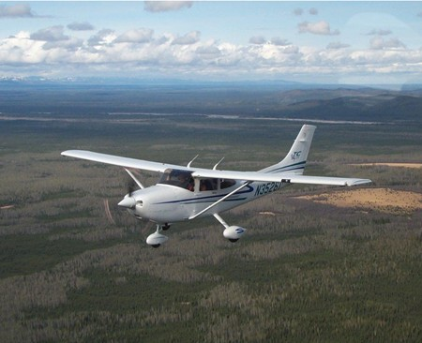
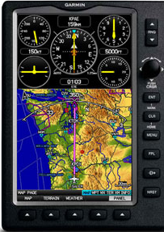
A matter of priority
Aviate
Navigate
Communicate
Notes:
Expressed another way the 3 things pilots must do in order of priority are: (Click)
Aviate – maintain aircraft control at all times. (Click)
Navigate – manage navigation systems and tasks including fuel reserves (Click)
Communicate – with passengers and ATC
That’s good advice. Loss of Control is the number one cause of fatal aircraft accidents. It doesn’t matter if we’re navigating and communicating perfectly if we lose control of the aircraft and crash.
That’s why the General Aviation Joint Steering Committee recommends this awareness raising program.
(Next Slide)

Slide 7
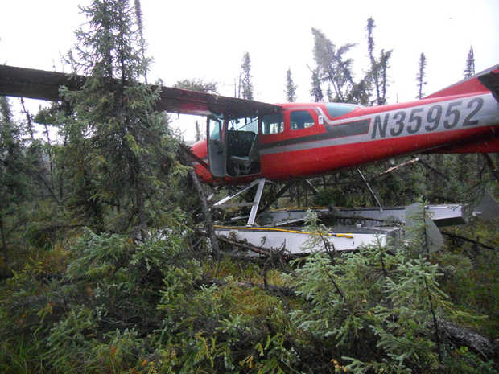
Fly the Aircraft First!
High stress
Short time frame
Limited options
Off airport landing?
Notes:
I know we all talk the Fly the Aircraft First talk but can we walk the talk? By that we mean of course; are we really prepared to fly the airplane under high stress to a safe – perhaps off airport – landing?
(Click)
The pilot of this aircraft had a total engine failure – mechanical – not fuel related – while en route at low altitude in Alaska.
Navigation was simple – we’ll be on the ground in a minute or two - well before we can get to anything that even remotely resembles an airport.
Communication was also simple – there was no one within radio range to talk to.
We’re not likely to be as successful as this pilot unless we think about what we’re going to do in various possible emergency situations and unless we prepare do deal with problems.
(Next Slide)
Background: The NTSB investigation report of this accident (ANC13LA085) is included with this program

Slide 8
So how do we prepare for problems?
Consider the hazards associated with each phase of flight
Think about what could go wrong
Plan for how you would deal with the problem
What would I do if?
What could I have done better
Train to plan proficiency
Practice – preferably with a CFI
Notes:
So how do we prepare for problems? We think about what could go wrong. It’s useful to consider things that could go wrong in each phase of flight. Generally speaking – problems are more serious – the less room we have to maneuver. Looking at it that way – a power loss on climb out would be more serious than one at altitude or in the pattern when a landing is assured.
We plan for how we would deal with the problem. Successful pilots consider, “what would I do if?” before and during flight. And and after each flight they consider, “what could I have done better?”
And finally we train to proficiency and practice – preferably with a CFI who can coach you to achieve your maximum performance.
(Next Slide)

Slide 9
Preparing for Problems
Prepare
Performance numbers, weather, survival gear
Plan
Route, flight plan, runway data, climb & descent profiles, escape routes, go no-go points & alternates
Practice – at mission weight
Short & soft field T.O. s & Ldgs.
Power off Appchs. & Ldgs.
Notes:
To maximize our chances of success in handling emergencies, we prepare, plan, and practice. (Click)
We prepare by making sure we know our performance numbers including best power off glide speed for the aircraft we’re going to fly. We have a good weather brief and we update along the route so we always know where the best weather is. We file a flight plan and request flight following service We have survival gear appropriate to the mission on board and we know how to use it. (Click)
We plan our route with alternate landing areas in mind. This means we may elect to take a longer route that offers better alternatives for off airport landings. We file a flight plan and request flight following. We plan and brief each takeoff, approach, and landing to include climb & descent expectations, go no-go points, escape routes, and alternates. En route we keep within gliding distance of suitable landing areas for as much of the flight as possible (Click)
And we practice emergency procedures, short and soft field takeoffs and landings; power off approaches and landings. It’s important to practice these maneuvers at our expected mission weight. An aircraft with a solo pilot and half tanks performs much better than one at close to max gross weight. Pilots need to be comfortable at the higher weights in order to be successful in real emergencies.
(Next Slide)

Slide 10
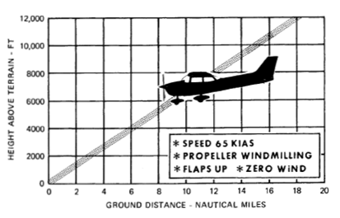
Power Loss
Fly the airplane
Establish, configure for, & maintain best glide speed
Identify landing site
Maneuver toward landing site
Diagnose the problem
Loss of power checklist (s)
Restore power and continue or….
Land
If possible, activate ELT & cell phone (s) before landing
Notes:
Let’s consider a sudden and unexpected loss of power. What’s the first and most important thing we must do?
Presentation note: Wait for the audience to answer. Usually they will say, “Fly the airplane!” then: (Click)
That’s right – If we don’t maintain aircraft control this will not end well. While maintaining control; establish, configure for, and maintain best glide speed. (Click)
If we’re VFR or maneuvering near an airport we should already have some idea of suitable off airport landing sites nearby. Heading toward the best choice of these is good insurance in case we’re unable to restore power. (Click)
Now, if there’s sufficient time, we can try to diagnose and correct the problem. The POH will likely have some checklists to follow but, because most power loss events are fuel related, Mixture – Rich, Fuel Pump – On, Fuel – On Proper Tank will often do the trick. But if we can’t restore power ……. (Click)
We land - keeping the aircraft under positive control throughout. If you can keep everything under control and you have a remote ELT switch, activate the ELT while maneuvering to land and turn cell phones on. Both will help in guiding rescuers to your landing site.
If we are able to restore power - unless we’re sure we know what caused the power loss, we know we’ve corrected the problem, and we’re emotionally and intellectually prepared to continue the flight, a precautionary landing is in order. At least it can be at an airport of our choosing instead of a farmer’s field. Seriously – responding to emergencies is physically, emotionally, and intellectually draining. Time spent regrouping on the ground is well spent.
(Next Slide)

Slide 11
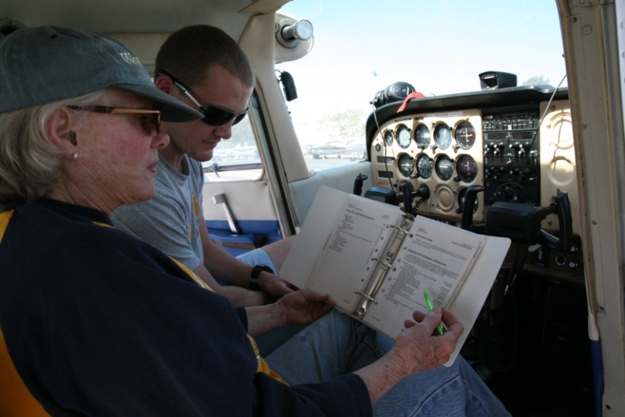
Tips & Tricks
Fatal Distractions
Set passenger expectations
Sterile Cockpit
Give passengers a job
Let George do it
Use the autopilot
Wing leveling only in Turbulence
Proficiency Training
Document in WINGS
Notes:
Passengers – and in some cases animals - have been known to provide fatal distractions so pilots must set expectations before flight. In addition to the standard seat belts, exits, and emergency equipment brief, take some time to explain your role and theirs. Insist on a sterile cockpit – no conversation that is not directly related to safety of flight during critical times. Give your passengers a job to do such as scanning for traffic. We know of one pilot who pays his kids a dollar for each aircraft they spot before he does. After one flight alone he had to visit an ATM to pay off his debt. (Click)
When your workload is increasing, by all means use the autopilot if you have one. Practice with and without the autopilot. If you never use the autopilot you won’t have confidence in it while dealing with an emergency. If you always use the autopilot you won’t have confidence in yourself. One more caveat here. Don’t engage altitude hold if you’re in significant turbulence. Basic wing leveling is what you want. That way the autopilot won’t overstress the airplane or disengage while trying to maintain altitude. (Click)
And finally, seek regular proficiency training with your CFI and document your training in WINGS.
(Next Slide)

Slide 12
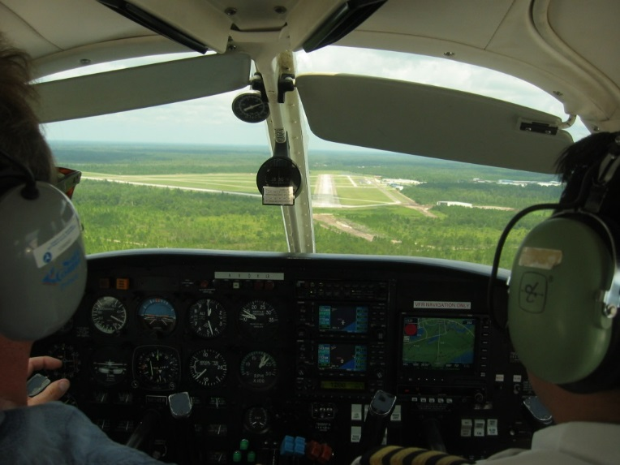
Recommendations:
Gold Seal
Brief each takeoff, approach, and landing
Runway and available distance for takeoff or landing
Aircraft configuration and target airspeeds
Rejected takeoff or landing decision point
Departure/approach path
Return to airport altitude
Forced landing opportunities
Notes:
Briefing each and every takeoff, approach, and landing is another gold seal best practice. When emergencies occur during these critical phases of flight, there will be little or no time to think about what should be done before doing it. Vocalizing important points and procedures just before takeoff or landing keeps them uppermost in your mind where they’re available for ready reference if something unforeseen happens. (Click)
Brief the assigned runway and available distance for takeoff or landing. Include aircraft configuration and target airspeeds. Vocalize your rejected takeoff or go-around decision point.
Include the departure or approach path and the altitude below which you’ll not attempt a return to the airport.
Finally, brief forced landing opportunities close to the airport.
(Next Slide)

Slide 13
Pattern Precision
Unusable portions of runway
Forced landings
Precise flying breeds confidence and it looks good!
Gold Seal
Notes:
We’re all familiar with pattern operations. They’re an essential part of every flight. But sometimes we take routine tasks for granted and that can lead to less precise flying. You may ask, “What does it matter if I land a little long? I have 4 times the runway I need.” Well even if you never fly to shorter fields it’s still important to be precise on longer runways for three reasons: (Click)
Runways occasionally are compromised so you may have less distance available to land. (Click)
Our aircraft are extremely reliable but we may have to carry out a forced landing at any time. (Click)
And last but certainly not least - precise flying in the pattern makes you sharper in other flight procedures. It breeds confidence in you and in your passengers and besides; it looks good!
(Next Slide)

Slide 14
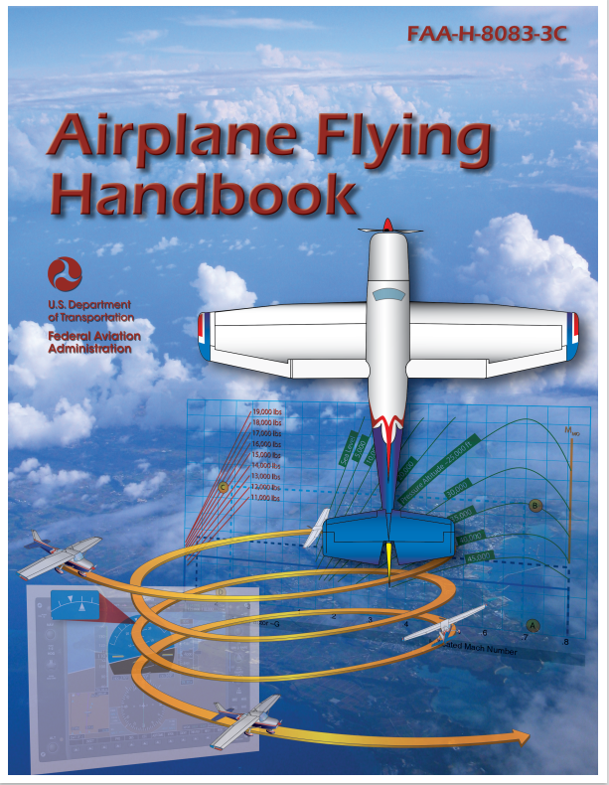
Want to learn more?
Airplane Flying Handbook
https://bit.ly/3wO1wMu
FAASTeam WINGS Pilot Proficiency Program
http://faasafety.gov/WINGS
Notes:
Want to learn more?
Check out the Airplane Flying Handbook – available at the web address shown.
Want to learn even more? Participate in the FAASTeam WINGS Proficiency Program. It’s a great way to get expert coaching that will keep you at the top of your flying game.
Presentation note: You can take questions while audience is copying information from this slide. Then advance to:
(Next Slide)

Slide 15
Questions?
Notes:
Presentation Note: You may wish to provide your contact information and main FSDO phone number here. Modify with
Your information or leave blank.
(Next Slide)

Slide 16
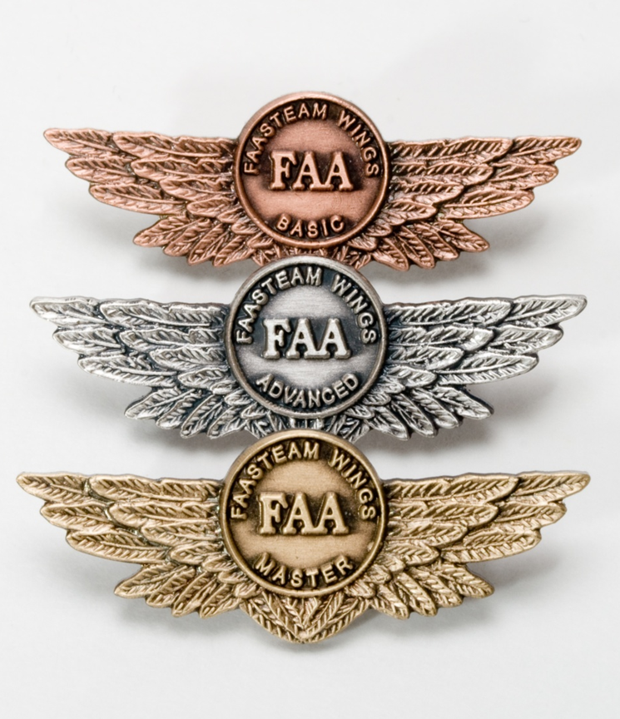
Proficiency and Peace of Mind
Fly regularly with your CFI
Perfect Practice
Document in WINGS
Notes:
There’s nothing like the feeling you get when you know you’re playing your A game and in order to do that you need a good coach (Click)
So fly regularly with a CFI who will challenge you to review what you know, explore new horizons, and to always do your best. Of course you’ll have to dedicate time and money to your proficiency program but it’s well worth it for the peace of mind that comes with confidence. (Click)
Vince Lombardi, the famous football coach said, “Practice does not make perfect. Only perfect practice makes perfect.” For pilots that means flying with precision. On course, on altitude, on speed all the time. (Click)
And be sure to document your achievement in the WINGS Proficiency Program. It’s a great way to stay on top of your game and keep you flight review current.
(Next Slide)

Slide 17
http://www.mywingsinitiative.org/
Notes:
Now there are even more reasons to participate in WINGS. Every time you complete a WINGS Phase you’re eligible to win cash the WINGS Sweepstakes.
The sweepstakes is generously funded by Paul Burger, a long time advocate for general aviation safety and a retired aviator who believes participation in this program saves lives. VISIT WWW.MYWINGSINITATIVE.ORG to learn more and enter the sweepstakes.
(Next Slide)

Slide 18
Safety Management Systems (SMS) Coming to General Aviation
https://www.faa.gov/about/initiatives/gasafetyoutreach
Notes:
Safety Management Systems are a set of policies and processes that can increase the safety and efficiency of any flight operation. And FAA is bringing SMS to General Aviation. You may have heard of SMS but thought it was only for large organizations but actually SMS can be scaled to fit any operation large or small.
There are 4 major components to a Safety Management System (Click)
Safety Policy – a documented commitment to safety that runs from the head of an organization to its newest member. (Click)
Safety Risk Management – a process that identifies hazards within an operation, determines to what extent an identified hazard may impact flight safety, and controls the risk of occurrence to an acceptable level. (Click)
Safety Assurance – By collecting and analyzing information derived from safety performance data Safety Assurance ensures the performance and effectiveness of Safety Risk Controls. (Click)
Safety Promotion communicates safety information and commitment throughout the organization. (Click)
You can find more information about Safety Management Systems at the URL on the Screen.
(Next Slide)

Slide 19
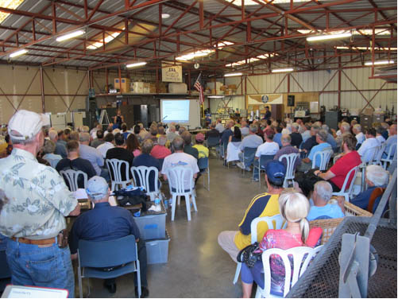
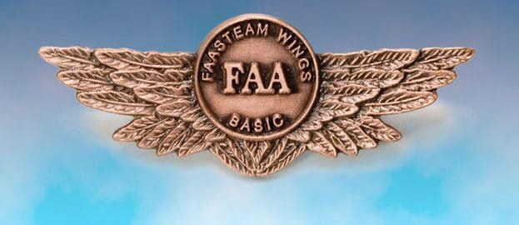
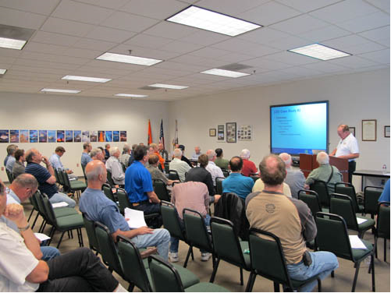
Thank you for attending
You are vital members of our GA safety community.
Notes:
Your presence here shows that you are vital members of our General Aviation Safety Community. The high standards you keep and the examples you set are a great credit to you and to GA.
Thank you for attending.
(Next Slide)

Slide 20
The National FAA Safety Team Presents
Topic of the Month July
Fly the Aircraft First
<Audience>
<Presenter>
< >
Notes:
(The End)

