Slide 1
The National FAA Safety Team Presents
Topic of the Month
April
Smart Cockpit Technology
<Audience>
<Presenter>
< >
Notes:
2017/8-14-112 (I) PP Original Author: J. Steuernagle July 2017 POC: K. CloverAFS-850 Operations Lead Phone: 562-888-2020
Presentation Note: This is the title slide for Smart Cockpit Technology
Presentation notes (stage direction and presentation suggestions) will be preceded by a Bold header: the notes themselves will be in Italic fonts.
Program control instructions will be in bold fonts and look like this: (Click) for building information within a slide; or this: (Next Slide) for slide advance.
Some slides may contain background information that supports the concepts presented in the program.
Background information will always appear last and will be preceded by a bold Background: identification.
We have included a script of suggested dialog with each slide. Presenters may read the script or modify it to suit their own presentation style.
The production team hope you and your audience will enjoy the show. Break a leg!
(Next Slide)

Slide 2
Welcome
Exits
Restrooms
Emergency Evacuation
Breaks
Sponsor Acknowledgment
Set phones & pagers to silent or off
Other information
Notes:
Presentation Note: Here’s where you can discuss venue logistics, acknowledge sponsors, and deliver other information you want your audience to know in the beginning.
You can add slides after this one to fit your situation. (Next Slide)

Slide 3
Overview
GAJSC* Safety Enhancements
Smart Cockpit Technology
  Electronic Engine Control (EEC)
  Performance monitoring
  Flight information stream
  Interconnected devices
    Cockpit instruments and displays
    Mobile devices
*General Aviation Joint Steering Committee
Notes:
In this presentation we’ll talk a little bit about recommendations from a work group that studies loss of control. The General Aviation Joint Steering Committee or GAJSC is a government/industry group that studies GA accidents and makes recommendations for adoption of what they call safety enhancements. One of their safety enhancements promotes equipping GA aircraft with Smart Cockpit Technology. We discussed Electronic Engine Control in a previous Topic of the Month but we’ll revisit it and aircraft performance monitoring in this presentation as key components of an integrated cockpit information stream. That information stream is informed by internal and external sensors and data sources.
Presentation Note: If you’ll be discussing additional items, add them to this list
(Next Slide)

Slide 4
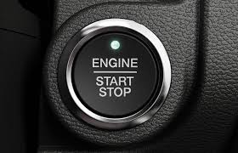
Electronic Ignition & Engine Control
Basic electronic ignition
Full Authority Digital Engine Control (FADEC)
Fewer Mechanical Parts
  More reliable than analog systems
  No maintenance on ignition control units
Increased fuel efficiency
Reduced maintenance expense
Notes:
If your car has one of these buttons – you’ve got some form of Electronic Engine Control. From Basic Electronic Ignition to Full Authority Digital Engine Control, EECs are more reliable, more efficient, and less costly to purchase and maintain than analog systems. Evaluating input from engine and environmental sensors hundreds of times per minute, the EEC keeps your engine running at peak efficiency for your operational environment. And those same sensors can provide valuable input as to the health of your power plant. If problems are detected you’ll see an indication – usually a service light – on your panel.
(Next Slide)

Slide 5
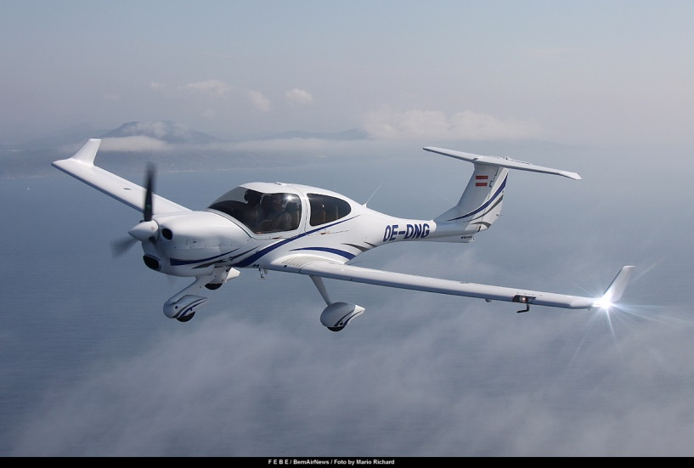
Electronic Ignition & Engine Control
Full Authority Digital Engine Control (FADEC)
Retrofit systems
Data availability
  Performance monitoring
  Predictive performance
  calculations
Notes:
Similar economy and reliability are available for aircraft now. Some new aircraft already feature Full Authority Digital Engine Control and electronic ignition systems can be retrofitted to many engines in the fleet.
But another huge feature of electronic control is data availability for performance monitoring and predictive performance calculations.
(Next Slide)

Slide 6
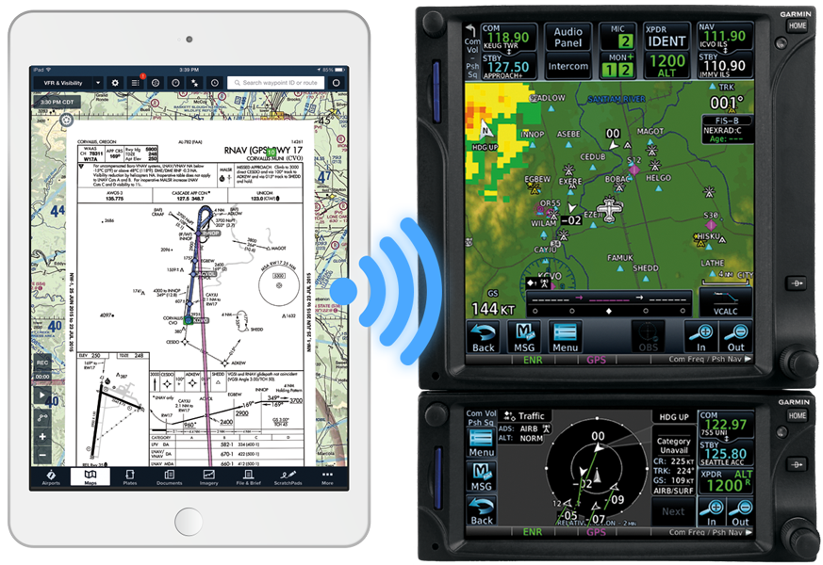
Interconnected Devices
Air/Ground Data Link
  ATC clearances and instructions
  Weather depiction, field condition, NOTAMS
Mobile/Installed Technology
  Flight plan transfer from tablet to aircraft
Available today!
Notes:
Interconnected Devices and sensors make more information available in the cockpit than ever before.
Air/Ground Data Links can provide ATC clearances and instructions as well as Weather depiction and field condition reports and NOTAMS.
And mobile - to installed equipment technology makes information transfer between your mobile device and your aircraft simple, speedy, and safe. There’s no chance of fumble fingering a route entry if it’s transferred directly from your flight plan to the aircraft.
This is not technology that will come to us sometime in the future. It’s technology that we can use today.
(Next Slide)

Slide 7
Flight Information Stream
Environmental
  Altitude, pressure, temperature, dew point, wind, ceiling, visibility, present & forecast weather conditions
Aircraft
  Available power, operational limits, historical data for trend analysis
  Abnormal conditions and impending component failures
  Aircraft system status
Notes:
Were talking about a Flight Information Stream. Drawing on information from internal and external sources, a comprehensive picture of aircraft state and component health can be formed, updated, and presented to pilots in text and graphical form.
(Next Slide)
Background: Here’s a list of some information that is now or will soon be available in the cockpit.
a. performance data
b. biometrics (O2 monitoring)
c. engine monitoring and exceedance resolution
d. fuel monitoring
e. system monitoring
f. aircraft configuration
g. general alerts/warnings
i. VMC imminent
ii. turbocharger failure
iii. clearance conformance
iv. weather
v. airspace and runway information
vi. NOTAMS
vii. flight planning
h. emergency situations
i. prompts pilots (orally/visually) through pertinent checklist items
j. conditional instructions based on aircraft position and condition of flight
k. energy management
l. best glide
m. best path “highway in the sky”
n. available runways

Slide 8
Flight Information Stream
Operational
  ATC clearances and instructions
  Airspace, en route, terminal, navigation
  NOTAMS and TFRs
  Aircraft configuration
  Smart checklists for normal and emergency operations.
  Predictive performance display
    Informed by environmental data
    Go/no-go, accelerate stop, balanced field length
Notes:
We’re used to seeing graphical navigation information in the cockpit – in installed avionics, hand held devices, or both. Weather and airspace is already integrated with many navigational displays. NOTAMS and TFRs are available as well. In the future, ATC communications and aircraft configuration will be integrated and smart checklists for normal and emergency operations will appear as needed. With all that information available, the aircraft will be able to predict performance in takeoff, cruise, approach, and landing operations. Imagine knowing exactly how much runway you’ll need for every takeoff and landing.
(Next Slide)

Slide 9
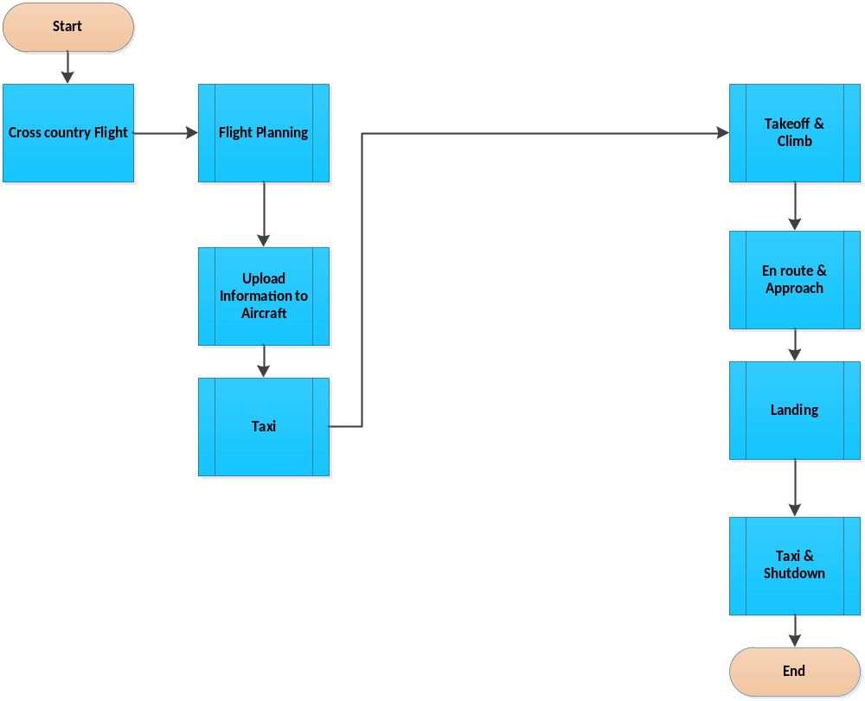
Information Stream Flow
Notes:
Here’s a high level diagram of a cross country flight. Currently most pilots do their flight planning before they get to the aircraft. Once the flight planning is complete and filed they manually upload the route information into the navigation system, secure the appropriate clearances, and they’re ready to taxi. Let’s see how this process will be informed with the advent of smart cockpit technology.
(Next Slide)

Slide 10
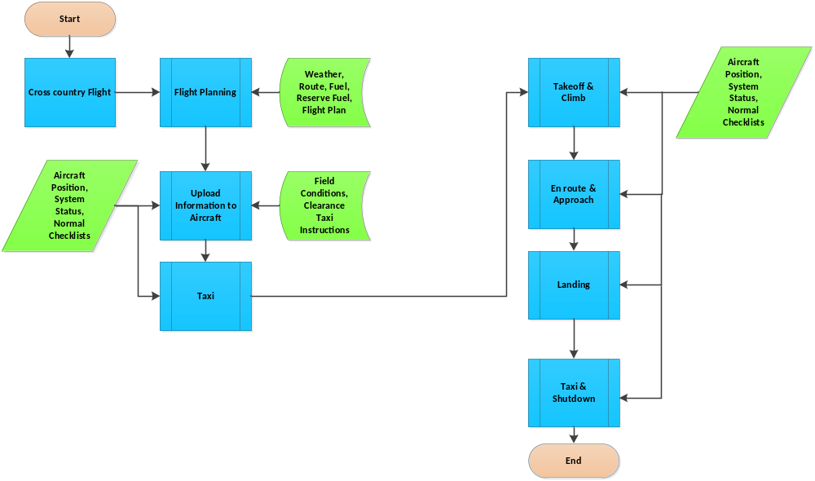
Information Stream Flow
Notes:
The green boxes represent internal and external information sources that are available in the aircraft. Flight plan information is transferred to the aircraft shortly after it is powered up. Aircraft position, system status, takeoff and climb calculations are based on internal information and external information such as field conditions, elevation, temperature, and dew point. After run up, pilots conduct the flight while internal systems keep track of performance and position presenting the appropriate checklists when needed. Let’s see what happens when an abnormal condition is encountered.
(Next Slide)

Slide 11
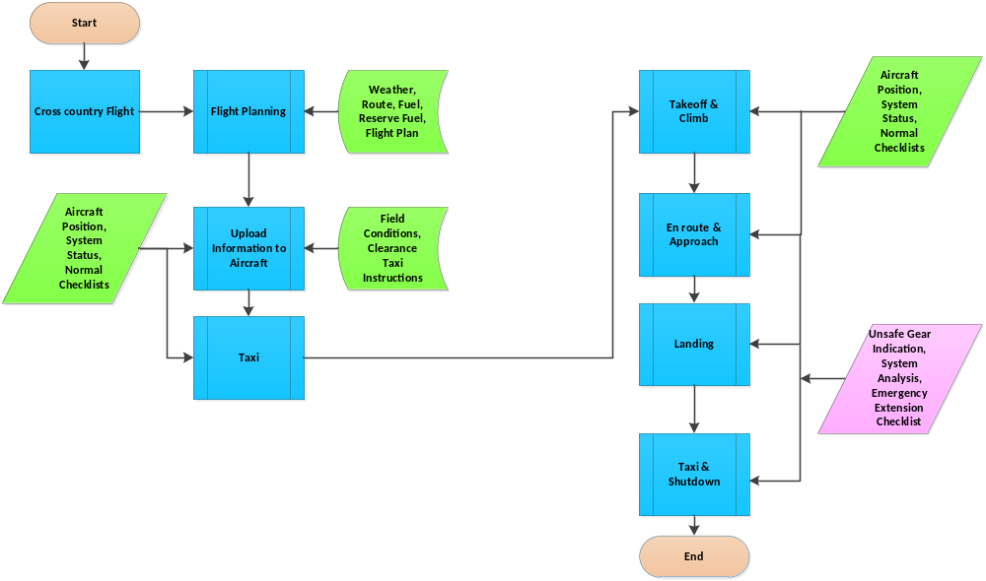
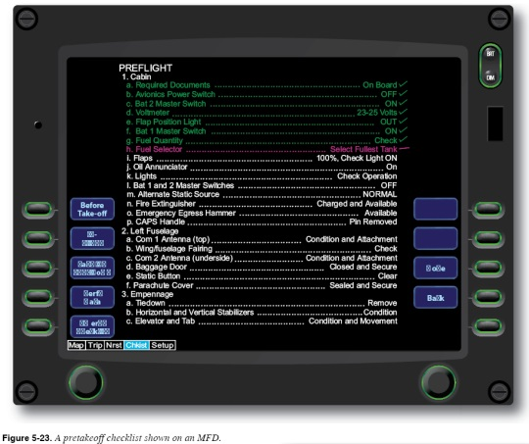
Information Stream Flow
Notes:
In this case an unsafe gear indication was reported shortly after the gear was selected down. Using internal systems data the aircraft will attempt to discover the condition cause. In this case, emergency gear extension is called for and the emergency gear extension checklist is presented. With “3 in the green” the aircraft lands normally.
(Next Slide)

Slide 12
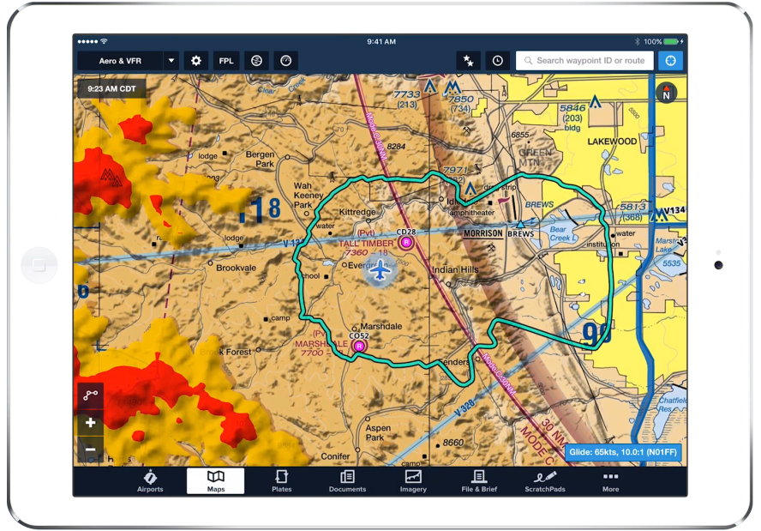
Smart cockpit technology is available now.
Not the distant future
  but we’re just getting started
  Progress will accelerate
It begins with ADS-B
  Aircraft position
  Collision alert and avoidance
  Data link
Avoid the last minute rush & equip with ADS-B soon.
Notes:
We’re not talking about the distant future here. Although in one sense we’re just getting started, smart cockpit tech is available right now and progress will accelerate as more manufacturers and aircraft owners adopt the technology.
It all begins with ADS-B. Not only do you have improved aircraft position data but those data can be used in collision avoidance. And ADS-B In comes with a data link for environmental information. That same data link can be used for ATC communications, NOTAMS, and up to the minute TFR information. The year 2020 is fast approaching. If you haven’t already equipped with ADS-B do so soon and avoid the last minute rush.
(Next Slide)

Slide 13
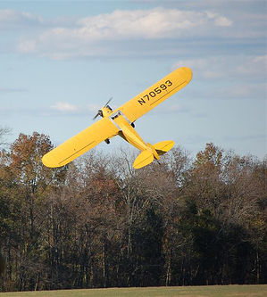
Questions?
Notes:
Presentation Note: You may wish to provide your contact information and main FSDO phone number here. Modify with
Your information or leave blank.
(Next Slide)

Slide 14


Proficiency and Peace of Mind
Fly regularly with your CFI
Perfect Practice
Document in WINGS
Notes:
There’s nothing like the feeling you get when you know you’re playing your A game and in order to do that you need a good coach (Click)
So fly regularly with a CFI who will challenge you to review what you know, explore new horizons, and to always do your best. Of course you’ll
have to dedicate time and money to your proficiency program but it’s well worth it for the peace of mind that comes with confidence. (Click)
Vince Lombardi, the famous football coach said, “Practice does not make perfect. Only perfect practice makes perfect.” For pilots that means
flying with precision. On course, on altitude, on speed all the time. (Click)
And be sure to document your achievement in the Wings Proficiency Program. It’s a great way to stay on top of your game and keep you flight review current.
(Next Slide)

Slide 15



Thank you for attending
You are vital members of our GA safety community
Notes:
Your presence here shows that you are vital members of our General Aviation Safety Community. The high standards you keep and the examples you set are a great credit to you and to GA.
Thank you for attending.
(Next Slide)

Slide 16
The National FAA Safety Team Presents
Topic of the Month
April
Smart Cockpit Technology
<Audience>
<Presenter>
< >
Notes:
(The End)

Slide 17
The National FAA Safety Team Presents
Topic of the Month
April
Smart Cockpit Technology
<Audience>
<Presenter>
< >
Notes:
(The End)

