Slide 1
The National FAA Safety Team Presents
Topic of the Month - January
Introduction to Safety Risk Management (SRM)
<Audience>
<Presenter>
< >
Notes:
2018/4-5-126 (I) PP Original Author: John Steuernagle FAA SPPM 03/14/2018; POC (Kevin Clover), FAA SPPM Operations Lead, Office 562-888-2020; revised by (Name) (MM/DD/YYYY)
Presentation Note: This is the title slide for Introduction to Safety Risk Management (SRM)
Presentation notes (stage direction and presentation suggestions) will be preceded by a Bold header: the notes themselves will be in Italic fonts.
Program control instructions will be in bold fonts and look like this: (Click) for building information within a slide; or this: (Next Slide) for slide advance.
Some slides may contain background information that supports the concepts presented in the program.
Background information will always appear last and will be preceded by a bold Background: identification.
We have included a script of suggested dialog with each slide. Presenters may read the script or modify it to suit their own presentation style.
The production team hope you and your audience will enjoy the show. Break a leg!
(Next Slide)

Slide 2

Welcome
Exits
Restrooms
Emergency Evacuation
Breaks
Set phones & pagers to silent or off
Sponsor Acknowledgment
Other information
Notes:
Presentation Note: Here’s where you can discuss venue logistics, acknowledge sponsors, and deliver other information you want your audience to know in the beginning.
You can add slides after this one to fit your situation.
(Next Slide)

Slide 3

Overview
What is Safety Risk Management
How do pilots use SRM
SRM aids and technologies
* General Aviation Joint Steering Committee
Notes:
In this presentation we’ll talk a little bit about recommendations from a work group that studies General Aviation mishaps. We’ll define and discuss safety risk management and how pilots use SRM to not only fly safer but more efficiently. Finally we’ll show you some SRM aids and technologies.
But first – let’s look at what SRM is
Presentation Note: If you’ll be discussing additional items, add them to this list
(Next Slide)

Slide 4
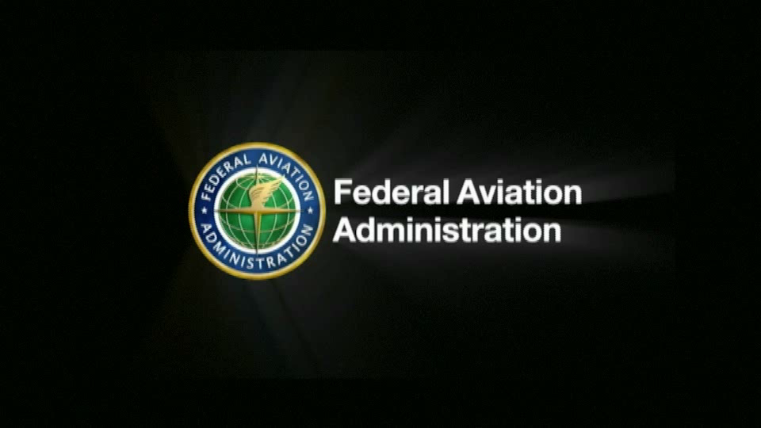
* General Aviation Joint Steering Committee
Notes:
Presentation note: Click on the video progress bar to start the video presentation.
(Next Slide)

Slide 5
Safety Risk Management
Hazard Identification
Risk Assessment
Risk Mitigation
Monitoring
Notes:
As we saw in the video, SRM is a 3-step process beginning with (Click)
Hazard identification – What conditions or circumstances could negatively affect your flight. (Click)
Risk Assessment – How likely are the identified hazards to cause a problem and how severe will be the consequences if they do? (Click)
Risk Mitigation – What can I do to reduce the risks to acceptable levels? (Click)
Finally, we need to constantly monitor the hazards and risks associated with our flight to make sure that the identified risks remain at an acceptable level.
(Next Slide)

Slide 6
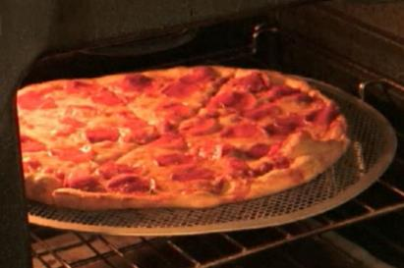
Hazard Identification
Hot oven & pizza pan
Notes:
So – back to the video – what are the hazards here?
Presentation note: Ask the audience to identify the hazards, then: (Click)
Right the hot oven, pizza, and the pizza pan are hazards.
(Next Slide)

Slide 7
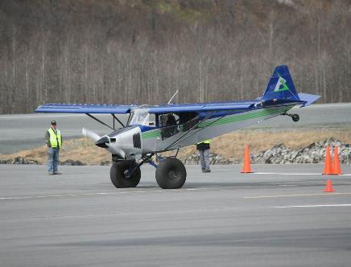
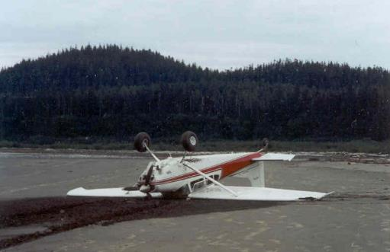
Risk Assessment
How bad is the wreck going to look?
Notes:
A famous Alaskan bush pilot was asked how he assessed the risks of landing at unfamiliar back country strips. His answer: “well the first thing you want to ask yourself is, how bad is the wreck going to look?” (Click)
Here’s a picture of a well executed short field landing at an annual Alaskan contest in Valdez. No airplanes were harmed in the filming of this event and the landing was success. No wreck. (Click)
But here’s a photo of another Alaskan landing on a beach. The combination of aircraft, pilot, and environment didn’t work out optimally in this case and, if the pilot had assessed this result as likely, he might not have attempted the landing.
(Next Slide)

Slide 8

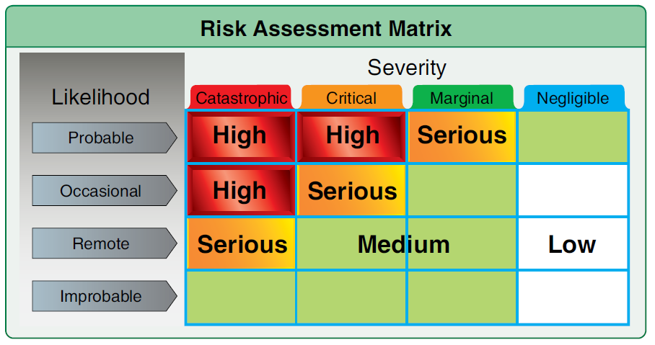
Risk Assessment
Hot oven, pizza pan, & pizza pie
  Likelihood
    Probable
    Occasional
    Remote
    Improbable
  Severity
    Catastrophic
    Critical
    Marginal
    Negligible
Notes:
But we were talking pizza – not planes. We have a hot oven, pan, and pie. How bad is this wreck going to look if we just reach in there and grab it. Think in terms of likelihood and severity. (Click)
Likelihood first – If we reach in with our bare hands and grab the pan, how likely is it that we’ll be burned?
Presentation note: Ask the audience for answers then:
Right you are it is highly probable that we’ll be burned. We’re going to be hurt. The question is, how bad is it going to look. Here are your severity choices: (Click)
Ask audience for input, then:
Well this burn won’t kill us but it’s not going to be marginal or Negligible either so we’re left with critical. Not in a life or death context but critical in that it’ll be a while before our hands are fully functional again and that could compromise the jobs we have to do. (Click)
Here’s a risk matrix from FAA’s Risk Management Handbook. (Click)
You can see that the combination of Probable and Critical equals High risk and we must do something to reduce that risk to an acceptable level.
(Next Slide)

Slide 9
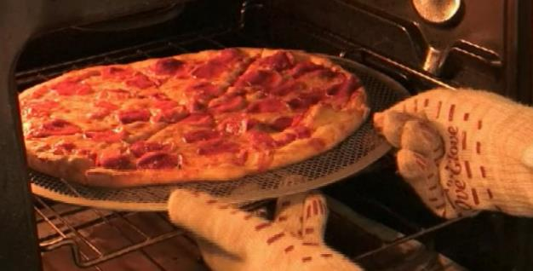
Risk Mitigation
The risk of injury is not eliminated – just reduced.
Notes:
We saw that the risk of injury from the hot oven & pie was mitigated to an acceptable level by using hot pads or gloves to get the pie on the table. Note that the risk of injury is less when the whole hand is protected; a little more likely if hot pads are used. Also note that the risk is not eliminated – just reduced. We could still burn an unprotected area or our gloves might be defective but, overall, the risk has been mitigated to an acceptable level.
The pizza example is simplistic. We all know that flying involves an extensive set of variables and a simple flight on one day can be impossible on another. Let’s take a look at a GA flight.
(Next Slide)

Slide 10
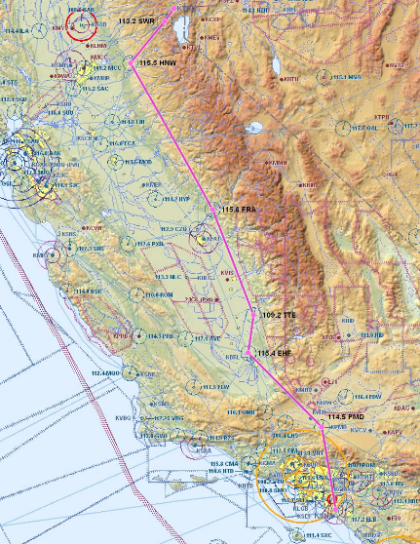
Hazard Identification
Mission – KSNA – KTRK
  391 nm 3Hrs. 22 Min
  Depart at 1800 Local Time
Pilot – Private, VFR
  850 hrs. TT, 30 in last 6 months
  Current medical, flight review, day/night
  currency
Aircraft – C-172-P
  43 Gal Fuel, Day/Night VFR
Environment – DAY/Night/VFR
  Mountains.
External Pressure (s) – Family Reunion
Notes:
In this example an 850 hour Private Pilot will be flying his family from Santa Ana, California to a reunion event in Lake Tahoe. The weather is forecast to be good along the route. The pilot will go straight to the airport after work and meet his family there. If all goes as planned, the flight will depart at or a little before six pm.
So what hazards should be considered for this trip? Would you say the risks are acceptable? If not, what could the pilot do to mitigate them?
Presentation note: Guide the audience in a discussion of hazards, risks, and mitigations. Some hazards include, VFR at night in mountainous terrain, possible fatigue due to departure after a full day at work, pressure to complete the flight in order to be present for the reunion, etc. Mitigations might include leaving work early in order to reduce fatigue and arrive in daylight or planning to leave early in the morning the following day. Make the point that going to this destination at night would be a particularly bad idea if the pilot were unfamiliar with the field.
(Next Slide)

Slide 11
Want an easier way to do it?
Introducing the FAASTeam FRAT
  Easy to use
  Basic flight risk assessment
  For General Aviation Pilots
FAAST FRAT
Notes:
Do you want and easier way to do it?
Introducing the FAAST FRAT; (Click)
an easy to use, basic flight risk assessment tool for general aviation pilots.
(Next Slide)

Slide 12
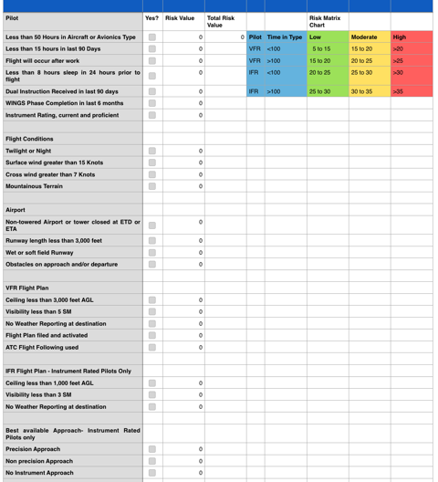
20 Statements - VFR
22 Statements - IFR
FAAST FRAT
Notes:
The FAAST FRAT is a simple automated spread sheet that contains 20 condition statements for VFR pilots; 22 for IFR pilots.
The statements describe common general aviation flight liabilities and assets. Pilots simply click the “yes” box next to each statement that applies to their flight.
Each yes statement generates a risk value and those values are totaled on the sheet.
The total risk value is related to the risk matrix chart to determine whether the flight risk is likely to be low, moderate, or high.
(Next Slide)

Slide 13
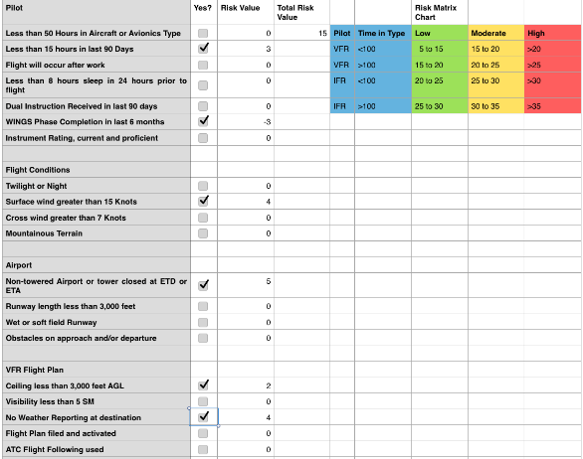
FAAST FRAT
Notes:
In this example, the pilot has fewer than 15 hours in the last 90 days but a WINGS Phase was completed in the last 6 months. The risk of low recent experience is cancelled by the WINGS Phase completion.
Surface winds will be greater than 15 knots resulting in a risk value of plus 4. The flight will be to a non-towered airport, ceiling will be less than 3,000 feet and there is no weather reporting at the destination. (Click)
This results in a total risk value of 15.
(Next Slide)

Slide 14
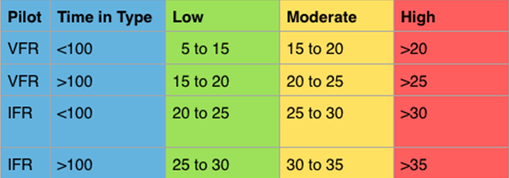
FAAST FRAT
Notes:
Looking at the Risk Matrix Chart we see that a Total Risk Value of 15 is between Low and Moderate for a VFR Pilot with fewer than 100 hours time in type, (Click)
but well within the low range for an IFR pilot with more than 100 hours time in type.
(Next Slide)

Slide 15
FAAST FRAT
Can’t cover all possible flight hazards
Does address common GA accident causal factors
Safety Risk Management - 101
Notes:
No FRAT can cover all possible flight hazards but this one – though simple – does address some factors that are common to GA accidents. We hope it’s use will prompt pilots to learn more about Safety Risk Management.
Now to get your copy here’s what you do……….
(Next Slide)

Slide 16
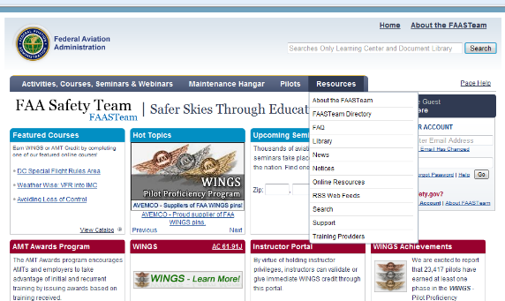
FAAST FRAT
Log on to FAASafety.gov
Click on Resources then click on Library
Notes:
Navigate to FAASafety.gov
Click on Resources, then click on Library.
(Next Slide)

Slide 17
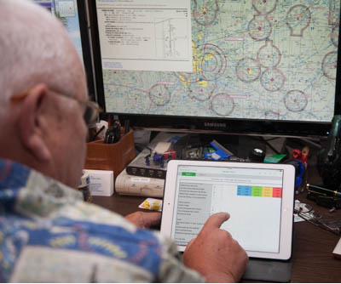
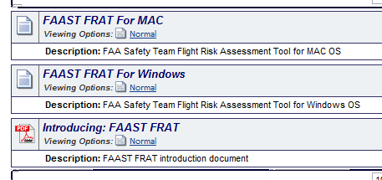
FAAST FRAT
Click on Flight Risk Assessment Tool
Download appropriate FRAT for your computer.
Notes:
Click on Flight Risk Assessment Tool (FRAT)
Download the appropriate FRAT for your computer
Note: FAAST FRAT for Windows will not run with Excel for MAC. If you want to run the FRAT on your Apple computer, you’ll need the Numbers application.
(Next Slide)

Slide 18
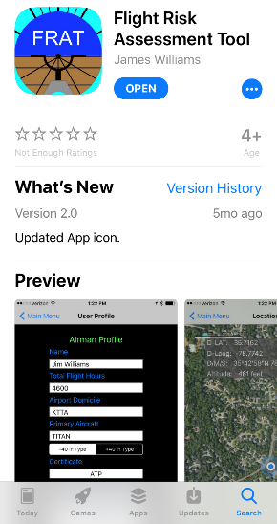
The FAAST FRAT App
Free Mobile App
For iPhone, iPad, iPod
Notes:
But how about those of us who don’t carry laptop computers with us everywhere we go?
Introducing the FAAST FRAT App – a free program for Apple iOS available in the App Store.
To use the app, simply enter your flight experience and certification level into your pilot profile. Then VFR-rated pilots select which of 21 conditions apply to your flight – IFR pilots consider 23 conditions. Some conditions increase risk – others decrease risk. As you select conditions, a total risk value accumulates and it’s displayed graphically on your device.
(Next Slide)

Slide 19
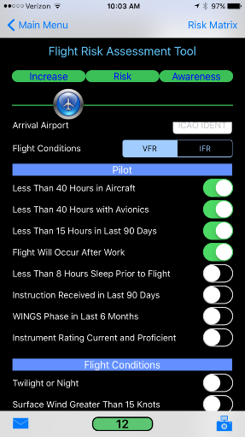
The FAAST FRAT App
Flight Risk Slider
Pilot Conditions
Flight Conditions
Notes:
Here you can see the beginning of a risk assessment. (Click)
The pilot has selected four conditions that apply to the flight. (Click)
After that the assessment will move on to flight conditions. (Click)
As conditions are selected, the Flight Risk Slider moves from left to right as risk values accumulate. When a risk reduction condition is selected, the slider moves from right to left – indicating the reduction in total risk value.
(Next Slide)

Slide 20

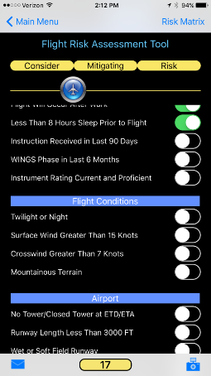
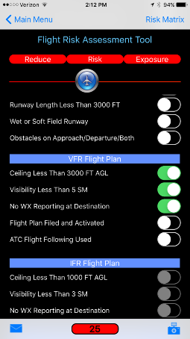
The FAAST FRAT App
Notes:
Here’s the display you’ll get when the risk value is low. (Click)
Note that the Slider Bar and Total risk value have a green background. (Click)
As the risk value becomes moderate the display background color changes to yellow. (Click)
And when the risk value goes into the red – it’s imperative that we do something to reduce our risk exposure.
(Next Slide)

Slide 21
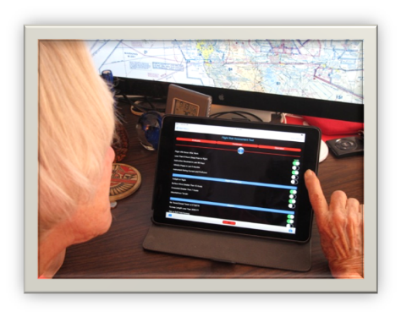
The FAAST FRAT App
Safety Risk Management for General Aviation
Simple & Easy
Data Sharing
  Student to CFI
  Club members to Club
  Pilots to Family
Notes:
The FAAST Frat App provides a simple and easy introduction to safety risk management for general aviation pilots. The device stores your pilot profile information but doesn’t automatically store individual risk assessments. Each time the App is opened, all condition statements are set to off. You can take a picture of your risk assessment though and save that image for future reference. (Click)
Users can, if they wish, share risk assessments with third parties such as CFIs, Flying Club dispatch personnel, or friends and family. Just click on the email icon to send a copy of the risk assessment to people you designate.
(Next Slide)

Slide 22
The FAAST FRAT App
A safety risk management tool for GA pilots
Available in the Apple App store
Search for Flight Risk Assessment tool
in the App Store
Notes:
To get your copy of the FRAT App just navigate to the Apple App store and search for Flight Risk Assessment Tool.
(Next Slide)

Slide 23

Questions?
Notes:
Presentation Note: You may wish to provide your contact information and main FSDO phone number here. Modify with
Your information or leave blank.
(Next Slide)

Slide 24
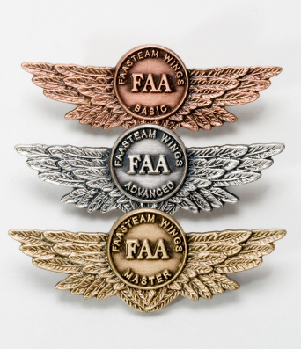

Proficiency and Peace of Mind
Fly regularly with your CFI
Perfect Practice
Document in WINGS
Notes:
There’s nothing like the feeling you get when you know you’re playing your A game and in order to do that you need a good coach (Click)
So fly regularly with a CFI who will challenge you to review what you know, explore new horizons, and to always do your best. Of course you’ll
have to dedicate time and money to your proficiency program but it’s well worth it for the peace of mind that comes with confidence. (Click)
Vince Lombardi, the famous football coach said, “Practice does not make perfect. Only perfect practice makes perfect.” For pilots that means
flying with precision. On course, on altitude, on speed all the time. (Click)
And be sure to document your achievement in the Wings Proficiency Program. It’s a great way to stay on top of your game and keep you flight review current.
(Next Slide)

Slide 25
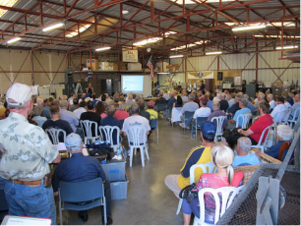


Thank you for attending
You are vital members of our GA safety community
Notes:
Your presence here shows that you are vital members of our General Aviation Safety Community. The high standards you keep and the examples you set are a great credit to you and to GA.
Thank you for attending.
(Next Slide)

Slide 26
The National FAA Safety Team Presents
Topic of the Month - January
Introduction to Safety Risk Management (SRM)
<Audience>
<Presenter>
< >
Notes:
(The End)

