Slide 1
The National FAA Safety Team Presents:
Topic of the Month August
Use of Weather Information
Notes:
2020/08-27-199(I)PP Original Author: Jay M. Flowers; POC (Kevin Clover), AFS-850 Operations Lead, Office 562-888-2020; revised by (Name) (MM/DD/YYYY)
Presentation Note: This is the title slide for Use of Weather Information.
Script - We have included a script of suggested dialog with most slides. The script will always appear in a non-italic font. Presenters may read the script or modify it to suit their own presentation style. See template slides 5 and 6 for examples of a slides with script.
Presentation Instructions - (stage direction and presentation suggestions) will be preceded by a Bold header: the instructions themselves will be in Italic fonts. See slides 2, for an example of slides with Presentation Instructions only.
Program control instructions - will be in bold fonts and look like this: (Click) for building information within a slide; or this: (Next Slide) for slide advance.
Background information - Some slides may contain background information that supports the concepts presented in the program.
Background information will always appear last and will be preceded by a bold Background: identification.
The production team hope you and your audience will enjoy the show. Break a leg!
(Next Slide)

Slide 2


Welcome
Exits
Restrooms
Emergency Evacuation
Breaks
Set phones & pagers to silent or off
Sponsor Acknowledgment
Other information
Notes:
Presentation Note: Here’s where you can discuss venue logistics, acknowledge sponsors, and deliver other information you want your audience to know in the beginning.
You can add slides after this one to fit your situation.
(Next Slide)

Slide 3

Overview
Use of Weather Information
Planning the Flight
Pitfalls
Best Practices
Notes:
Presentation Note: If you’ll be discussing additional items, add them to this list
Todays discussion will include the following:
Use of Weather Information
Planning the Flight
Pitfalls of the sources and weather in general
Best Practices
(Next Slide)

Slide 4
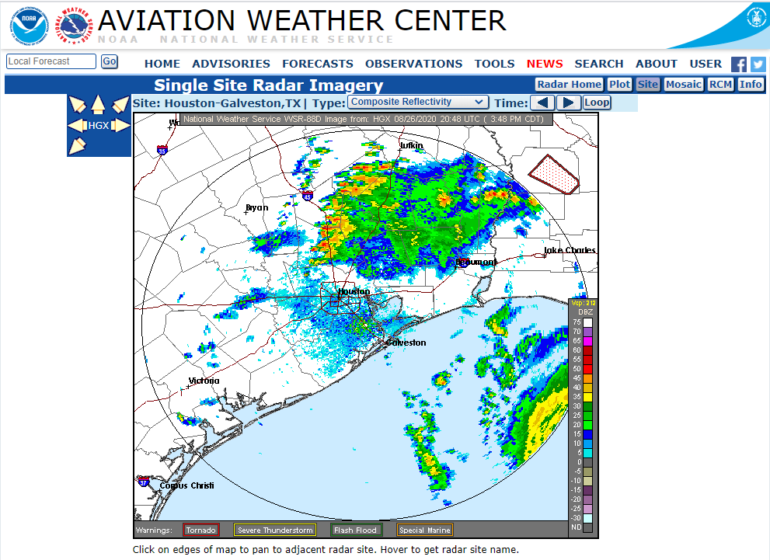
Notes:
Today’s pilots enjoy an abundance of weather information sources, but having weather information available is only part of the weather decision-making equation. Knowing how to acquire, interpret, and make operational decisions based on weather information is essential to safe flying. This brief presentation acquaints general aviation pilots with available weather information sources and offers guidance on making well-informed weather decisions.
(Next Slide)

Slide 5
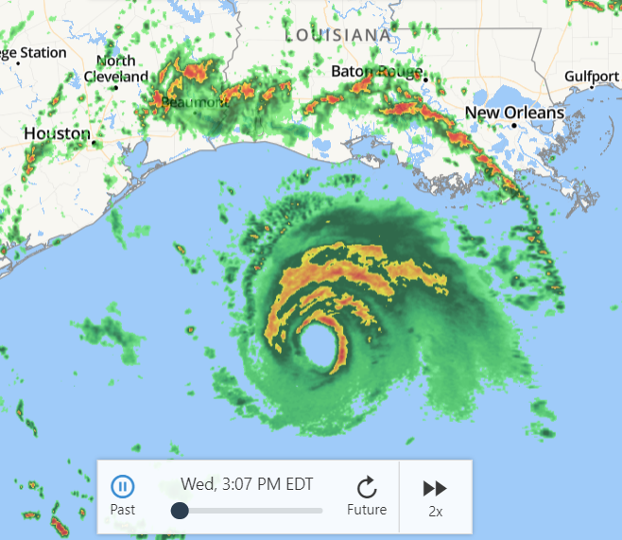
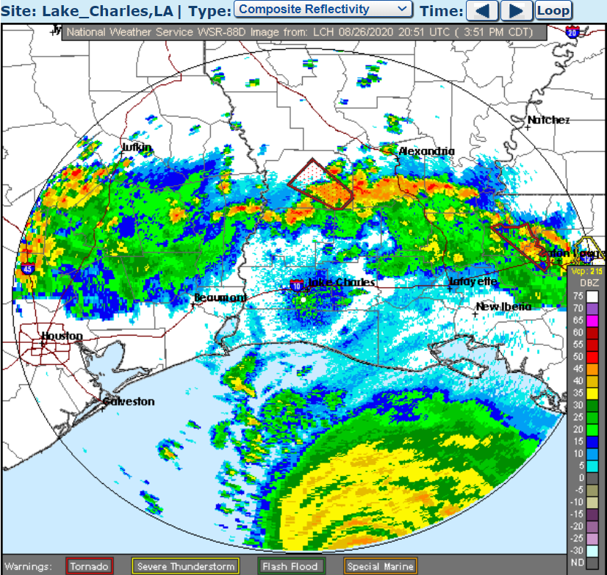
Not all weather sources report the same data.
The decision making process requires you to make operational decisions based on ALL information available for your flight.
Notes:
Not all weather sources report the same data.
The decision making process requires you to make operational decisions based on ALL information available for your flight.
(Next Slide)

Slide 6
Study and Evaluate
You got it now what do you do with it?
In the beginning you were tested on theory and the use of weather products
Now you need to use your experiences and skill to process and apply that data specific to your flight
Notes:
Study and Evaluate
You got it now what do you do with it?
In the beginning you were tested on theory and the use of weather products
Now you need to use your experiences and skill to process and apply that data specific to your flight
(Next Slide)

Slide 7
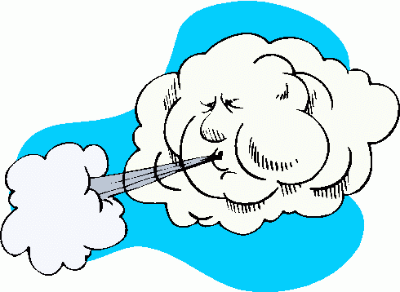


Three Basic Elements of Weather are…
  Temperature (warm or cold)
  Wind (a vector with speed and direction)
  Moisture (or humidity)
Temperature, wind, and moisture combine to
varying degrees to create conditions that affect pilots.
Notes:
The three basic elements of weather are:
Temperature (warm or cold)
Wind (a vector with speed and direction)
Moisture (or humidity)
Temperature, wind, and moisture combine to varying degrees to create conditions that affect pilots.
(Next Slide)

Slide 8
Anything is Possible…
Weather primarily affects pilots in three ways:
Weather can create wind or turbulence.
Weather can reduce ceiling and visibility.
Weather can affect aircraft performance through conditions such as high density altitude or icing.
Notes:
Anything is possible.
Weather primarily affects pilots in three ways:
Weather can create wind or turbulence.
Weather can reduce ceiling and visibility.
Weather can affect aircraft performance through conditions such as high density altitude or icing.
One approach to practical weather analysis is to review weather data in terms of how current and forecast conditions will affect visibility, turbulence, and aircraft performance for your specific flight.
(Next Slide)

Slide 9

Making Sense of the data
How will the weather affect my flight?
Turbulence
Visibility
Aircraft performance.
Notes:
Making Sense of the data and using it in the practical sense has a few steps to get the job done.
Note: Audience participation time.
Look at your weather data in terms of the ways that weather can affect your flight How about turbulence? Mountainous terrain can be a killer when turbulent
How about visibility?
Is this a photo Op flight?
Joy ride?
Aircraft performance?
Aircraft loaded to maximum weight?
Short Field?
Long trip?
(Next Slide)

Slide 10
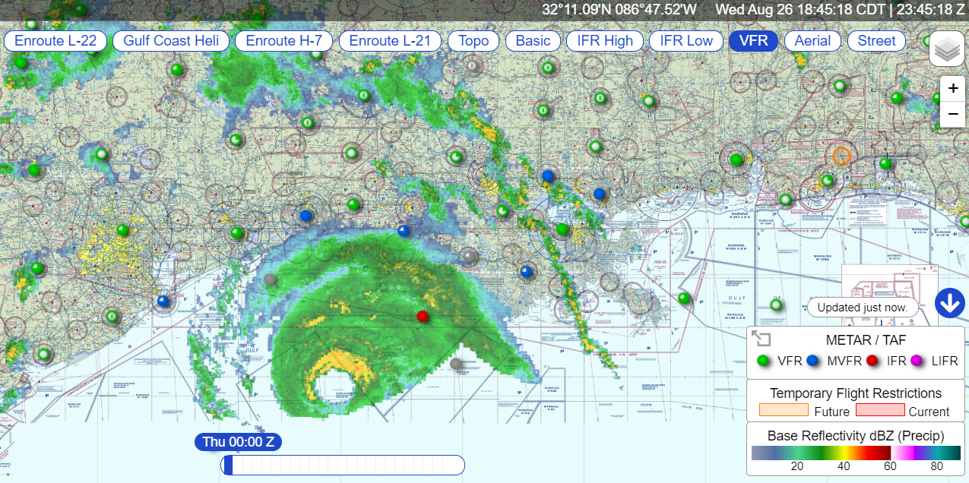
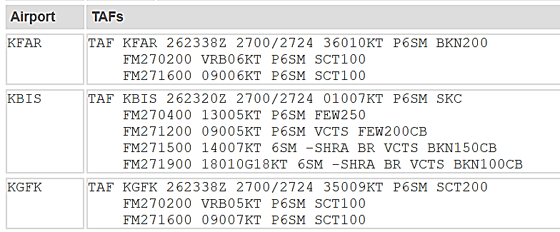
Organize the information into a format that works for you, and then make the decision.
Notes:
Organize the information into a format that works for you, and then make the
decision:
Get the big picture, take the time necessary to do the task prior to the flight, not
while you’re walking out the door to preflight.
Check your sources and confirm with local airman if need be.
(Next Slide)

Slide 11
Never thought of that…
Are you or the aircraft up to the challenge?
Your technologically advanced airplane can be very helpful, but no airplane can adequately compensate for deficiencies in its pilot’s knowledge, training, experience, or skill.
Notes:
Never thought of that…
Make an honest evaluation of whether your skill and/or aircraft capability are up to the challenge posed by this particular set of weather conditions.
IFR? VFR? Icing? New aircraft to you? Equipment familiarity?
It is very important to consider whether the combined “pilot-aircraft team” is sufficient.
(Next Slide)

Slide 12

READ ALL ABOUT IT!
If the result of your evaluation process leaves you in any doubt, then you need to develop safe alternatives.
Notes:
One way to “self-check” your decision (regardless of your experience) is to ask yourself if the flight has any chance of appearing in the next day’s newspaper. If the result of the evaluation process leaves you in any doubt, then you need to develop safe alternatives.
(Next Slide)

Slide 13
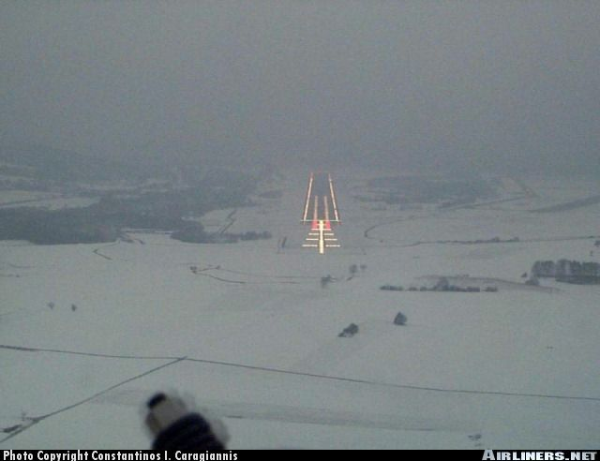
Preflight Weather Planning is the BIG PICTURE!
Eliminate or mitigate any risks found
Escape Options
Reserve Fuel
Terrain Avoidance
Service or Repair
Emergency Options
Notes:
Preflight weather planning is the BIG PICTURE.
Eliminate or mitigate any risks found
Note: Risk strategies vary across the country. Seasonal weather, snow, rain, temperatures, wind, terrain, runway surface type, and available procedures if IFR need to be considered for your intended and alternate routes.
Escape Options – Alternates, box canyons, poor visibility
Reserve Fuel – If I turn around now, can I make it?
Terrain Avoidance – Wind induced issues, hills, mountains, trees at the airport
Service or Repair – if I get there and something breaks, can I continue IFR?
Emergency Options – Unforecast conditions, Ice, reduced visibility, fog
(Next Slide)

Slide 14
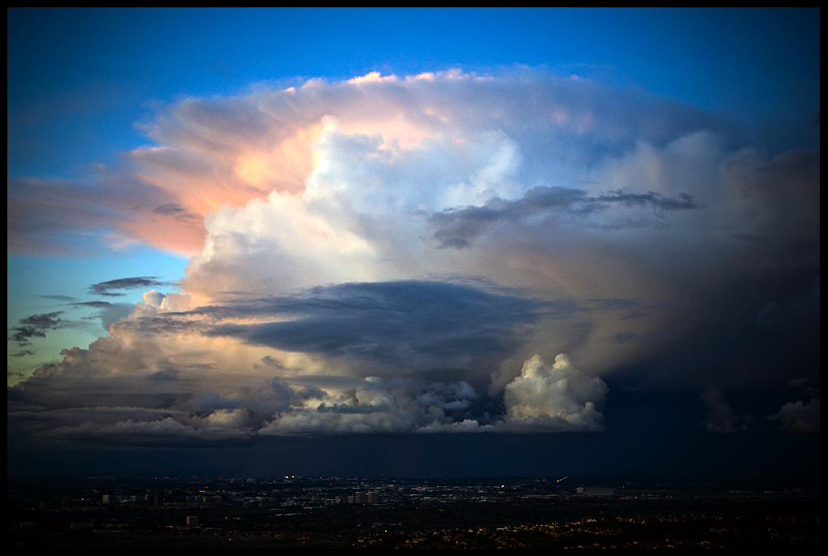
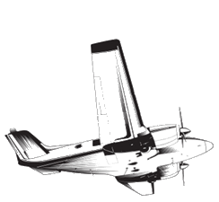
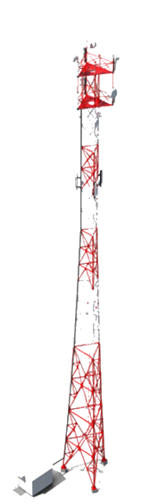


Everything considered, Let’s Go!
Notes:
Everything Considered?
Weather is constantly changing. What we see out the window may not always be what they report in the data you planned on.
(Next Slide)

Slide 15

Weather Related Risk Management
Expectations – What the data told you
Reality – What it really looks like
Risk – Is my plan still working
Options – Consider Option B
Risk – Is my plan still working
Notes:
Weather related Risk Management never stops.
Comprehensive preflight risk assessments allow you the best possible outcome for your flight, however… the trick is to constantly reassess your risk while enroute.
ERROR is a rather humbling acronym that may remind you of the need to correct or manage your risk along the way:
Expectations – Seeing is believing. Is the weather what you see out the window? Is your groundspeed as predicted? Will the change in weather affect your Expected Time of Arrival? Will you have enough fuel to get there?
Reality – The weather is not quite what you planned for.
Risk – If the weather is not as expected, will it affect your planned flight? Is fatigue going to be a factor? Can you continue with your flight given your current assessment? Are you making your decisions solely on the safety of flight or are you feeling pressure to complete the flight?
Options – Are your options still open? If the weather is unforecast, maybe your destination is now south of course rather than north of course. Did you plan for that?
Risk – Has the safety of the flight been jeopardized?
How you answer these questions will determine if your plan of action pays off.
(Next Slide)

Slide 16
Best Practices When Planning
Use more than one weather source
Plan to be late
Plan an Alternate
Plan for the worst possible scenario
Train for weather related contingencies
Check weather often while enroute
Notes:
Best Practices when planning:
Use more than one weather source – utilize local weather cameras, ASOS and AWOS data by phone for actual current weather, pilot reports (if nobody has been reporting the weather ask flight service or ATC to pass along the request for some.
Plan to be late – Get thereitis is an excuse not a planned solution.
Plan an Alternate – If IFR and weather is questionable you must. Why not for VFR?
Plan for the worst possible scenario – See “Plan for an Alternate”.
Train for weather related contingencies – “The weather is predictable and the weather man is always right…maybe”.
Check weather often while enroute – Altimeter settings every 100 miles…why not the weather?
(Next Slide)

Slide 17


WINGS!
Starting the Day Right
Notes:
WINGS! Starting the day right.
(Next Slide)

Slide 18

Pilots never stop learning, and those who participate in regular proficiency training are competent, confident, and safe.
Earn WINGS awards and recognition based on a combination of practical knowledge and hands-on coaching. Skill will be the result of your efforts.
Get started now!
Notes:
The WINGS Pilot Proficiency Program.
Pilots never stop learning, and those who participate in regular proficiency training are competent, confident, and safe.
Earn WINGS awards and recognition based on a combination of practical knowledge and hands on coaching or skill
Get started now!
(Next Slide)

Slide 19
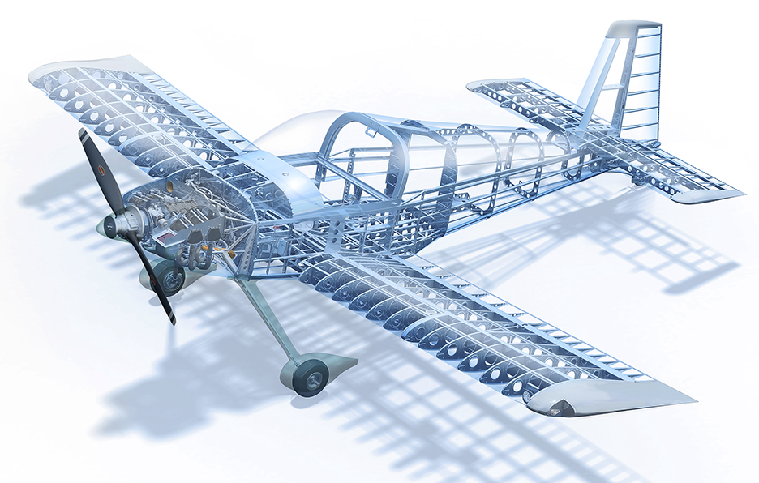
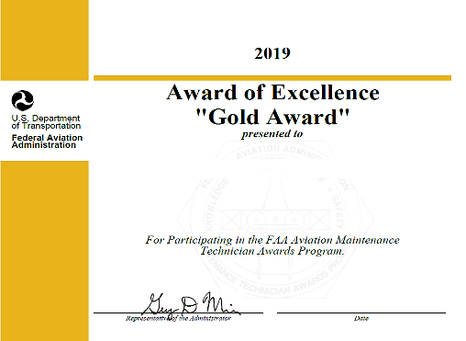
AMT On-line for the A&P
Notes:
AMT On-line for the A&P.
(Next Slide)

Slide 20

The AMT Awards program can help you fulfill your commitment to aviation maintenance excellence through continuing education and training.
Earn annual awards based on core training hours at Bronze, Silver, and Gold levels.
Get started now!
Notes:
The AMT Awards Program.
The AMT Awards program can help you fulfill your commitment to aviation maintenance excellence through continuing education and training.
Earn annual awards based on core training hours at Bronze, Silver, and Gold levels.
Get started now!
(Next Slide)

Slide 21

We need your feedback:
Go to your favorite search engine and type in the search:
FAASTeam Feedback
Notes:
Presenter: For each presentation year, update this link by verifying the QR code link.
THIS SLIDE IS REQUIRED AS PART OF ALL FAASTEAM PRESENTATIONS!
(Next Slide)

Slide 22


Contact Us:
FLIGHT STANDARDS OFFICE
(Your Office Address
and Contact Information Here)
(000) 000-0000
Notes:
Presenter: Update this slide for your presentation.
(Next Slide)

Slide 23
Thank You!
Use of Weather Information s
Notes:
Thank You for stopping by! Join us again soon.
(The End)

