Slide 1
The National FAA Safety Team Presents
Topic of the Month - February
Expanding Your Horizons
<Audience>
<Presenter>
< >
Notes:
2020/02-21-183(I)PP Original Author: John Steuernagle; POC Kevin Clover, AFS-850 Operations Lead, Office 562-888-2020
Presentation Note: This is the title slide for Expanding Your Horizons.
Presentation note: This is the title slide for Aeronautical Decision Making (ADM).
Script - We have included a script of suggested dialog with most slides. The script will always appear in a non-italic font. Presenters may read the script or modify it to suit their own presentation style. See template slides 5 and 6 for examples of a slides with script.
Presentation Instructions - (stage direction and presentation suggestions) will be preceded by a Bold header: the instructions themselves will be in Italic fonts. See slide 2 for an example of a slide with Presentation Instructions only.
Program control instructions - will be in bold fonts and look like this: (Click) for building information within a slide; or this: (Next Slide) for slide advance.
Background information - Some slides may contain background information that supports the concepts presented in the program.
Background information will always appear last and will be preceded by a bold Background: identification.
The production team hope you and your audience will enjoy the show. Break a leg!
(Next Slide)

Slide 2


Welcome
Exits
Restrooms
Emergency Evacuation
Breaks
Sponsor Acknowledgment
Set phones and pagers to silent or off
Other information
Notes:
Presentation Note: Here’s where you can discuss venue logistics, acknowledge sponsors, and deliver other information you want your audience to know in the beginning.
You can add slides after this one to fit your situation.
(Next Slide)

Slide 3

Overview
Expanding your Horizons
  Proficiency & Recency
  Transition Training
  Environmental Unfamiliarity
Broad range of piloting experience
  Better at handling new challenges
Notes:
We pilots can become quite comfortable in our normal flying. Most of us don’t range very far from home base and when we travel, we tend to frequent airports that are similar to those at home. A recent study of general aviation accidents suggests that, in addition to piloting proficiency, robust environmental transition training and the resultant environmental familiarity can go a long way toward reducing General Aviation mishaps.
Just as importantly pilots with a broad range of experience tend to be better at meeting new challenges.
Presentation Note: If you’ll be discussing additional items, add them to this list
(Next Slide)

Slide 4

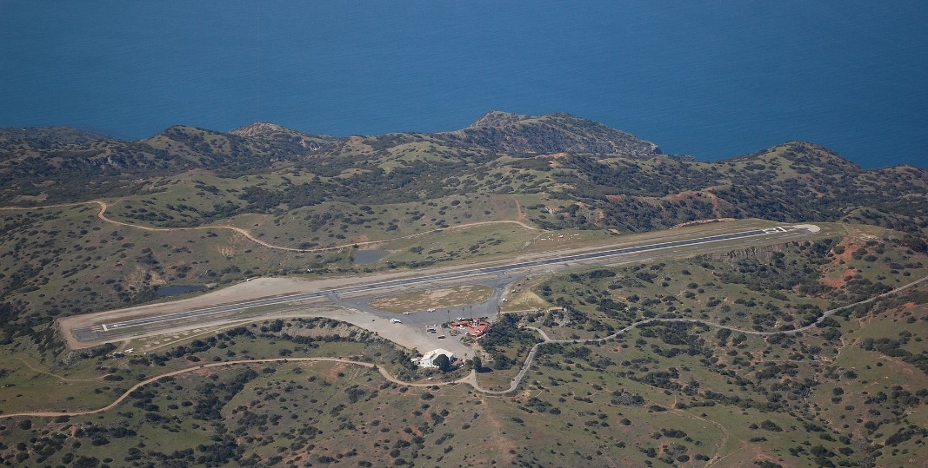
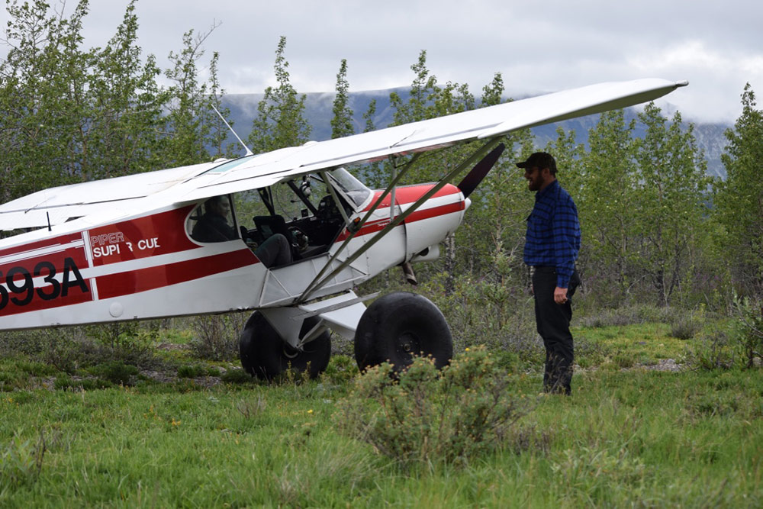

Where would you fly?
Notes:
We all dream of places we’d like to visit by air. (Click)
It might be a resort destination in the Bahamas, (Click)
Or perhaps a challenging mountain airstrip. (Click)
A challenging flight to New York and La Guardia’s iconic Marine Air Terminal. (Click)
Or the solitude of a back country airstrip.
It’s always good to take on new challenges and we encourage you to do so but expanding our horizons can be a little tricky. We need to understand our limitations and
the new environments we’ll be flying in. And we need to be proficient enough to handle any of the challenges those environments present.
(Next Slide)

Slide 5
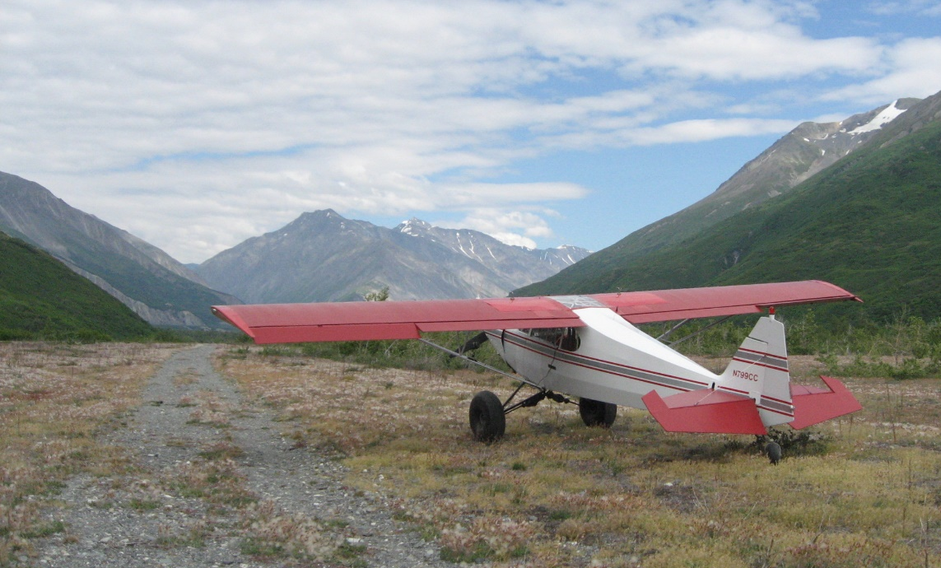
Recent flight experience – 14 CFR 61.57
Takeoffs & Landings
  Day - night
  Tailwheel
  Instrument
Tailwheel
Instrument
Notes:
We’re all familiar with the recent flight experience requirements in CFR 61.157. You may have met all those requirements and you may be proficient in your home environment.
With recent tailwheel takeoff and landing practice and perhaps an IPC you’ll be confident in your proficiency at your home field. (Click)
But you may find yourself wishing for more experience if you try to tackle a remote airstrip in the Alaskan bush.
(Next Slide)

Slide 6
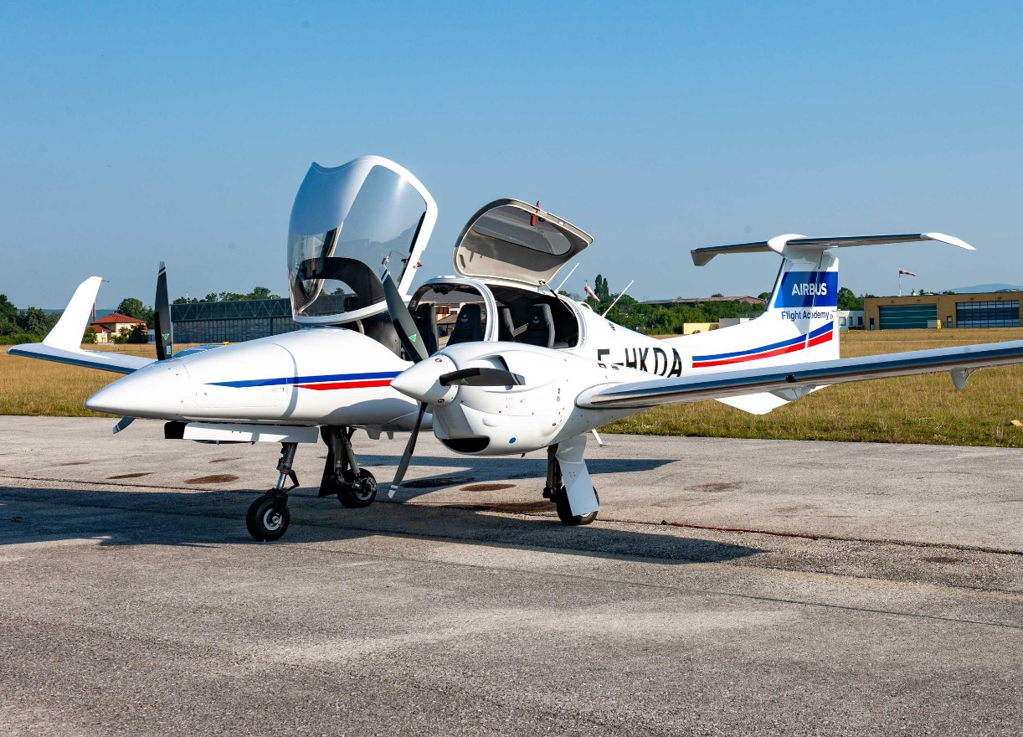
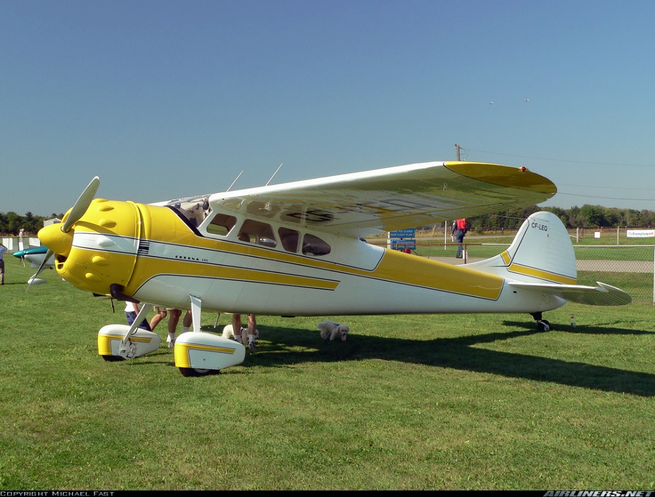
Pick an airframe
Notes:
One way to expand your horizons is to check out in a different aircraft. Maybe you’d like to step up to the latest twin-engine technology. Or perhaps you’d like to step back in time to the age of tail draggers. Either way you’ll want to get some quality transition training to maximize safety, utility, and fun. Comprehensive transition training and practice will ensure you’ll get the most out of the machine – and yourself.
(Next Slide)

Slide 7
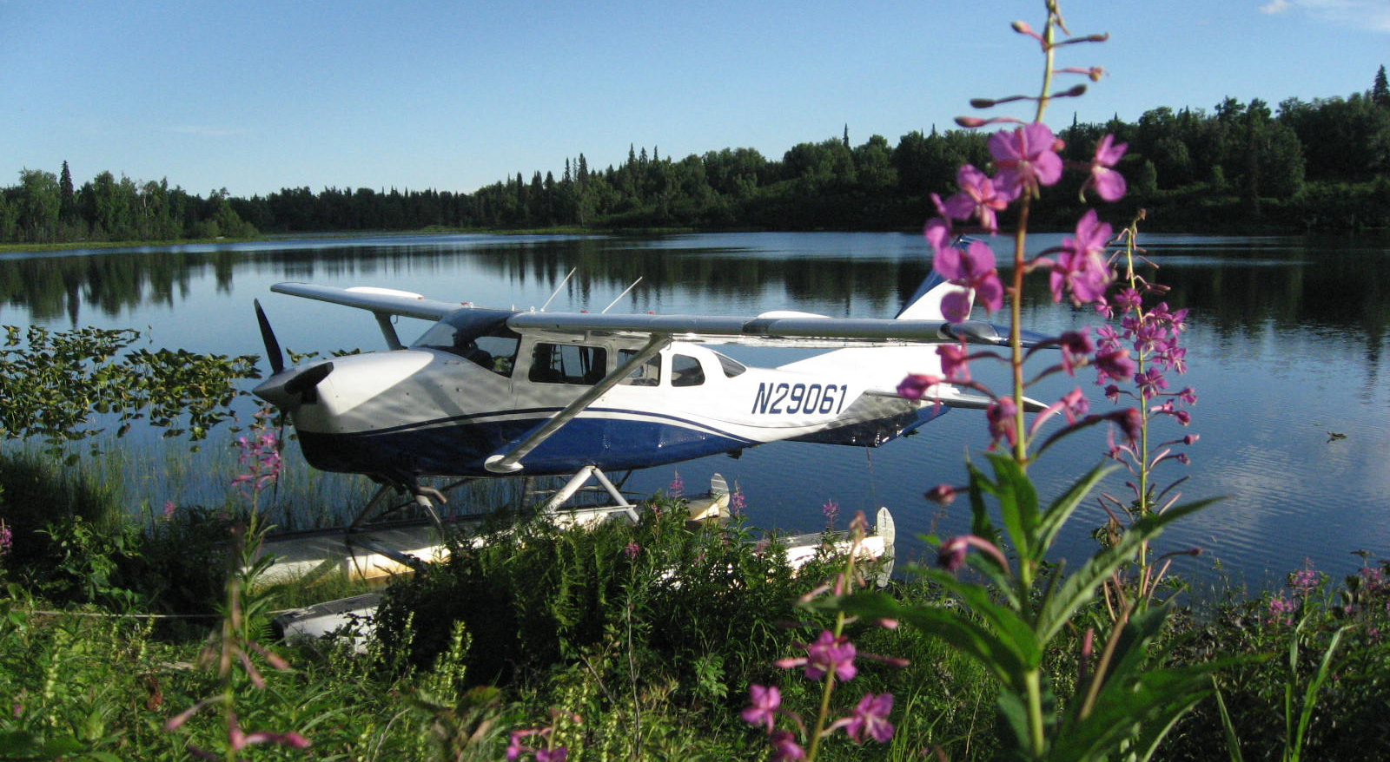
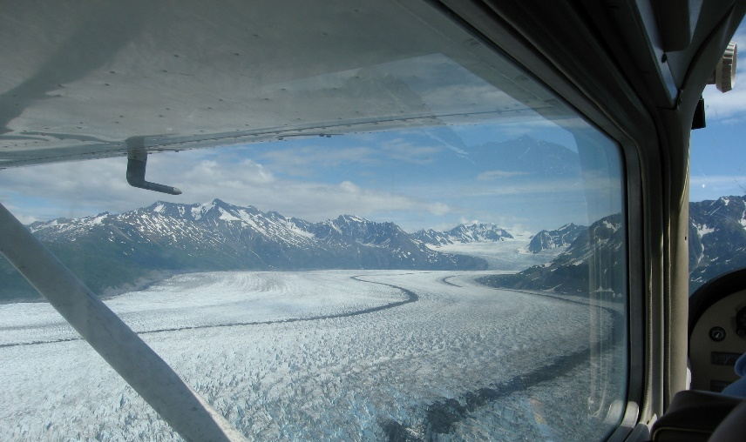
Pick a destination
Maritime
Mountains
Desert
Complex high-traffic airport
Short/Soft Field
High density altitude
Survival considerations
Notes:
One way to expand your horizons is to consider where you’d like to go and what you’d like to do that you’re not doing now. Perhaps you’d like to make an
over water flight to an island destination. Maybe you’d like to tackle a large airport with lots of traffic. Or you might be thinking of a ski trip to the mountains or a desert exploration.
Each new operational environment presents unique challenges and opportunities. The trick is to know what you’re getting into and how to operate safely and confidently in unfamiliar environments. For that you’ll need to do some research.
(Next Slide)

Slide 8
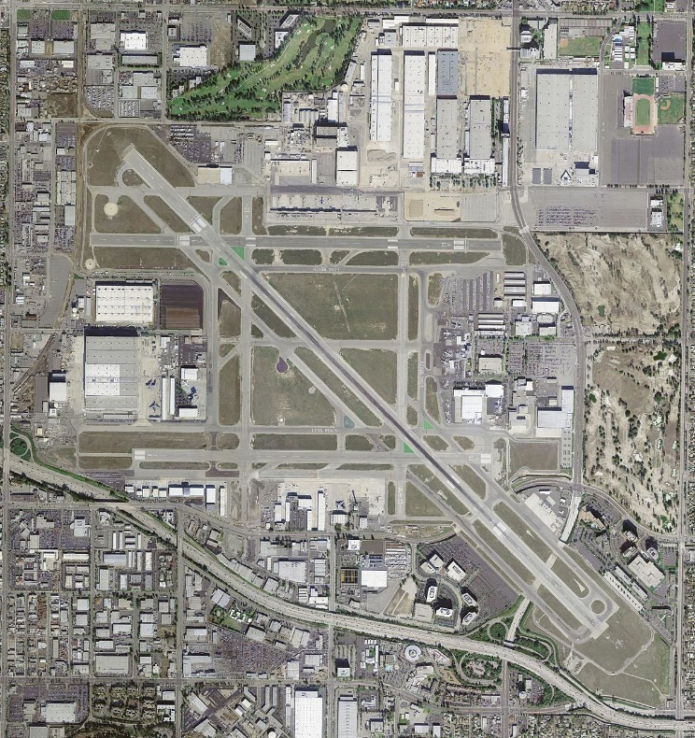
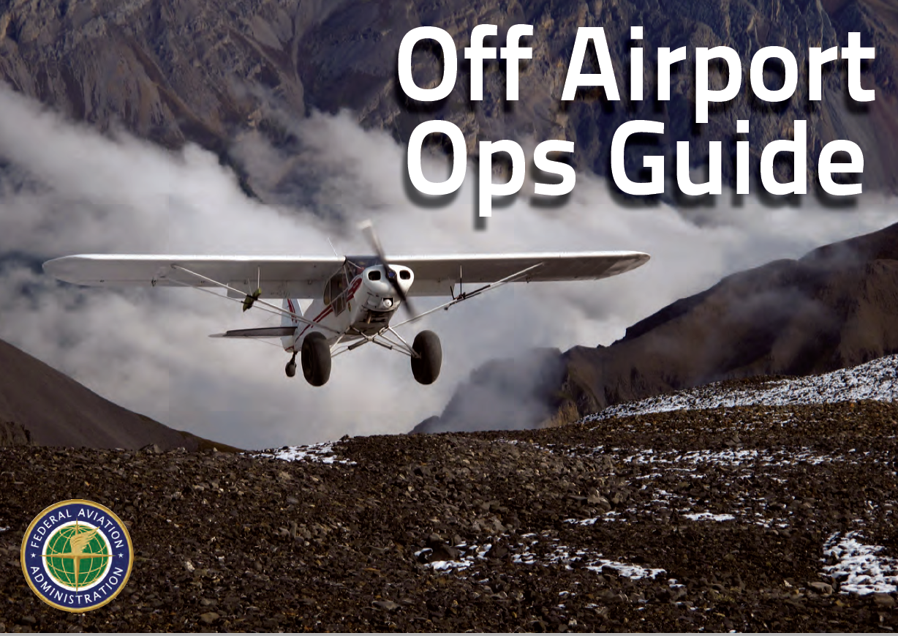
Research the destination
Chart Supplement – formerly A/FD
VFR Charts
Magazine articles
Aircraft Type Clubs
and Pilot Associations
On-line videos
  Caution!
Pilot/Instructor interviews
Notes:
The Chart Supplement – formerly known as the Airport/Facility Directory - and VFR charts will give you airport, terrain, and some obstruction information but that’s just a start. For in-depth destination information you need to consult someone who’s been there. Magazine articles can be good general sources of information as can Aircraft Type Clubs and Pilot Clubs and Associations. As you might imagine, the Colorado Pilots’ Association is a particularly good source for mountain flying information.
A word of caution about on-line videos: Many of the videos on video sharing sites depict extreme and potentially dangerous operations. Their entertainment value is undisputed but as teaching aids they may be quite inadequate.
Your best sources of information will always be pilots and instructors who regularly operate in the environment. It’s well worth the time and effort to seek them out.
(Next Slide)

Slide 9
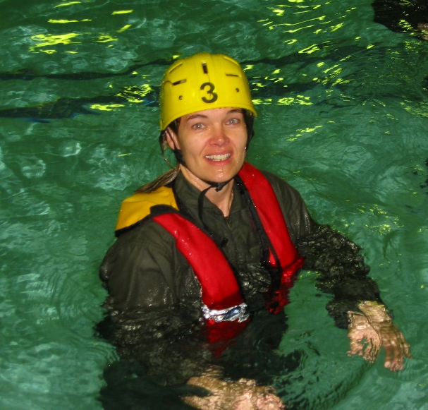
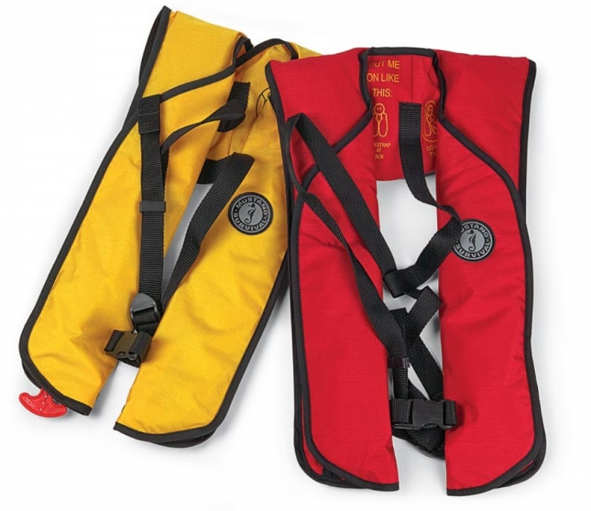
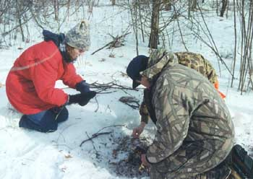
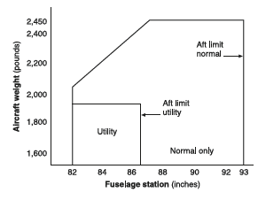
Research the requirements
Over water equipment
Survival gear
Weight & balance calculation
Notes:
If you’re planning a flight over water, through Canada, or to Alaska be sure to research requirements for flotation, signaling, and survival equipment. And be sure to do a weight and balance calculation to include the extra gear.
(Next Slide)

Slide 10
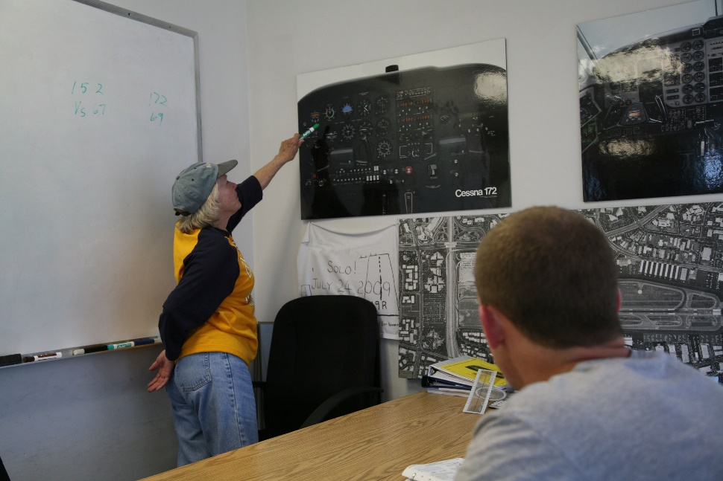
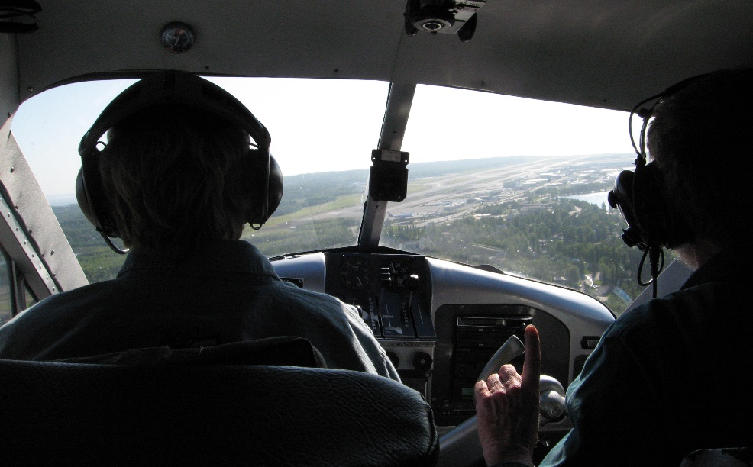
Find an Instructor
You may have to travel
  Look for schools, instructors & courses near
  your destination
  Ask for local instructor recommendations
Interview several instructors
  Pick the best fit
Get a thorough local checkout
Notes:
There may be local instructional options. Ask your local instructor for recommendations. But you may have to travel to the area you’re interested in to find an expert. It’s a good idea to interview several instructors and pick the one who’s the best fit for you and your level of piloting ability.
Once you’ve had a thorough local check out, you’ll fly with confidence and your flights will be more enjoyable.
While you’re learning the new environment why not work on a phase in the WINGS Pilot Proficiency Program.
(Next Slide)

Slide 11
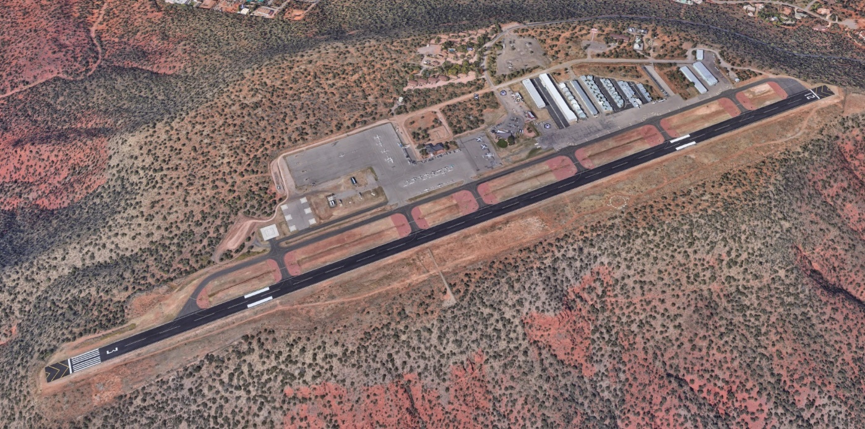
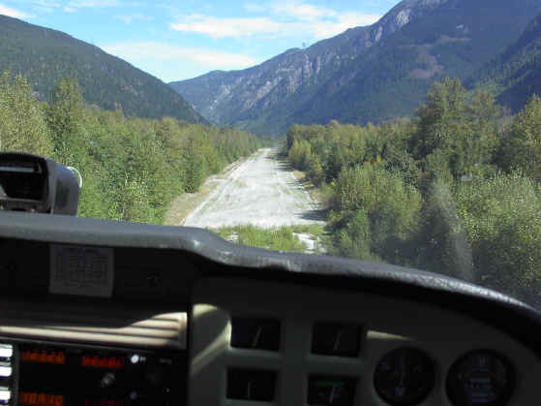
Work up to the challenge
Get some hours in the density altitude environment
  At a good-sized airport
Before you tackle something like this
Notes:
Work up to new horizons challenges. If, for instance, you’re considering operations in a high density altitude environment start out at a good-sized high density altitude airport.
Get a feel for the longer takeoff runs and lower climb performance. (Click)
Before you tackle something like this short mountain airstrip. And remember to calculate your takeoff and obstacle clearance performance before you land. You may have plenty of room for landing in the morning but takeoff and climb out may be impossible in the heat of the afternoon.
(Next Slide)

Slide 12

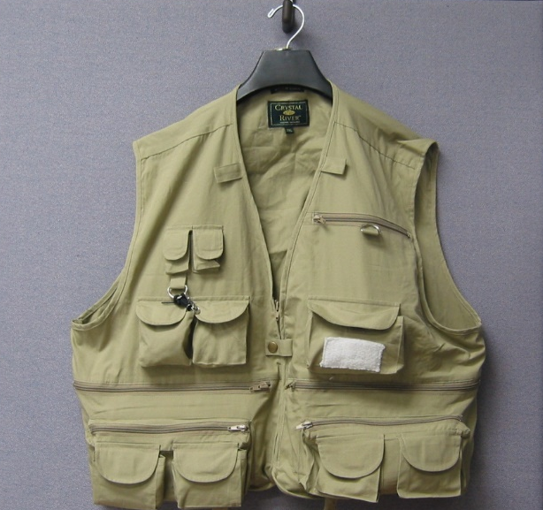
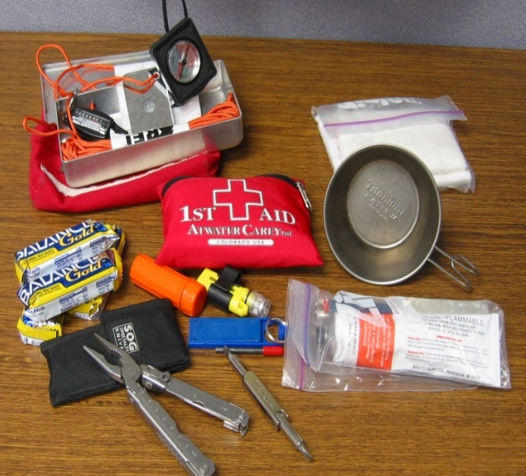
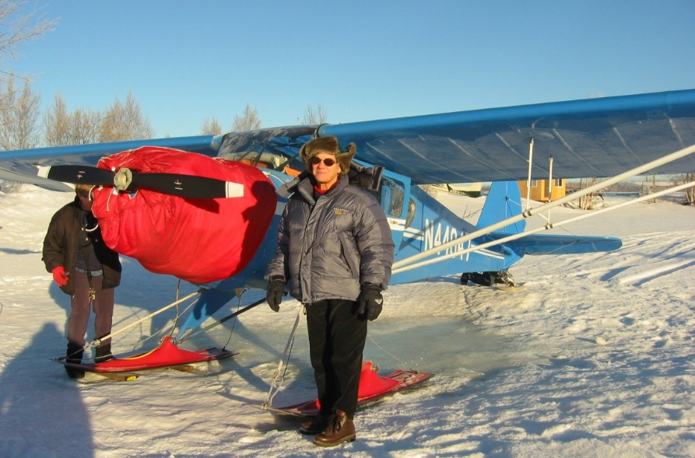
Dress for Success
In an emergency, what you have in your pockets is survival equipment. What you have in the baggage compartment is camping gear.
Notes:
Plan to dress for success. That means wearing – not just packing - clothing that matches the environment over which you’re flying. You may be comfortable in your climate controlled cabin at ten thousand feet but in the event of a forced
Landing, you may have to exit the aircraft quickly and gear that’s stowed in baggage compartments may not be accessible. (Click)
In an emergency, what you have in your pockets is survival equipment. What you have in the baggage compartment is camping gear. Many bush pilots wear vests that contains essential survival equipment. That way they’re at least equipped with the basics to survive the first few hours on the ground.
(Next Slide)

Slide 13
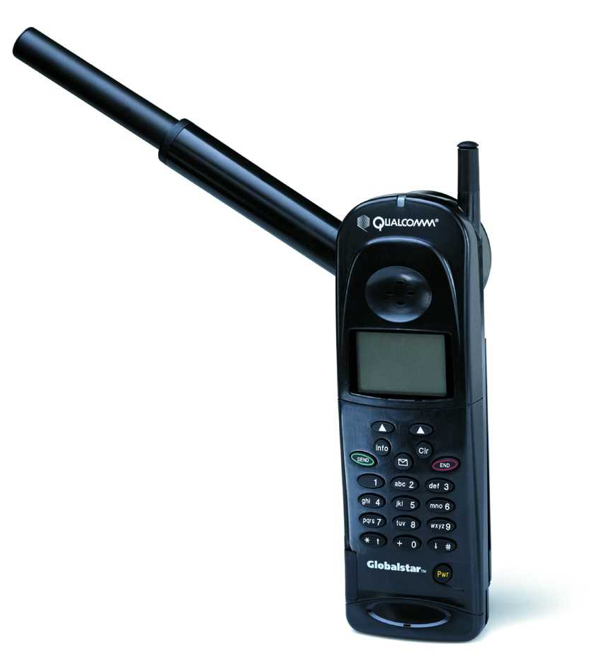
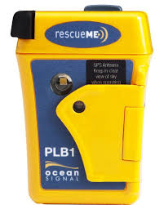

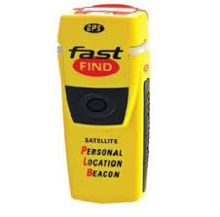
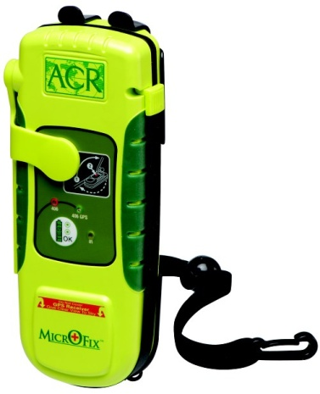
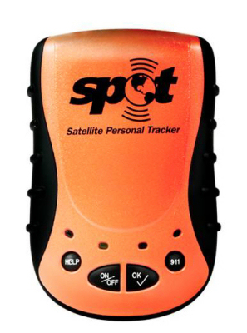
One more thing-
File a Flight Plan and….
Notes:
Filing a flight plan is an obvious safety benefit for any flight – particularly if you’re operating over water or in sparsely populated areas. Particularly for extended trips it’s also a good idea to leave a detailed itinerary that includes a communication schedule, with a trusted agent before you depart. If you haven’t called in on schedule, your agent can notify authorities to begin a search. You should also consider carrying some recent technology on your trips to the bush.
There should be enough room in your vest for a 406 Mhz Personal Locator Beacon. These relatively low cost devices are a great adjunct to the aircraft ELT.
They’re handy enough to always have with you and they’re not just for aviation. You can use them for hiking, camping, hunting, & fishing – or for peace of mind on any road less
travelled. Many of them can also process messages from you to the folks back home. You can let them know if you need help or if everything’s all right. (Click)
Satellite phones are now available for purchase or rent. Not a bad idea if you’re planning over water or remote area flying.
(Next Slide)

Slide 14
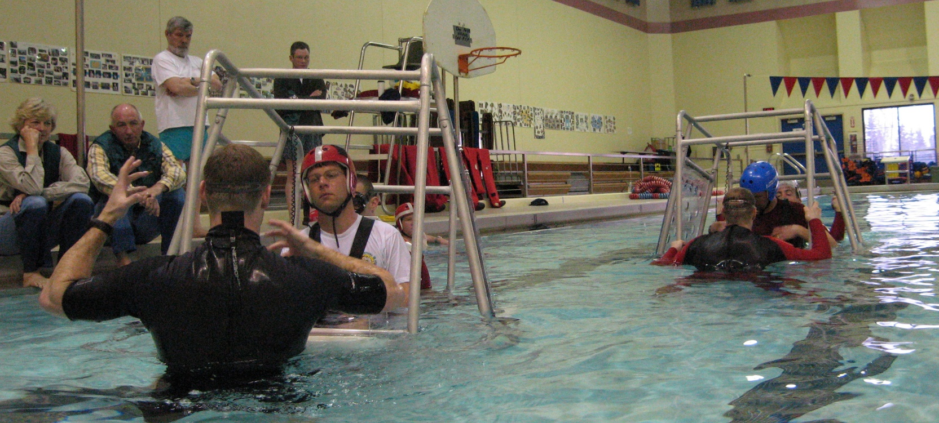
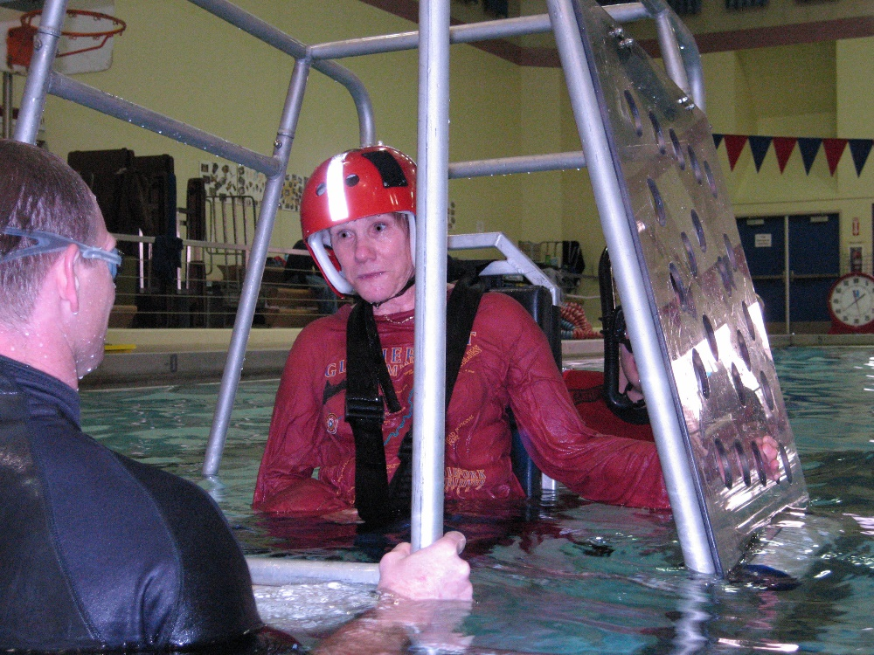
Want to learn more?
Civil Aerospace Medical Institute
  Basic Survival Training
  http://www.faa.gov/pilots/training/airman_education/survival_training/
Notes:
Want to learn more?
The Civil Aerospace Medical Institute offers a free Basic Survival Training course. You can learn more about it by navigating to this website. (Click)
Presentation note: If you have time and an internet connection you can click on the hot link and go to the CAMI website.
There are many commercial in-depth survival training courses available as well. We encourage you to consider attending one of them.
(Next Slide)

Slide 15

Have you earned your WINGS?
Proficient Pilots are:
  Confident
  Capable
  Safe
WINGS will keep you
on top of your game
Notes:
Proficiency is key to success in almost every thing worth doing – especially flying. Proficient pilots are confident, capable, and safe.
WINGS is a proficiency training system specifically designed for general aviation pilots and, regular participation will keep you on top of your flying game.
Your FAA Safety Team Program Managers and volunteer WINGSPros are available to help you with the program.
(Next Slide)
Presentation Note: This is a good time to introduce any Reps or WINGSPros in attendance.

Slide 16
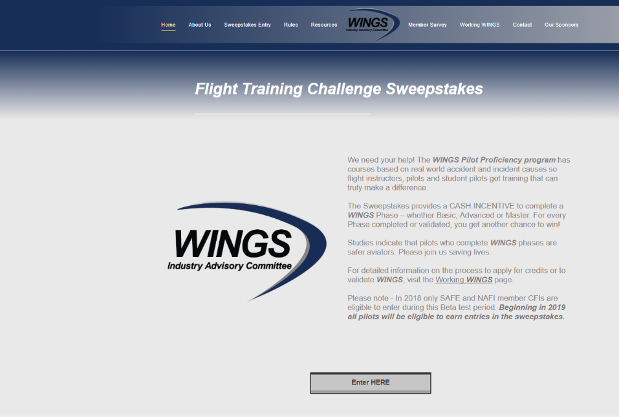
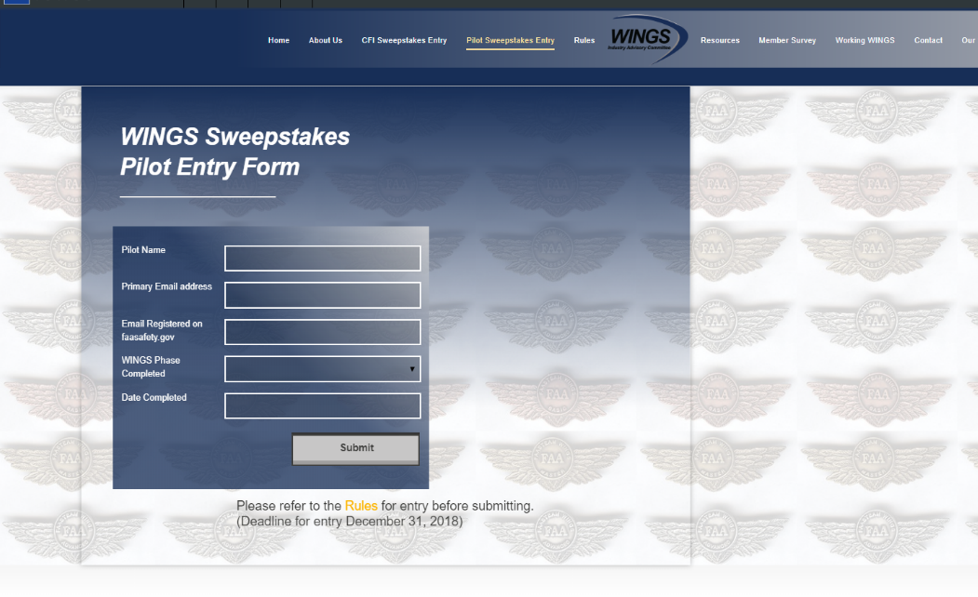
The Paul & Fran Burger 2019
WINGS $10,000 Sweepstakes
Complete WINGS Phases and WIN Cash Awards!
http://www.mywingsinitiative.org/
Notes:
Now there’s even more reasons to participate in WINGS. Every time you complete a WINGS Phase you’re eligible to win cash the WINGS Sweepstakes.
The sweepstakes is generously funded by Paul Burger, a long time advocate for general aviation safety and a retired aviator who believes participation in this program saves lives. VISIT WWW.MYWINGSINITATIVE.ORG to learn more and enter the sweepstakes.
(Next Slide)

Slide 17

How To Win – It’s Easy
Whenever you complete a WINGS phase, select WINGS Sweepstakes on the Team Member Award section of your My WINGS page
Or Visit www.mywingsinitiative.org & click on “Sweepstakes Entry”
Complete the form, get chances to win one of 10 cash prizes!
Four $1,500, Four $750,Two $500 Winners
Notes:
After you’ve completed a phase of WINGS you can enter the sweepstakes by clicking on “Claim Rewards” in the “WINGS – at a glance” section of your My WINGS page and select WINGS Sweepstakes. Or you can go directly to the mywingsinitiative.org website.
(Next Slide)

Slide 18

Questions?
Notes:
Presentation Note: You may wish to provide your contact information and main FSDO phone number here. Modify with
your information or leave blank.
(Next Slide)

Slide 19



Thank you for attending
You are vital members of our GA safety community
Notes:
Your presence here shows that you are vital members of our General Aviation Safety Community. The high standards you keep and the examples you set are a great credit to you and to GA.
Thank you for attending.
(Next Slide)

Slide 20
The National FAA Safety Team Presents
Topic of the Month - February
Expanding Your Horizons
<Audience>
<Presenter>
< >
Notes:
(The End)

