Slide 1
The National FAA Safety Team Presents
Topic of the Month - December
Engine Maintenance and
Flight Data Monitoring
<Audience>
<Presenter>
< >
Notes:
2020/12-01-215(I)PP Original Author: J. Steuernagle Nov 2020 POC: K CloverAFS-850 Operations Lead Office 562-888-2020.
Presentation Note: This is the title slide for Engine Maintenance and Performance Monitoring
Presentation notes (stage direction and presentation suggestions) will be preceded by a Bold header: the notes themselves will be in Italic fonts.
Program control instructions will be in bold fonts and look like this: (Click) for building information within a slide; or this: (Next Slide) for slide advance.
Some slides may contain background information that supports the concepts presented in the program.
Background information will always appear last and will be preceded by a bold Background: identification.
We have included a script of suggested dialog with each slide. Presenters may read the script or modify it to suit their own presentation style.
The production team hope you and your audience will enjoy the show. Break a leg!
(Next Slide)

Slide 2


Welcome
Exits
Restrooms
Emergency Evacuation
Breaks
Phones & Pagers to Silent or Off
Sponsor Acknowledgment
Other information
Notes:
Presentation Note: Here’s where you can discuss venue logistics, acknowledge sponsors, and deliver other information you want your audience to know in the beginning.
You can add slides after this one to fit your situation.
(Next Slide)

Slide 3
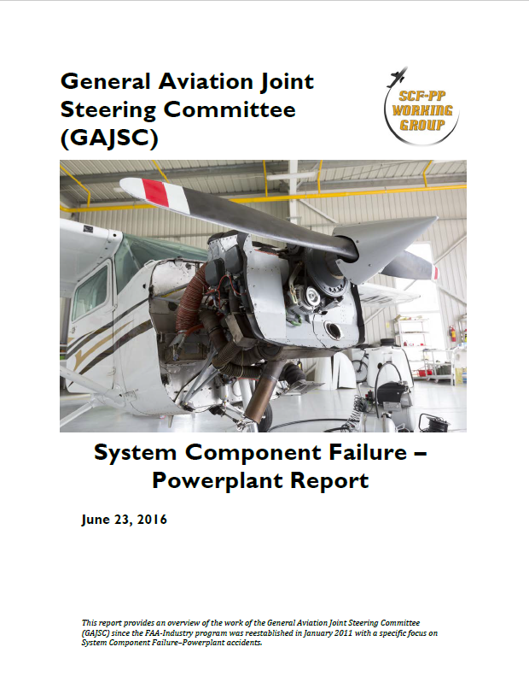
Overview
*GAJSC System/Component Failure Study
Best Practices for Engine Maintenance
Best Practices for Engine Operation
Safety Benefits of Flight Data Monitoring
Present & Future FDM Technologies
How GA pilots can use FDM today
*General Aviation Joint Steering Committee
Notes:
Recently, the GAJSC System/Component Failure Work Group released Safety Enhancements dealing with Engine Maintenance and Flight Data Monitoring. The work group feels that
performance monitoring can help to identify emerging problems with aircraft systems and components and facilitate replacement or repair before failure.
We want to take just a few minutes to talk about best practices for reciprocating engine maintenance and operation, and
the safety benefits of Flight Data Monitoring – a technology and process that’s now coming to General Aviation.
We’ll look at present & future FDM technologies, and we’ll talk about how to use FDM today.
Presentation Note: If you’ll be discussing additional items, add them to this list
(Next Slide)

Slide 4
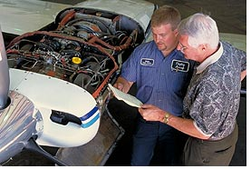
Know your mechanic
Take an active role
Review inspection results
Review ADs and Service Bulletins
Assist with inspections
Notes:
Ideally, pilots and mechanics should work together to ensure that aircraft are operated and maintained properly. Pilots are encouraged to take
an active role in maintenance; reviewing inspection results and discussing Airworthiness Directives and Service Bulletins.
Assisting with inspections is a great way to get to know your mechanic and your aircraft but let’s face it, most of us don’t have the opportunity to so.
Still, as pilots we have extensive airworthiness responsibilities. Let’s take a look at why that’s so.
(Next Slide)

Slide 5
14 CFR Part 1
Definition of Operate.
Operate, with respect to aircraft, means use, cause to use, or authorize to use aircraft, for the purpose (except as provided in § 91.13 of this chapter) of air navigation including the piloting of aircraft, with or without the right of legal control (as owner, lessee, or otherwise).
Notes:
We’ll begin with 14 CFR Part 1 – Definitions. To operate an aircraft means to use, cause to use or authorize an aircraft for the purpose of air navigation.
By the way 14CFR 91.13 has to deal with careless and/or reckless operation of aircraft. Interestingly, whether or not you have the legal right or permission to do so, piloting an aircraft is operating it and the importance of that is addressed in the next slide.
(Next Slide)

Slide 6

but I don’t own the aircraft; I just fly them.
14 CFR 91.3 Responsibility & authority of the pilot in command.
  PIC is “directly responsible” and
  “final authority”
14 CFR 91.7 Civil aircraft airworthiness
  PIC is responsible for:
    Determining aircraft condition and
    Discontinuing flight when unairworthy
    conditions occur.
Notes:
A common misconception among renter pilots is that they are only responsible for the preflight walk around inspection and perhaps VOR and Navigational Data Base checks. Others are responsible for maintenance inspections, service bulletins, and AD Compliance. Well CFR 91.3 makes the Pilot in Command directly responsible for and the final authority as to the operation of an aircraft and CFR 91.7 specifically charges the PIC with determining the airworthiness of an aircraft before flight and for discontinuing flight when un-airworthy conditions occur.
That’s a tall order for a rental pilot and impossible to execute without some communication between aircraft maintainers and pilots. But before we talk about that, what does airworthy mean?
(Next Slide)

Slide 7
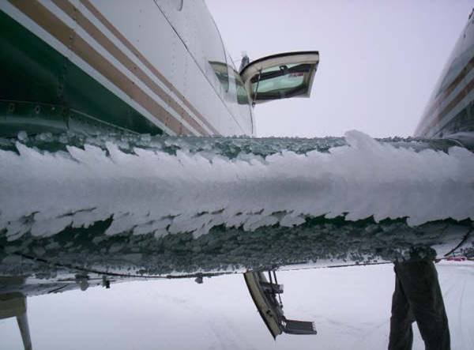
So what does airworthy mean?
1. Must conform to type design
  As manufactured
    Type Certificate (TC)
  As modified
    Supplemental Type Certificate (STC)
    Other approved alterations
2. Must be in condition for
safe operation
Notes:
There are two tests for airworthiness. (Click)
First – the aircraft must conform to its’ type design. The Type Certificate (TC) attests to the fact that the aircraft conforms to all design specifications.
But we know that many aircraft are extensively modified over time. Those modifications are memorialized in Supplemental Type Certificates (STCs). TCs, STCs, and other approval documents
specify conformance to type design. (Click)
Second – In addition to conforming to type design, the aircraft must be in condition for safe operation. An aircraft may conform to type design yet not be safe to fly. That’s a determination that pilots make each time they do their preflight walk around checks.
(Next Slide)

Slide 8
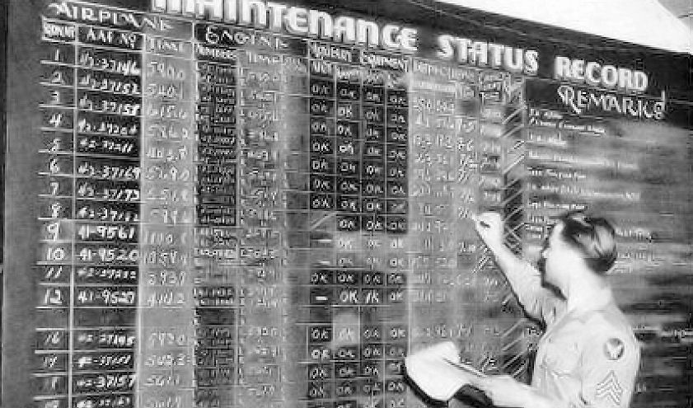
Aircraft Status
Online, paper, or wall chart
Inspections – aircraft & equipment
  Time next inspection is due
ADs & Service Bulletins
  Status sheets
Out of service & Return to Service
Caution! These are not permanent records. Trust but verify.
United States Army Air Forces, Public Domain, via Wikimedia Commons
Notes:
Researching applicable Ads and compiling a status report can take an experienced mechanic 6 to 8 hours to accomplish. Most pilots will
take longer….. a lot longer! That’s why it’s vitally important to have a good information sharing process. A trusted aircraft status information
source is essential to fulfilling pilot in command responsibilities.
Aircraft status can be documented on paper (logbooks, status sheets, squawk sheets), on a wall chart, or in a computer. Whatever method is chosen
the documentation must be accurate and up to date. Whenever an aircraft is taken out of service there must be a documented Return to Service
statement in the appropriate airframe or power plant log. (Click)
Caution! – With the possible exception of an online maintenance documentation system, the information sources discussed here are not the official “permanent” records
for maintenance and inspection. For most of us, the permanent records are the Airframe and Power Plant logbooks. If we’re not looking at these we must have utmost
confidence in the information we’re getting, as it were, second hand.
(Next Slide)

Slide 9
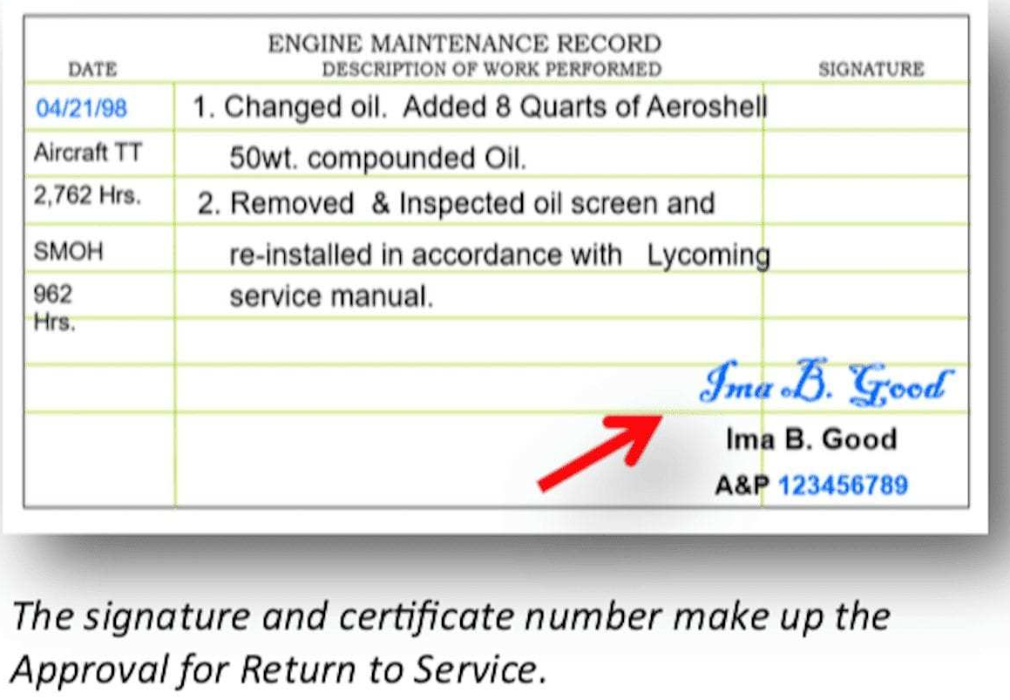
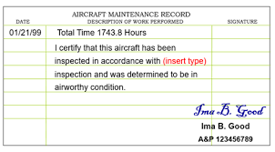
Return to service
Notes:
Here are two examples of aircraft return to service documentation. Pilots don’t usually check the aircraft logs before each flight but they are still responsible
for knowing that maintenance has been completed and, more importantly, that work is still being done and the aircraft has not been returned to service. A simple check to verify that an aircraft has been returned to service can prevent a nasty surprise in flight. There are too many cases of accidents occurring in aircraft that were flown before maintenance was complete.
(Next Slide)

Slide 10

Service intervals
Oil & Filter Change
  50 Hrs. (30 Hrs. for Turbos)
    Filter Inspection – Immediate Results
    Oil Analysis – Multiple results over time, for trending
  100 Hrs. add:
    Compression Check
    Magneto Timing
    Spark plug inspection & maintenance
    Exhaust system check
ADs & Service Bulletins
Notes:
Comply with all manufacturer-recommended service intervals. Fifty-hour oil changes are recommended for most normally aspirated piston engines.
Turbo-charged engines should undergo oil changes more frequently. Oil filter inspection with each oil change yields immediate feedback. If metal particulate is discovered in the filter, it could be cause for concern.
Oil analysis can reveal a lot about engine health as well but it works best when a trend can be identified over several samples. It’s not a bad idea to do a compression check, Mag timing, Spark plug inspection and Exhaust system check every other oil change.
It’s also a good idea to check ADs & Service Bulletins during regular service as well.
(Next Slide)

Slide 11
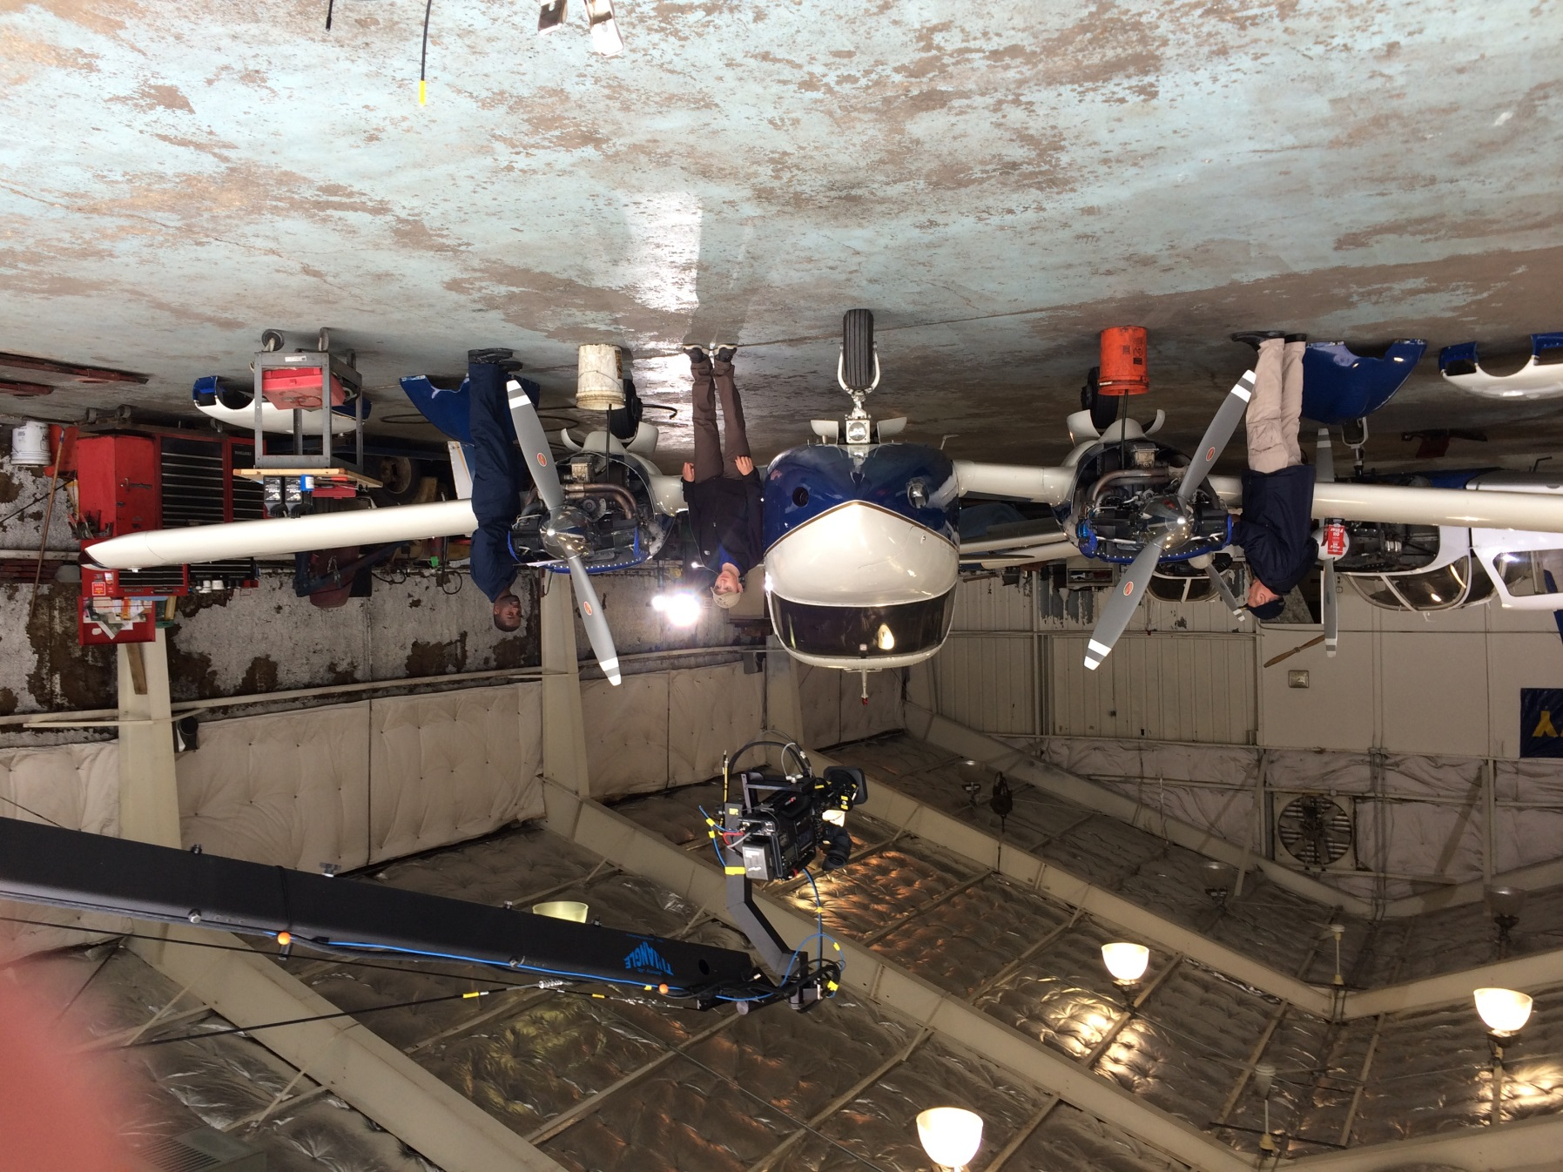
Not just an oil change
Opportunity for inspection
  Leaks and stains
  Missing, broken, or loose hardware
  Tires
  Brakes
  Oleo struts
Notes:
Whether you’re assisting your mechanic or doing it yourself, every service interval is an opportunity to see parts of the aircraft that are covered most of the time. While the oil is draining, take the time to give your aircraft a once-over. Look for leaks and stains in the engine compartment and wherever fuel or hydraulic fluid flows. Look for missing, broken or loose hardware. Check the condition of hoses, belts, and baffles. Tires, brakes, and oleo struts deserve your attention as well. It’s a lot easier to identify and quicker to correct deficiencies while your bird is in the shop than to make another service appointment.
(Next Slide)

Slide 12

Engine Operation
Fly Often
Minimize thermal shock
  Warm up before flying.
  Smooth power application and reduction
  Be careful when operating lean of peak EGT
  Plan descents to avoid shock cooling.
    Especially important for Turbos
    And in cold weather.
Monitor performance
  Small changes can forecast developing problems.
Notes:
How we operate our engines has a lot to do with how long they’ll last.
First of all – fly often. It’s actually harder on an engine if the airplane is in a hangar – or worse - a ramp queen. Regular operation keeps your engine
components lubricated - markedly reducing corrosion potential.
Thermal shock can be very hard on engines so be sure yours has reached operating temperature before taking off.
Smooth, steady power changes are good for engine longevity. This is especially true for turbo charged power plants.
Be sure to strictly follow manufacturers’ recommendations when operating on the lean side of peak Exhaust Gas Temperature. It’s not worth
saving a gallon or so per hour if your engine overheats in the process.
Once again - especially for Turbos - plan your descents with some power to keep the engine warm.
Finally, monitor engine performance from flight to flight. Small changes over time can forecast developing problems.
We’ll talk about monitoring in detail in the next slides.
(Next Slide)

Slide 13

Flight Data Monitoring
Notes:
Flight data monitoring has been around since before the jet age and modern airplanes make extensive use of the technology. Through Flight Data Monitoring, aircraft operators can develop
optimal maintenance schedules, confirm aircraft performance expectations, and predict system or component failures before they occur. Flight Data Monitoring and Recording are also
of great value in accident investigation.
(Next Slide)

Slide 14
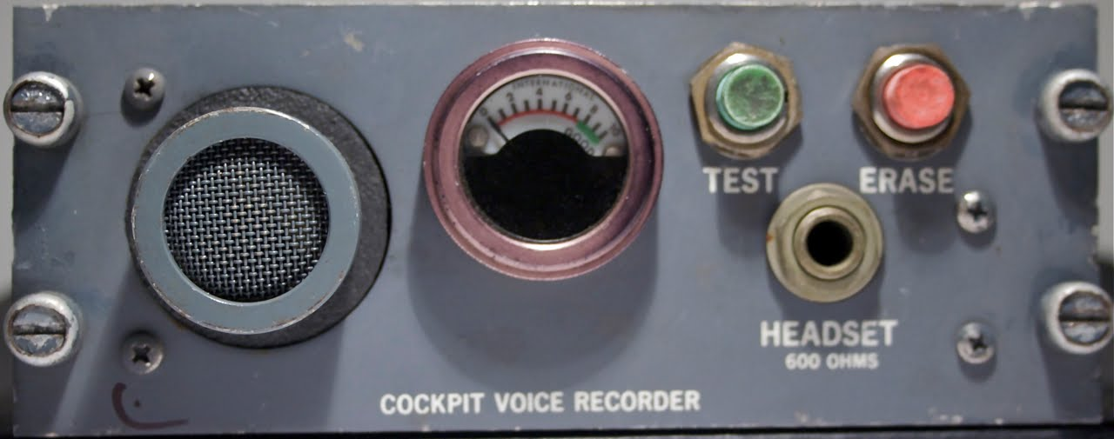
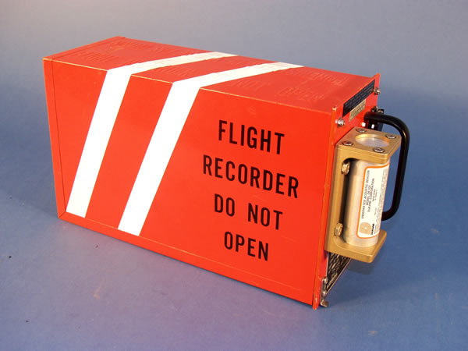
Flight Data Monitoring
FOQA
Cockpit Voce Recorder (CVR)
Flight Data Recorder (FDR)
Notes:
In its’ simplest form, FDM consists of a cockpit voice recorder that records at least the most recent 15 minutes of crew conversations, and a flight data recorder that preserves such things as engine parameters, control position, heading, altitude, and airspeed data. (Click)
The equipment and processes to acquire and distribute the data are collectively known as Flight Operational Quality Assurance or FOQA (pronounced: Fohqua)
But this equipment is only for the big guys right? General Aviation aircraft don’t have anything like this ……………………. Or do they?
(Next Slide)

Slide 15
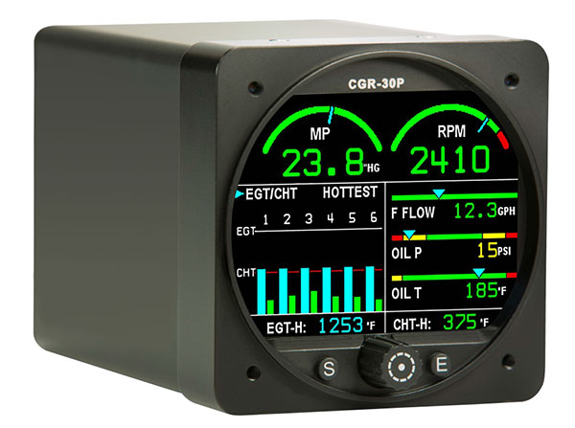
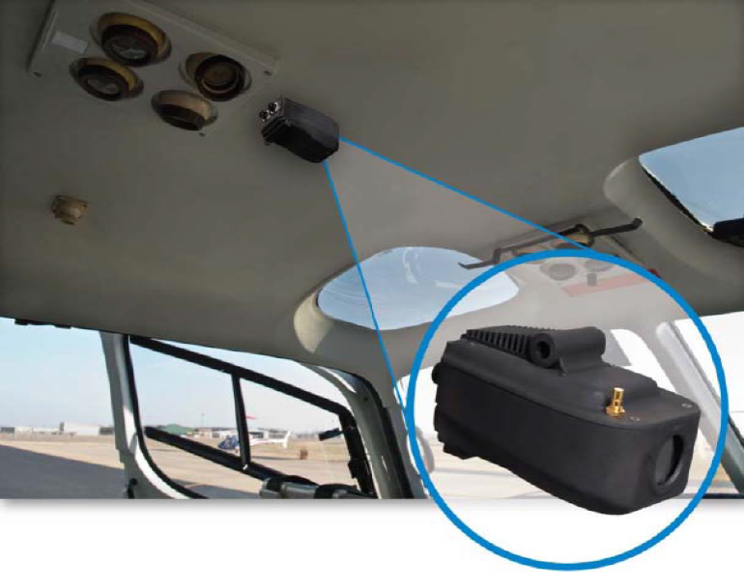
Flight Data Monitoring for GA
Flight Data
Flight Data + Visual
Notes:
While it’s true that most GA aircraft don’t have dedicated automatic flight data recording devices now; we will be able to enjoy the benefits of equipage in the future. In the meantime it’s often surprising to see what we already have. (Click)
Manufacturers are already offering self-contained flight data and visual data recorders for GA airplanes and helicopters. Most operators of this equipment must periodically down load and analyze the recorded data – often with the aid of dedicated computer programs.
(Next Slide)

Slide 16
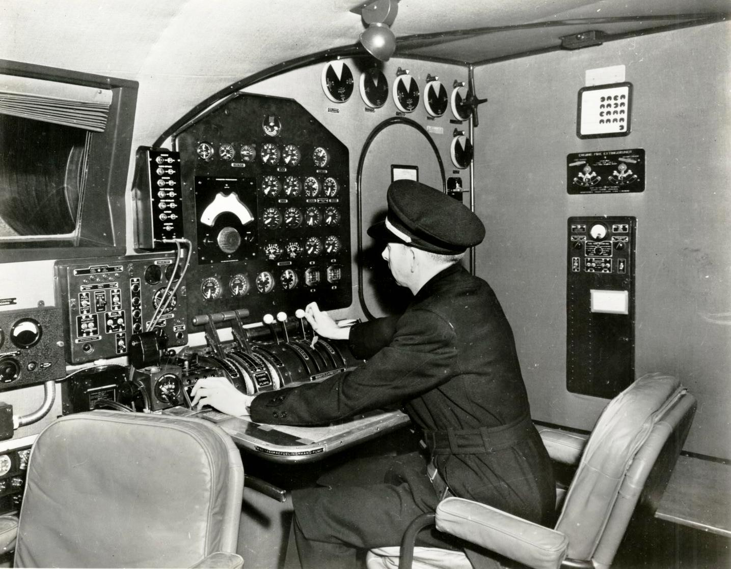
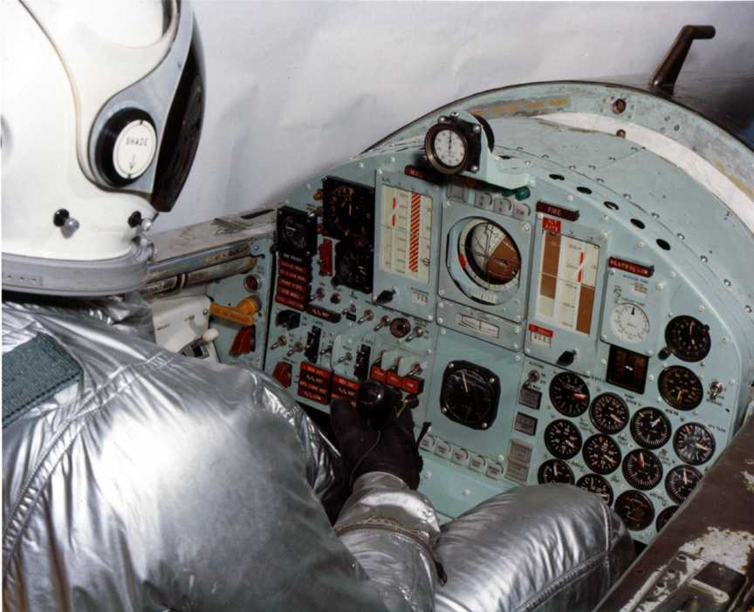
Flight Data Monitoring for GA
Notes:
Many data monitoring operations involve no automation at all. Flight engineers used to handle the monitoring and record keeping (Click)
And test pilots were expected to keep notes while flying.
(Next Slide)

Slide 17
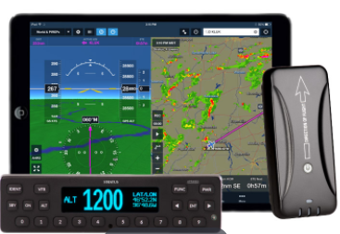

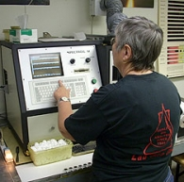
Flight Data Monitoring for GA
Notes:
GA pilots can do much the same thing by tracking engine power, fuel flow, oil temperature and pressure. Some GPS systems and engine monitors have recording capability and many aircraft owners participate in oil analysis programs – a tool for gauging engine health and heading off expensive or, in some cases, disastrous problems. Some aircraft – particularly helicopters - are equipped with metallic chip detectors that can forecast engine and transmission failures in time to make a safe landing.
(Next Slide)

Slide 18
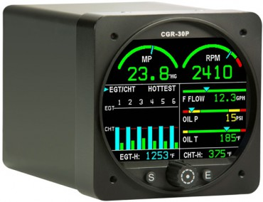
Sample of What's Available to the GA Community
PRIMARY ENGINE MONITOR SYSTEM
RPM M.P. EGT/CHT Bar Graph Oil Pressure Oil Tempreature TIT Hyd Pressure C.O. OAT Vac. | Fuel Pressure Fuel Level Fuel Flow Fuel Remaning Fuel Used Fuel -GPS Related Data Low Fuel Alarm Recurring Fuel Alarm Volts Amps | Flight Timer Tach Timer Local Time Zulu Time Annuciators Data Recording USB Port External Caution Lights And More
Notes:
Here’s just one example of the information available in one small box. This example doesn’t include recording capability but it’s certainly one-stop shopping for engine information.
(Next Slide)

Slide 19
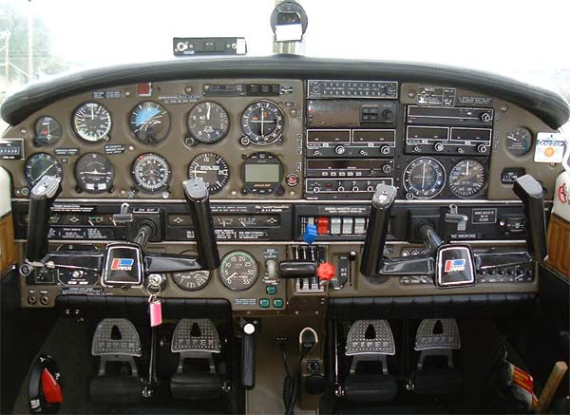
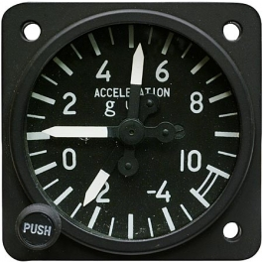
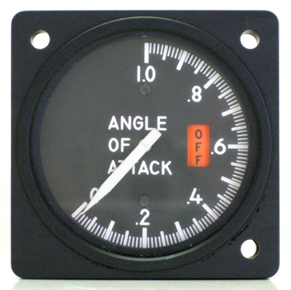
Flight Data Monitoring for GA
Notes:
And don’t forget basic instrumentation such as Air Speed Indicators, Attitude Indicators, Angle of Attack, Manifold Pressure, RPM, and G indicators – all of which give immediate feedback as to whether design limitations have or are about to be exceeded.
(Next Slide)

Slide 20
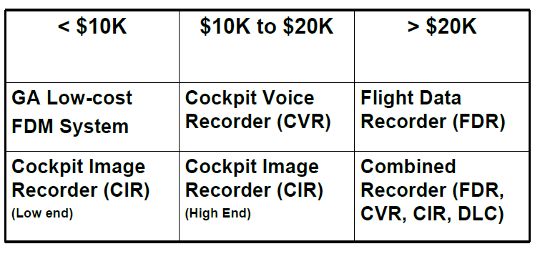
FDM Technology Cost
Notes:
At present FDM Technology costs from a little less than $10,000.00 to more than $20,000.00 but as competition and equipage increase, prices are expected to fall.
(Next Slide)

Slide 21


Flight Data Monitoring for GA
Notes:
In the meantime, we urge you to consider the information that’s already available on every flight.
(Next Slide)

Slide 22

Questions?
Notes:
Presentation Note: You may wish to provide your contact information and main FSDO phone number here. Modify with
Your information or leave blank. (Next Slide)

Slide 23


Proficiency and Peace of Mind
Fly regularly with your CFI
Perfect Practice
Document in WINGS
Notes:
There’s nothing like the feeling you get when you know you’re playing your A game and in order to do that you need a good coach (Click)
So fly regularly with a CFI who will challenge you to review what you know, explore new horizons, and to always do your best. Of course you’ll
have to dedicate time and money to your proficiency program but it’s well worth it for the peace of mind that comes with confidence. (Click)
Vince Lombardi, the famous football coach said, “Practice does not make perfect. Only perfect practice makes perfect.” For pilots that means
flying with precision. On course, on altitude, on speed all the time. (Click)
And be sure to document your achievement in the Wings Proficiency Program. It’s a great way to stay on top of your game and keep you flight review current.
(Next Slide)

Slide 24
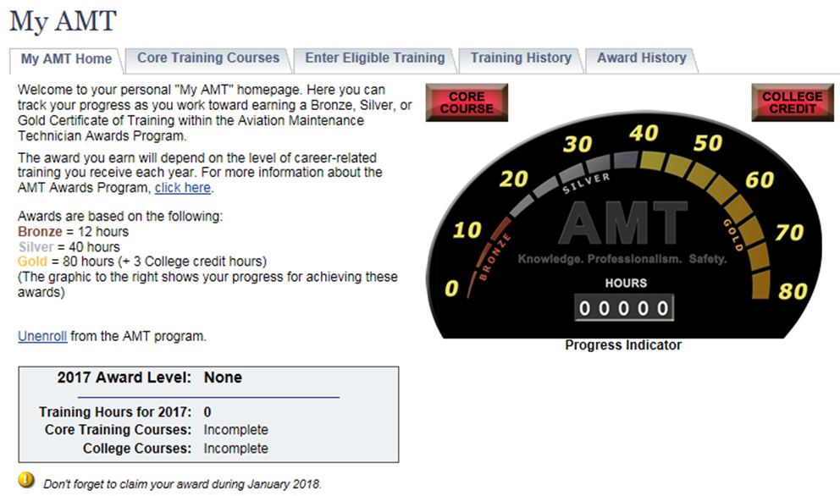
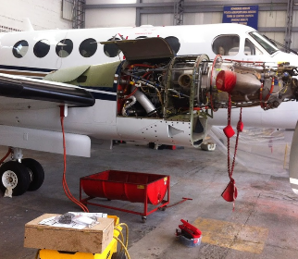
Training and Peace of Mind
Technical Training
Safety Related Training
Document in My AMT
Notes:
The AMT Awards program encourages AMTs and employers to take advantage of initial and recurrent training by issuing awards based on training received in one calendar year.
The program has several levels, or phases, of recognition for both you and your employer. You can obtain an FAA Certificate of Training upon successful completion of the program requirements. Employers can obtain a Gold or Diamond Award of Excellence yearly depending on the percentage of their employees receiving awards.
Training earned toward an AMT Award falls into one of two categories; Mandatory Core Training and Eligible Training.
Mandatory Core Training is one or more on-line training courses, depending on FAA evaluation of training needs. The Core Training course(s) can be located and completed in the Aviation Learning Center at FAASafety.gov.
Eligible Training is the hourly training that can be credited toward an individual AMT Certificate of Training. This training must be aviation maintenance career related training.
Be sure to document your achievement in the AMT Awards Program. It’s a great way to stay on top of your game and keep stay proficient.
(Next Slide)

Slide 25



Thank you for attending
You are vital members of our GA safety community
Notes:
Your presence here shows that you are vital members of our General Aviation Safety Community. The high standards you keep and the examples you set are a great credit to you and to GA.
Thank you for attending.
(Next Slide)

Slide 26
The National FAA Safety Team Presents
Topic of the Month - December
Engine Maintenance and
Flight Data Monitoring
<Audience>
<Presenter>
< >
Notes:
(The End)

