Slide 1
The National FAA Safety Team Presents
Topic of the Month
February
Transition Training
<Audience>
<Presenter>
< >
Notes:
2022/03-16-247(I)PP Original Author: J. Steuernagle March 2022 POC: K. Clover National FAASTeam Program Manager (Operations) Office 562-888-2020
Presentation Note: This is the title slide for Transition Training
Script - We have included a script of suggested dialog with most slides. The script will always appear in a non-italic font. Presenters may read the script or modify it to suit their own presentation style. See template slides 5 and 6 for examples of a slides with script.
Presentation Instructions - (stage direction and presentation suggestions) will be preceded by a Bold header: the instructions themselves will be in Italic fonts. See slides 2, 3, and 4 for examples of slides with Presentation Instructions only.
Program control instructions - will be in bold fonts and look like this: (Click) for building information within a slide; or this: (Next Slide) for slide advance.
Background information - Some slides may contain background information that supports the concepts presented in the program.
Background information will always appear last and will be preceded by a bold Background: identification.
The production team hope you and your audience will enjoy the show. Break a leg!
(Next Slide)

Slide 2


Welcome
Exits
Restrooms
Emergency Evacuation
Breaks
Set cell phones and pagers to silent or off
Sponsor Acknowledgment
Other information
Notes:
Presentation Note: Here’s where you can discuss venue logistics, acknowledge sponsors, and deliver other information you want your audience to know in the beginning.
You can add slides after this one to fit your situation.
(Next Slide)

Slide 3

Overview
Loss of Control Accidents
GAJSC* Safety Enhancements
Transition Training Types
Tips and Tricks
*GAJSC – General Aviation Joint Steering Committee
Notes:
In this presentation we’ll talk a little bit about Loss of Control Accidents and recommendations from a work group that studies loss of control. We’ll talk about the different types of transition training and offer suggestions that will help you to get the most from your training. Finally we’ll give you some tips and tricks that will help you to avoid loss of control in any aircraft.
Presentation Note: If you’ll be discussing additional items, add them to this list (Next Slide)

Slide 4
Fatal LOC Accidents – 10 Years
Notes:
There were 1250 fatal loss of control accidents in a recent 10 year period. (Click)
About half of those accidents occurred in the maneuvering and approach phases of flight – think stall/spin/crash
It’s also true that many accidents occur when pilots fly aircraft they’re unfamiliar with. In fact the first 50 to 100 hours in a new aircraft type are particularly dangerous; particularly when a formal transition training program is not followed.
(Next Slide)

Slide 5

LOC Workgroup Findings
Lack of single – pilot CRM skills
Un-stabilized approaches
Inappropriate go-around procedures
Flight after extended periods of not flying
Over reliance on automation
Flight after use of drugs
Lack of Aeronautical Decision Making Skills
Insufficient transition training
Notes:
Here are some findings of a recent study of Loss of Control accidents. Most fatal GA Loss of Control accidents have one or more of these causal factors.
Single-pilot Cockpit Resource Management skills are often cited as deficient. There’s a lot of information and resources available and the most successful pilots know how to make use of all of it without introducing distractions.
Many loss of control accidents result from un-stabilized approaches – both VFR and IFR. This is closely tied to the next item on the list – go-around procedures. If you’re not stable on final approach – go around. Don’t give in to pressure to get it on the ground. Learn to recognize and correct for de stabilizing influences.
For flight after extended periods of not flying think of aircraft builders who spend years of spare time building and then begin a flight test program in a brand new aircraft. Or imagine a pilot who’s taken time off from flying to work on career, education, or family and then returns to the game. Transition and refresher can make all the difference here.
Over reliance on automation and the proliferation of “glass” cockpits have contributed to a remarkable number of loss of control accidents.
Toxicology studies following fatal GA accidents found some sort of medication in 80 % of accident pilots. Although we can’t say the medication caused the accident it could be a factor as is the underlying medical condition requiring the medication. Obviously full disclosure to your Aviation Medical Examiner is key to avoiding compromise of your piloting skills.
Finally, Investigators suggest the need for improvement in Aeronautical Decision Making.
And Finally, Insufficient transition training We’re seeing it in the airlines and also in general aviation. It’s interesting to note that, with the exception of the possible misuse of drugs, a structured transition training program can address each of these causal factors.
(Next Slide)

Slide 6
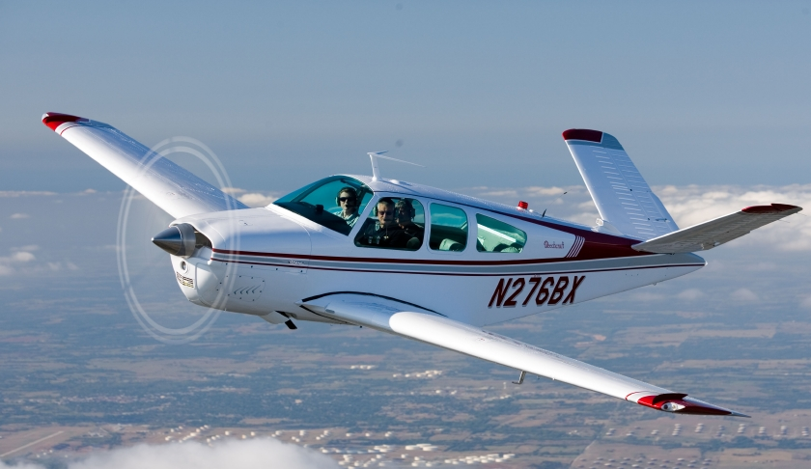

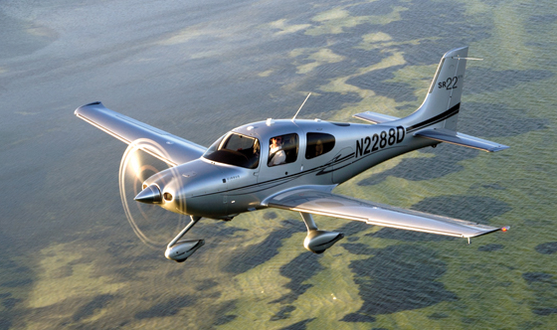
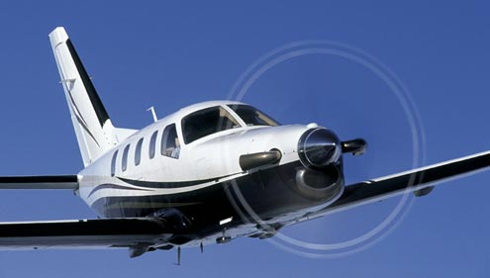
Stepping up
Notes:
Pilots usually think of transition training in the context of stepping up to a larger, faster, or more complex aircraft.
Complex airplanes are generally faster than what transitioning pilots are used to. With more to do and less time to do it, staying ahead of the airplane can be a challenge.
(Next Slide)

Slide 7

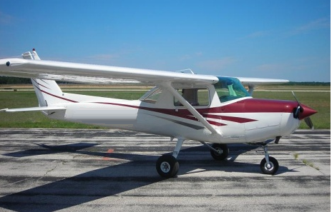
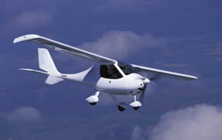
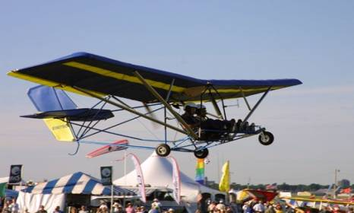
Transition Training for Pilots
Notes:
But transition training works both ways. Believe it or not; it’s equally challenging to transition from high performance airplanes to lower performance craft.
Pilots trained in C152 “Heavies” approaching at 60 knots may find themselves floating down the runway in designs with lower wing loading and lower approach speeds.
Stories abound of light sport aircraft damaged at the hands of certificated pilots who were trained in traditional aircraft.
So stepping down is just as important as stepping up. Let’s face it – we all want to get the best performance out of our flying machines and we want to do it safely. That means we need to be thoroughly familiar with each aircraft we fly.
Presentation note: Poll the audience as to what types of aircraft they fly i.e. experimental, light sport, tail wheel, single vs multi engine, transport category. Many audiences will have a wide diversity of experience.
Well it’s obvious that the need for transition training isn’t going away soon. Now let’s take a look at how to get started.
(Next Slide)

Slide 8
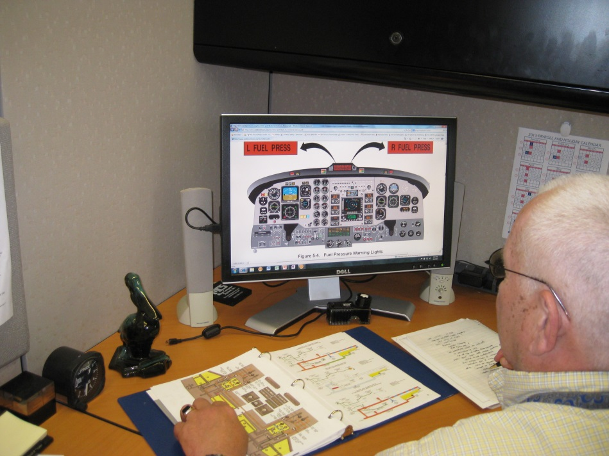
Read the book
Pilot’s Operating Handbook
Performance Charts
Speeds for safe operation
Weight & balance
Mission planning
Emergency procedures
Systems
Notes:
You can get a leg up on your transition if you study the book first. Especially if you’ve flown similar aircraft before. If the systems are all new to you get a flight instructor to guide your study.
Know these cold:
Emergency procedures
Speeds, power settings, & configurations for normal operations
Plan several flights that represent the types of operations you intend to pursue. You’ll get a feel for what you can and can’t do with the new flying machine.
As you progress keep a list of questions and review them with your CFI.
(Next Slide)

Slide 9

Find an Instructor
Experienced and current in make & model
Interview
  Current Owners
  Aircraft Type Clubs https://bit.ly/37qLNIM
  Pilot organizations
    AOPA http://aopa.org/
    EAA http://eaa.org/
  Simulation Training Providers
Use a Syllabus
Budget
  Time and Money
Notes:
Presentation note: Underlined text on this slide links to websites with additional information.
Finding the right flight instructor is key. Your CFI must be experienced and current in the make and model you’re transitioning to.
To find the right instructor, Interview:
Current owners – they can recommend training organizations and flight instructors
and they may also be willing to loan some training materials for you to look over.
Aircraft Type Clubs
Excellent sources of aircraft-specific information
Many maintain rosters of CFI’s
Can often get you discounts on insurance
Pilot Organizations
May refer you to training providers and owners
Simulation Training Providers
Expensive but worth it – especially if you’re new to high performance aircraft
May be required to qualify for insurance
Use a Syllabus
Effective transition training conforms to a syllabus – a roadmap through the instructional process. A good syllabus will contain:
Training events and schedules
Satisfactory completion standards
Instructor and student roles and responsibilities
Instructors should share their syllabi with their students. That way both know what needs to be done, when it needs to be done, and what success looks like.
Budget your time and money
Plan for a regular training schedule – many instructors recommend no less than 2 training periods per week
Progress is slower and information retention is poorer, if you stretch your training out.
Simulation training providers usually plan transitions for a week of training.
(Next Slide)

Slide 10

Find an Instructor
Interview several candidates
  Discuss your mission (s)
    Your experience and capabilities
    The aircraft you’ve flown
    What you expect to get out of transition training.
  Assess CFI experience
    Overall
    In your aircraft and operations
  Assess communication style
    Effective teacher
Notes:
It’s a good idea to interview more than one flight instructor. During “pre-employment interviews” you’ll want to accurately inform CFIs of your experience and capabilities. Discuss the aircraft you’ve flown and ask for input on your planned transition. Be sure to clearly state what you expect to get out of the training and how you intend to use the aircraft. (Click)
This is also the time for CFIs to tell you about their flying. Overall experience is always valuable but more important is recent experience in your aircraft and operations. (Click)
Also assess the CFI’s communication style. Is information conveyed clearly and without ambiguity? Is the candidate an effective teacher?
(Next Slide)

Slide 11
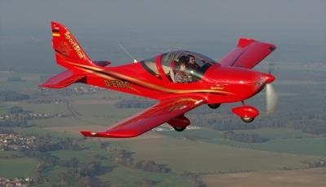
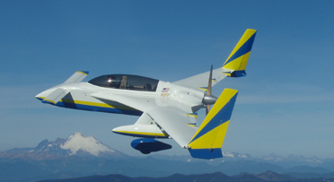
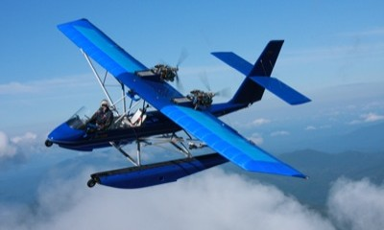
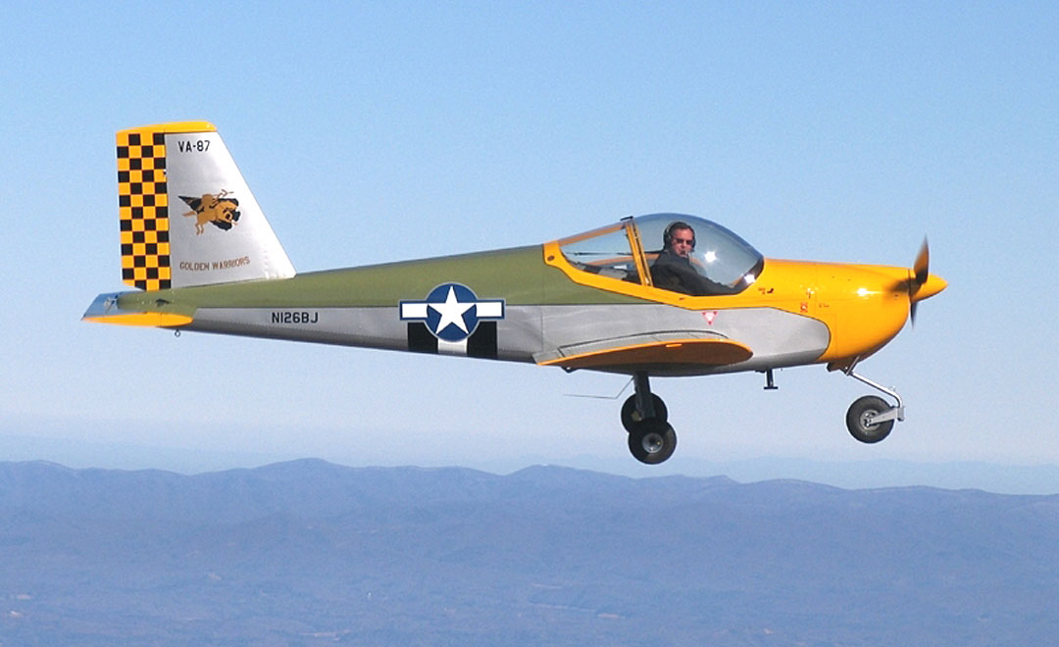
Amateur built & Light Sport
Notes:
Amateur built and Light-sport aircraft have a huge range of flight characteristics and performance
Cruise speeds range from less than 60 to more than 300 mph.
High wing loading can result in higher stall and approach speeds
Low wing loading can result in excessive float if approach & landing speed is too high
Structure may not be as crash worthy as standard type certificated designs
Amateur-built aircraft, in particular, may vary from airframe to airframe – even within the same make, model, series.
Construction differences abound.
Builders often modify design during construction.
Amateur-built aircraft often feature non-standard placement of instruments and controls.
Builders develop their Pilot’s Operating Handbooks during the flight test phase of the project
Some POHs are comprehensive some are minimal
Another reason why instructor selection is critical. You need a transition instructor who is experienced in the aircraft type
and familiar with the airframe flight characteristics, control and instrument configuration.
(Next Slide)

Slide 12
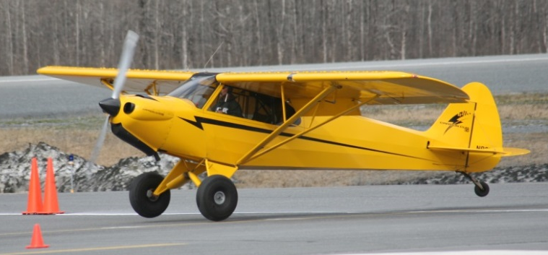
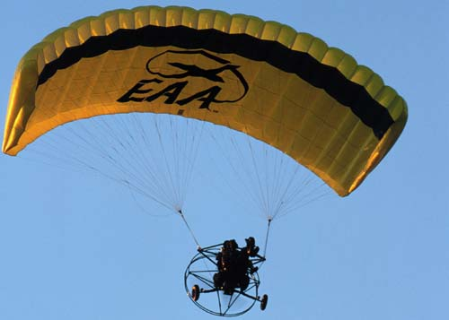
LSA Categories
Light Sport Aircraft (LSA)
  Reference: 14 CFR Part 21.190
  Ready To Fly From Manufacturer
  Uses: Personal, Towing, Flight Training
Experimental –Light Sport Aircraft (ELSA)
  Reference: 14 CFR Part 21.191(i)
  Light Sport Kit Aircraft
  Kit-built Light Sport Aircraft
  Downgrade From LSA To ELSA
  Personal Use Only
Notes:
Light-sport Aircraft come in many forms including airplanes, gliders, powered parachutes, weight-shift-control, and lighter than air designs.
LSAs are manufacturer-built to LSA consensus standards and are issued a special airworthiness certificate and standard operating limitations.
Owners and operators are required to maintain these aircraft according to manufacturer’s specifications.
E-LSAs are either amateur built or may have been moved to the E-LSA category by their owners.
They are issued experimental airworthiness certificates and operating limitations appropriate to the individual airframe.
Obviously transitioning pilots will need to know what type of certificate and operating limitations pertain to the airframe they’re flying.
Another good argument for engaging a CFI who’s thoroughly familiar with the nuances of the flying machine and who can explain the paperwork to transitioning pilots.
(Next Slide)

Slide 13

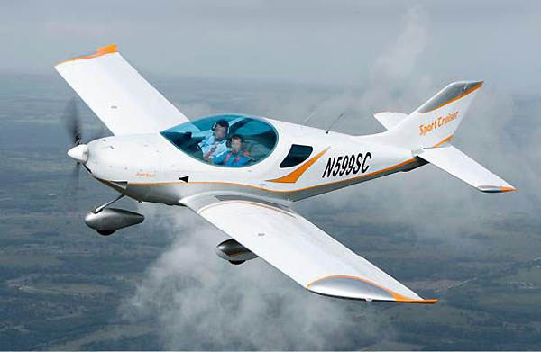
Fatal Accidents
Standard Aircraft 2.0 / 100,000 Hrs.
Amateur built Aircraft 4.2 / 100,000 Hrs.
First 50 hours of flight in Experimental/Amateur-built Aircraft are particularly hazardous
  Transition Training can make this period much safer.
Private pilots or higher are more than twice as likely to crash LSAs then LSA pilots
Notes:
Here we can see that Fatal accidents in Amateur built aircraft occur at more than twice the rate for Standard Aircraft.
The first 50 hours in Experimental/Amateur Built aircraft are particularly hazardous. Constructors must conduct a test flight program to develop performance and control parameters and, based on those test flights, adjustments and modifications may be required - all while learning how to fly a new aircraft. Constructors use the test flight data to produce a Pilot’s Operating Handbook that may be comprehensive or minimal. Future pilots of that aircraft with access to the POH will have something to go on but, for the original constructor, it’s all new territory.
Many Amateur-built aircraft are faster and less crash worthy than standard aircraft.
Higher stall speeds and different handling characteristics make aircraft control more challenging. (Click)
For this reason, the first fifty hours of flight in Experimental/Amateur-built Aircraft are particularly hazardous. That’s why solid transition training with an experienced Flight Instructor is essential. Transition training with the right CFI is just as important because……. (Click)
Pilots who trained in standard aircraft and who are certificated at the Private Pilot or higher level are more than twice as likely to crash a light sport aircraft than LSA pilots who were trained in light-sport aircraft to begin with! In many of these cases, previous experience actually compromises success in the new airframe.
Skills learned in standard aircraft don’t directly translate to LSA operation.
LSAs often have lower performance than the aircraft that pilots are used to.
Lower wing loading can make aircraft more susceptible to wind and turbulence.
(Next Slide)
Background: In 2012, NTSB completed a safety study of E-AB aircraft that included the use of an EAA survey of E-AB pilots.
Among other findings, NTSB concluded that the flight test period—the first 50 hours of flight—is uniquely challenging for most E-AB pilots because they must learn to manage the handling characteristics of an unfamiliar aircraft while also managing the challenges of the flight test environment, including instrumentation that is not yet calibrated, controls that may need adjustments, and possible malfunctions or adverse handling characteristics. NTSB added that the E-AB safety record could be improved by providing pilots with additional training resources and, accordingly, made several recommendations to FAA and EAA regarding
flight training and testing.

Slide 14
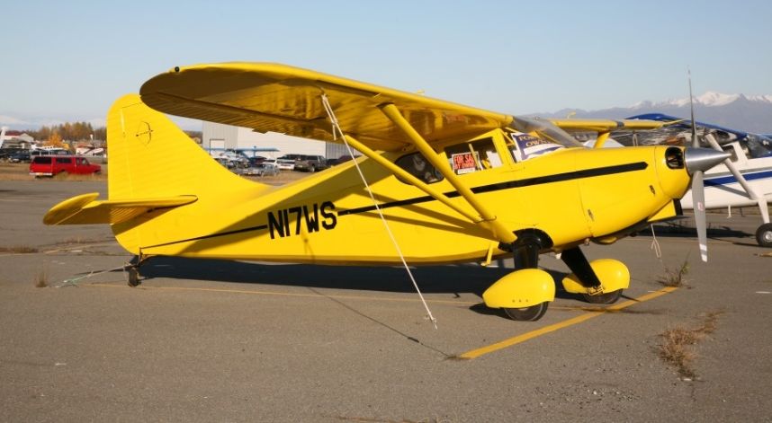
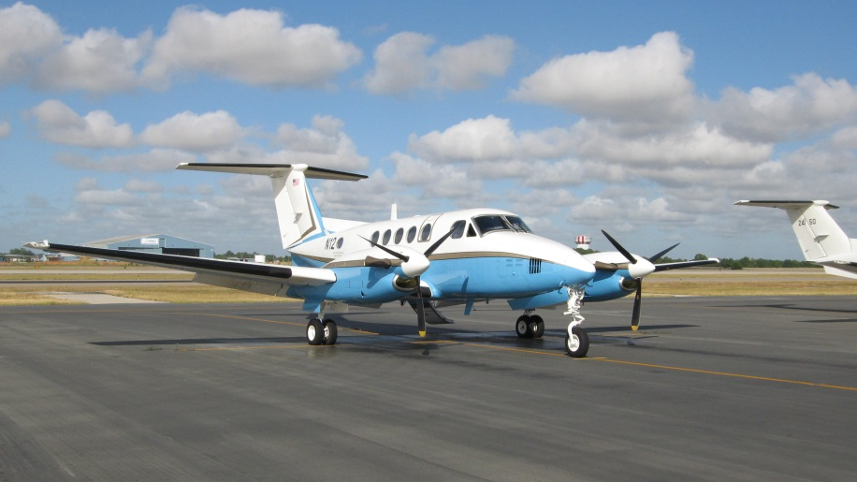
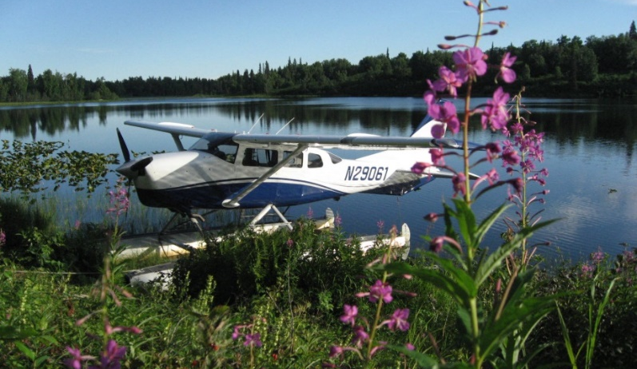
Required Training
Tail wheel
Sea Plane
Multi-engine
High Altitude
Complex
High Performance
Notes:
Some transitions require documented training and/or additional certification.
Tail wheel, complex, high performance, & high altitude operations require training and an endorsement.
Multi-engine and Sea Planes require training, endorsement, & a certification test.
(Next Slide)
Presentation Note: You may want to poll the audience as to how many have received this required training. Some may be willing to share stories of their transitions and offer suggestions for improvement.

Slide 15
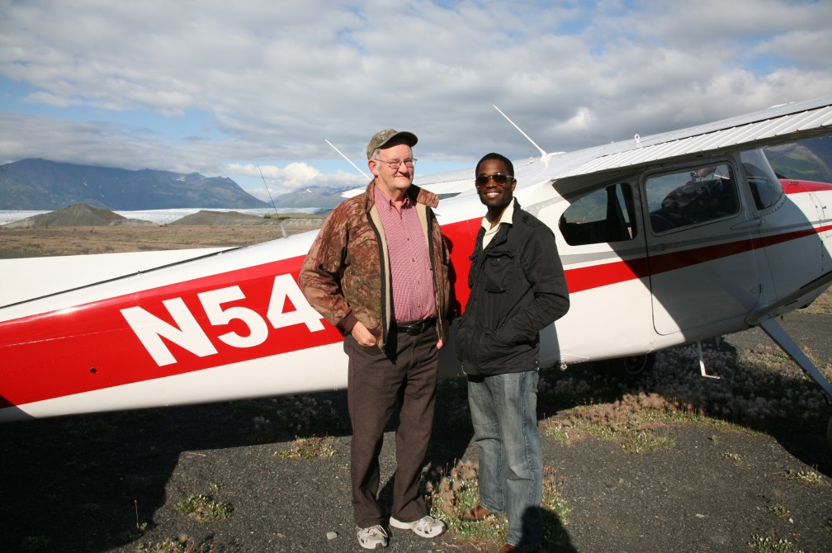
Required Training
Get the right instructor
Train where you will fly
Develop Personal Performance Figures and Minimums
Fly at mission weights
Notes:
Whether or not you’ll be taking a flight test, it’s always important to get the right instructor – one who’s not only thoroughly familiar with the airplane but also with the environment where you intend to fly. Obviously getting your tail wheel endorsement at a 3,000 foot paved airport in Florida won’t prepare you for off airport operations in Alaska.
Work with your instructor during your training to develop personal performance figures and personal minimums. This will tell you what you’re capable of doing with the aircraft in your chosen operations environment. We suggest you revise the data you develop annually. That way you’ll know exactly what you’re capable of – and what you’re not.
Make sure you do some training and develop your personal performance data at mission weights. There’s often a big difference in performance and handling between a fully loaded aircraft and one that only hauls a couple of people and half fuel.
(Next Slide)

Slide 16
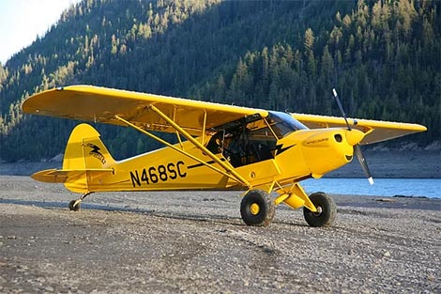
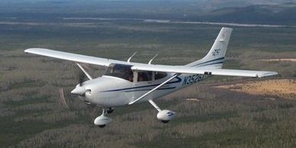
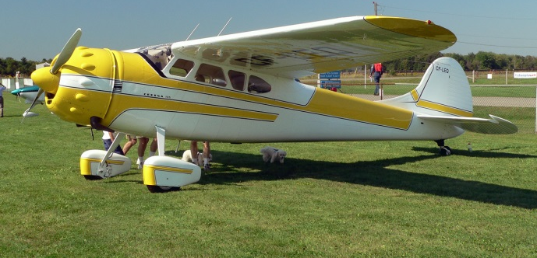
Legal vs Safe
Notes:
There can be a big difference between being legal and being safe. You might get your high performance training in a Cessna 182 (Click)
and your tail wheel endorsement in a Piper Cub (Click)
but that doesn’t mean you’ll be safe in a Cessna 195 without some additional training.
Next, let’s talk about a big group of aircraft that may require transition training or at least – a thorough test flight.
Presentation note: Pause for audience to answer then:
(Next Slide)

Slide 17
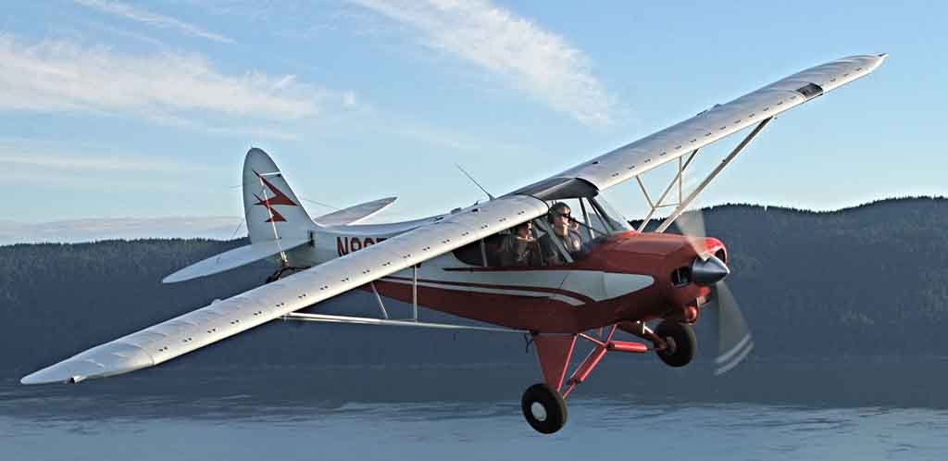
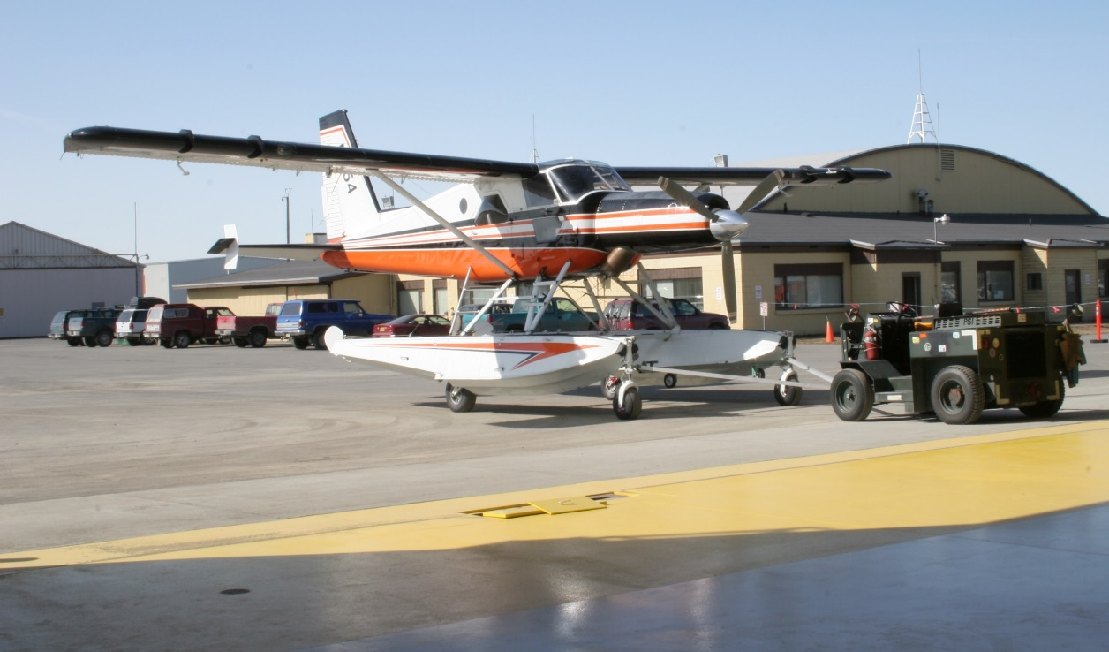
After-market modifications
May have different flight characteristics
Notes:
Even aircraft that pilots have flown before may require transition training or at least thorough familiarization flights if they have been modified. Aircraft modifications not only increase utility and performance but they may alter flight characteristics as well. (Click)
For example vortex generators may decrease stall speed but they may also reduce aerodynamic indications of approaching stalls.
And aircraft with multiple alterations may exhibit flight characteristics that are different from those associated with single modifications.
This means that pilots must be especially careful when transitioning to modified aircraft – even if they have extensive experience with unmodified versions.
Before we talk about transitioning let’s take a couple of minutes and a clean sheet of paper to see how modifications are approved.
(Next Slide)

Slide 18
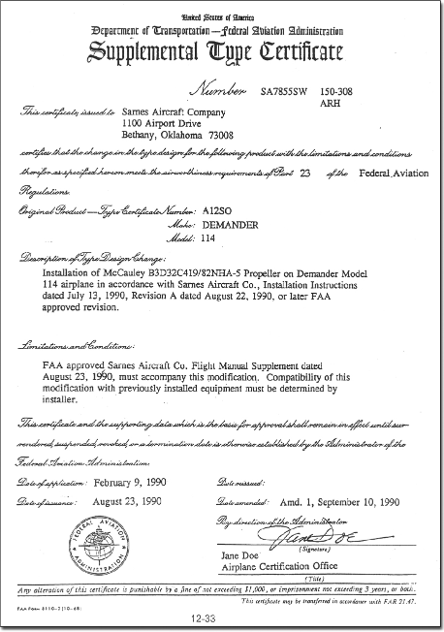
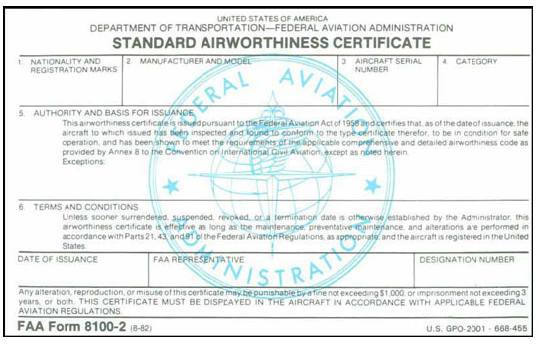
Airworthiness Standards
FAR 23,25,27,33
Manufacturers
Type Design
Standard
Airworthiness
Condition for
Safe Operation
Wear and Tear
STC
Conformity to
Type Design
Maintenance and
Documentation
FAR 21, 43,91
Notes:
In the beginning we had the earth, the sky, and the laws of Physics. Eventually there were airplanes (Click)
Shortly after, there were airworthiness standards documented in the Code of Federal Regulations. (Click)
Airplane manufacturers submit data for their type designs to FAA for evaluation during which the designs are compared against the standards. (Click)
Designs that conform to the standards are issued Standard Airworthiness Certificates. (Click)
In the field aircraft must be maintained in a condition for safe operation and they must continue to conform to the type design. (Click)
Periodic maintenance, repairs, and inspections address wear, tear, and damage ensuring continued type design conformity. (Click)
Most aircraft modifications don’t conform with type design so manufacturers submit data to FAA for evaluation. (Click)
Successful modification evaluations are issued a Supplemental Type Certificates or STCs.
All of this is reflected in required Maintenance Documentation.
(Next Slide)

Slide 19
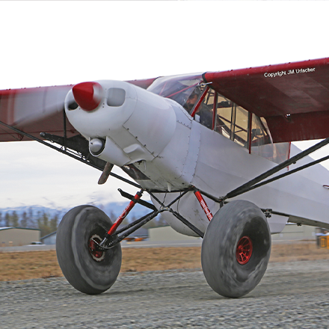
How many STCs can you install on one aircraft?
As many as will collectively not compromise aircraft integrity or control
STC installers certify the installations.
Most STC installations require test or verification flight.
Notes:
So here’s a question, How many STCs can you install on one aircraft?
Presentation note: Collect audience responses then: (Click)
There is no limit. As many as will collectively not compromise aircraft integrity or control. But who’s responsible for evaluating the interaction of all STCs on an aircraft?
Presentation note: Collect audience responses then: (Click)
Well, the STC installer is responsible for assessing not only the latest installation but also the interaction among all STCs on the aircraft (Click)
Each STC should include a test or verification flight. That may be done by the installer or a contracted test pilot. But it might also be done by the aircraft owner.
(Next Slide)

Slide 20
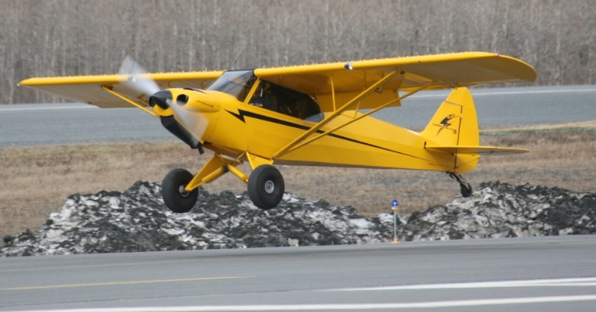
Differences all vary by aircraft make, model, and equipment or STC.
Here are some examples:
Control Surface Alteration
Adding Large Tires, Skis, or Floats
Vortex Generators Wing and/or Winglets
Landing Gear Alteration such as oversized Tires, Skis or Floats
Leading and/or Trailing edge STOL alterations
Talk to Owners/Users of the STC or alteration you intend to Purchase.
Talk to the Installer to verify the necessary testing was completed.
Heed the manufacturers’ recommendations relevant to the specific type/make or model.
Notes:
There are hundreds of STCs available for general aviation aircraft including:
Control Surface Alterations
Adding Large Tires, Skis, or Floats
Vortex Generators and/or Winglets
Landing Gear Alterations such as oversized Tires, Skis or Floats
Leading and/or Trailing edge STOL alterations (Click)
If you’re considering modifying your aircraft we strongly suggest that you talk to Owners/Users of the STC or alteration you intend to Purchase.
Talk to the Installer to verify any necessary testing was completed.
Heed the manufacturers’ recommendation relevant to the specific type/make or model.
(Next Slide)

Slide 21
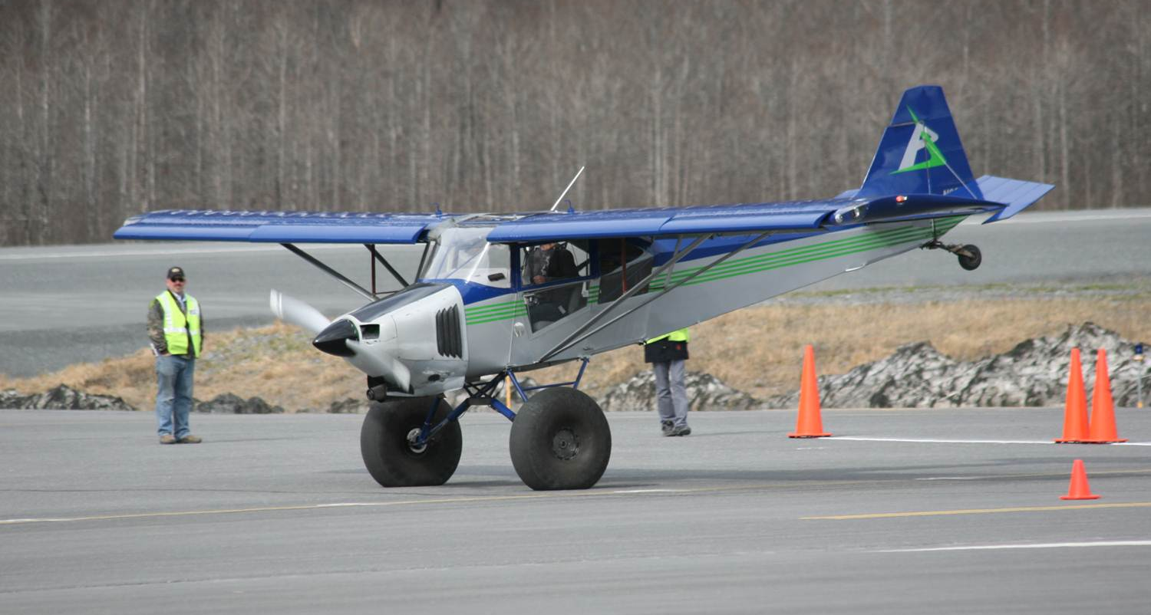
Transitioning to modified aircraft
The first flight IS a TEST flight
  AC90-89B Amateur Built Aircraft and Ultralight Flight Test Handbook/Section 4/
Fly with a Flight Instructor
  Experienced in aircraft type and STC
  modification.
Take it easy
  Ease into the altered performance envelope
  Have plenty of altitude, good weather, and
  long runway
Notes:
Regardless of any testing the installer may have done, your first flight in a modified aircraft will be a test flight.
AC90-89B Amateur Built Aircraft and Ultralight Flight Test Handbook/Section 4/ provides excellent guidance on test flying. You may not be conducting a full test program but a review of the content will give you some useful information on test flying.
Presentation note: Although the AC is specific to Amateur Built and Ultralight aircraft, it provides information applicable to any flight test program.
It’s a very good idea to engage a flight instructor who’s familiar with the aircraft and its’ modifications to assist you in your transition.
Give yourself plenty of altitude.
Take it slowly – don’t try to win a short field landing contest or demonstrate ultimate performance right away. Ease into the altered performance envelope.
Make sure you have good VFR weather, plenty of altitude, and long runways for the test flight (s)
(Next Slide)

Slide 22
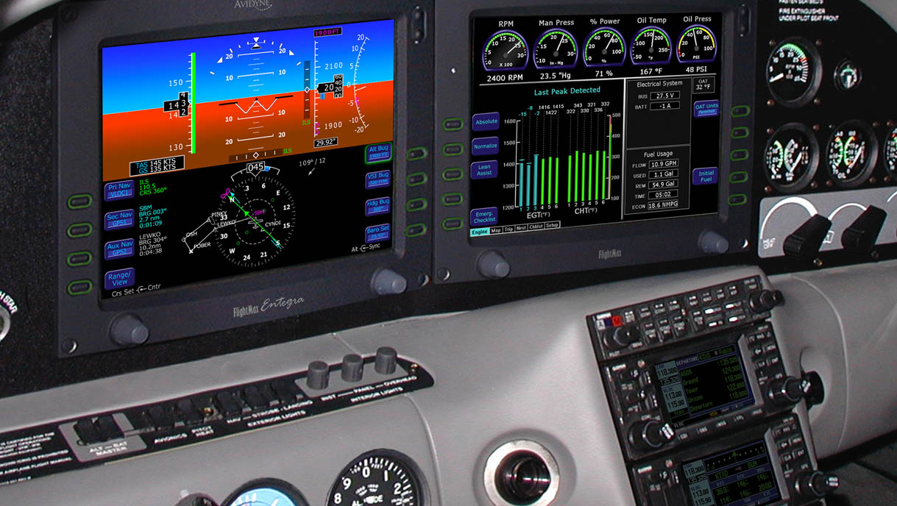
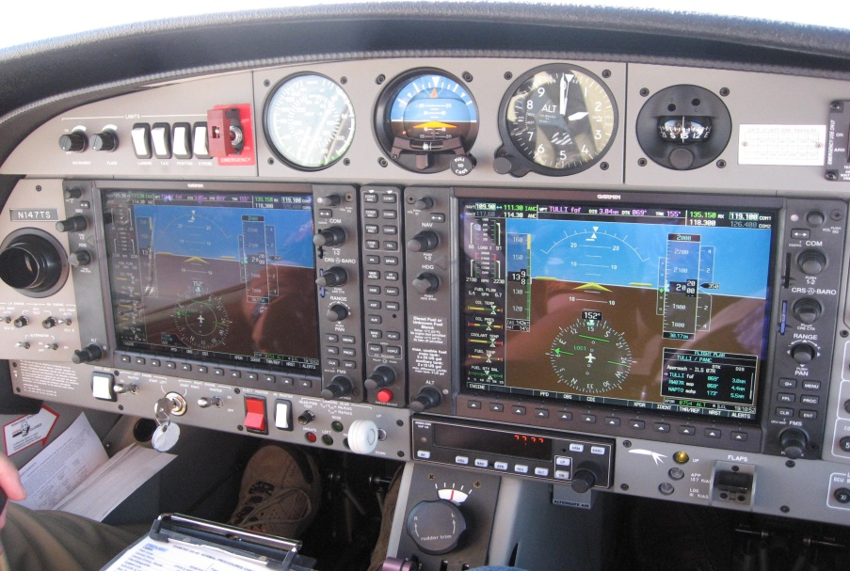
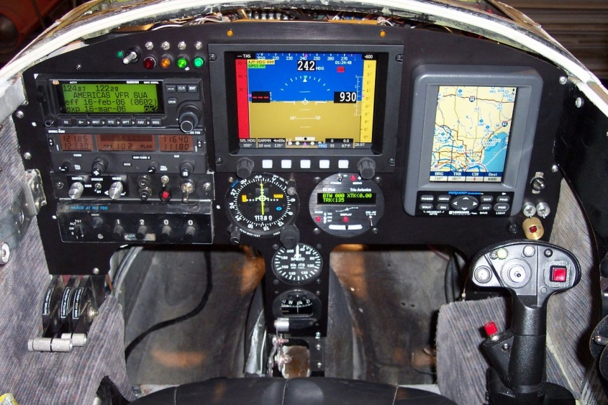
Not just the airplane
Notes:
New avionics systems require transition training too. Not just to get the most out of them but for basic safety as well.
Many transitioning pilots feel overwhelmed by the volume of information available on today’s avionics systems.
Trouble separating critical information from non-critical.
Confusion over multiple ways to do the same thing
Soft key’s that can represent multiple functions
Increased heads down time
Presentation Note: Poll audience as to what sort of instrumentation they’re flying. If there are glass cockpit aviators in the audience ask them to talk about their transition experience and how long it took to be comfortable with the new technology.
You can expect transitions to take longer if the aircraft you’re training in has unfamiliar glass cockpit instrumentation.
You can reduce training time and make time in the aircraft more productive if you log some time on an avionics simulator. Most manufacturers have personal computer-based simulations for their products and many avionics packages can be operated in simulator mode.
(Next Slide)

Slide 23
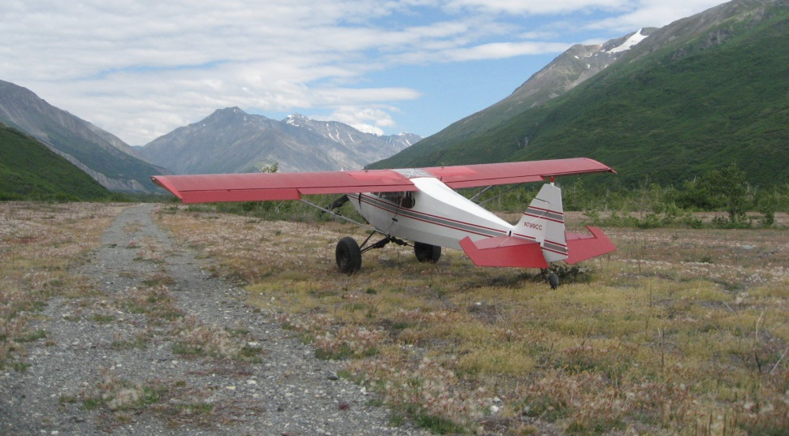
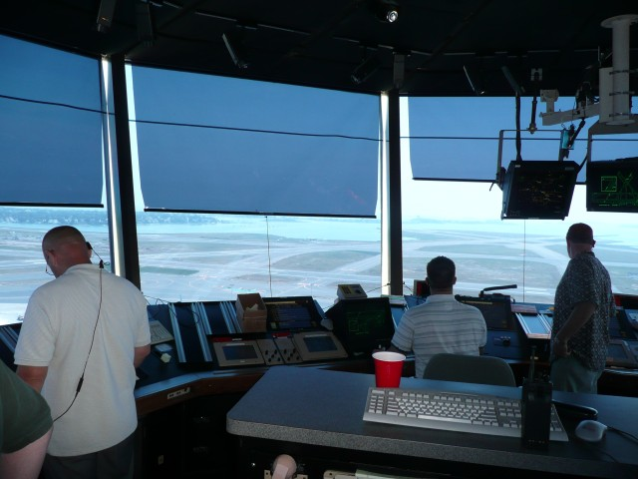
Operations Environments
Notes:
Big changes in operations environments should also be viewed as transitions. Although Private Pilots must be trained and tested on towered operations it’s a good idea to take a CFI along on your first trip to a major metropolitan area.
The pace of operations at busy airports can easily overwhelm even experienced pilots who are not used to the environment. In one case, a private pilot with less than 50 hours in type crashed on final approach while complying with a series of controller requests for S turns to accommodate departing traffic. Never compromise a stabilized approach by maneuvering. If maneuvering is requested or required - go around.
Similarly requests, for speed changes should not be honored if they would result in a destabilized approach.
Big city pilots who are comfortable with busy towered operations can be at a loss when operating to back country airstrips. Back country transition training can acquaint you with the nuances of rural environments and ensure your wilderness flying can be done safely.
(Next Slide)

Slide 24
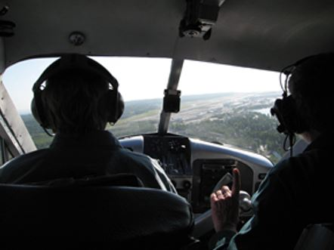
Tips and Tricks
Give yourself some room
Manage Distractions
Fly by – not around
Document Personal Performance
Seek refresher training
  Within six months of original transition training
  Annually thereafter
    Wings Pilot Proficiency Program
  When returning to flying after period of inactivity
Practice
Notes:
Finally here are some tips and tricks to help you avoid a loss of control accident”
Give yourself some room
Most stall/spin/crash sequences begin close to the ground. Many happen in the traffic pattern so, when you’re thinking about going slow don’t think low at the same time. Practice slow speed maneuvering at altitude where you have time to recover from a stall or spin. Do this regularly to maintain proficiency
Manage Distractions
Learn to manage distractions – especially while maneuvering close to the ground
Sterile cockpit while in departure & approach flight segments and while maneuvering
Make sure aircraft is stable before copying ATC instructions, changing charts, reviewing approach, etc.
Assign 2nd pilot or a passenger to help you scan for traffic.
Presentation Note: Ask audience about how they manage distractions. Relate additional things you do to keep distractions to a minimum
Fly by – not around
When viewing scenery or photographing subjects on the ground fly by your target in straight & level flight then turn and fly by in the opposite direction.
Concentrate on the mission task while stable then concentrate on the turn. This is also a good time to have a 2nd pilot aboard to share the workload.
Document your personal performance
Do this at mission weight and in the environment you’ll be operating in. This will tell you what you’re capable of doing with the aircraft.
Seek regular refresher training.
Even though your transition training was excellent, regular proficiency training will keep you at the top of your game.
We recommend a refresher within six months of your original transition training and an annual checkup after that. The Wings Pilot Proficiency Program is an excellent way to keep your skills sharp and your Flight Review up to date.
And finally, Practice
It’s amazing how quickly pilot skills can go from razor sharp to not so hot. Regular practice is essential to keep you at the top of your game so fly as often as you can. You’ll aviate with confidence and besides – it’s fun.
(Next Slide)

Slide 25
_______ and _______ together account for about half of all fatal LOC Accidents:
Landing
Maneuvering Flight
Take off
Approach
Notes:
Presentation Note: Ask the audience to answer this question. When they have answered; click to reveal the correct answers.
Now for a quick review:
Blank and Blank together account for about half of all fatal LOC accidents:
About half of all fatal LOC accidents occur in the (Click) maneuvering and (Click) approach phases of flight.
(Next Slide)

Slide 26

To get the most out of transition training:
Read the POH
Select the right CFI
Train at least Twice a week
All of the above
Notes:
Presentation Note: Ask the audience to answer this question. When they have answered; click to reveal the correct answers.
To get the most out of transition training (Click) All of the above.
(Next Slide)

Slide 27

Transition training is more important when stepping up than when stepping down.
True
False
Notes:
Presentation Note: Ask the audience to answer this question. When they have answered; click to reveal the correct answers.
Transition training is more important when stepping up than when stepping down.
(Click) False – Transition training is important whenever you’re operating an unfamiliar aircraft or avionics system as well as when you’re operating in unfamiliar environments.
(Next Slide)

Slide 28

Pilots trained in traditional aircraft are ____ likely to crash in LSAs than pilots trained in LSAs to begin with.
More
Less
Neither more nor less
Notes:
Presentation Note: Ask the audience to answer this question. When they have answered; click to reveal the correct answers.
(Click) Pilots trained in traditional aircraft are more likely, less likely, or neither more nor less likely to crash in LSAs than pilots trained in LSAs to begin with.
and What’s to be done about it?
(Next Slide)

Slide 29
Good practices to avoid Loss of Control are:
Avoid Distractions
Seek Refresher Training
Fly by – not around
Practice slow maneuvering at altitude
Participate in “Wings”
All of the above
Notes:
Presentation Note: Ask the audience to answer this question. When they have answered; click to reveal the correct answers.
Good practices to avoid Loss of Control are: (Click)
All of the above.
(Next Slide)

Slide 30

Questions?
Notes:
Presentation Note: You may wish to provide your contact information and main FSDO phone number here. Modify with
Your information or leave blank.
(Next Slide)

Slide 31


Proficiency and Peace of Mind
Fly regularly with your CFI
Perfect Practice
Document in WINGS
Notes:
There’s nothing like the feeling you get when you know you’re playing your A game and in order to do that you need a good coach (Click)
So fly regularly with a CFI who will challenge you to review what you know, explore new horizons, and to always do your best. Of course you’ll
have to dedicate time and money to your proficiency program but it’s well worth it for the peace of mind that comes with confidence. (Click)
Vince Lombardi, the famous football coach said, “Practice does not make perfect. Only perfect practice makes perfect.” For pilots that means
flying with precision. On course, on altitude, on speed all the time. (Click)
And be sure to document your achievement in the Wings Proficiency Program. It’s a great way to stay on top of your game and keep you flight review current.
(Next Slide)

Slide 32



http://www.mywingsinitiative.org/
Notes:
Every time you complete a WINGS Phase you’re eligible to win cash in the WINGS Sweepstakes.
The sweepstakes is generously funded by Paul Burger, a long time advocate for general aviation safety and a retired aviator who believes participation in this program saves lives. VISIT WWW.MYWINGSINITATIVE.ORG to learn more and enter the sweepstakes.
Just navigate to http://www.mywingsinitiative.org or scan the QR code for details. By the way, Instructors can also enter the sweepstakes. But there are even better reasons to participate in WINGS.
(Next Slide)

Slide 33


Safety Management Systems (SMS)
Coming to General Aviation
https://www.faa.gov/about/initiatives/gasafetyoutreach
Notes:
Safety Management Systems are a set of policies and processes that can increase the safety and efficiency of any flight operation. And FAA is bringing SMS to General Aviation. You may have heard of SMS but thought it was only for large organizations but actually SMS can be scaled to fit any operation large or small.
There are 4 major components to a Safety Management System (Click)
Safety Policy – a documented commitment to safety that runs from the head of an organization to its newest member. (Click)
Safety Risk Management – a process that identifies hazards within an operation, determines to what extent an identified hazard may impact flight safety, and controls the risk of occurrence to an acceptable level. (Click)
Safety Assurance – By collecting and analyzing information derived from safety performance data Safety Assurance ensures the performance and effectiveness of Safety Risk Controls. (Click)
Safety Promotion communicates safety information and commitment throughout the organization. (Click)
You can find more information about Safety Management Systems at the URL on the Screen.
(Next Slide)

Slide 34



Thank you for attending
You are vital members of our GA safety community
Notes:
Your presence here shows that you are vital members of our General Aviation Safety Community. The high standards you keep and the examples you set are a great credit to you and to GA.
Thank you for attending.
(Next Slide)

Slide 35
The National FAA Safety Team Presents
Topic of the Month
June
Transition Training
<Audience>
<Presenter>
< >
Notes:
(The End)

