Slide 1
Topic of the Month
August
Personal Minimums and Weather Cameras
<Audience>
<Presenter>
< >
Produced by:
The National FAA Safety Team (FAASTeam
Notes:
2022/03-17-253(I)PP Original Author: John Steuernagle; POC Kevin Clover, National FAASTeam Operations FPM, Office 562-888-2020
Presentation Note: This is the title slide for Personal Minimums and Weather Cameras
Script - We have included a script of suggested dialog with most slides. The script will always appear in a non-italic font. Presenters may read the script or modify it to suit their own presentation style. See template slides 5 and 6 for examples of a slides with script.
Presentation Instructions - (stage direction and presentation suggestions) will be preceded by a Bold header: the instructions themselves will be in Italic fonts. See slides 2, 3, and 4 for examples of slides with Presentation Instructions only.
Program control instructions - will be in bold fonts and look like this: (Click) for building information within a slide; or this: (Next Slide) for slide advance.
Background information - Some slides may contain background information that supports the concepts presented in the program.
Background information will always appear last and will be preceded by a bold Background: identification.
The production team hope you and your audience will enjoy the show. Break a leg!
(Next Slide)

Slide 2


Welcome
Exits
Restrooms
Emergency Evacuation
Breaks
Sponsor Acknowledgment
Set phones and pagers to silent or off
Other information
Notes:
Presentation Note: Here’s where you can discuss venue logistics, acknowledge sponsors, and deliver other information you want your audience to know in the beginning.
You can add slides after this one to fit your situation.
(Next Slide)

Slide 3

Overview
GAJSC* Studies and Safety Enhancements
Personal Minimums
Weather Cameras
Using Wx Cam data to inform Personal
Minimum decision making.
* General Aviation Joint Steering Committee
Notes:
In this presentation we’ll talk a little bit about a recent GAJSC study that features some interesting findings with respect to loss of control or Controlled Flight Into Terrain (CFIT) while operating in areas with little or no weather information.
We’ll discuss the concept of personal weather minimums and how weather camera images can inform Personal Minimum decision making.
Presentation Note: If you’ll be discussing additional items, add them to this list
(Next Slide)

Slide 4
ADM and Personal Minimums
ADM is critical to success
  and sometimes to survival
Personal minimums
  What conditions do I need to fly safely?
VMC
IMC
Ceiling
Wind
Night
Visibility
Day
Pressure
Notes:
Aeronautical Decision Making is a huge subject that covers every task pilots perform from preflight to securing their aircraft after flight. How we go about gathering relevant information and acting appropriately on that information is critical to our success…………………. and sometimes – to our survival. (Click)
One aspect of ADM is knowing what we and our aircraft are capable of accomplishing on a given day. Or put another way – what conditions do I need to ensure a safe flight? (Click)
If I’m not instrument qualified, current, and proficient – I’ll have to have VMC weather at a minimum in order to be legal and safe. How much crosswind am I capable of handling in this aircraft?
Am I capable of flying this mission at night or is daylight required. How much pressure to complete the flight am I under? And I’m sure you can think of some more.
(Next Slide)

Slide 5
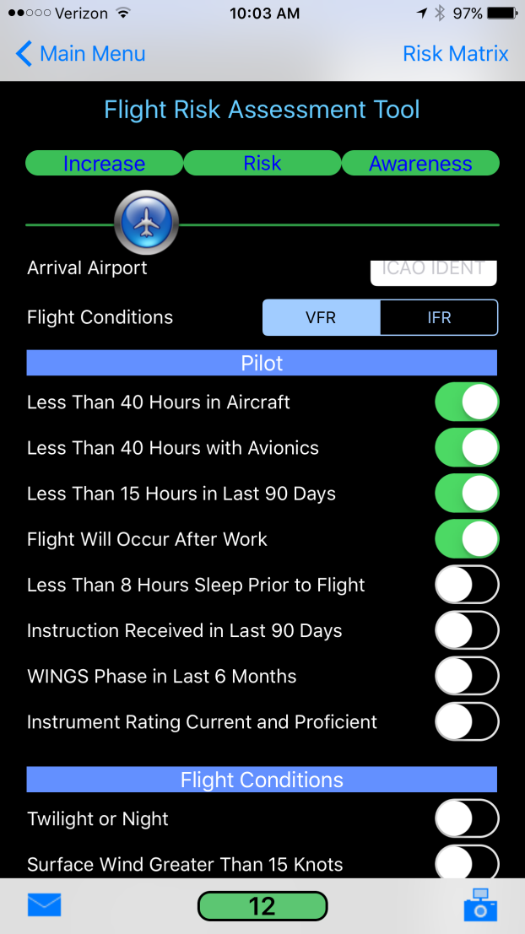
Personal minimums pave the way to safety
Developing Personal Minimums
  Do it in advance of need.
    Document and Save
  Do it with your CFI
    Self assessment is tough to do.
Notes:
So personal minimums are the minimum conditions you need for safe flight and they’re personal because they pertain to you. If you know what you need beforehand it’s easy to say yes, I’ve got the minimums I need or no – I don’t and consequently I’ll have to make another plan. (Click)
Obviously you’ll need some time to develop you personal minimums and that precipitates a couple of thoughts
1. You can’t develop your personal minimums just before takeoff. They need to be established well in advance of your flight. And they need to be documented – recorded some place where you can easily retrieve them for reference.
2. It’s tough to do an accurate self-assessment of your flying. Much better to develop your personal minimums with the guidance of your CFI.
(Next Slide)

Slide 6
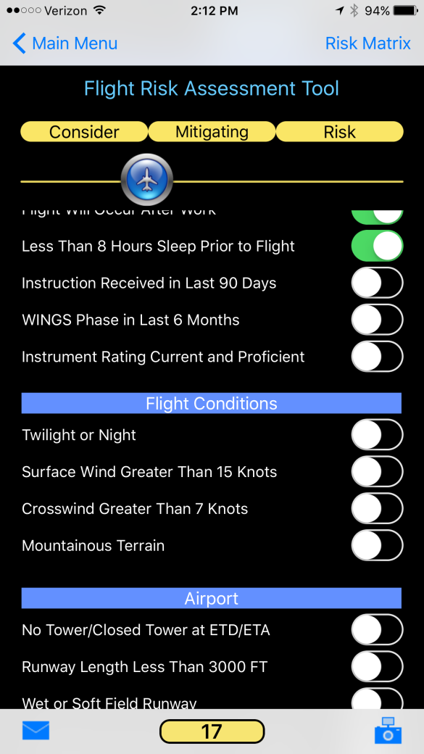
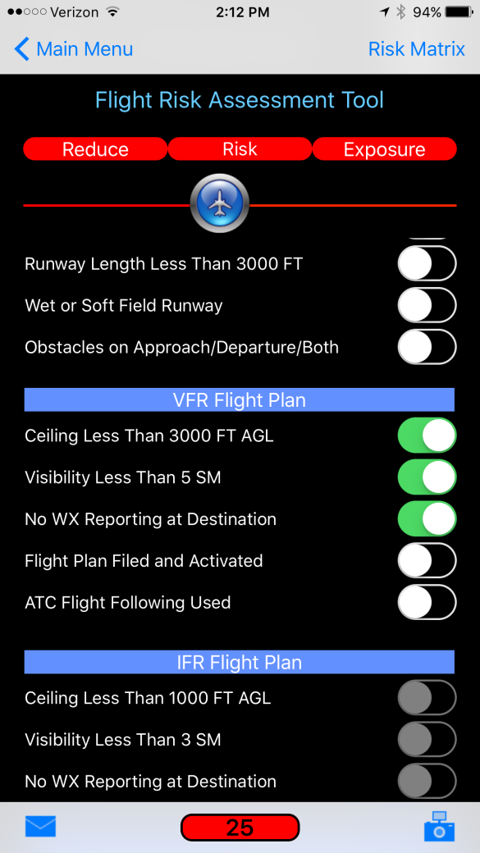

The PAVE Checklist
Pilot
Aircraft
enVironment
External Pressure (s)
https://bit.ly/3aKm3cD
Notes:
The Pilot - Am I feeling well and rested today? Is my stress level such that I can devote all my attention and energy to completing this flight safely? Are my pilot skill set and certification level equal to the flight I’m contemplating? Am I current and proficient in the aircraft I’ll be flying today? Have I had transition training in this aircraft? (Click)
The Aircraft - Is the aircraft I’ll be flying capable of & equipped to complete this flight? Do the maintenance history and my preflight inspection indicate the aircraft is airworthy and, as simple as it may sound, is there sufficient fuel on board. (Click)
The enVironment - Are the aircraft and I capable and qualified to fly in the expected weather conditions? Are alternate airports available. Can I handle any special conditions with respect to the airports I’ll be operating from on this flight. (Click)
External Pressures - Is it imperative that this flight be completed today? Am I under pressure from peers or passengers to perform? Must the aircraft be returned today or can I postpone my return trip? Do I have commitments after the flight that must be met? (Click)
By the way – There are various Flight Risk Assessment Tools or FRATs that can help you assess the risk associated with any flight. The link or QR code on the screen will take you to the FAAST Frat page in the FAASafety.gov library. From there, you can download the FAAST FRAT.
(Next Slide)

Slide 7
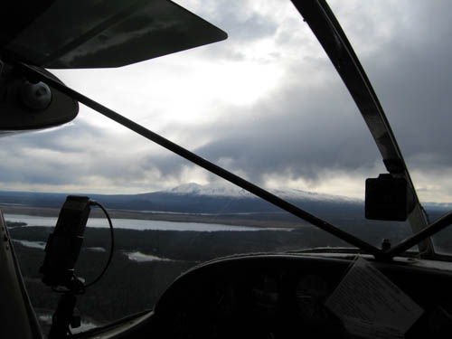
enVironment
Easy to describe at takeoff
  What you see is what you’ve got
More difficult at destination
  Wx reports and forecasts
Even more difficult en route
  Especially if there are no en route
  reporting points.
Notes:
There are times when it’s easy to describe the flight environment and unfortunately there are also some times when it’s not so easy. (Click)
Local flights that never leave the airport are pretty easy to define. The weather you see is the weather you’ve got. A local forecast will
tell you what to expect in the way of changes and comparing that forecast with present conditions will give you a pretty good idea as to
weather the forecast will pan out. (Click)
You can’t see the destination weather before takeoff. Well actually there are some times when you can but we’ll get to that a little later.
For now we have to assume that METARS and TAFs, and Pilot Reports for the destination are what we’ll be referencing before flight. If the
destination has weather reporting we should be able to update the situation while en route. (Click)
En route weather is a little more difficult to define, especially if there are few or no en route reporting points.
(Next Slide)

Slide 8
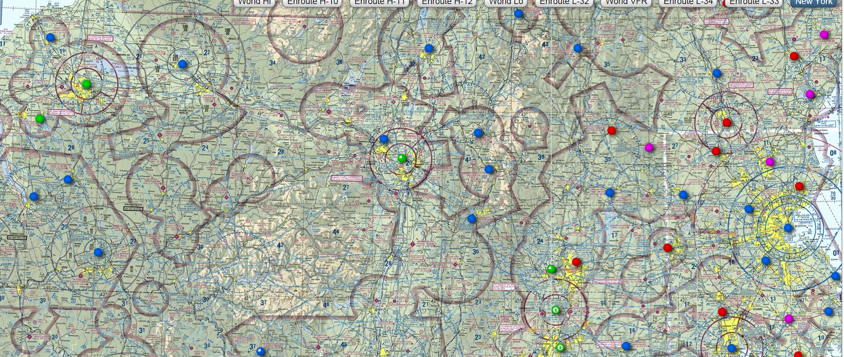
Lots of information
Notes:
Thankfully we’ve got a lot of information available – at least near cities and towns that have airports. Each colored dot on this sectional represents an available weather report. (Click)
Note that this section doesn’t have any weather information and no airports either. And it’s mountainous ….. well at least hilly terrain. No problem if it’s good VMC weather or you can fly over it IFR. But if you have to fly close to the ground it would be great to have some idea of what sort of weather you’re getting into.
Then there’s Alaska. Alaska has weather information too.
(Next Slide)

Slide 9
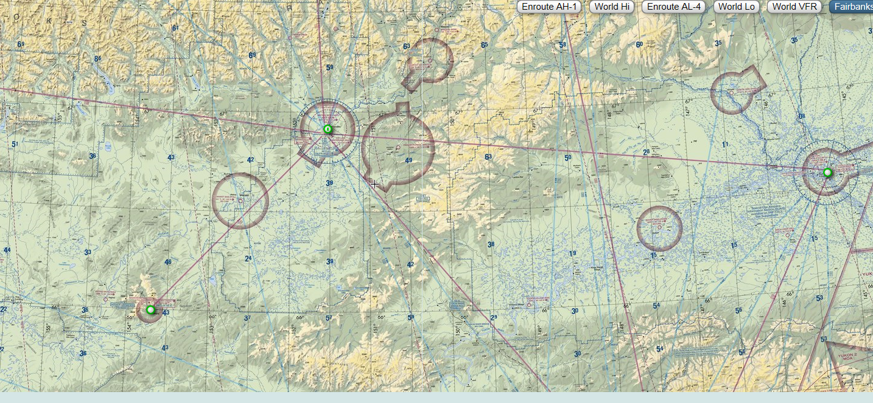
Alaska?...... Not so much
--172 miles--
Notes:
Just not as much as we typically get in the other 48 states. I say 48 because Hawaii has weather information challenges similar to Alaska such as rapidly changing
conditions in areas not covered by weather observations. (Click)
The distance between Bettles and Fort Yukon AK, the airports circled here, is 172 miles. That’s a long way to go with no weather reporting. And that’s why Alaska was
selected to pioneer a new weather information technology – Aviation Weather Cameras.
(Next Slide)

Slide 10
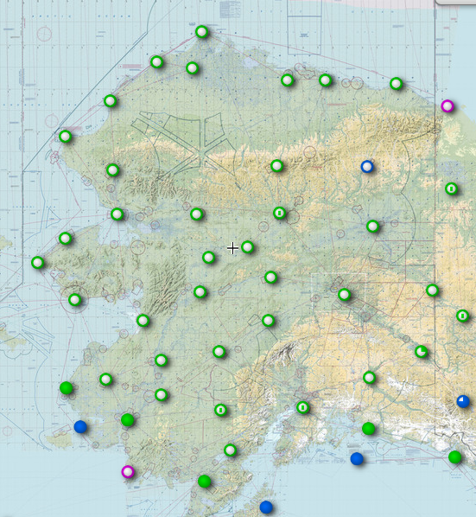
Alaska weather stations
Notes:
Here are the points with available weather in Alaska. Doesn’t look so bad until you realize that if Alaska were cut in half, Texas would become the third largest state.
Let’s look at it another way.
(Next Slide)

Slide 11
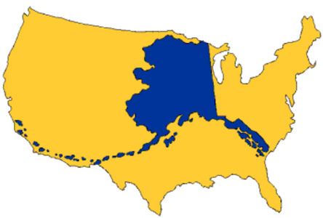
Alaska – lots of land - few people
Notes:
This will give you an idea of how large Alaska is. That’s a lot of area to cover with weather information – especially the rapidly changing coastal areas. And there’s lots of coastline – six thousand six hundred and forty miles of it to be precise.
(Next Slide)

Slide 12
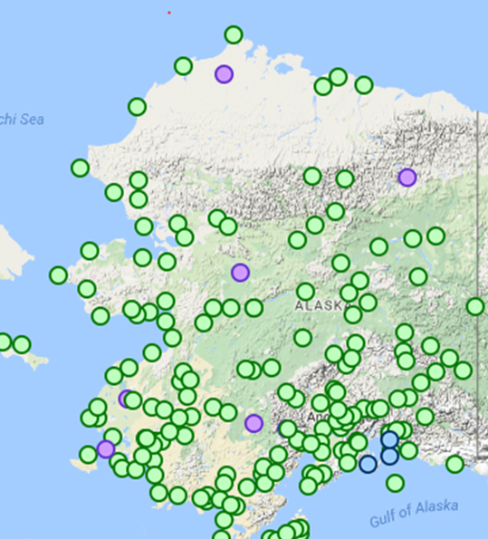
AK Weather Stations & Cameras
Notes:
Returning to this view we realize there are thousands of square miles with no weather information at all. And because there are few roads in Alaska, airplanes are flying through those areas every day. We can’t create roads, cities, towns, and airports where there are no people but we can supplement weather information with weather cameras. (Click)
Here’s where weather cameras have been installed. They provide vital supplemental weather information in remote areas and it’s not surprising that they’re sited along common Alaskan air routes.
(Next Slide)

Slide 13
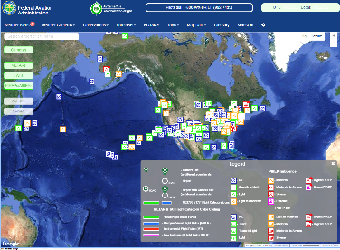
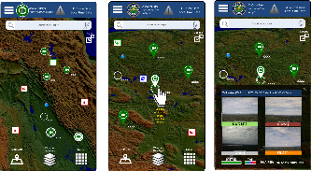
FAA Weather Camera Program Improvements
Web App Modernization
New website design and Mobile Apps
  IOS and Android
Provides Integrated aviation data portal
  Weather, airport, and flight data
  Enables flight planning/decision making
  Reduced visual clutter and ease of use
User-centered, Data-driven design
Pilot SME interviews and BETA testing
Documented Functional Design Requirements
Integrated Aviation Human Factors provided by FAA’s Civil Aviation Medical Institute (CAMI)
Notes:
Beginning in 2017 major enhancements were brought to the Weather Camera program including a new website design and mobile Apps for IOS & Android platforms and an integrated data portal.
(Next Slide)

Slide 14
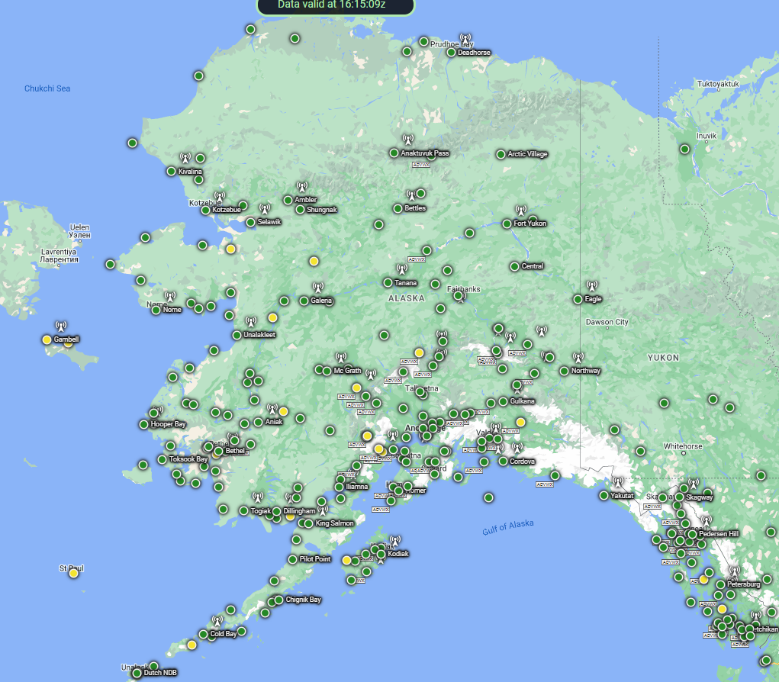

http://weathercams.faa.gov
Notes:
And here’s the Alaskan weather camera web page. Just click on any of the dots to access information for that location.
That’s the northern (odd year) route for the Iditarod Race shown in red. A volunteer group of pilots supplies
the race each year and they rely heavily on weather camera information.
(Next Slide)
Presentation note: If your presentation venue is connected to the internet you can click on the slide title URL to access the weathercams site.

Slide 15
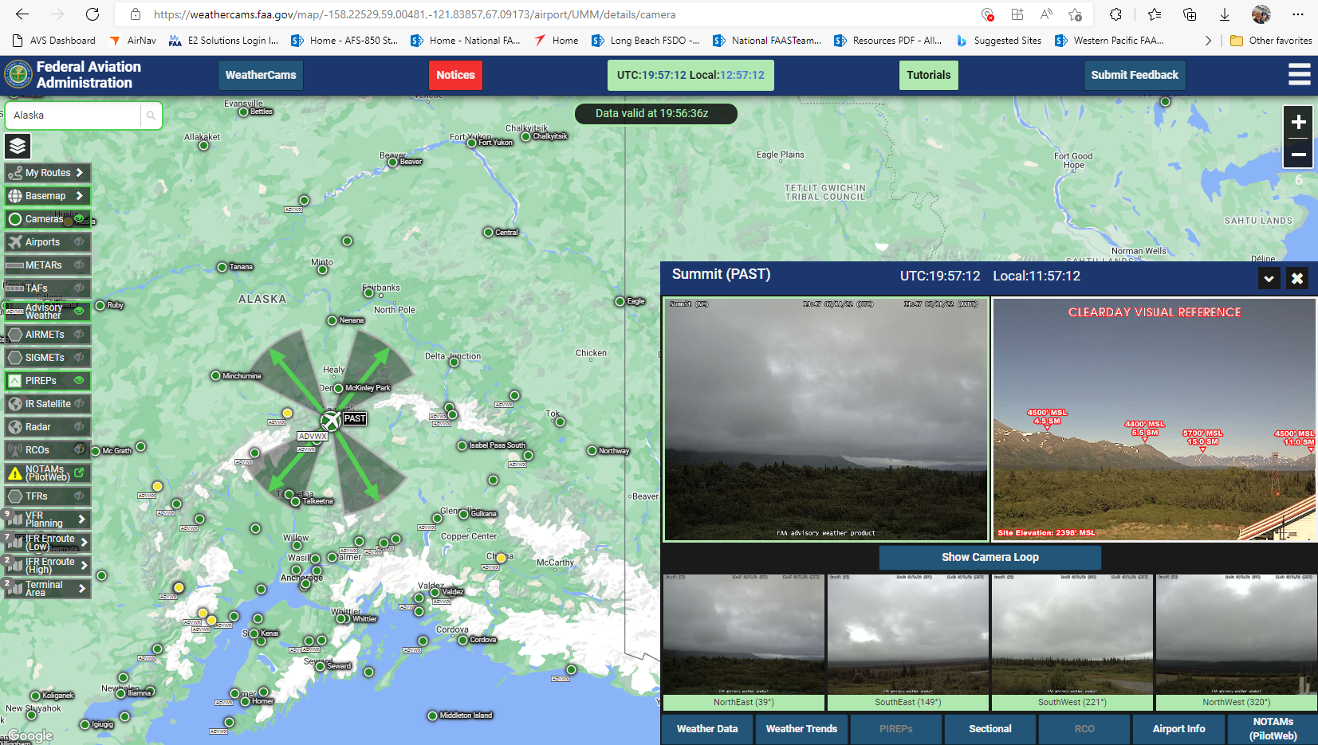
Notes:
Here’s the view from Cantwell, Alaska – just a few miles south of Mt. McKinley. (Click)
You can customize the map view with the menu on the left side of the screen.
Clicking on a camera icon will reveal coverage area for each camera. (Click)
And the map inset shows the view from each of the four cameras. Clicking on a camera will return the present and clear day reference views from that camera. Here we’re looking at the northeast view. Note that the ridge line leading to Mt. McKinley is obscured.
(Next Slide)

Slide 16
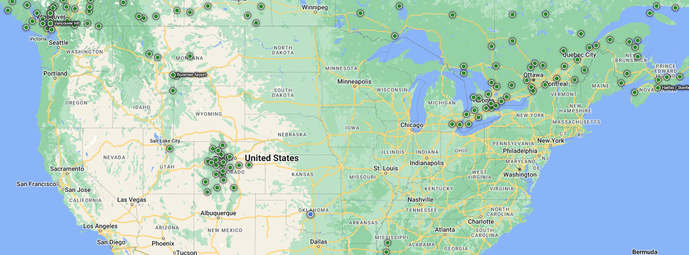
FAA Weather Camera Program Improvements
Expanded Camera Services - CONUS and Hawaii
2017-2020
Use Third Party Hosting to develop the initial outlay of camera services
Use existing airport camera images
Use current funding to complete this work
2017-2025:
Fund FAA Cams to “fill gaps” in the hosted
Network:
2017-2019: Conduct Investment Analysis
2020-2025: Install FAA funded cameras
Notes:
2017 was also a landmark year because it began the expansion of weather cameras to the continental US and Hawaii. Here we can see installations in the Rocky mountains and along the Canadian border. As weather cams become available be sure to work them into your preflight planning and personal minimum checklists.
(Next Slide)

Slide 17
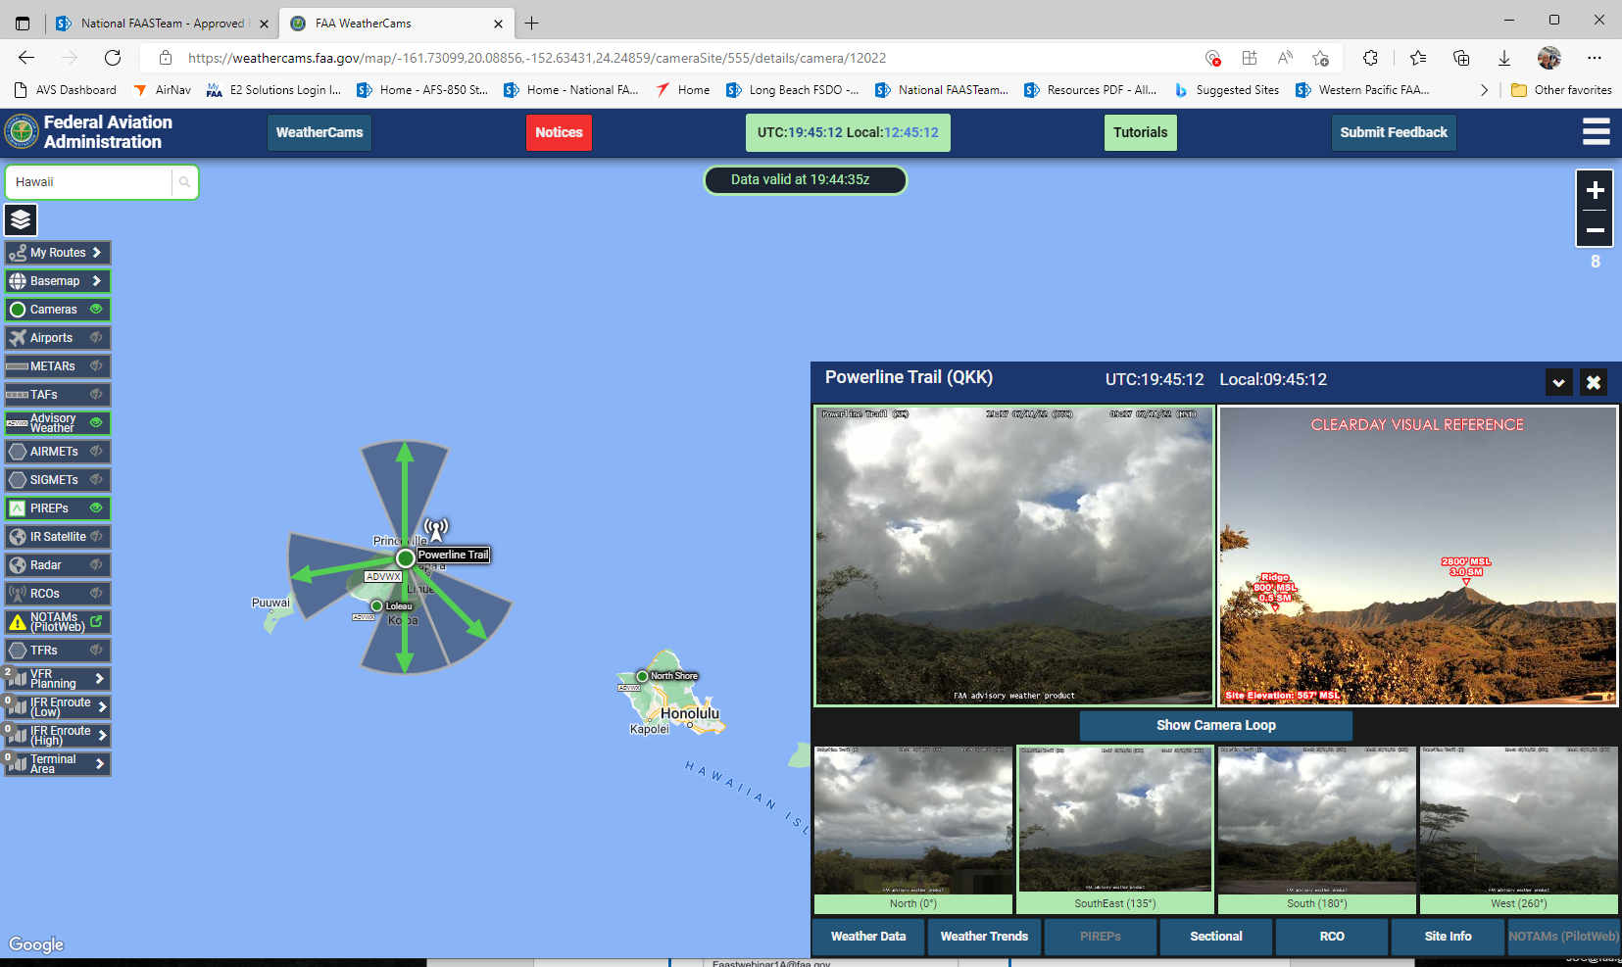
Notes:
Here’s what you’ll see if you click on the Powerline trail site on Kauai, HI. (Click)
A map shows the area of coverage for each of four cameras (Click)
When you select a camera you’ll get a fair weather thumbnail for that camera’s coverage area and (Click)
an enlarged view of the present situation. Note the ridge obscuration (Click)
Finally – there are tabs for additional information including a loop of recent images that will show you how the weather is developing.
(Next Slide)

Slide 18

Questions?
Notes:
Presentation Note: You may wish to provide your contact information and main FSDO phone number here. Modify with
your information or leave blank.
(Next Slide)

Slide 19


Proficiency and Peace of Mind
Fly regularly with your CFI
Perfect Practice
Document in WINGS
Notes:
There’s nothing like the feeling you get when you know you’re playing your A game and in order to do that you need a good coach (Click)
So fly regularly with a CFI who will challenge you to review what you know, explore new horizons, and to always do your best. Of course you’ll
have to dedicate time and money to your proficiency program but it’s well worth it for the peace of mind that comes with confidence. (Click)
Vince Lombardi, the famous football coach said, “Practice does not make perfect. Only perfect practice makes perfect.” For pilots that means
flying with precision. On course, on altitude, on speed all the time. (Click)
And be sure to document your achievement in the Wings Proficiency Program. It’s a great way to stay on top of your game and keep you flight review current.
(Next Slide)

Slide 20

Why WINGS?
Proficient Pilots are:
  Confident
  Capable
  Safe
WINGS will keep you
on top of your game
Notes:
So why WINGS? Well proficiency is key to success in almost every thing worth doing – especially flying. Proficient pilots are confident, capable, and safe.
WINGS is a proficiency training system specifically designed for general aviation pilots and regular participation will keep you on top of your flying game.
(Next Slide)

Slide 21



http://www.mywingsinitiative.org/
Notes:
Now there are even more reasons to participate in WINGS. Every time you complete a WINGS Phase you’re eligible to win cash the WINGS Sweepstakes.
The sweepstakes is generously funded by Paul Burger, a long time advocate for general aviation safety and a retired aviator who believes participation in this program saves lives. VISIT WWW.MYWINGSINITATIVE.ORG to learn more and enter the sweepstakes.
(Next Slide)

Slide 22


Safety Management Systems (SMS)
Coming to General Aviation
https://www.faa.gov/about/initiatives/gasafetyoutreach
Notes:
Safety Management Systems are a set of policies and processes that can increase the safety and efficiency of any flight operation. And FAA is bringing SMS to General Aviation. You may have heard of SMS but thought it was only for large organizations but actually SMS can be scaled to fit any operation large or small.
There are 4 major components to a Safety Management System (Click)
Safety Policy – a documented commitment to safety that runs from the head of an organization to its newest member. (Click)
Safety Risk Management – a process that identifies hazards within an operation, determines to what extent an identified hazard may impact flight safety, and controls the risk of occurrence to an acceptable level. (Click)
Safety Assurance – By collecting and analyzing information derived from safety performance data Safety Assurance ensures the performance and effectiveness of Safety Risk Controls. (Click)
Safety Promotion communicates safety information and commitment throughout the organization. (Click)
You can find more information about Safety Management Systems at the URL on the Screen.
(Next Slide)

Slide 23



Thank you for attending
You are vital members of our GA safety community
Notes:
Your presence here shows that you are vital members of our General Aviation Safety Community. The high standards you keep and the examples you set are a great credit to you and to GA.
Thank you for attending.
(Next Slide)

Slide 24
Topic of the Month
August
Personal Minimums and Weather Cameras
<Audience>
<Presenter>
< >
Produced by:
The National FAA Safety Team (FAASTeam
Notes:
(The End)

