Slide 1
The National FAA Safety Team Presents
Topic of the Month – December
Making the Numbers
<Audience>
<Presenter>
< >
Notes:
2022/12-05-268(I)PP Original Author: John Steuernagle; POC Kevin Clover, AFS-850 Operations Program Manager, Office 562-888-2020
Presentation Note: This is the title slide for Making the Numbers
Script - We have included a script of suggested dialog with most slides. The script will always appear in a non-italic font. Presenters may read the script or modify it to suit their own presentation style. See template slides 5 and 6 for examples of a slides with script.
Presentation Instructions - (stage direction and presentation suggestions) will be preceded by a Bold header: the instructions themselves will be in Italic fonts. See slides 2, 3, and 4 for examples of slides with Presentation Instructions only.
Program control instructions - will be in bold fonts and look like this: (Click) for building information within a slide; or this: (Next Slide) for slide advance.
Background information - Some slides may contain background information that supports the concepts presented in the program.
Background information will always appear last and will be preceded by a bold Background: identification.
The production team hope you and your audience will enjoy the show. Break a leg!
(Next Slide)

Slide 2


Welcome
Exits
Restrooms
Emergency Evacuation
Breaks
Sponsor Acknowledgment
Set phones and pagers to silent or off
Other information
Notes:
Presentation Note: Here’s where you can discuss venue logistics, acknowledge sponsors, and deliver other information you want your audience to know in the beginning.
You can add slides after this one to fit your situation.
(Next Slide)

Slide 3

Overview
Aircraft Performance Awareness
*GAJSC safety enhancements
Aircraft & Pilot Performance expectations
Recommendations for Pilot Proficiency
*GAJSC – General Aviation Joint Steering Committee
Notes:
In this presentation we’ll talk a little bit about aircraft performance awareness and personal performance documentation.
We’ll offer suggestions for equaling Pilot Operating Handbook performance figures and, in some cases, improving on them.
And finally, we’ll give you our recommendations for making realistic performance expectations and achieving results.
Presentation Note: If you’ll be discussing additional items, add them to this list
(Next Slide)

Slide 4
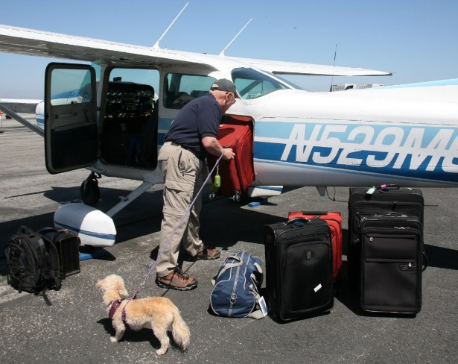
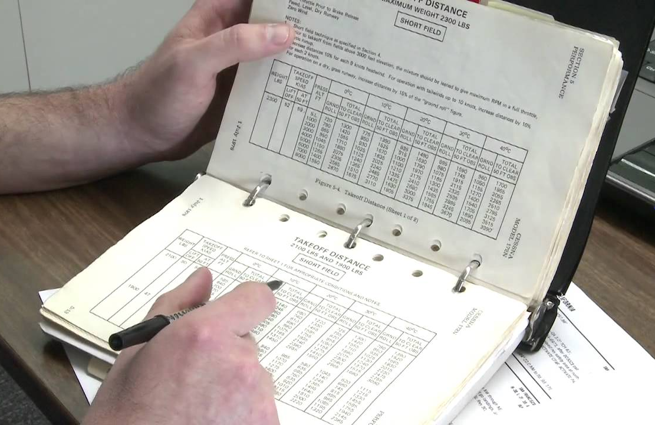
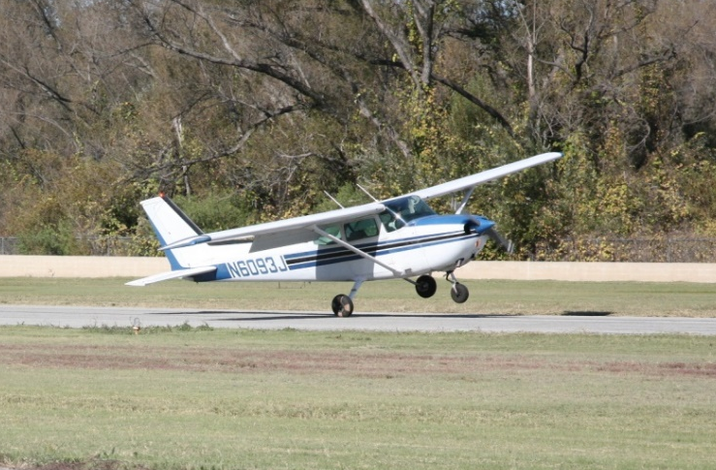
Previously….
Performance calculations
Performance expectations
Notes:
Previous topics of the month have dealt with aircraft performance calculations and pilot expectations. But in the end, it matters little whether pilots can calculate expected performance if they don’t have the skill and experience to achieve it.
In this program we’ll go a step further and talk about ensuring pilot performance with respect to meeting our expectations.
(Next Slide)

Slide 5
Pilots need to predict
Takeoff and climb performance
Cruise performance
Approach and Landing performance
Emergency performance
  Aircraft weight
  Wind
  Runway composition, condition, & slope
  Obstacles
Notes:
Pilots need to know how to calculate expected takeoff, climb, cruise, approach, landing, and emergency performance. Those calculations are informed by a number of variables including:
Aircraft weight, wind, runway composition, condition, and slope, and obstacles on departure and approach paths. Of these, what would be the most profound influencer?
Presentation note: Pause for audience to discuss and answer. Then: (Click)
Actually weight and wind are both powerful performance influencers. We can predict their effects before we even arrive at the airport. But how do we know that we’ll be able to achieve that predicted performance?
Let’s talk about that.
(Next Slide)

Slide 6

Pilots need to know
Weight and Balance calculations
  Takeoff weight and CG location
    Don’t guess – weigh it!
    Location, location, location
    Objects may shift ……
    Document your work
Fly the airplane
  At or near max gross weight
  With a CFI
Notes:
In order to meet our performance expectations we need to be sure of what they are. If weight is a profound influencer of performance it makes sense to know how much our aircraft and contents weigh.(Click)
Weight and balance limitations come immediately to mind. Are the takeoff weight and center of gravity within acceptable limits? Let’s face it; many pilots haven’t done a weight and balance calculation in years but, especially if you’re going to be operating near max gross weight, you’ve got to know how much your plane, fuel, passengers, and luggage weigh. (Click)
This is not a good time to estimate weight. Don’t guess – weigh it. (Click)
Where you distribute that weight matters. Make sure you’re well within the center of gravity envelope. Too far aft and you’re inviting a stall – too far forward and you may get a nasty surprise when you try to flare for landing. (Click)
And objects may shift during the course of your flight so make sure your cargo is secure. Use a cargo net, cargo straps, and seat belts to make sure your cargo stays put throughout the flight.
One more thing – Document your calculations and preserve that documentation for a while. It’s nice to be able to review how you got to a figure and a record of weight and balance calculations will show how the aircraft at least, tends to gain weight over time.
Once you calculate takeoff and climb distances you’ll have an expectation of performance. But how do you know you’ll meet that expectation?
Presentation note: Pause for audience to discuss and answer. Hopefully they will suggest documenting actual takeoff performance then:
Now comes the fun part. (Click)
In order to know whether we can “make the numbers” we’ll have to fly the airplane and document our results. (Click)
It stands to reason that we should fly at or near max gross weight. Any reduction in weight will yield an increase in performance. So load up with your favorite CFI and passengers - be sure to include typical weight in the baggage compartment – and establish a baseline of your personal performance.
(Next Slide)

Slide 7
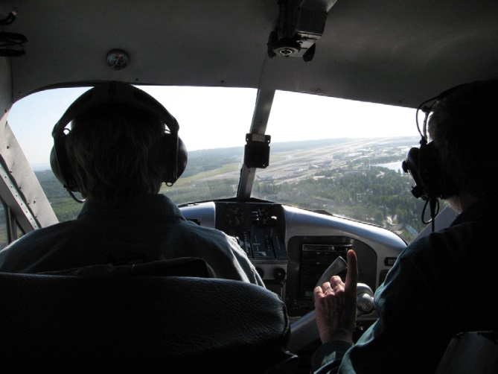
Baseline performance
Aircraft
  Mission weight
  Maximum wind experienced
    In aircraft type
Airfield
  Typical for mission
  Seek local knowledge
Notes:
In order to establish personal performance expectations you need to have a baseline – think of it as your personal, documented, demonstration of performance. We suggest you document your performance at least once a year with a CFI. Try to pick a day when you can experience actual wind and weather conditions in the airplane you usually fly loaded to your typical mission weight. Select an airfield that’s typical for the missions you fly. If you’re planning a trip to a short, obstructed runway; try to find something similar to train on. If you’re contemplating a trip to an unfamiliar airport try to gather information about the destination airfield from pilots who’ve flown there and share that information with your instructor. That will help your CFI to construct realistic scenarios for you to fly.
(Next Slide)

Slide 8
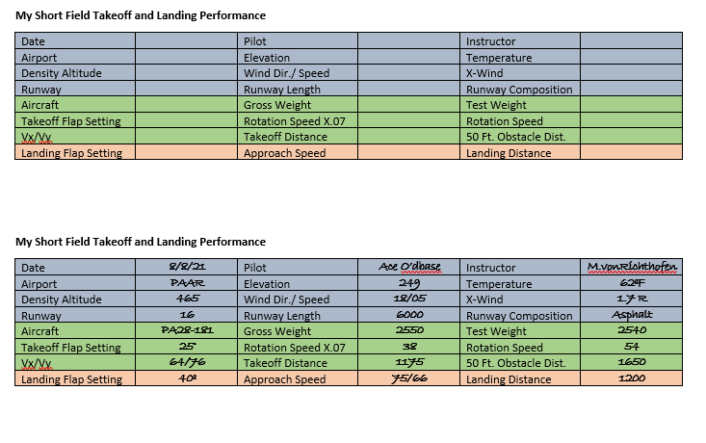


Baseline performance
Gold Seal
Notes:
Here’s a chart that some pilots use to document their takeoff and landing performance. We’ll tell you where you can find this and other useful documents at the end of this program.
Once you’ve completed the chart you’ll have a performance baseline to work with. You can adjust your baseline as you gain experience and skill. If you want to adjust your baseline we strongly suggest that you do it with a CFI. That way you’ll have an objective assessment of your capabilities and a
flight instructor may offer suggestions and instruction for improving your baseline performance.
(Next Slide)

Slide 9
Baseline performance
Gold Seal
Notes:
Here’s the completed chart. (Click)
Notice that it includes a rotation speed. (Click)
But it also documents a figure that’s 70% of the rotation speed. Does anyone know what that’s about?
Presentation note: Pause for audience input then:
Some of you know about the 50/70 rule that’s used to establish a go/no-go decision point for every takeoff. It’s especially useful for short runways and here’s how it works.
(Next Slide)

Slide 10

Pilots need to know
Takeoff and departure calculations
Rejected takeoff decision point
  50/70 rule
    54 Kts or Mph rotation speed
      60 x 70% = 42
    2,200 ft. available
      2,200 x 50% = 1,100
Terrain and obstructions
Forced landing opportunities
Notes:
We know how much runway is available and how much we’ll need for takeoff. The 50/70 rule of thumb will be helpful in assessing whether the takeoff is going as planned. The rule goes like this. If you haven’t attained seventy percent of your flying speed by the time you’re half way down the available runway it’s time to abort the takeoff.
Whether you’re working with knots or miles per hour the math is the same. If your takeoff speed is 54 – 70 percent of that number is 42. Assuming you have 2,200 feet of runway available, you need to see 42 knots or miles per hour at the half-way point on the runway. Obviously – if you have eight to ten thousand feet of runway to work with, you can delay your abort decision. (click)
We should also be mindful of terrain elevation and obstructions along our departure plan. They may dictate our departure path. (click)
and while we’re looking at terrain we should identify forced landing opportunities near the field.
(Next Slide)

Slide 11
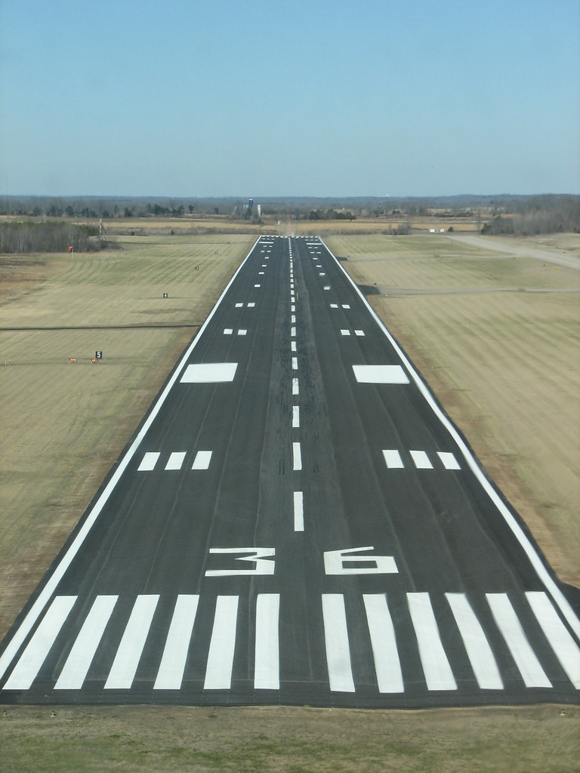
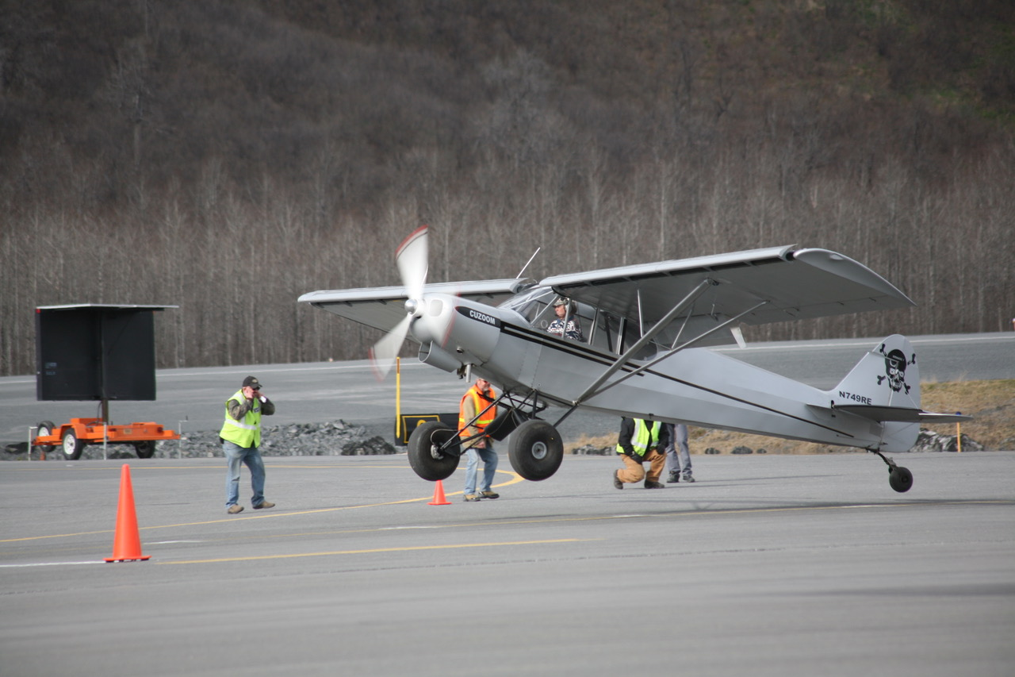
How do you know?
200
x 6
1,200
+ 60
1,260
Notes:
So how do you know exactly where you touched down and how much runway you used to stop. (Click)
Well you can always enter a takeoff and landing contest like this annual gathering in Valdez, Alaska. But that’s a far way to go for most of us. The fact is, we won’t know exactly but we can come pretty close. (Click)
The key is to have access to a runway with standard instrument markings and an observer – preferably your CFI – to record your performance.
The landing aiming point markings are 150 feet long and 20 feet wide. For runways shorter than 4,200 feet the aiming point markers may be shortened to 100 feet.
Centerline stripes are 120 feet long and they are spaced 80 feet apart, so from any point on a runway stripe to the same point on the next stripe will be 200 feet. (Click)
So, if we begin a takeoff at the beginning of the first centerline stripe and we lift off in the middle of the seventh stripe, our takeoff run will be 1,260 feet.
Sometimes centerline stripe space must be adjusted to accommodate runway length but any adjustments are made to the middle of the runway so spacing at either end will be accurate.
(Next Slide)

Slide 12
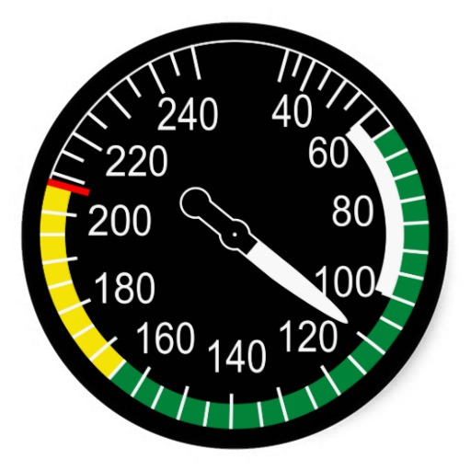
While we’re at it …..
Power off Approaches and Landings
Best Glide Speed
  Speed to fly for greatest distance
  Speed to fly for greatest time
  They’re the same thing
    The longer you fly, the further you go
  It depends.
Notes:
While we’re working in the pattern why not mix it up with some power off approaches and landings? (Click)
To ensure success in forced landings, we must be well acquainted with best glide speed. We’ll start with a definition. (Click)
Which of these statements is true with respect to best glide speed?
Presentation note: Ask the audience to comment then: (Click)
Well as so often is the case best glide speed depends on what you’re trying to do. Let’s look at some alternatives.
(Next Slide)

Slide 13
Distance
Maximum range speed
  Greatest distance covered for altitude lost
  Often referred to as best glide speed
  Roughly half way between Vx & Vy
  Speed Increases with weight
Aircraft | Vx | Best Glide | Vy
C172 | 53 | 65 | 73
AA5A | 78 | 83 | 91
PA 28 161 | 63 | 73 | 79
Notes:
If distance is what you want, you’ll need a speed and configuration that will get you the most distance forward for each increment of altitude lost. This speed is often referred to as best glide speed and, on most airplanes it’ll be roughly half way between Vx and Vy. The speed will increase with weight so most manufacturers will establish the best glide speed at gross weight for the aircraft. That means your best glide speed will be a little lower for lower aircraft weights.
Not all manufacturers publish a best glide speed but here’s a chart with examples from some who do.
(Next Slide)

Slide 14
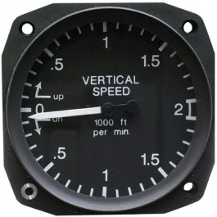
Time
Minimum sink speed
  Lowest rate of descent
  Slightly slower than maximum range speed
  Rarely cited in POH
Notes:
If you’re looking to maximize your time in the air then Minimum Sink Speed is what you’ll need. It’s slightly slower than maximum range speed and rarely cited in the POH.
But you and your CFI can figure out what it is for your aircraft. We’ll get to how you do that next.
Next Slide)

Slide 15

What about my airplane?
Experiment with your CFI
  Best glide speed and attitude - note sink rate.
  Minimum sink speed and attitude – note sink rate
Notes:
If you’re wondering about the airplane you fly, you can do some experiments on a dual flight with your CFI. Start at Vy or manufacturer’s recommended best glide speed with power off – you did remember the carb heat didn’t you? – and note speed vs sink rate as you adjust pitch to reduce airspeed. For the most useful results, you should do this as close to typical mission weight as possible. Remember optimal glide speeds will be slower as aircraft weight decreases.
It’ll be easy to identify minimum sink speed. It’s the speed to fly for the lowest rate of descent. Maximum Glide Range speed will be a little higher than minimum sink. Here you’re looking for the highest speed forward for the lowest rate of descent.
Once you’ve identified minimum sink and maximum range glide speeds you’ve got a couple of good numbers to use for the future. The next big challenges are to know your height above the terrain and to glide the airplane to a point from which you can make a successful forced landing. Power off approaches and landings are the best ways to train for the main event.
(Next Slide)

Slide 16
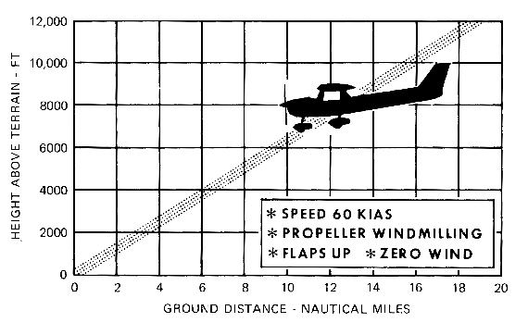
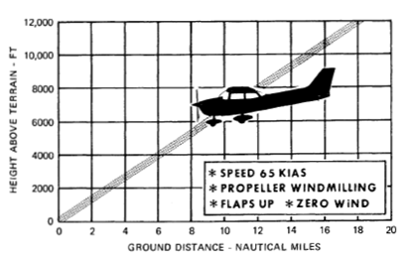
Forced landing tips & tricks
Know how far you can glide
1.5 NM per 1,000 Ft. AGL
Notes:
How many miles you can glide per 1,000 feet of altitude is a very useful thing to know. A rule of thumb for Cessna 152s and 172s is 1.5 nautical miles per 1,000 feet of altitude AGL. Remember this is altitude above ground level – not sea level.
Experiment to see how far you can glide in your airplane.
(Next Slide)

Slide 17
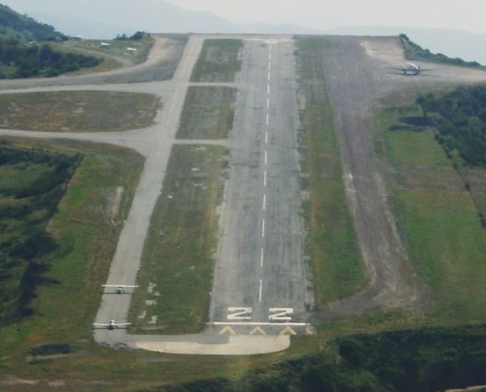
Forced landing tips & tricks
Frequent practice
  At typical mission weights
Flaps up approach to between 1st and 2nd third of runway of landing area.
Notes:
Frequent forced landing practice at typical mission weights as an excellent way to maintain proficiency and peace of mind. Forced landing skills diminish rapidly over time but with practice, you’ll be able to consistently land on your chosen touchdown spot regardless of wind. (Click)
Some pilots choose a spot between the 1st and 2nd third of the available landing area for an initial aim point.
(Next Slide)

Slide 18
Pilots need to know
Return to airport decision criteria
  Loss of control accidents are usually fatal
  Go/No-go – what’s your number?
  Determine with a CFI
    In each airplane you fly
    At operational weight at altitude
    Consider Startle Response
      3-second delay
  Brief return to airport criteria for each
  takeoff
Notes:
This topic is extremely controversial and a comprehensive discussion would take more than an hour. We’ll just cover some of the most important points here.
Every year we see accidents resulting from Loss of Control after pilots decide to return to the airport in response to emergencies during takeoff or climb out. More often than not a partial or complete loss of power prompts the decision to return to the field. (click)
Loss of Control accidents are usually fatal and these are no exception to the rule. That’s why it’s imperative for pilots to understand all the factors involved and commit to the appropriate course of action before the need arises. (click)
The question of course is; Is it safer to land straight ahead or to return to the airport for landing. We know that, if we have three to five thousand feet of altitude to work with, returning to the airport should be no problem. We also know that there’s a number below which it’s just too dangerous to turn back. The problem is that most of us don’t know what that number is.
The safe way to find your number is to work at altitude with your Flight Instructor. Simulate power loss on climb out and see how much altitude is lost in a 200 degree turn. We say 200 degrees because, if the power loss occurs while you’re on runway heading, a 180 degree likely won’t get you aligned with the runway. Do this exercise at your typical operational weight and wait approximately 3 seconds after the simulated power loss to begin maneuvering. This delay is necessary because humans typically don’t react immediately to startling events. They take a few moments to process the event before taking action.
(Next Slide)

Slide 19
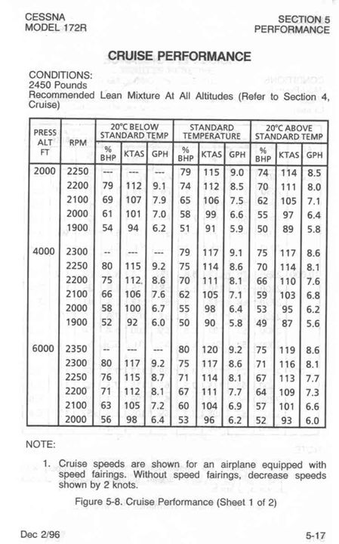
Takeoff and climb
Aircraft configuration
  Per POH for takeoff type
Power setting
  Takeoff, climb, cruise climb
  Power setting & fuel consumption
  Altitude, wind, & ground speed
  En route fuel availability
Lean per POH
Notes:
Having enough fuel for every flight or landing to refuel en route should be a no brainer but pilots still make off airport landings due to running out of gas. So lets consider what pilots need to know in order to predict cruise performance.
We’ll need to consult the POH for power setting and fuel consumption information at our planned cruising altitude. The winds aloft forecast will give us information from which we can calculate our expected ground speed. Factor in time to climb, approach, and land plus not less than 30 minutes reserve and you’ll have a good idea of how much fuel you’ll need.
Keep abreast of your fuel state while en document fuel usage for each flight. That way you’ll have a good idea for what fuel consumption to expect when you fly. As for making the fuel consumption numbers in the book? Well you won’t come close to book figures unless you do what?
Presentation note: Pause for audience to answer. Then: (Click)
That’s right! The only way you can make book fuel consumption figures is if you lean the mixture in accordance with book recommendations.
(Next Slide)

Slide 20
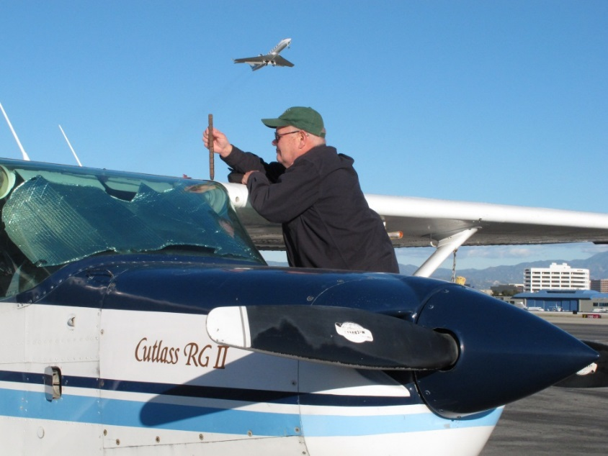
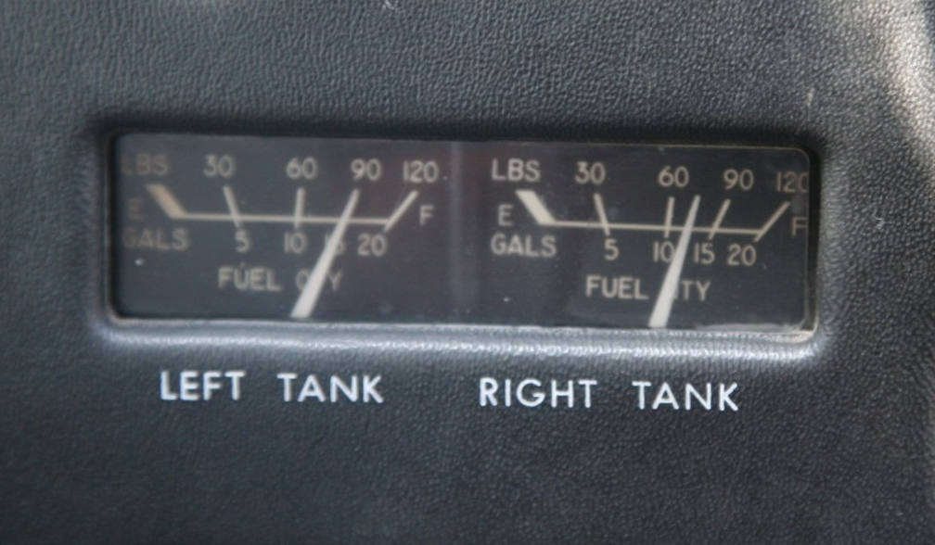
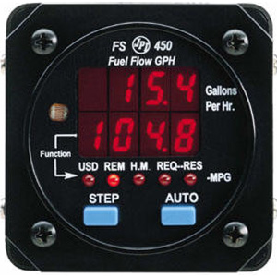
Pilots need to know
Fuel consumption
  Power setting & fuel consumption
  Altitude, wind, & ground speed
  En route fuel availability
Notes:
By the way – unless they’re reading empty, aircraft fuel gauges give at best, an approximation of how much fuel you have on board. Fuel flow computers give a much better picture but most require pilots to input fuel quantity so starting with the right fuel state is paramount. Regardless of how you’re equipped, It’s a good practice to double check fuel quantity when you’re launching with less than full tanks. And for all flights – be sure to monitor fuel consumption and compute fuel remaining while in flight.
(Next Slide)

Slide 21
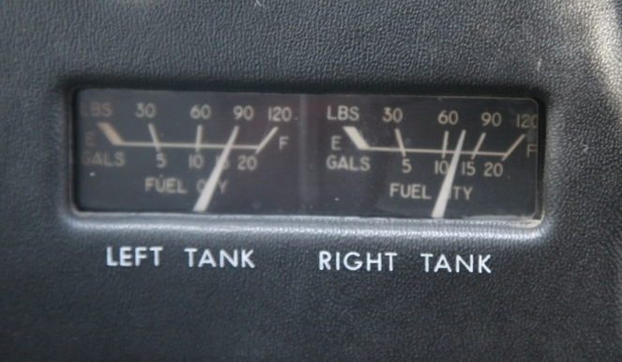
Recommendations:
Gold Seal
Be aware of en route fuel state
  Confirm “time in your tanks” hourly
Don’t wait to land & refuel
  Too easy to press on
Don’t land with less than one hour of fuel
  You’ll always have VFR reserves
Notes:
Here are some gold seal best practices that are recommended for all pilots (Click)
It’s essential to keep track of your available fuel. Hourly – or whenever you switch tanks – calculate how long you can fly with your remaining
fuel. Compare that to your predicted time to destination. If it looks as if you’re going to dip into your fuel reserve, it’s time to plan an en route fuel stop. (Click)
Don’t wait till your close to your destination to refuel. The closer you get – the more you’ll be tempted to continue on your reserve fuel supply. (Click)
Many pilots plan their flights so that they never land with less than one hours’ fuel in their tanks. That way they know they always meet VFR fuel reserve requirements.
Whether or not this practice meets IFR reserve requirements depends on how far it is to your alternate airport.
(Next Slide)

Slide 22

Recommendations:
Gold Seal
Brief each takeoff, approach, and landing
  Runway and available distance for takeoff or landing
  Aircraft configuration and target airspeeds
  Rejected takeoff or landing decision point
  Departure/approach path
  Return to airport altitude
  Forced landing opportunities
Notes:
One more gold seal best practice before we go. Briefing each and every takeoff, approach, and landing is another gold seal best practice. Vocalizing important points and procedures just before takeoff or landing keeps them uppermost
in your mind where they’re available for ready reference if something unforeseen happens. (Click)
Brief the assigned runway and available distance for takeoff or landing. Include aircraft configuration and target airspeeds. Vocalize your rejected takeoff or go-around decision point.
Include the departure or approach path and the altitude below which you’ll not attempt a return to the airport.
Finally, brief forced landing opportunities close to the airport.
(Next Slide)

Slide 23

Questions?
Notes:
Presentation Note: You may wish to provide your contact information and main FSDO phone number here. Modify with your information or leave blank.
(Next Slide)

Slide 24
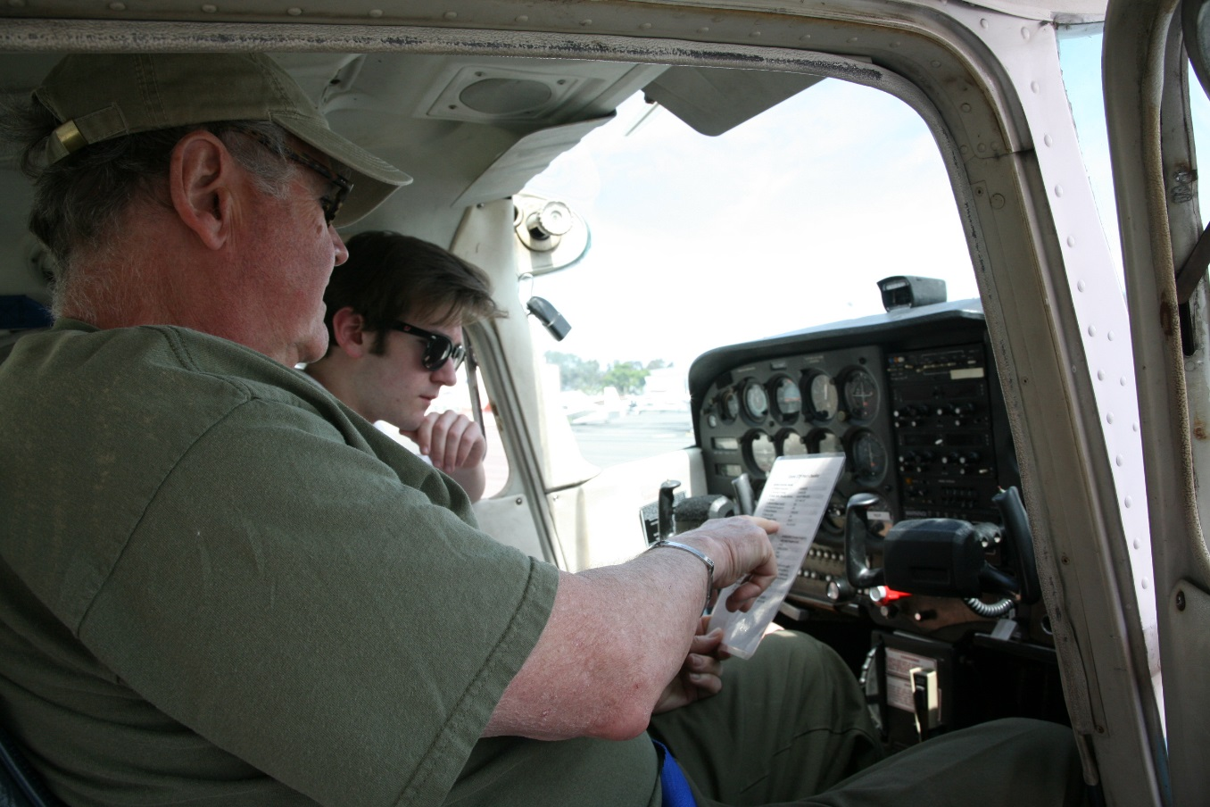
Have you earned your WINGS?
Proficient Pilots are:
  Confident
  Capable
  Safe
WINGS will keep you
on top of your game
Notes:
Have you earned your WINGS? Proficiency is key to success in almost every thing worth doing – especially flying. Proficient pilots are confident, capable, and safe.
WINGS is a proficiency training system specifically designed for general aviation pilots and, regular participation will keep you on top of your flying game.
(Next Slide)

Slide 25



http://www.mywingsinitiative.org/
Notes:
Every time you complete a WINGS Phase you’re eligible to win cash in the WINGS Sweepstakes.
The sweepstakes is generously funded by Paul Burger, a long time advocate for general aviation safety and a retired aviator who believes participation in this program saves lives. VISIT WWW.MYWINGSINITATIVE.ORG to learn more and enter the sweepstakes.
Just navigate to http://www.mywingsinitiative.org or scan the QR code for details. By the way, Instructors can also enter the sweepstakes. But there are even better reasons to participate in WINGS.
(Next Slide)

Slide 26

How To Win – It’s Easy
Whenever you complete a WINGS phase, select WINGS Sweepstakes on the Team Member Award section of your My WINGS page
Or Visit www.mywingsinitiative.org & click on “Sweepstakes Entry”
Complete the form, get chances to win one of 10 cash prizes!
Four $1,500, Four $750,Two $500 Winners
Notes:
After you’ve completed a phase of WINGS you can enter the sweepstakes by clicking on “Claim Rewards” in the “WINGS – at a glance” section of your My WINGS page and select WINGS Sweepstakes. Or you can go directly to the mywingsinitiative.org website to complete your entry form.
(Next Slide)

Slide 27

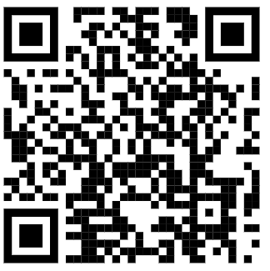
Safety Management Systems (SMS)
Coming to General Aviation
https://www.faa.gov/about/initiatives/gasafetyoutreach
Notes:
Safety Management Systems are a set of policies and processes that can increase the safety and efficiency of any flight operation. And FAA is bringing SMS to General Aviation. You may have heard of SMS but thought it was only for large organizations but actually SMS can be scaled to fit any operation large or small.
There are 4 major components to a Safety Management System (Click)
Safety Policy – a documented commitment to safety that runs from the head of an organization to its newest member. (Click)
Safety Risk Management – a process that identifies hazards within an operation, determines to what extent an identified hazard may impact flight safety, and controls the risk of occurrence to an acceptable level. (Click)
Safety Assurance – By collecting and analyzing information derived from safety performance data Safety Assurance ensures the performance and effectiveness of Safety Risk Controls. (Click)
Safety Promotion communicates safety information and commitment throughout the organization. (Click)
You can find more information about Safety Management Systems at the URL on the Screen.
(Next Slide)

Slide 28



Thank you for attending
You are vital members of our GA safety community
Notes:
Your presence here shows that you are vital members of our General Aviation Safety Community. The high standards you keep and the examples you set are a great credit to you and to GA.
Thank you for attending.
(Next Slide)

Slide 29
The National FAA Safety Team Presents
Topic of the Month – December
Making the Numbers
<Audience>
<Presenter>
< >
Notes:
(The End)

