Slide 1
The National FAA Safety Team Presents
Topic of the Month – May
Human Factors Training
Notes:
2022/12-07-273(I)PP Original Author: John Steuernagle 07/25/2023; POC Kevin Clover National FAASTeam Program Mgr. (Operations), Office (562-888-2020 revised by John Steuernagle (03/23/2022)
Presentation Note: This is the title slide for Human Factors Training
Script - We have included a script of suggested dialog with most slides. The script will always appear in a non-italic font. Presenters may read the script or modify it to suit their own presentation style. See template slides 5 and 6 for examples of a slides with script.
Presentation Instructions - (stage direction and presentation suggestions) will be preceded by a Bold header: the instructions themselves will be in Italic fonts. See slides 2, for an example of slides with Presentation Instructions only.
Program control instructions - will be in bold fonts and look like this: (Click) for building information within a slide; or this: (Next Slide) for slide advance.
Background information - Some slides may contain background information that supports the concepts presented in the program.
Background information will always appear last and will be preceded by a bold Background: identification.
The production team hope you and your audience will enjoy the show. Break a leg!
(Next Slide)

Slide 2


Welcome
Exits
Restrooms
Emergency Evacuation
Breaks
Phones & pagers to silent or off
Sponsor Acknowledgment
Other information
Notes:
Presentation Note: Here’s where you can discuss venue logistics, acknowledge sponsors, and deliver other information you want your audience to know in the beginning.
You can add slides after this one to fit your situation.
(Next Slide)

Slide 3

Let’s Celebrate!
US General Aviation has never been safer
  < 6 accidents/100,000 hours
±1 fatal accidents/100,000 hours
Notes:
We’ve done this before but let’s take a moment to celebrate and reflect on a remarkable aviation achievement. (Click)
General Aviation operations in the United States have never been safer. We are experiencing fewer than six accidents and just over one fatal accident per 100,000 hours of GA flying.
(Next Slide)

Slide 4

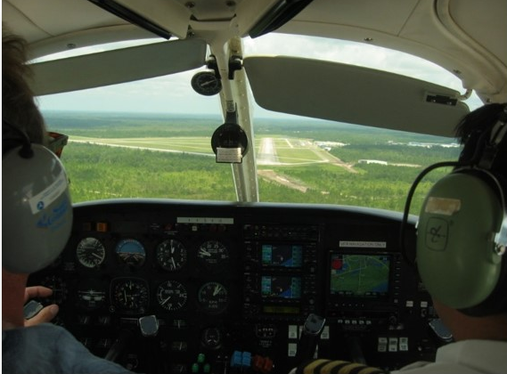
We all have a part
Notes:
Every GA pilot shares in the responsibility for our impressive record so hearty congratulations and well done to all of us!
That said – accidents still happen. People are still injured and people still die.
So let’s take a quick look at the history of GA accidents in the United States and see what we find?
(Next Slide)

Slide 5


A system in equilibrium
Data source: US DOT Bureau of Transportation Statistics
Accident Prevention Program
Aviation Safety Program
FAASTeam
2015
2018
Notes:
Prior to 1960 General Aviation was experiencing more than 35 accidents per 100,000 hours of flight. Improvements in aircraft, facilities, and training began a significant reduction in accidents and in just 10 years the GA accident rate was reduced by half. (Click)
In 1970, FAA launched the GA Accident Prevention Safety Program that continues to make significant contributions to the reduction in general aviation accidents. That program is now known as the FAA Safety Team - the FAASTeam. (Click)
Since about 1980 we’ve averaged less than 7 accidents and 2 fatal accidents per one hundred thousand hours of flying. And today we have fewer than six total and just over one fatal accident each one hundred thousand hours. (Click)
Everything we’ve done to reduce accidents in the past 60 years has brought us to this point of equilibrium and we’ll continue with traditional efforts to keep the accident rate where it is. But to get the accident rate even lower we’ll need to do some work on the General Aviation System and the individual people who operate within it.
(Next Slide)

Slide 6


Human Factors
The Final Frontier
Notes:
If we want to improve the ways people – individually and collectively – conduct and support flight operations, we’ll have to understand how humans think, what motivates them, what are their needs, fears, and biases. We’ll need to know how intrinsic human qualities contribute to success – and failure. And, with that knowledge of human thought and behavior, we’ll have to design aircraft and systems that support and leverage our human strengths while compensating for our weaknesses. (Click)
So here is where we begin the next leg of our journey to excellence with an in-depth study of Human Factors – The Final Frontier.
(Next Slide)

Slide 7
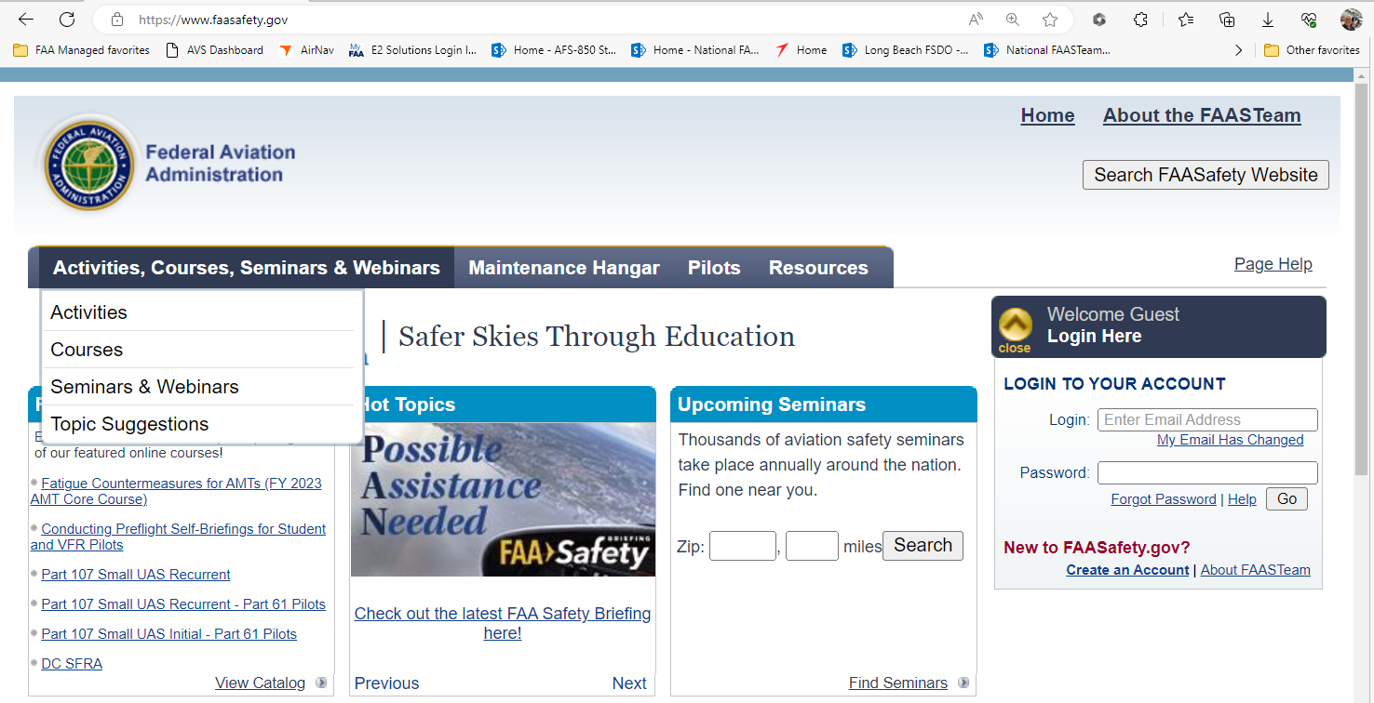
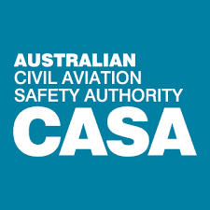
New program and new technology
Notes:
In partnership with the Australian Civil Aviation Safety Authority, we’ve created a series of human factors courses for pilots and flight instructors. Using Articulate Rise – a course authoring program – we can now deploy quality learning experiences, not only to computers, but also to any mobile device. Let’s take a quick look human factors offerings in the FAASafety.gov course catalog.
You can access the series from the FAASafety.gov home page by hovering over Activities, Courses, Seminars, and Webinars and clicking Courses – (Click)
or by clicking ‘View Catalog’ in the Featured Courses box.
(Next Slide)

Slide 8
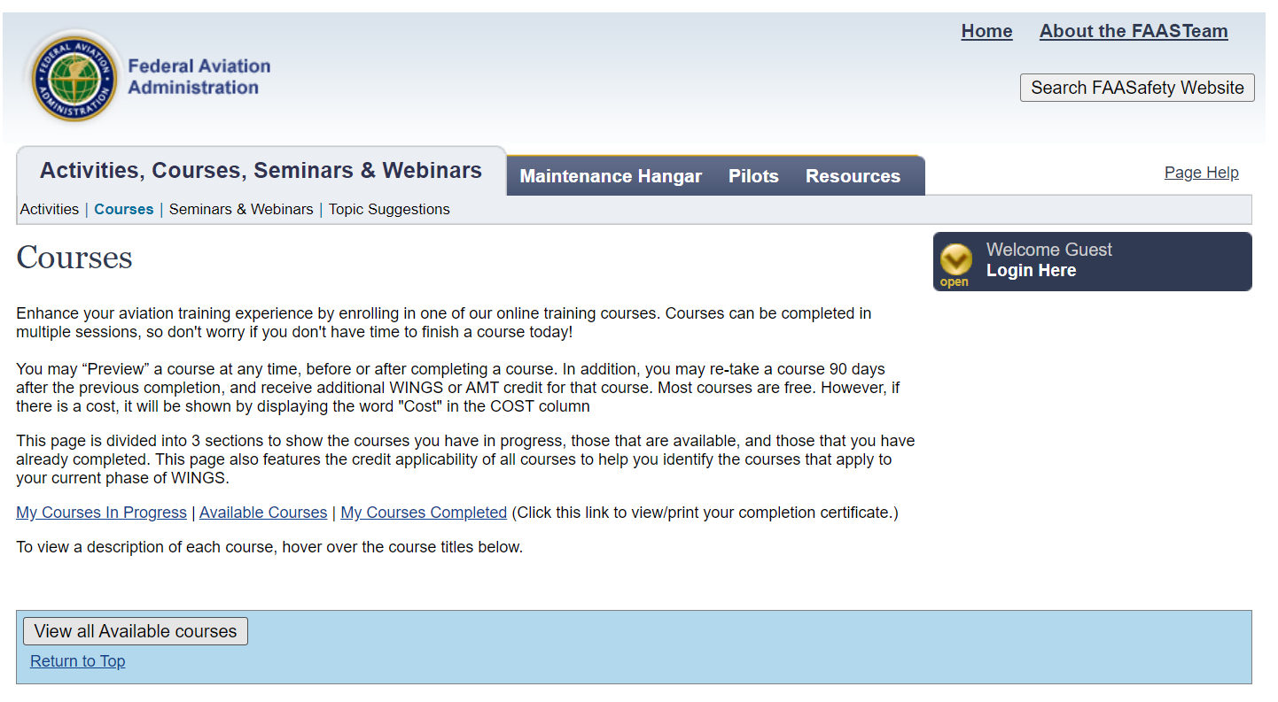
Notes:
Next click on ‘View all Available courses’
(Next Slide)

Slide 9
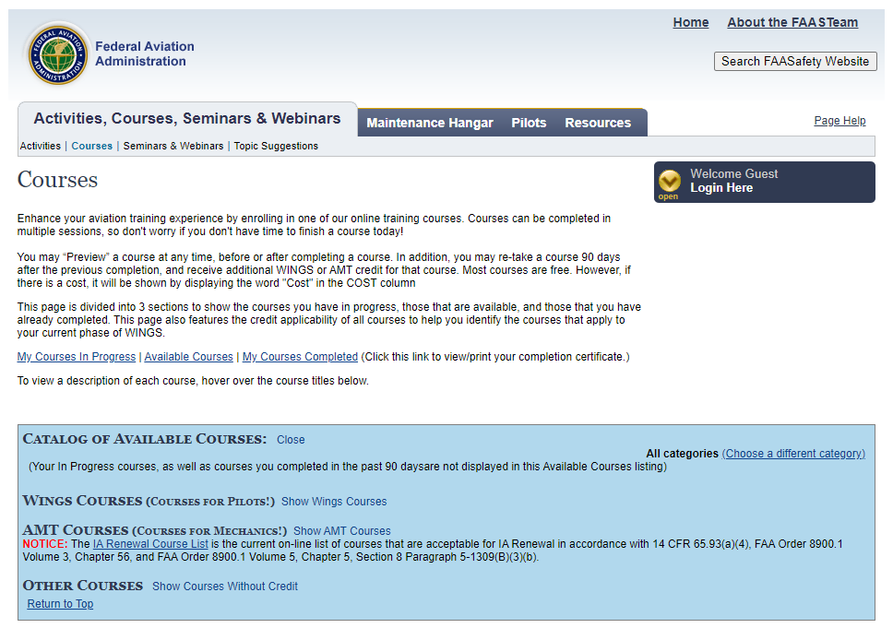
Notes:
Click on ‘Show WINGS Courses’
(Next Slide)

Slide 10
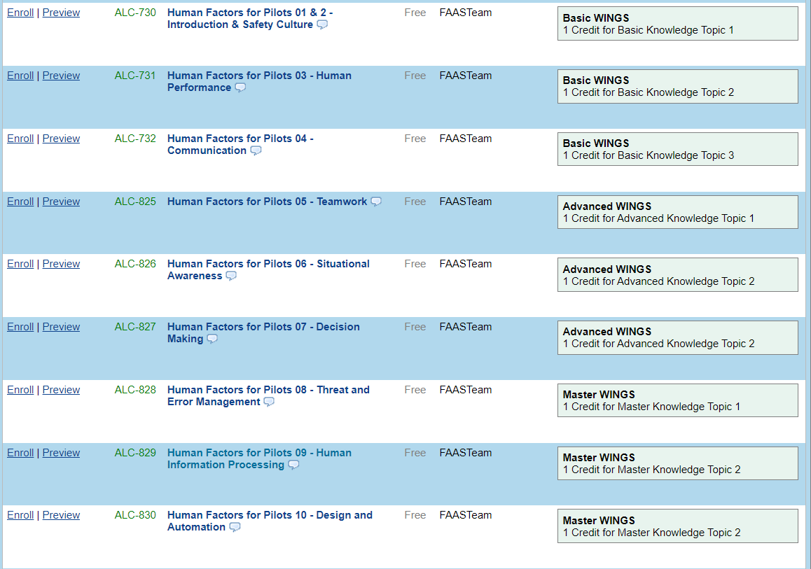
New program and new technology
Notes:
And the system will return an alphabetical listing of courses. Scroll down to the Human Factors for Pilots series.
(Next Slide)

Slide 11
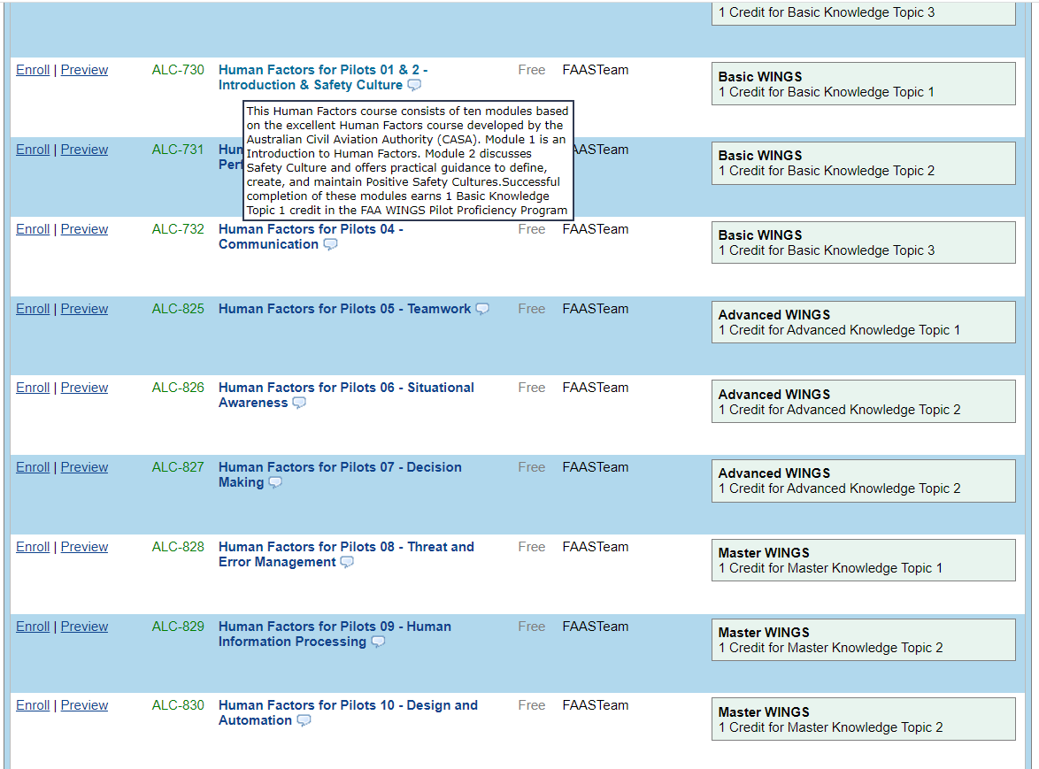
New program and new technology
Notes:
Hovering over the course title will return information on the topics addressed in each course module.
There are ten modules in all and aviators who complete the series will earn 3 WINGS Pilot Proficiency Program knowledge credits in each of the basic, advanced, and master levels.
Although the modules can be taken in any order, we strongly recommend addressing them in sequence. (Click)
When you’re ready to begin a module, simply click on ‘enroll’ and you can begin the course.
(Next Slide)

Slide 12
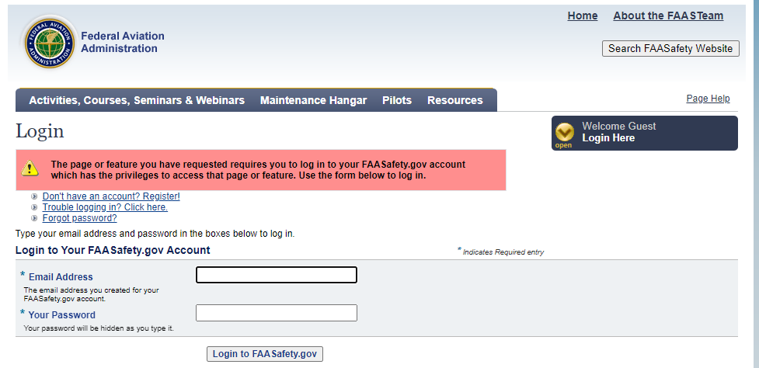
Log in to your FAASafety.gov account
Notes:
If you’re not logged in to your FAASafety.gov account, the system will prompt you to do so.
Once you’re logged in you can access the course.
(Next Slide)

Slide 13
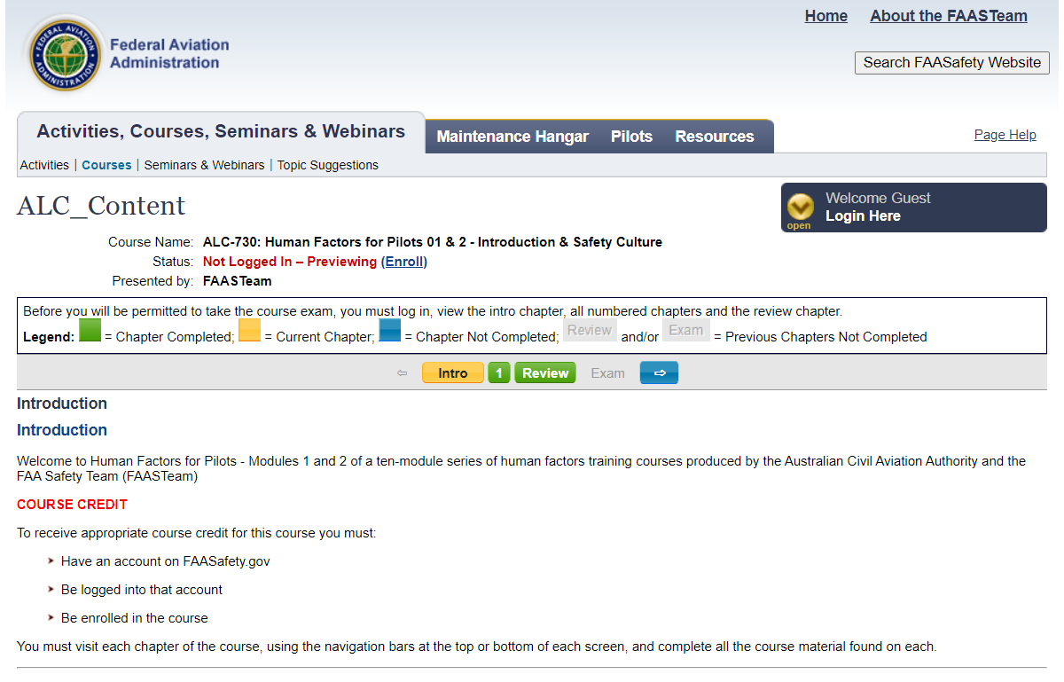
Notes:
Here’s the home page for Modules one and two. Course navigation controls are in the center. After reading the introduction, proceed in sequence.
(Next Slide)

Slide 14
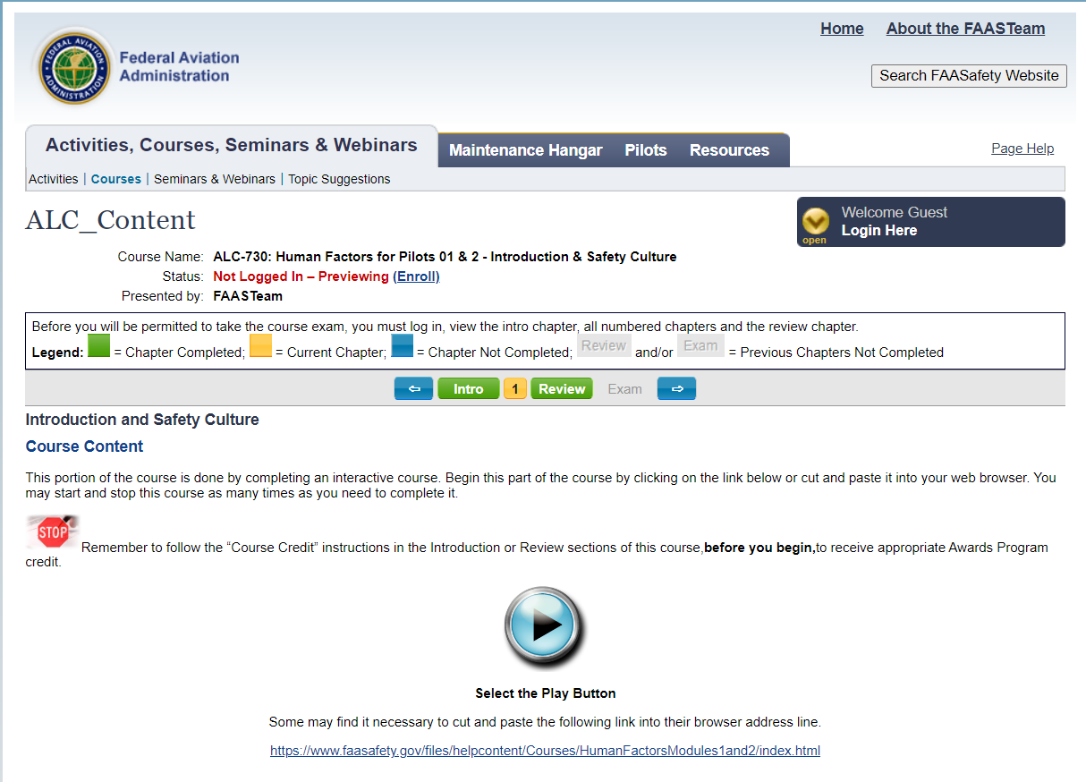
Notes:
The course content page has some additional instructions and a button to access the course content.
(Next Slide)

Slide 15
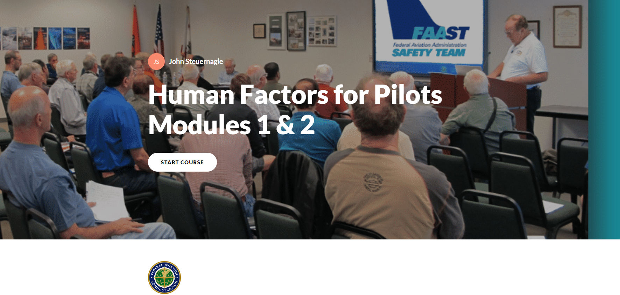
Notes:
Click on ‘START COURSE to begin.
(Next Slide)

Slide 16
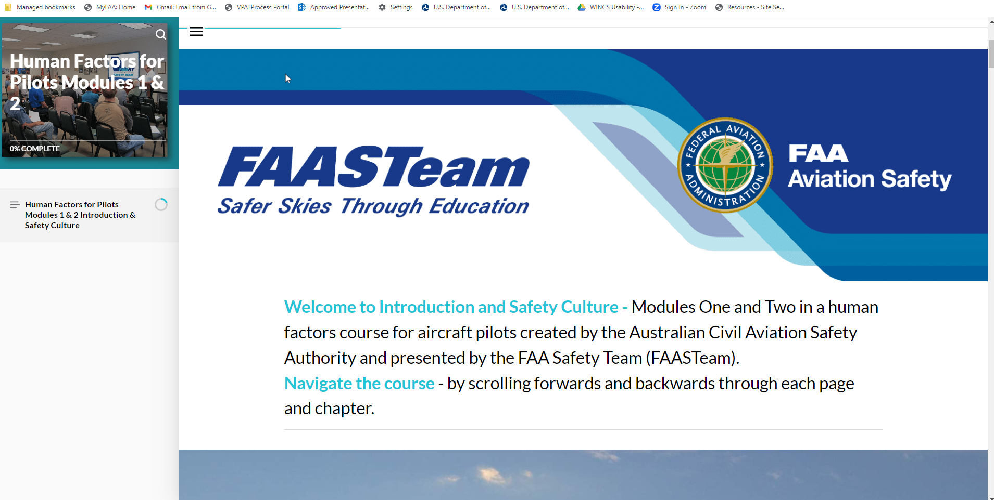
Computer monitor
Notes:
Here’s the first page of Module 1 – Introduction. The program will automatically scale content to match your access device. Here we see content displayed on a computer monitor.
(Next Slide)

Slide 17
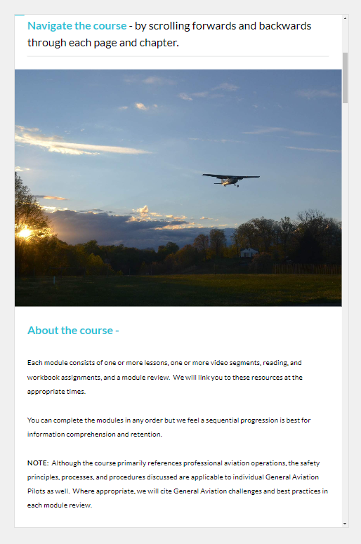
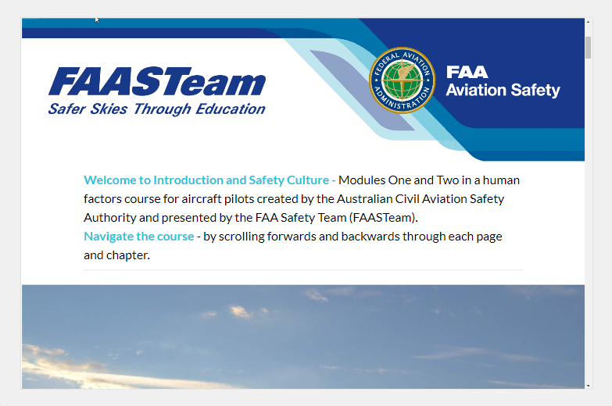
Tablet
Notes:
Here’s the same page on a tablet in horizontal and vertical orientations.
(Next Slide)

Slide 18

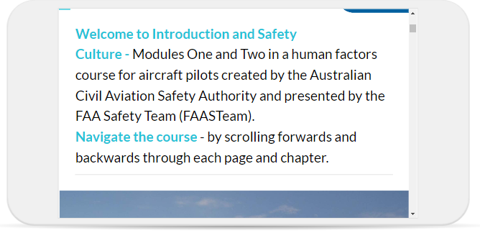
Phone
Notes:
And the same page scaled for a cell phone screen. Users can access all of the information by scrolling through the program.
(Next Slide)

Slide 19
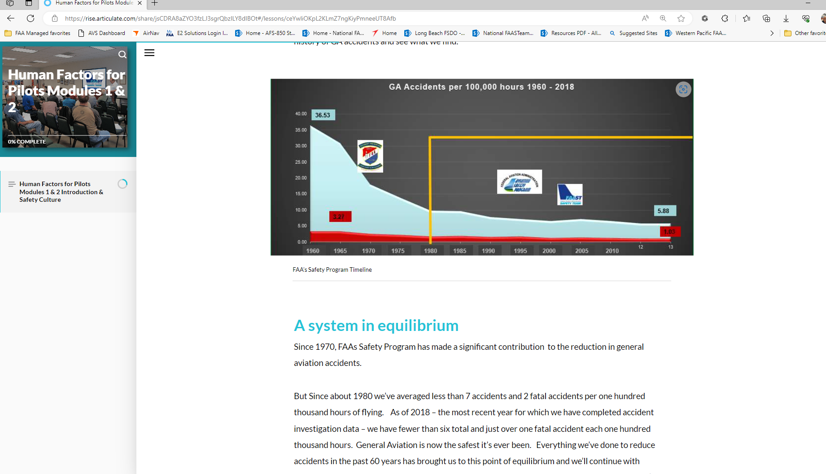
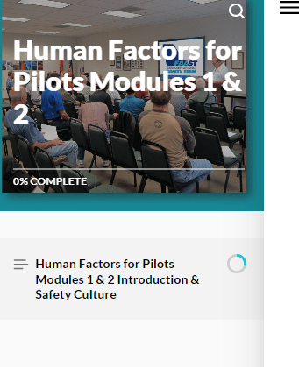
Notes:
Here, we’ve scrolled to the system in equilibrium discussion you saw earlier. (Click)
A course progress pane on the left side shows us which chapter we’re viewing and a course progress indicator.
(Next Slide)

Slide 20
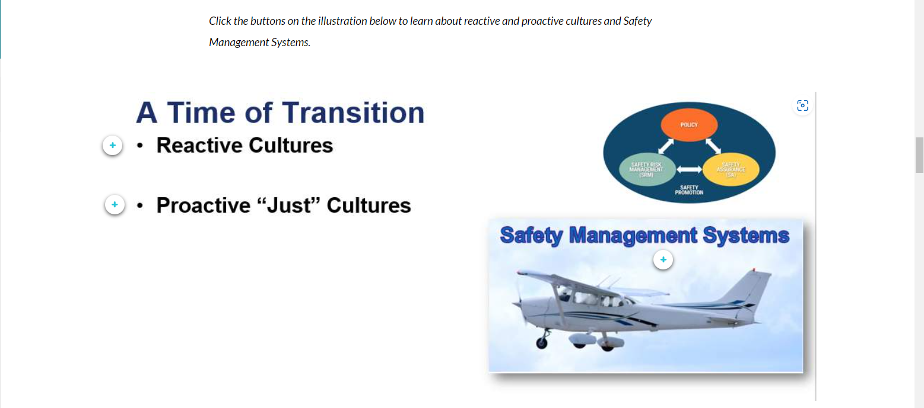
Interactive content
Notes:
Using a course authoring tool allows us to enhance the learning experience with interactive content. Here we discuss the fact that, in addition to dealing with a system in equilibrium, we’re also thinking about safety in a new way as we transition from Reactive, blame, shame, retrain cultures to Proactive “just” cultures. Learners interact with the program by clicking the on-screen buttons to learn more.
(Next Slide)

Slide 21
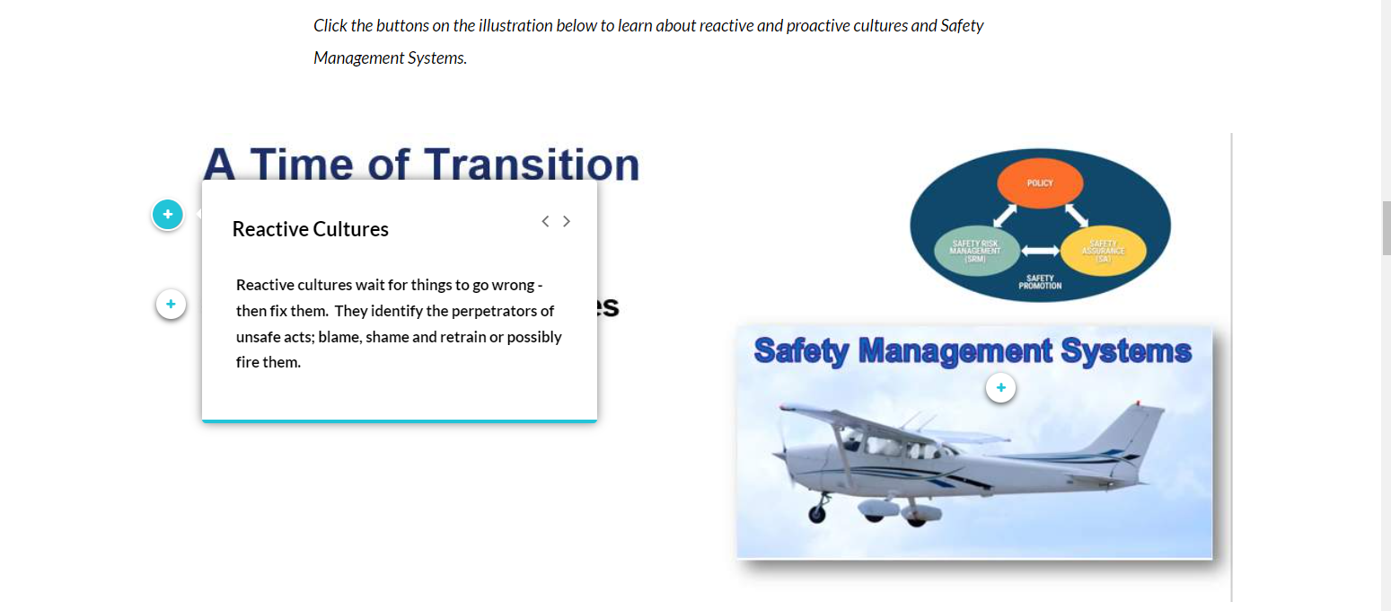
Interactive content
Notes:
We define Reactive….
(Next Slide)

Slide 22
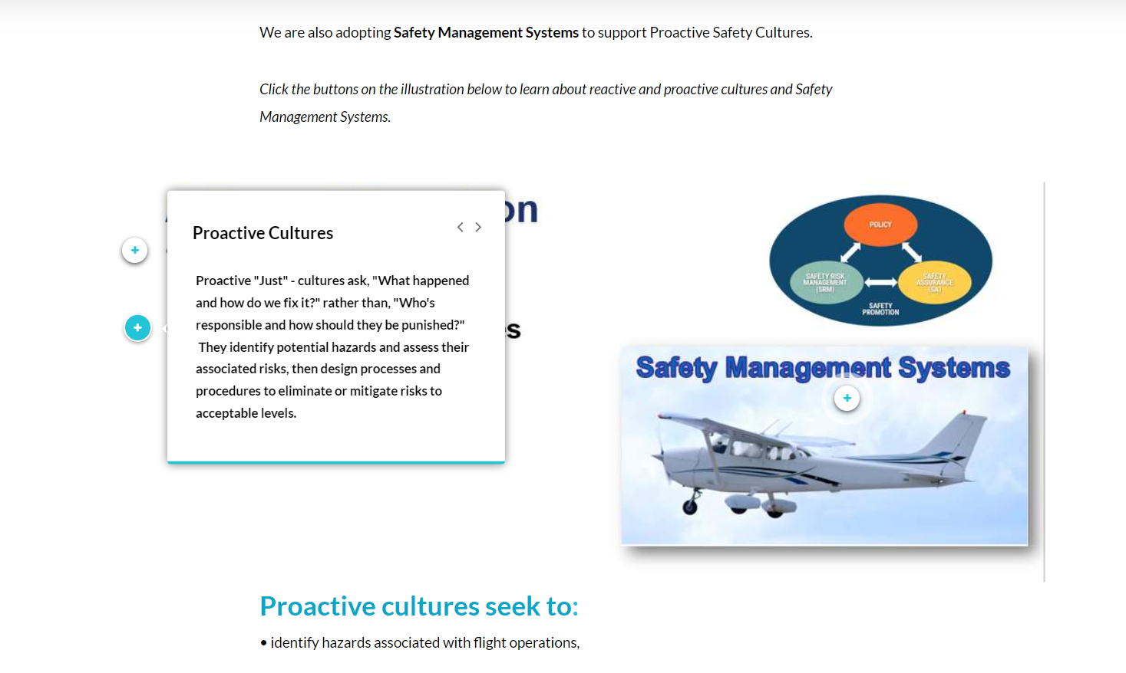
Notes:
and Proactive cultures and explain how proactive safety cultures support the adoption of Safety Management Systems.
(Next Slide)

Slide 23
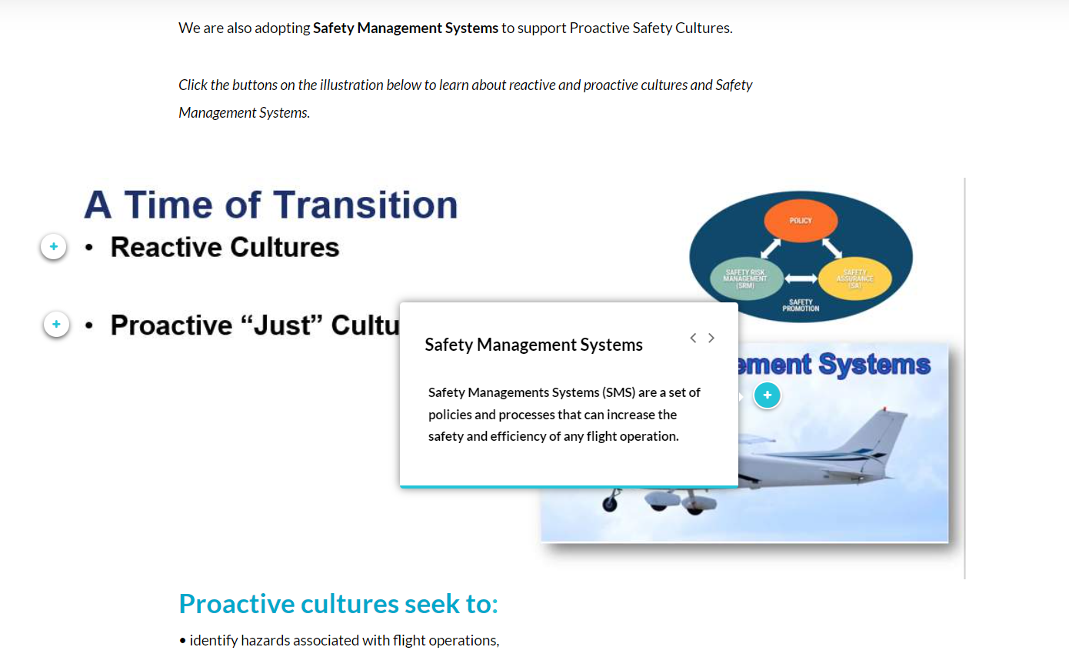
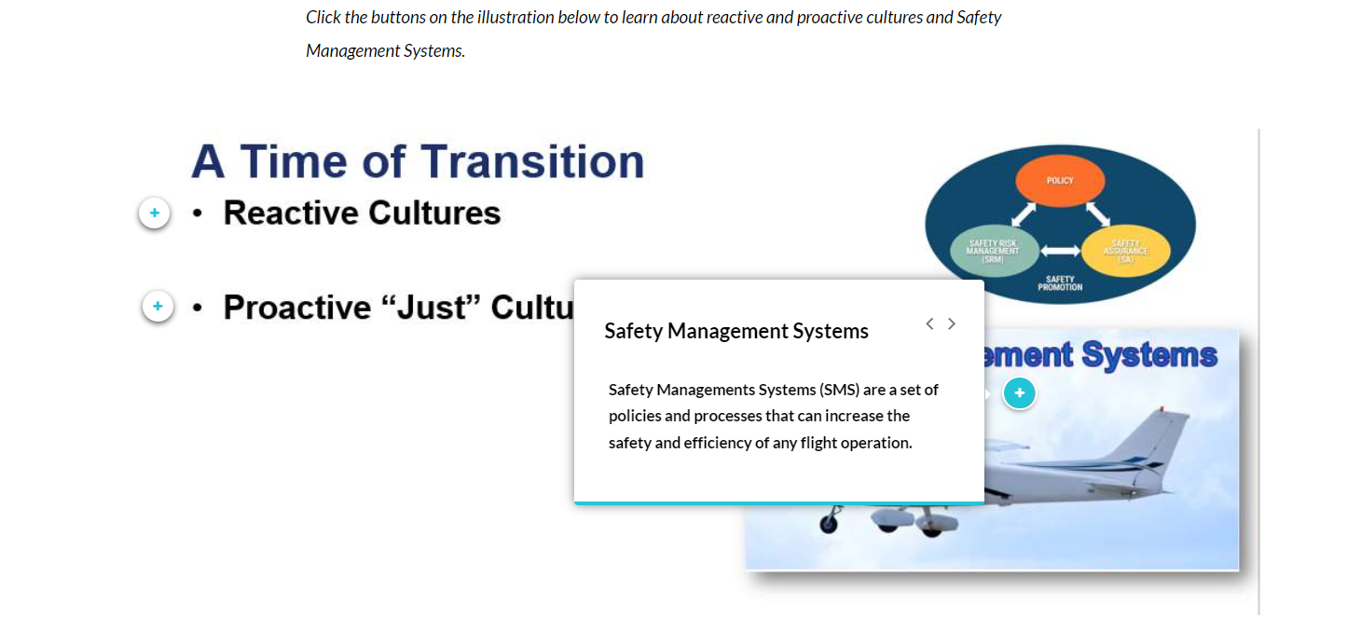
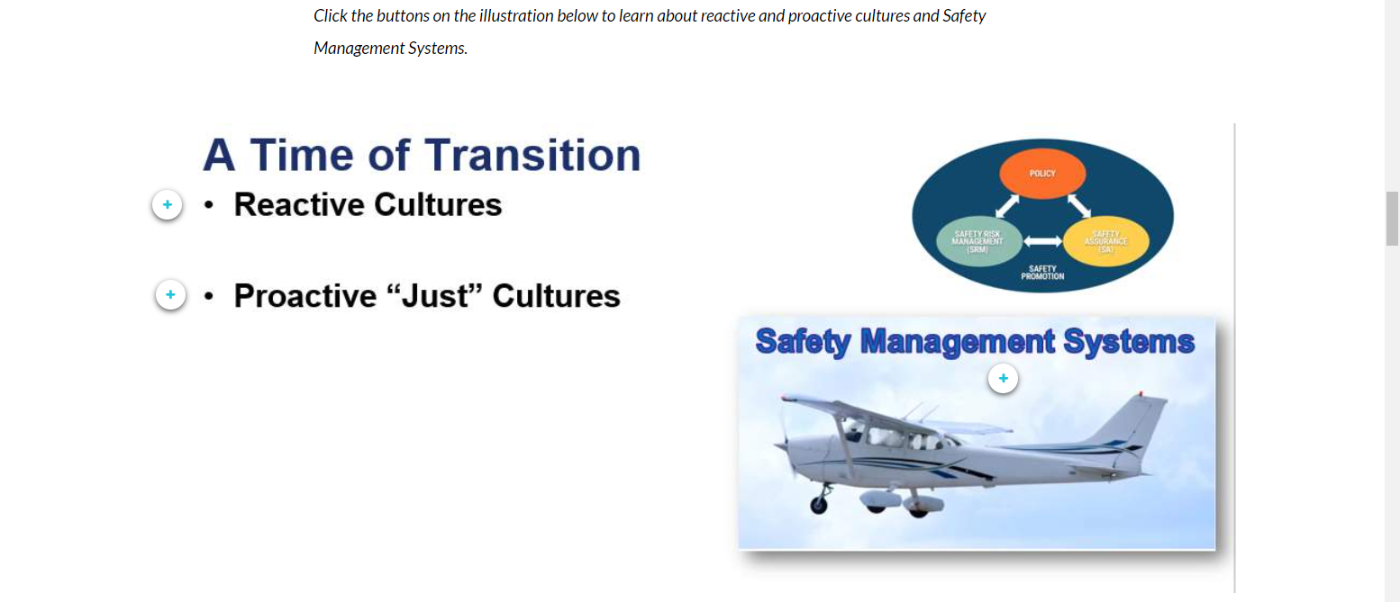
Interactive content
Notes:
Many general aviation pilots are unaware that Safety Management Systems exist or, if they know a little about SMS philosophy and organization, they feel they don’t apply to their flight operations. Let’s take a few minutes to discuss whether that’s actually true. We’ll try to relate organizational SMS to individual flight operations.
(Next Slide)

Slide 24
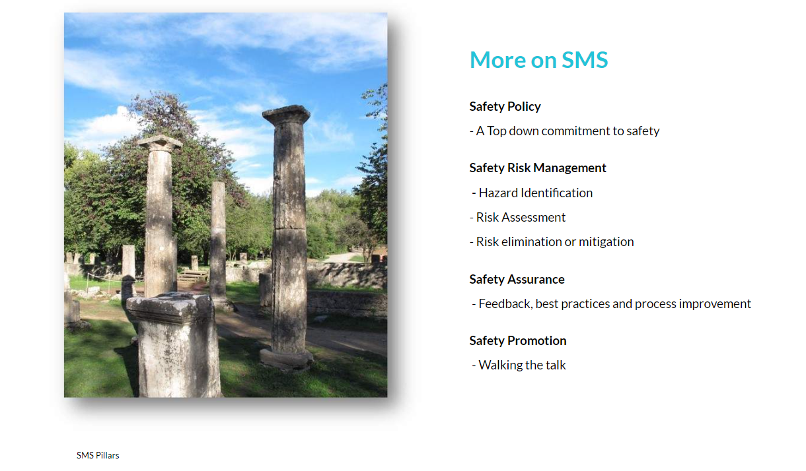
Notes:
We’ll spend a little time with SMS because it’s revisited in an interactive knowledge check that we’ll see later.
SMS is supported by 4 pillars:
Safety Policy – a Top down commitment to safety. In large organizations that means safety is paramount for the CEO all the way to the latest entry-level new hire. For individuals it means an unwavering commitment to safe operations.
Safety Risk Management – is a formal process that identifies potential hazards, assesses the likelihood that identified hazards will negatively compromise operations, and predict what the consequences will be should a mishap occur. SRM also identifies ways to either eliminate hazards or mitigate the risk of their occurrence to acceptable levels of safety. Certainly Safety Risk Management can be practiced by individuals as well as organizations.
Safety Assurance – monitors operational data and feeds back results and best practices from day-to-day operations. This feedback is used to refine processes and procedures. Safety Assurance relies on analysis of data – the more the better – to adjust processes and procedures, to mitigate risk, and to define and refine best practices . Airlines and large aviation organizations have a wealth of data to mine. Individual pilots – maybe not so much. But reflection on what works well defines best practices. And analysis of what doesn’t work well supports continuous improvement.
Safety Promotion – actively and constantly demonstrates the commitment to safety. In other words Safety Promotion is walking the talk. Effective Safety Promotion can be practiced by organizations and individuals alike. Flight Instructors are keenly aware of the need to promote and exhibit safety. The community looks to them to set the example and they’re always on stage. Individual pilots must also be aware that their actions speak louder than their words. Safe organizations and safe individuals do the right things – even when no one is looking. (Click)
(Next Slide)

Slide 25

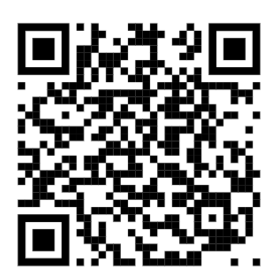
SMS for General Aviation
Safety Policy
Safety Risk Management
Safety Assurance
Safety Promotion
FAA GA Safety Outreach Initiative
https://bit.ly/3iPAlsw
Notes:
By the way, FAA is bringing SMS to General Aviation. To find out more about SMS for GA, capture the QR code or navigate to the FAA General Aviation Safety Outreach Initiative URL on this screen.
Next, let’s learn a little more about the course components.
(Next Slide)

Slide 26
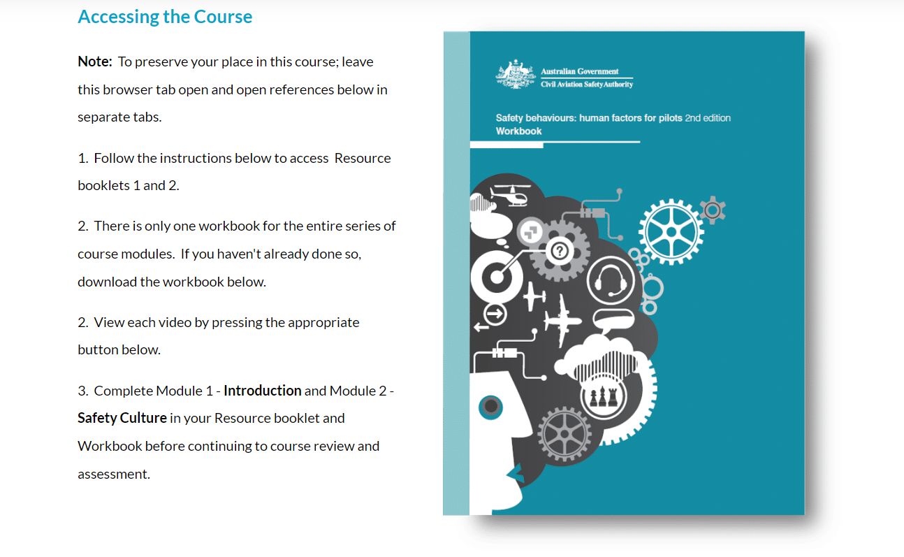
Australian CASA-produced content
Notes:
The bulk of each module is comprised of content produced by the Australian Civil Aviation Authority (CASA). Each module contains instructions for accessing the CASA content for that module.
(Next Slide)

Slide 27
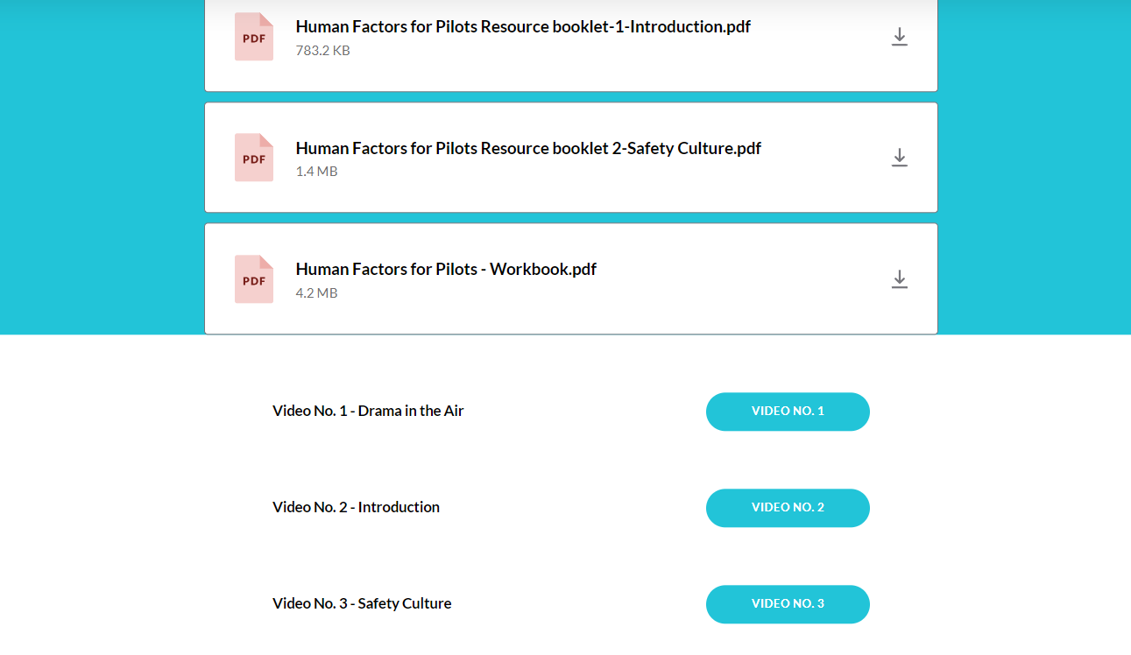
Accessing CASA Content
Notes:
The content consists of print products and, with the exception of Module 9 – Human Information Processing – one or more video presentations.
Each module includes instructions to download or access the CASA Content for that module.
Thus far we’ve been talking about Module 1 – Introduction. We’ll get to Module 2 – Safety Culture – in a minute but first let’s take a look at that knowledge check.
(Next Slide)

Slide 28
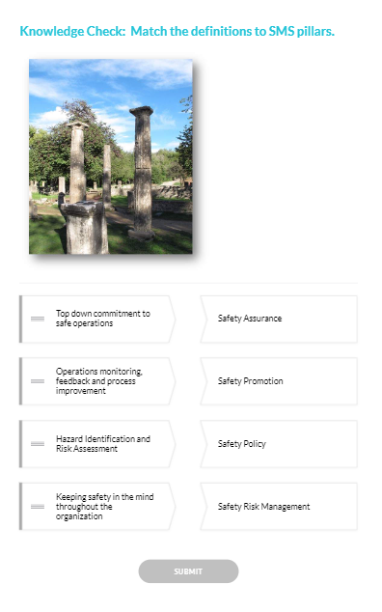
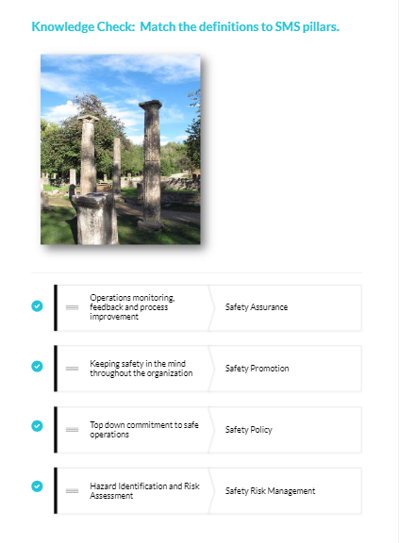
Notes:
The first page of Module 2 is a Knowledge Check on information learned in Module 1. Let’s work this together now.
Presentation note: Lead the audience In matching SMS elements to their definitions. When consensus is reached, (Click) to reveal the correct answers.
Great work folks. Now let’s take a look at what the Module 2 has to say about Safety Culture.
(Next Slide)

Slide 29
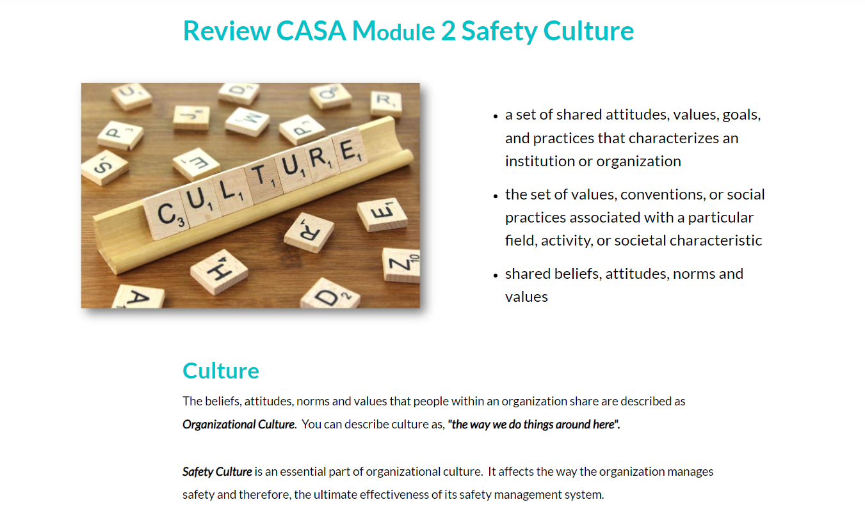
Notes:
Here’s the Module 2 title screen that defines Culture & Safety Culture. You’re may be familiar with these definitions. Culture is a profound influence on how we view the world, and how we manage safety. Organizations, companies, schools, and families exert cultural pressure on individuals associated with them. Culture very much drives, ‘the way we do things around here.’ And yet……
(Next Slide)

Slide 30
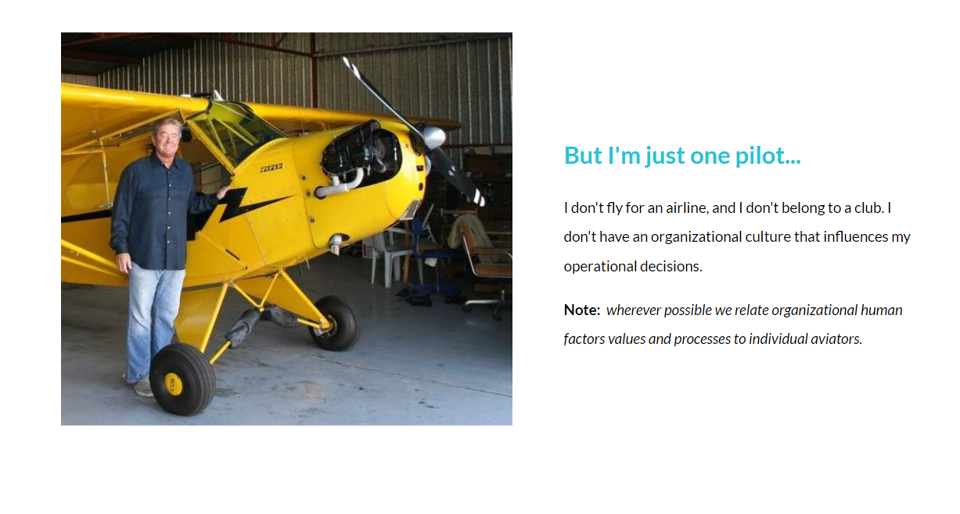
Notes:
Presentation note: Pause for a few seconds before speaking. Allow the audience to read and consider what they see on screen. Then:
It’s not unusual for individual pilots to hold this view. They may feel that because they don’t fly for an aviation organization, they’re not subject to cultural influences. But the truth is that we’re all subject to cultural influences good or bad. (Click)
Although much of the training addresses organizational cultures, wherever possible, we relate organizational human factors values and processes to individual aviators.
(Next Slide)

Slide 31
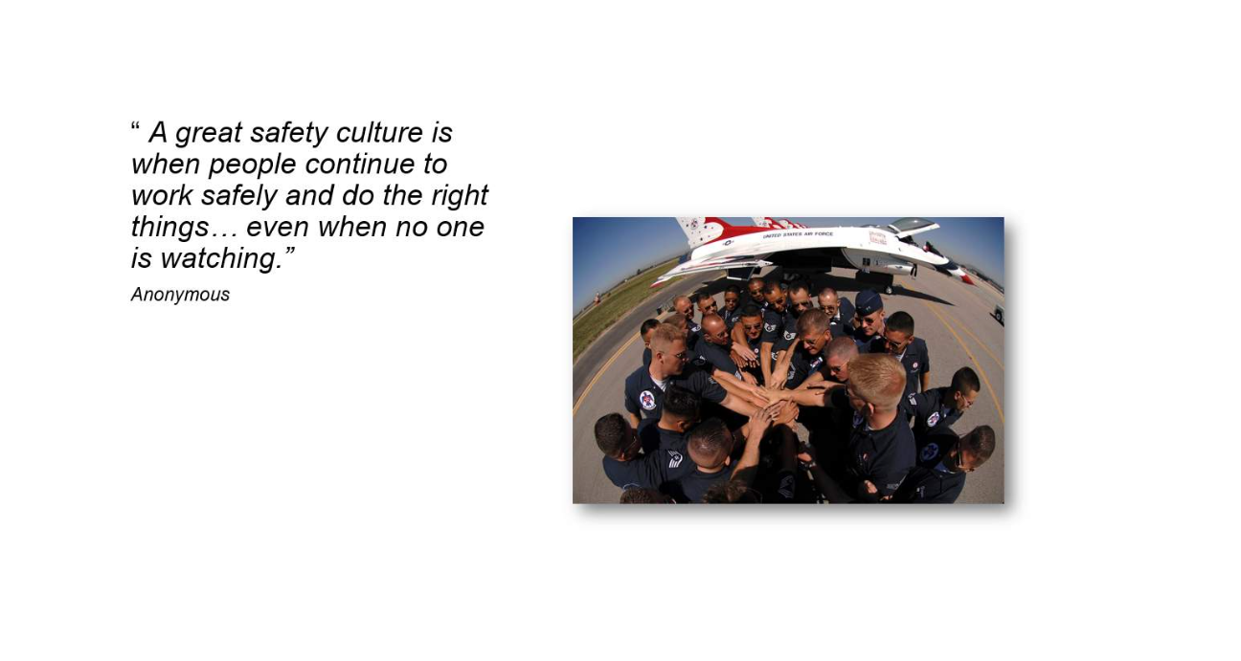
Notes:
While we might not think we’re part of an aviation organization the fact is, we are all subject to cultural influences. We share values and beliefs with our Flight Instructors, fellow pilots, and aviation mentors. Likewise we’re influenced by the values and beliefs of our family, work colleagues, and friends. All of these influence, “the way we do things around here”. Hopefully those influences argue for a positive and robust safety culture that supports flying safely and doing the right things… even when no one is watching.
Well that’s a brief introduction to Modules one and two. In the time we have left, I’d like to show you the topics covered in the remaining course modules.
(Next Slide)

Slide 32
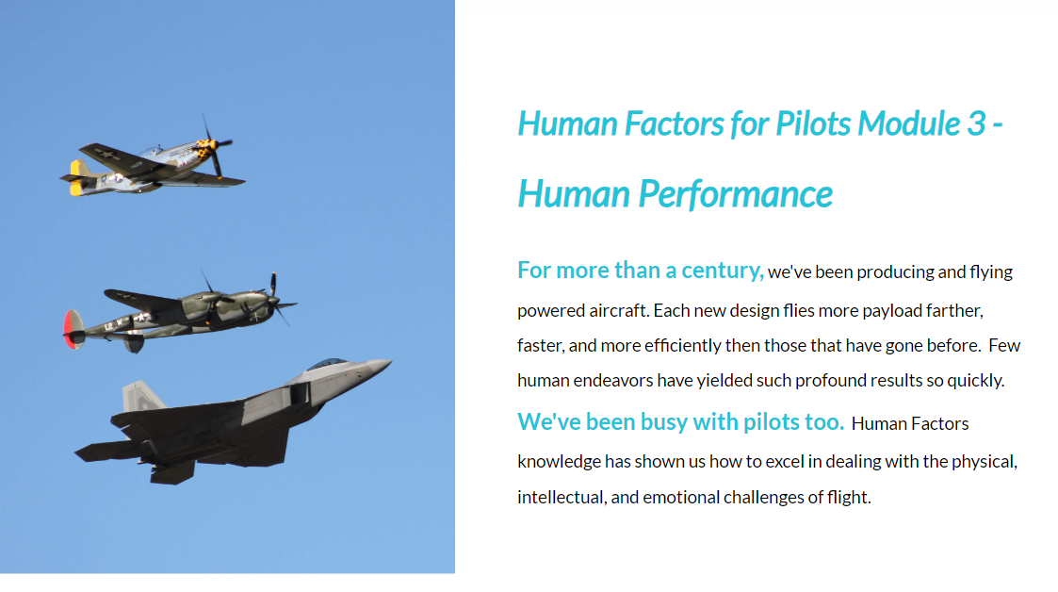
Notes:
Module 3 discusses human performance and how to excel in dealing with the physical, intellectual, and emotional challenges of flight.
(Next Slide)

Slide 33
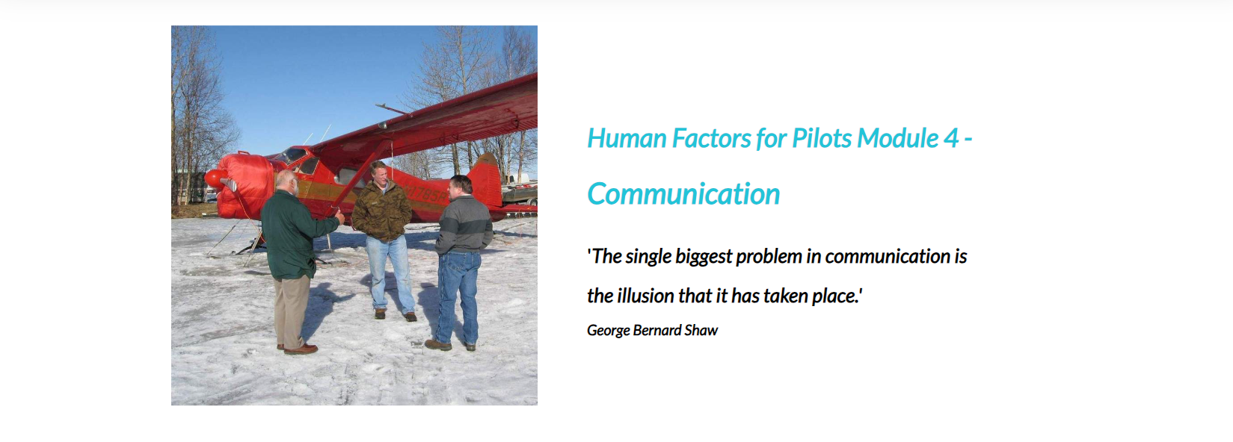
Notes:
Effective communication is critical to safe flight operations. Module 4 discusses the many facets of communication. We discuss communication challenges and offer tips on how to communicate effectively.
(Next Slide)

Slide 34
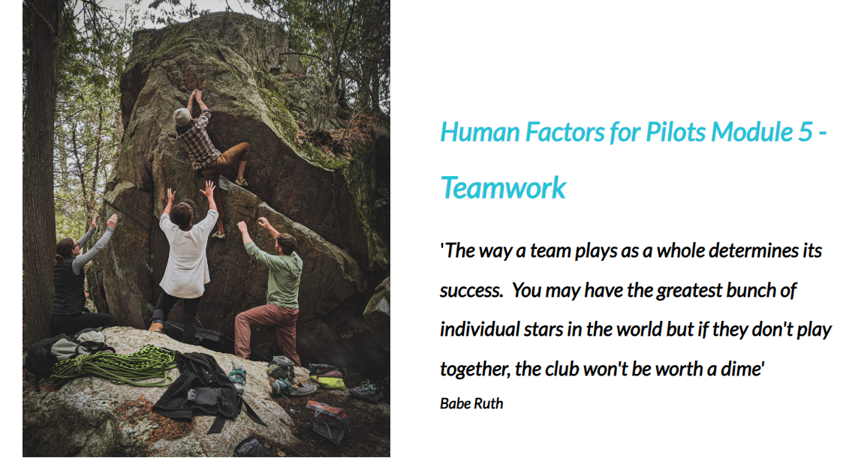
Notes:
Teamwork is critical to safe and efficient flight operations. We pilots tend to be self-reliant, take charge individuals who willingly take responsibility – and credit – for our accomplishments. That’s good – but many of us see flying as a solo act rather than a team endeavor and that’s not so good. The truth is; there is a huge network of individuals and services available to every pilot, and working with these assets as a team, we can fly to more places, more efficiently, and more safely than we can on our own.
Module 5 shows us how best to work with and Captain our teams.
(Next Slide)

Slide 35
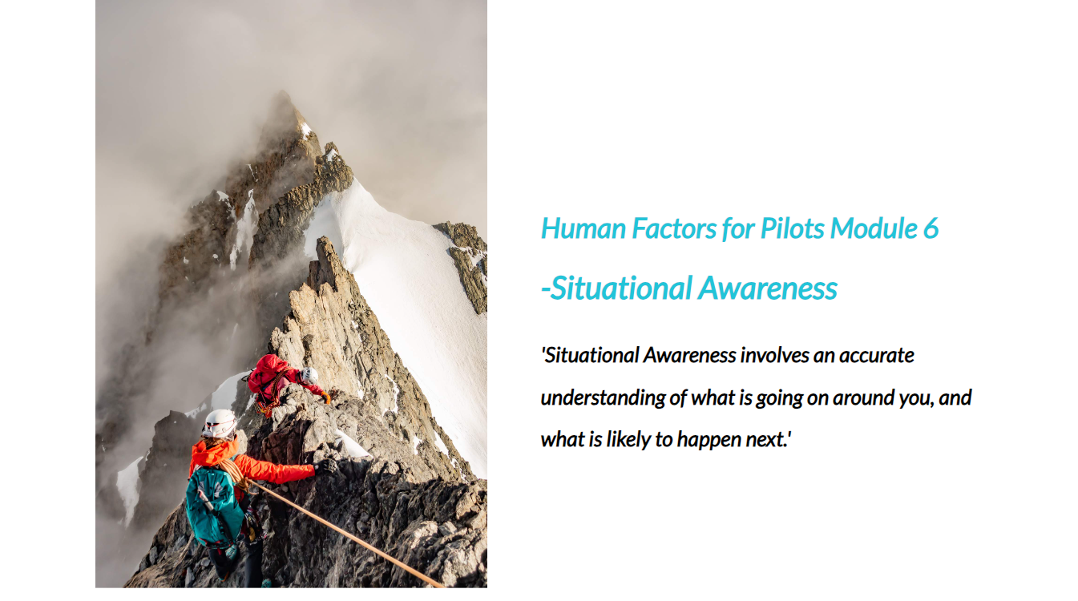
Notes:
Situationally aware pilots have accurate understandings of what’s going on around them and what’s likely to happen next.
Module 6 offers sound advice on how to attain and maintain situational awareness.
(Next Slide)

Slide 36
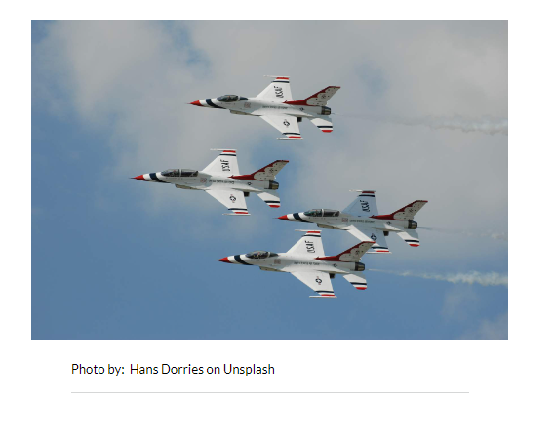
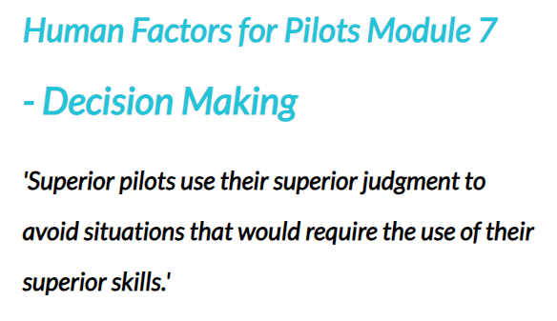
Notes:
If Decision Making is defined as, ‘the act of choosing between alternatives under conditions of uncertainty,”
then Aeronautical Decision Making is, ‘the act of choosing between alternatives under conditions of uncertainty while maintaining control in a dynamic and often hostile environment.
Module 7 offers sound advice on how to make good decisions.
(Next Slide)

Slide 37
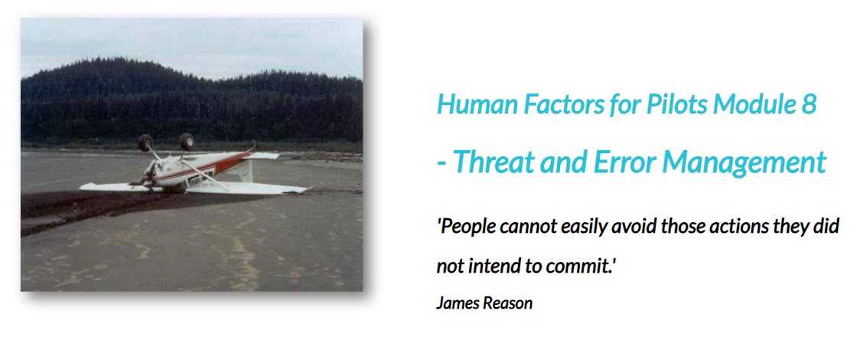
Notes:
Threat and Error Management is a safety management approach that detects, recognizes, and manages:
Threats – such as adverse weather and,
Errors – such as unclear communications
If not properly managed, Threats and errors can lead to
Undesired Aircraft States such as loss of control.
Module 8 is all about managing threats and errors so that they don’t precipitate undesired aircraft states.
(Next Slide)

Slide 38

Notes:
In order for pilots to make decisions and act on them, they gather, assess, and prioritize information from their senses, knowledge bases, and life experiences.
This fascinating module explains how humans process information and offers suggestions for effective information processing management.
(Next Slide)

Slide 39
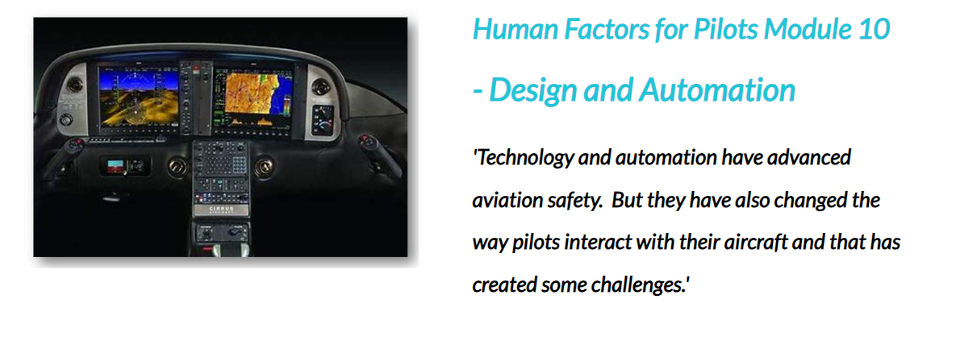
Notes:
Technology and automation have and will continue to advance aviation safety but they’ve also created some problems.
As with the aviation boom period following World War II, General Aviation aircraft instrumentation and automation are
evolving rapidly and pilots are struggling to keep up. Module 10 describes the challenges pilots face and how best to meet them.
(Next Slide)

Slide 40
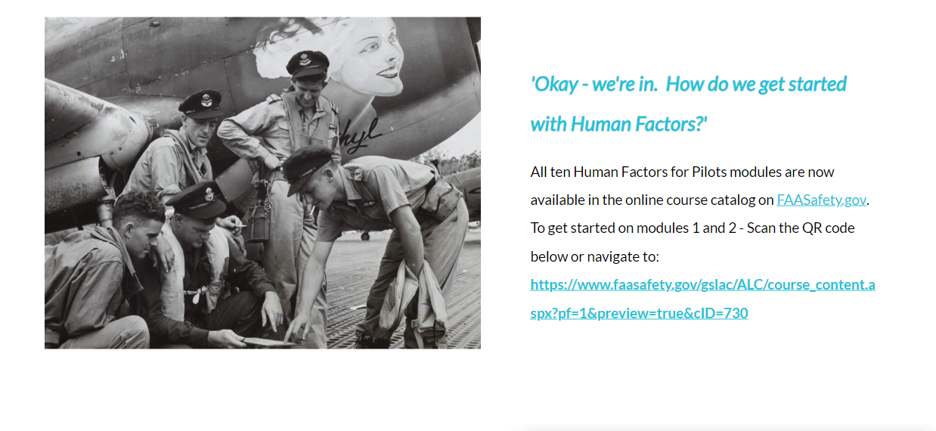
Notes:
We hope you’re ready to begin the human factors journey. All ten Human Factors for Pilots for Pilots modules are now available
In the FAASafety.gov course catalog. Here’s a URL for direct access to Modules 1 and 2. Or you can scan the QR code on the next
screen to get started.
(Next Slide)

Slide 41

Notes:
Presentation note: Leave this slide on screen until audience has copied QR code. You can begin Q&A now or wait for the next slide.
When audience is done copying:
(Next Slide)

Slide 42


Questions?
Notes:
Presentation Note: You may wish to provide your contact information and main FSDO phone number here. You can also add WINGSPro contact information.
Modify with your information or leave blank.
(Next Slide)

Slide 43



Thank you for attending
You are vital members of our GA safety community
Notes:
Your presence here shows that you are vital members of our General Aviation Safety Community. The high standards you keep and the examples you set are a great credit to you and to GA.
Thank you for attending.
(Next Slide)

Slide 44
The National FAA Safety Team Presents
Topic of the Month – May
Human Factors Training
Notes:
(The End)

