Slide 1
The National FAA Safety Team Presents
Topic of the Month
September
GA Aircraft Exhaust Systems
Presented by:
Date:
Notes:
2022/12-07-277(I)PP Original Author: J. Kelley 2023 POC: K. Clover, National FAASTeam Program Mgr. (Operations) Office 562-888-2020
Presentation Note: This is the title slide for Exhaust Systems
Script - We have included a script of suggested dialog with most slides. The script will always appear in a non-italic font. Presenters may read the script or modify it to suit their own presentation style.
Presentation Instructions - (stage direction and presentation suggestions) will be preceded by a Bold header: the instructions themselves will be in Italic fonts. See slide 2, for an example of slides with Presentation Instructions only.
Program control instructions - will be in bold fonts and look like this: (Click) for building information within a slide; or this: (Next Slide) for slide advance.
Background information - Some slides may contain background information that supports the concepts presented in the program.
Background information will always appear last and will be preceded by a bold Background: identification.
The production team hope you and your audience will enjoy the show. Break a leg!
(Next Slide)

Slide 2
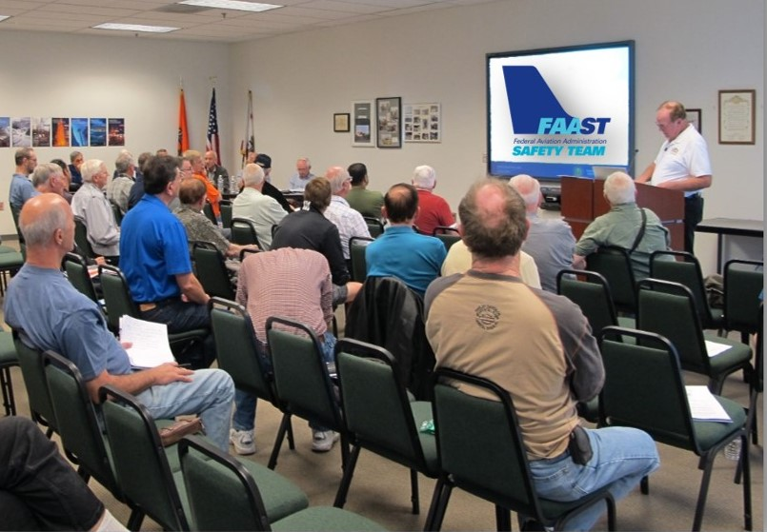
Welcome
Exits
Restrooms
Emergency Evacuation
Breaks
Sponsor Acknowledgment
Set phones & pagers to silent or off
Other information
Notes:
Presentation Note: Here’s where you can discuss venue logistics, acknowledge sponsors, and deliver other information you want your audience to know initially.
You can add slides after this one to fit your situation.
(Next Slide)

Slide 3
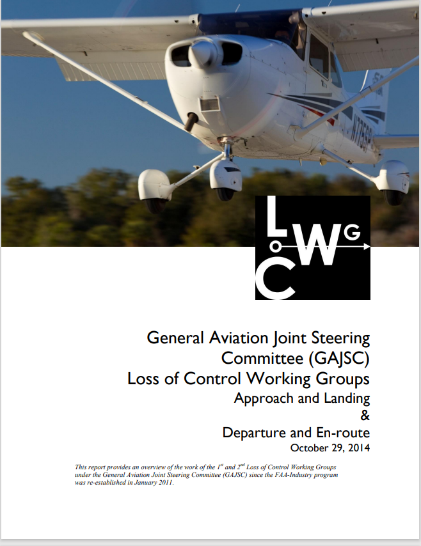
Overview
Types of exhaust systems
Muffler and Heat
Exchangers
Repairs and Replacements
Joint types V-Band
Flanges and Gaskets
Accident Cases
* General Aviation Joint Safety Committee
Notes:
The General Aviation Joint Safety Committee has noted accident causes related to inadequate and inspection of aircraft exhaust systems. This program will discuss common General Aviation exhaust systems, repair or replacement of exhaust system components, and methods of joining components. We’ll also look at some relevant accident cases.
Presentation Note: If you’ll be discussing additional items, add them to this list
(Next Slide)

Slide 4
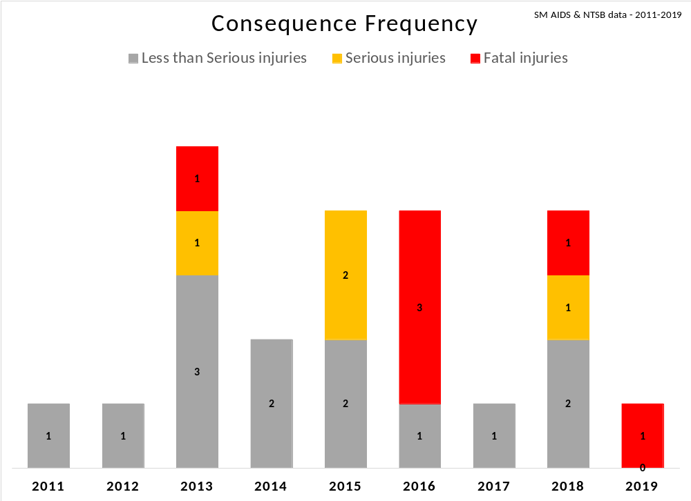
The Problem
2011 – 2019
23 accidents / incidents* involving GA exhaust system failures
  Various aircraft models
  Various engine types
* source: FAA AIDS / NTSB records
Notes:
NTSB Data from 2011 through 2019 reveals that there have been 23 accidents/incidents directly linked to exhaust system failures in various GA aircraft incorporating multiple engine types.
(Next Slide)

Slide 5
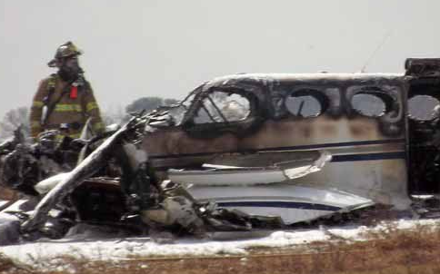
History
There have been several V-band/exhaust system failures that have involved accidents.
These have prompted Airworthiness Directives as well as manufactures’ bulletins.
NTSB probable cause: The fatigue failure of the turbocharger exhaust band clamp.
Notes:
The pilot of a turbocharged aircraft who experiences a sudden unexplained loss of manifold pressure in-flight should assume that an exhaust failure may have occurred and put the airplane on the ground at the earliest possible moment. If the aircraft is a twin, the pilot should consider shutting down and securing the engine to minimize the threat of in-flight fire.
(Next Slide)

Slide 6
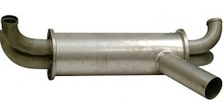
Muffler and Heat Exchangers
Failures in the heat exchanger surface allow exhaust gases to escape directly into the cabin heat system.
Heat Exchanger area
Notes:
Air circulating around the engine exhaust pipes warms many light airplane cabins. The most common exhaust system component failures are muffler or exhaust gas-to-air heat exchanger related. Failures in the heat exchanger surface (usually in the outer wall) allow exhaust gases to escape directly into the cabin heat system. This can result in carbon monoxide (CO) exposure. When this occurs in a plane, the result could be an accident.
(Next Slide)

Slide 7
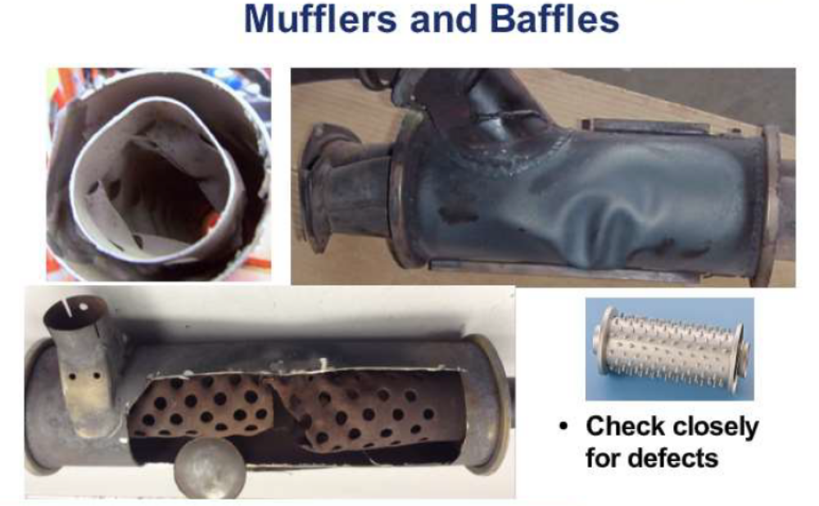
The Problem
The FAA is concerned about GA exhaust system failures continuing to contribute to accidents/incidents
  Muffler failures – internal baffles, external mounts
  Exhaust system leaks – noxious fumes (CO poisoning)
  Exhaust system cracks – heat impingement and fire
Notes:
The most common exhaust system failures contributing to General Aviation accidents are Muffler Failures – internal baffles and external mounts. Exhaust system leaks leading to noxious fume/CO poisoning. Exhaust system cracks causing heat impingement/fire.
(Next Slide)

Slide 8
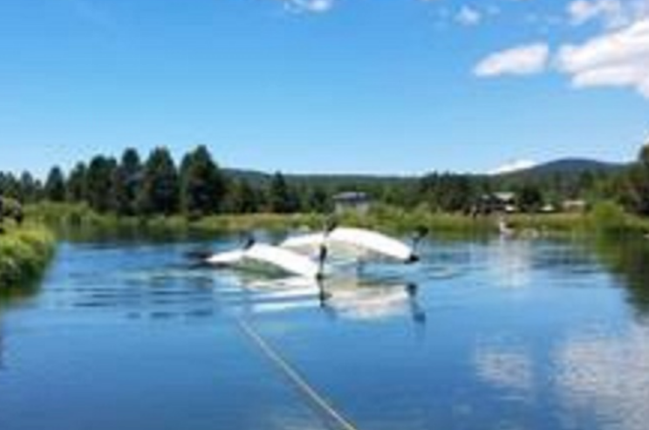
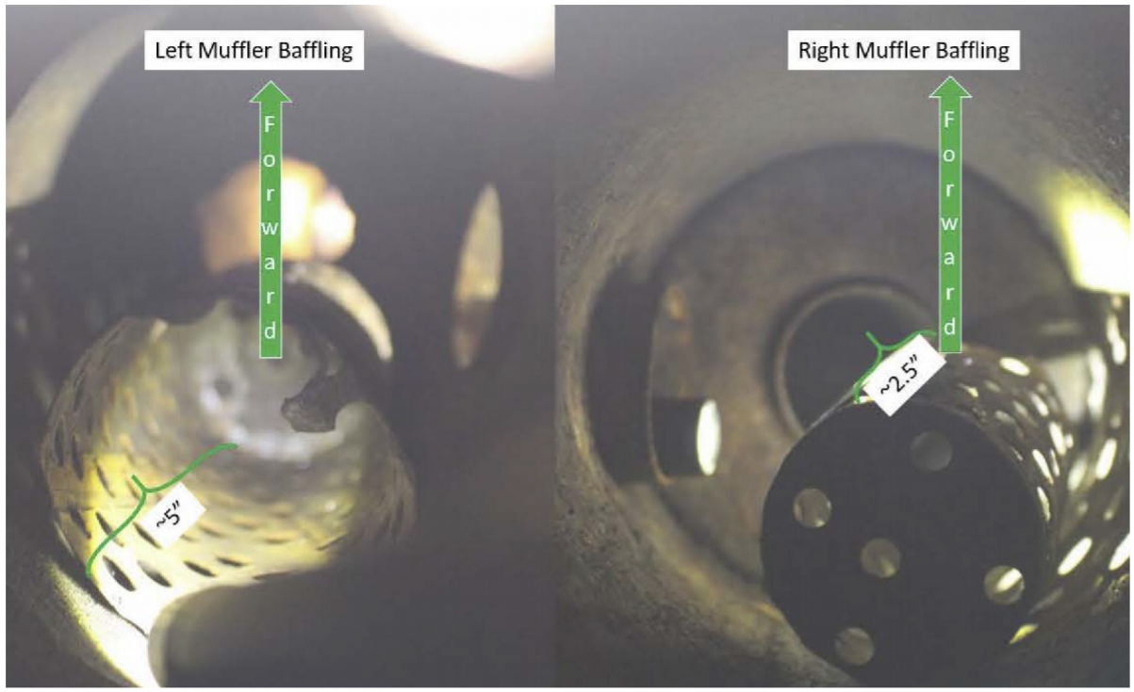
The Problem - example
“Blockage on right muffler due to baffling turned 180º and plugged muffler exhaust.”, NTSB
22 Jun 2019, Sunriver, OR - 1 Fatal; 1 Serious injury
Photo credit: NTSB
“… available [exhaust] outflow reduction of 89%”
NTSB
Photo credit: NTSB
Notes:
WPR19FA178: The pilot and passenger departed from a paved runway on a local flight in an amphibious airplane. The passenger described the airplane's rate of climb after takeoff as "slow" and stated that it was apparent that the plane would not clear the 50-ft-tall trees ahead. A witness described the aircraft as "struggling to gain altitude" and noticed a "definite power loss." The pilot performed a forced landing on a river, where the plane immediately nosed over and began filling with water. The landing gear was extended, and the water rudders were retracted. The landing gear position indicators were operational and indicated that the landing gear was extended. The position of the landing gear likely resulted in the airplane nosing over upon impact with the water. An examination of the engine revealed that the muffler baffles had broken at the weld point. The left muffler baffling moved freely inside the muffler. The right muffler baffling was turned 180° and obstructed the exhaust outlet. A test run of the engine with the mufflers installed was unsuccessful; however, upon removal of the mufflers, the engine was performed with no anomalies. There is no requirement to check the inside of a muffler during annual or 100-hour inspections to ensure that the baffling is intact. How long these mufflers had been in this condition could not be determined. The airflow restriction caused by the separated baffling likely resulted in a partial loss of engine power and the airplane's subsequent inability to climb after takeoff.
(Next Slide)

Slide 9
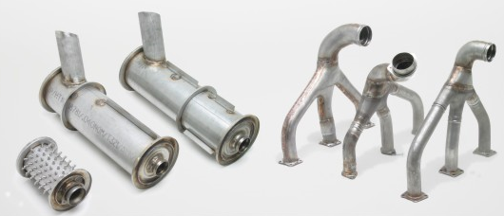
Replace or Repair?
Replace
New or reconditioned components
Qualified repair station.
Notes:
It is generally recommended that exhaust stacks, mufflers, tailpipes, etc., be replaced with new or reconditioned components by a qualified repair station rather than repaired. Special jigs, tools, and welding skills are needed to make a proper repair.
(Next Slide)

Slide 10
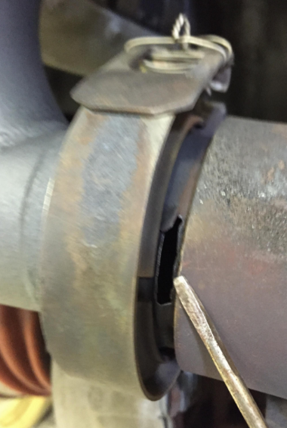
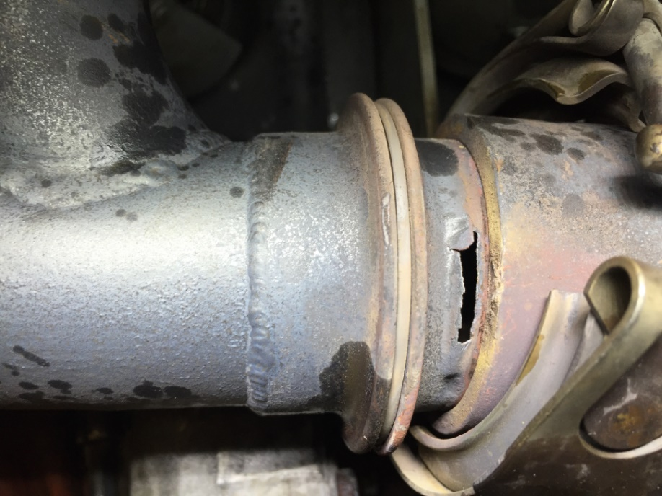
Other Exhaust Components
Exhaust system components require special attention.
Notes:
Nearly all maintenance and inspections address situations with the potential for significant damage or harm if not performed correctly.
Inspectors aim to identify deficiencies and confirm the airworthiness status to reduce the likelihood of mishaps.
Exhaust system components require special attention.
A primary reason for most exhaust system failures is inadequate and infrequent inspections/checks and the need for routine and preventive maintenance between inspections. Exhaust systems deteriorate due to engine operating temperatures, vibrations that cause metal fatigue in stress concentration areas, and wear at joints or connections.
(Next Slide)

Slide 11
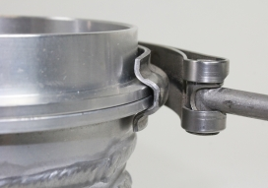
V-Band Usage
V-band clamps have become the preferred connection for many exhaust or intake systems.
Notes:
V-band clamps have become the preferred connection for many exhaust or intake systems.
(Next Slide)

Slide 12
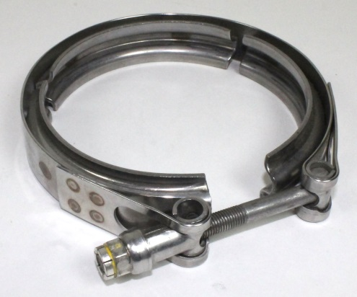
Theory of operation
The V-band he applies a uniform and equal closing force around the entire circumference of the flange.
Once tightened, friction between the flanges and V-retainer actually reduce the load on the bolt and clamp.
Notes:
As torque is applied to the coupling nut, the retainer applies an inward radial force compressing the flange together. Unlike bolted flanges, the retainer applies a uniform and equal closing force around the entire circumference of the flange during and after tightening.
Once tightened, friction between the flanges and V-retainer helps reduce the bolt and clamp load.
(Next Slide)

Slide 13
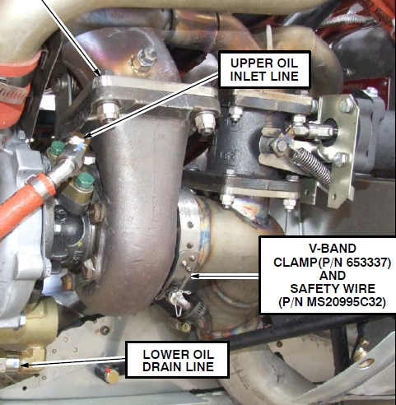

V-band Gasket & Safety Wire
Comply with the manufacture's instructions for use of V-band gaskets.
Safety Wire
Gasket
Notes:
For acceptable results, maintainers must follow the manufacturers’ guidelines in using V-band gaskets and safety wire to secure the V-band. The procedure is not as simple as it sounds. The next slides will detail what maintainers must do to ensure a safe and secure installation.
(Next Slide)

Slide 14
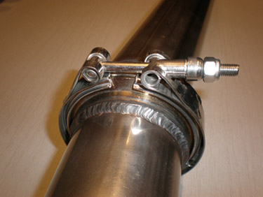
V-band Cautions
Tubes and components of the coupling must be aligned before installing the coupling. The flanges must be aligned correctly to prevent failures.
Ensure that the V-band does not bottom out on the flange before reaching the required torque.
Notes:
For a V-band clamp to work correctly, tubes and components of the coupling must be joined and aligned before installing the coupling.
The flanges must also be aligned correctly before coupling installation to prevent failures.
Ensure the V-band does not bottom out on the flange before reaching the required torque.
(Next Slide)

Slide 15

V-band Cautions
The installation process includes proper torque, seating and retorquing the coupling until the torque value is stable.
Tapping the coupling with a rubber mallet can help seating the coupling while retorquing.
Safety wire if needed.
https://youtu.be/-gimmqTA6zk
Notes:
The installation process should include torquing the latch to its proper torque value, then seating the coupling and re-torquing it until the torque value is stable.
Tapping the coupling with a rubber mallet can help to seat the coupling while re-torquing.
Safety wire as needed.
A link is provided to a YouTube video from GE Aviation which shows a demonstration of installing a V-band. (You must have internet access to make the link work) https://youtu.be/-gimmqTA6zk
(Next Slide)

Slide 16
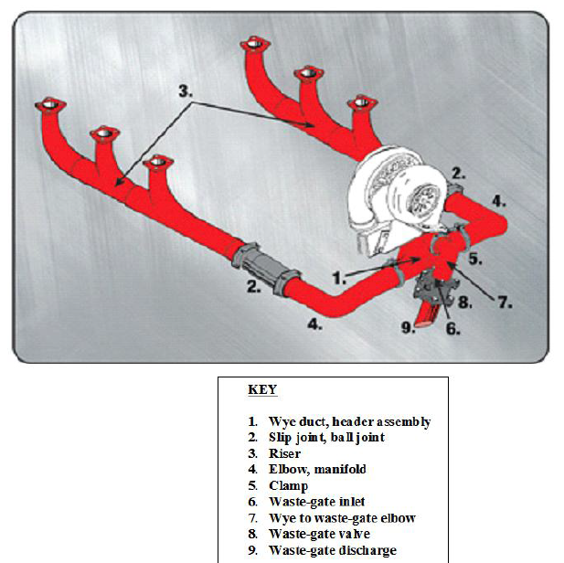
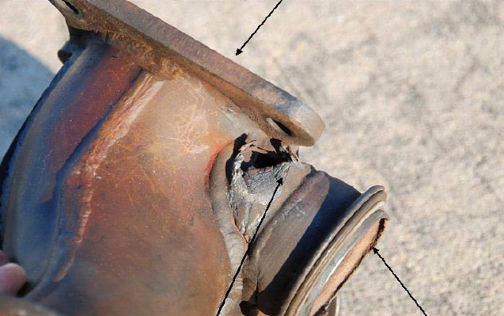
Exhaust Failures
With exhaust temperatures reaching up to 1,300 °F, the V-Band Clamp assembly could quickly be compromised if exhaust leaks.
Notes:
Exhaust leaks are inherently much more dangerous than induction leaks, because of the possibility of introducing carbon monoxide to the cabin air supply of course but also the very serious threat of in-flight fire. Fortunately, exhaust leaks are usually a lot easier to detect because they typically leave brightly-colored exhaust stains (and sometimes obvious heat damage) that can be detected visually during an engine-compartment inspection.
Next let’s take a look at 5 accidents with exhaust system causal factors from the NTSB data base. We’ve included the NTSB File numbers on screen if you’d like to read the entire reports.
(Next Slide)

Slide 17
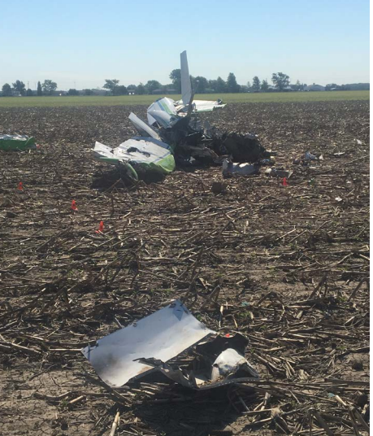
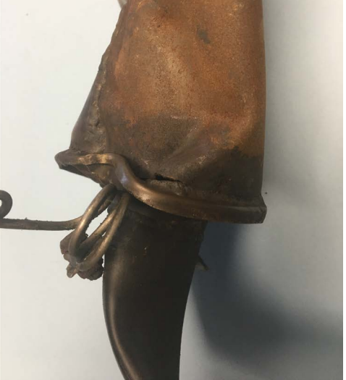
CEN17FA207 - Wreckage
CEN17FA207 – Heat Exchanger
Notes:
CEN17FA207 The private pilot was performing a visual flight rules cross-country flight after purchasing the airplane. After flying for about 1 hr 20 minutes, the aircraft suddenly entered a spiraling descent from cruise flight. Witnesses observed the plane flying erratically at a low altitude before it impacted an open field; they stated that the engine was running until impact. Toxicological testing of specimens taken from the pilot found 55% carbon monoxide saturation in the blood. At carbon monoxide levels above 40%, people typically experience incapacitating symptoms such as severe confusion, agitation, seizures, loss of consciousness, and death. Examination of the airplane's heat exchanger showed that the outside casing had either previously been repaired or had been constructed initially of metals with different properties. About one-half of the casing was discolored and exhibited varying signs of corrosion (the other half did not). Small holes were found where corrosion had occurred in the casing material. The holes from the corrosion provided a means for carbon monoxide to enter the cockpit from the exhaust system. Federal guidelines for annual aircraft inspections require inspecting the exhaust systems for cracks, defects, and improper attachment during each 100-hour or annual aircraft inspection. Maintenance logbooks indicated that the airplane's most recent annual inspection was completed less than one month before the accident. The available maintenance logbooks did not contain any record of repairs or replacement of the heat exchanger. However, the heat exchanger condition indicates an insufficient annual inspection that did not detect and correct the corroded heat exchanger.
(Next Slide)

Slide 18
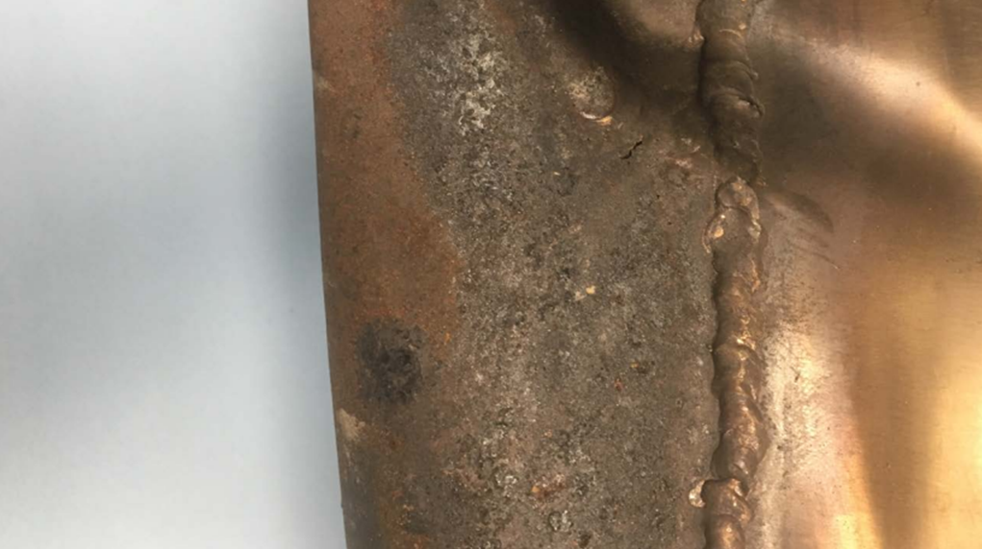
CEN17FA207 – Heat Exchanger
Notes:
CEN17FA207 It is likely that impairment caused by acute carbon monoxide poisoning led to the pilot's loss of airplane control. The corrosion in the heat exchanger allowed carbon monoxide to enter the cabin. Page 2 of 8 CEN17FA207 Probable Cause and Findings The National Transportation Safety Board determines the probable cause(s) of this accident: The pilot's loss of control due to impairment from carbon monoxide poisoning. Contributing to the accident were the corrosion of the heat exchanger and the failure of maintenance personnel to adequately inspect and repair or replace the exchanger during the most recent annual inspection.
(Next Slide)

Slide 19
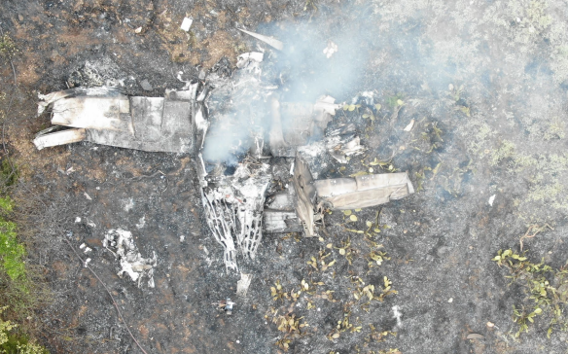
CEN20LA256
Notes:
CEN20LA256 The pilot departed in the multi-engine airplane and proceeded east. The aircraft turned north and impacted trees about 30 nm west of the last flight track data. A postimpact fire ensued, and the wreckage was destroyed. A witness driving near the accident site said the airplane flew low, and she thought the aircraft would land. Another witness driving near the accident site, observed the aircraft flying “erratically” with flames emitting from the left engine but did not remember seeing smoke in the sky or from the plane. Another witness near the accident site reported that the aircraft was "sputtering" and "popping" as it flew over his home. Post-accident examination showed that the plane descended through trees and was highly fragmented and mostly consumed by fire. Both propellers had indications consistent with low amounts of rotational energy. The right engine propeller blades were at a blade angle near feather pitch at impact, and the left engine propeller blades appeared fully feathered. All engine control levers were found full forward except the left engine propeller lever, which was full aft.
(Next Slide)

Slide 20
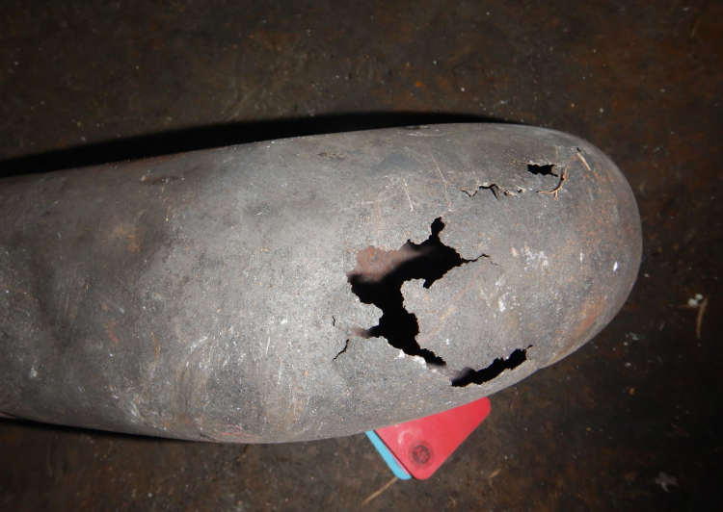
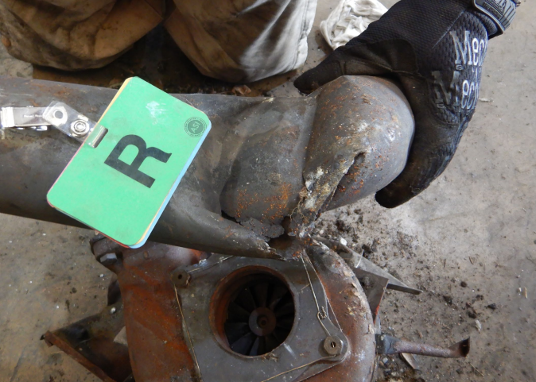
CEN20LA256 – Left exhaust system
CEN20LA256 – Right exhaust system
Photos: courtesy of Textron Aviation
Notes:
CEN20LA256 Additional examination revealed that the right magneto installed on the left engine would not rotate due to a failed bearing. The failure signatures were indicative of a loss of lubrication in the bearing. The airplane likely experienced at least a partial loss of engine power in the left engine as a result. The evidence is consistent with the pilot attempting to shut down the left engine due to the failed magneto and failing to maintain single-engine flight resulting in an impact with trees and terrain. Both engine exhaust systems were unairworthy due to very thin metal, holes, cracks, and signs of oxidative degradation. Exhaust leaks can result in an inflight fire. However, the post-impact fire prevented determination if an inflight fire occurred, and the witness testimony of flames coming from the engine could not be verified.
(Next Slide)

Slide 21
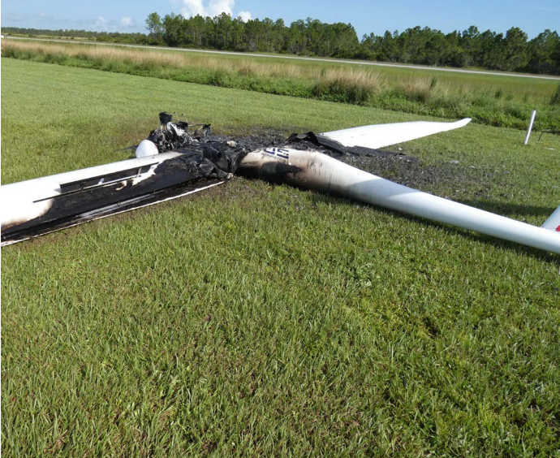
ERA18LA214
Notes:
ERA18LA214 On August 12, 2018, at about 0840 Eastern daylight time, Pipistral Sinus 912, N467L, was destroyed when it was involved in an accident near West Palm Beach, Florida. The private pilot was not injured. The airplane was operated as a Title 14 Code of Federal Regulations Part 91 personal flight.
According to the pilot of the motor glider, after dropping off a passenger from a previous flight, he restarted the engine and taxied out to runway 27R. After checking his instrument gauges, he made a radio call indicating that he would remain in the traffic pattern. During takeoff, he noticed the engine sounded "a little rough," as he turned downwind, he started to smell smoke. He shut down the engine and returned for landing. The landing was uneventful, but the pilot noticed flames below the right door when the aircraft stopped. After he exited the airplane, the fire grew and eventually consumed the airplane.
(Next Slide)

Slide 22
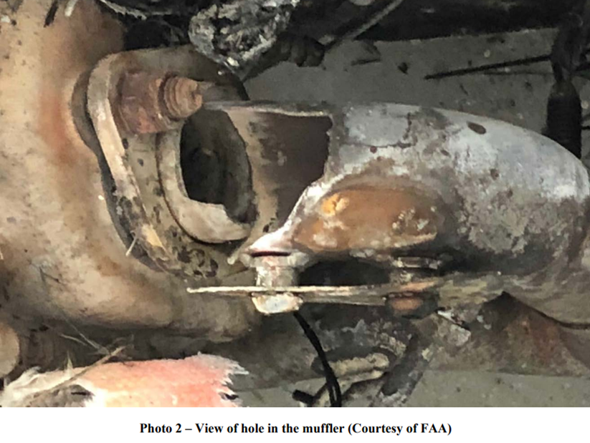
ERA18LA214 – Hole in muffler
Notes:
ERA18LA214 Post-accident examination of the airplane’s engine by a Federal Aviation Administration inspector revealed that the fire consumed the cockpit. The motor glider’s engine examination revealed that the exhaust manifold was cracked. Further examination of the exhaust manifold by the NTSB Materials Laboratory showed that the fracture and cracking of the exhaust manifold tubes were due to fatigue. In each failed manifold tube, the fatigue cracking initiated on the inner surface near circumferential welds and propagated through to the outer surface, indicating that the fatigue cracks were likely present before the accident. The fatigue cracking at the fitting led to a complete fracture, whereas the cracking in the opposite tube elbow had progressed only part way.
(Next Slide)

Slide 23
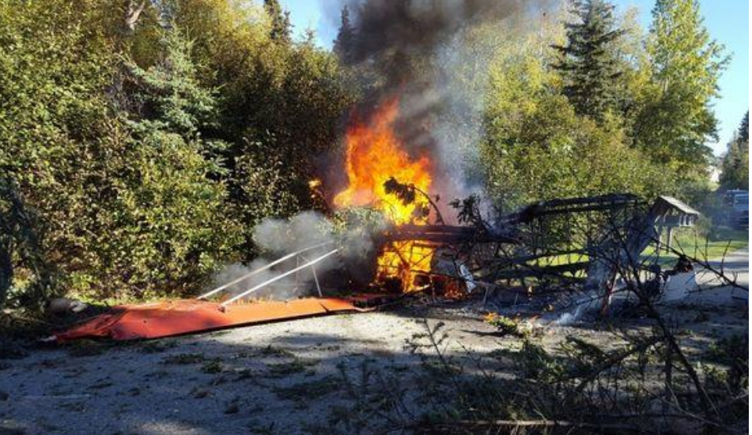
ANC16FA065
Notes:
ANC16FA065 The private pilot departed in his float-equipped, experimental, amateur-built airplane during day-visual meteorological conditions. According to a friend of the pilot, the purpose of the flight was to fly over a proposed hunting site and then return. About 90 minutes later, multiple witnesses saw the airplane complete two low-level, high-speed, 360° right turns over a residential neighborhood. The witnesses said the airplane's first 360° turn was accomplished at 150 and 200 ft above ground level, but the second turn was much lower. Witnesses near the accident site reported that, as the airplane completed the second, steep, 360° turn, the nose of the aircraft pitched down, and the plane began a rapid nose-down descent. The engine rpm then increased significantly, and the wings rolled level just before the airplane impacted a stand of tall trees adjacent to a home. The aircraft subsequently descended onto a neighborhood road and came to rest inverted. A post-crash fire ensued about 30 seconds after impact, quickly engulfing the entire plane. According to family members and close friends, this was highly unusual behavior for this pilot.
(Next Slide)

Slide 24
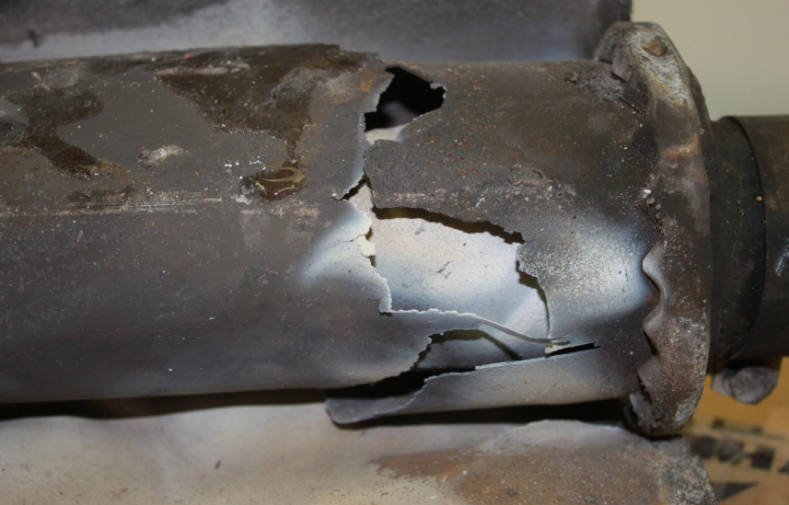
ANC16FA065 – damaged muffler can
Notes:
ANC16FA065 Post-accident examination of the airplane's exhaust system revealed that the muffler can assembly was cracked around most of its circumference near the inlet portion of the muffler, which would have allowed exhaust gases to enter the cockpit/cabin. Toxicology tests revealed 48% carboxyhemoglobin (carbon monoxide) in the pilot's blood. The pilot was a nonsmoker, and nonsmokers normally have no more than 3% carboxyhemoglobin. The pilot's cause of death was extensive blunt force trauma, including lacerations of the aorta, heart, and liver, and there was no soot found in his trachea. Although there was a postimpact fire, given the extensive blunt force injuries the pilot sustained and the lack of soot in his trachea, the pilot's elevated carboxyhemoglobin level was likely from acute exposure to carbon monoxide during the 90-minute flight and not from postimpact fire.
(Next Slide)

Slide 25
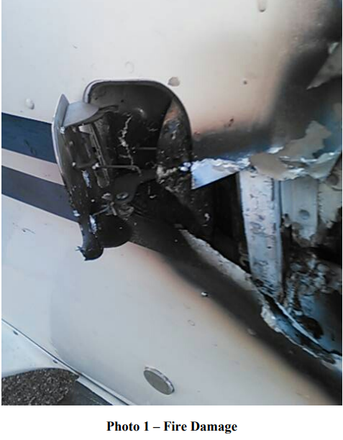
WPR15IA263 – fire damage
Notes:
WPR15IA263 On September 21, 2015, at about 0645 mountain daylight time, a Cessna T206H, N7269T, experienced an in-flight fire during its initial climb from Idaho Falls Regional Airport, Idaho Falls, Idaho. The airplane was being operated as an aerial survey flight under the provisions of 14 Code of Federal Regulations Part 91. The flight instructor and passenger/camera operator sustained minor injuries related to smoke inhalation. The airplane sustained minor damage. The local flight departed Idaho Falls at about 0640; visual meteorological conditions prevailed, and no flight plan had been filed. The pilot reported that he performed a preflight inspection, and the passenger checked the external camera equipment before the flight. No anomalies were noted, and the engine run-up was normal. During the initial climb, the pilot retracted the flaps and having reached about 200 ft above ground level, the passenger began to see smoke. The pilot initiated a turn to the crosswind leg, and smoke rapidly filled the cabin. The passenger opened the side window and, concerned that it may fan the source of the smoke, the pilot asked him to close it. The pilot then put on his oxygen cannula, but it did not provide relief, and by now he was having trouble breathing due to the smoke density. The smoke was now obscuring the instrument panel, but he could partially see the runway and immediately turned the airplane towards it. He opened his side window and put his head outside for a better view. However, the force of the wind made breathing difficult. The pilot then pushed the airplane's nose down, initiating a steep dive to the runway. He could not recall the final stages of the landing, but as soon as the airplane touched the ground, he applied full brake action, locking up the wheels. Once they had stopped, the pilot shut off the fuel mixture control, and they rapidly egressed.
(Next Slide)

Slide 26
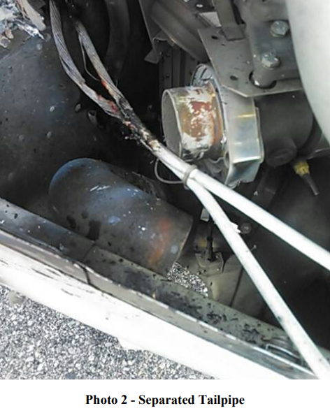
WPR15IA263 – separated tailpipe
Notes:
WPR15IA263 The airplane sustained thermal damage to the right side of the firewall, the upper and lower engine cowlings, and the forward right section of the fuselage skin, which had burned through to the cabin at the air inlet door. The fire location being so near the air inlet forced smoke into the airplane's fresh air intake system. Subsequent examination revealed that the wastegate overboard exhaust tailpipe had come away from the turbocharger housing. The turbocharger housing outlet was directly in line with the battery mounting tray on the right side of the firewall. The battery had partially melted, and both its positive and negative electrical connecting cables had partially melted. Both cables exhibited globular damage to their copper conductors consistent with arcing and an electrical short circuit. Cessna Service Bulletin SB99-71-06, released December 6, 1999, recommended the installation of a tailpipe lanyard to "provide a safety link ensuring positive turbocharger exhaust tailpipe retention should the clamp become loose." No lanyard was found on the airplane, and no record in the maintenance logbooks indicated that the service bulletin had been complied with. The service bulletin affected 111 Cessna T206H airplanes, and records provided by Cessna revealed that in the 2-year period Page 4 of 6 WPR15IA263 following issuance of the service bulletin, 91 of the service bulletin's sub-assembly components were sold, with sales then averaging about 3 per year through to 2015. Federal Aviation Administration regulations do not require compliance with service bulletins for aircraft operating under the provisions of 14 Code of Federal Regulations Part 91. The airplane experienced a similar separation of the tailpipe during takeoff on April 28, 2015. On this occasion, smoke was again drawn into the cockpit, but damage was limited to the battery and its associated cables. Maintenance records indicated that the tailpipe clamp and gaskets were replaced following the event.
(Next Slide)

Slide 27
Conclusion
Knowledge is key to the maintenance of exhaust systems
Have appropriate service information.
Inspect closely
  During service
  On each preflight
When in doubt, get a second opinion.
Remember: Danger of fire and/or carbon monoxide if not maintained.
Notes:
A few closing points: Knowledge and education are key to the maintenance of exhaust system. Make sure your maintainers reference the appropriate service information and inspect exhaust system components closely. Inspection is important for pilots too. We should closely inspect all accessible exhaust system components during preflight. Remember: there is an increased danger of fire and/or carbon monoxide if the exhaust system is not inspected and maintained in an airworthy condition.
(Next Slide)

Slide 28

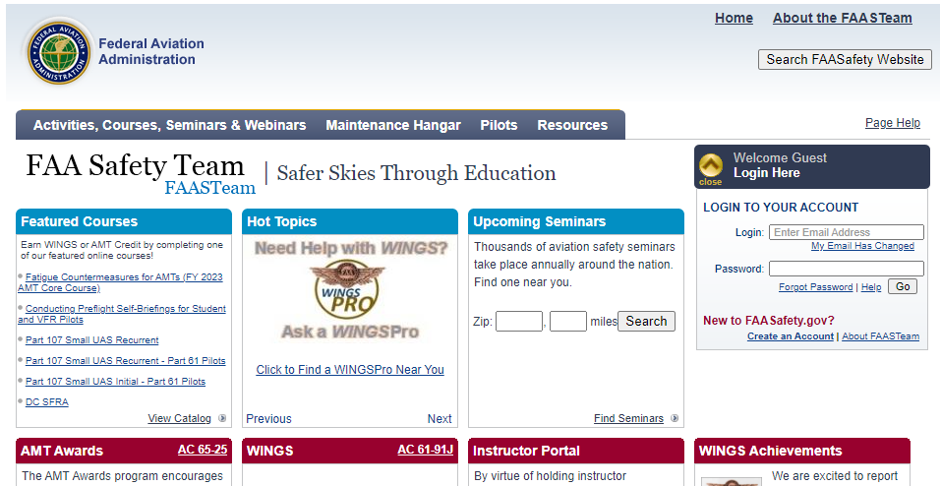
For More Information
The ALC-498 course “Aircraft Exhaust Systems” at FAASafety.gov:
aircraft exhaust systems, types, repairs, and inspections
best practices for maintenance
https://www.faasafety.gov/gslac/ALC/course_catalog.aspx
Activities, Courses, Seminars & Webinars - Courses - FAA - FAASTeam - FAASafety.gov
Notes:
The ALC-498 course at FAASafety.gov is designed to give you an overview of guidance about aircraft exhaust systems, types, repairs, and inspections, as well as best practices for maintenance. As Maintenance Technicians, Pilots, and aircraft owners, we encourage you to take this course.
The QR code on screen will take you to the course. Or navigate to faasafety.gov and search the course catalog.
(Next Slide)

Slide 29


Safety Management Systems (SMS)
Coming to General Aviation
Safety Management System (SMS) | Federal Aviation Administration (faa.gov)
Notes:
Safety Management Systems are a set of policies and processes that can increase the safety and efficiency of any flight operation. And FAA is bringing SMS to General Aviation. You may have heard of SMS but thought it was only for large organizations but actually, SMS can be scaled to fit any operation large or small.
There are 4 major components to a Safety Management System (Click)
Safety Policy – a documented commitment to safety that runs from the head of an organization to its newest member. (Click)
Safety Risk Management – a process that identifies hazards within an operation, determines to what extent an identified hazard may impact flight safety, and controls the risk of occurrence to an acceptable level. (Click)
Safety Assurance – By collecting and analyzing information derived from safety performance data Safety Assurance ensures the performance and effectiveness of Safety Risk Controls. (Click)
Safety Promotion communicates safety information and commitment throughout the organization. (Click)
You can find more information about Safety Management Systems at the URL on the Screen.
(Next Slide)

Slide 30

Questions?
Notes:
Presentation Instruction: You may wish to provide your contact information and main FSDO phone number here. Modify with Your information or leave blank.
(Next Slide)

Slide 31


Proficiency and Peace of Mind
Fly regularly with your CFI
Perfect Practice
Document in WINGS
Notes:
There’s nothing like the feeling you get when you know you’re playing your A game and in order to do that you need a good coach (Click)
So fly regularly with a CFI who will challenge you to review what you know, explore new horizons, and to always do your best. Of course you’ll
have to dedicate time and money to your proficiency program but it’s well worth it for the peace of mind that comes with confidence. (Click)
Vince Lombardi, the famous football coach said, “Practice does not make perfect. Only perfect practice makes perfect.” For pilots that means
flying with precision. On course, on altitude, on speed all the time. (Click)
And be sure to document your achievement in the WINGS Proficiency Program. It’s a great way to stay on top of your game and keep you flight review current.
(Next Slide)

Slide 32



Thank you for attending
You are vital members of our GA safety community.
Notes:
Your presence here shows that you are vital members of our General Aviation Safety Community. The high standards you keep and the examples you set are a great credit to you and to GA.
Thank you for attending.
(Next Slide)

Slide 33
The National FAA Safety Team Presents
Topic of the Month
September
GA Aircraft Exhaust Systems
Presented by:
Date:
Notes:
(The End)

