Slide 1
The National FAA Safety Team Presents
Topic of the Month – March
Risk-based Flight Review & WINGS
Notes:
2022/12-07-272(I)PP Original Author: John Steuernagle 03/17/2021; POC Kevin Clover National FAASTeam Program Mgr. (Operations), Office (562-888-2020
Presentation Note: This is the title slide for Risk-based Flight Review and WINGS
Script - We have included a script of suggested dialog with most slides. The script will always appear in a non-italic font. Presenters may read the script or modify it to suit their own presentation style. See template slides 5 and 6 for examples of a slides with script.
Presentation Instructions - (stage direction and presentation suggestions) will be preceded by a Bold header: the instructions themselves will be in Italic fonts. See slides 2, for an example of slides with Presentation Instructions only.
Program control instructions - will be in bold fonts and look like this: (Click) for building information within a slide; or this: (Next Slide) for slide advance.
Background information - Some slides may contain background information that supports the concepts presented in the program.
Background information will always appear last and will be preceded by a bold Background: identification.
The production team hope you and your audience will enjoy the show. Break a leg!
(Next Slide)

Slide 2


Welcome
Exits
Restrooms
Emergency Evacuation
Breaks
Phones & devices to silent or off
Sponsor Acknowledgment
Other information
Notes:
Presentation Note: Here’s where you can discuss venue logistics, acknowledge sponsors, and deliver other information you want your audience to know in the beginning.
You can add slides after this one to fit your situation.
(Next Slide)

Slide 3
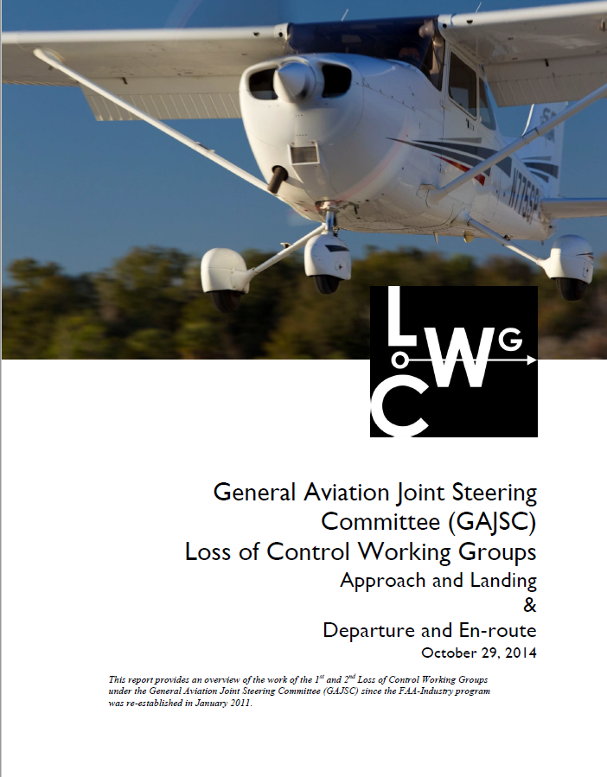
Overview
GAJSC* and Risk-based Flight Reviews
Effective Flight Reviews
WINGS and Flight Reviews
Safety
*General Aviation Joint Safety Committee
Notes:
Today’s presentation is dedicated to Flight Reviews. They’re something nearly all of us go through every two years and the General Aviation Joint Safety Committee feel that Flight Reviews that are based on risk can go a long way toward preventing accidents.
Basing flight reviews on risk is one way to achieve an effective evaluation and education experience. So, we’ll discuss elements of effective Flight Reviews as well. And, to do that, we’ll reference a document available on FAASafety.gov.
Presentation Note: If you’ll be discussing additional items, add them to this list.
(Next Slide)

Slide 4
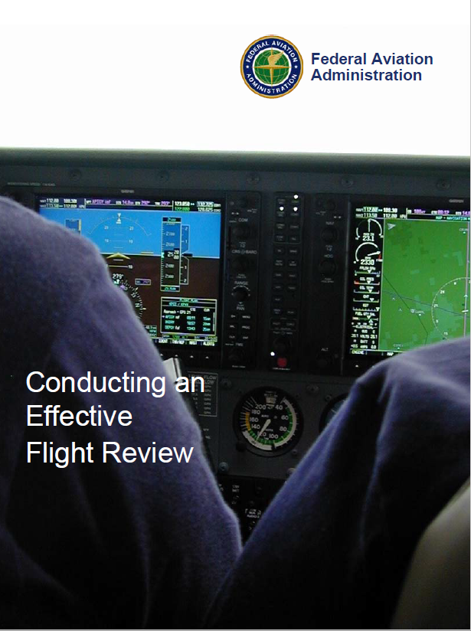
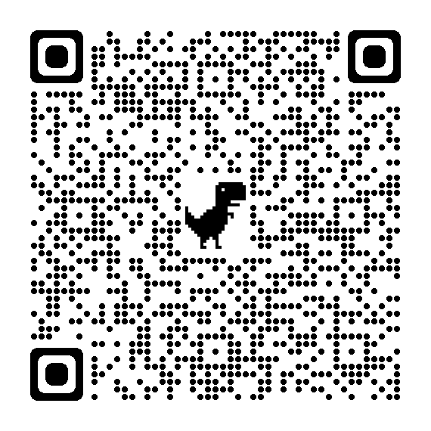
Conducting an Effective Flight Review
https://tinyurl.com/2s4ekbw2
Notes:
You can download a copy of Conducting an Effective Flight Review by accessing the QR code or URL on screen. It’s written for flight instructors but it’s also excellent for preparing their clients for a great flight review experience. And it features dozens of hyperlinks to useful information for pilots and Flight Instructors alike. Let’s see how we can use this document to prepare for a risk-based flight review.
(Next Slide)

Slide 5

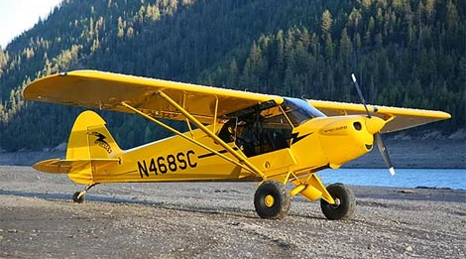
What’s a Risk-based Flight Review?
Tailored to Pilot’s typical mission
And to Pilot’s aspirations
Notes:
As the name implies – a Risk-based Flight Review addresses risks associated with the familiar missions and flight environments
where the pilots normally operate. (Click)
But it also addresses things the pilot wants to do in the future. Both of these review aspects require a conversation with your Flight Instructor and some advance planning.
That’s why it’s essential to conduct a pre-review interview to plan what will be covered in the review.
(Next Slide)

Slide 6
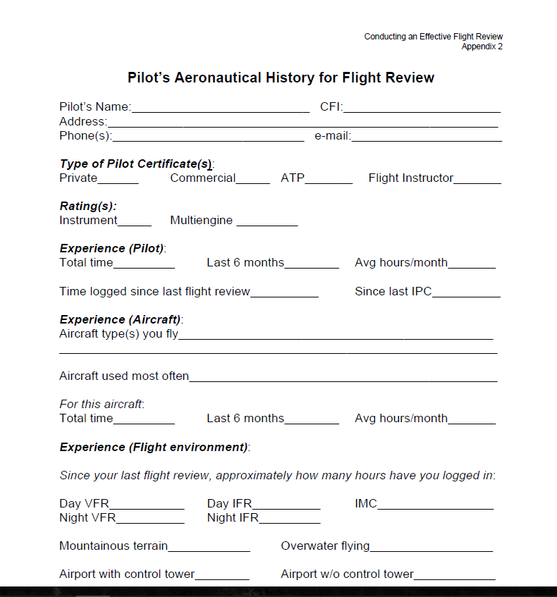
Pre-review Activities
Aeronautical History
  Certificates and ratings
  Experience
    Pilot time and time in type
    Typical flight environment
      Metropolitan
      Rural
      Terrain
      Weather
  Aspirations and Expectations
  Safety Risk Management
Notes:
The Conducting an Effective Flight Review appendix contains a form to collect aeronautical history. Providing this information before the review will allow your CFI to develop a review plan to efficiently evaluate your capabilities in normal operations and to explore flying challenges that you would like to pursue. If, for instance, you fly in a high-traffic density operational environment, some time spent in non-towered airport and short field operations will make you more competent and confident when flying to remote areas. Similarly, if you’re at home in the boonies, a trip to a tower-controlled field in Class B or C airspace will help you to be more comfortable in high-traffic environments and Air Traffic Control. When discussing these topics, it’s also a good practice to set instructor and client expectations for the review. Reviews for pilots who don’t fly often or who don’t fly to unfamiliar destinations will likely take longer than reviews for pilots who are current and comfortable in all airspace classes.
(Next Slide)

Slide 7
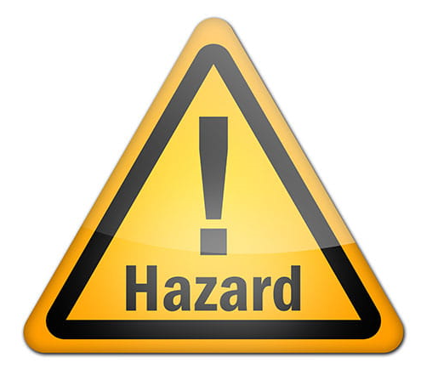

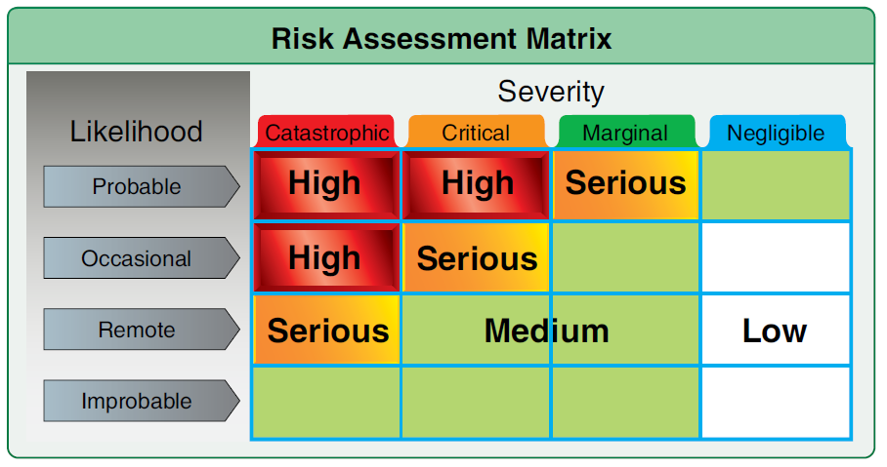
Assessing risk
Hazard – a condition, event, object, or circumstance that could compromise safety.
Risk – the future impact of hazards that are not eliminated or controlled.
Risk Assessment – considers the likelihood that a hazard will compromise safety and the severity of consequences if it does.
Notes:
You and your Instructor can discuss flight hazards that are unique to your flight operations. (Click)
And you can identify the risk that those hazards will negatively impact your flying. (Click)
Your Risk Assessment – will tell you the likelihood that a given risk will negatively impact your operation and the severity of consequences if it does. Armed with that information, you and your CFI can plan instructional activities that will mitigate your risks to acceptable levels.
(Next Slide)

Slide 8

Risk-based Flight Review
Action Plan
  Schedule
  Standards
  Pre-review preparation
    Study/courses
    Flight Planning
    Weight & Balance calculations
    A/C Performance calculations
This Photo by Unknown Author is licensed under CC BY-SA
Notes:
The Risk-based Flight Review Action will include a schedule of pilot capabilities to be evaluated and risk reduction/mitigation activities to pursue. Successful completion standards for each activity will be agreed to and any Pre-review preparation activities will be identified.
Preparation activities might include study of regulations or completion of courses on FAASafety.gov, planning a flight, weight and balance, and aircraft performance calculations.
(Next Slide)

Slide 9
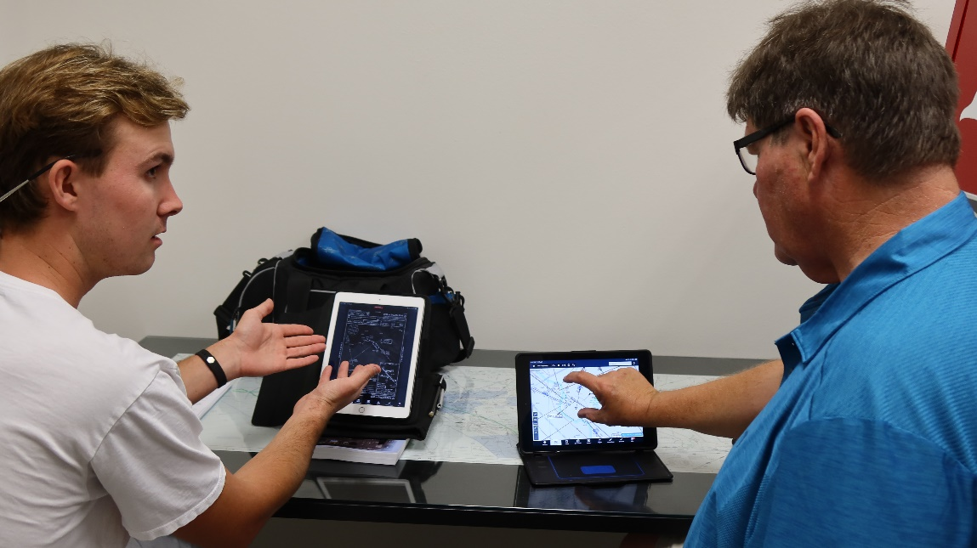
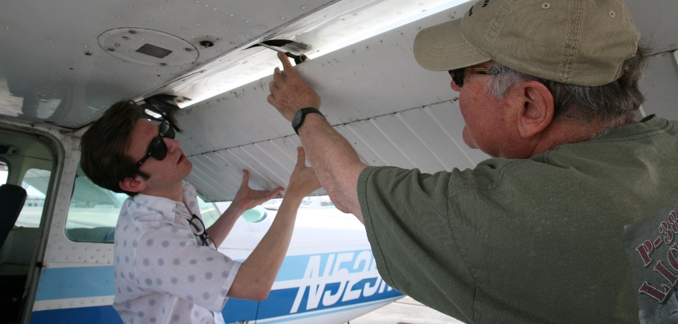
Pre-flight activities
Pre-flight discussion
  Pilot/Aircraft documentation
  Pre-review assignments
  Rules and Procedures discussions
Aircraft inspection
Notes:
Flight Review pre-flight activities will include a review of pilot and aircraft documentation, pre-review study assignments and activities, and a discussion of aviation rules and procedures. Pre-flight activities will generally end with an aircraft inspection just prior to flight.
(Next Slide)

Slide 10
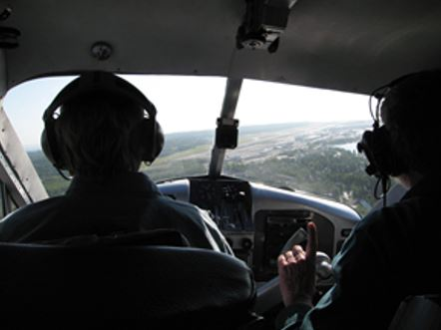
Flight Activities
Airport operations
Cross-country and diversion to alternate
Slow flight and stalls
Performance maneuvers
Ground reference maneuvers
Emergency procedures
Takeoffs and Landings
Notes:
Flight activities will include the items listed on screen and any special activities discussed in the pre-review.
(Next Slide)

Slide 11
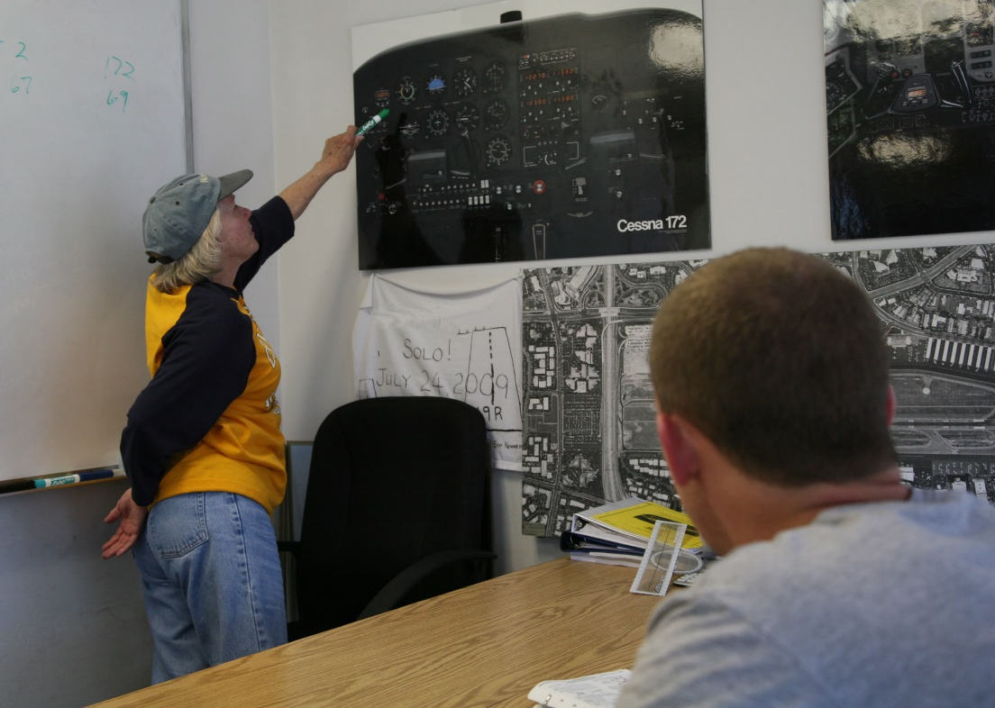
Post-flight activities
Debrief
Proficiency Training Plan
Notes:
Post-flight activities should include a thorough debrief. You should expect an honest and comprehensive assessment of your performance with suggestions for improvement. This is also an excellent time to develop a proficiency training plan that will not only ensure that you maintain your performance level but also enable you to attain higher levels of performance and additional capabilities.
(Next Slide)

Slide 12

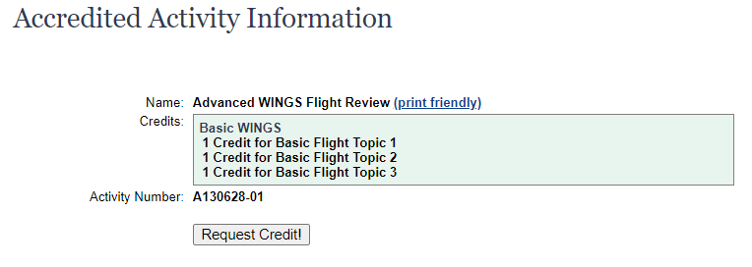
WINGS and Flight Reviews
WINGS credit
  Knowledge and Flight
Notes:
WINGS knowledge and flight activities are available on FAASafety.gov. Completing the Advanced WINGS Flight Review Flight Activity, together with 3-WINGS knowledge activities will earn a Flight Review. In fact, earning any phase of WINGS satisfies the requirements of 14.CFR § 61.56.
(Next Slide)

Slide 13
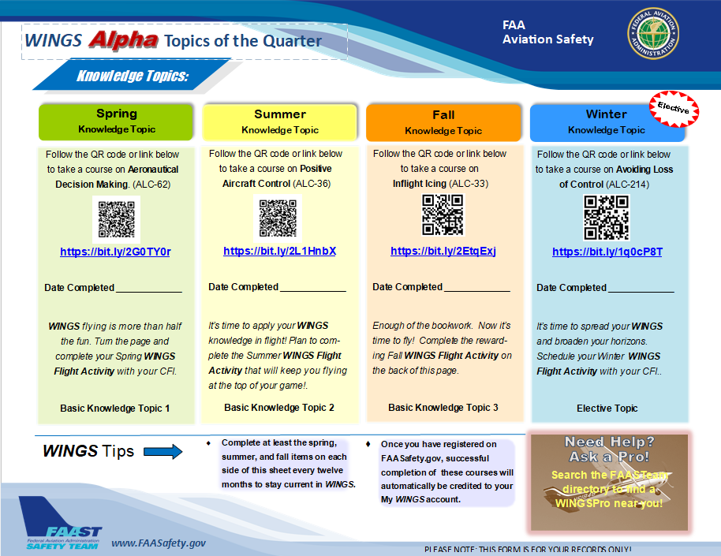

WINGS Topic of the Quarter
On line proficiency courses
  Self-paced
  Do it at home
  Build solid decision making skills on the ground and in the air.
Notes:
Proficiency Training works best if it’s not done all at once, but rather spaced out at regular intervals. The WINGS Topic of the Quarter program consists of eight activities pursued over the course of one year. Because a full year’s proficiency is mapped out for you, It’s an excellent way to get started with WINGS.
Each quarter, WINGS Pilots take an on-line safety course. All courses are self-paced. Most take no more than an hour or two and they can be completed at home. Our online courses build solid decision-making skills that you’ll employ on the ground and in the air.
(Next Slide)

Slide 14
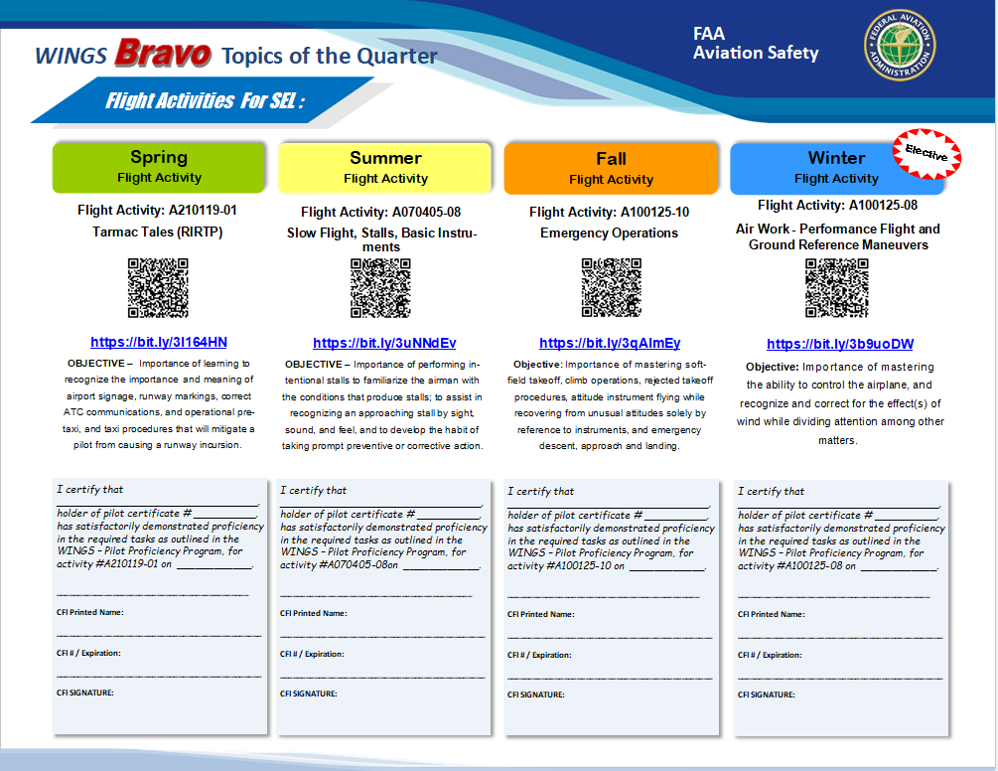

WINGS Topic of the Quarter
Rewarding Flight Activities
  With your CFI
faasafety.gov\resources\library\WINGS
Notes:
Program participants also fly with a Flight Instructor to complete a WINGS Flight Activity at least once each quarter. (Click)
To access WINGS Topic of the Quarter Checklists and other WINGS information just navigate to FAASafety.gov. then click on Resources\Library\WINGS or scan the QR code on screen.
(Next Slide)
Background: You can access the FAASafety.gov library here: https://faasafety.gov/gslac/ALC/lib_categoryview.aspx?categoryId=39

Slide 15
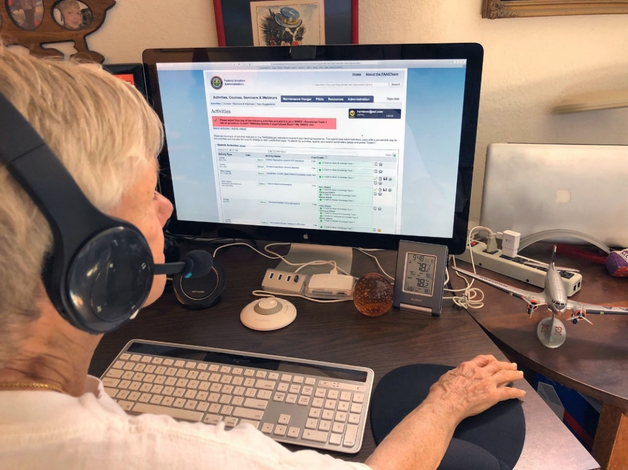

Need help with WINGS?
Contact your local WINGSPro
  Or your FAASTeam Program
  Manager (FPM)
Orville Wright
WINGSPro
Dayton, OH
(927) 003-1217
Notes:
WINGS is a robust proficiency training program that works for all pilot certification levels and all general aviation aircraft. As such, it can be a little intimidating at first. That’s why volunteer WINGSPros in your area are available to help you with anything related to WINGS. Here’s how to find your local WINGSPro(s).
Presentation note: You may want to introduce local WINGSPros in attendance and ask them to present this section. Your WINGSPros can edit the slide text to include their name and contact information.
(Next Slide)

Slide 16
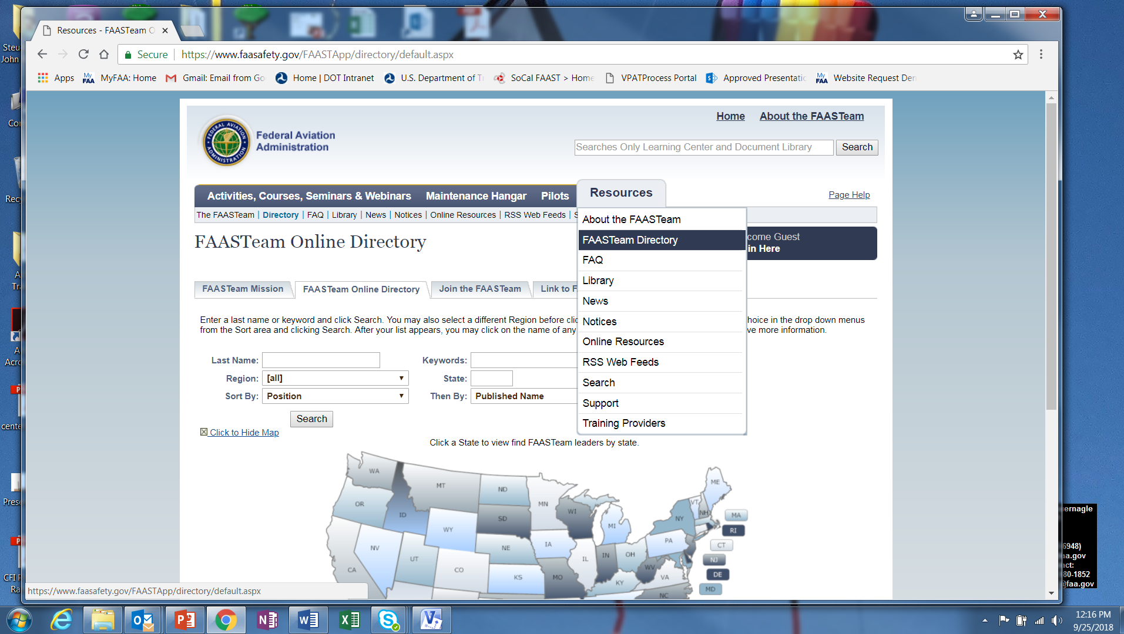
Find your WINGSPro
Notes:
To find your local WINGSPros just navigate to FAASafety.gov. Hover over the resources tab and click on FAASTeam Directory.
(Next Slide)

Slide 17
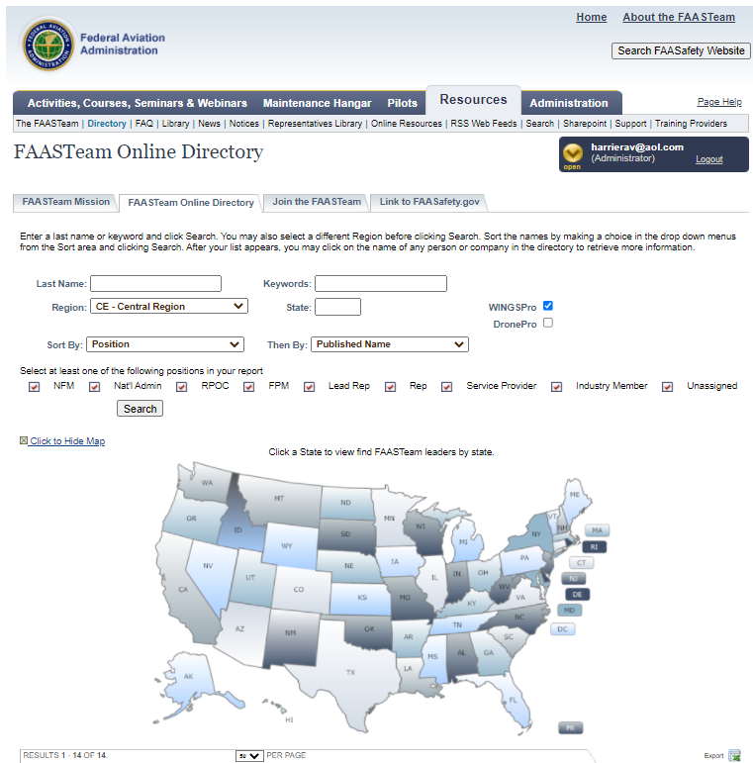
Notes:
Presentation note: This will be more effective if you replace the following illustrations with those that feature local AOR searches and WINGS Pro results.
First select your region and district in this dropdown box. (Click)
Next click the WINGSPro box, (Click)
Then click on search. Your WINGSPros will appear in the list below.
(Next Slide)

Slide 18
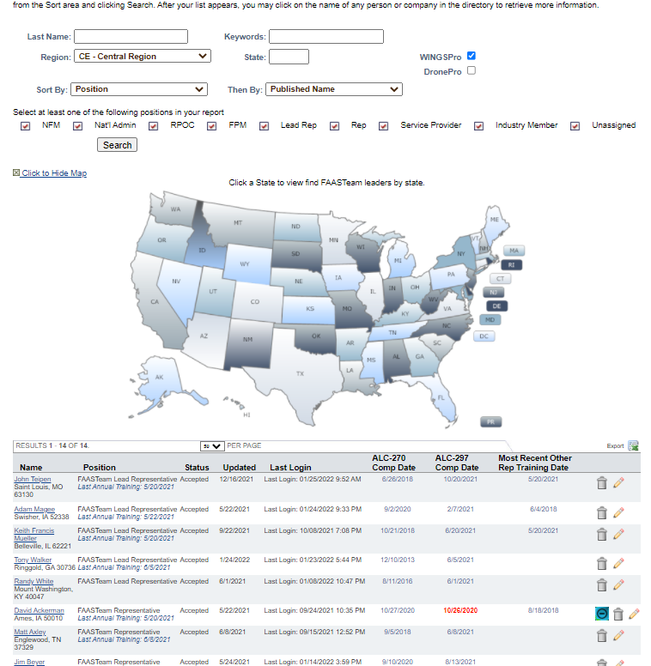
Notes:
Here’s a partial list of WINGS Pros in the Central Region.
(Next Slide)

Slide 19


WINGS pilots are:
Competent
Confident
Safe
Notes:
Finally, WINGS training yields Proficiency and Peace of Mind. There’s nothing like the feeling you get when you know you’re playing your A game and in order to do that you need good coaching. (Click)
WINGS pilots are Competent. They fly regularly with WINGS CFIs who challenge them to review what they know, explore new horizons, and to always do their best. Vince Lombardi, the famous football coach said, “Practice does not make perfect. Only perfect practice makes perfect”. For pilots that means flying with precision, on course, on altitude, on speed all the time. (Click)
WINGS pilots are Confident. They are well aware of their capabilities and their limitations. They are coached to exercise sound pre and in-flight risk management so they are rarely surprised by unanticipated conditions. Of course, they must dedicate time and money to their proficiency programs but it’s well worth it for the peace of mind that comes with confidence. (Click)
And, most importantly; WINGS pilots and their passengers enjoy the benefits of safe flight operations every time they take to the air.
(Next Slide)

Slide 20
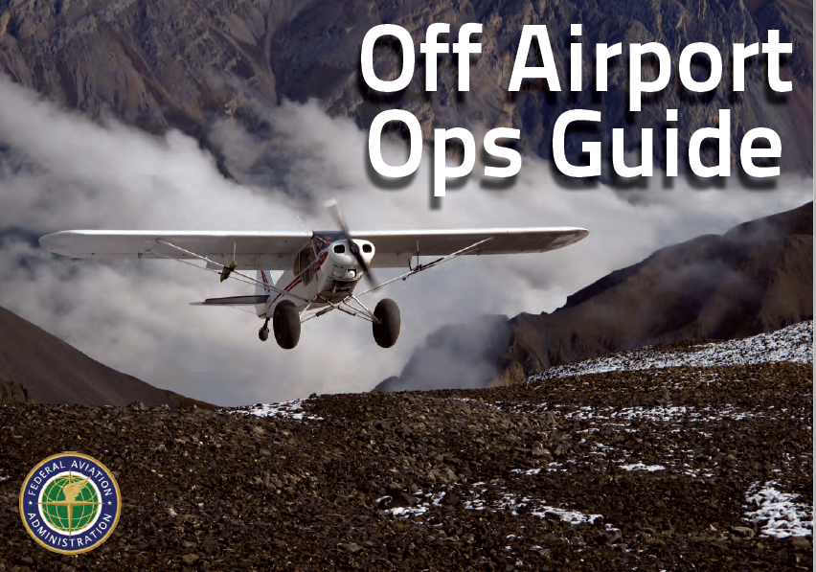
References
Conducting an Effective Flight Review
  https://tinyurl.com/2s4ekbw2
FAASafety.gov
  Information and enrollment for WINGS Pilot Proficiency Program
Off Airport Ops Guide
  https://tinyurl.com/4r9pnhtt
Personal Minimums Development Guide
  https://tinyurl.com/4zy2ydue
WINGS Information and Guidance
  https://tinyurl.com/msep592w
Notes:
Here are a few references for additional information:
FAASafety.gov is the FAASTeam website where you’ll find a wealth of safety information. You can enroll and track your progress in the FAA WINGS Pilot Proficiency Program here.
Look in the FAASafety.gov library for the Off Airport Operations Guide. In it you’ll find instructions for developing a short field performance baseline together with other useful information on operating to small fields.
Also, in the FAASafety.gov Library – the Personal Minimums Development Guide – Your documented proficiency performance can be used to develop minimums that are tailored to you, your aircraft, and your mission.
The Library also contains additional WINGS Information and Guidance
I’ll leave this slide on screen while I take some questions from the audience.
Presentation note: Take questions from the audience while they copy information from the screen. Then:
(Next Slide)

Slide 21

Questions?
Notes:
Presentation Note: You may wish to provide your contact information and main FSDO phone number here. You can also add WINGSPro contact information.
Modify with your information or leave blank.
(Next Slide)

Slide 22



Thank you for attending
You are vital members of our GA safety community
Notes:
Your presence here shows that you are vital members of our General Aviation Safety Community. The high standards you keep and the examples you set are a great credit to you and to GA.
Thank you for attending.
(Next Slide)

Slide 23

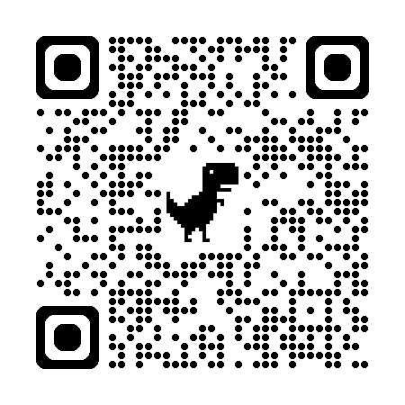

Safety Management Systems (SMS)
Coming to General Aviation
https://www.faa.gov/about/initiatives/sms
Notes:
Safety Management Systems are a set of policies and processes that can increase the safety and efficiency of any flight operation. And FAA is bringing SMS to General Aviation. You may have heard of SMS but thought it was only for large organizations but actually SMS can be scaled to fit any operation large or small.
There are 4 major components to a Safety Management System (Click)
Safety Policy – a documented commitment to safety that runs from the head of an organization to its newest member. (Click)
Safety Risk Management – a process that identifies hazards within an operation, determines to what extent an identified hazard may impact flight safety, and controls the risk of occurrence to an acceptable level. (Click)
Safety Assurance – By collecting and analyzing information derived from safety performance data Safety Assurance ensures the performance and effectiveness of Safety Risk Controls. (Click)
Safety Promotion communicates safety information and commitment throughout the organization. (Click)
You can find more information about Safety Management Systems at the URL on the Screen.
(End)

Slide 24
The National FAA Safety Team Presents
Topic of the Month – March
Risk-based Flight Review & WINGS
Notes:
(Next Slide)

