Slide 1
The National FAA Safety Team Presents
Topic of the Month – May What is an Approval for Return to Service?
<Audience>
<Presenter>
< >
Notes:
2023/10-29-301(I)PP Original Author: (Guy Minor) (10-03-2018); POC (Guy Minor), National FAASTeam Program Manager - Airworthiness, Office (707-704-3530); revision: 1
Presentation Note: This is the title slide for What is an Approval for Return to Service
Script - We have included a script of suggested dialog with most slides. The script will always appear in a non-italic font. Presenters may read the script or modify it to suit their own presentation style. See template slides 3 and 4 for examples of a slides with script.
Presentation Instructions - (stage direction and presentation suggestions) will be preceded by a Bold header: the instructions themselves will be in Italic fonts. See slides 2 for an example of slides with Presentation Instructions only.
Program control instructions - will be in bold fonts and look like this: (Click) for building information within a slide; or this: (Next Slide) for slide advance.
Background information - Some slides may contain background information that supports the concepts presented in the program.
Background information will always appear last and will be preceded by a bold Background: identification.
The production team hope you and your audience will enjoy the show. Break a leg!
(Next Slide)

Slide 2

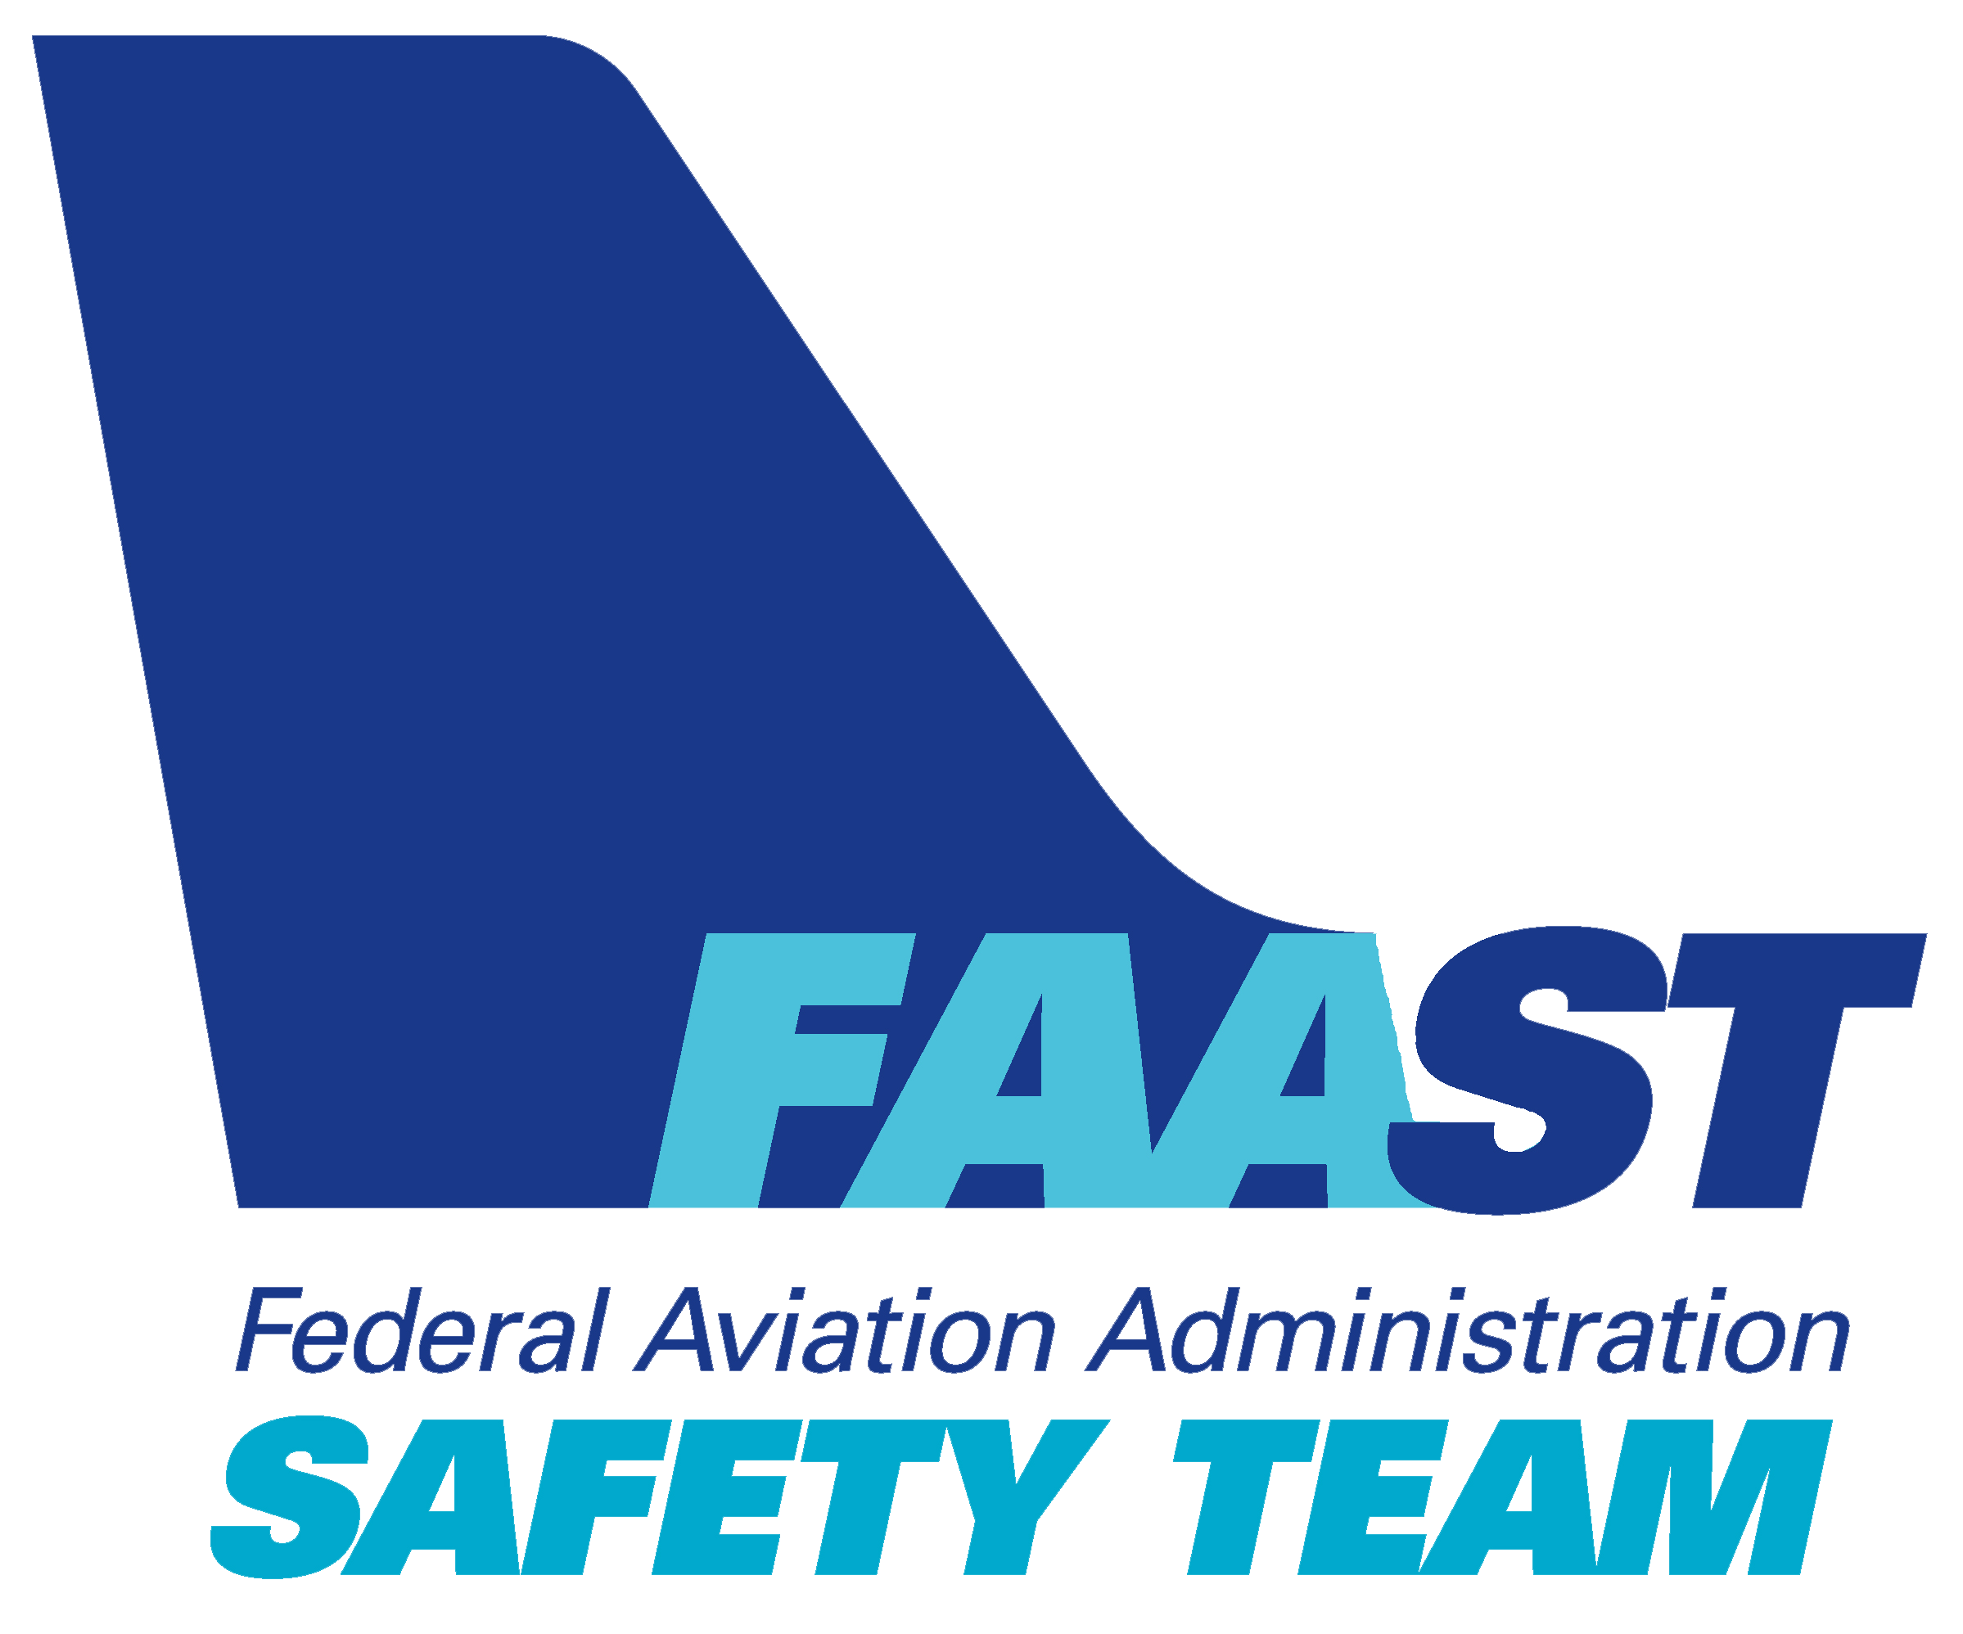
Welcome
Exits
Restrooms
Emergency Evacuation
Breaks
Phones and Devices to silent or off
Sponsor Acknowledgment
Other information
Notes:
Presentation Note: Here’s where you can discuss venue logistics, acknowledge sponsors, and deliver other information you want your audience to know in the beginning.
You can add slides after this one to fit your situation.
(Next Slide)

Slide 3
Don’t take an Airplane without seeing the
Approval for Return to Service!
Notes:
This is the bottom line…on top. But just what is an Approval for Return to Service and where do you find it? An Approval for Return to Service is a document, created by a certificated aircraft maintenance professional, that attests to the airworthiness of aircraft that have undergone maintenance. That makes sense. Almost any maintenance activity in progress will render an aircraft unairworthy. Before they can accept an aircraft for flight operations pilots have to know that maintenance has been performed to accepted standards and the aircraft is once again airworthy.
So that’s what an Approval for Return to Service is. Now, what does it look like and where might a pilot find it?
(Next Slide)

Slide 4

What is an Approval for Return to Service?
Notes:
Is it when the mechanic walks by and gives you a thumbs up? “Good to go”…. No…ooo!
(Next Slide)

Slide 5
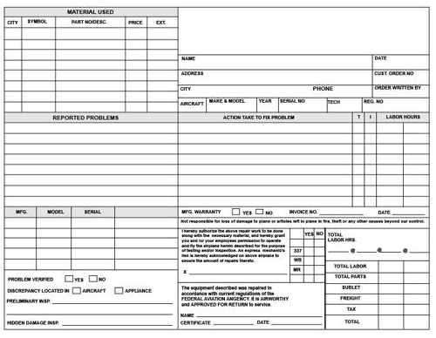
What is an Approval for Return to Service?
Discrepancy list
Registration Number
W/O Number
Notes:
Is it when the mechanic says, “Don’t worry it is all documented on the work order”? That’s what I used to tell my customers, but ......Nope that’s not it!
(Next Slide)

Slide 6

What is an Approval for Return to Service?
Notes:
Is it when the mechanic calls you to leave a message with your spouse that the airplane should be ready tomorrow? ….Da Nyet! Not it!
(Next Slide)

Slide 7
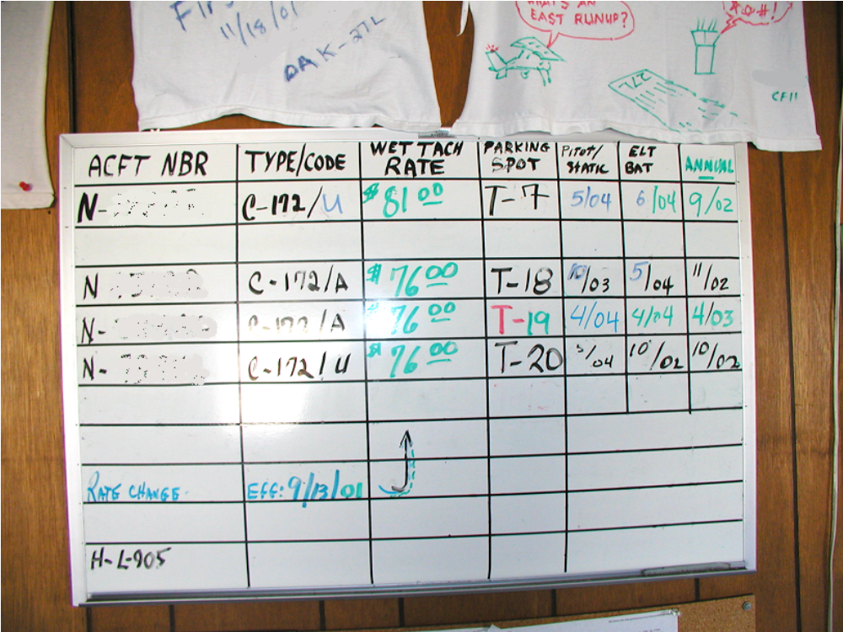
What is an Approval for Return to Service?
Notes:
Is it when the date and tach time look good on the status board?....... Negative!
(Next Slide)

Slide 8
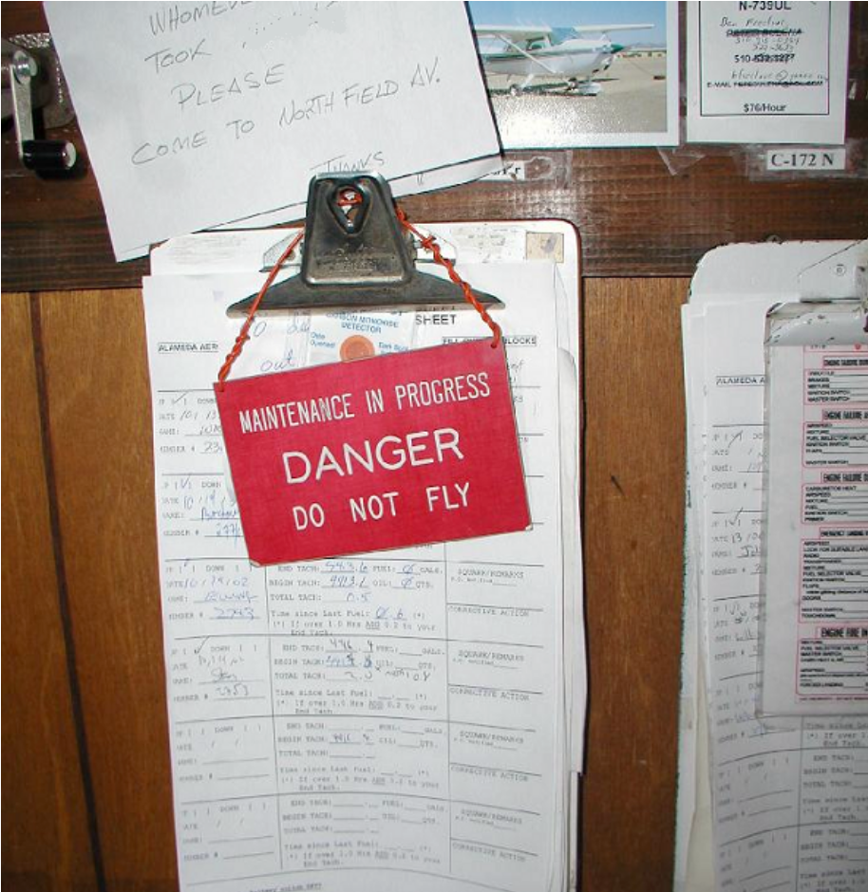
What is an Approval for Return to Service?
Notes:
Is it when the big red sign is not hanging on the yoke? ……. That’s not it!
(Next Slide)

Slide 9
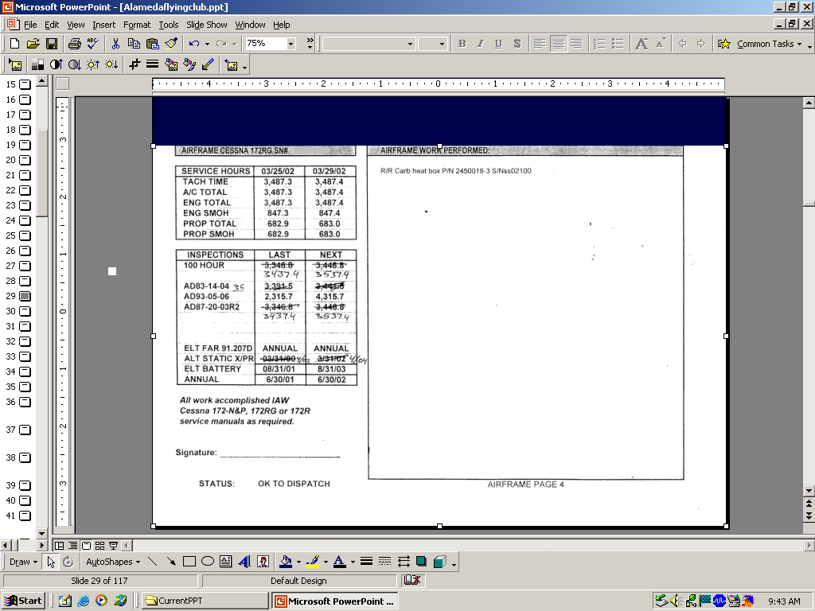
What is an Approval for Return to Service?
Notes:
The status clipboard says, “OK to dispatch….No Way!
*If you want to get an inspector to ask the question, then put that on your dispatch sheet.
(Next Slide)

Slide 10
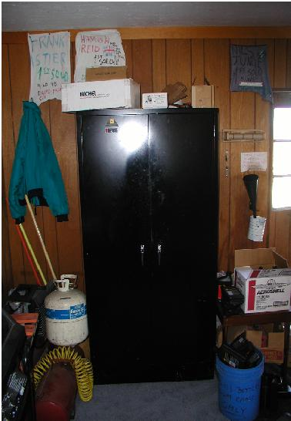
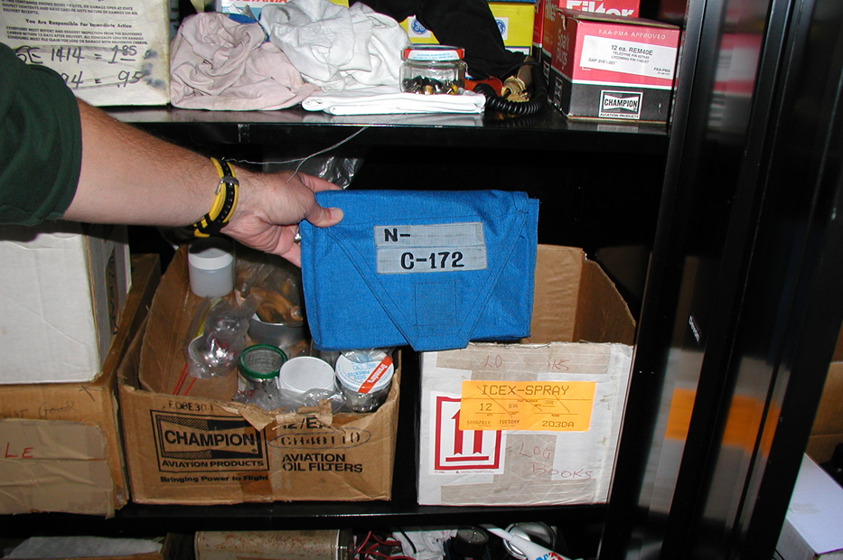
What is an Approval for Return to Service?
1234GM
Notes:
Yep…..This is where you will probably find it. Dig thorough the half-used cans of Ozium, broken microphones, bottles of oil, spark plugs, and toilet plungers. There you will find the aircraft’s logbooks. In those logbooks you will find the approval for return to service.
(Next Slide)

Slide 11
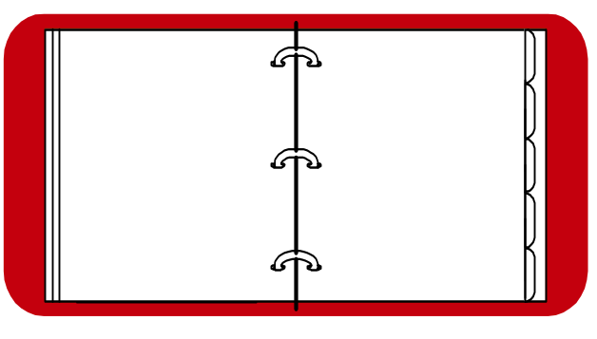
What is an Approval for Return to Service?
For Maintenance
  A Description of the work performed
  Date
  Signature
  Certificate Number
Notes:
You should expect to see this for any maintenance that has been done to the aircraft.
(Next Slide)

Slide 12
What is an Approval for Return to Service?
For Maintenance
  A Description of the work performed
  Date
  Signature
  Certificate Number
This is the Approval for Return to Service
Notes:
The signature and certificate number are the approval for return to service.
(Next Slide)

Slide 13
Sample Maintenance Record Entry
ENGINE MAINTENANCE RECORD
DATE
DESCRIPTION OF WORK PERFORMED
SIGNATURE
04/21/98 1. Changed oil. Added 8 Quarts of Aeroshell
50wt. compounded Oil.
Aircraft TT
2,762 Hrs.
2. Removed & Inspected oil screen and
re-installed in accordance with Lycoming
service manual.
SMOH
962 Hrs.
Ima B. Good
Ima B. Good
A&P 123456789
Notes:
The entry should look like this. Notice the Date, Signature and Certificate number.
(Next Slide)

Slide 14
What is an Approval for
Return to Service?
For Inspection
  A certification statement
  The date of the inspection
  The aircraft total time in service
  The signature, certificate number, and kind of certificate held by the person approving for return to service.
Notes:
You should see this for every inspection, and you will be able to check either the date, or the total time, to see if the aircraft can still fly.
(Next Slide)

Slide 15
What is an Approval for
Return to Service?
This is the Approval for Return to Service
For Inspection
  A certification statement
  The date of the inspection
  The aircraft total time in service
  The signature, certificate number, and kind of certificate held by the person approving for return to service.
Notes:
Again, here is the approval for return to service.
(Next Slide)

Slide 16
Sample Maintenance Record Entry
AIRCRAFT MAINTENANCE RECORD
DATE
DESCRIPTION OF WORK PERFORMED
SIGNATURE
01/21/99 Total Time 1743.8 Hours
I certify that this aircraft has been
inspected in accordance with (insert type)
inspection and was determined to be in
airworthy condition.
Ima B. Good
Ima B. Good
A&P 123456789
Notes:
The entry should look like this.
(Next Slide)

Slide 17
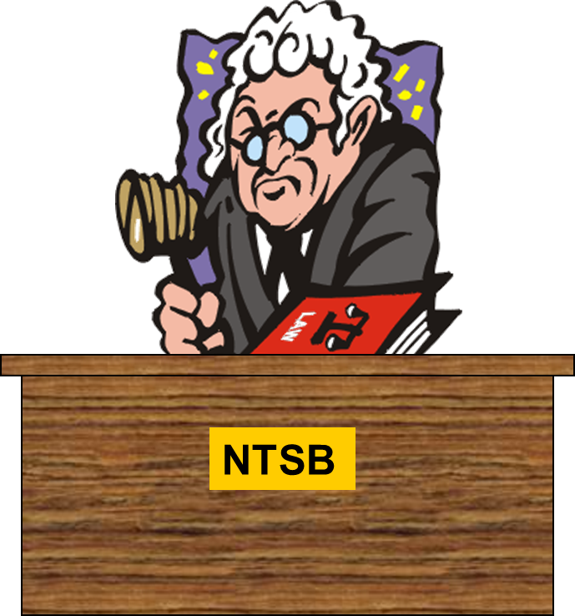
What is an Approval for Return to Service?
Notes:
If you fly without an approval for return to service, and something happens, you will get to meet the NTSB Administrative Law Judge. The meeting will be all you. The mechanic won’t be there. That is the topic of a different presentation.
(Next Slide)

Slide 18
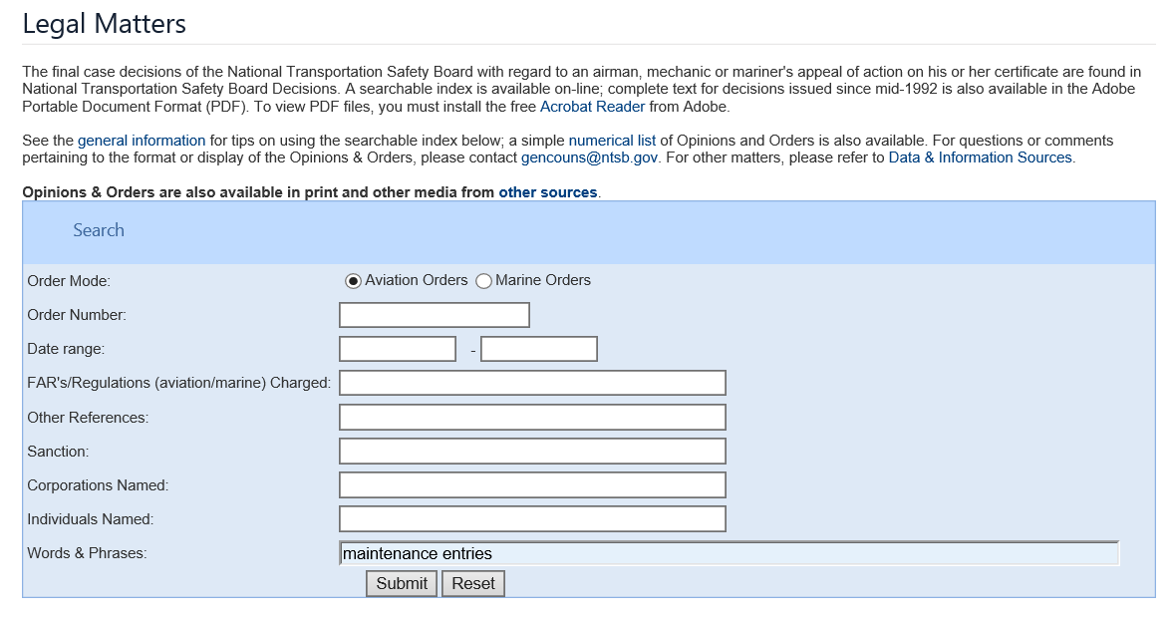

NTSB Legal Matters
Search “NTSB Legal Matters” on the web
Notes:
If you would like to read some appealed cases on the topic of maintenance entries, search NTSB Legal Matters, and then enter maintenance entries in the, words and phrases, box of the search engine. You will find that it is the pilot’s responsibility to make sure the mechanics put the appropriate entry in the permanent maintenance records indicating their approval for return to service.
(Next Slide)

Slide 19
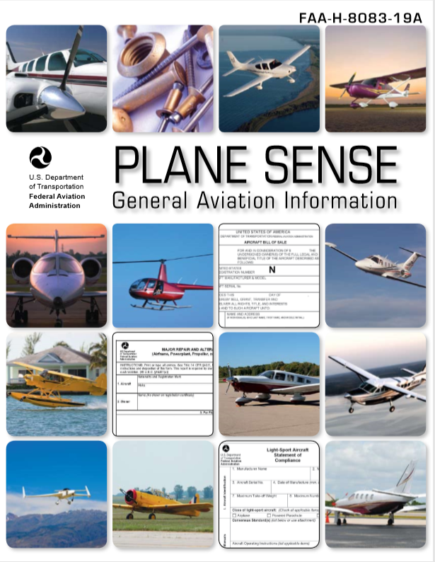
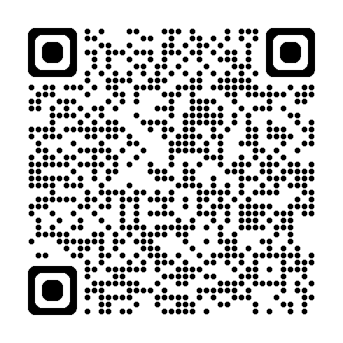

Plane Sense
FAA Handbook FAA-H-8083-19A
faa.gov/sites/faa.gov/files/regulations_policies/handbooks_manuals/aviation/faa-h-8083-19A.pdf
Notes:
This is a GREAT…FREE… publication that will explain many other ways to stay out of trouble. Just put Plane Sense in your browser. It is free on FAA.gov.
(Next Slide)

Slide 20
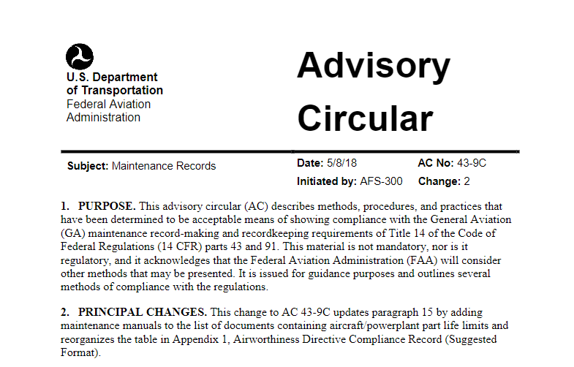
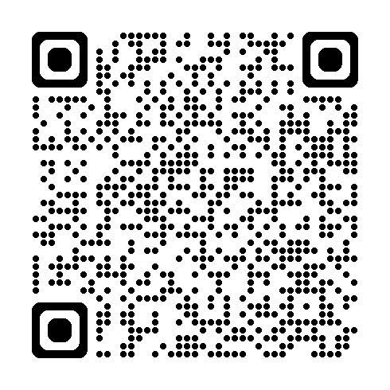
AC 43-9C
https://drs.faa.gov/browse/excelExternalWindow/DRSDOCID191020188820240412190740.0001
Notes:
This is also a good resource to help you understand maintenance records. It is free on FAA.gov. Just scan the QR code on screen or put AC 43-9C in your browser.
(Next Slide)

Slide 21
Don’t take an Airplane without seeing the
Approval for Return to service!
Notes:
This is the bottom line…on the bottom, because it is the bottom line. Don’t take an Airplane without seeing the Approval for Return to service!
(Next Slide)

Slide 22

Questions?
Notes:
Presentation Note: You may wish to provide your contact information and main FSDO phone number here. Modify with your information or leave blank.
(Next Slide)

Slide 23

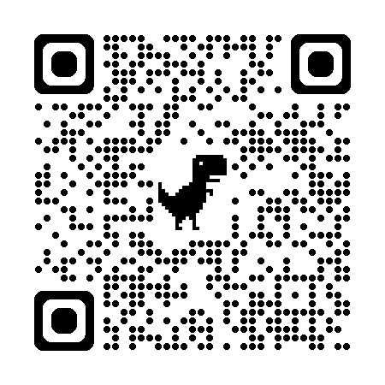

Safety Management Systems (SMS)
Coming to General Aviation
https://www.faa.gov/about/initiatives/sms
Notes:
Safety Management Systems are a set of policies and processes that can increase the safety and efficiency of any flight operation. And FAA is bringing SMS to General Aviation. You may have heard of SMS but thought it was only for large organizations but actually SMS can be scaled to fit any operation large or small.
There are 4 major components to a Safety Management System (Click)
Safety Policy – a documented commitment to safety that runs from the head of an organization to its newest member. (Click)
Safety Risk Management – a process that identifies hazards within an operation, determines to what extent an identified hazard may impact flight safety, and controls the risk of occurrence to an acceptable level. (Click)
Safety Assurance – By collecting and analyzing information derived from safety performance data Safety Assurance ensures the performance and effectiveness of Safety Risk Controls. (Click)
Safety Promotion communicates safety information and commitment throughout the organization. (Click)
You can find more information about Safety Management Systems at the URL on the Screen.
(End)

Slide 24


Proficiency and Peace of Mind
Fly regularly with your CFI
Perfect Practice
Document in WINGS
Notes:
There’s nothing like the feeling you get when you know you’re playing your A game and in order to do that you need a good coach (Click)
So, fly regularly with a CFI who will challenge you to review what you know, explore new horizons, and to always do your best. Of course you’ll
have to dedicate time and money to your proficiency program but it’s well worth it for the peace of mind that comes with confidence. (Click)
Vince Lombardi, the famous football coach said, “Practice does not make perfect. Only perfect practice makes perfect.” For pilots that means
flying with precision. On course, on altitude, on speed all the time. (Click)
And be sure to document your achievement in the Wings Proficiency Program. It’s a great way to stay on top of your game and keep you flight review current.
(Next Slide)

Slide 25



Thank you for attending
You are vital members of our GA safety community
Notes:
Your presence here shows that you are vital members of our General Aviation Safety Community. The high standards you keep and the examples you set are a great credit to you and to GA.
Thank you for attending.
(Next Slide)

Slide 26
The National FAA Safety Team Presents
What is an Approval for Return to Service?
<Audience>
<Presenter>
< >
Notes:
(The End)

