Slide 1
The National FAA Safety Team Presents
Advanced Air Mobility (AAM)
<Audience>
<Presenter>
< >
Notes:
2024/09-10-325(I)PP Original Author: Guy Minor, 06/03/2024; POC Guy Minor, AFG-930 Airworthiness Program Manager, Office (707-704-3530); revised by J. Steuernagle
This is the title slide for Advanced Air Mobility
Script - We have included a script of suggested dialog with most slides. The script will always appear in a non-italic font. Presenters may read the script or modify it to suit their own presentation style. See template slides 5 and 6 for examples of a slides with script.
Presentation Instructions - (stage direction and presentation suggestions) will be preceded by a Bold header: the instructions themselves will be in Italic fonts. See slides 2, 3, and 4 for examples of slides with Presentation Instructions only.
Program control instructions - will be in bold fonts and look like this: (Click) for building information within a slide; or this: (Next Slide) for slide advance.
Background information - Some slides may contain background information that supports the concepts presented in the program.
Background information will always appear last and will be preceded by a bold Background: identification.
The production team hope you and your audience will enjoy the show. Break a leg!
(Next Slide)

Slide 2
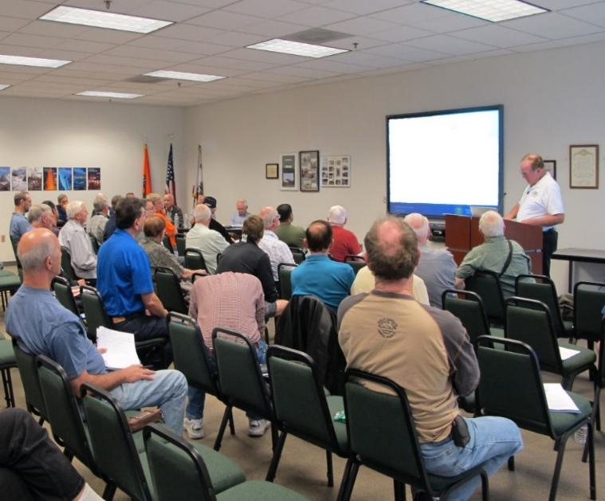
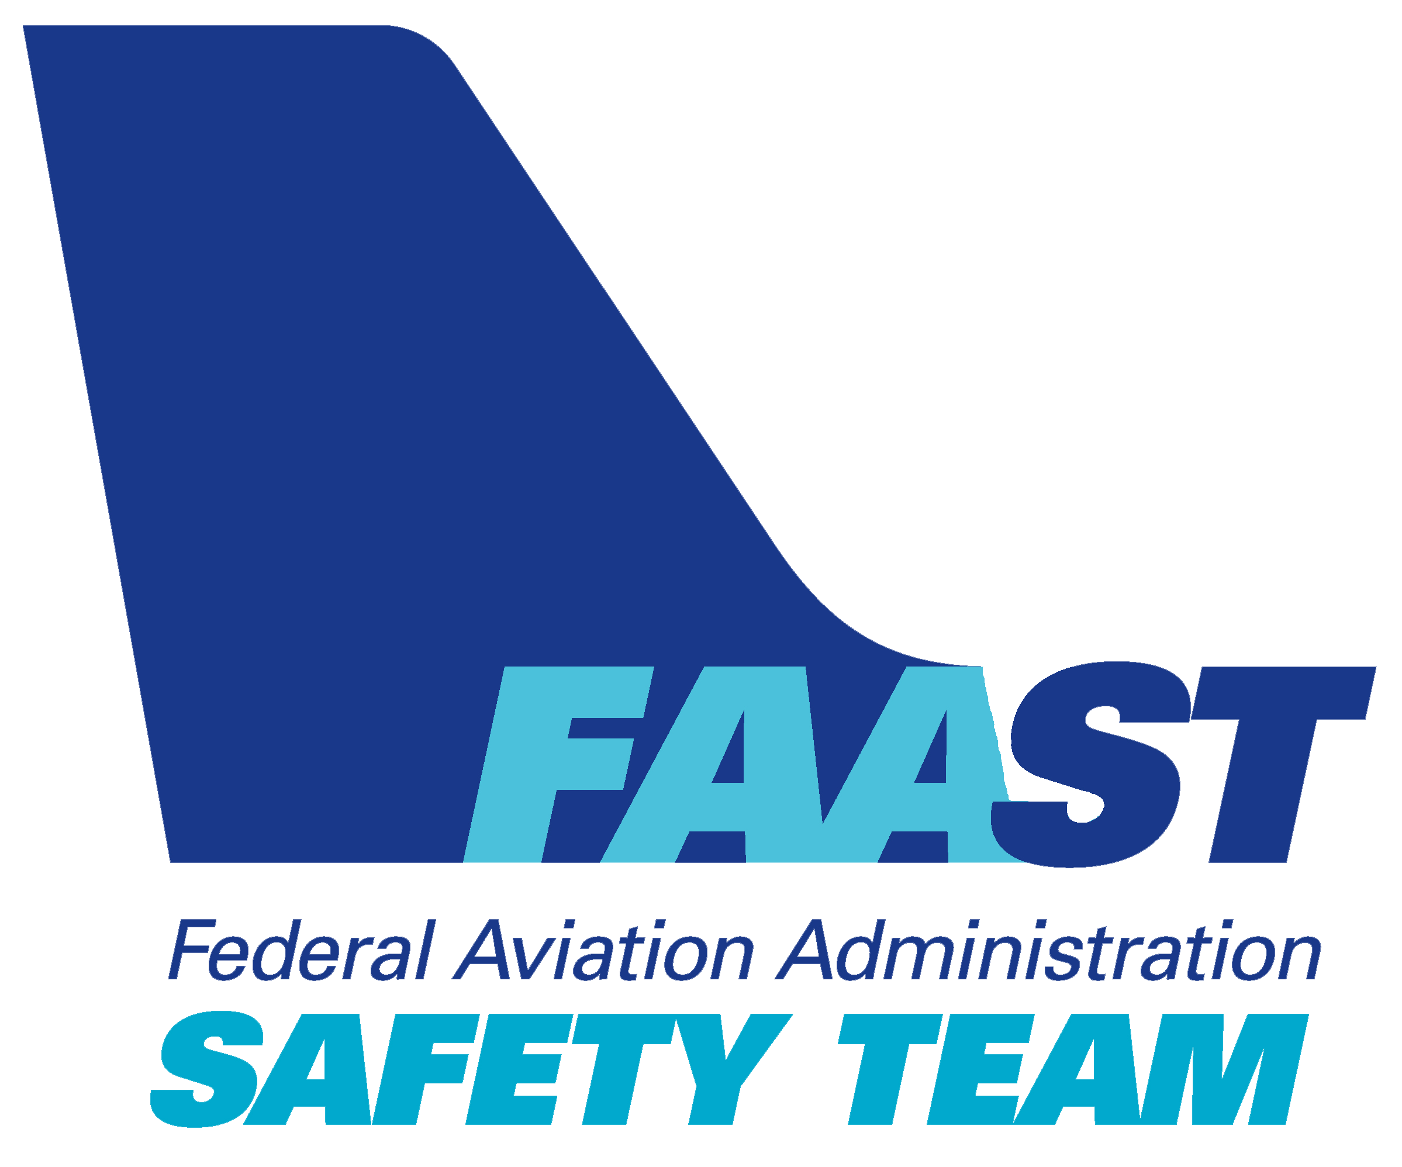
Welcome
Exits
Restrooms
Emergency Evacuation
Breaks
Devices to silent or off
Sponsor Acknowledgment
Other information
Notes:
Presentation Instruction: Here’s where you can discuss venue logistics, acknowledge sponsors, and deliver other information you want your audience to know in the beginning. You can add slides after this one to fit your situation.
(Next Slide)

Slide 3

Today, flying is safer than any other mode of transportation in history. The next era of aviation will be too.
Notes:
A new era of aviation is taking off. What once seemed only real in movies or cartoons is happening. Our job is to ensure this new generation of air taxis maintains the high level of safety that defines commercial aviation today.
(Next Slide)

Slide 4
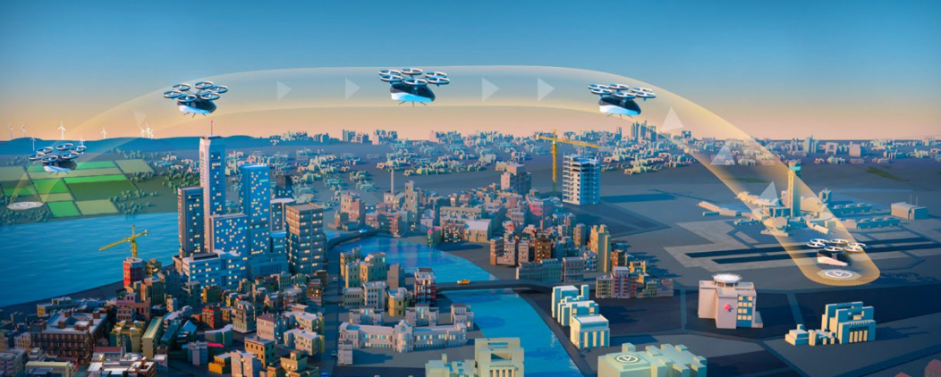
What is this new aviation era?
Notes:
What is this new aviation era?
Advanced Air Mobility (AAM) is an umbrella term for highly automated and electric aircraft. These aircraft are often referred to as air taxis or electric Vertical Takeoff and Landing (eVTOL) aircraft.
AAM has the potential to achieve the Administration's vision of more efficient, sustainable, and equitable transportation while creating thousands of great jobs.
But AAM is not just about passenger transport. It holds the potential to revolutionize cargo transportation, aid in firefighting and search and rescue operations, and, crucially, bridge the gap for underserved and rural communities.
(Next Slide)

Slide 5

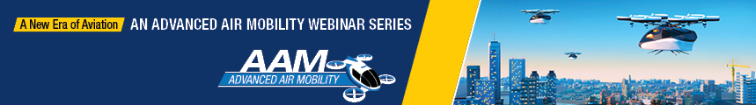
A New Era of Aviation
An AAM Webinar Series
  Community Engagement
  Wake Turbulence
  AAM Overview
  Vertiports
  And more webinars to come
https://www.faa.gov/air-taxis/webinars
Notes:
The aviation industry is experiencing growth in new and innovative aircraft design and operations. The FAA is at the forefront of establishing an operational AAM ecosystem at one or more key sites in the United States soon. We are providing programmatic support, coordinating key projects and research, synchronizing messaging, and working to safely and responsibly usher in this new era in aviation. Photo the QR Code to learn more about AAM by viewing a webinar series.
(Next Slide)

Slide 6
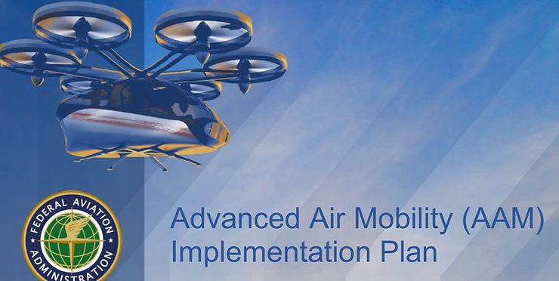
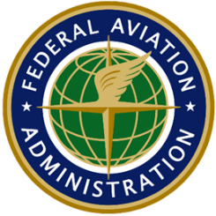
What is the FAA’s role?
Notes:
These aviation dreams will only happen if people are confident they are safe, just like flying in the United States today. That's the FAA's job: making sure this new generation of air taxis maintains the high level of safety that defines modern aviation. Many AAM companies are the designers, manufacturers, and operators, requiring them to obtain several certifications.
(Next Slide)

Slide 7
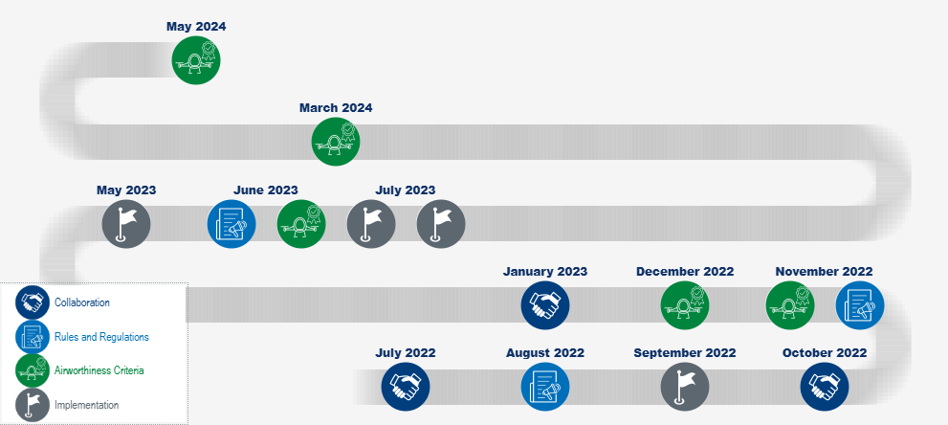
Advanced Air Mobility Milestones
Notes:
Progress is being made on the introduction of this new and innovative combination of drone and existing aviation technology.
Background:
July 2022
Joins National Aviation Authorities Network, which consists of the UK, Canada, Australia and New Zealand, to harmonize certification criteria and integration plans.
August 2022
Meets first milestone on time for developing standards that pilots must meet to operate aircraft that might have flying characteristics of both helicopters and airplanes.
September 2022
Issues vertiport design standards to serve as the foundation to begin safely building infrastructure in this new era.
October 2022
Signs Declaration of Cooperation with Japan Civil Aviation Bureau (JCAB) to support future Advanced Air Mobility aircraft development and operation.
November 2022
Proposes rule that would update the air carrier definition to add “powered-lift” operations to the regulations covering other commercial operations, such as airlines, charters and air tours. Lays the foundation that will allow operators to use powered-lift aircraft.
November 2022
Releases proposed airworthiness criteria that Joby Aviation, Inc. will have to meet for its Model JAS4-1 electric vertical takeoff and landing (eVTOL) aircraft to be certified.
December 2022
Releases proposed airworthiness criteria that Archer Aviation will have to meet for its M001 electric vertical takeoff and landing (eVTOL) aircraft to be certified.
January 2023
Signs Declaration of Cooperation with Korea Office of Civil Aviation (KOCA) to support future Advanced Air Mobility aircraft development and operation.
May 2023
Releases an updated blueprint for air taxi operations in and around urban areas.
June 2023
Proposes rule for training and certifying powered-lift pilots.
June 2023
Releases proposed airworthiness criteria that AgustaWestland Philadelphia Corp. will have to meet for Model AW609 aircraft to be certified.
July 2023
Releases an Implementation Plan to safely enable advanced air mobility in the near term.
July 2023
Issues final rule updating air carrier definitions to include powered-lift operations
March 2024
Issues final airworthiness criteria that Joby Aviation, Inc., will have to meet for its Model JAS4-1 electric vertical takeoff and landing (eVTOL) aircraft to be certified.
May 2024
Issues final airworthiness criteria that Archer Aviation will have to meet for its M001 electric vertical takeoff and landing (eVTOL) aircraft to be certified.
(Next Slide)

Slide 8
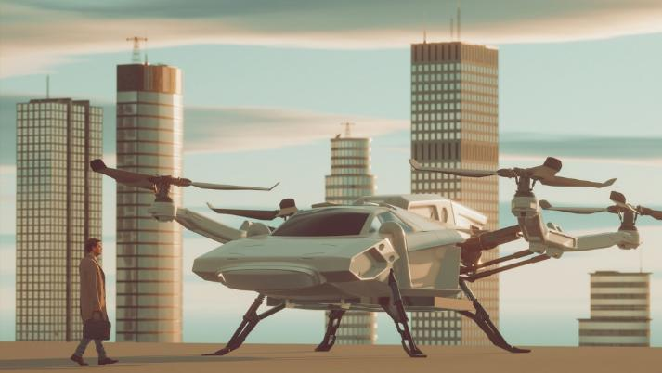
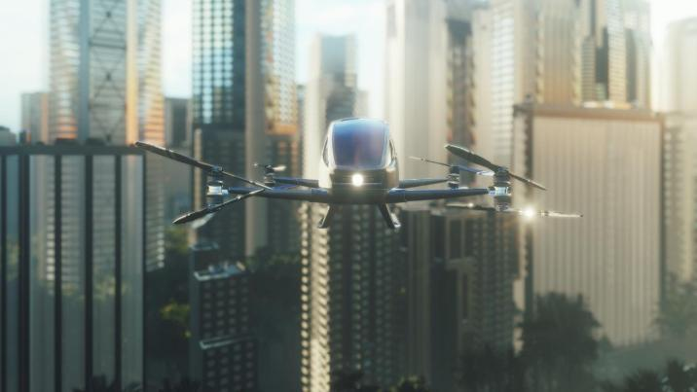
Make it Safe
Vehicle Certification
Operator Certification & Framework
Notes:
Vehicle Certification
The FAA has the regulations in place that allow manufacturers to achieve our safety standards in innovative ways. When tailoring existing rules to a new concept, the FAA determines the certification requirements for the eVTOL’s design, production, airworthiness, and operation. Some certifications could require the FAA to issue special conditions or additional airworthiness criteria, depending on the type of project. We use the same data-driven approach when evaluating these complex systems that has created the safest aviation system in the world.
Operator Certification & Framework
Many of these new aircraft take off in helicopter mode, transition into airplane mode for drone over-skyline flying, and then transition back to helicopter mode for landing.
In June 2023, we issued a proposed rule for training and certifying pilots.
In July 2023, the FAA issued a final rule updating the air carrier definition to add “powered-lift” operations to the regulations covering other commercial operations, such as airlines, charters, and air tours.
In August 2022, the FAA met its first milestone on time for rules (Special Federal Aviation Regulations) that will govern these operations. Several manufacturers have publicly said they anticipate no delays in certification from this approach.
(Next Slide)

Slide 9
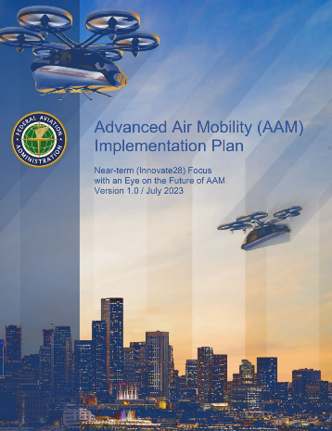
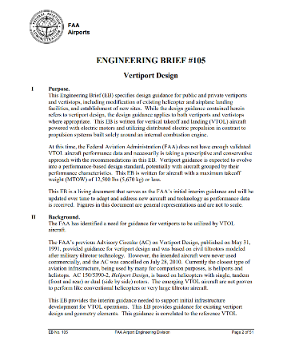
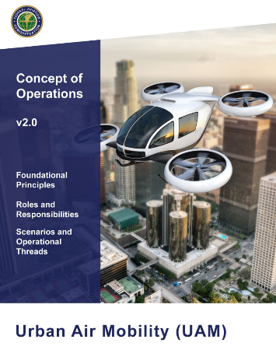
Integrating AAM into the Airspace
Implementation Plan
Infrastructure Development
Operations
Notes:
Implementation Plan
The FAA released an implementation plan providing the steps it and others will need to take to safely enable advanced air mobility operations in the near term. The “Innovate28” plan includes various components and the sequence they will occur in for operations to be at scale at one or more sites by 2028.
Infrastructure Development
We expect that initial AAM vehicles will use existing infrastructure such as helipads, routes, and air traffic control services where possible. In September 2022, the FAA issued vertiport design standards to serve as the foundation to begin safely building infrastructure in this new era.
Operations
Initial operations will be similar to those of helicopters today. As operations increase, we could have corridors for these vehicles and rules for communicating with air traffic control when necessary. In May 2023, the FAA issued an updated blueprint for Advanced Air Mobility operations in and around urban areas.
(Next Slide)

Slide 10
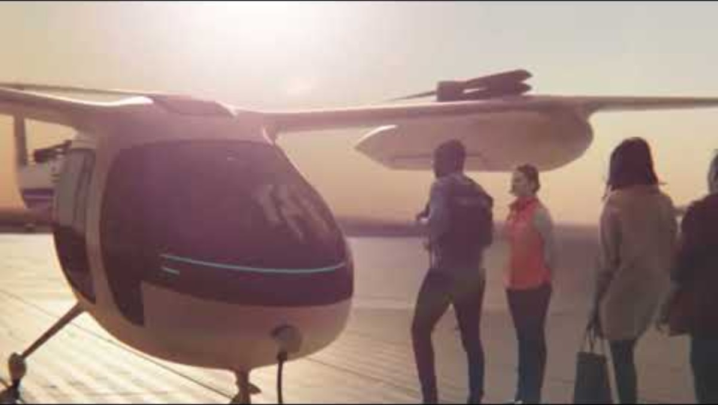
Airspace Blueprint for Air Taxis
Notes:
Presentation note:
This is a short animation introducing the airspace blueprint for air taxi operations.
(Next Slide)

Slide 11

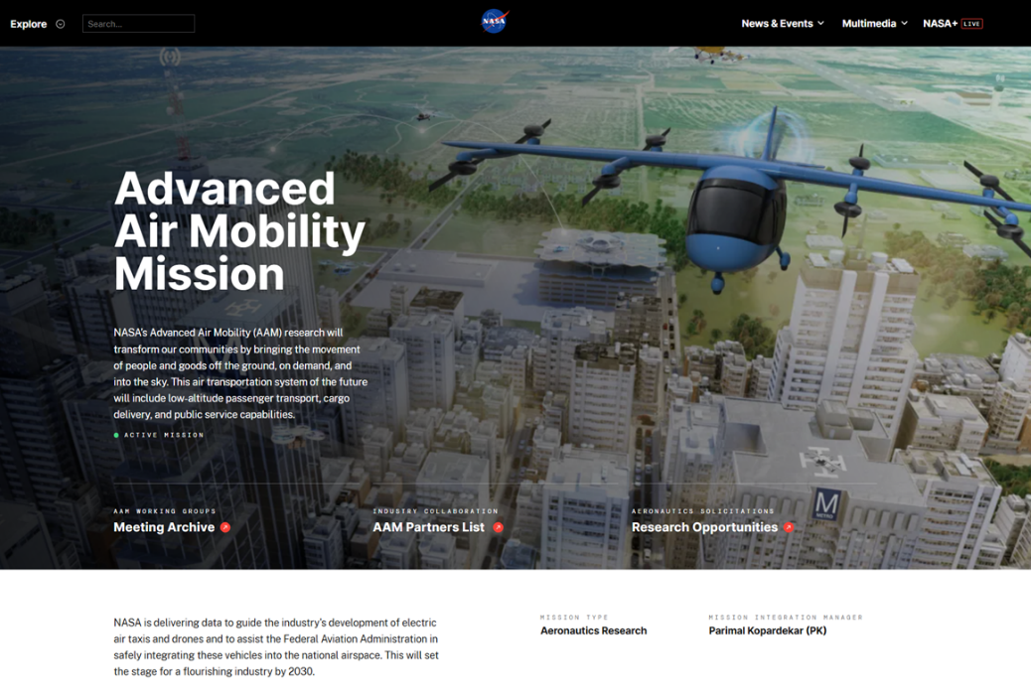
Community Engagement
NASA Advanced Air Mobility Mission
Notes:
Just like with drones, we are learning about and addressing local community concerns about AAM operations in and around metropolitan areas. For this effort, we’re engaging with state, local, and tribal governments and communities. One of our initiatives is working with NASA on a national campaign to help communities learn about AAM.
We encourage communities to get involved now while we’re in these early phases.
(Next Slide)

Slide 12

Global Partners
Notes:
The FAA is working with other civil aviation authorities to harmonize our AAM integration strategies. The FAA has joined the National Aviation Authorities Network, which consists of the UK, Canada, Australia and New Zealand, and signed declarations of cooperation with Japan and South Korea on integrating and certifying AAM aircraft.
Through these partnerships, as well as our work with European Union Aviation Safety Agency (EASA), we’re looking to align our certification processes and standards for AAM aircraft. And we’re eager to work with other nations so we can exchange expertise and share progress with each other.
(Next Slide)

Slide 13
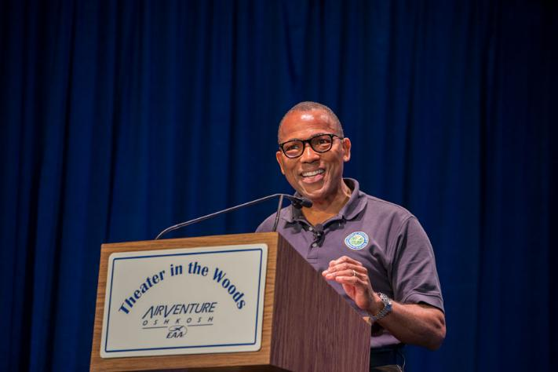

Resources- Farnborough Royal Aeronautical Society
https://www.faa.gov/speeches/farnborough-royal-aeronautical-society-remarks
Notes:
Former Acting FAA Administrator Billy Nolen addresses the Farnborough Royal Aeronautical Society.
Background:
Tuesday, July 19, 2022
Former Acting FAA Administrator Billy Nolen (April 1, 2022 – June 9, 2023)
Remarks as prepared for delivery.
Good evening.
It is great to be with you to celebrate our shared passion and commitment to aviation, and I am particularly honored to rejoin you as a Royal Aeronautical Society Fellow.
You know, we often like to think that we invented flying in America, but the pursuit of the skies has always been an international enterprise.
Where would global aviation we be without the contributions of Britons such as George Cayley, the father of aviation, or Geoffrey de Havilland, who designed revolutionary aircraft in his day? Or pioneer Amy Johnson, who deserves a place in history alongside Amelia Earhart for helping women see a future in the skies.
There are so many that I could go on all night. Prince Philip, Prince William, Peter Pan, The Lost Boys…
In all seriousness, I am sure that many of you have been looking forward to an “in-person” Farnborough Air Show for months.
It has been a long pandemic. I think we can all agree that while much of our time was spent meeting virtually, the challenges to aviation were anything but virtual.
I am happy to say that we took on the safety and business challenges posed by a global health crisis and are emerging not only intact, but, in some ways, stronger.
One of the things that we missed, though, was the opportunity to gather as an aviation community to share ideas and to recognize, in-person, the progress we have made. After getting a chance to look at some of the exhibit halls and static displays at Farnborough, it’s apparent that the pioneering spirit of aviation is alive and well.
Today, we are on the cusp of an evolution that could turn out to be as exciting as Charles Lindbergh’s first solo flight across the Atlantic … or when Frank Whittle – another Briton – invented the jet engine.
It seems like during the pandemic, concepts that a couple of years ago appeared to be on the distant horizon are beginning to look like reality.
It’s no longer laughable to think that a rocket booster could hurl a capsule into space and then land safely a few minutes later, ready to be used again – or that “Captain Kirk” might make it into space in real life.
We find ourselves asking what we can do to make sure we are ready for whatever comes after the Jet Age. How can we help these new entrants benefit from more than a century of lessons learned while also giving them room to innovate?
I was thinking while flying here from the U.S. about how safe aviation has become. Not for a second did I – nor probably anyone else on that plane – need to worry about the flight arriving safely. But we all know that that safety can never be taken for granted.
Before coming to the FAA in January, I spent a full career as a pilot, flying everything from helicopters to jetliners. I know firsthand that most things in aviation that appear to happen seamlessly are indeed the result of a tremendous amount of work.
We have checklists and procedures. Redundancies and safety nets are built throughout the system. Every morning, those of us in the aviation safety business wake up knowing that no matter how good of a job we did yesterday, we must do better today.
It’s against that backdrop that I look at the challenges ahead.
Today, we are deep into conversations about subjects such as Advanced Air Mobility and how to make commercial aviation more sustainable with new fuels and methods of propulsion.
Not many people remember this, but shortly after Henry Ford revolutionized the mass-production of automobiles in the U.S., he turned his sights toward making a “poor man’s airplane.”
The resulting product was a single-seat contraption called the “Air Lizzie,” after the iconic nickname for the Model T.
The aircraft never caught on, but the dream never died. Through the years, inventors tried time and again to make a small, personal aircraft a reality.
In the not-too-distant future, it’s possible that an air taxi powered by electric motors could land in your neighborhood and shuttle you across town in minutes for a meeting. That same trip would have taken an hour to reach in a car.
As I mentioned earlier, the technology is on its way. In the U.S., a couple of the most promising players are expecting to earn their certification by the FAA as early as 2024.
While the inventors are working on the technical aspects of the machines, we working on operational rules and pilot training. But we’re also considering the best ways to integrate this new type of aviation into our existing airspace system.
It is a challenge that requires all of us to think differently – to question conventional wisdom, if you will.
As with all aspects of aviation that came before, this new era will be an evolution, where advancement to the next step will be based on safety. As safety regulators, it is the job of the FAA and its counterparts around the world – to help strike that delicate balance between safety and innovation.
We must see safety as an enabler, because nothing will ground these innovations faster than serious incidents or accidents.
At the same time, we must also find ways to help traditional aviation move into the future. Around the world, nations are grappling with climate change and looking for ways to reduce greenhouse gas emissions.
Aviation faces some particular challenges, but we are serious about addressing them head-on. We’ve been encouraged by some of the latest trials of Sustainable Aviation Fuel, and we know that chemists and botanists are hard at work to make fossil fuels a thing of the past.
I can tell you that the U.S. is committed to its goal of being net-zero by 2050. Regardless of the political climate, I we will achieve this because the aviation community has seen the wisdom of doing its part to protect the world while still staying connected.
And, of course, engine manufacturers and airframers continue to pursue designs that promise greater fuel and aerodynamic efficiency.
In the U.S., we have been working for more than a decade to build more fuel-efficient routes between major cities and to eliminate wasteful holding patterns.
Before I conclude, I want to return to our No. 1 priority – safety.
We are extremely fortunate to be in a period when aviation is safer than ever. No mode of transportation in human history has ever been safer. But that does not mean we can – or should –declare victory.
Every day we must challenge ourselves to find even more ways to reduce and eliminate the risk inherent to an industry that spans the globe and has little tolerance for mistakes.
Rather than responding to incidents, we are getting better at predicting them through the careful analysis of data. But we need to do more of this, and we need to get better at it. Being preventative is no longer enough; we must become predictive.
Safety Management Systems have proved their worth, particularly during the pandemic. Airlines have embraced the discipline of a culture that prizes a free exchange of information and the willingness to drive process and discipline into the farthest corners of the operation.
We are now expanding this methodical discipline into manufacturing, with the same prospects of building additional safety into the system.
I am excited about the future. Every time I meet a young person who is entering aviation with big dreams, I tell them to go for it.
If you think about it, aviation is a business that has always been propelled by disruptors – people who have the audacity to question conventional wisdom.
That’s one of the reasons why I believe so strongly in strengthening the diversity of our workforce. Organizations perform better when they benefit from new views and experiences that come from different backgrounds.
This is true whether we are talking about ethnic and gender diversity, or intellectual diversity – and we must strive to do better on all counts.
People ask me at least once a week what we are doing about pilot shortages, or controller shortages, or trained technical experts. It’s a valid question. The answer is that we must do whatever we can to encourage new talent to enter the field of aviation.
I think these emerging players in aviation can help show us the way. Despite having been around for almost 120 years, aviation as we know it continues to change.
Some people look at some of the headlines about our daily struggles and they wonder whether aviation’s best days are behind it.
I don’t see it that way. As far back as we can remember, humans looked to the sky and dreamed of flying. The same was true for me, growing up in a small Alabama town … building paper airplanes after hearing a helicopter in the distance one day.
I believe that in the end, that is something that will never change.
The question is what form it will take, and what will aviation look like a few years from now?
I can tell you that Charles Lindbergh and Frank Whittle – both of whom lived well into the Jet Age – would be surprised at what has happened even in the last few years.
Imagine what they would say if they knew what was on the horizon.
Thank you.
(Next Slide)

Slide 14

Resources- White House Summit on AAM
https://www.faa.gov/speeches/white-house-summit-advanced-air-mobility
Notes:
Former Acting FAA Administrator Billy Nolen addresses the Farnbourough Royal Aeronautical Society.
Background:
Wednesday, August 3, 2022
Former Acting FAA Administrator Billy Nolen (April 1, 2022 – June 9, 2023)
Thanks, Alex [Macgillivray]. Good morning, everyone.
I’d like to start off by thanking our colleagues here at the White House, specifically the Office of Science and Technology Policy, for convening this summit.
It’s an honor to be here with our federal partners and members of industry to discuss the evolution and safe integration of drones and Advanced Air Mobility into our National Airspace.
Sixty-years ago – when President Kennedy sat in the Oval Office – the idea of futurism picked up speed.
The jet age began. The space race was underway. And the idea of flying cars created an impression in many people’s minds while inspiring a generation.
Many years have passed, but the notion of flying cars never left America’s imagination.
And as we’ve been discussing this morning, this idea will be realized.
We’re here today to take another step forward. Advanced Air Mobility – or AAM – is the next addition to the world of aviation.
AAM has the potential to achieve the Biden-Harris Administration’s vision to enable more transportation options that are more efficient, more sustainable, and more equitable, while creating thousands of great jobs in the process.
If the public is not confident in their safety, then the benefits may never be realized.
Today, flying is safer than any other mode of transportation in history. That’s not by chance. It’s because the FAA has and continues to work closely with the aviation community to ensure safety is always the top consideration.
When it comes to exciting new technologies such as AAM, our mission is to constantly advance our outstanding level of safety, without stifling the innovators. We aim to be a gateway, not a hurdle.
That’s why the FAA has a comprehensive integration strategy for drones and AAM. I want to thank our federal partners – like NASA, Homeland Security, Defense, and other agencies who are working with us to ensure the success of this strategy.
We’re also working with the AAM industry to develop consensus safety standards for these technologies.
Let’s start by discussing drones.
More than 860,000 drones are registered today in the United States. To put this into context, that’s more than three times as many crewed aircraft.
By 2025, we could have a total of more than 2.6 million commercial and recreational drones flying in our airspace, according to FAA forecasts.
It’s critical that we have a standard set of rules for operations beyond visual line of sight – or BVLOS, as we call it – where you no longer have eyes on the drone. This would enable operations for things like routine package deliveries, infrastructure inspections and agriculture spraying and inspection.
We’re working closely with the drone community to make these kinds of operations routine, scalable and economically viable. As you can image, this is a huge collaborative effort.
We just heard from the Chief of the Choctaw Nation of Oklahoma. As part of an integration program called BEYOND, we’re working with them, and numerous other organizations—including states like Kansas, North Dakota, North Carolina, the city of Reno, Nevada and others—to understand the ups and downs of BVLOS.
Through BEYOND, we’re able to learn about and address state and local government concerns about drone operations – concerns related to safety, security, noise, and privacy, to name a few.
And we’re also partnering with more than 20 companies to safely advance complex drone operational capabilities.
For instance, we’re working with Xcel Energy to conduct inspections of their power transmission lines.
These partnerships help us to identify and mitigate safety hazards in a way that allows the industry to gain experience and develop industry consensus standards.
And the FAA is currently reviewing recently-received recommendations from an aviation rulemaking committee on how to enable safe, routine, BVLOS operations.
All of these efforts are enabling us to execute an integration strategy for new airspace entrants in which the more complex or higher risk the operation, the higher the level of safety that needs to be achieved.
Simply put, that means that aircraft operations that carry people are going to require a higher level of performance and oversight than those that don’t carry people – period.
And that brings us to the concept of Advanced Air Mobility.
Through AAM, we could potentially see electric powered air taxis land in your city, and transport you across town or maybe to the airport in just minutes, whereas the same trip by car would have taken much longer.
AAM aircraft could also be used to transport large cargo, or help with firefighting, air ambulance and search & rescue operations.
And AAM could eventually be a more equitable form of transportation, as it has the potential to connect underserved and rural communities with larger cities. This could be especially beneficial for communities that are reliant on aviation, like in Alaska.
And because these vehicles would be electric-powered, they could offer a more sustainable method of transportation.
This technology is on its way. In fact, two companies expect to earn FAA certification of their vehicles as early as 2024.
We’ve received many proposals for a diverse set of AAM concepts. Some have pilots on board the aircraft, some are remotely piloted, and sometimes the aircraft is autonomous.
We’re looking at every aspect of this enterprise – the vehicle itself, the framework for operations, access to the airspace, operator training, infrastructure development, and community engagement.
In other words, it’s not just about air taxis. It’s also about everything necessary to support air taxi flights.
As these vehicles are being developed, the FAA is working to establish operational rules and pilot training standards. And we’re looking at how to best integrate these new vehicles into the national airspace system.
We’re modifying our regulatory approach to enable powered lift operations including the certification of powered-lift vehicles and the pilots who operate them.
Longer term, the agency plans to continue to develop permanent regulations to safely enable powered-lift operations and pilot training and certification.
AAM also has unique qualities compared to traditional aviation. So we must also think differently.
For example, aircraft pilots are traditionally required to communicate with air traffic controllers. But what if the software that enables an autonomous vehicle to remain aloft also allows it to safely separate itself from other aircraft?
As with all aspects of aviation that came before, this new era will be an evolution, where advancement to the next step will be based on safety. As safety regulators, it is the job of the FAA and its counterparts around the world to help ensure that innovation doesn’t come at the expense of safety.
We must see safety as an enabler, because nothing will ground these innovations faster than incidents or accidents.
And just like with drones, we are learning about and addressing local community concerns about AAM operations in and around metropolitan areas.
For this effort, we’re engaging with state, local, and tribal governments and communities.
One of our initiatives is working with NASA on a national campaign to help communities learn about AAM. We’ve been testing AAM concepts, and collecting data in areas like automated flight plan communications, BVLOS, traffic avoidance, trajectory management and approach to landing and takeoff areas.
There’s a lot of work to do to move toward AAM integration and we will need a broad collection of voices at the table. We encourage communities to get involved now, while we’re in these early phases, and we need to continue to hear from industry, many of whom are represented here today.
We’re also reaching out globally. Many of the players seeking to operate AAM in the U.S. are also seeking to operate in other countries.
So, the FAA is working with civil aviation authorities from other nations to explore how we can harmonize our integration strategies.
Two weeks ago, I was in the U.K. meeting with aviation officials in government and industry throughout the world.
And I was encouraged to see that several American and British manufacturers of AAM vehicles are moving through their home country’s certification process and now asking their American or U.K. counterpart for validation.
We’re working to establish these processes. One example is a group called the National Aviation Authorities Network, which is a partnership involving the FAA, the U.K., Canada, Australia, and New Zealand.
Through this group, we’re looking at how we might align our certification processes and standards for AAM aircraft. And we’re eager to work with other nations so we can exchange expertise and share progress with each other.
Just a short time ago, the idea of having prescription medication airlifted to your front door during a pandemic or taking a flying car to the airport was the stuff of science fiction.
Today, there is a real chance that these technologies could become a daily reality.
This industry is writing and rewriting the history of aviation in real time, and we have the opportunity to lay the foundation for the decade ahead while inspiring the next generation.
We must continue to work together – across government and industry and with our international partners – to ensure that these technologies are safe and sustainable.
Then and only then, will they live up to their promise.
Thank you.
(Next Slide)

Slide 15


Resources- 60 Minutes
https://www.youtube.com/watch?v=1YUv0AMq0x8
Notes:
This QR will take you to the YouTube posting of a 60-minute video introducing eVTOL.
(Next Slide)

Slide 16
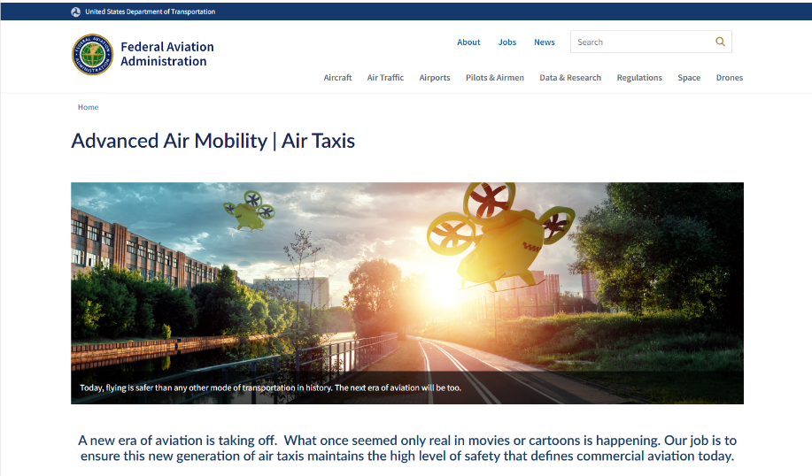

Resources- FAA AAM Page
https://www.faa.gov/air-taxis
Notes:
Follow the QR code to the FAA Advanced Air Mobility page on faa.gov. Here, you will find the newest developments in Advanced Air Mobility.
(Next Slide)

Slide 17

Questions?
Notes:
Presentation Instruction: You may wish to provide your contact information and main FSDO phone number here. Modify with
Your information or leave blank.
(Next Slide)

Slide 18
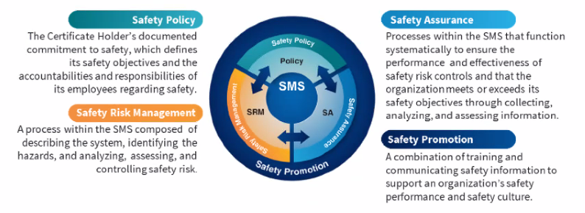

Safety Management Systems (SMS)
Coming to General Aviation
https://www.faa.gov/about/initiatives/gasafetyoutreach
Notes:
Safety Management Systems are a set of policies and processes that can increase the safety and efficiency of any flight operation. And FAA is bringing SMS to General Aviation. You may have heard of SMS but thought it was only for large organizations but actually SMS can be scaled to fit any operation large or small.
There are 4 major components to a Safety Management System (Click)
Safety Policy – a documented commitment to safety that runs from the head of an organization to its newest member. (Click)
Safety Risk Management – a process that identifies hazards within an operation, determines to what extent an identified hazard may impact flight safety, and controls the risk of occurrence to an acceptable level. (Click)
Safety Assurance – By collecting and analyzing information derived from safety performance data Safety Assurance ensures the performance and effectiveness of Safety Risk Controls. (Click)
Safety Promotion communicates safety information and commitment throughout the organization. (Click)
You can find more information about Safety Management Systems at the URL on the Screen.
(Next Slide)

Slide 19

Have you earned your WINGS?
Proficient Pilots are:
  Confident
  Capable
  Safe
WINGS will keep you
on top of your game
Notes:
Have you earned your WINGS? Proficiency is key to success in almost everything worth doing – especially flying. Proficient pilots are confident, capable, and safe.
WINGS is a proficiency training system specifically designed for general aviation pilots and regular participation will keep you on top of your flying game.
(Next Slide)

Slide 20
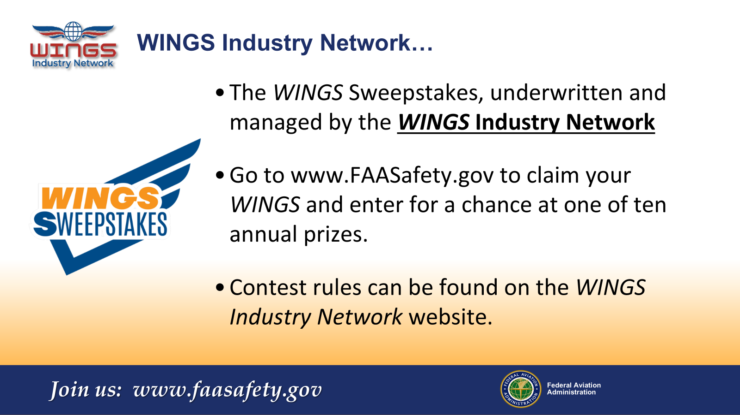

Go to FAASTeam Team Member Rewards page to learn more about how to enter a chance to win one of ten annual prizes
Notes:
Every time you earn a WINGS phase, you’re eligible to enter the WINGS Sweepstakes sponsored by the WINGS Industry Network. Flight Instructors can also enter once for each WINGS phase they validate. Click on the QR code for details.
(Next Slide)

Slide 21
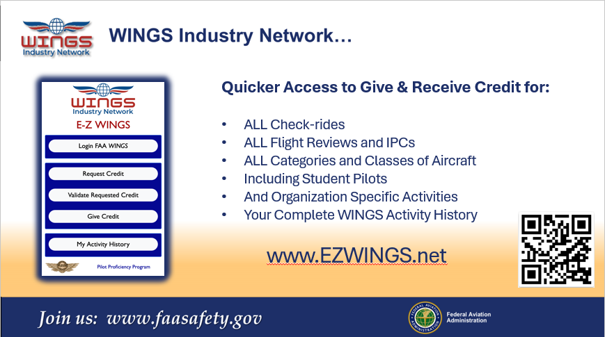
Notes:
The WINGS Industry Network also hosts an easy way to request and validate WINGS credit. Just navigate to EZWINGS.net or capture the QR Code to access the App.
(Next Slide)

Slide 22
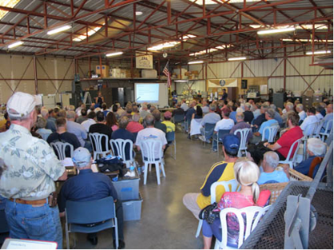


Thank you for attending
You are vital members of our GA safety community
Notes:
Your presence here shows that you are vital members of our General Aviation Safety Community. The high standards you keep and the examples you set are a great credit to you and to GA.
Thank you for attending.
(Next Slide)

Slide 23
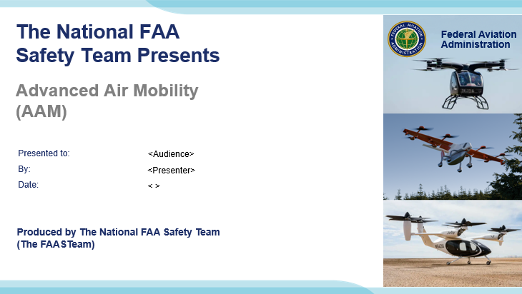
Notes:
(The End)

